Slide 1

Algorithms and Data Structures 2 CS 1501
Spring 2022
Sherif Khattab
ksm73@pitt.edu
(Slides are adapted from Dr. Ramirez’s and Dr. Farnan’s CS1501 slides.)

Slide 2
Announcements
Upcoming deadlines:
Assignment 1 late deadline is tonight 3/16
Homework 8 due on 3/21
Lab 7 due on 3/18
Assignment 2 due on 3/28

Slide 3
Previous Lecture …
Graphs
Definitions, representation, traversal (BFS and DFS)
Given two LI accounts, how “far” are they from each other?
E.g., 1st connection, 2nd connection, etc.
Are the accounts in the file all connected?
If not, how many connected components are there?

Slide 4
Muddiest Points (confusing)
I was confused about how many adjacent lines exist between undirected graphs vs directed graphs.
In the neighbor lists, are directed edges counted once or twice?
LZW is still a little confusing at times. Is there an easier way to break it down into steps.
I was confused to how DFS would find the articulation points of a graph
the DFS and BFS algorithms
How the queue works for DFS/BFS but I think it’ll be more clear once I look over it again/we have the homework on it
- The different operations that can be performed on a graph was most confusing.

Slide 5
Muddiest Points (interesting)
Graphs were interesting to think about and reminded me of math concepts
I found it interesting how going through the searches produced spanning trees
Top hat questions help a lot with learning the material. Having them through lecture is nice
Edges , vertices
That trees are just a special subclass of graphs and that graphs have so many uses in the real world
runtime of graph search algorithms
That we can model many different relationships and connections using graphs and graph theory
I worked with graph theory before for research but it was interesting to see other applications
The applications of a graph was most interesting.
the matrix vs array comparison

Slide 6
Problem of the Day (contd.)
Input: A file containing LinkedIn Connection information formatted like the following:
Account1: Connection1, Connection2, …
Account2: Connection1, Connection2, …
…
Output: Answer the following questions:
Given two LI accounts, how “far” are they from each other?
E.g., 1st connection, 2nd connection, etc.
Are the accounts in the file all connected?
If not, how many connected components are there?
Are there certain accounts that if removed, the remaining accounts become partitioned?
These account are called articulation points

Slide 7
DFS example 2
0
0
2
1
2
1
3
3
6
6
4
5
4
5
7
7
9
9
8
8

Slide 8
Analysis of graph traversals
At a high level, DFS and BFS have the same runtime
Each vertex must be seen and then visited, but the order will differ between these two approaches
How will the representation of the graph affect the runtimes of of these traversal algorithms?
Notes:
Adjacency matrix
Θ(v) to consider all neighbors
To traverse a row/column of the matrix
Doing this for each of v vertices leads to Θ(v²) runtime
Adjacency list
Must consider the neighbor list of each vertex in the array
So, we must visit every vertex in the whole adjacency list
Θ(v + e)

Slide 9
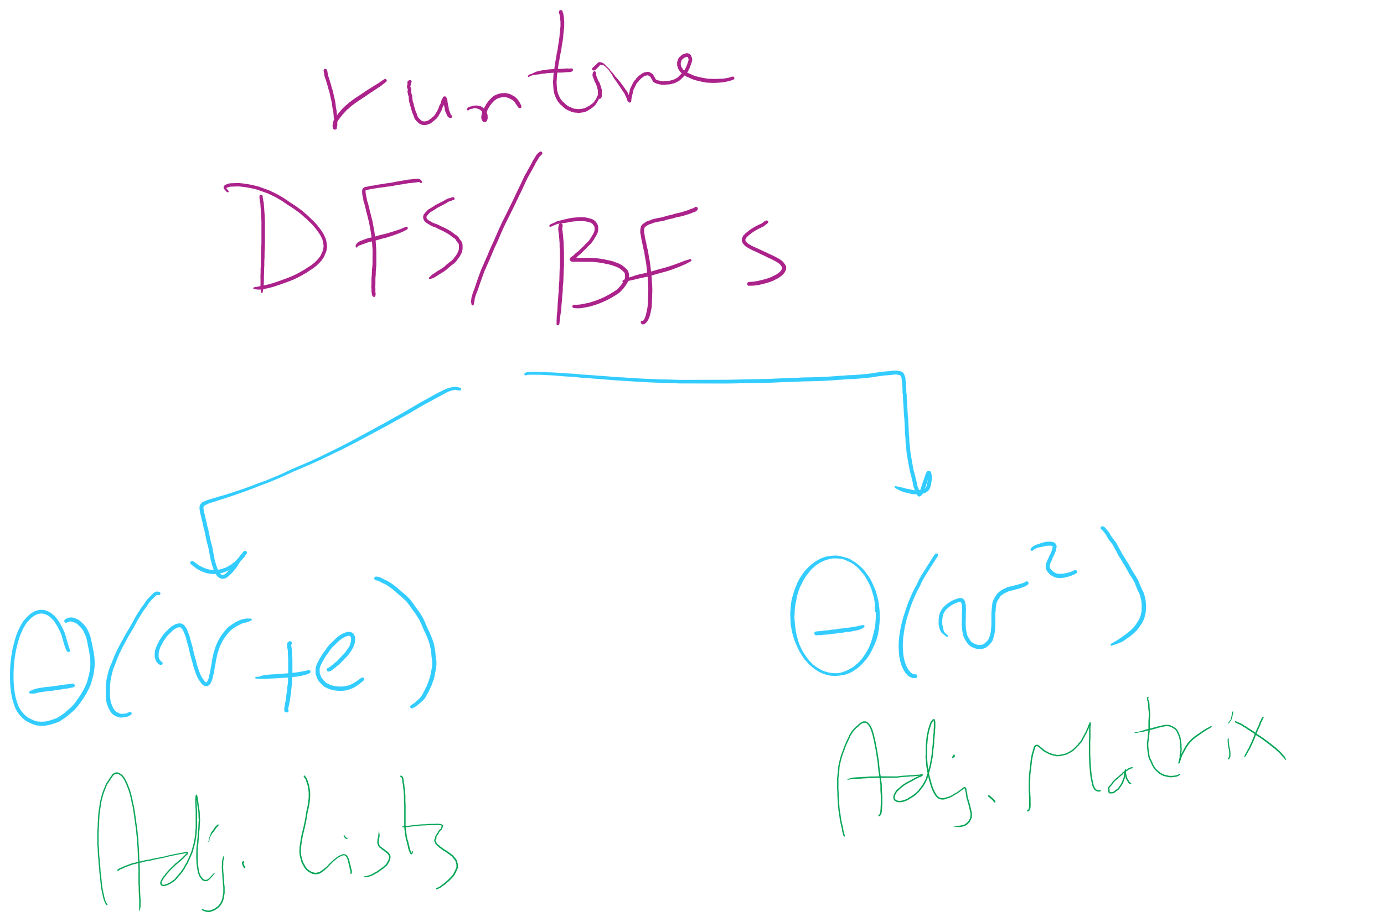
Runtime of BFS/DFS

Slide 10
Biconnected graphs
A biconnected graph has at least 2 distinct paths (no common edges or vertices) between all vertex pairs
Any graph that is not biconnected has one or more articulation points
Vertices, that, if removed, will separate the graph
Any graph that has no articulation points is biconnected
Thus we can determine that a graph is biconnected if we look for, but do not find any articulation points

Slide 11
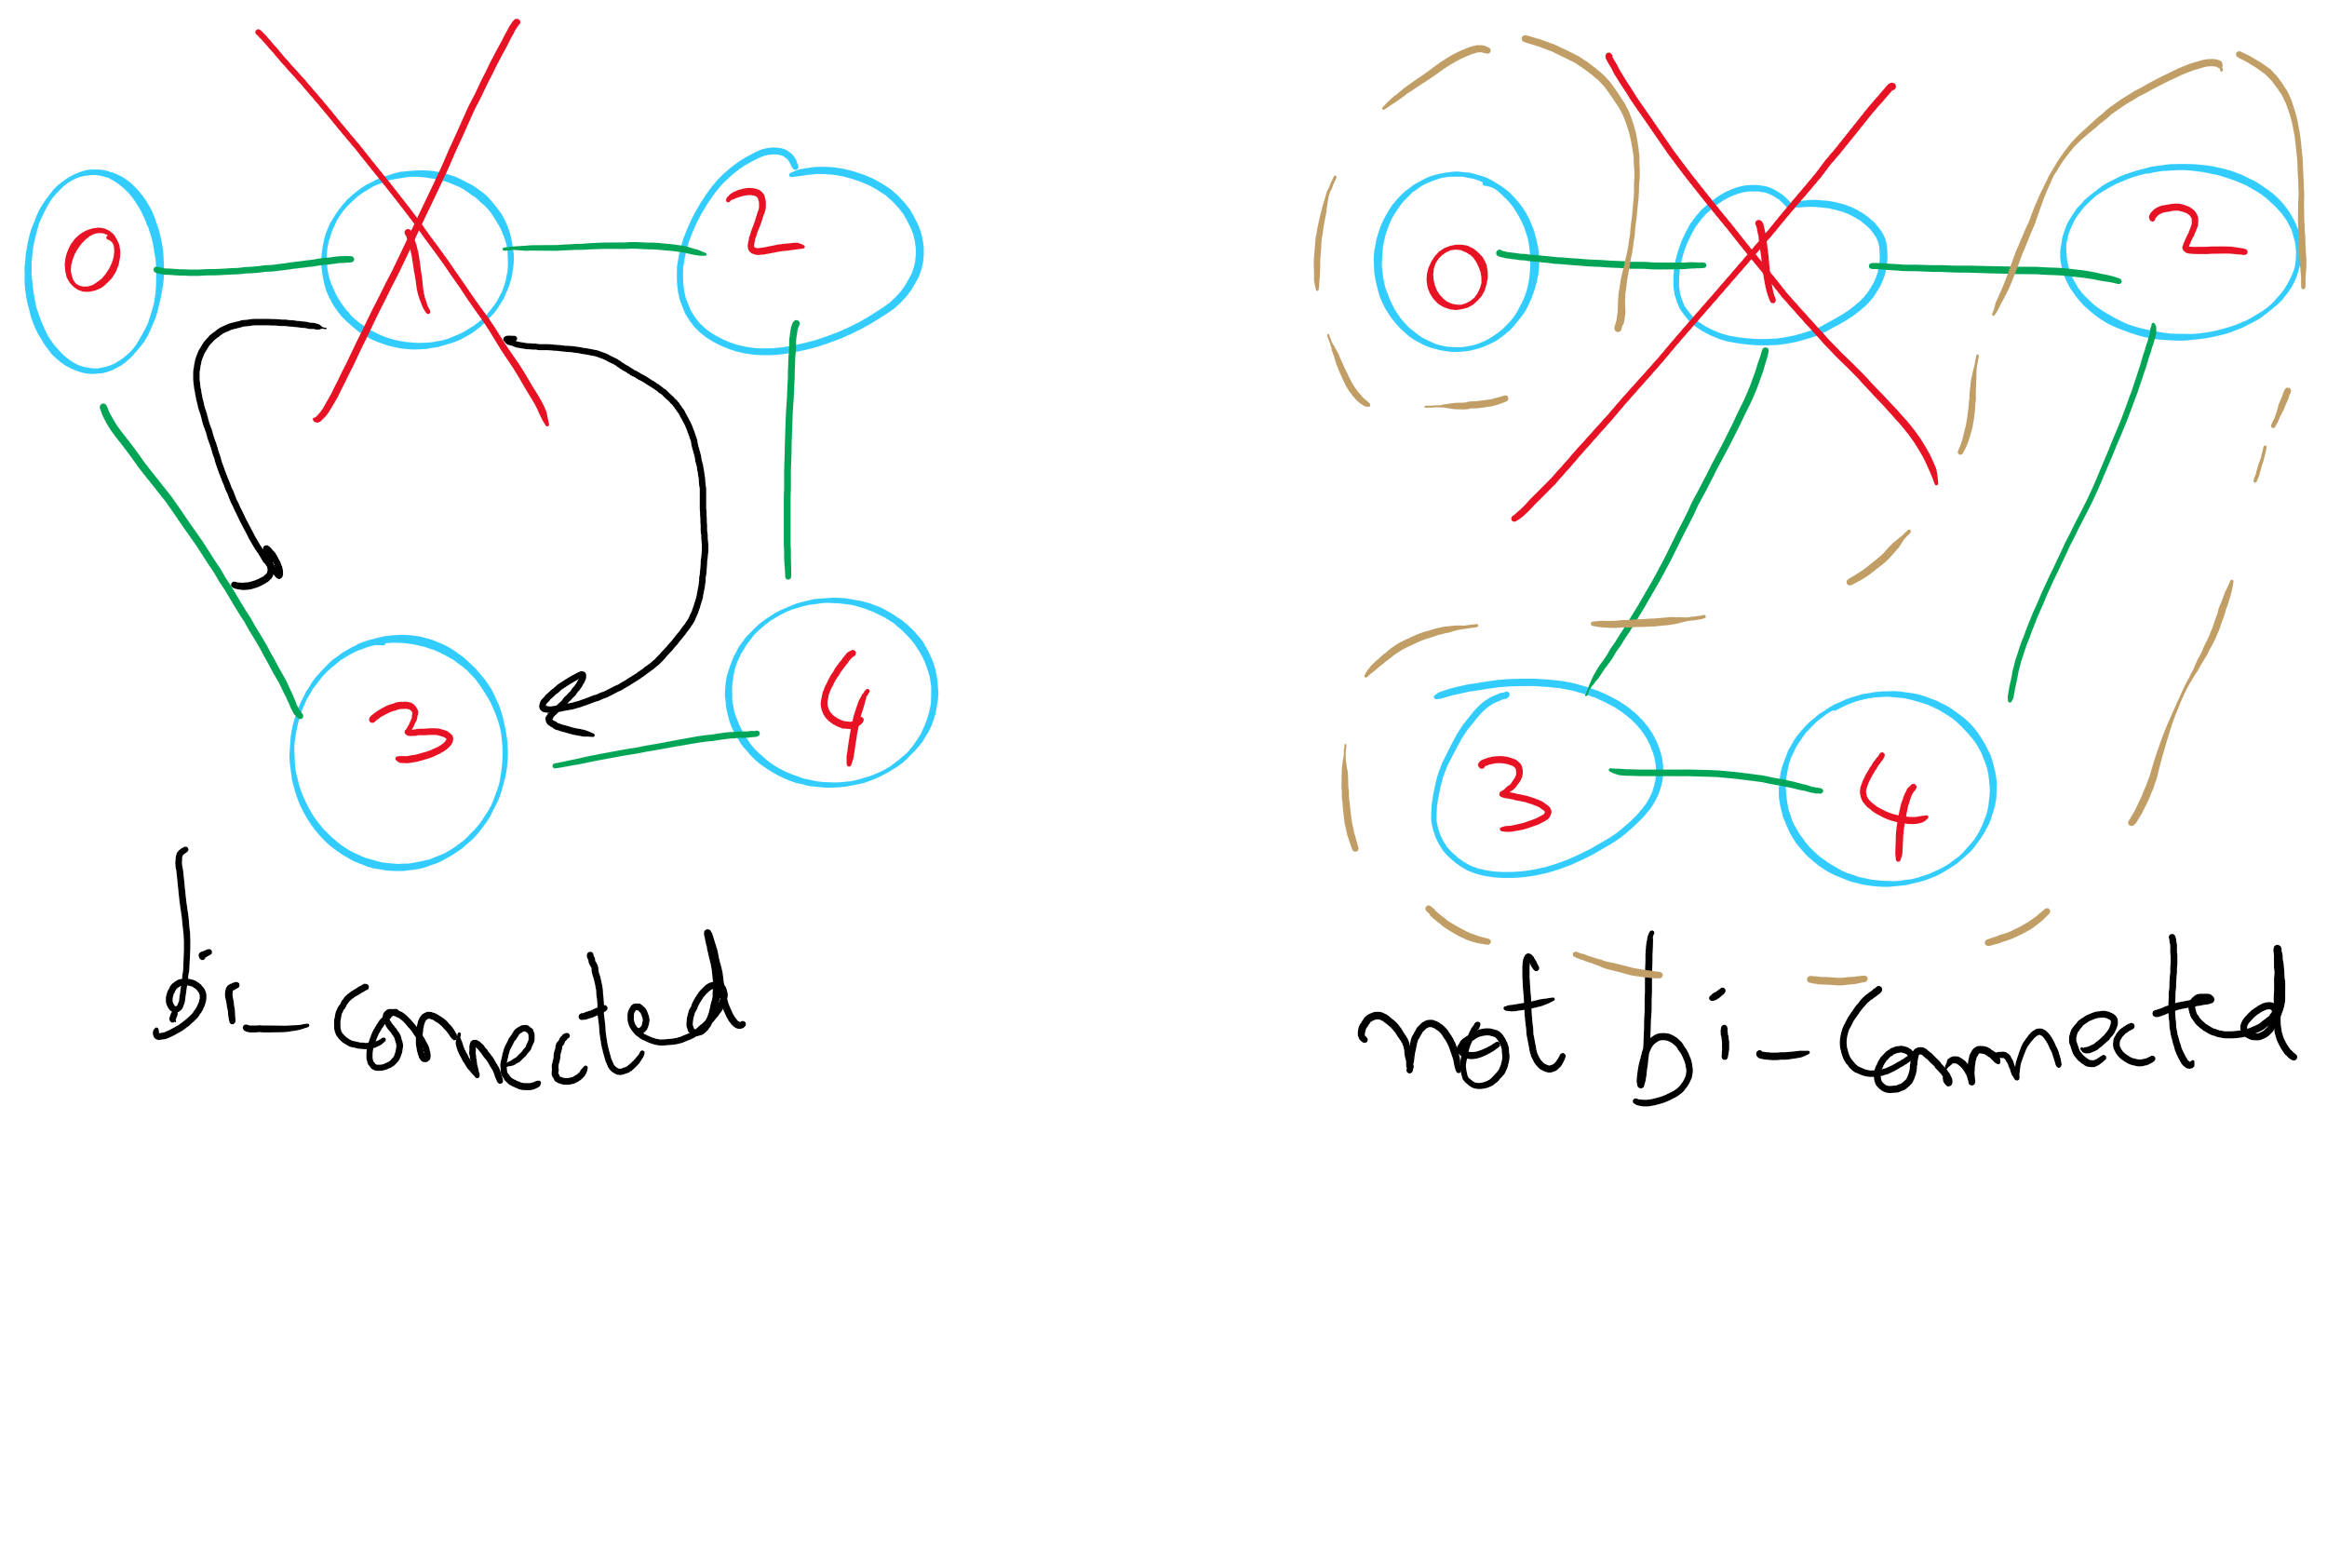
Bi-connected Graph

Slide 12
Finding articulation points
Variation on DFS
Consider building up the spanning tree
Have it be directed
Create “back edges” when considering a vertex that has already been visited in constructing the spanning tree
Label each vertex v with with two numbers:
num(v) = pre-order traversal order
low(v) = lowest-numbered vertex reachable from v using 0 or more spanning tree edges and then at most one back edge
Min of:
num(v)
Lowest num(w) of all back edges (v, w)
Lowest low(w) of all spanning tree edges (v, w)

Slide 13
Finding articulation points example
num
low
0
0
F
E
D
E
1
0
A
A
C
B
2
0
B
3
0
C
4
0
D
5
5
F

Slide 14
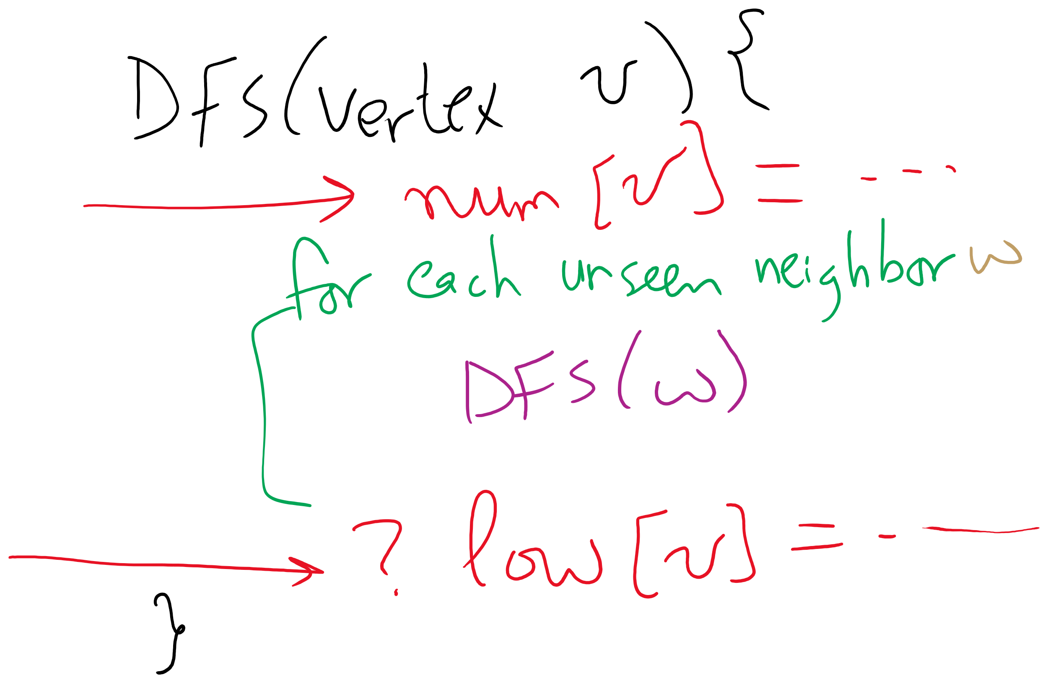
Using DFS to find articulation points

Slide 15
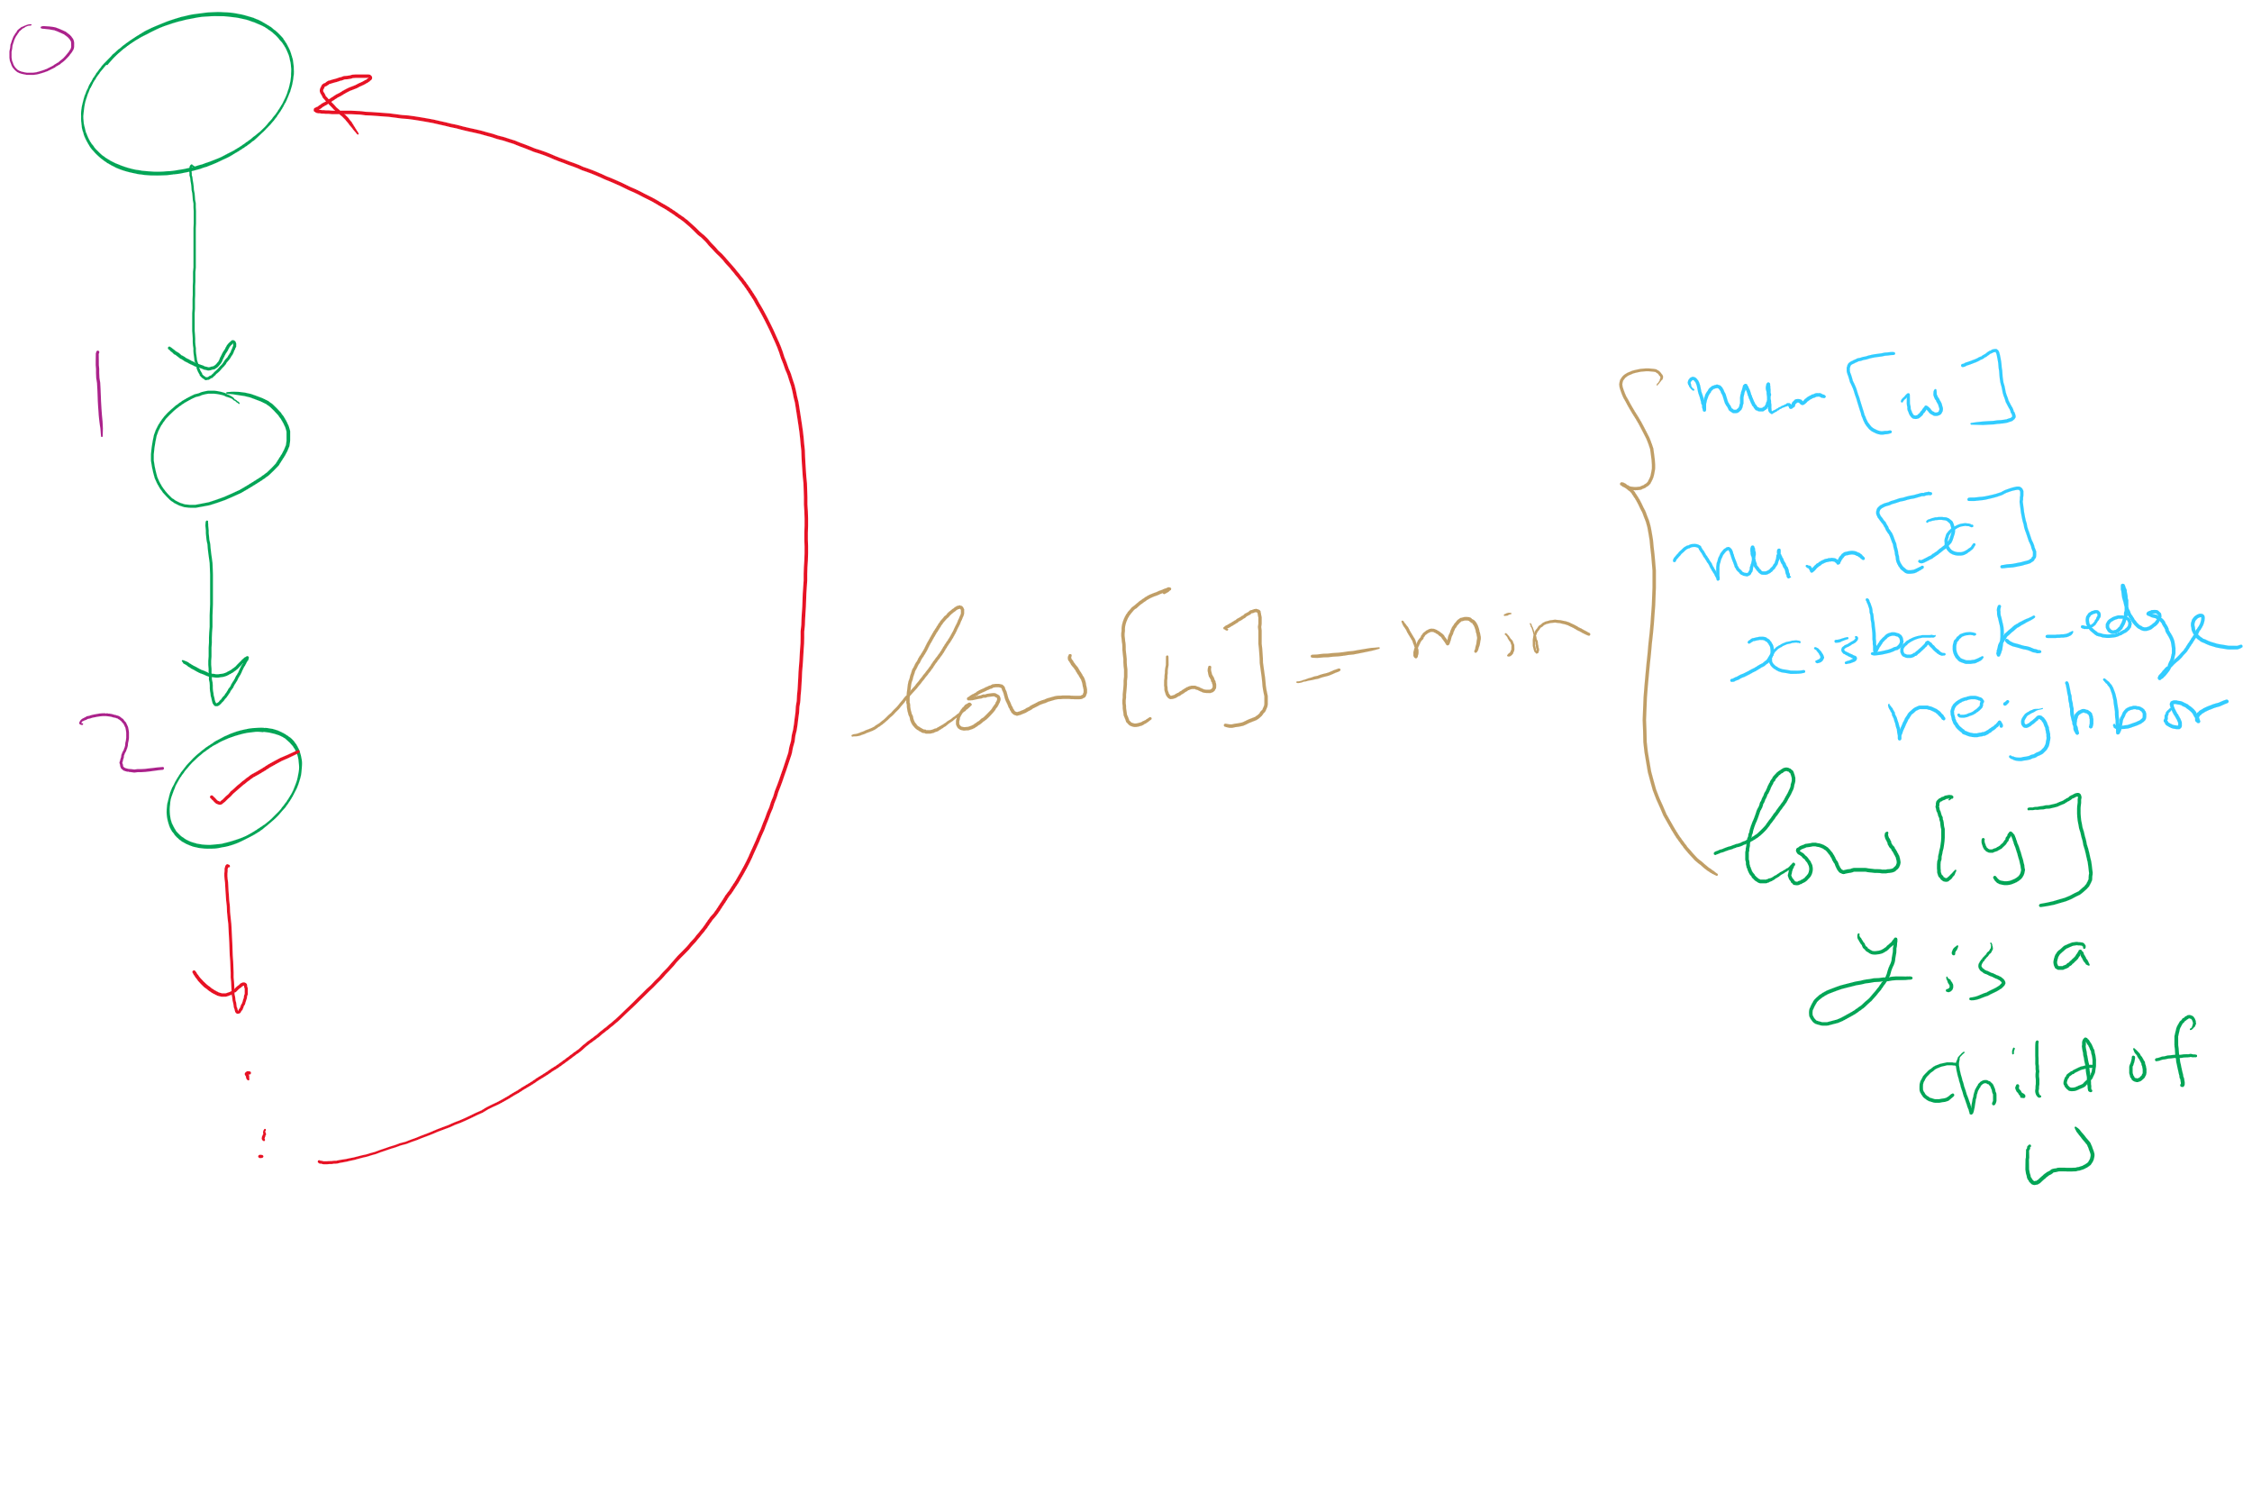
Articulation Points Algorithm

Slide 16
So where are the articulation points?
If any (non-root) vertex v has some child w such that low(w) ≥ num(v), v is an articulation point
What about if we start at an articulation point?
If the root of the spanning tree has more than one child, it is an articulation point

Slide 17
Problem of the Day (contd.)
Input: A file containing LinkedIn Connection information formatted like the following:
Account1: Connection1, Connection2, …
Account2: Connection1, Connection2, …
…
Output: Answer the following questions:
Given two LI accounts, how “far” are they from each other?
E.g., 1st connection, 2nd connection, etc.
Are the accounts in the file all connected?
If not, how many connected components are there?
Are there certain accounts that if removed, the remaining accounts become partitioned?
These account are called articulation points

Slide 18
Problem of the Day
Neighborhood connectivity project
We want to keep a set of neighborhoods connected with the minimum cost possible
Input: A set of neighborhoods and a file with the following format:
neighborhood i, neighborhood j, cost of connecting the two neighborhoods
…
Output: A set of neighborhood pairs to be connected and a total cost
We can go from any neighborhood to any other (connected)
The total cost should be minimum (i.e., as small as it can be) (minimal cost)

Slide 19
Thin Data Structures First!
How can we structure the input in computer memory?
Can we use Graphs?
What about the costs? How can we model that?

Slide 20
We said spatial layouts of graphs were irrelevant
We define graphs as sets of vertices and edges
However, we’ll certainly want to be able to reason about bandwidth, distance, capacity, etc. of the real world things our graph represents
Whether a link is 1 gigabit or 10 megabit will drastically affect our analysis of traffic flowing through a network
Having a road between two cities that is a 1 lane country road is very different from having a 4 lane highway
If two airports are 2000 miles apart, the number of flights going in and out between them will be drastically different from airports 200 miles apart

Slide 21
We can represent such information with edge weights
How do we store edge weights?
Adjacency matrix?
Adjacency list?
Do we need a whole new graph representation?
How do weights affect finding spanning trees/shortest paths?
The weighted variants of these problems are called finding the minimum spanning tree and the weighted shortest path
Notes:
Adjacency matrix:
Instead of 1, store the edge weight for all edges that exist
Adjacency list:
Add a field to list verticies to store the weight

Slide 22
Minimum spanning trees (MST)
Graphs can potentially have multiple spanning trees
MST is the spanning tree that has the minimum sum of the weights of its edges

Slide 23
Prim’s algorithm
Initialize T to contain the starting vertex
T will eventually become the MST
While there are vertices not in T:
Find minimum edge weight edge that connects a vertex in T to a vertex not yet in T
Add the edge with its vertex to T

Slide 24
Prim’s algorithm
10
1
4
1
4
4
6
8
7
0
9
5
0
3
6
3
6
2
9
8
2
2
2
5
5
1
Notes:
Green verticies/red edges in T
be sure to highlight the set of edges that could possibly be used to bring a vertex into T
grey edges that connect two green vertices dont need to be considered, thing to come back to when we talk about implementation, should we try to remove them from consideration?
not really, no asymptotic improvement for parent and best edge implementation
even with eager prims, that would just be more updates to try and avoid unneccesary removals, but both have the same asymptotic cost

Slide 25
Runtime of Prim’s
At each step, check all possible edges
For a complete graph:
First iteration:
v - 1 possible edges
Next iteration:
2(v - 2) possibilities
Each vertex in T shared v-1 edges with other vertices, but the edges they shared with each other already in T
Next:
3(v - 3) possibilities
…
Runtime:
Σ_{i = 1 to v} (i * (v - i))
Evaluates to Θ(v³)
Notes:
naively what we did on the previous slide looking at the images

Slide 26
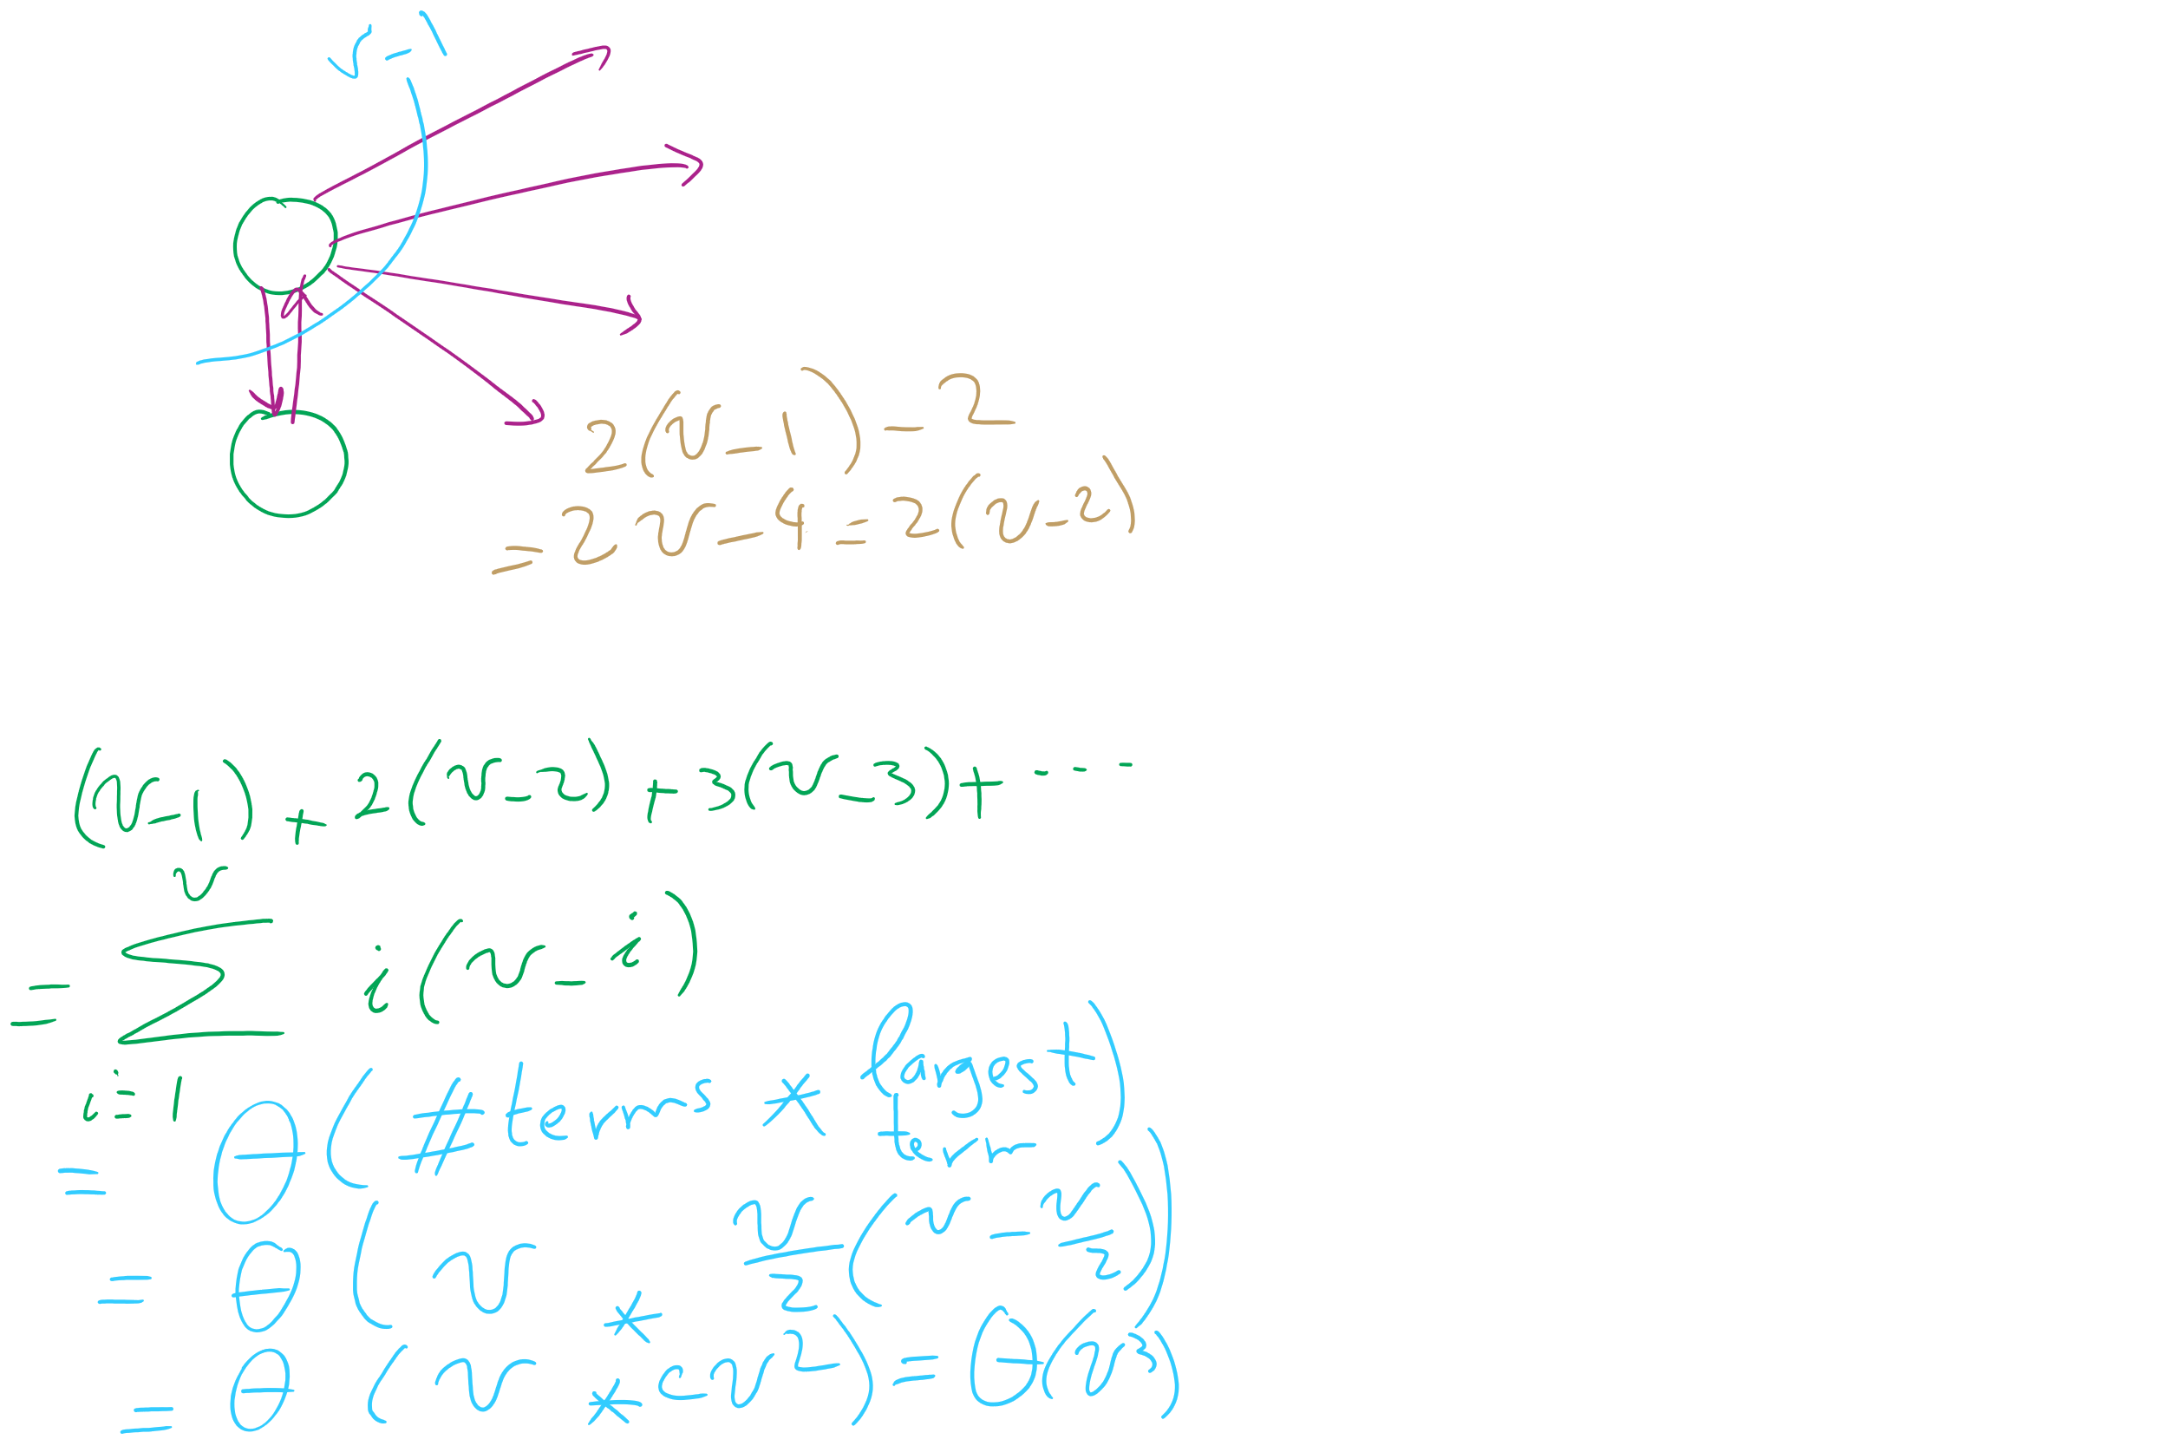
Analysis of Naïve implementation of Prim’s MST Algorithm

Slide 27
Do we need to look through all remaining edges?
No! We only need to consider the best edge possible for each vertex!

Slide 28
Prim’s algorithm
10
1
4
1
4
4
6
8
7
0
9
5
0
3
6
3
6
2
9
8
2
2
2
5
5
1
0
1
2
3
4
5
6
Parent:
--
--
--
--
--
--
--
0
0
2
1
1
5
2
5
Best Edge:
∞
0
∞
∞
∞
∞
∞
∞
4
8
2
8
10
5
1
2
Notes:
Green vertices/red edges in T

Slide 29
OK, so what's our runtime?
For every vertex we add to T, we’ll need to check all of its neighbors to check for edges to add to T next
Let's assume we use an adjacency matrix:
Takes Θ(v) to check the neighbors of a given vertex
Time to update parent/best edge arrays?
Time to pick next vertex?
What about with an adjacency list?
Notes:
v vertices will be added to T, so we do the following v times:
Search through the neighbors of the next vertex to adjust the parent and best edge arrays as needed
Constant time to update parent/best edge arrays
Neighbor enumeration:
Matrix:
Θ(v)
List:
Θ(degree)
Search through the best_edge array to find the next addition to T
Θ(v)
So, matrix:
We do v * 2 * Θ(v) work
Θ(v²)
List:
We do v * Θ(v) * degree work
Θ(v²)

Slide 30
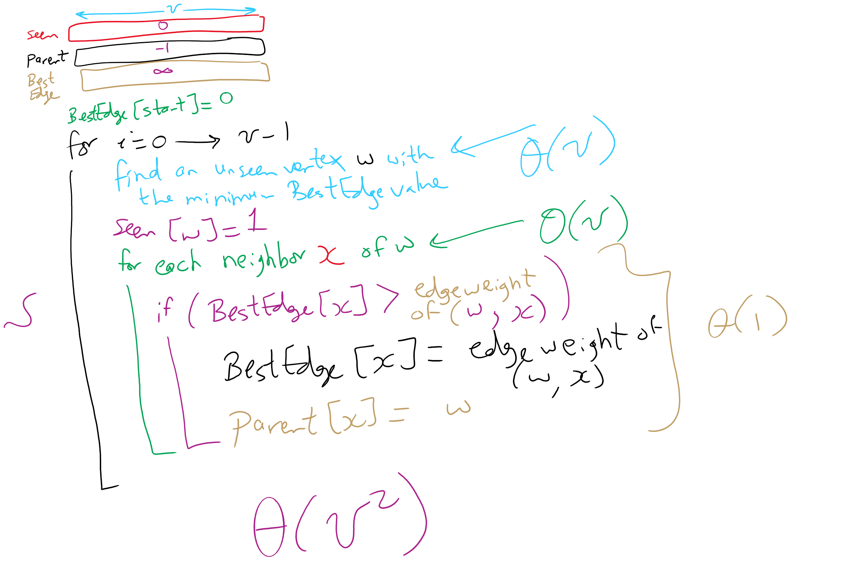
Prim’s MST Algorithm

Slide 31
Another MST algorithm
Kruskal’s MST:
Insert all edges into a PQ
Grab the min edge from the PQ that does not create a cycle in the MST
Remove it from the PQ and add it to the MST

Slide 32
Kruskal's example
0
PQ:
6
5
1
1
3
1: (0, 2)
2: (3, 5)
5
5
3: (1, 4)
2
3
2
4: (2, 5)
6
4
5: (2, 3)
5: (0, 3)
4
5
6
5: (1, 2)
6: (0, 1)
6: (2, 4)
6: (4, 5)
Notes:
note that we can stop after we add (1, 2)
get the students to realize why
its connected, adding any more edges would create a cycle
do we have to stop or can we keep popping and doing cycle detection?
is it better to stop or keep going and doing cycle check for each remove?
why?
depends on time to do connected detection vs time to continue popping/cycle detection

Slide 33
Kruskal’s runtime
Instead of building up the MST starting from a single vertex, we build it up using edges all over the graph
How do we efficiently implement cycle detection?

Slide 34
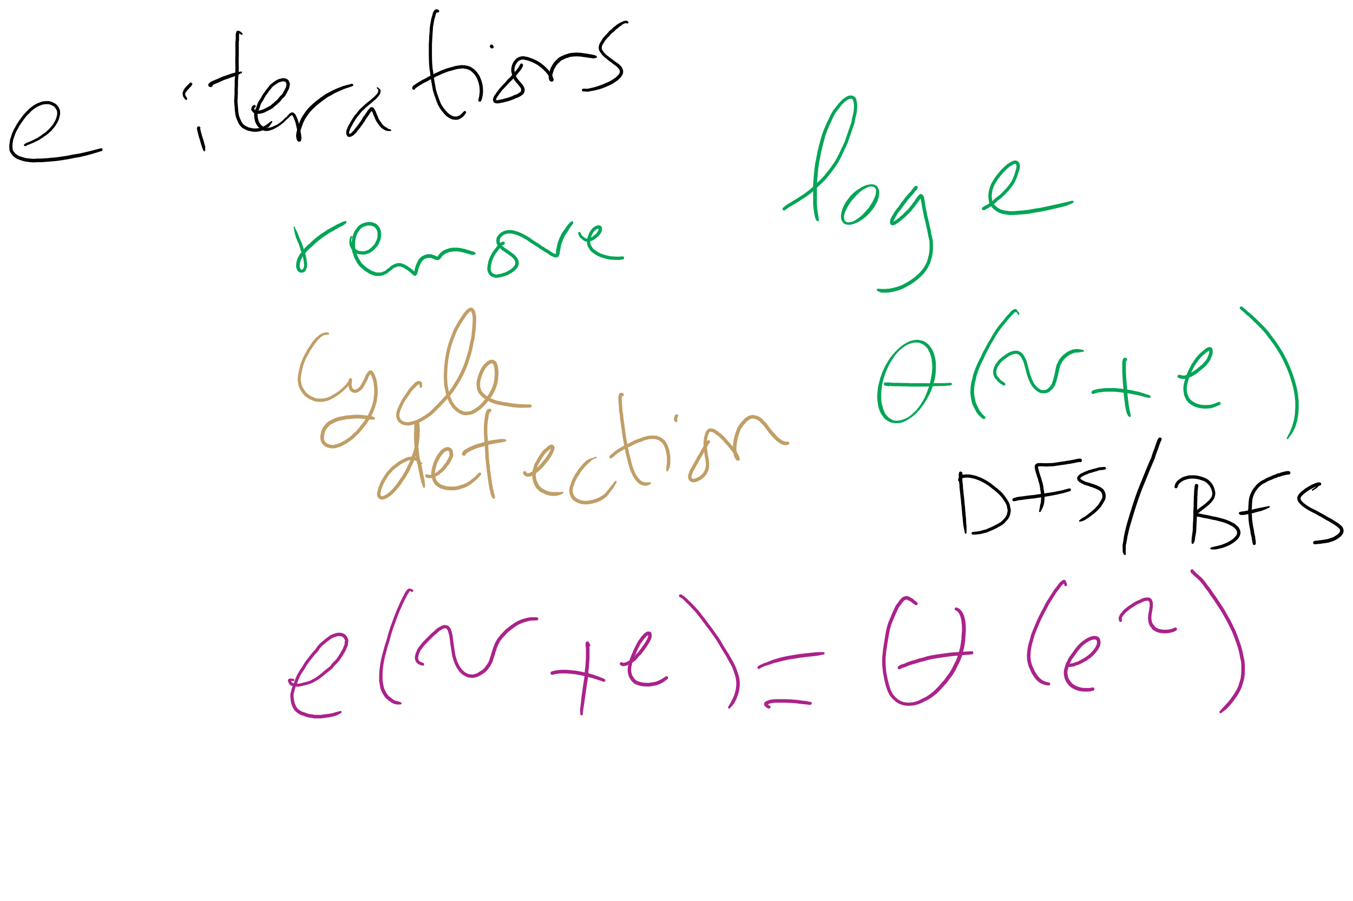
Kruskal’s Runtime: Take 1

Slide 35
Please submit your reflections by using the CourseMIRROR App
If you are having a problem with CourseMIRROR, please send an email to coursemirror.development@gmail.com
Notes:
All right!
Upcoming Due Dates at A Glance

