Slide 1

Algorithms and Data Structures 2 CS 1501
Fall 2021
Sherif Khattab
ksm73@pitt.edu
(Slides are adapted from Dr. Ramirez’s and Dr. Farnan’s CS1501 slides.)

Slide 2
Announcements
Upcoming deadlines:
11/12: Lab 8 and Homework 9
11/15: Assignment 3

Slide 3
Previous lecture …
Minimum Spanning Tree
Prim’s
Priority Queue ADT
Heap implementation

Slide 4
Weighted shortest path
Dijkstra’s algorithm:
Set a distance value of MAX_INT for all vertices but start
Set cur = start
While destination is not visited:
For each unvisited neighbor of cur:
Compute tentative distance from start to the unvisited neighbor through cur
Update any vertices for which a lesser distance is computed
Mark cur as visited
Let cur be the unvisited vertex with the smallest tentative distance from start

Slide 5
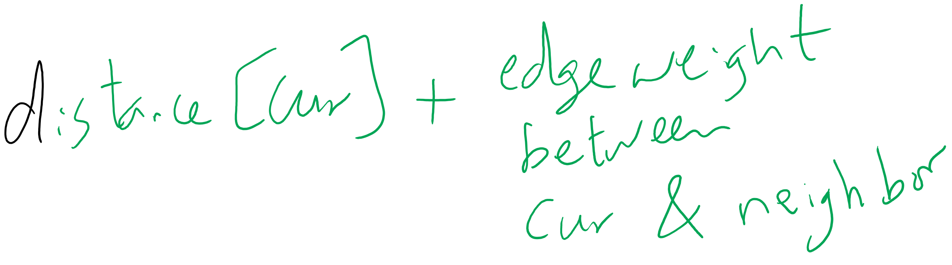
Tentative Distance

Slide 6
Dijkstra's example
0
0
Distance
Via
7
14
0
0
--
1
9
3
1
3
1
∞
7
--
0
2
∞
9
--
10
2
0
2
2
3
11
∞
14
2
--
15
0
9
4
22
21
∞
1
2
--
12
13
5
∞
22
20
--
2
3
4
5
4
5
2

Slide 7
Analysis of Dijkstra’s algorithm
How to implement?
Best path/parent array?
Runtime?
PQ?
Turns out to be very similar to Eager Prims
Storing paths instead of edges
Runtime?

Slide 8
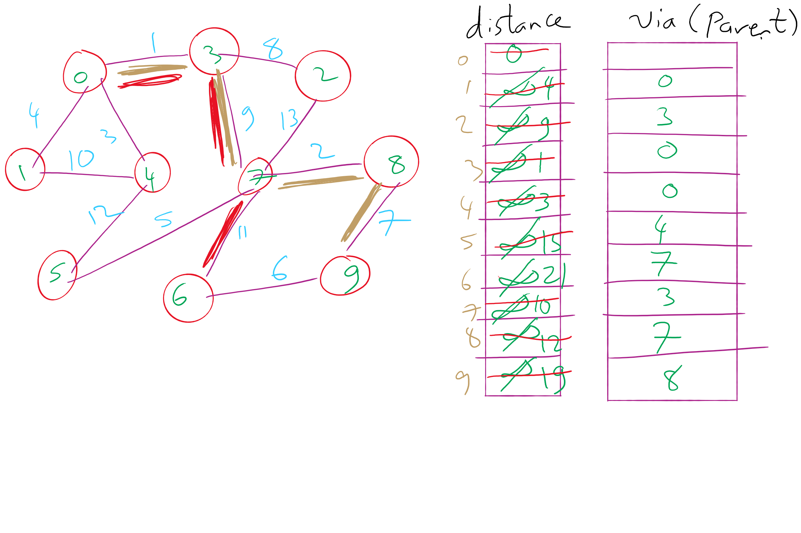
Dijkstra’s Shortest Paths Example 1

Slide 9
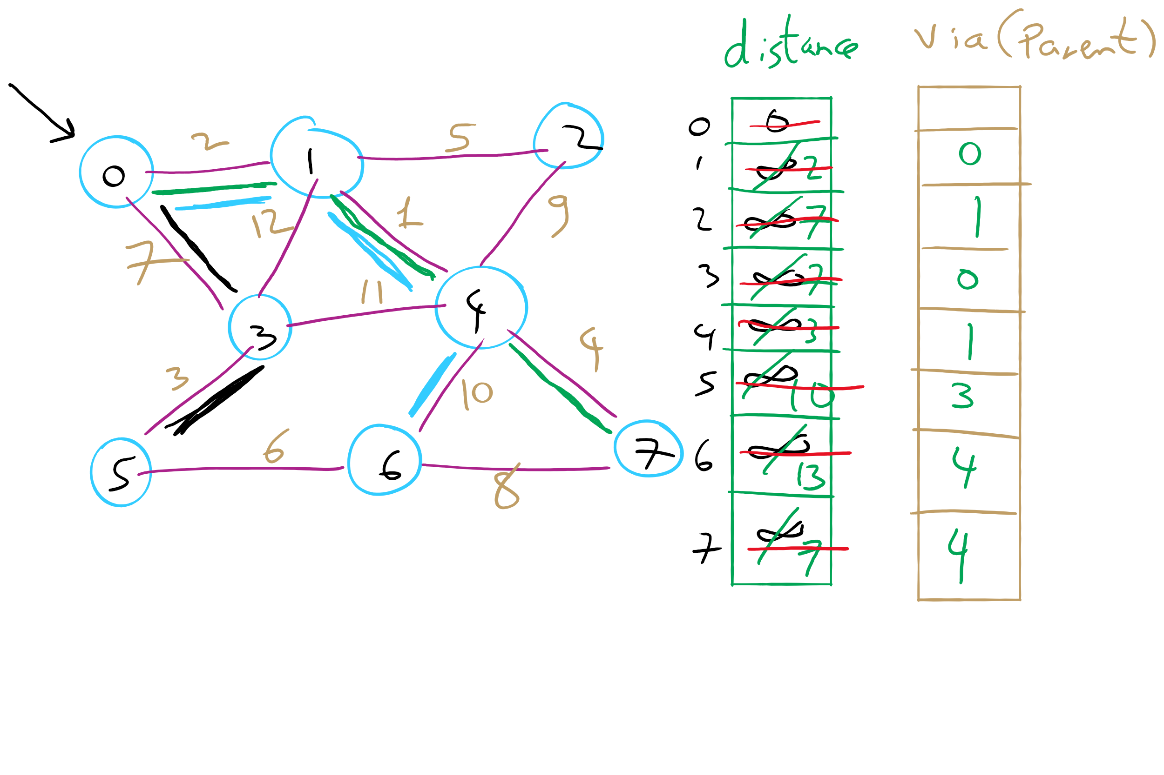
Dijkstra’s Shortest Paths Example 2

Slide 10
Please submit your reflections by using the CourseMIRROR App
If you are having a problem with CourseMIRROR, please send an email to coursemirror.development@gmail.com
Notes:
All right!
Upcoming Due Dates at A Glance

