Slide 1
AI & Society

Slide 2
The success of neural networks has fueled an explosive growth in the adoption of AI across many domains. So far, have the benefits of this adoption outweighed the costs?

Slide 3
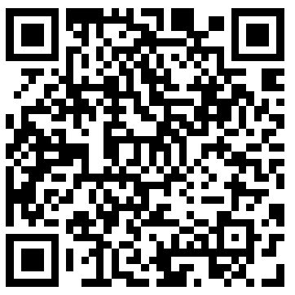
Brainstorming benefits and costs
https://pollev.com/gabrielhope098

Slide 4
Things to consider
For benefits of AI adoption:
For costs of AI adoption
Who is benefiting?
How much do they benefit?
Is this a realized or hypothetical benefit?
Are there alternative ways to achieve the same outcome?
How could the impact of this benefit be improved?
Who is harmed by this cost?
How significant is this harm?
Is this a realized or hypothetical cost?
What is being done to mitigate this cost?
What could be done to further mitigate this cost?

Slide 5
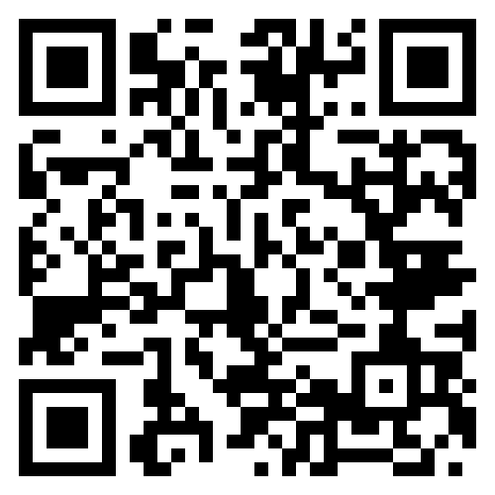
How machine learning researchers view the benefits and costs
Activity
Find another classmate and form a pair
Open the link 👉
Read one subsection of your choice from the society chapter
Discuss with your partner
Be prepared to share your discussion with the class
https://bit.ly/foundationmodels

Slide 6
What does it mean to use AI responsibly?
Will you do it?

