Slide 1

Introduction to Operating Systems CS/COE 1550
Fall 2021
Sherif Khattab
ksm73@pitt.edu
(Some slides are from Silberschatz, Galvin and Gagne ©2013)

Slide 2
Announcements
Upcoming deadlines:
3/19: Homework 8
3/26: Lab 3
4/2: Project 3 (Virtual Memory Simulator)
Tophat questions due one week after each lecture

Slide 3
Last Lecture …
Virtual Memory
Page Replacement Algorithms
OPT
NRU
FIFO

Slide 4
Muddiest Points (1/3)
Page replacement algorithm
Can you re-explain the optimal memory management arrangement?
Why exactly the optimal algorithm is not feasible on modern devices
What real world scenarios can we use the optimal algorithm?
more visual examples for algorithms
NRU algorithm
How does NRU work like step by step
NRU is not Least recently used correct? It seems similar to LRU...
Does page replacement load pages from storage, and evict victim pages back to storage?
Page fault
what exactly causes page faults
how to figure out when a page fault will occur
the exact conditions for a page-fault

Slide 5
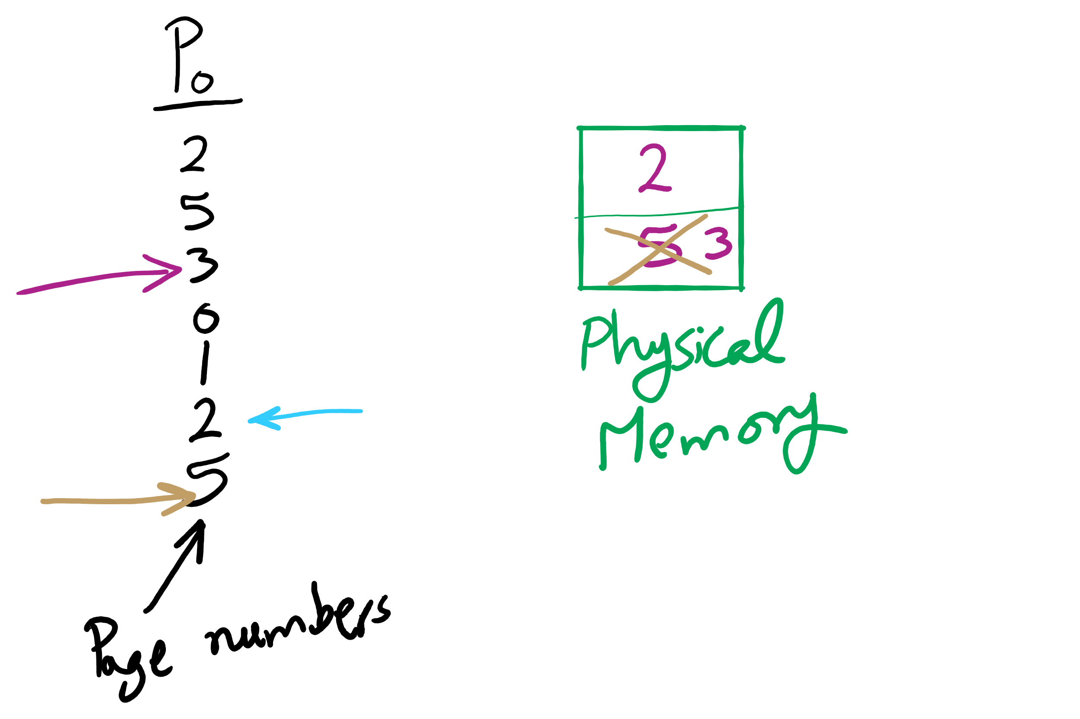
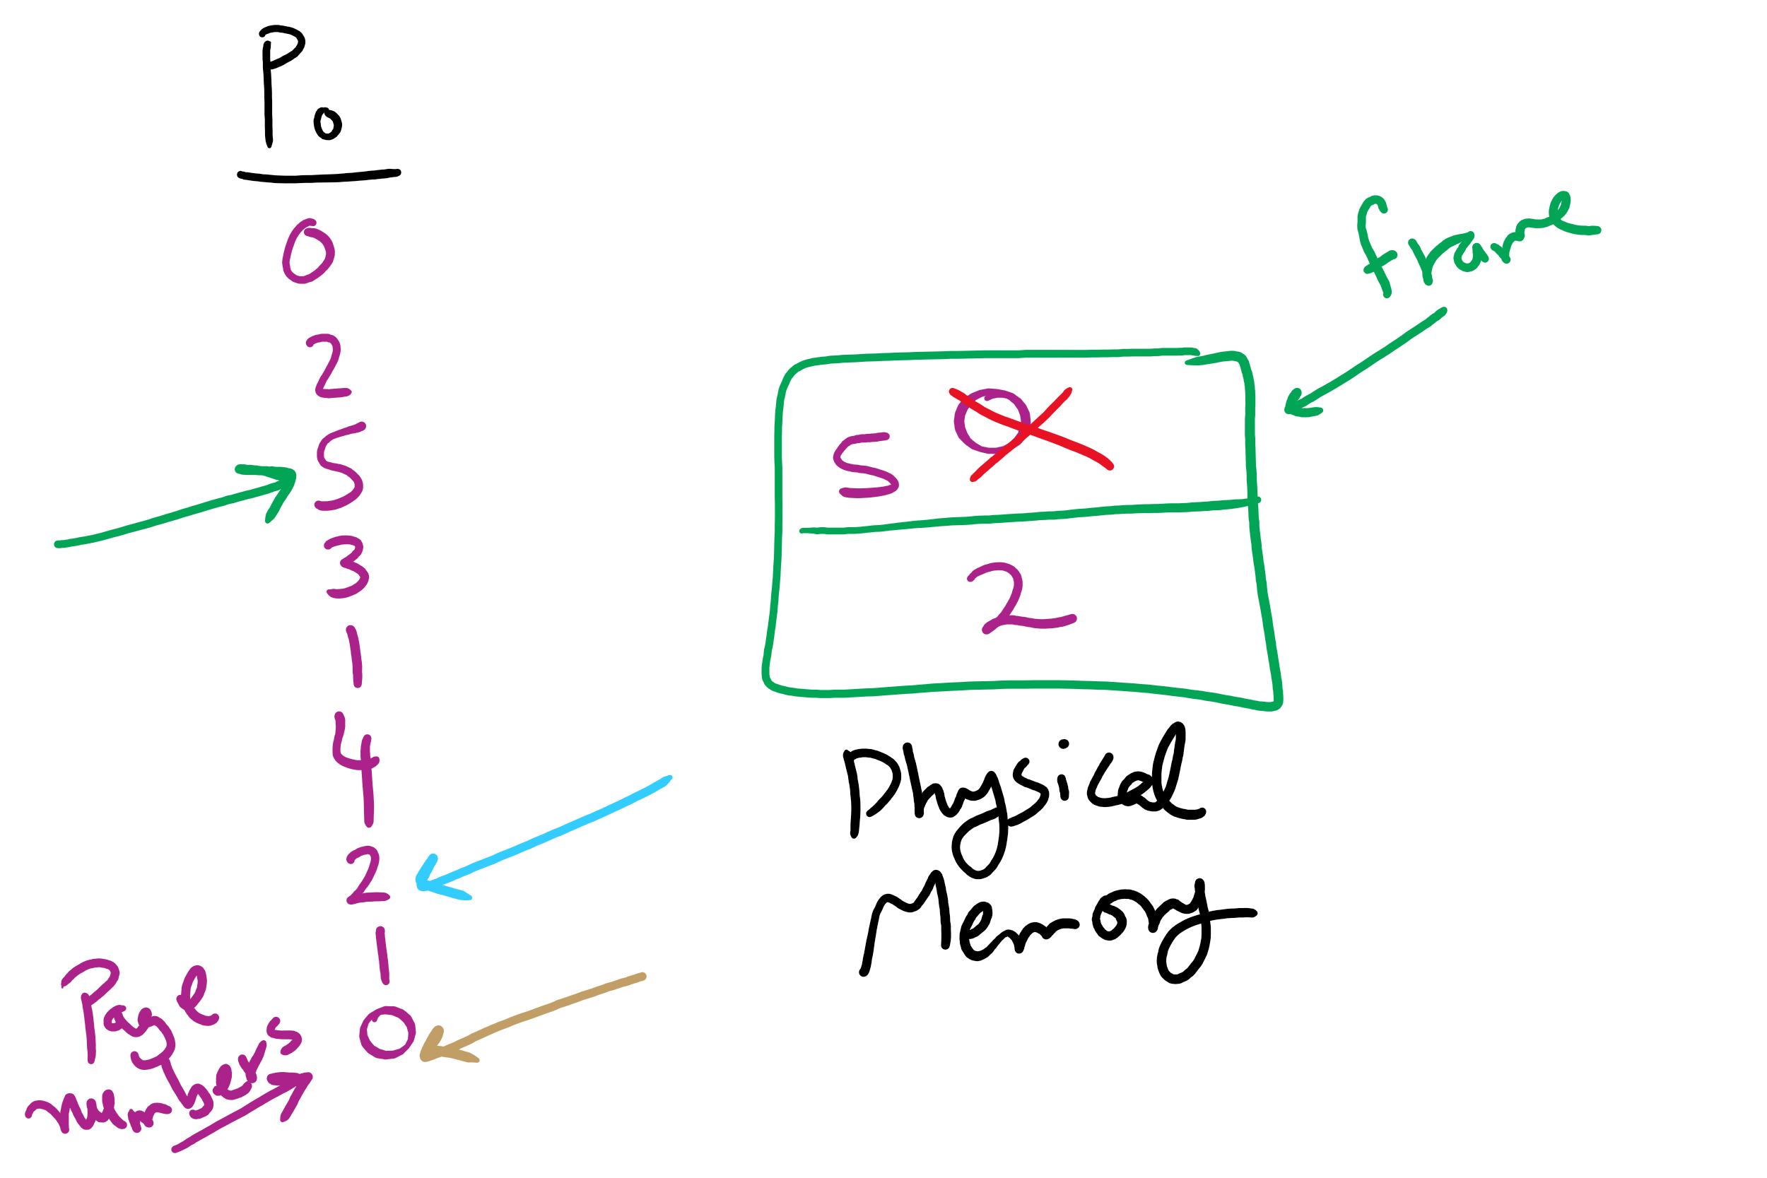
OPT Examples

Slide 6
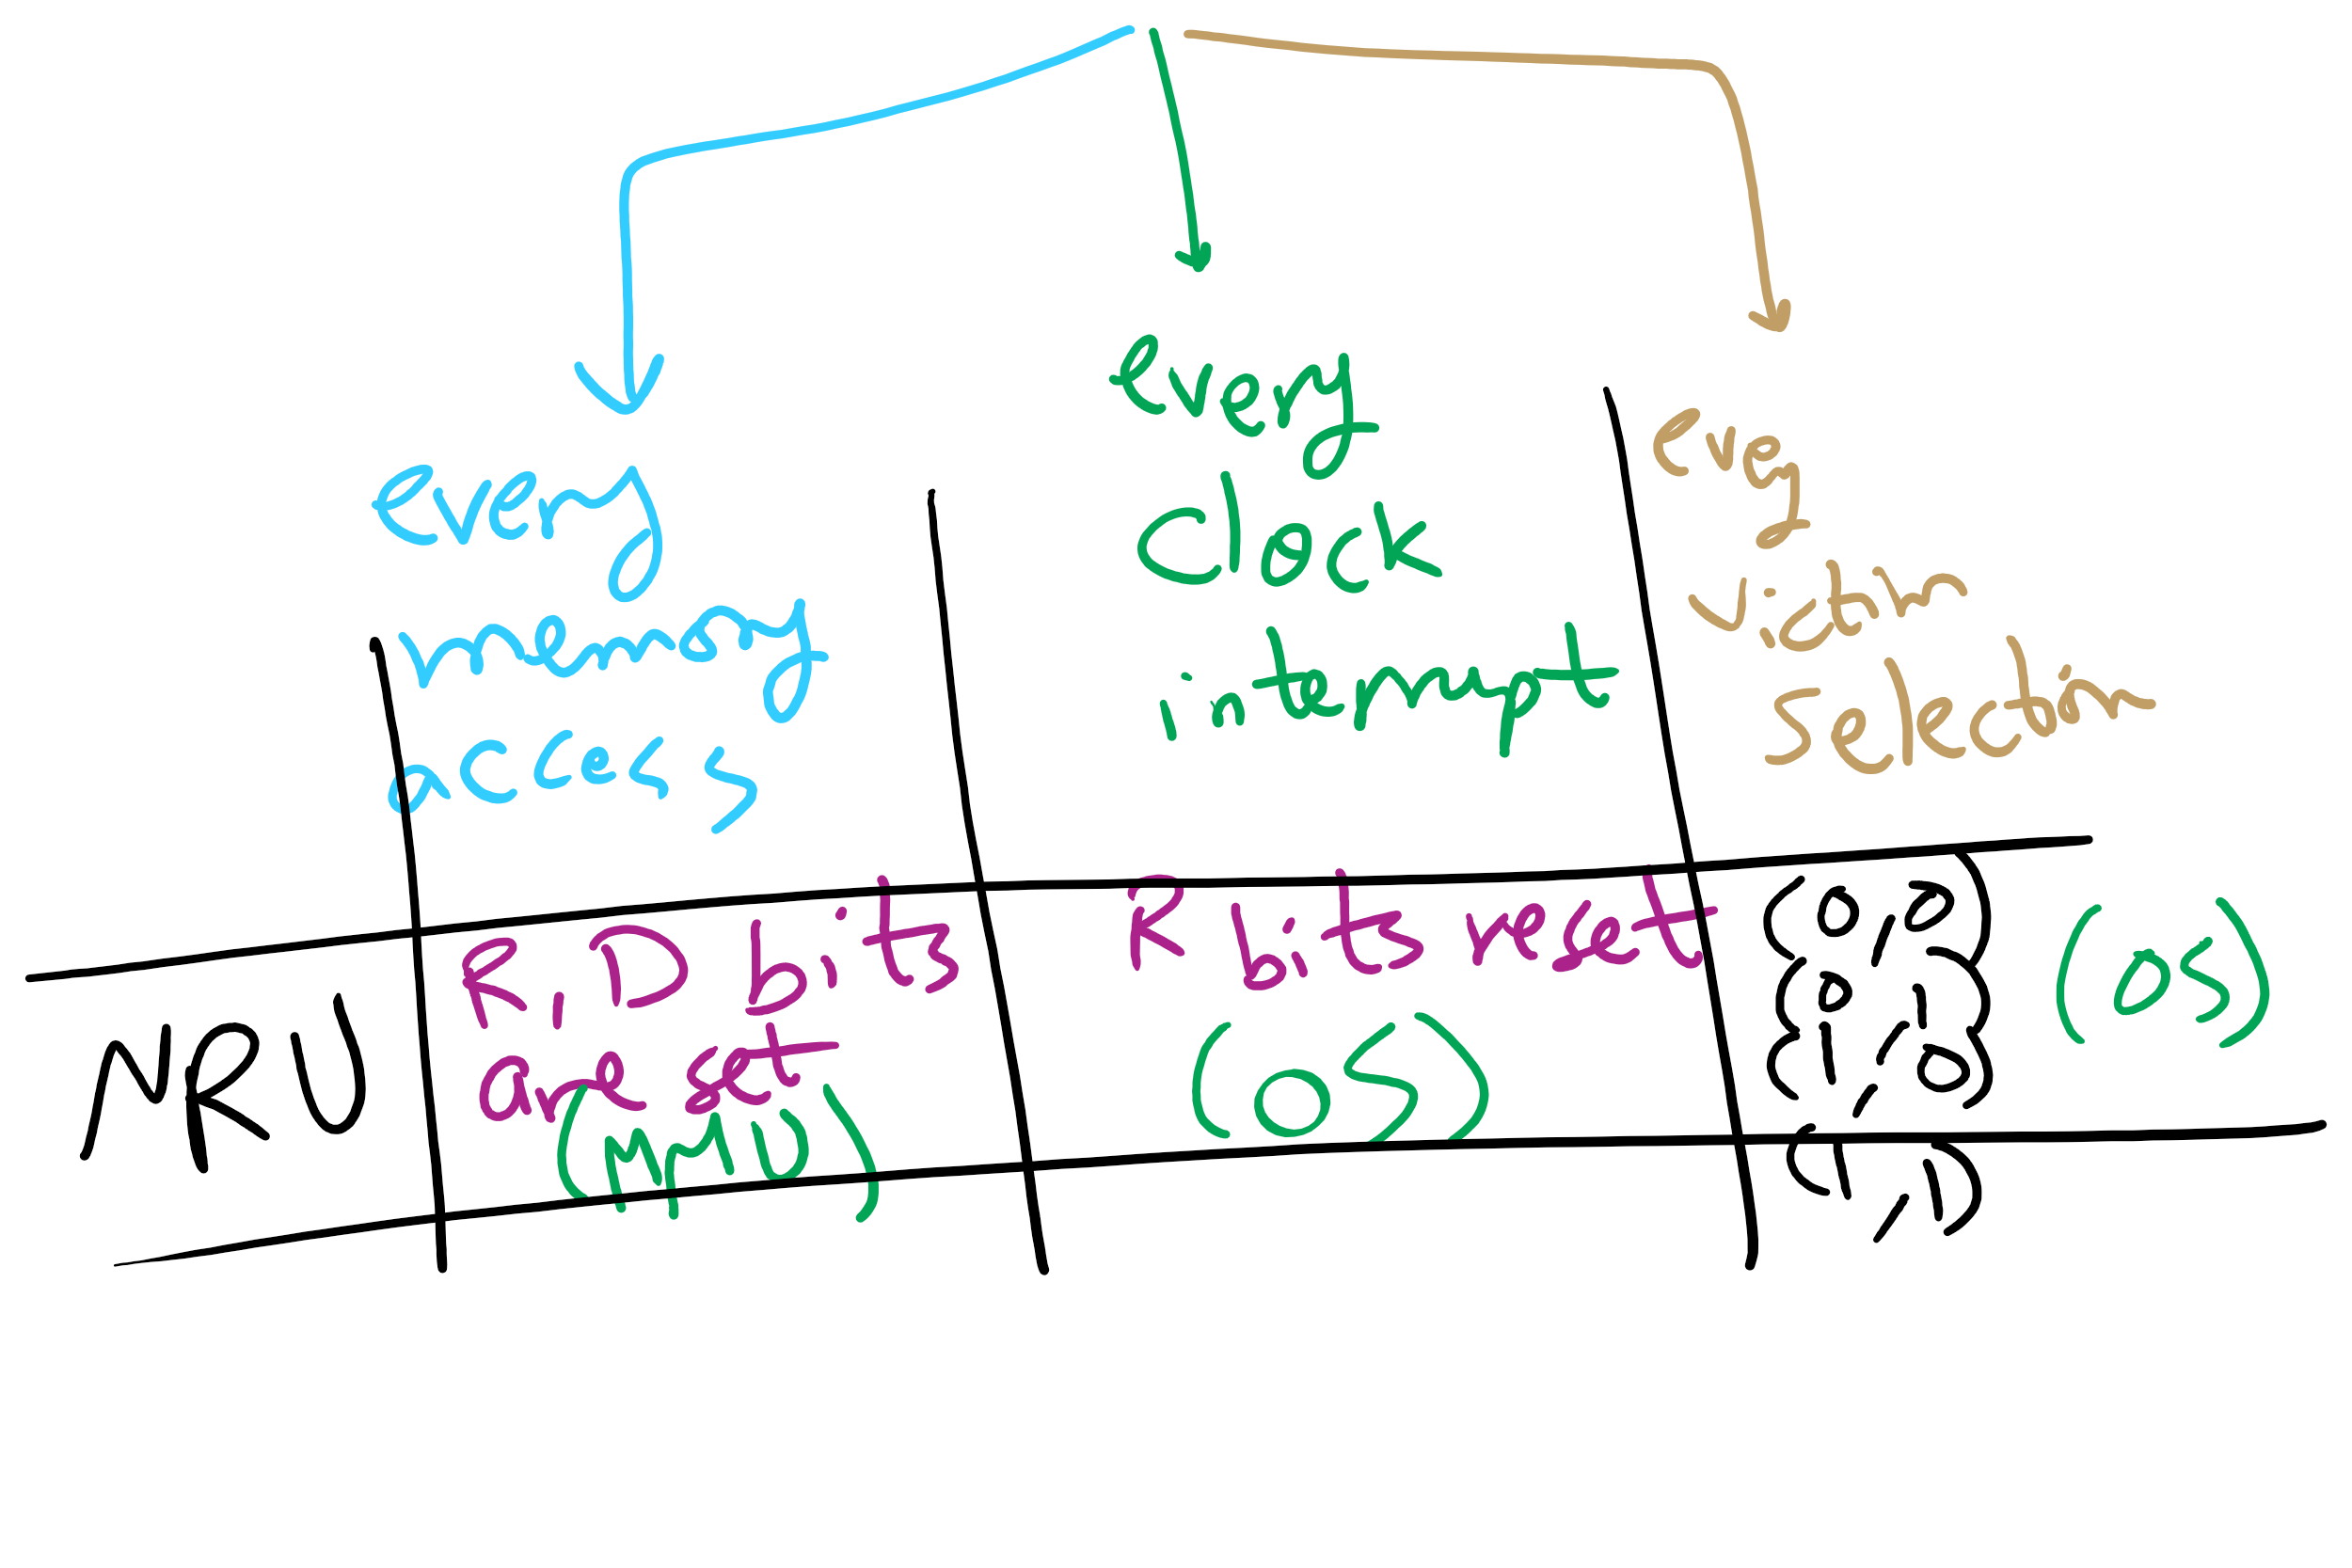
NRU Operation

Slide 7
Muddiest Points (2/3)
Page Table
TLB and general indirection of paging... what points to what?
Is it possible to remove the reference bit for algorithms other than NRU to save space, or does it have other uses?
What is the page table? Does it hold the page table entry for every currently running process?
page table entries
can you go over the use of PTBR vs PTLR again
Where is the page reference bit stored?
page table entries and the dirty bit
Translation from virtual to physical memory
virtual address space vs physical address space
Can physical memory addresses have multiple associated virtual memory addresses? Or am I misremembering something else from 449?
Where are things stored when they arent in physical memory?
The base and limit registers were the most confusing

Slide 8
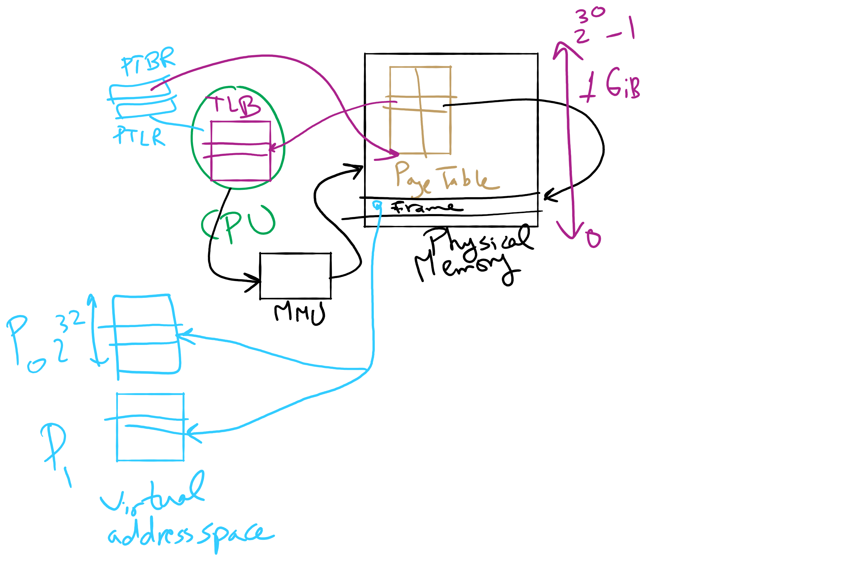
Address Translation

Slide 9
Muddiest Points (3/3)
more practice with process scheduling algorithms (like the question we went over today)
What are the device drivers being protected from and how could that happen?
Also, could you walk through Q18,19 on HW7?
could you explain again more detailedly why more processes in the system can lead to higher cpu utilization

Slide 10
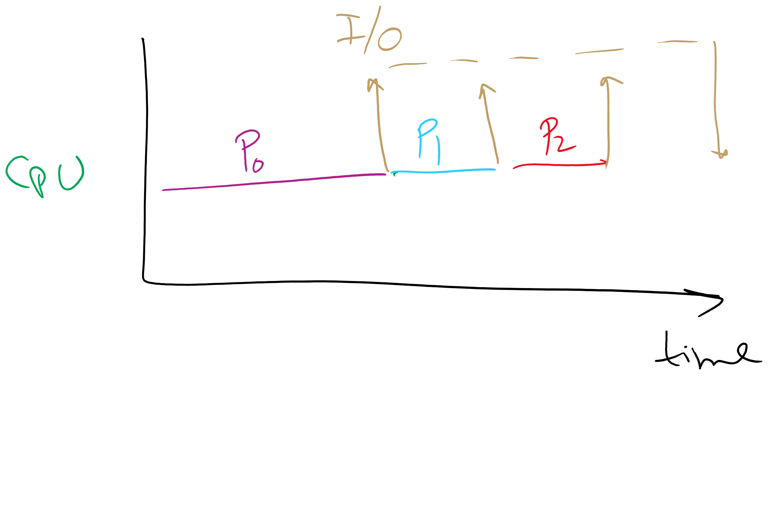
Why are more processes needed for higher CPU utilization?

Slide 11
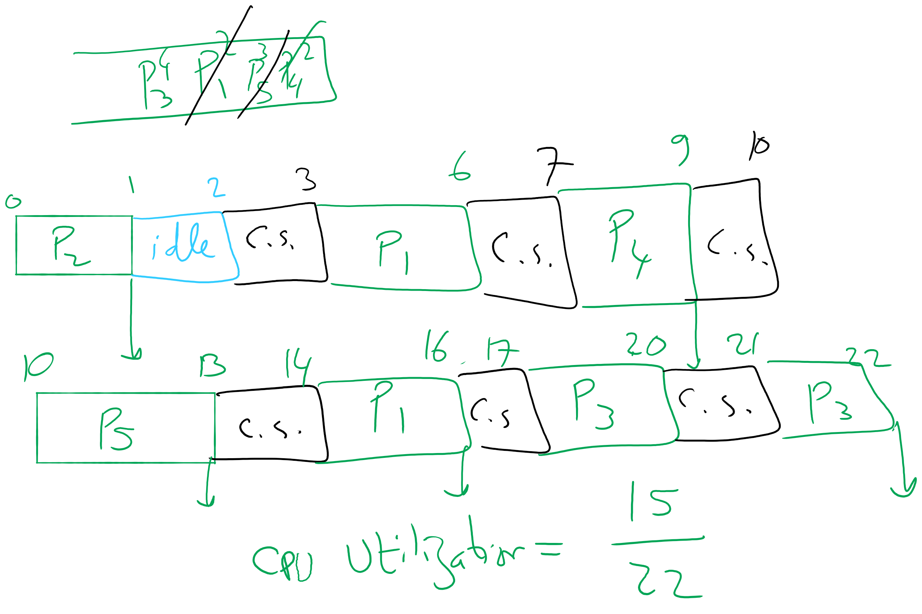
Q18,19 in HW7

Slide 12
Today’s Agenda …
Page Replacement Algorithms
Second Chance
CLOCK
LRU
Aging
NFU
Working Set
WS-CLOCK
Address Translation

Slide 13
Second chance page replacement
Modify FIFO to avoid throwing out heavily used pages
If reference bit is 0, throw the page out
If reference bit is 1
Reset the reference bit to 0
Move page to the tail of the list
Continue search for a free page
Still easy to implement, and better than plain FIFO
referenced
unreferenced
A t=0
B t=4
C t=8
D t=15
E t=21
F t=22
G t=29
H t=30
A t=32

Slide 14
Clock algorithm
Same functionality as second chance
Simpler implementation
“Clock” hand points to next page to replace
If R=0, replace page
If R=1, set R=0 and advance the clock hand
Continue until page with R=0 is found
This may involve going all the way around the clock…
A t=0
A t=32
H t=30
B t=4
B t=32
G t=29
C t=8
C t=32
F t=22
D t=15
J t=32
E t=21
referenced
unreferenced

Slide 15
Least Recently Used (LRU)
Assume pages used recently will be used again soon
Throw out page that has been unused for longest time
Must keep a linked list of pages
Most recently used at front, least at rear
Update this list every memory reference!
This can be somewhat slow: hardware has to update a linked list on every reference!
Alternatively, keep counter in each page table entry
Global counter increments with each CPU cycle
Copy global counter to PTE counter on a reference to the page
For replacement, evict page with lowest counter value

Slide 16
Simulating LRU in software
Few computers have the necessary hardware to implement full LRU
Linked-list method impractical in hardware
Counter-based method could be done, but it’s slow to find the desired page
Approximate LRU with Not Frequently Used (NFU) algorithm
At each clock interrupt, scan through page table
If R=1 for a page, add one to its counter value
On replacement, pick the page with the lowest counter value
Problem: no notion of age—pages with high counter values will tend to keep them!

Slide 17
Aging replacement algorithm
Reduce counter values over time
Divide by two every clock cycle (use right shift)
More weight given to more recent references!
Select page to be evicted by finding the lowest counter value
Algorithm is:
Every clock tick, shift all counters right by 1 bit
On reference, set leftmost bit of a counter (can be done by copying the reference bit to the counter at the clock tick)
Referenced this tick
Tick 0
Tick 1
Tick 2
Tick 3
Tick 4
Page 0
10000000
11000000
11100000
01110000
10111000
Page 1
00000000
10000000
01000000
00100000
00010000
Page 2
10000000
01000000
00100000
10010000
01001000
Page 3
00000000
00000000
00000000
10000000
01000000
Page 4
10000000
01000000
10100000
11010000
01101000
Page 5
10000000
11000000
01100000
10110000
11011000

Slide 18
Working set
Demand paging: bring a page into memory when it’s requested by the process
How many pages are needed?
Could be all of them, but not likely
Instead, processes reference a small set of pages at any given time—locality of reference
Set of pages can be different for different processes or even different times in the running of a single process
Set of pages used by a process in a given interval of time is called the working set
If entire working set is in memory, no page faults!
If insufficient space for working set, thrashing may occur
Goal: keep most of working set in memory to minimize the number of page faults suffered by a process

Slide 19
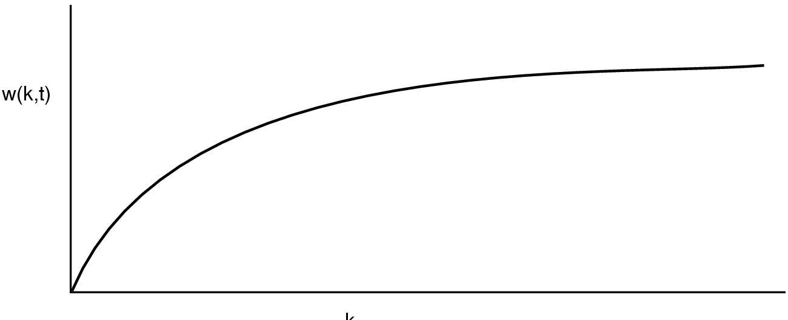
How big is the working set?
w(k,t)
k
Working set is the set of pages used by the k most recent memory references
w(k,t) is the size of the working set at time t
Working set may change over time
Size of working set can change over time as well…

Slide 20
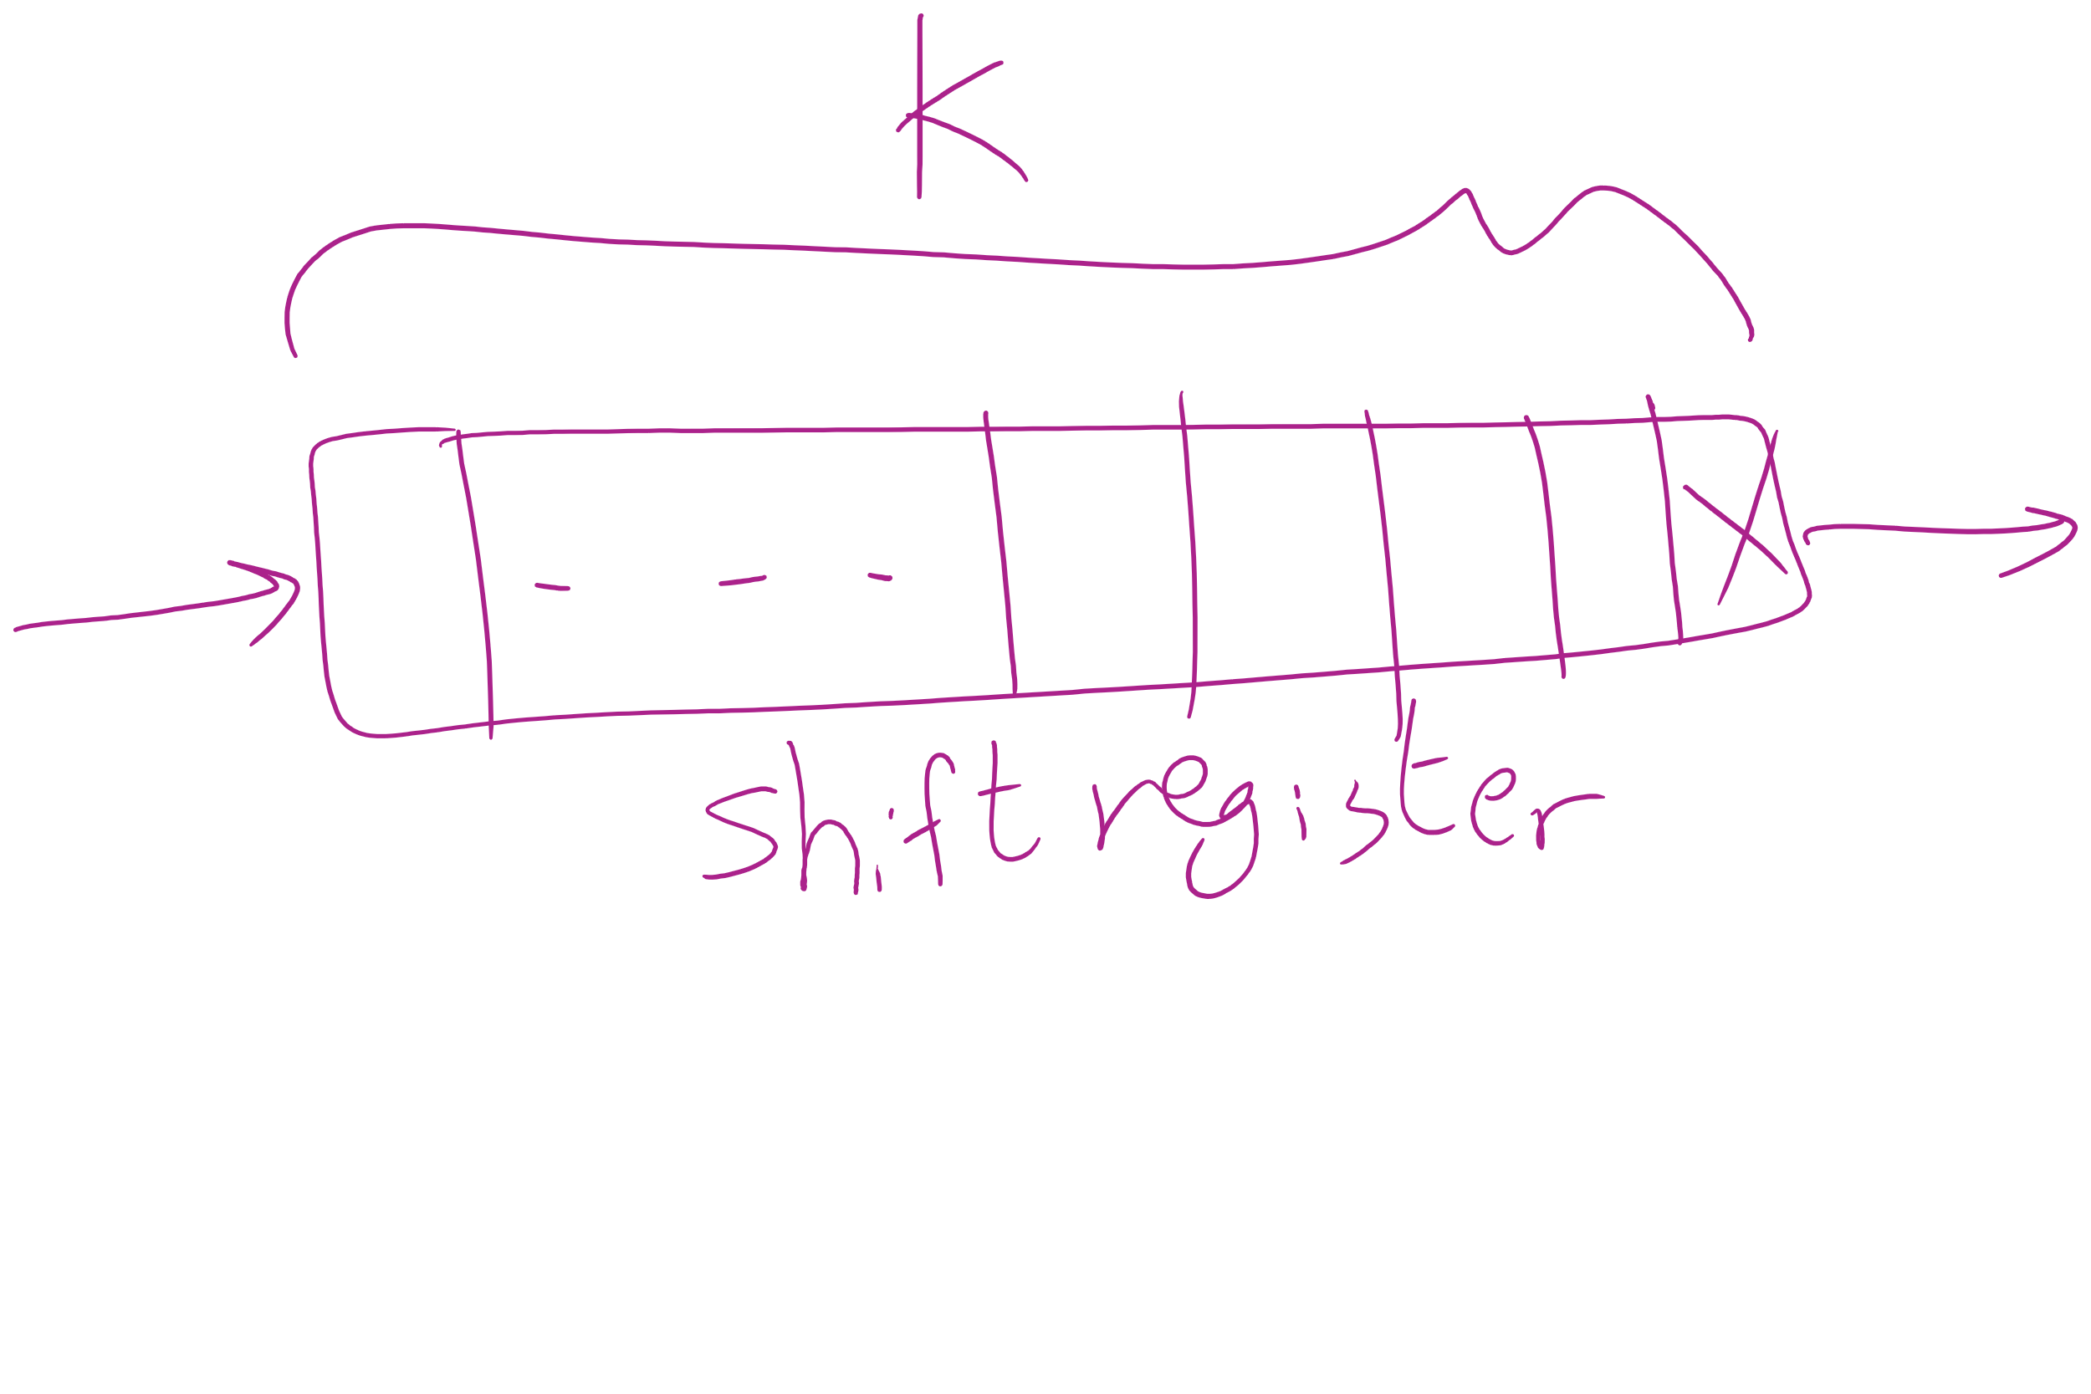
Keeping track of the Working Set

Slide 21
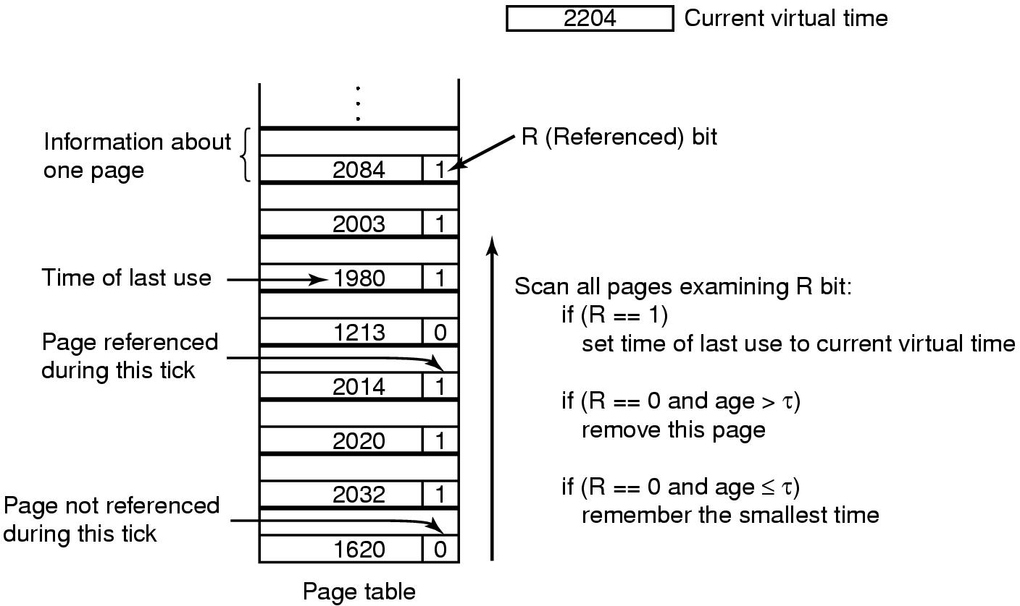
Working set page replacement algorithm

Slide 22
Page replacement algorithms: summary
Algorithm | Comment
OPT (Optimal) | Not implementable, but useful as a benchmark
NRU (Not Recently Used) | Crude
FIFO (First-In, First Out) | Might throw out useful pages
Second chance | Big improvement over FIFO
Clock | Better implementation of second chance
LRU (Least Recently Used) | Excellent, but hard to implement exactly
NFU (Not Frequently Used) | Poor approximation to LRU
Aging | Good approximation to LRU, efficient to implement
Working Set | Somewhat expensive to implement
WSClock | Implementable version of Working Set

Slide 23
Modeling page replacement algorithms
Goal: provide quantitative analysis (or simulation) showing which algorithms do better
Workload (page reference string) is important: different strings may favor different algorithms
Show tradeoffs between algorithms
Compare algorithms to one another
Model parameters within an algorithm
Number of available physical pages
Number of bits for aging

Slide 24
How is modeling done?
Generate a list of references
Artificial (made up)
Trace a real workload (set of processes)
Use an array (or other structure) to track the pages in physical memory at any given time
May keep other information per page to help simulate the algorithm (modification time, time when paged in, etc.)
Run through references, applying the replacement algorithm
Example: FIFO replacement on reference string 0 1 2 3 0 1 4 0 1 2 3 4
Page replacements highlighted in yellow
Page referenced |  | 0 | 1 | 2 | 3 | 0 | 1 | 4 | 0 | 1 | 2 | 3 | 4
Youngest page |  | 0 | 1 | 2 | 3 | 0 | 1 | 4 | 4 | 4 | 2 | 3 | 3
 |  |  | 0 | 1 | 2 | 3 | 0 | 1 | 1 | 1 | 4 | 2 | 2
Oldest page |  |  |  | 0 | 1 | 2 | 3 | 0 | 0 | 0 | 1 | 4 | 4

Slide 25
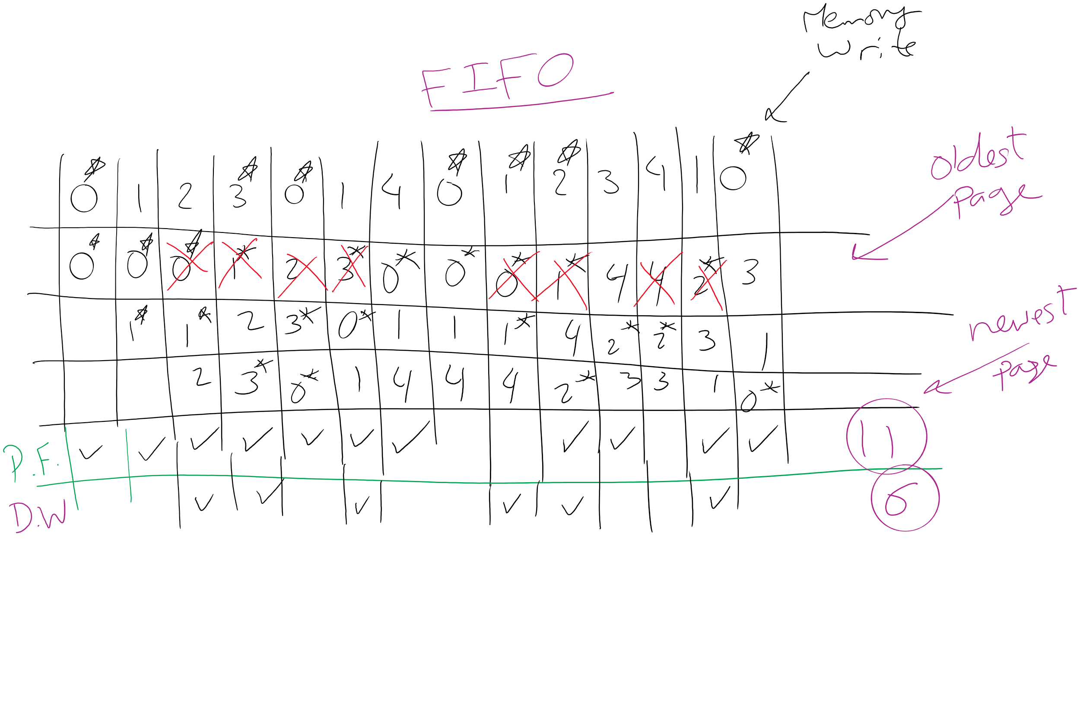
FIFO Example 1

Slide 26
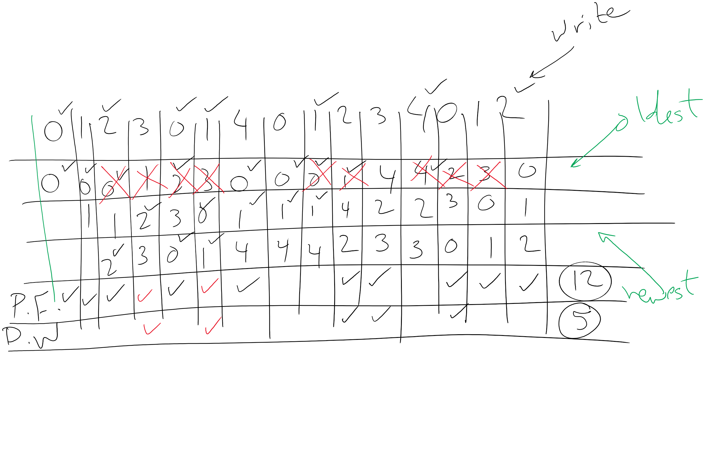
FIFO Example 2

