Slide 1

Introduction to Operating Systems CS/COE 1550
Fall 2021
Sherif Khattab
ksm73@pitt.edu
(Some slides are from Silberschatz, Galvin and Gagne ©2013)

Slide 2
Announcements
Upcoming deadlines:
4/2: Homework 10
4/5: Project 3 (Virtual Memory Simulator)
Tophat questions due one week after each lecture

Slide 3
Last Lecture …
Memory Management Issues
File System Implementation

Slide 4
Muddiest Points
HW 10
Q2, Q3, Q4, Q10, 1, Q12
disk map
When dirty pages are written on the disk.
the different disk partitions
separating policy and mechanism
How similar is a partition table to a page table?
static vs dynamic swapping when storing pages to disk
Does each partition contain the same sections (boot block, super block, free space management, etc.)
disk vs memory vs file system
Could you go over how to calculate number of pages needed for an execution?
maybe a demo on the "separating policy and mechanisms" slide

Slide 5
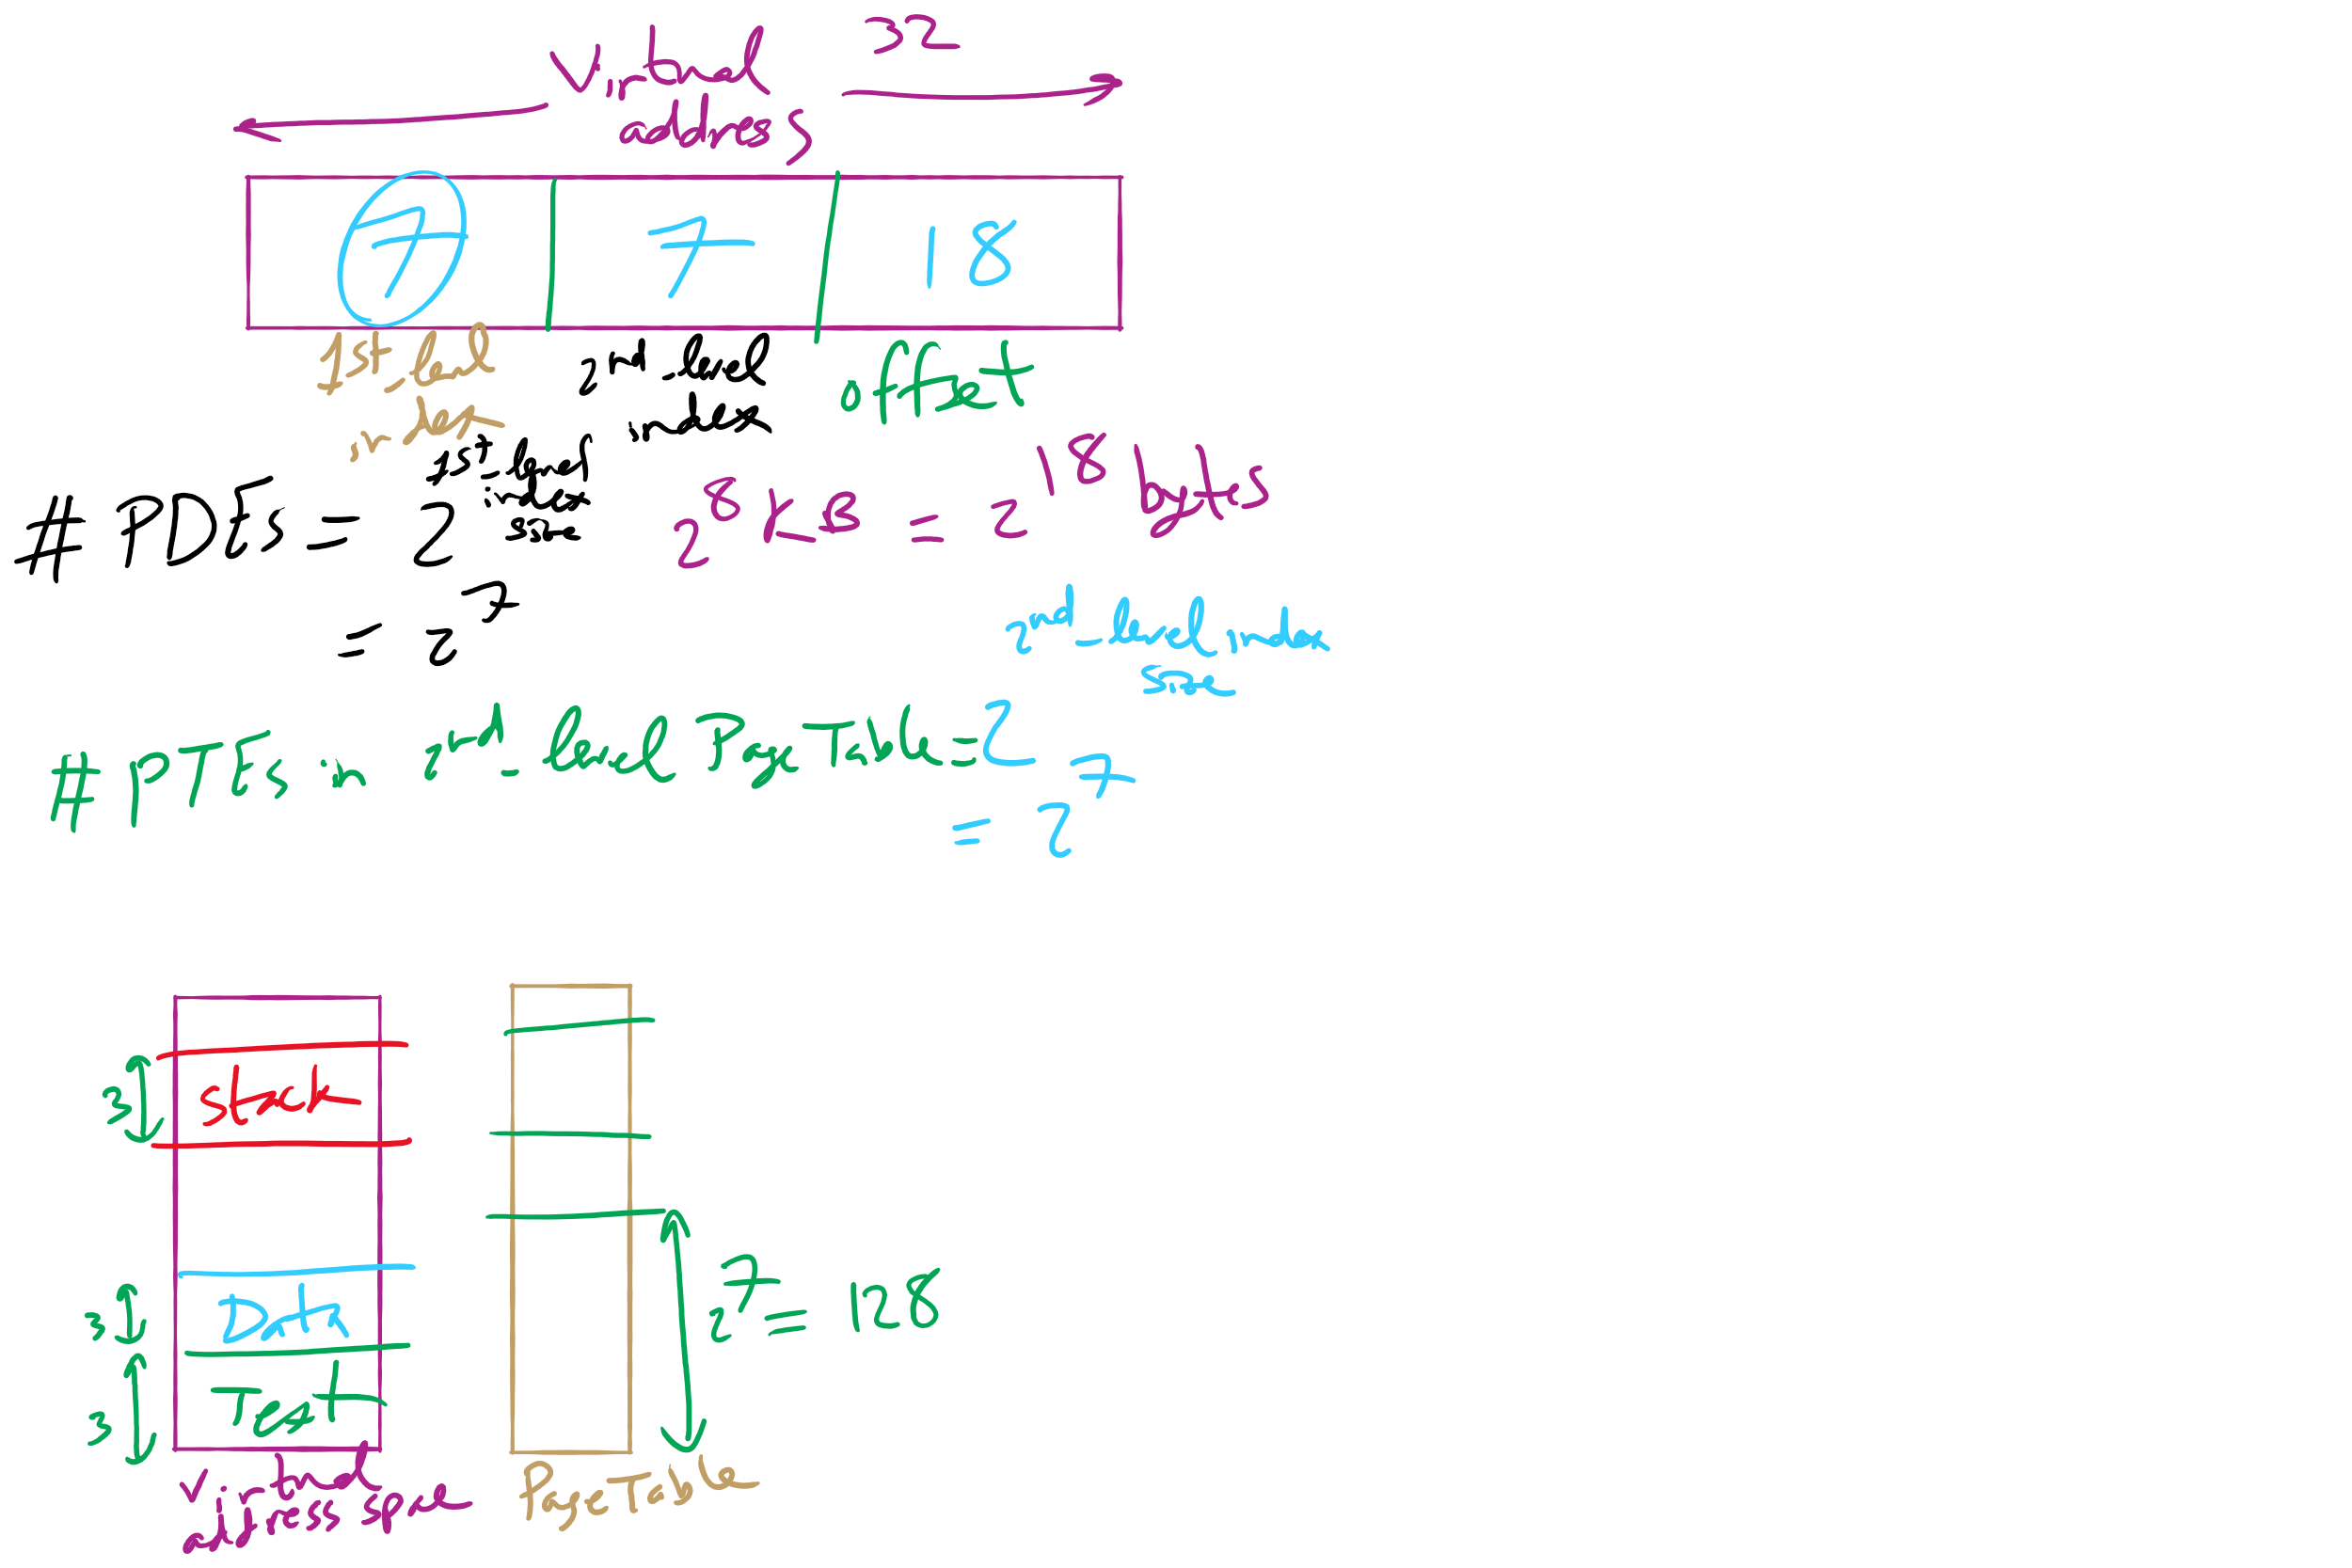
HW 10: Q 2-4

Slide 6
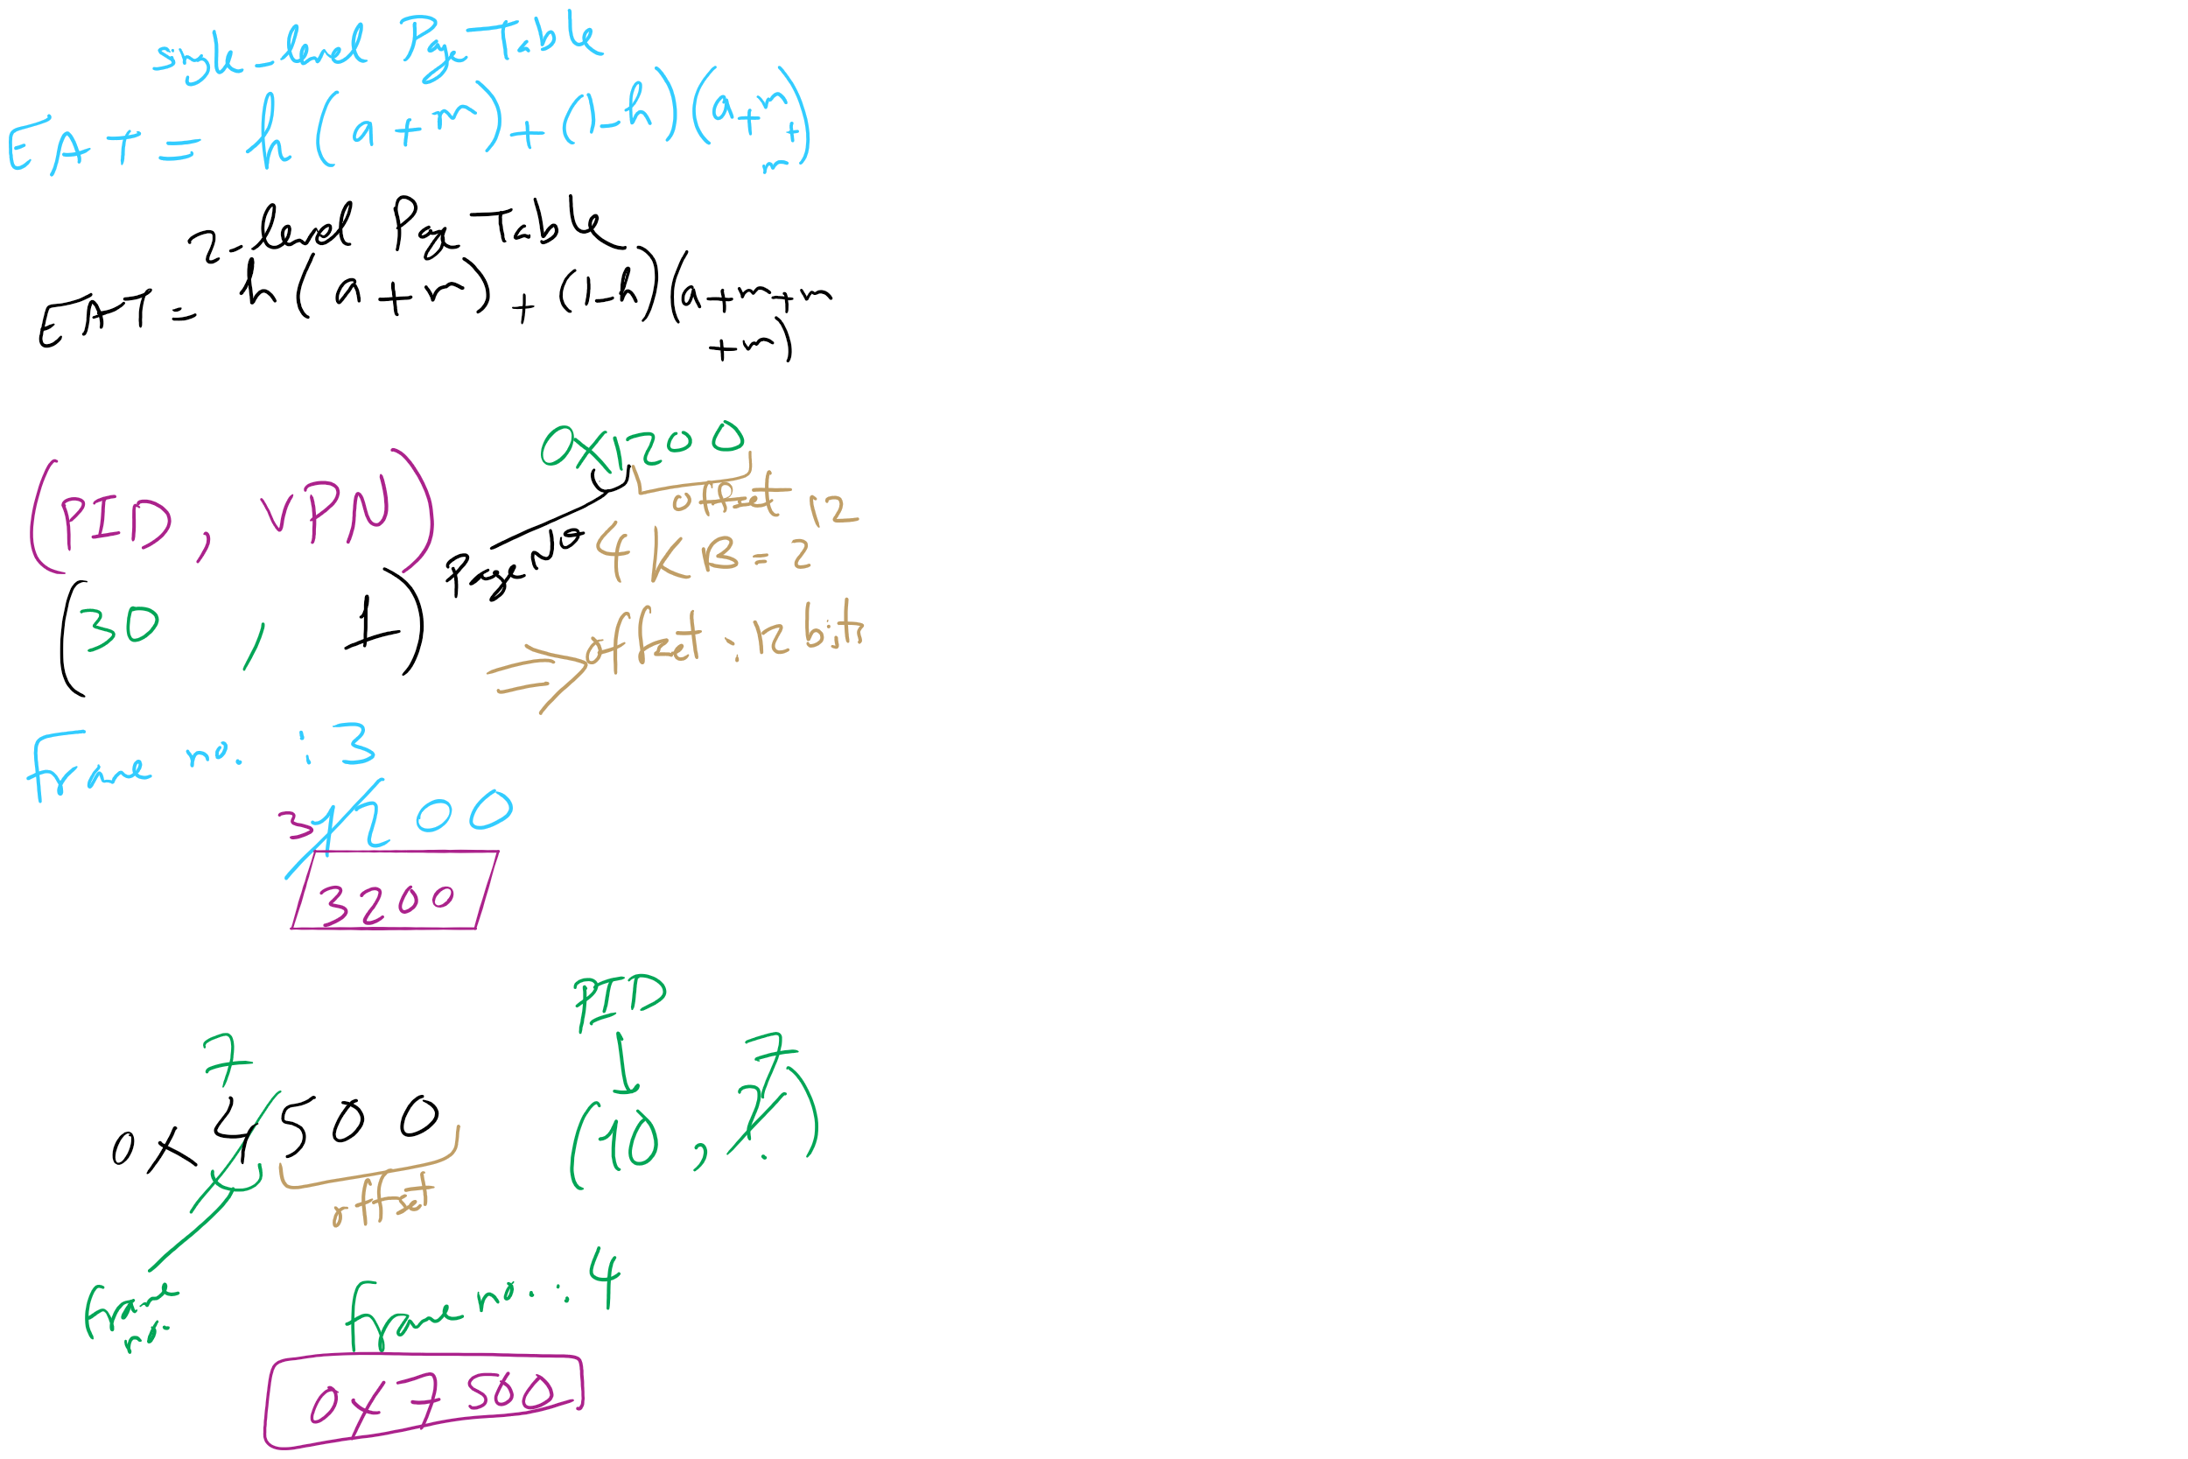
HW 10: Q 10-13

Slide 7
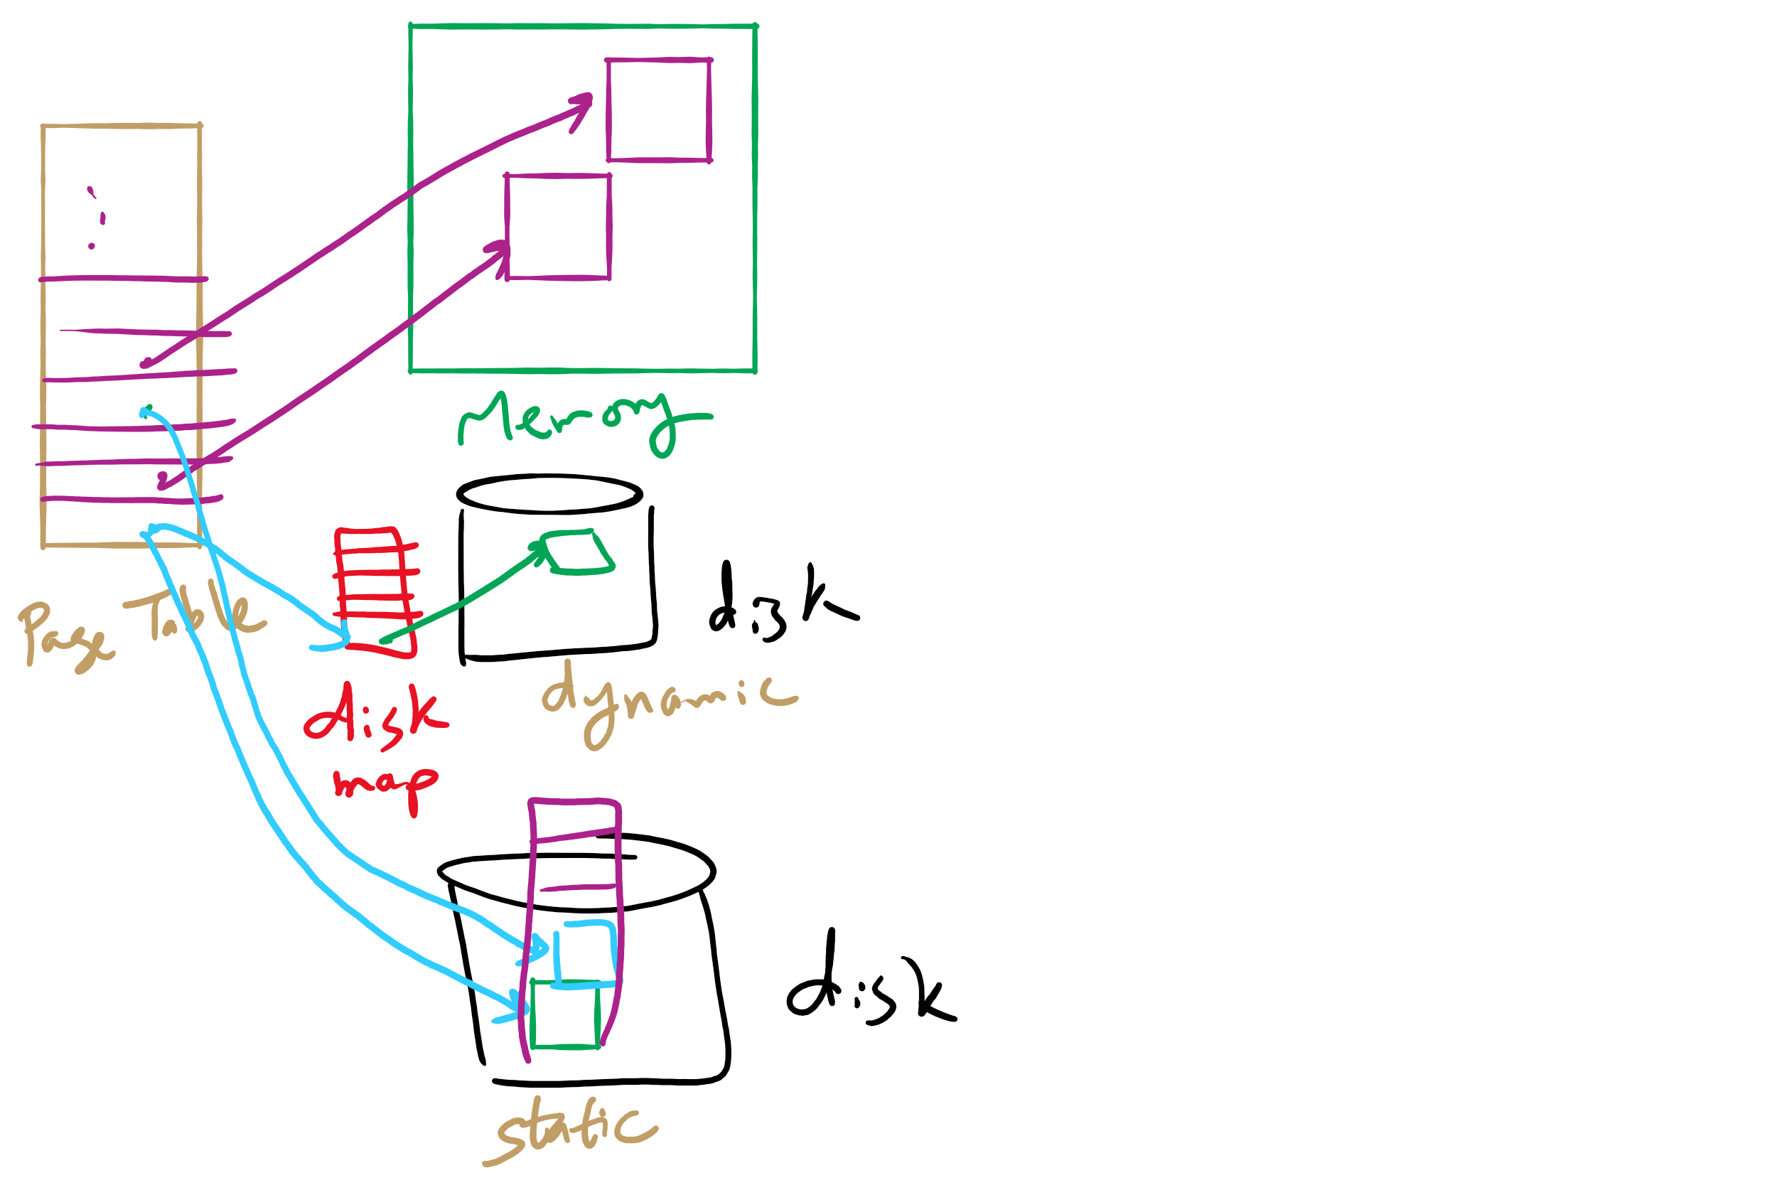
Disk Map

Slide 8
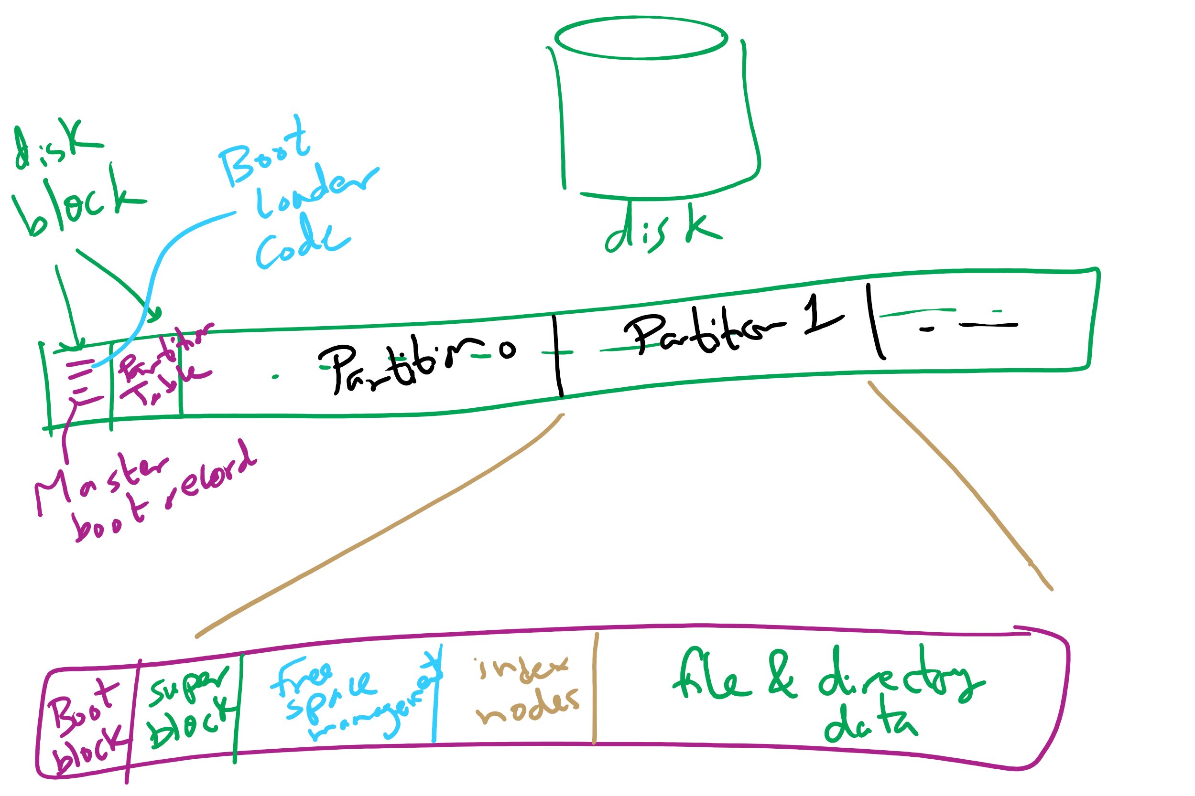
Carving Up a Disk

Slide 9
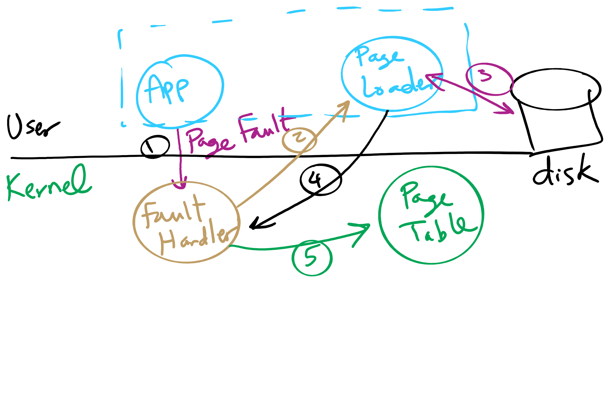
Separating Policy and Mechanism for Page Replacement

Slide 10
Today’s Agenda …
File System Implementation

Slide 11
Contiguous allocation for file blocks
Contiguous allocation requires all blocks of a file to be consecutive on disk
Problem: deleting files leaves “holes”
Similar to memory allocation issues
Compacting the disk can be a very slow procedure…
A
B
C
D
E
F
A
Free
C
Free
E
F

Slide 12
Contiguous allocation
Data in each file is stored in consecutive blocks on disk
Simple & efficient indexing
Starting location (block #) on disk (start)
Length of the file in blocks (length)
Random access well-supported
Difficult to grow files
Must pre-allocate all needed space
Wasteful of storage if file isn’t using all of the space
Logical to physical mapping is easy blocknum = (pos / 1024) + start; offset_in_block = pos % 1024;
0
1
2
3
4
5
6
7
8
9
10
11
Start=5
Length=2902

Slide 13
Linked allocation
File is a linked list of disk blocks
Blocks may be scattered around the disk drive
Block contains both pointer to next block and data
Files may be as long as needed
New blocks are allocated as needed
Linked into list of blocks in file
Removed from list (bitmap) of free blocks
0
1
2
3
4
6
4
5
6
7
x
x
8
9
10
11
0
Start=9
End=4
Length=2902
Start=3
End=6
Length=1500

Slide 14
Finding blocks with linked allocation
Directory structure is simple
Starting address looked up from directory
Directory only keeps track of first block (not others)
No wasted blocks - all blocks can be used
Random access is difficult: must always start at first block!
Logical to physical mapping is done by block = start; offset_in_block = pos % 1020; for (j = 0; j < pos / 1020; j++) { block = block->next; }
Assumes that next pointer is stored at end of block
May require a long time for seek to random location in file

Slide 15
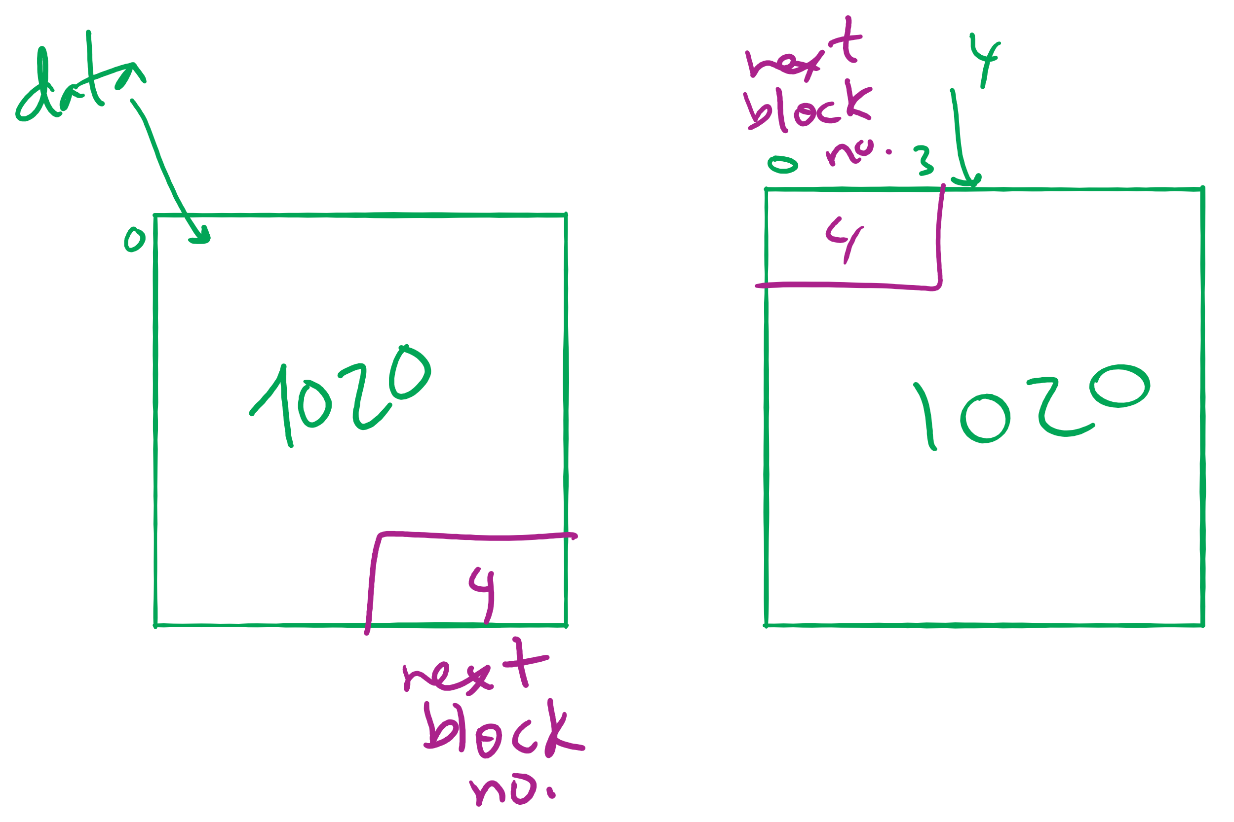
Offset Calculation

Slide 16
File Allocation Table (FAT)
Links on disk are slow
Keep linked list in memory
Advantage: faster
Disadvantages
Have to copy it to disk at some point
Have to keep in-memory and on-disk copy consistent
0
4
1
-1
2
-1
3
-2
4
-2
5
-1
6
3
B
7
-1
8
-1
9
0
A
10
-1
11
-1
12
-1
13
-1
14
-1
15
-1

Slide 17
Using a block index for allocation
Store file block addresses in an array
Array itself is stored in a disk block
Directory has a pointer to this disk block
Non-existent blocks indicated by -1
Random access easy
Limit on file size?
Name index size
grades 4 4802
0
1
2
3
6
9
7
0
8
4
5
6
7
8
9
10
11

Slide 18
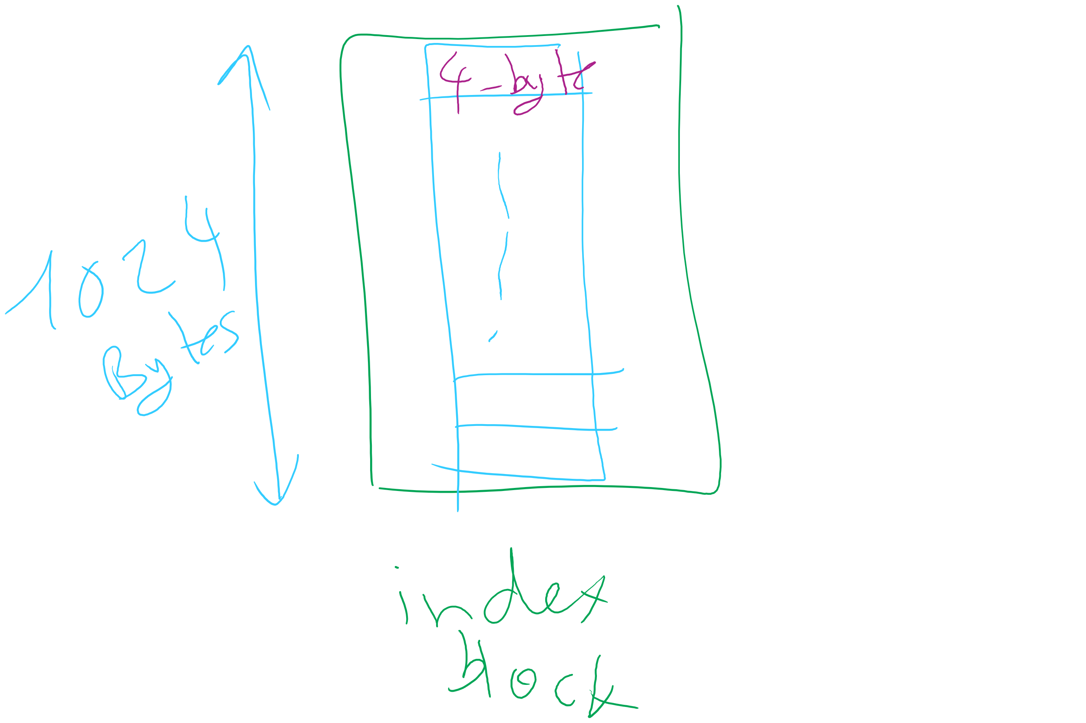
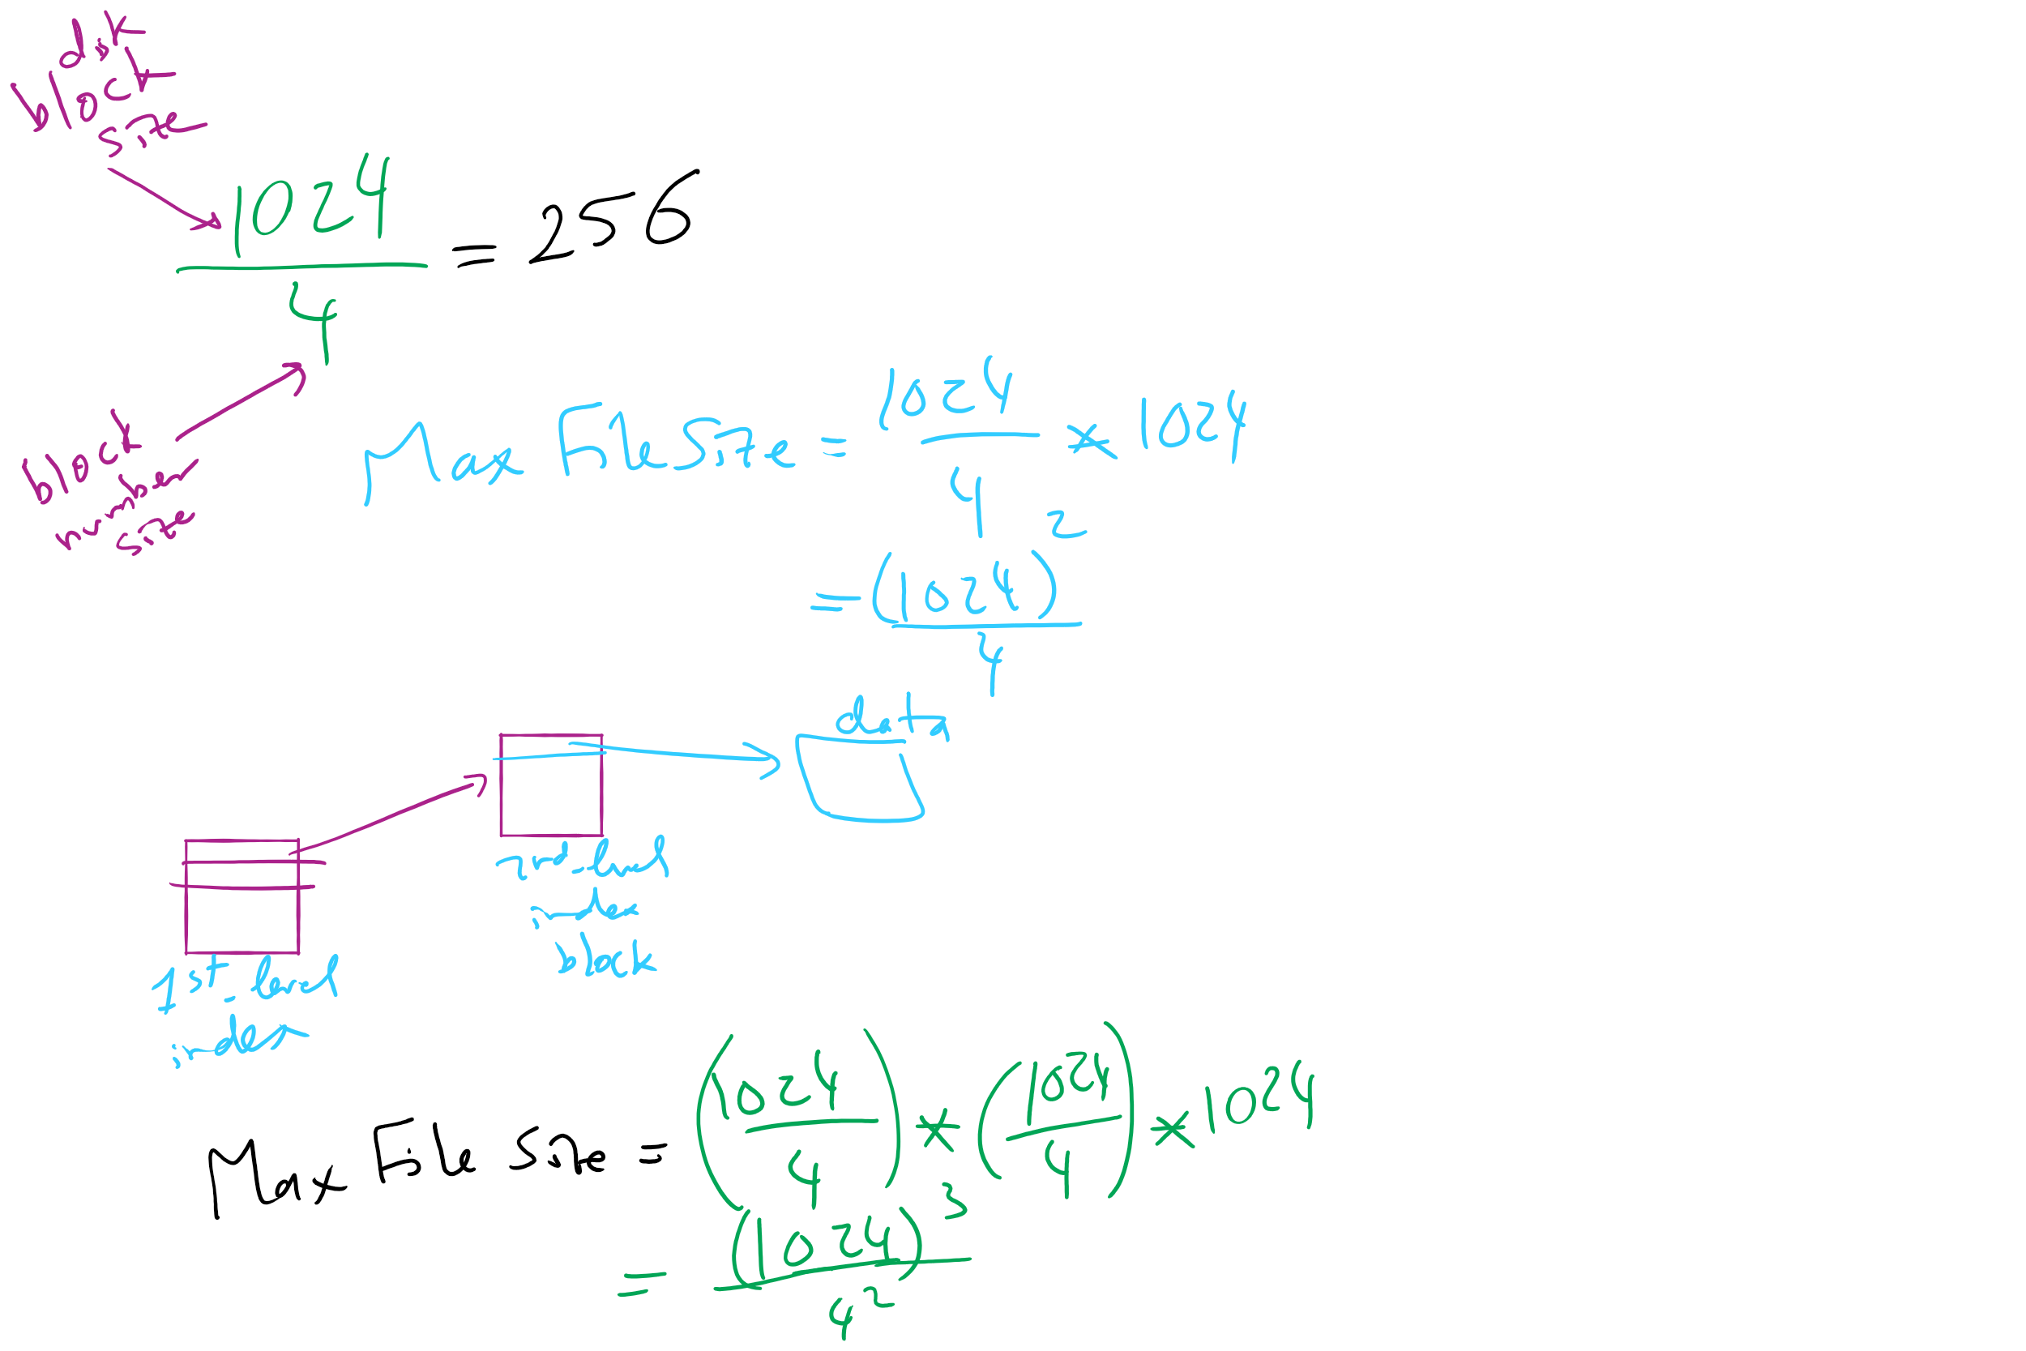
Max File Size for Indexed Allocation

Slide 19
Unix Fast File System indexing scheme
protection mode
data
owner & group
data
.
.
.
timestamps
size
data
block count
•
data
•
.
.
.
link count
•
Direct pointers
.
.
.
data
•
•
•
data
•
.
.
.
•
•
single indirect
•
•
data
double indirect
•
•
data
•
•
•
•
.
.
.
triple indirect
•
•
•
inode
•
•
•
data

