Slide 1

Introduction to Operating Systems CS/COE 1550
Fall 2021
Sherif Khattab
ksm73@pitt.edu
(Some slides are from Silberschatz, Galvin and Gagne ©2013)

Slide 2
Announcements
Homework 1 is due this Friday at 11:59 pm
Special late deadline until Monday 2/8 at 11:59 pm
Tophat questions assigned as homework
Lab 1 is up (with autograder on Gradescope)
Using GitHub Classroom
Explained in this week’s recitation
Project 1 will be up this Friday

Slide 3
Last Lecture …
Process scheduling
Process creation and termination

Slide 4
Muddiest Points
Scheduling
Queues
How processes actually get scheduled by the scheduler
How to invoke the schedulers
What is the definition degree of multiprogramming?
What is the difference between the short-term and medium-term schedulers. They seem to both do similar things
How the CPU determines which processes can be safely swapped out without affecting performance.
Moving of registers
fork()
Tracing
IDs of forked processes, and forks of forks
zombie vs orphan
How the parent knows how long to wait when using the wait() syscall
pid for children
exec()
how it works
difference between fork() and exec()
understand the whole process with CODE

Slide 5
Muddiest points
Xv6 code for context switching
Process lifecycle
CPU mode switching in context switching
What is inside PCB
Switching register sets in context switching
the code plus the diagram side by side
Determining when a context switch is actually required - if it's needed between each individual process regardless of user/kernel bit
monotlithic vs microkernel
Pros and cons
What a microkernel OS would look like in practice
the two tophat questions we all got wrong about immediately performing instructions in priviledged/non-priviledged mode
How long the context switching takes on average compared to the processes themselves.

Slide 6
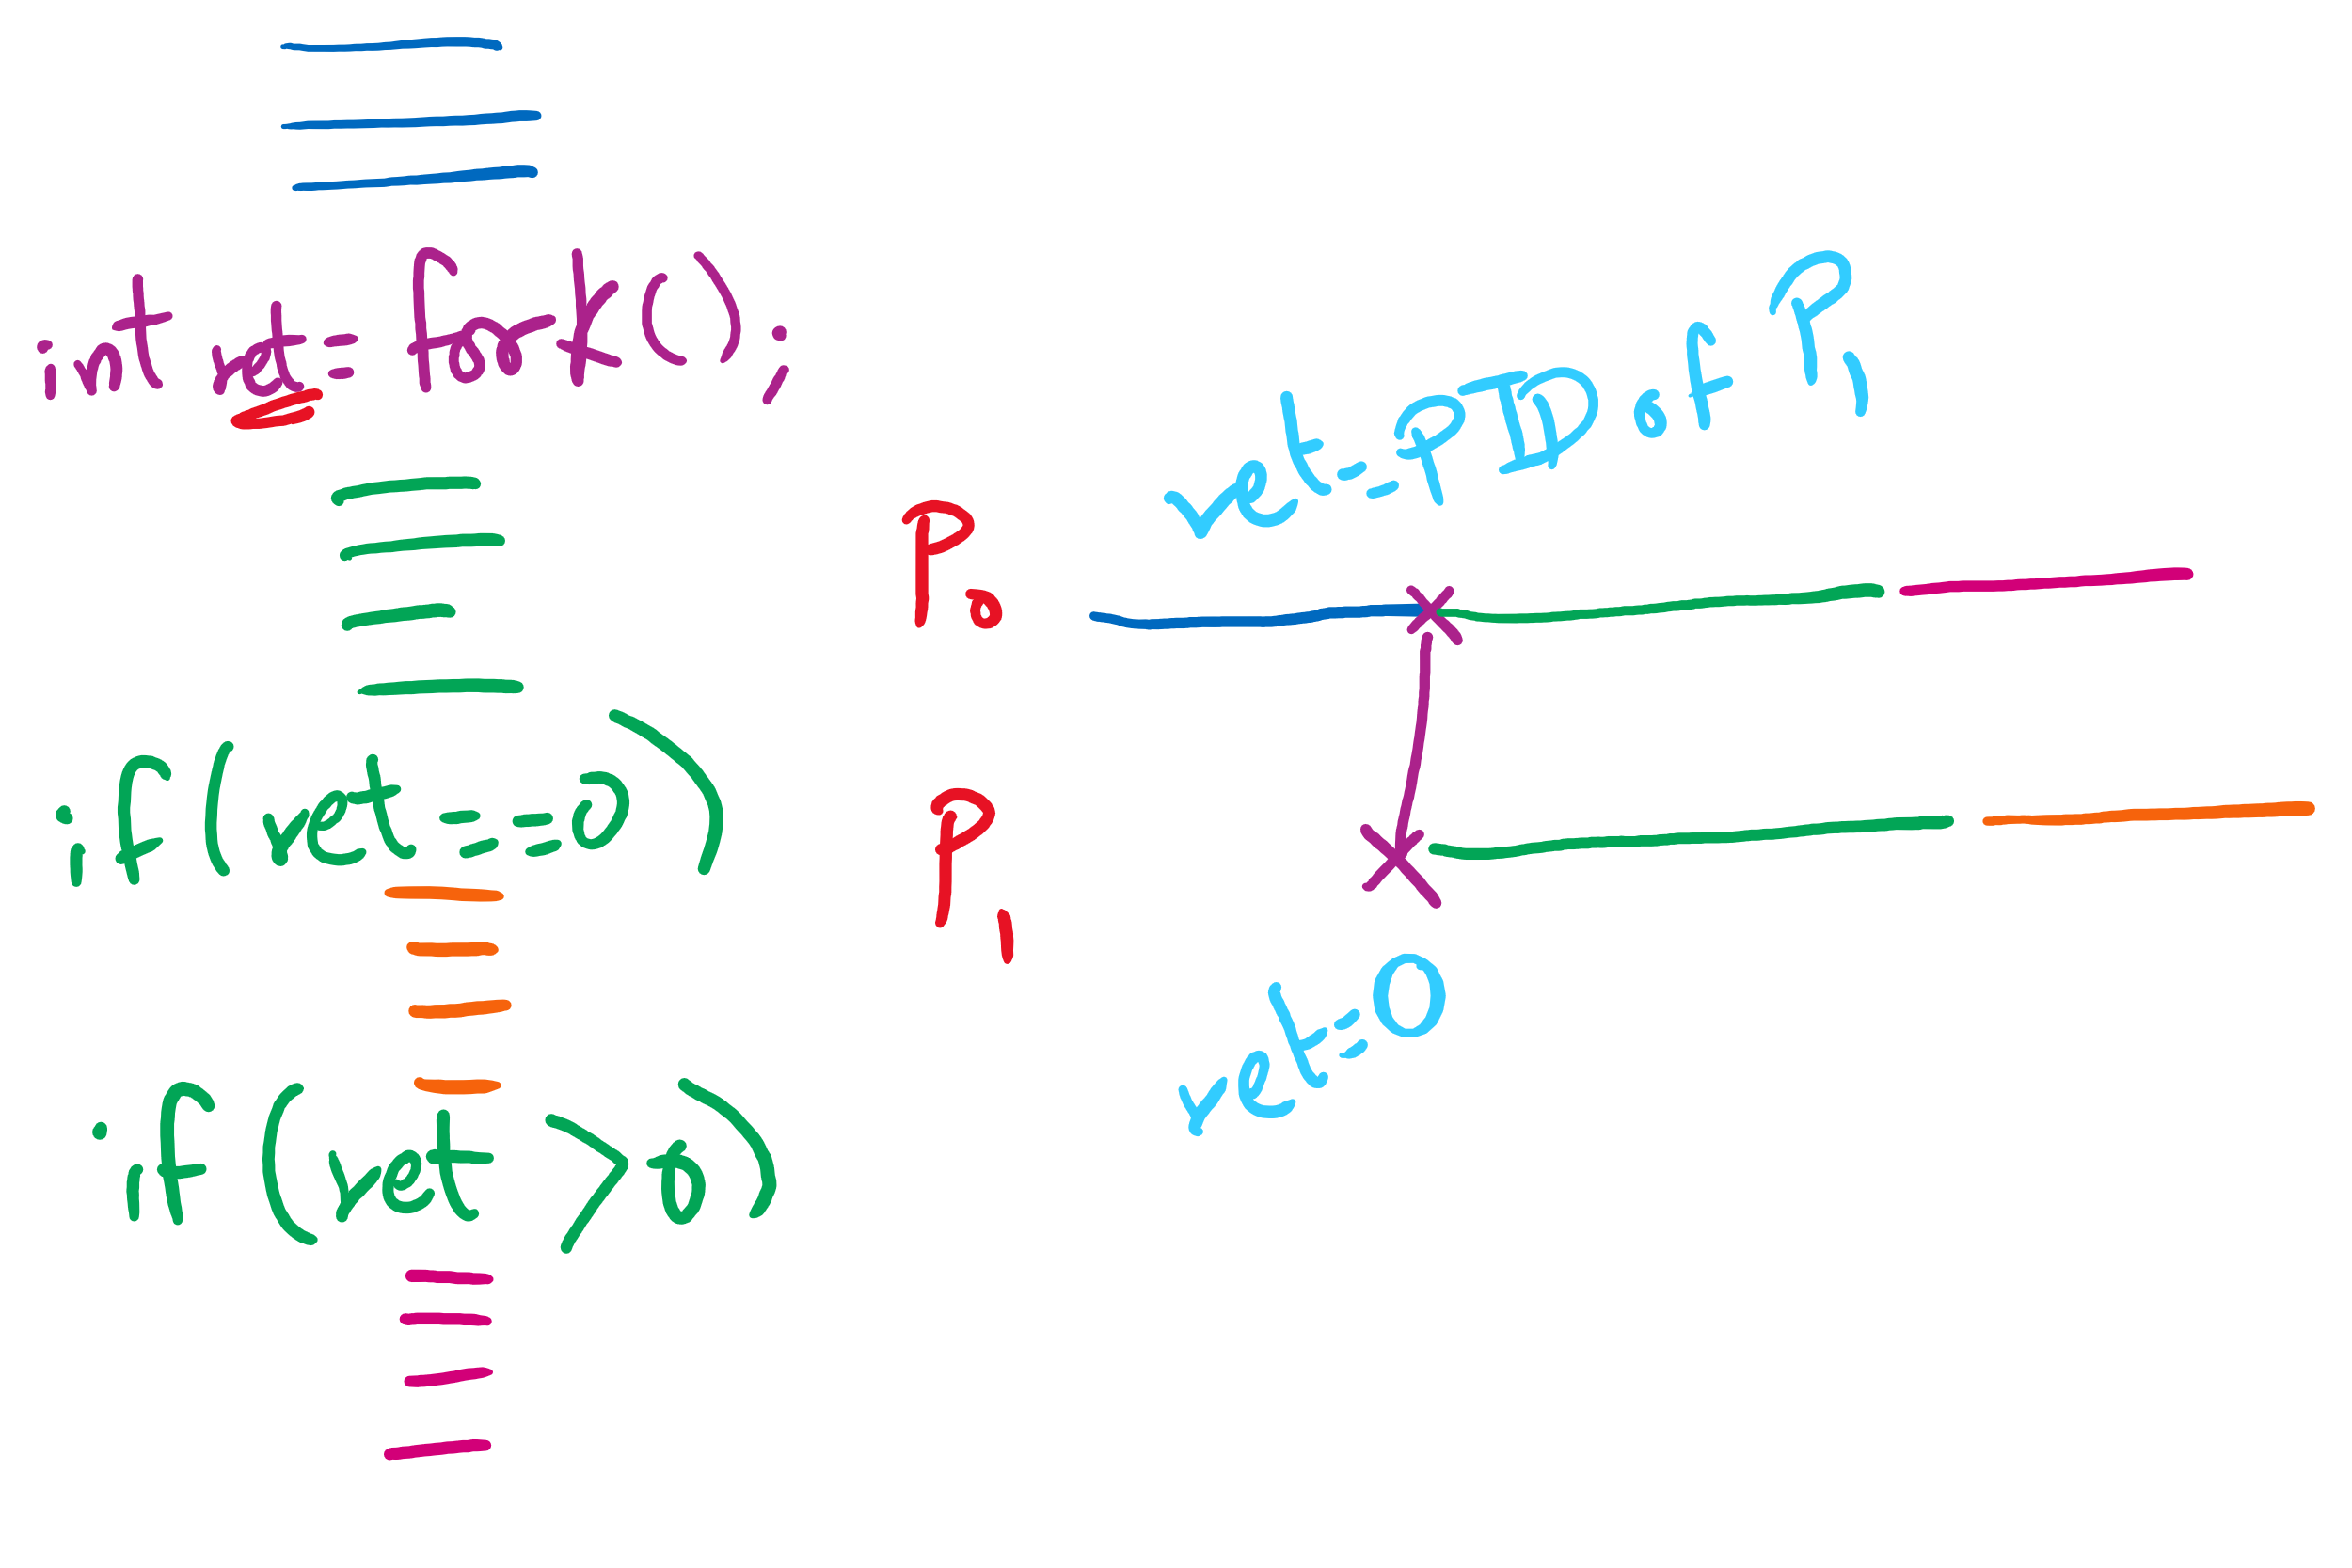
fork() tracing

Slide 7
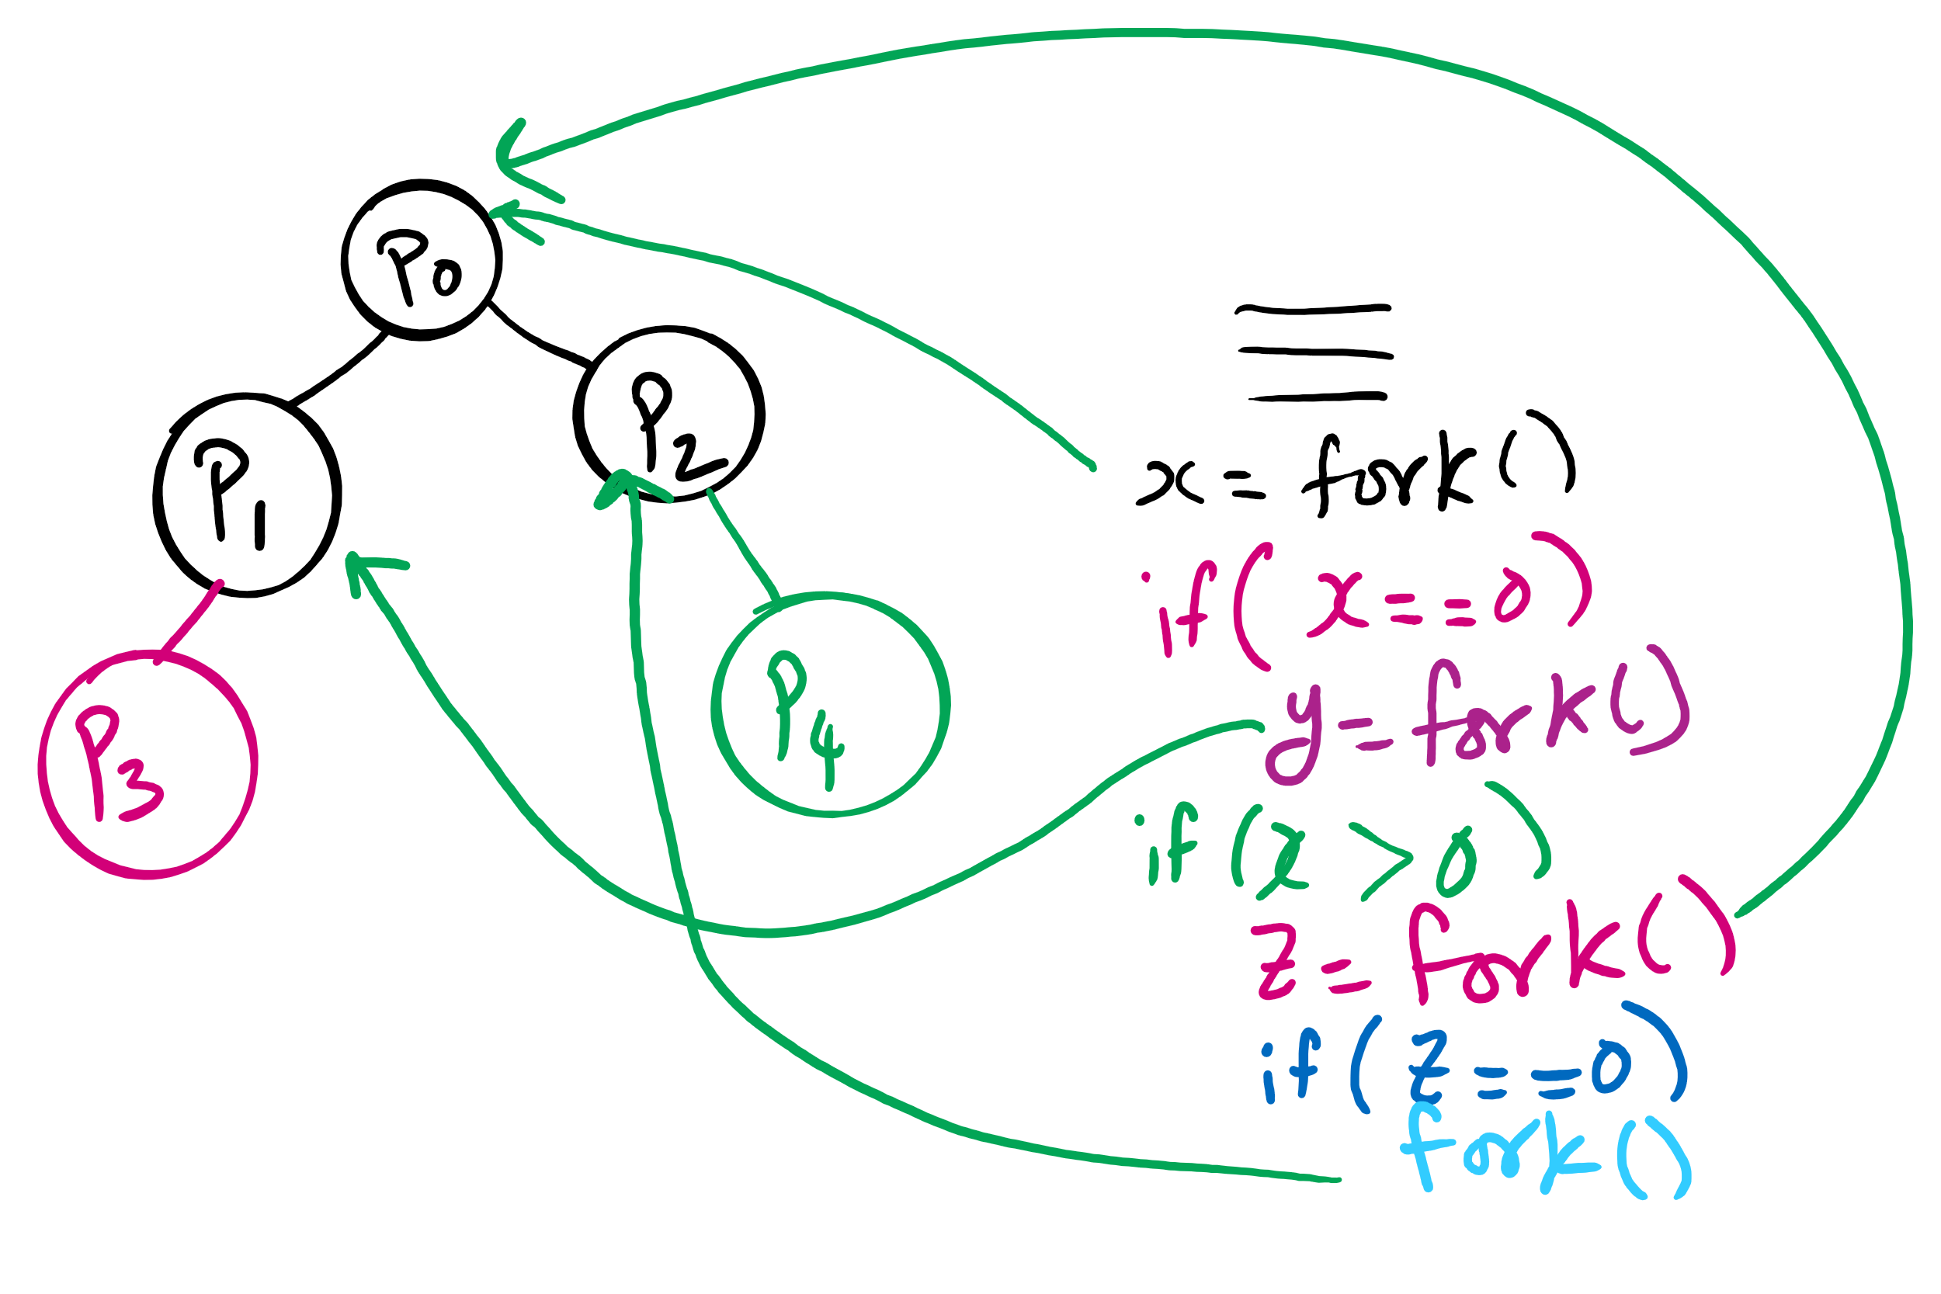
fork()’s of fork()’s

Slide 8
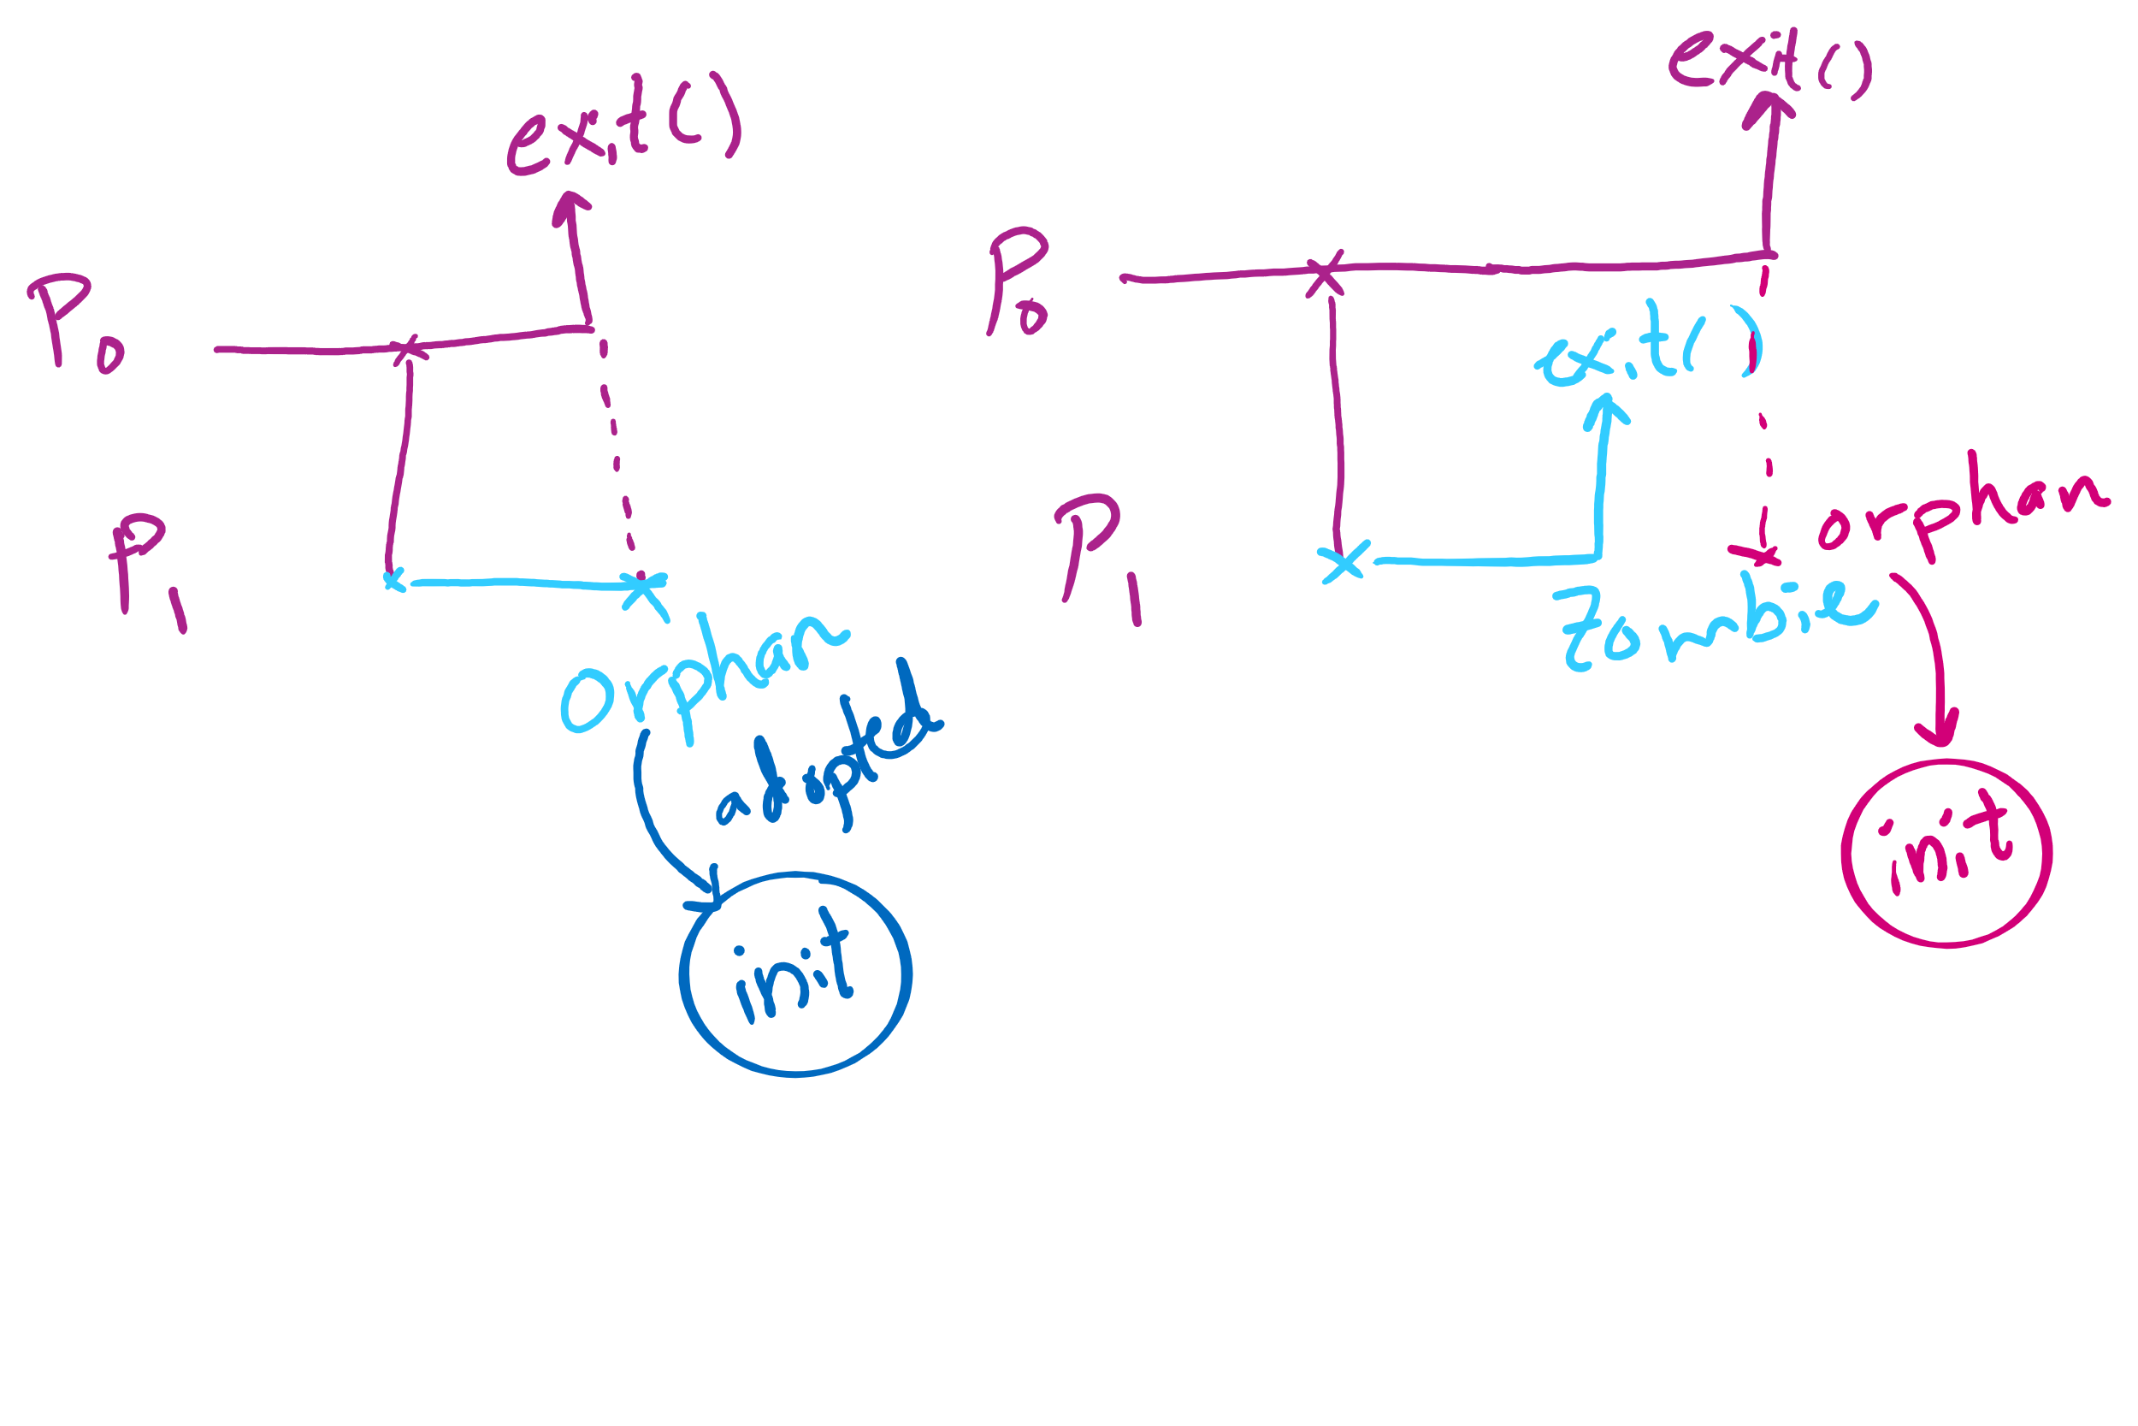
Orphan vs. Zombie Processes

Slide 9
Xv6 Code Walkthrough
Context switching
Calling of the swtch routine
fork()
exit()
wait()

Slide 10
Today ….
Spinlocks
How to use
How to implement
Semaphores
How to use
How to implement

Slide 11
Why do we need Synchronization?
Each process operates sequentially
All is fine until processes want to share data
Exchange data between multiple processes
Allow processes to navigate critical regions
Maintain proper sequencing of actions in multiple processes
These issues apply to threads as well
Threads can share data easily (same address space)
Other two issues apply to threads

Slide 12
Example: bounded buffer problem
Shared variables const int n; typedef … Item; Item buffer[n]; int in = 0, out = 0, counter = 0;
Atomic statements:
Counter += 1;
Counter -= 1;
Producer
Item pitm; while (1) { … produce an item into pitm … while (counter == n) ; buffer[in] = pitm; in = (in+1) % n;
counter += 1; }
Consumer
Item citm; while (1) { while (counter == 0) ; citm = buffer[out]; out = (out+1) % n;
counter -= 1;
… consume the item in citm … }

Slide 13
Problem: race conditions
Cooperating processes share storage (memory)
Both may read and write the shared memory
Problem: can’t guarantee that read followed by write is atomic
Ordering matters!
This can result in erroneous results!
We need to eliminate race conditions…
P1
P2
x=3
R1 <= x
R1 = R1+1
R1 => x
R3 <= x
R3 = R3+1
R3 => x
x=5
R1 <= x
R3 <= x
R3 = R3+1
R1 = R1+1
R1 => x
R3 => x
x=6!

Slide 14
Critical regions
Use critical regions to provide mutual exclusion and help fix race conditions
Four conditions to provide mutual exclusion
No two processes simultaneously in critical region
No assumptions made about speeds or numbers of CPUs
No process running outside its critical region may block another process
No process must wait forever to enter its critical region
A enters critical region
A leaves critical region
Process A
B enters critical region
B leaves critical region
B tries to enter critical region
Process B
B blocked
Time

Slide 15
Using Spinlocks
Spinlock lock;
Code for process P_{i}
While(1){
Lock(lock)
// critical section
Unlock(lock);
// remainder of code
}
}

Slide 16
Spinlock implementation (1/2)
Solution: use hardware
Several hardware methods
Test & set: test a variable and set it in one instruction
Atomic swap: switch register & memory in one instruction
Turn off interrupts: process won’t be switched out unless it asks to be suspended
Can be in user land

Slide 17
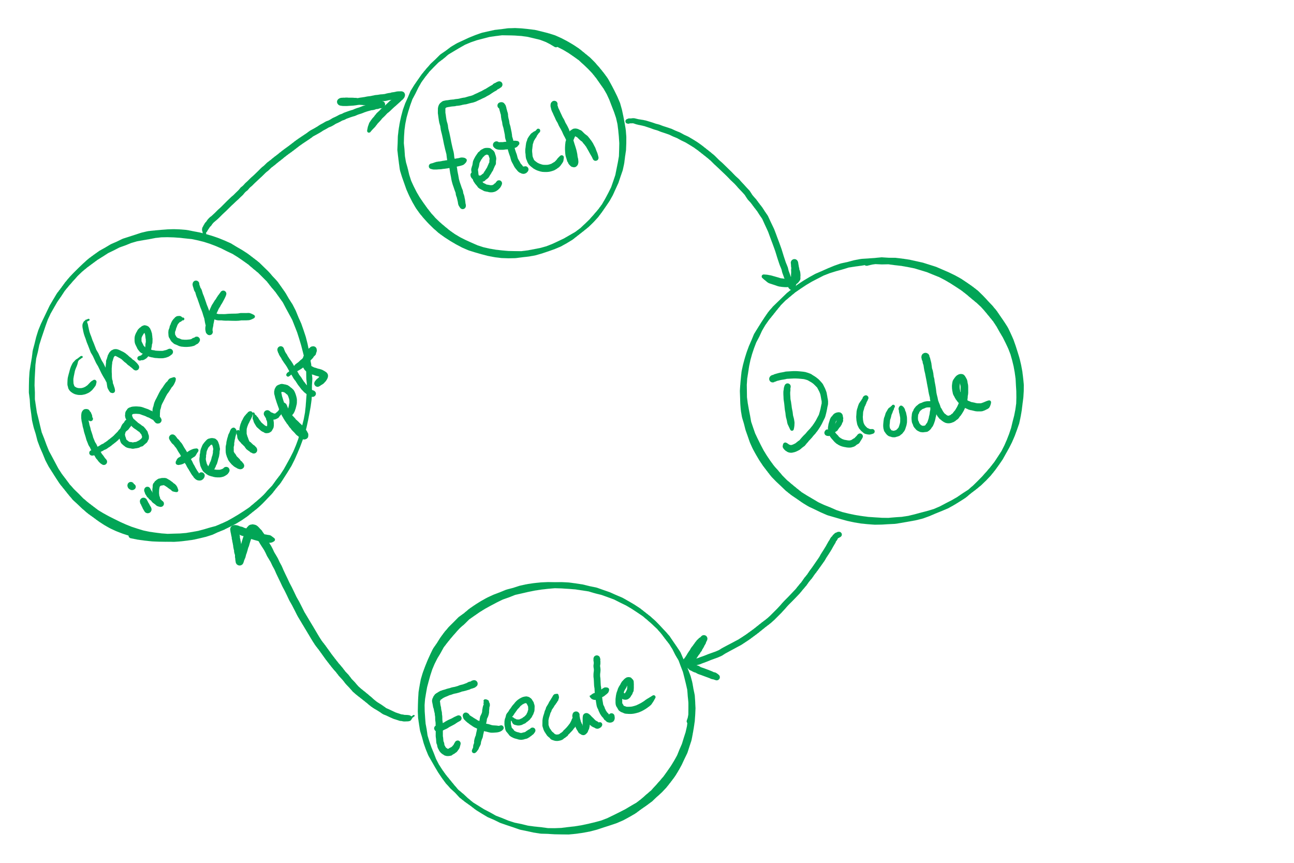
Atomic operations
If done in one instruction, then not interruptible

Slide 18
Spinlock implementation (2/2)
Single shared variable: lock
requires busy waiting, but code is much simple
Two versions
Test and set
Swap
Works for any number of processes
Possible problem with requirements
can lead to unbounded waiting
int lock = 0;
Lock(){
while (TestAndSet(lock))
;
}
Unlock(){
lock = 0;
}
Lock(){
while (Swap(lock,1) == 1)
;
}
Unlock(){
lock = 0;
}

Slide 19
Semaphores
Solution: use semaphores
Synchronization mechanism that doesn’t require busy waiting
Implementation
Semaphore S accessed by two atomic operations
Down(S): while (S<=0) {}; S-= 1;
Up(S): S+=1;
Down() is another name for P()
Up() is another name for V()
Modify implementation to eliminate busy wait from Down()

