Slide 1

Introduction to Operating Systems CS/COE 1550
Fall 2021
Sherif Khattab
ksm73@pitt.edu
(Some slides are from Silberschatz, Galvin and Gagne ©2013)

Slide 2
Announcements
Upcoming deadlines:
Lab 1, Homework 1, Homework 2, Tophat questions: due on 2/8
Project 1: due on 2/19
Midterm Reviews
Office hours
VS Code Setup
SheInnovates: Starting 2/5
Pitt’s only all-women hackathon
http://sheinnovates.us/
Job Talk: 2/5 at 1:00 pm
https://pitt.co1.qualtrics.com/jfe/form/SV_391YsRaJ4mPBUX3

Slide 3
Last Lecture …
Spinlock problems
Semaphore
Usage
Implementation

Slide 4
Muddiest Points (1/2)
Semaphores
the problems with using semaphores
Implementation
How is a semaphore using a spin lock better than a spinlock
Semaphores, all of it lol, but I'm planning on reading the textbook too.
preventing errors with down() and up()
counting semaphores (How do the other values in counting semaphores work)
Semaphore starvation
semaphores in code
Semaphore vs. Spinlock
recognizing when you'd use a semaphore vs a spinlock
What is the difference between a spinlock and a semaphore that uses busy waiting? They both seem to do the same thing
Priority Inversion
Priority inversion in semaphores and what practical effects it can have on your system? Maybe an example
A little hazy on how priority queue effects semaphores and spinlocks
How priority inheritance works with processes and semaphores

Slide 5
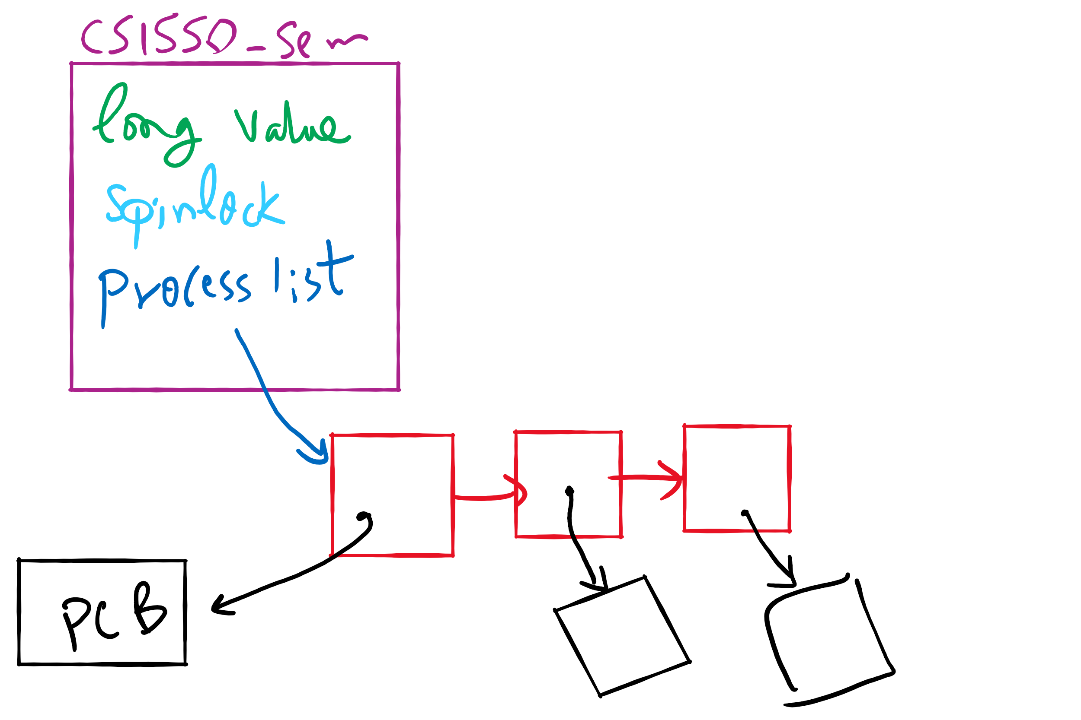
Semaphore Implementation in Project 1

Slide 6
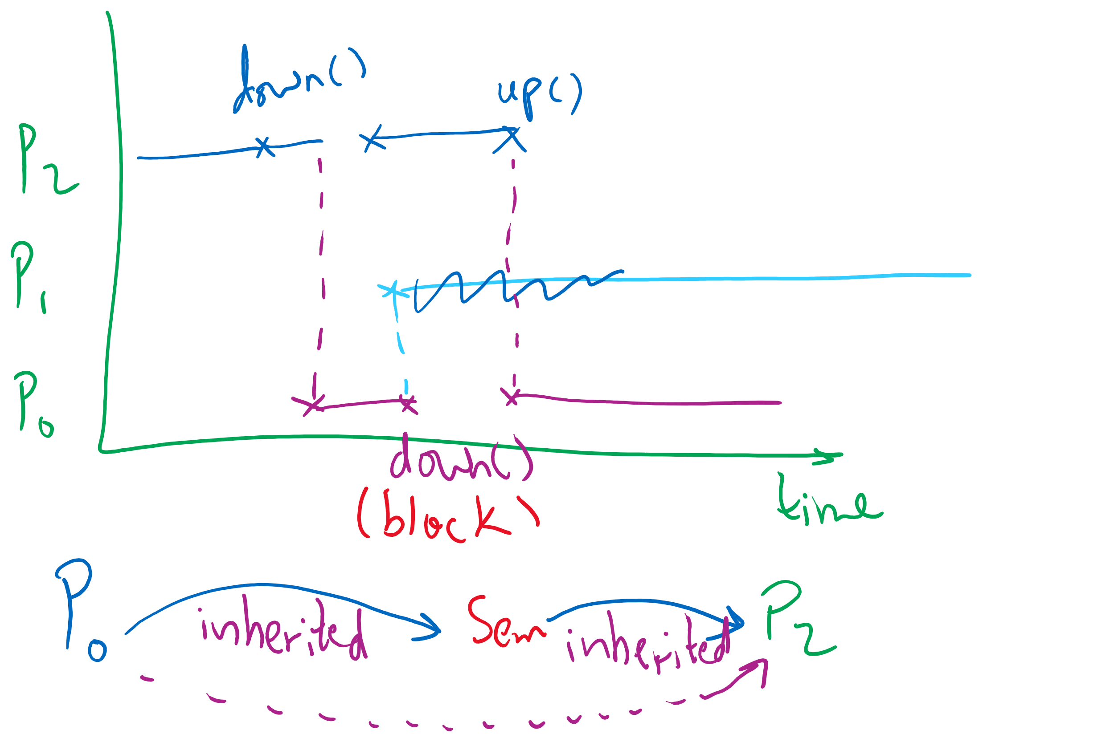
Priority Inheritance

Slide 7
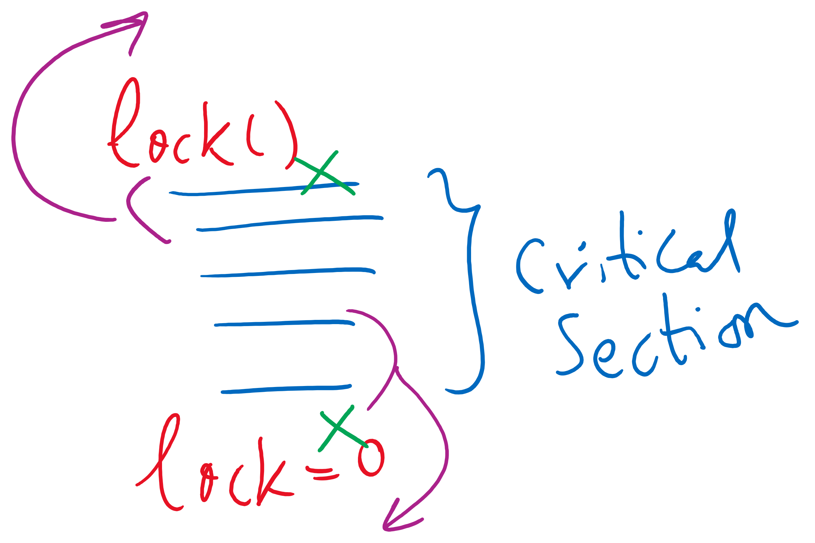
Code reordering

Slide 8
Muddiest Points (2/2)
What exactly monitors are
The implementation of the stuff talked about today
Please explain more about cs1550.c file in project
How does a mutex know if it’s being down()d by different process that didn’t up()d it?
Maybe a little more on the events leading up to starvation.
How a critical section can be re-ordered
according to the slides, there is no max limitation for the wakeup linked list, is this always the case? and if spinlock better under few processes, any ways to use spinlock under fewer processes in parellel with semaphores under larger processes
Busy wait

Slide 9
Today’s Agenda …
Monitors
Usage
Implementation
Other synchronization mechanisms

Slide 10
Monitors
A monitor is another kind of high-level synchronization primitive
One monitor has multiple entry points
Think multiple methods in a Java class
Only one process may be in the monitor at any time
Enforces mutual exclusion - less chance for programming errors
Monitors provided by high-level language
Variables belonging to monitor are protected from simultaneous access
Procedures in monitor are guaranteed to have mutual exclusion

Slide 11
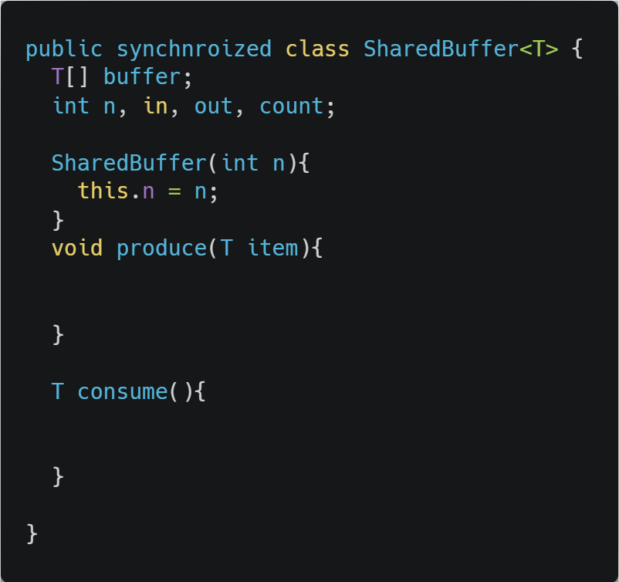
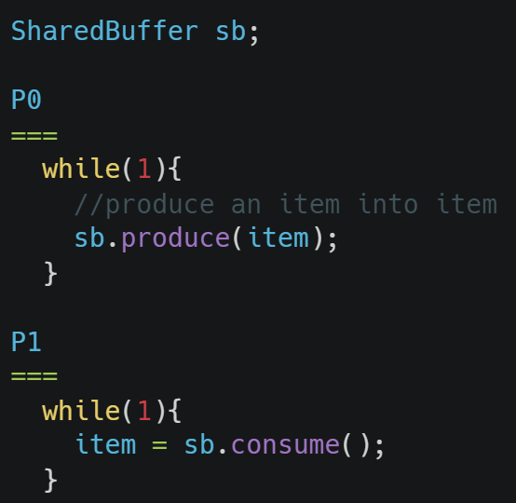
Monitor usage
Supported by Java
synchrnoized keyword
Only one process can be executing in either produce or consume at any time

Slide 12
Condition variables in monitors
Problem: how can a process wait inside a monitor?
Can’t simply sleep: there’s no way for anyone else to enter
Solution: use a condition variable
Condition variables support two operations
Wait(): suspend this process until signaled
Signal(): wake up exactly one process waiting on this condition variable
If no process is waiting, signal has no effect
Signals on condition variables aren’t “saved up”
Different from semaphores!
Condition variables are only usable within monitors
Process must be in monitor to signal on a condition variable

Slide 13
Locks & condition variables
Monitors require native language support
What if native support is not there (e.g., in C)?
Provide monitor support using special data types and procedures
Locks (Acquire(), Release())
Condition variables (Wait(), Signal())
Lock usage
Acquiring a lock == entering a monitor
Releasing a lock == leaving a monitor
Condition variable usage
Each condition variable is associated with exactly one lock
Lock must be held to use condition variable
Waiting on a condition variable releases the lock implicitly and reacquires the lock upon returning

Slide 14
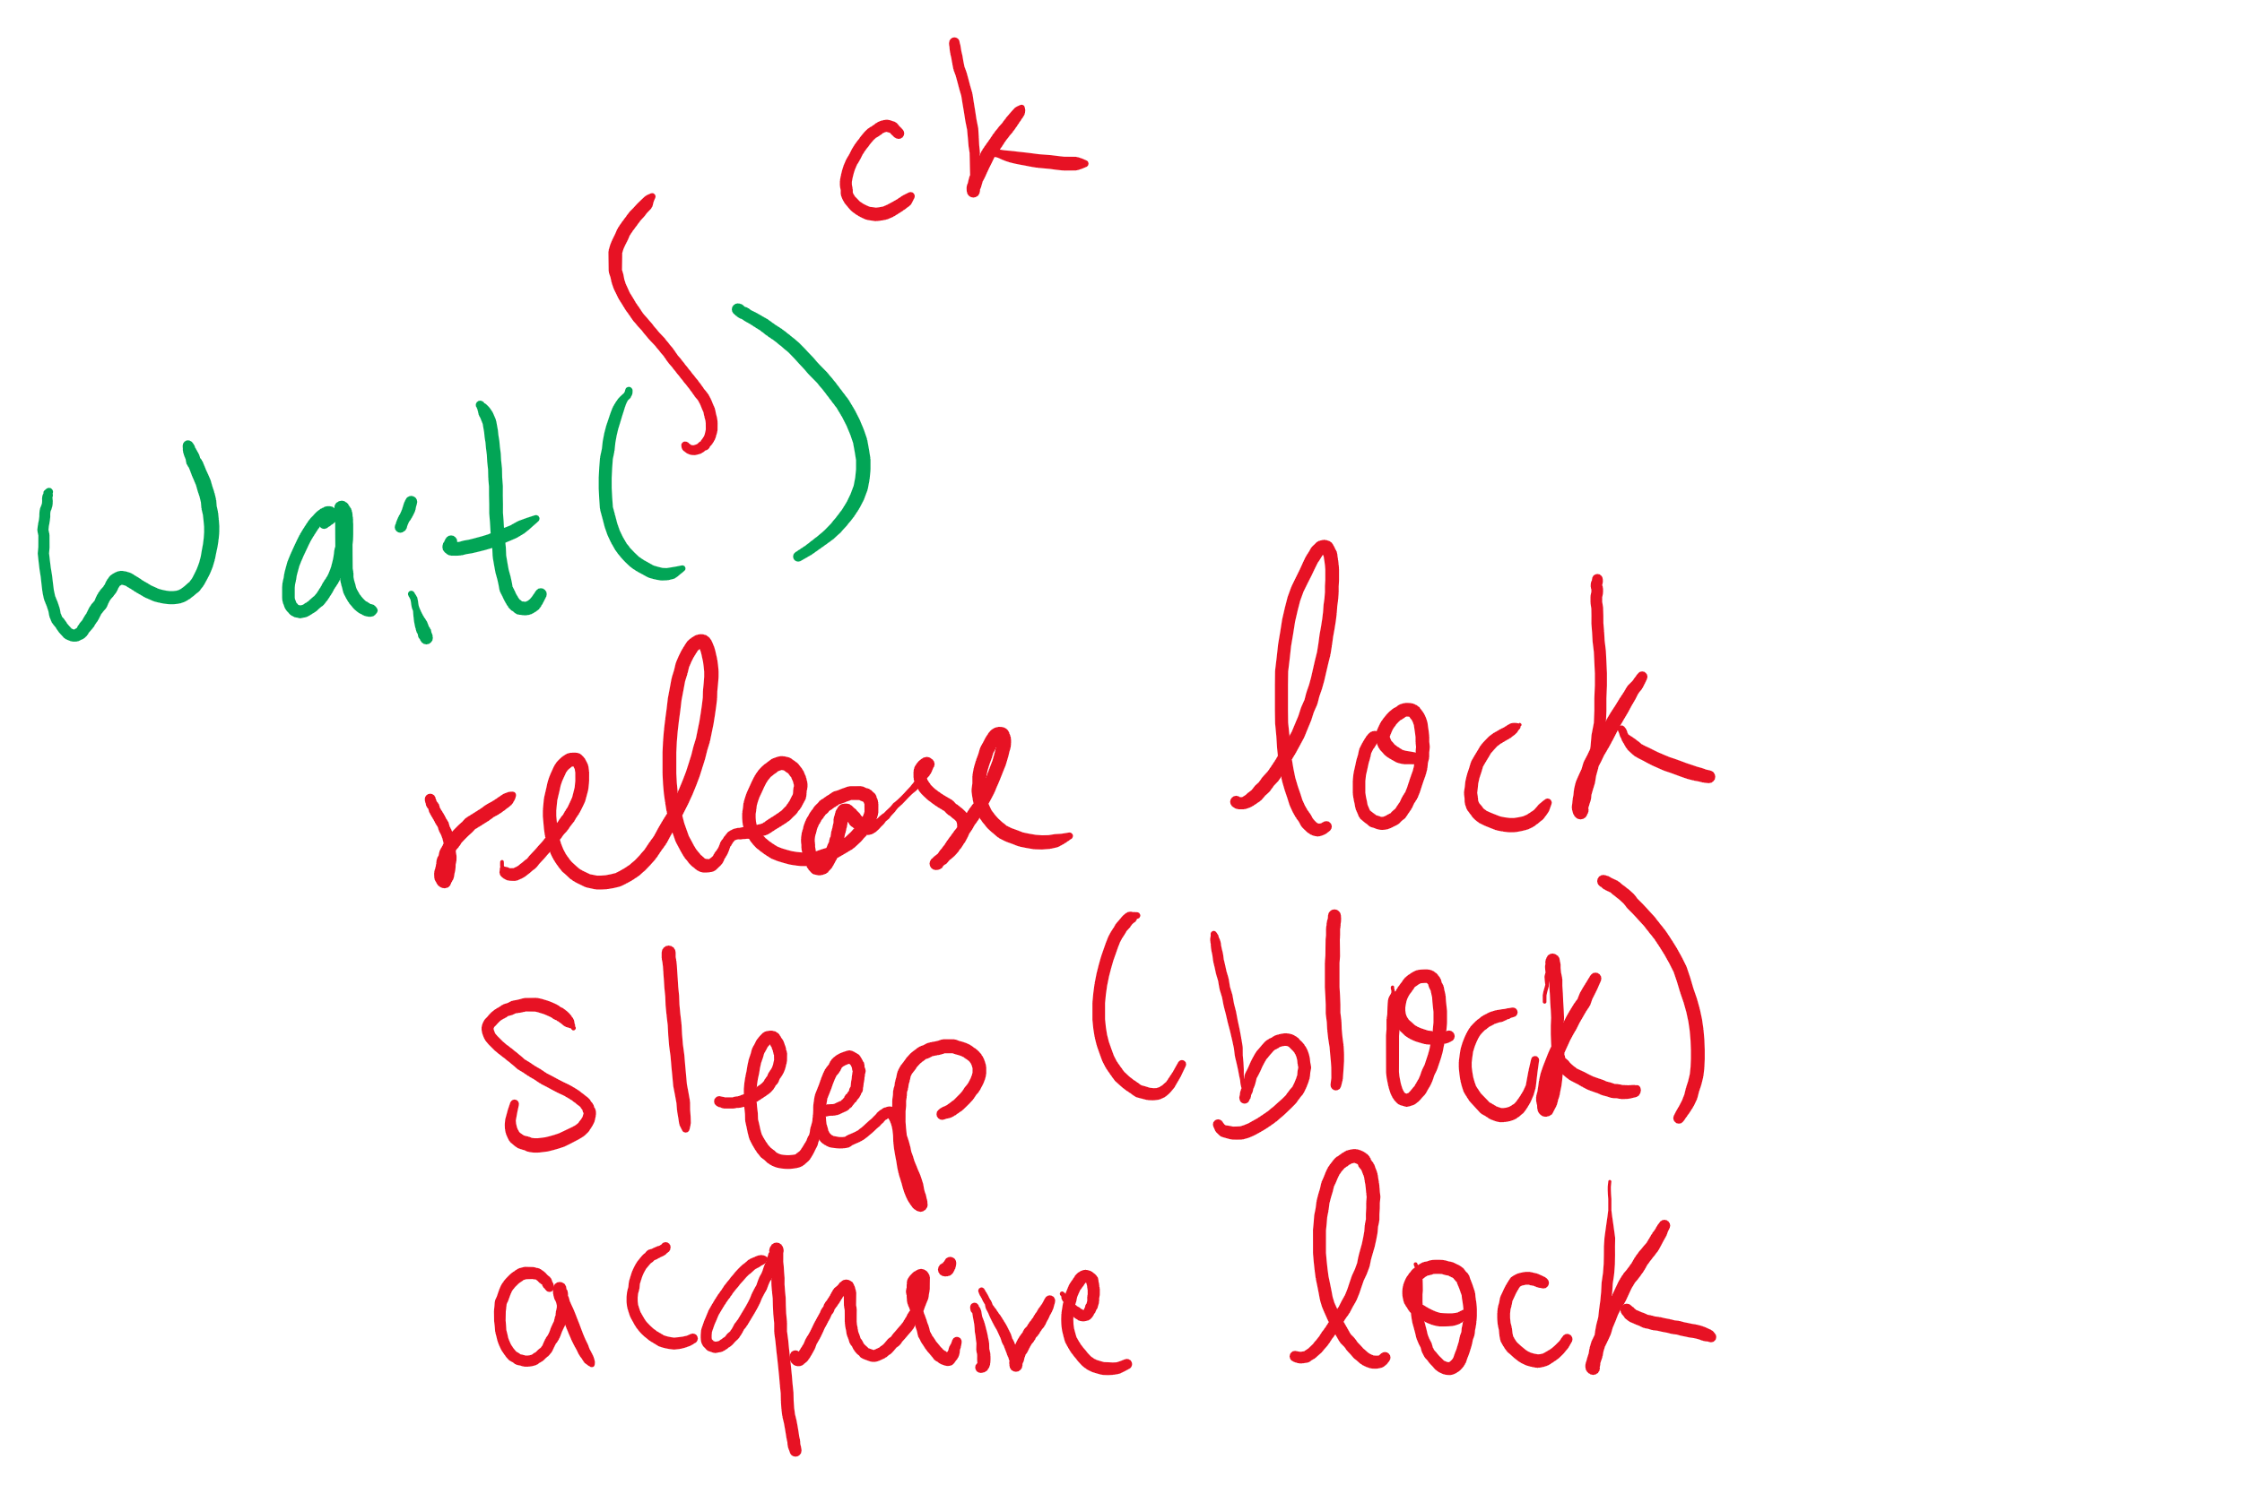


The three steps of the wait() operation

Slide 15
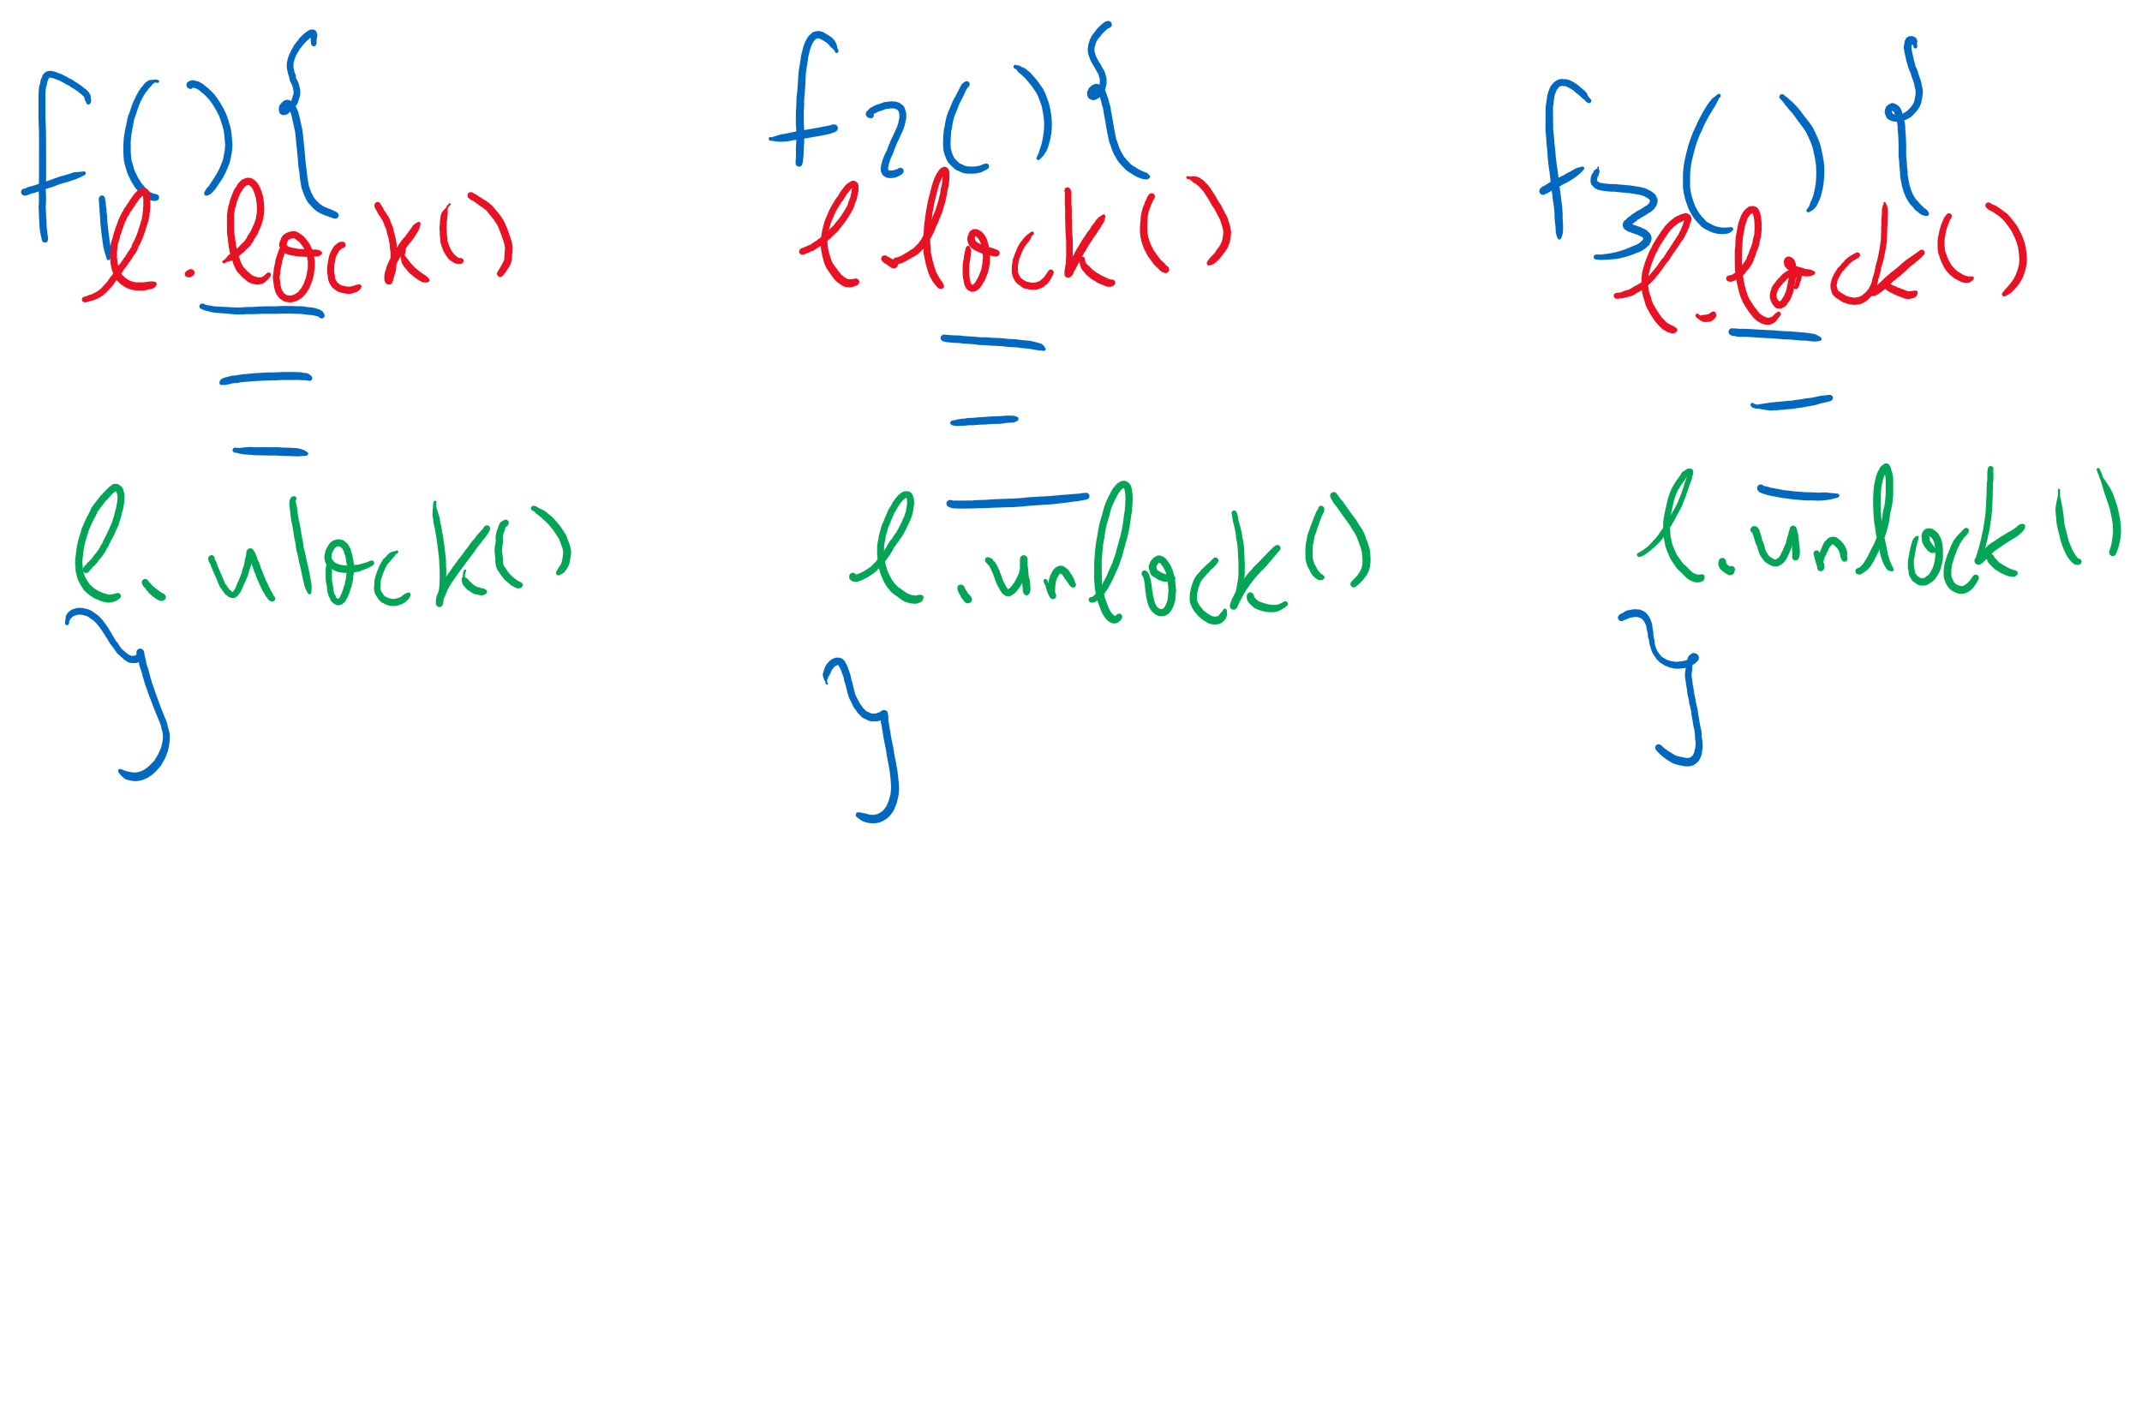
Adding Monitors in C

Slide 16
Monitor semantics
Question: which process gets the monitor after Signal()?
Problem: P signals on condition variable X, waking Q
Both can’t be active in the monitor at the same time
Which one continues first?
Mesa semantics
Signaling process (P) continues first
Q resumes when P leaves the monitor
Seems more logical: why suspend P when it signals?
Hoare semantics
Awakened process (Q) continues first
P resumes when Q leaves the monitor
May be better: condition that Q wanted may no longer hold when P leaves the monitor

Slide 17
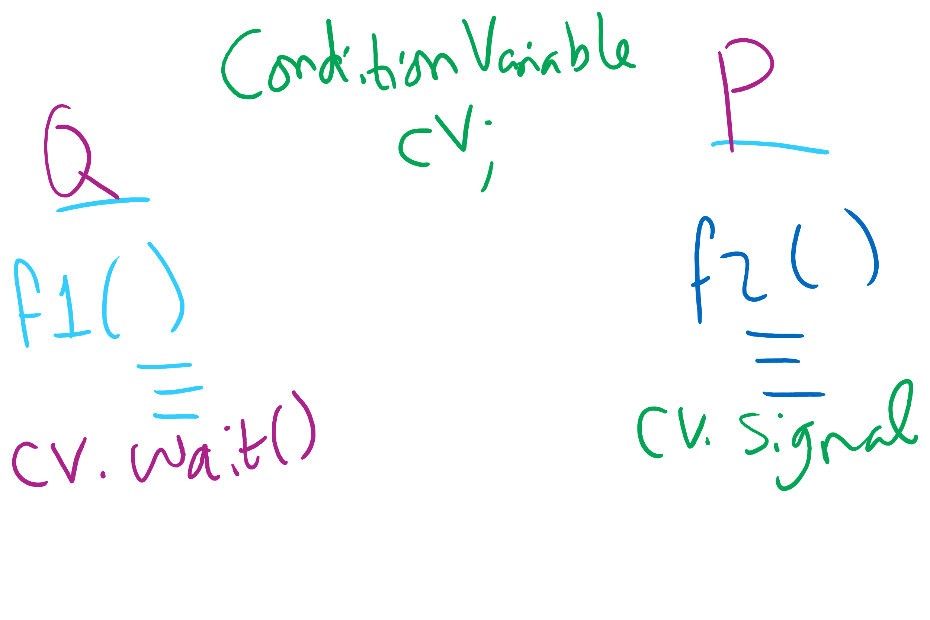
Signaling and Signaled Processes

Slide 18
Condition Variables wait()
Use a while loop around the wait()
While(some condition)
condvar.wait();
Why??
Think Mesa semantics!
Spurious wakeups

Slide 19
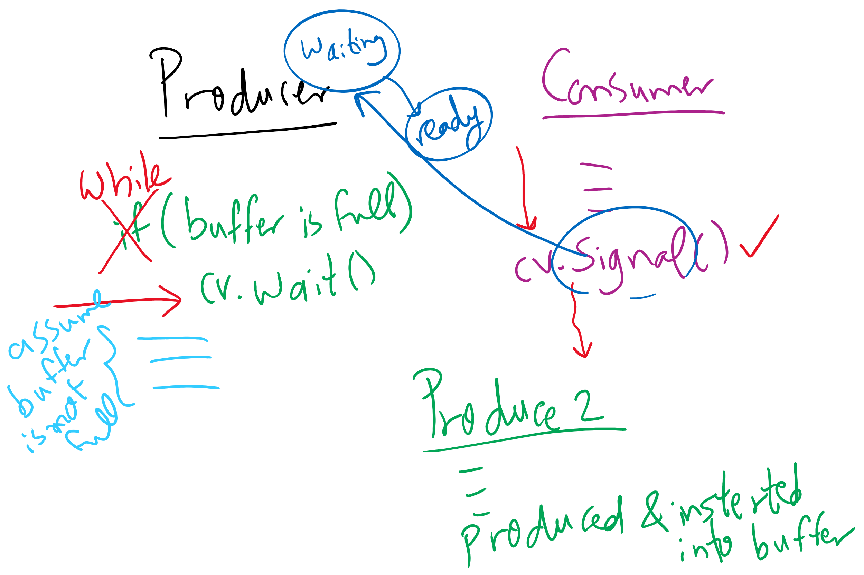
Using while instead of if with wait()

Slide 20
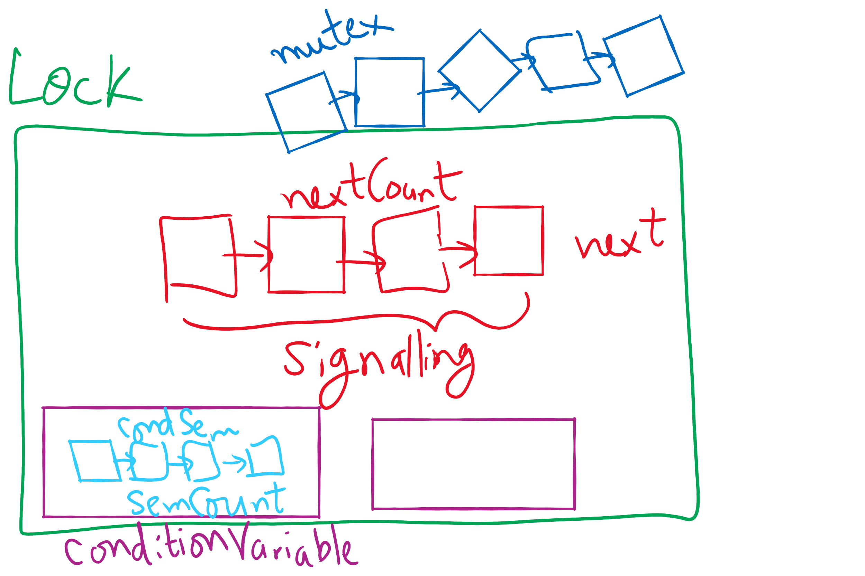
Lock and Condition Variable Implementation

Slide 21
Implementing locks with semaphores
Use mutex to ensure exclusion within the lock bounds
Use next to give lock to processes with a higher priority (why?)
nextCount indicates whether there are any higher priority waiters
class Lock {
Semaphore mutex(1);
Semaphore next(0);
int nextCount = 0;
};
Lock::Acquire()
{
mutex.down();
}
Lock::Release()
{
if (nextCount > 0)
next.up();
else
mutex.up();
}

Slide 22
Implementing condition variables
Are these Hoare or Mesa semantics?
Can there be multiple condition variables for a single Lock?
class Condition {
Lock *lock;
Semaphore condSem(0);
int semCount = 0;
};
Condition::Signal ()
{
if (semCount > 0) {
lock->nextCount += 1;
condSem.up ();
lock->next.down ();
lock->nextCount -= 1;
}
}
Condition::Wait ()
{
semCount += 1;
if (lock->nextCount > 0)
lock->next.up();
else
lock->mutex.up();
condSem.down ();
semCount -= 1;
}

Slide 23
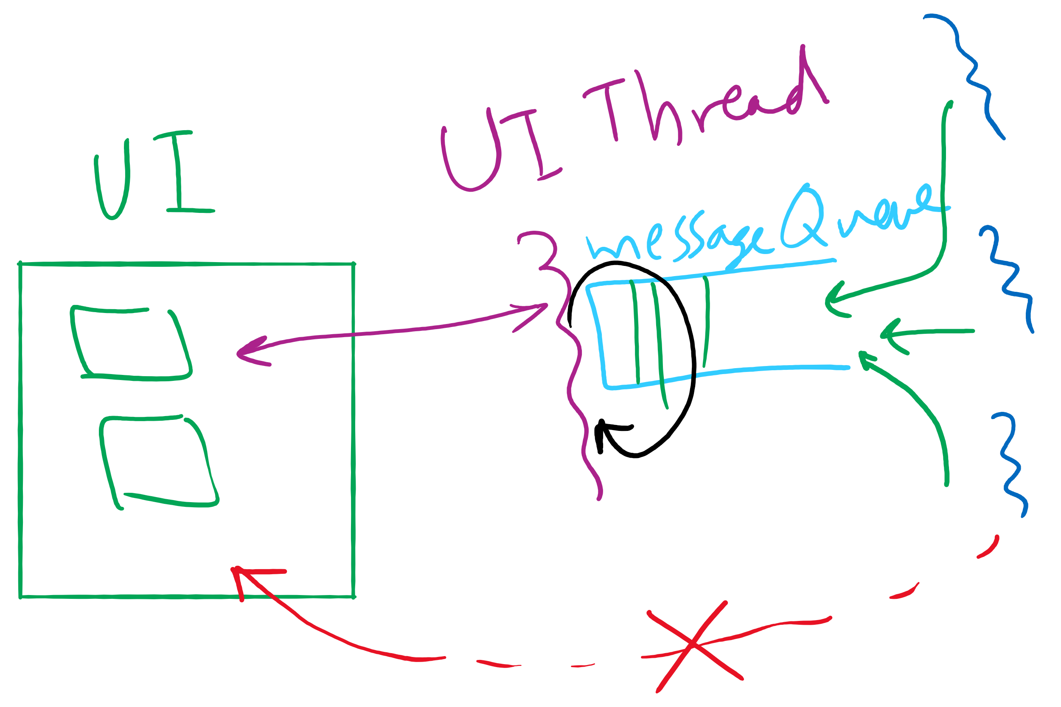
Message passing
Synchronize by exchanging messages
Two primitives:
Send: send a message
Receive: receive a message
Both may specify a “channel” to use
Issue: how does the sender know the receiver got the message?
Issue: authentication

Slide 24
Barriers
Used for synchronizing multiple processes
Processes wait at a “barrier” until all in the group arrive
After all have arrived, all processes can proceed
May be implemented using locks and condition variables
A
A
A
A
B
B
B
B
C
C
C
C
D
D
D
D
Processes approaching
barrier
B and D at
barrier
All at
barrier
Barrier releases all processes

Slide 25
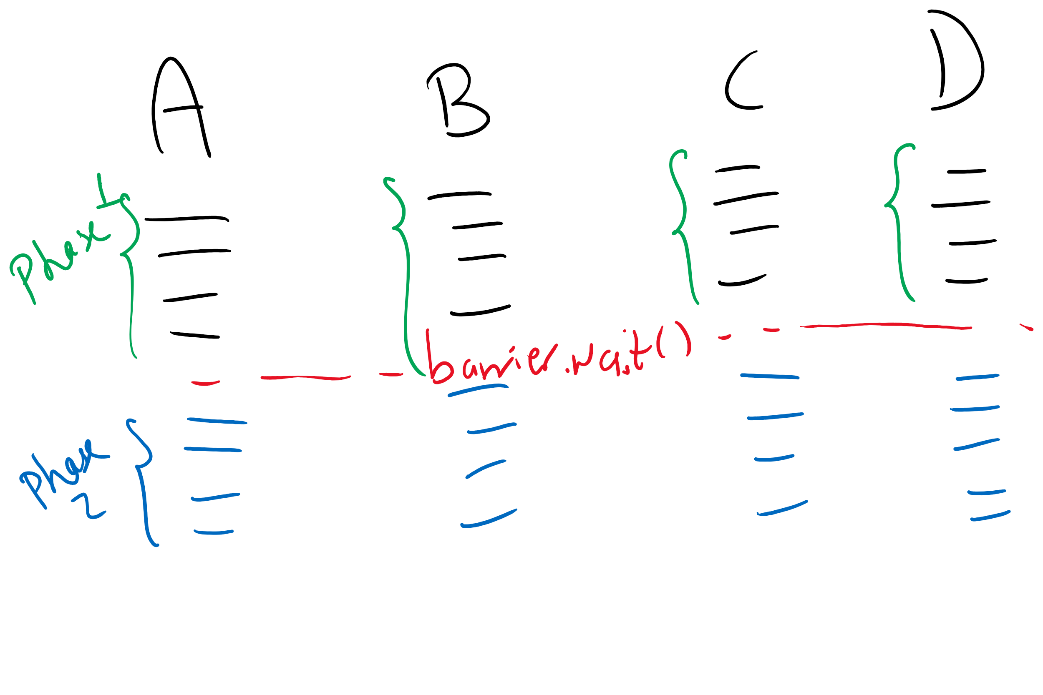
Barriers Example

