Slide 1

Introduction to Operating Systems CS/COE 1550
Fall 2021
Sherif Khattab
ksm73@pitt.edu
(Some slides are from Silberschatz, Galvin and Gagne ©2013)

Slide 2
Announcements
Upcoming deadlines:
Project 1 and Homework 4: due on 2/19
Tophat questions due one week after each lecture
Three free extension days for homework assignments and labs only.
Please make good use of the office hours of the entire teaching team. We are all here to help you.
Tophat grades on Canvas are not accurate
Last week's recitations are particularly useful for Project 1.
Applications for the 2021 virtual Randall Family Big Idea Competition are due Feb. 19 by 11:59 p.m.

Slide 3
Last Lecture …
Classical Process Synchronization Problems
Dining Philosophers
correct solution
Sleepy Barber

Slide 4
Muddiest Points (1/3)
Sleepy Barber Problem
The purpose of the mutex used within the context of the sleepy barber solution
Barber problem- who waits, the barber or the customer?
customer.down vs up, barber.down vs up?
Dining Philosophers
if condition of philosopher solution
Application Examples of Dining Philosophers Problem
Why does the proposed solution for the dining philosopher problem work? If all but one of the philosophers are all "downing" on their left chopstick, wouldn't that cause issues for the philosophers when they try to down on their right chopstick?

Slide 5
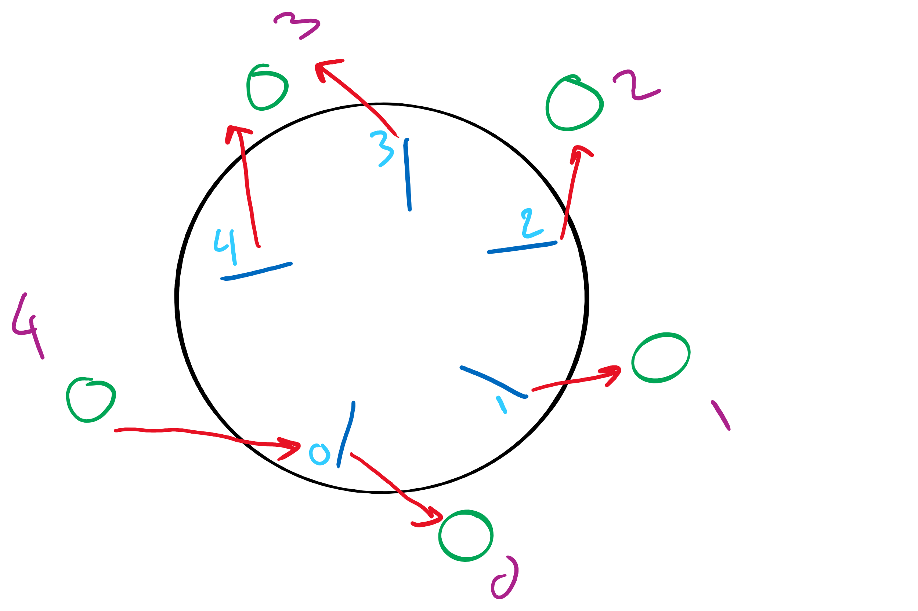
Dining Philosophers Solution

Slide 6
Code for the Sleepy Barber Problem
#define CHAIRS 5
Semaphore customers=0;
Semaphore barbers=0;
Semaphore mutex=1;
int waiting=0;
void barber(void)
{
while(TRUE) {
// Sleep if no customers
customers.down();
// Decrement # of waiting people
mutex.down();
waiting -= 1;
// Wake up a customer to cut hair
barbers.up();
mutex.up();
// Do the haircut
cut_hair();
}
}
void customer(void)
{
mutex.down();
// If there is space in the chairs
if (waiting<CHAIRS) {
// Another customer is waiting
waiting++;
// Wake up the barber. This is
// saved up, so the barber doesn’t
// sleep if a customer is waiting
customers.up();
mutex.up();
// Sleep until the barber is ready
barbers.down();
get_haircut();
} else {
// Chairs full, leave the critical
// region
mutex.up ();
}
}

Slide 7
Dining Philosophers: solution 2
Use a semaphore for each chopstick
A hungry philosopher
Gets lower, then higher numbered chopstick
Eats
Puts down the chopsticks
Potential problems?
Deadlock
Fairness
Code for philosopher i
int i1,i2;
while(1) {
if (i != (n-1)) {
i1 = i;
i2 = i+1;
} else {
i1 = 0;
i2 = n-1;
}
chopstick[i1].down();
chopstick[i2].down();
// eat
chopstick[i1].up();
chopstick[i2].up();
// think
}
Shared variables
const int n;
// initialize to 1
Semaphore chopstick[n];

Slide 8
Muddiest Points (2/3)
Tophat Questions
Why D in reader writer problem is impossible? If there's no writer and there are two readers, the first reader will call down(write) make writing semaphore equals to 0 and second reader will increment nreader to 2. That will make the case where write semaphore is 0 and nreader > 1
can empty semaphore<0 in tophat q1? and for RW semaphore mutex and writing are both binary sem and nReaders is just a integer right?
second TopHat question and the explanation for the "empty > 0 and full > 0 " option for the first TopHat question
What are the possible semaphore values and their meanings in the bounded buffer and read and write problems?

Slide 9
Tophat questions
Which of the following can NOT happen in the semaphore-based solution of the Bounded Buffer Problem?
empty == 0 and full == 0
empty > 0 and full > 0
empty <= 0 and full == n
empty == n and full > 0
Which of the following can NOT happen in the semaphore-based solution of the Readers Writers Problem?
The value of the writing semaphore is 0 and the mutex is locked
The value of the writing semaphore is 0 and the mutex is unlocked
The value of the writing semaphore is 0 and nReaders == 1
The value of the writing semaphore is 0 and nReaders > 1
All the above scenarios can happen

Slide 10
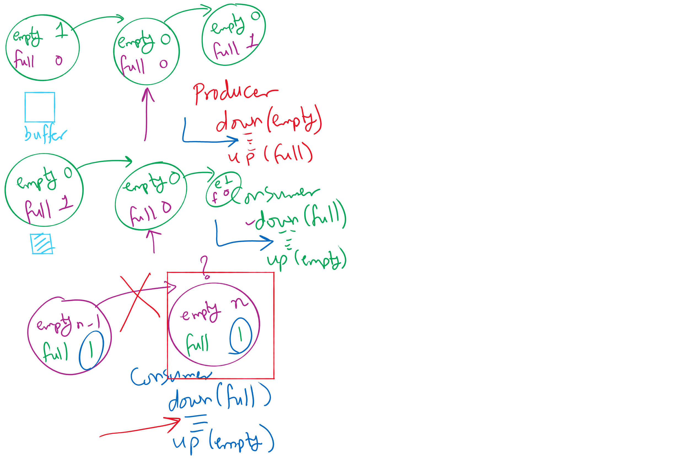
Possible states in Bounded Buffer Solution

Slide 11
Muddiest Points (3/3)
semophore vs mutex
Project 1
create
question 2 in homework 3
What exactly is a thread?

Slide 12
Today’s Agenda …
Using Monitors to solve Classical Process Synchronization Problems
Bounded Buffer
Readers Writers
Dining Philosophers
Sleepy Barber

Slide 13
Monitor-based Solutions
Code Walkthrough at:
https://cs1550-2214.github.io/cs1550-code-handouts/ProcessSynchronization/Slides/

