Slide 1

Introduction to Operating Systems CS/COE 1550
Fall 2021
Sherif Khattab
ksm73@pitt.edu
(Some slides are from Silberschatz, Galvin and Gagne ©2013)

Slide 2
Announcements
Upcoming deadlines:
3/5: Homework 6
3/12: Project 2
Tophat questions due one week after each lecture
Extension days must be requested before the deadline
for labs and homework assignments only
Midterm on 3/4
2-3 days time-window to start the exam

Slide 3
Last Lecture …
Detecting Deadlocks
Avoiding Deadlocks

Slide 4
Muddiest Points (1/3)
Too many n/a’s!!
bankers algorithm for multiple resources
can we do a trace of banker's algorithm for multiple resources?
Getting used to determining whether safe is state
For the banker's algorithm with multiple resources, does a process require all the needed resource amounts for every resource type at once in order for it to return any resources?
Just to clarify, when doing the bankers' algorithm. We are sorta doing a "what if" on the state after the current state considering that the resources have been allocated?
Why is there an M in the runtime for detecting deadlocks?
For the deadlock detection algorithm does the want mean how much it wants total or is it how much is wanted not including how much it already has

Slide 5
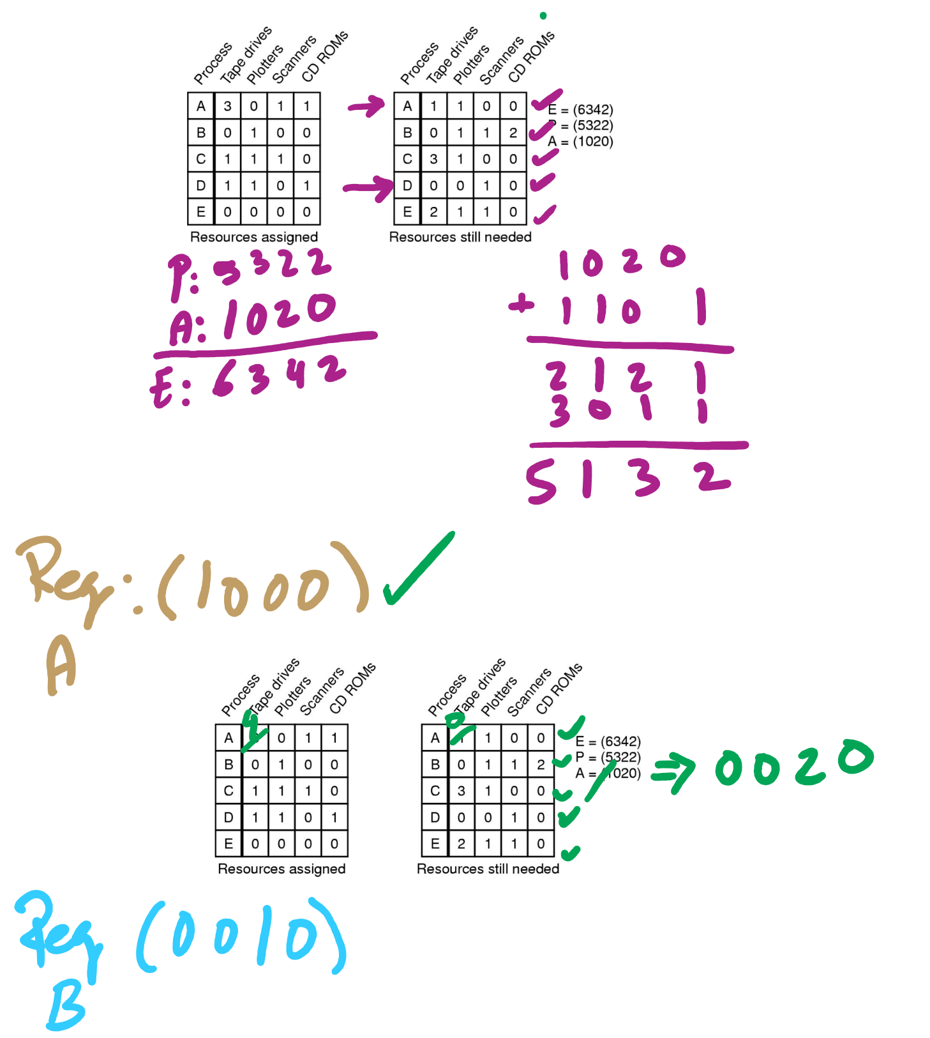
Banker’s Algorithm Example

Slide 6
Muddiest Points (2/3)
Would like to see implementation of the resource trajectories algorithm
Can the trajectory graph be applied to more than 2 processes running simultaneously? I didnt understand the point of the graph, since it seems to show the same information as the banker's algorithm chart
For the resource trajectory graphs, I'm assuming that you cannot go down or to the right?
I understand the banker's algorithm, but I don't think I understood the definition of resource trajectories
How resource trajectories are useful

Slide 7
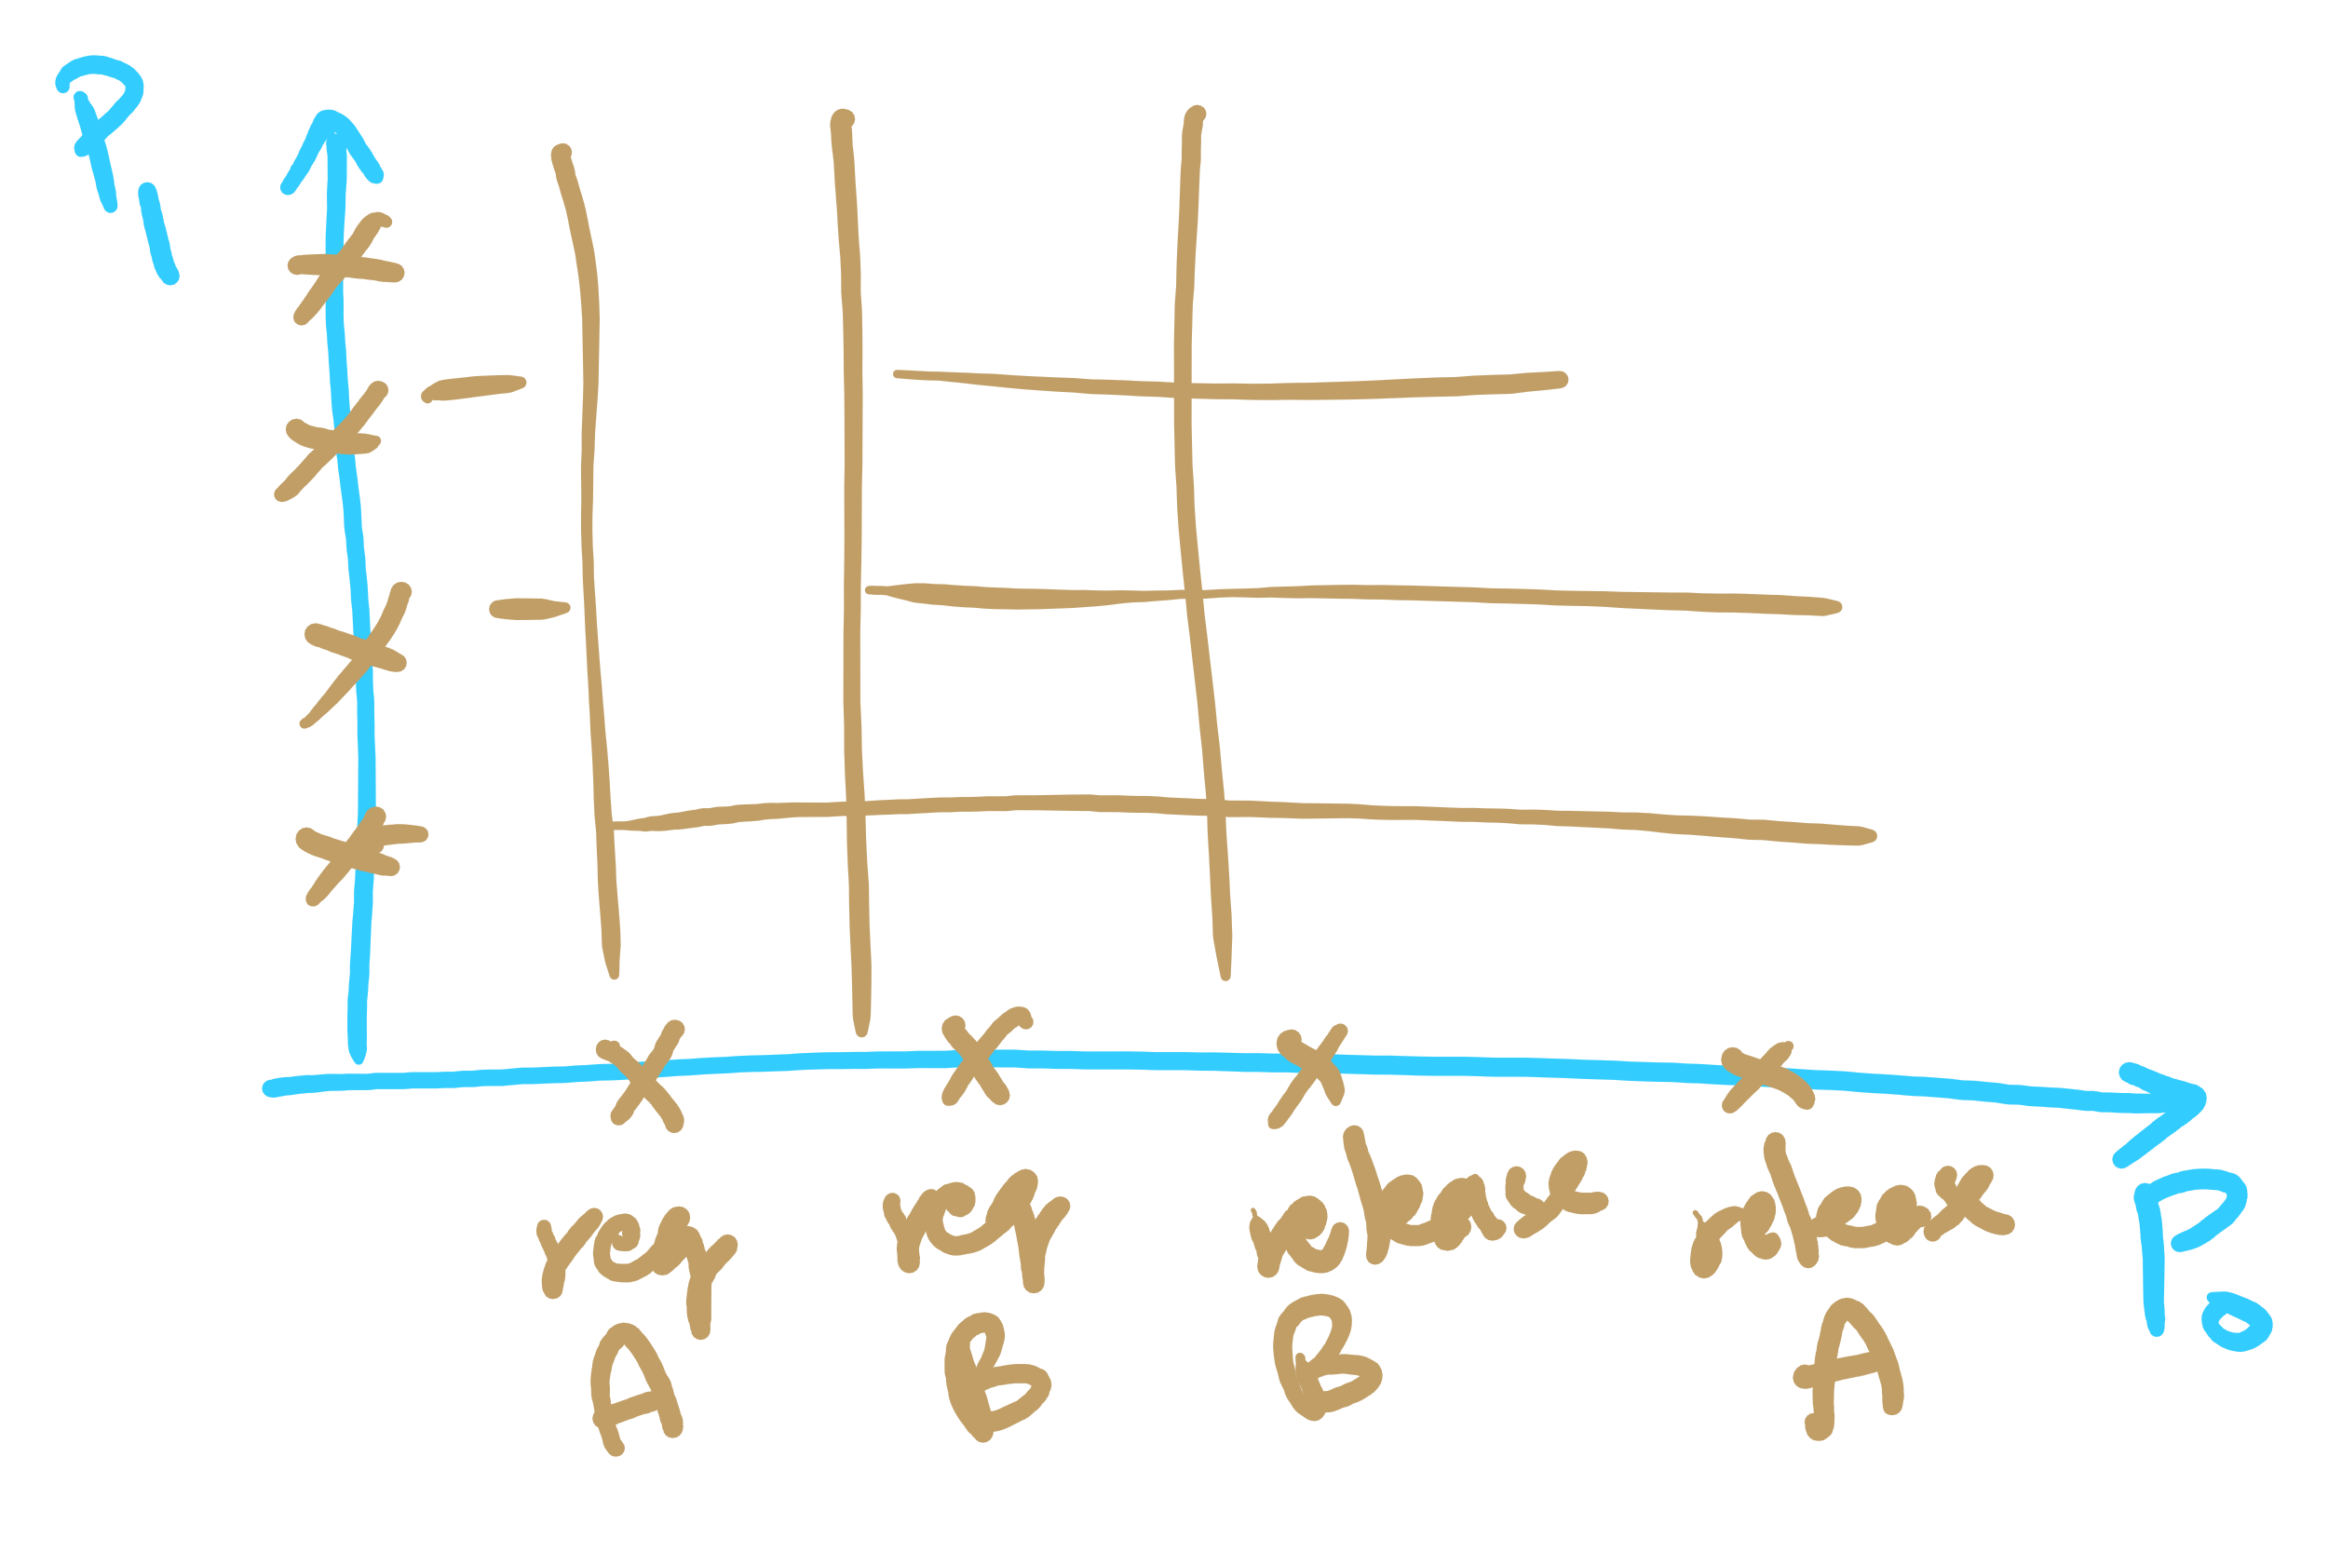
Resource Trajectories

Slide 8
Muddiest Points (3/3)
For deadlock detection, wouldn't arrows all be possibly double arrows? The process that requests the resources can also be ones that already grant them.
dining problem on hw5
Best study method to prepare for the midterm?
what happens to a process if resources aren’t allocated
comparison of deadlock algorithms, when to use which one?

Slide 9
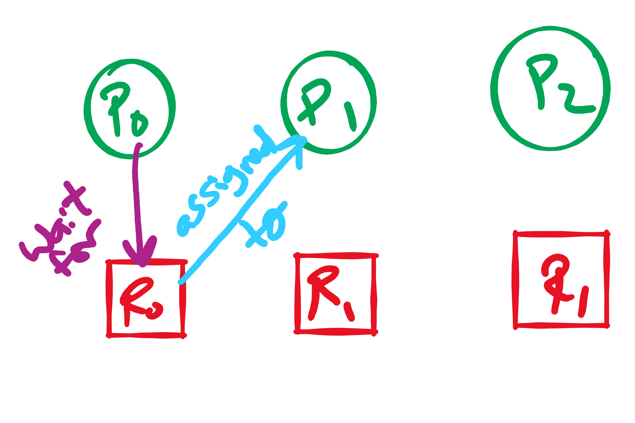
Arrows in Resource Allocation Graph

Slide 10
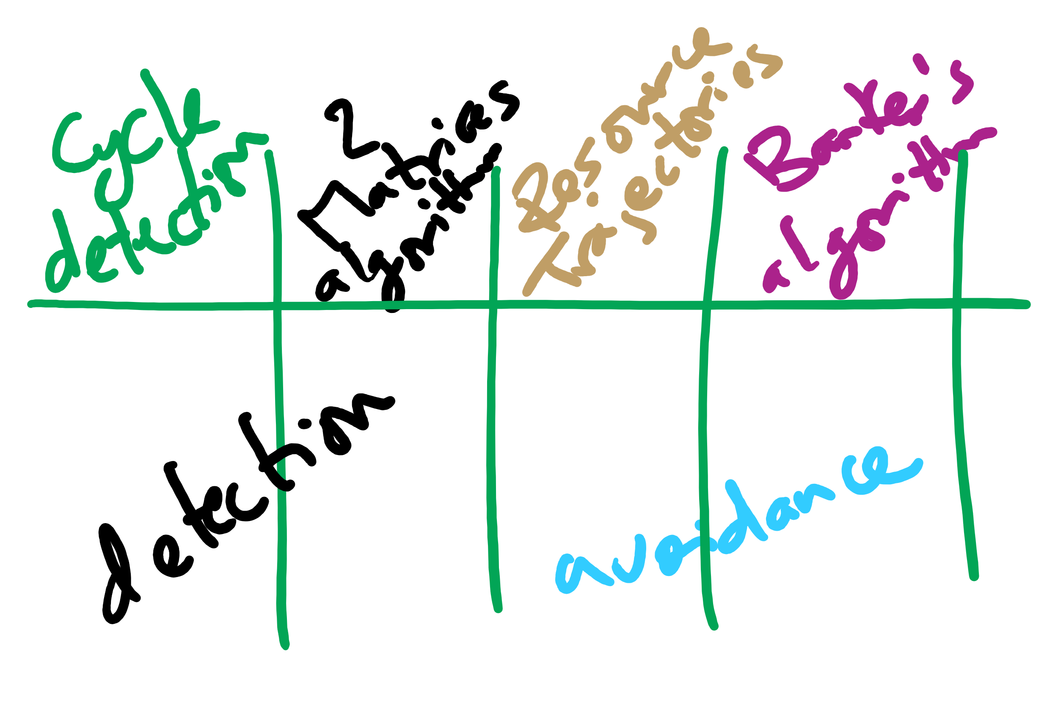
Deadlock Detection and Avoidance Algorithms

Slide 11
Today’s Agenda …
Preventing Deadlocks
CPU Scheduling Algorithms

Slide 12
Preventing deadlock
Deadlock can be completely prevented!
Ensure that at least one of the conditions for deadlock never occurs
Mutual exclusion
Circular wait
Hold & wait
No preemption
Not always possible…

Slide 13
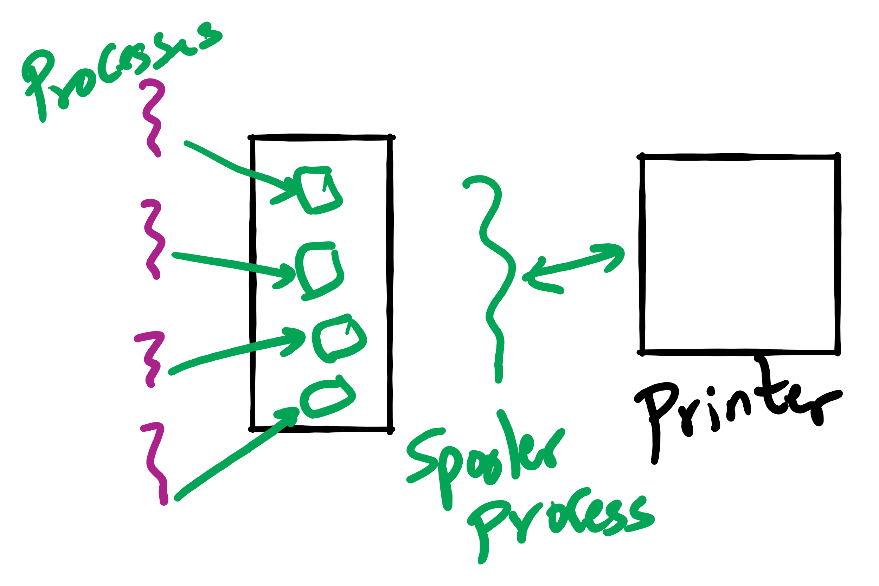
Eliminating mutual exclusion
Some devices (such as printer) can be spooled
Only the printer daemon uses printer resource
This eliminates deadlock for printer
Not all devices can be spooled
Principle:
Avoid assigning resource when not absolutely necessary
As few processes as possible actually claim the resource

Slide 14
Attacking “hold and wait”
Require processes to request resources before starting
A process never has to wait for what it needs
This can present problems
A process may not know required resources at start of run
This also ties up resources other processes could be using
Processes will tend to be conservative and request resources they might need
Variation: a process must give up all resources before making a new request
Process is then granted all prior resources as well as the new ones
Problem: what if someone grabs the resources in the meantime—how can the process save its state?

Slide 15
Attacking “no preemption”
This is not usually a viable option
Consider a process given the printer
Halfway through its job, take away the printer
Confusion ensues!
May work for some resources
Forcibly take away memory pages, suspending the process
Process may be able to resume with no ill effects

Slide 16
Attacking “circular wait”
Assign an order to resources
Always acquire resources in numerical order
Need not acquire them all at once!
Circular wait is prevented
A process holding resource n can’t wait for resource m if m < n
No way to complete a cycle
Place processes above the highest resource they hold and below any they’re requesting
All arrows point up!
D
C
B
A
1
2
3

Slide 17
Attacking “circular wait”
Assign an order to resources
Always acquire resources in numerical order
Need not acquire them all at once!
Circular wait is prevented
A process holding resource n can’t wait for resource m if m < n
No way to complete a cycle
Place processes above the highest resource they hold and below any they’re requesting
All arrows point up!
D
C
B
1
A
2
3

Slide 18
Attacking “circular wait”
Assign an order to resources
Always acquire resources in numerical order
Need not acquire them all at once!
Circular wait is prevented
A process holding resource n can’t wait for resource m if m < n
No way to complete a cycle
Place processes above the highest resource they hold and below any they’re requesting
All arrows point up!
D
C
2
B
1
A
3

Slide 19
Attacking “circular wait”
Assign an order to resources
Always acquire resources in numerical order
Need not acquire them all at once!
Circular wait is prevented
A process holding resource n can’t wait for resource m if m < n
No way to complete a cycle
Place processes above the highest resource they hold and below any they’re requesting
All arrows point up!
D
C
3
2
B
1
A

Slide 20
Deadlock prevention: summary
Mutual exclusion
Spool everything
Hold and wait
Request all resources initially
No preemption
Take resources away
Circular wait
Order resources numerically

Slide 21
Example: two-phase locking
Phase One
Process tries to lock all data it needs, one at a time
If needed data found locked, start over
(no real work done in phase one)
Phase Two
Perform updates
Release locks
Note similarity to requesting all resources at once
This is often used in databases
It avoids deadlock by eliminating the “hold-and-wait” deadlock condition

Slide 22
“Non-resource” deadlocks
Possible for two processes to deadlock
Each is waiting for the other to do some task
Can happen with semaphores
Each process required to do a down() on two semaphores (mutex and another)
If done in wrong order, deadlock results
Semaphores could be thought of as resources…

Slide 23
Starvation
Algorithm to allocate a resource
Give the resource to the shortest job first
Works great for multiple short jobs in a system
May cause long jobs to be postponed indefinitely
Even though not blocked
Solution
First-come, first-serve policy
Starvation can lead to deadlock
Process starved for resources can be holding resources
If those resources aren’t used and released in a timely fashion, shortage could lead to deadlock

Slide 24
CPU Scheduling
Scheduling the processor among all ready processes
User-oriented criteria
Response Time: Elapsed time between the submission of a request and the receipt of a response
Turnaround Time: Elapsed time between the submission of a process to its completion
System-oriented criteria
Processor utilization
Throughput: number of process completed per unit time
Fairness

Slide 25
Short-Term Scheduler Dispatcher
The dispatcher is the module that gives control of the CPU to the process selected by the short-term scheduler
The functions of the dispatcher include:
Switching context
Switching to user mode
Jumping to the location in the user program to restart execution
The dispatch latency must be minimal

Slide 26





The CPU-I/O Cycle
Processes require alternate use of processor and I/O in a repetitive fashion
Each cycle consist of a CPU burst followed by an I/O burst
A process terminates on a CPU burst
CPU-bound processes have longer CPU bursts than I/O-bound processes

Slide 27
Scheduling Algorithms
First-Come, First-Served Scheduling
Shortest-Job-First Scheduling
Also referred to as Shortest Process Next
Priority Scheduling
Round-Robin Scheduling
Multilevel Queue Scheduling
Multilevel Feedback Queue Scheduling

Slide 28
Characterization of Scheduling Policies
The selection function determines which ready process is selected next for execution
The decision mode specifies the instants in time the selection function is exercised
Nonpreemptive
Once a process is in the running state, it will continue until it terminates or blocks for an I/O
Preemptive
Currently running process may be interrupted and moved to the Ready state by the OS
Prevents one process from monopolizing the processor

Slide 29
Process Mix Example
Process
Arrival Time
Service Time
1
0
3
2
2
6
3
4
4
4
6
5
5
8
2
Service time = total processor time needed in one (CPU-I/O) cycle
Jobs with long service time are CPU-bound jobs and are referred
to as “long jobs”

Slide 30







First Come First Served (FCFS)
Selection function: the process that has been waiting the longest in the ready queue (hence, FCFS)
Decision mode: non-preemptive
a process runs until it blocks for an I/O
Process
Arrival Time
Service Time
1
0
3
2
2
6
3
4
4
4
6
5
5
8
2

Slide 31
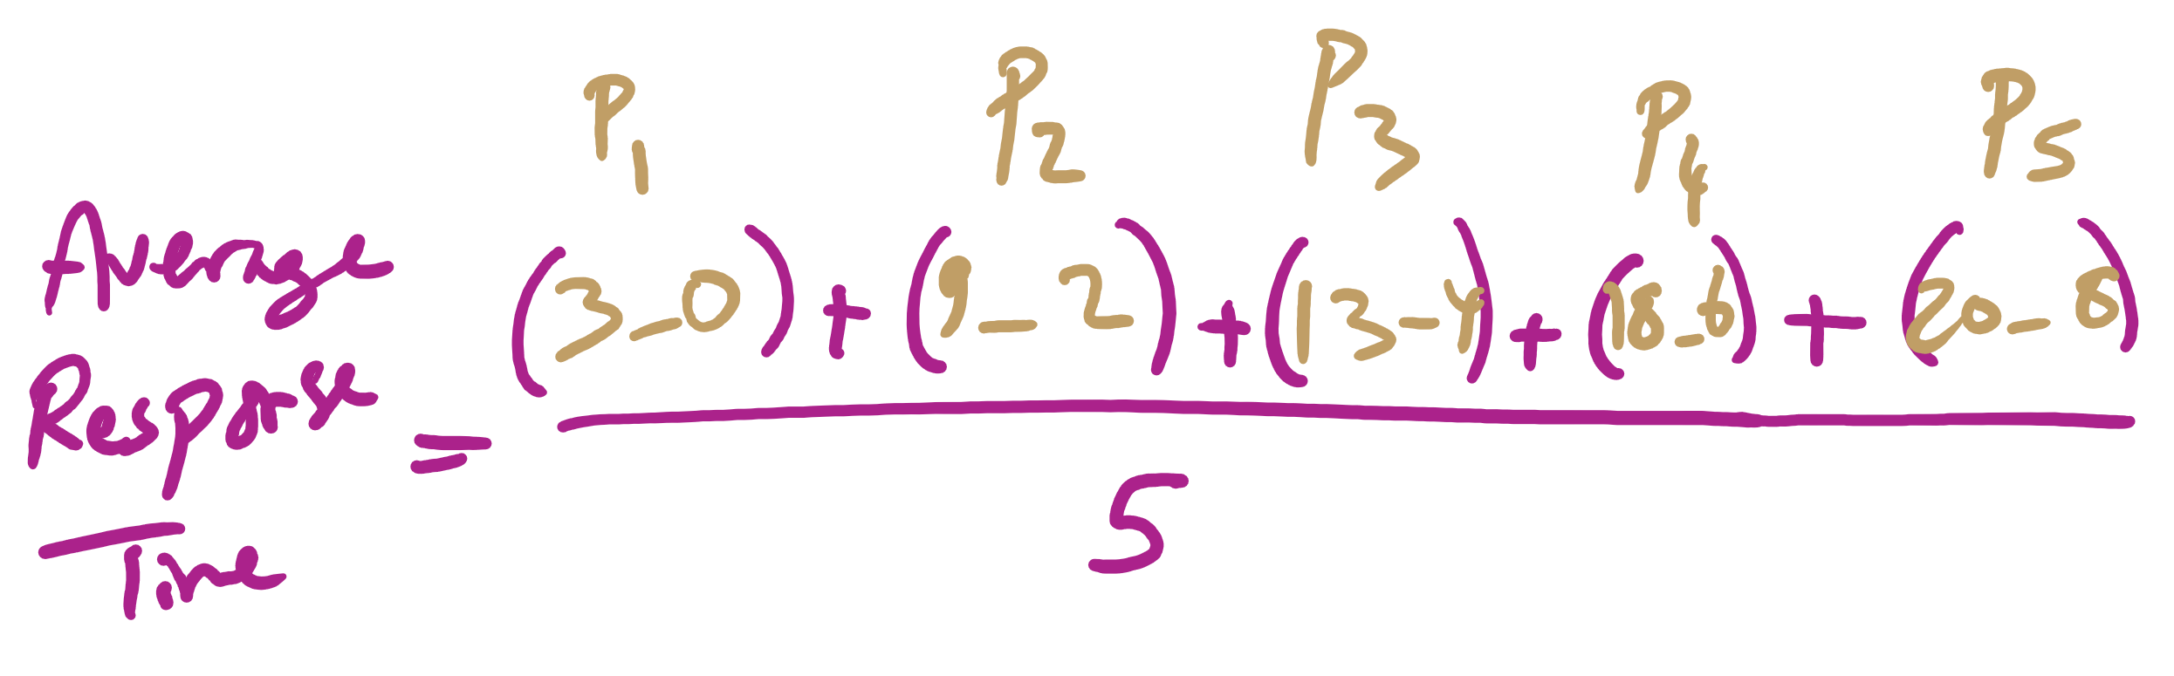
Average Response Time

Slide 32
FCFS drawbacks
Favours CPU-bound processes
A CPU-bound process monopolizes the processor
I/O-bound processes have to wait until completion of CPU-bound process
I/O-bound processes may have to wait even after their I/Os are completed (poor device utilization)
Better I/O device utilization could be achieved if I/O bound processes had higher priority

