Slide 1

Introduction to Operating Systems CS/COE 1550
Fall 2021
Sherif Khattab
ksm73@pitt.edu
(Some slides are from Silberschatz, Galvin and Gagne ©2013)

Slide 2
Announcements
Upcoming deadlines:
3/26: Lab 3, Quiz 2, and Homework 9
4/2: Project 3 (Virtual Memory Simulator)
Tophat questions due one week after each lecture

Slide 3
Last Lecture …
Modeling of Page Replacement Algorithms
Address Translation
Single-level Page Table

Slide 4
Muddiest Points (1/2)
Even though I feel like I know how to calculate waiting/response times, every time I try to actually do it it seems like something always goes wrong
Still catching up on lectures.
Address Translation
memory and paging structures
relation between page size and table size and how the logical address size affects them
still kind of confused on calculating page numbers
Does the page table hold physical or virtual addresses? When are they translated?
What does the page offset do when accessing the memory on the last step of the address translation architecture?
page number vs offset
Will the offset bits always be 32- the page bits?
The second tophat question (I understand how you got the answer, but I don't understand why that was the correct process to get it). And converting page numbers when transforming from logical --> physical
Logical address to page frame calculations
the point of a dirty bit
Belady's Algorithm

Slide 5
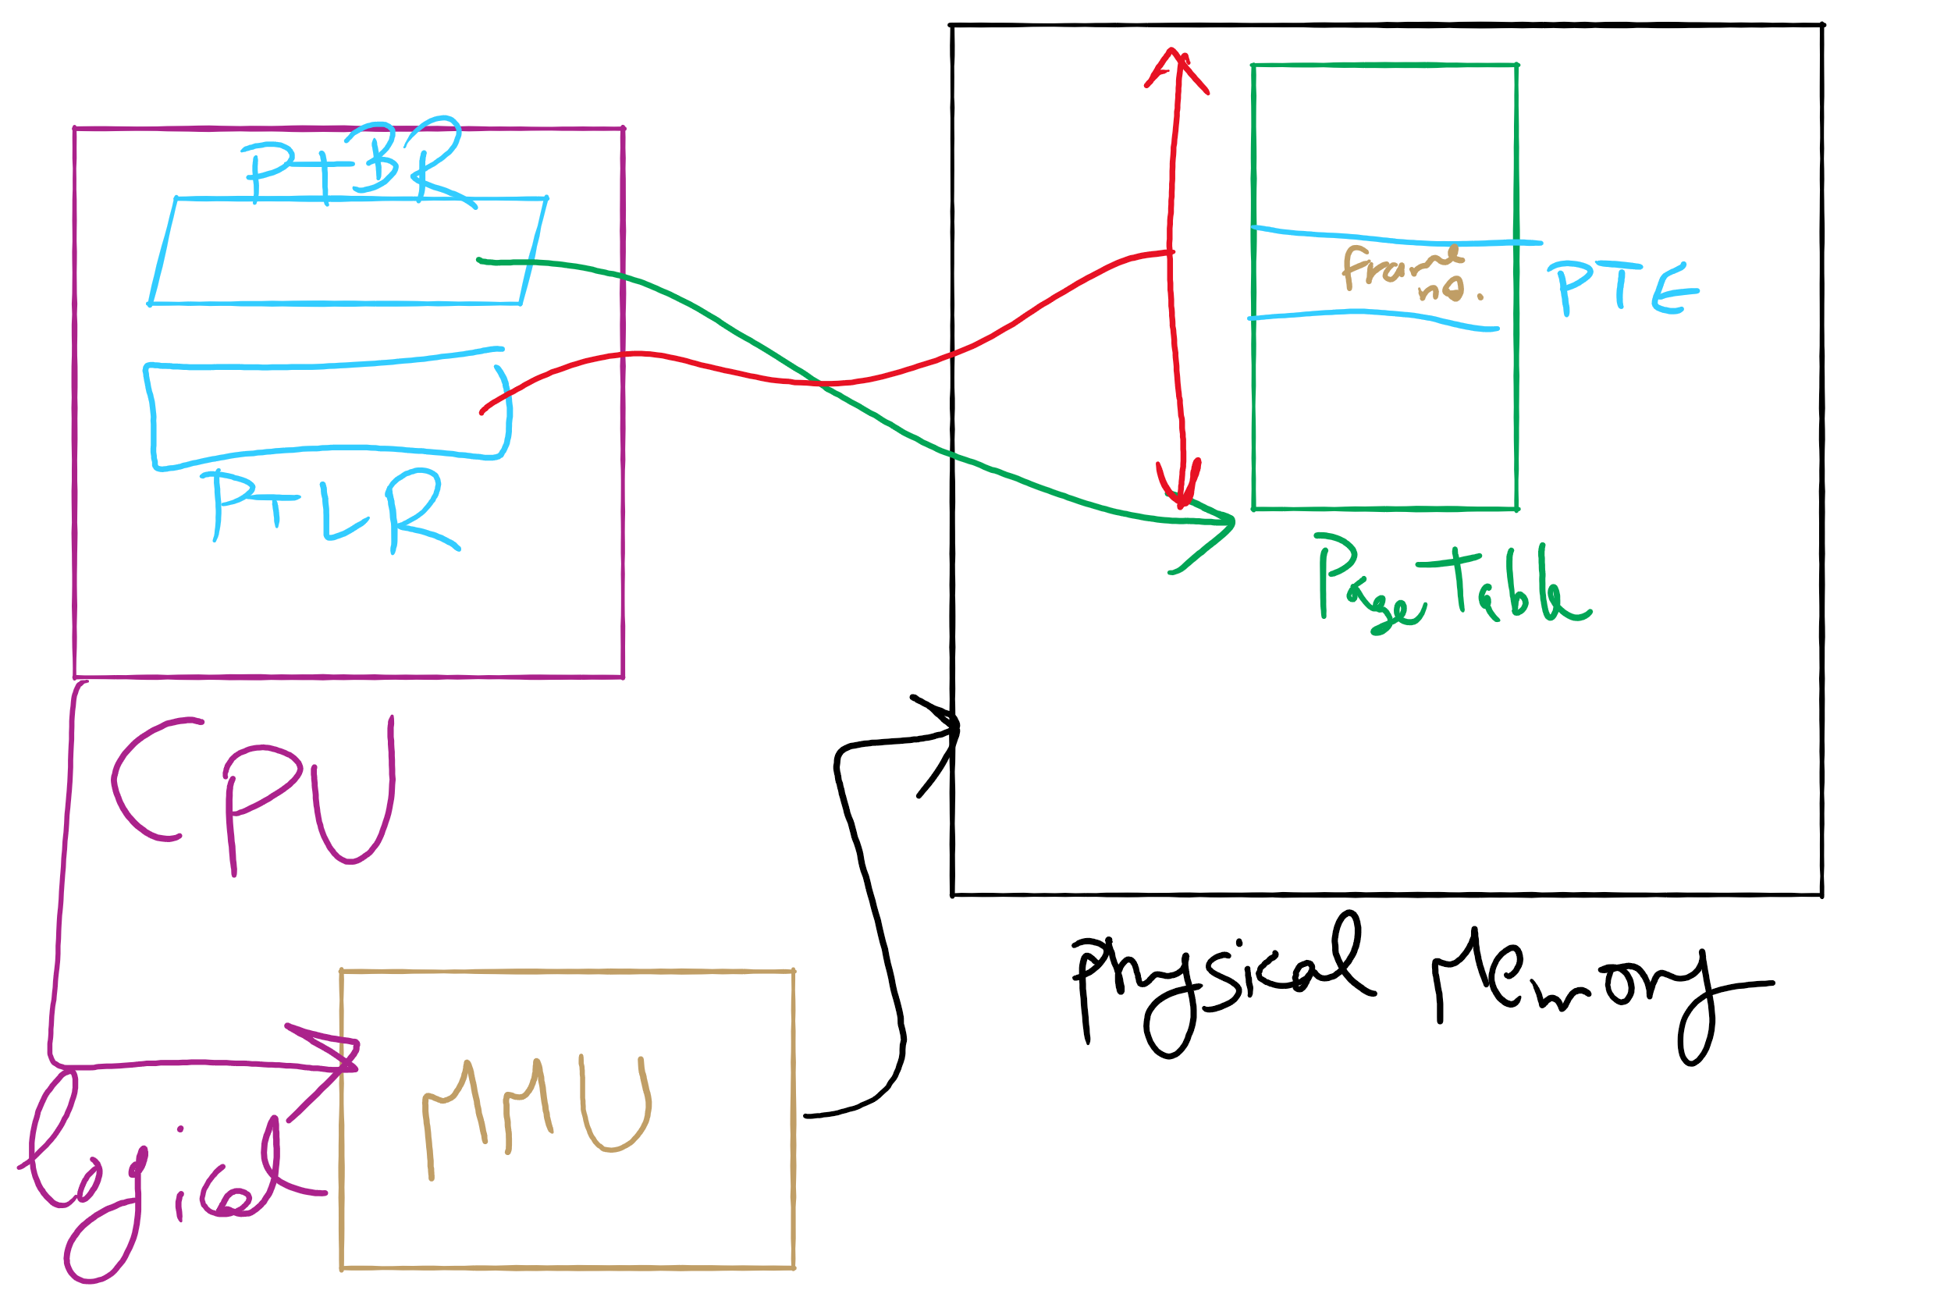
Address Translation Structures

Slide 6
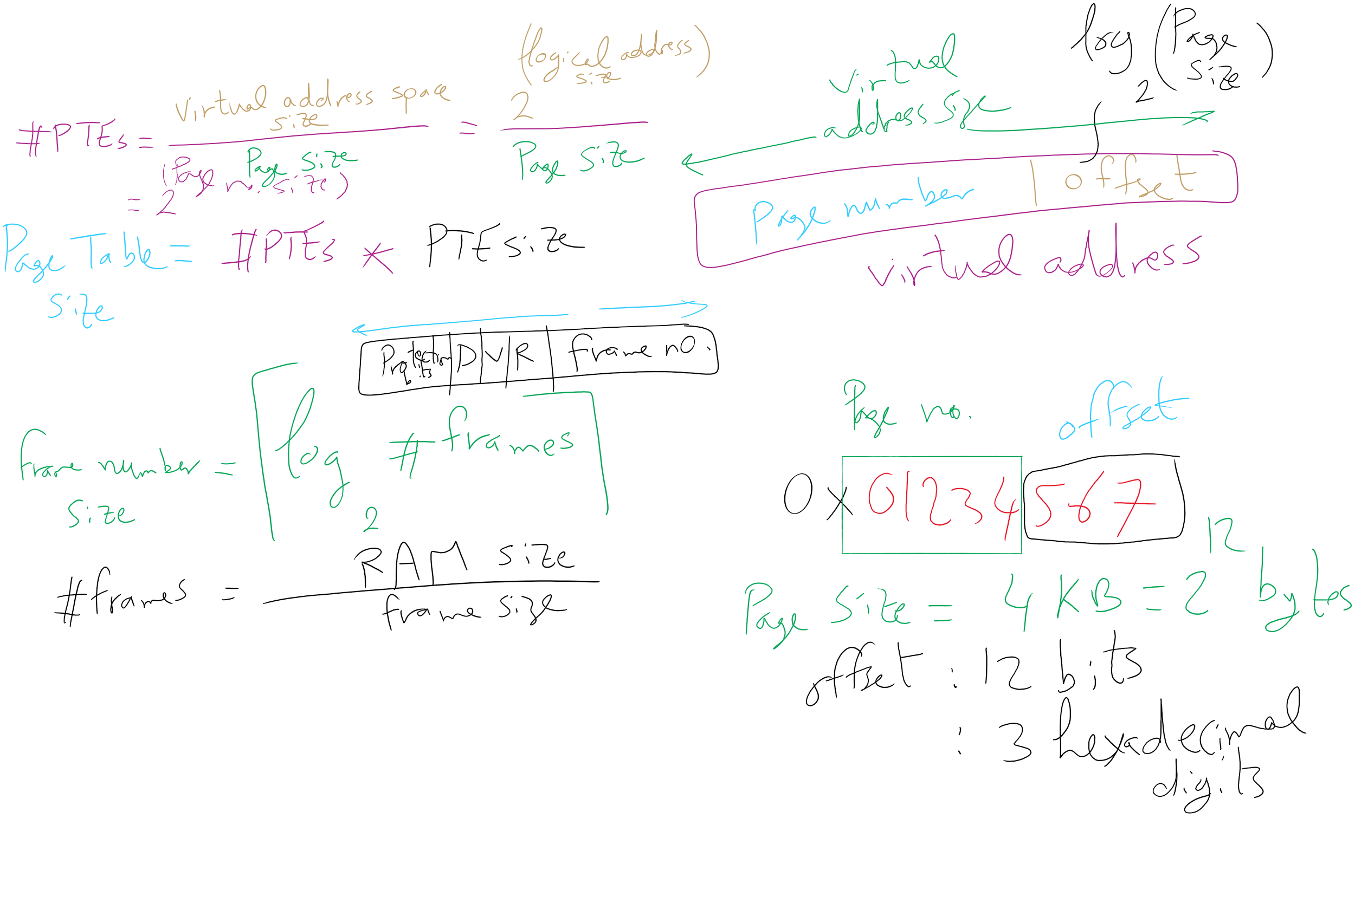
Address Translation Relations

Slide 7
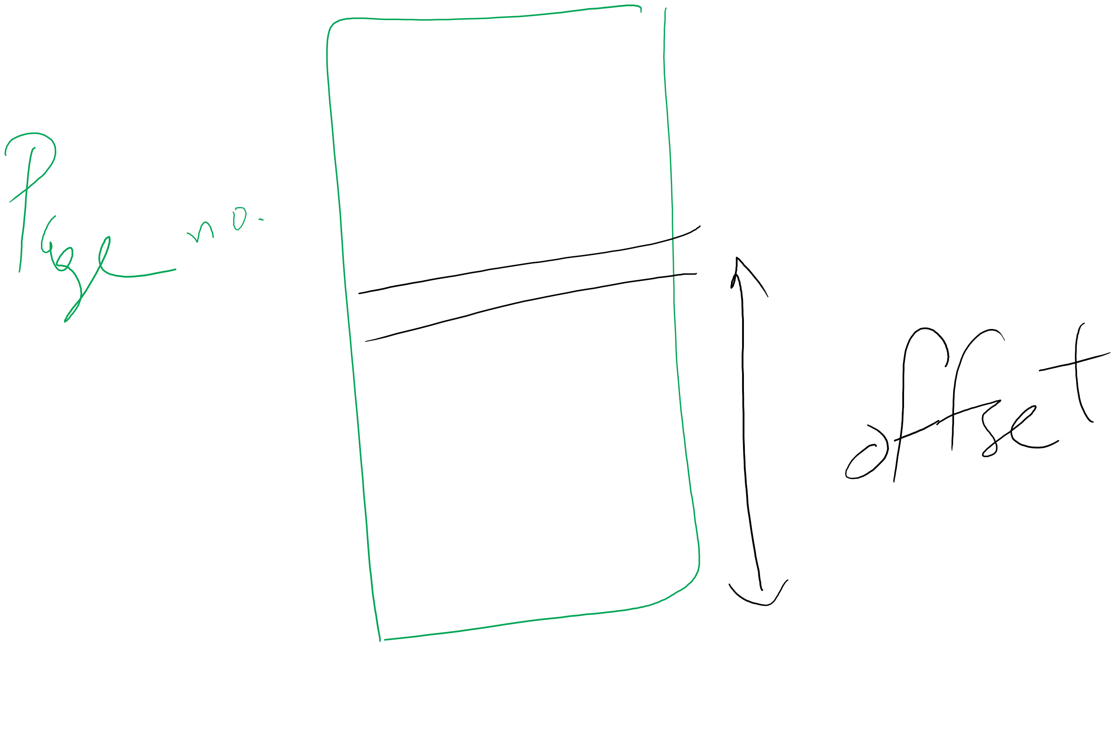
Page number vs. Offset

Slide 8
Muddiest Points (2/2)
HW 8
question 1
questions 6 and 7
Page Replacement Algorithms
Why do some algorithms suffer from Belady's anomaly and how do stack algorithms avoid this issue?
lru trace
Could you run through the LRU diagram example and explain how it works( from slide 9)
Stack Algorithms
Getting the number of page faults from the stack algorithm
distance in stack algorithm
What does it takes for the stack algorithm to save all of those
Why do we use distance in a 2D structure instead of a counter to keep track of page faults?
what are some other stack algorithms?
How are the distances in memory used to count the number of page faults in LRU?
The logic behind adding extra rows for stack algorithms
How can you predict the number of page faults again?
Project 3
Getting it started
Creating the programming version of the paper solution sounds pretty abstract, but I think once I do it for myself it will clear more things up

Slide 9
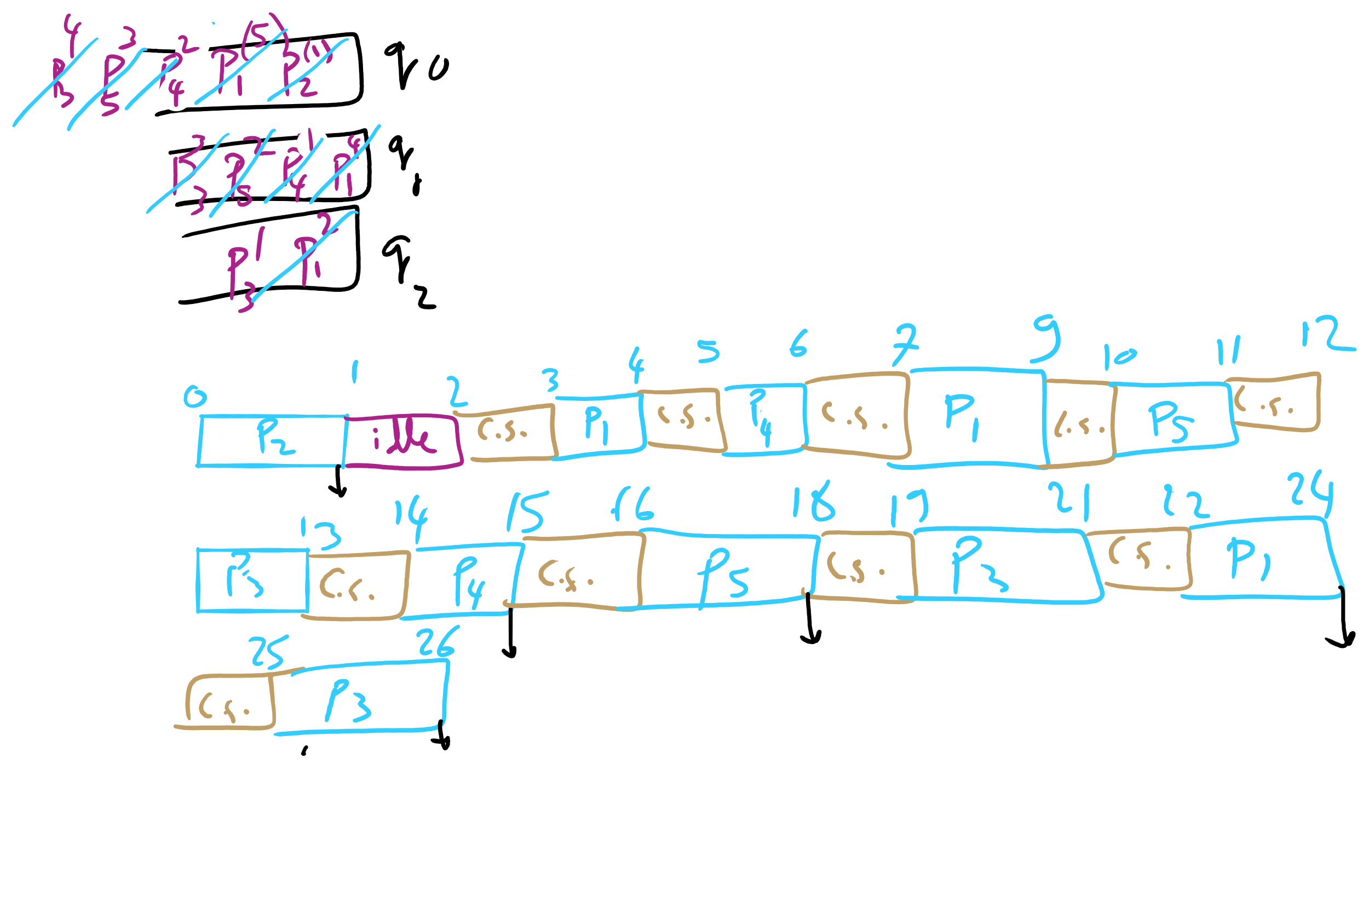
HW 8 Q1

Slide 10
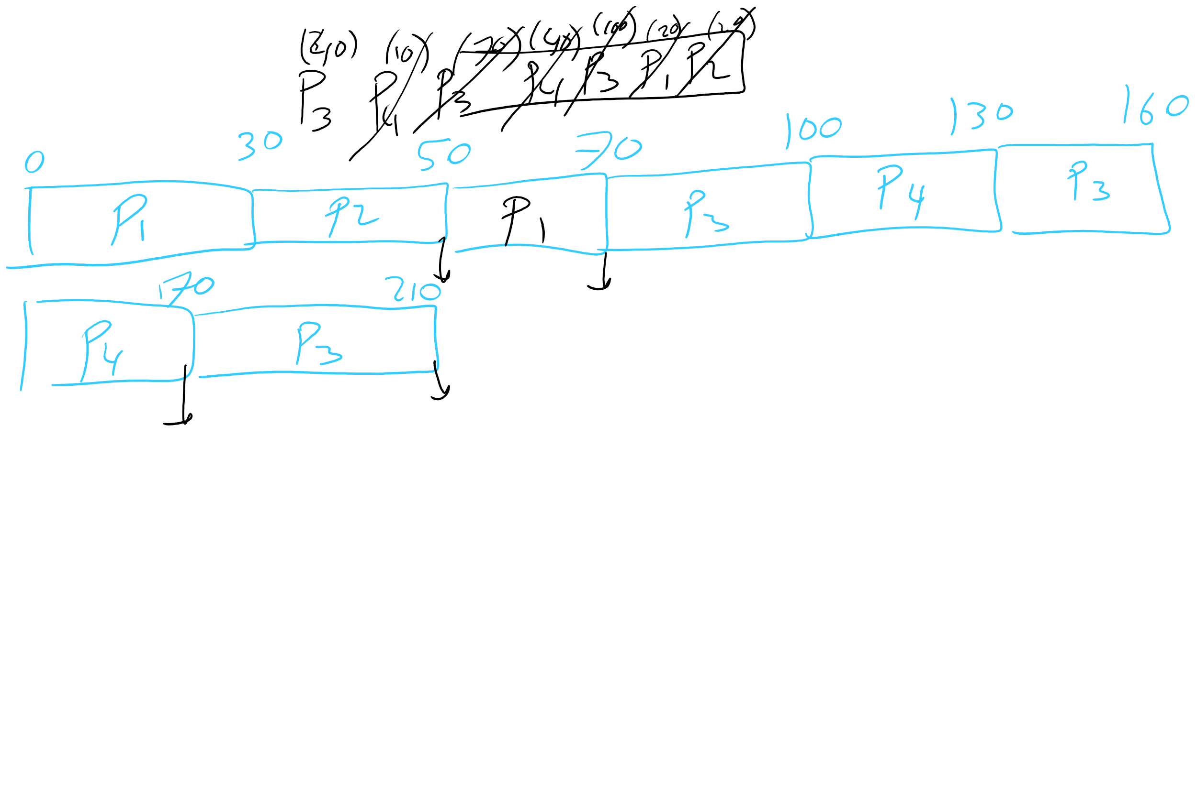
HW 8 Q6

Slide 11
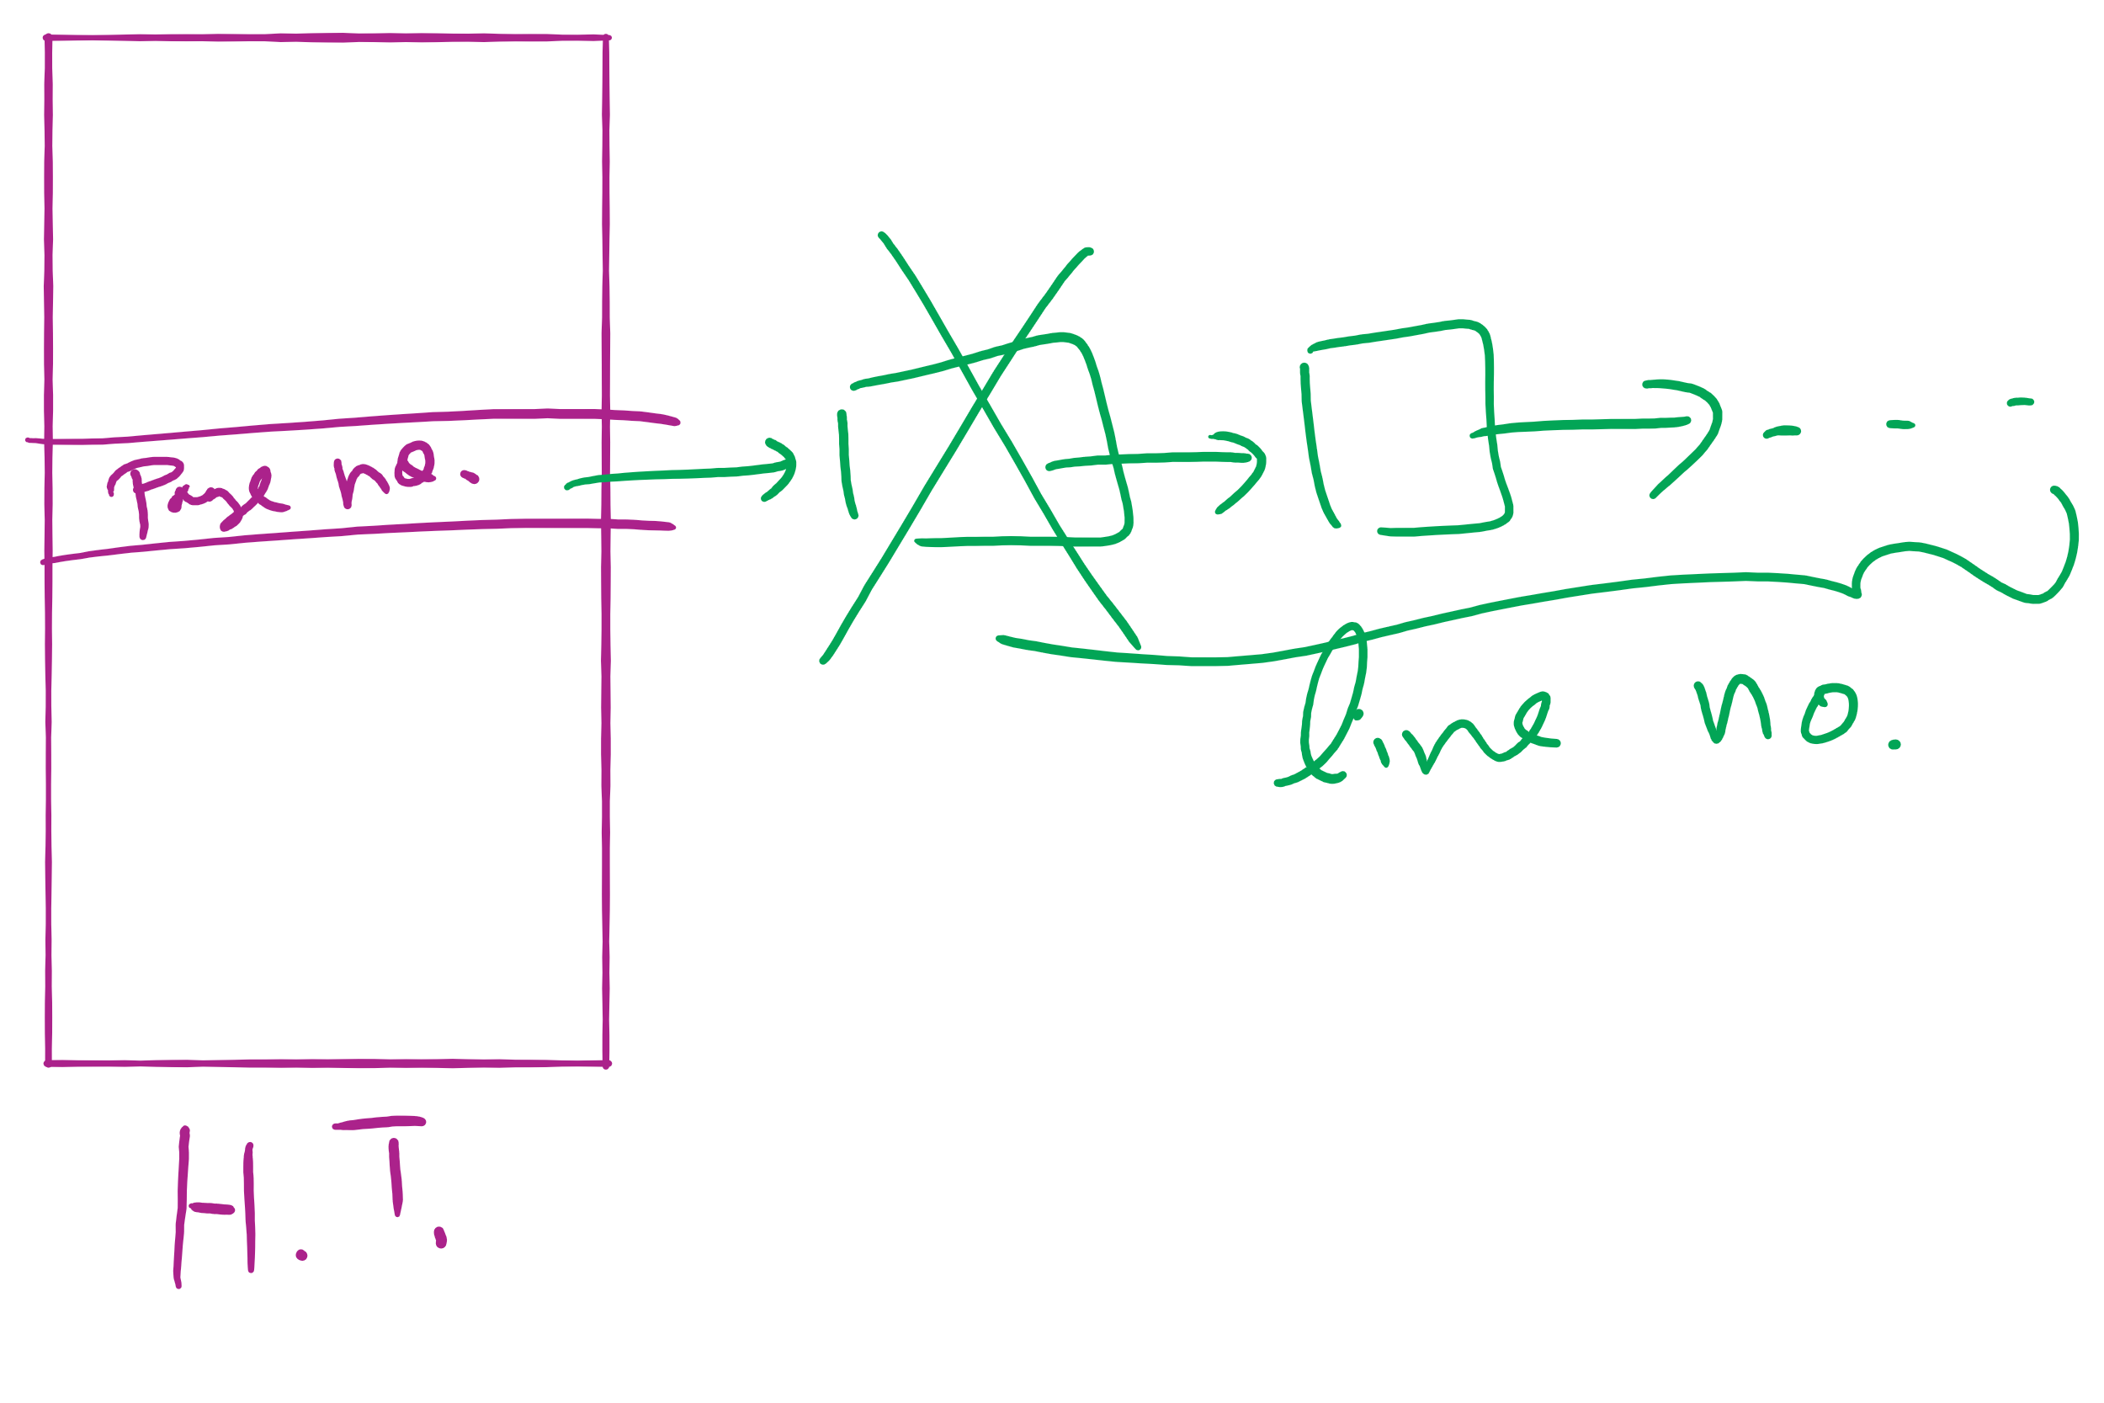
Hash Table for OPT in Project 3

Slide 12
Today’s Agenda …
Address Translation
2-level Page Table
TLB

Slide 13
Two-level page tables
Problem: page tables can be too large
2³² bytes in 4KB pages need 1 million PTEs
Solution: use multi-level page tables
“Page size” in first page table is large (megabytes)
PTE marked invalid in first page table needs no 2nd level page table
1st level page table has pointers to 2nd level page tables
2nd level page table has actual physical page numbers in it
. . .
220
. . .
657
. . .
. . .
401
. . .
. . .
. . .
125
613
. . .
. . .
. . .
1st level page table
961
. . .
884
960
. . .
2nd level page tables
. . .
main memory
955

Slide 14
More on two-level page tables
Tradeoffs between 1st and 2nd level page table sizes
Total number of bits indexing 1st and 2nd level table is constant for a given page size and logical address length
Tradeoff between number of bits indexing 1st and number indexing 2nd level tables
More bits in 1st level: fine granularity at 2nd level
Fewer bits in 1st level: maybe less wasted space?
All addresses in table are physical addresses
Protection bits kept in 2nd level table

Slide 15
Two-level paging: example
System characteristics
8 KB pages
32-bit logical address divided into 13 bit page offset, 19 bit page number
Page number divided into:
10 bit page number
9 bit page offset
Logical address looks like this:
p₁ is an index into the 1st level page table
p₂ is an index into the 2nd level page table pointed to by p₁
page number
page offset
p₁ = 10 bits
p₂ = 9 bits
offset = 13 bits

Slide 16
2-level address translation example
page number
page offset
p₁ = 10 bits
p₂ = 9 bits
offset = 13 bits
frame number
0
Page table base
physical address
1
0
19
13
. . .
1
. . .
0
1
p₁
. . .
. . .
. . .
p₂
main memory
1st level page table
. . .
2nd level page table

Slide 17
Translation Lookaside Buffer (TLB)
Search the TLB for the desired logical page number
Search entries in parallel
Use standard cache techniques
If desired logical page number is found, get frame number from TLB
If desired logical page number isn’t found
Get frame number from page table in memory
Replace an entry in the TLB with the logical & physical page numbers from this reference
Logical page #
Physical frame #
8
3
unused
2
1
3
0
12
12
29
6
22
11
7
4
Example TLB

Slide 18
Handling TLB misses
If PTE isn’t found in TLB, OS needs to do the lookup in the page table
Lookup can be done in hardware or software
Hardware TLB replacement
CPU hardware does page table lookup
Can be faster than software
Less flexible than software, and more complex hardware
Software TLB replacement
OS gets TLB exception
Exception handler does page table lookup & places the result into the TLB
Program continues after return from exception
Larger TLB (lower miss rate) can make this feasible

