Slide 1

Introduction to Operating Systems CS/COE 1550
Fall 2021
Sherif Khattab
ksm73@pitt.edu
(Some slides are from Silberschatz, Galvin and Gagne ©2013)

Slide 2
Announcements
Homework 1 is due this Friday at 11:59 pm
Special late deadline until Monday 2/8 at 11:59 pm
Recitations started last week
Please watch the video
Tophat questions assigned as homework
Lab 1 will be up shortly
Using GitHub Classroom
Explained in this week’s recitation

Slide 3
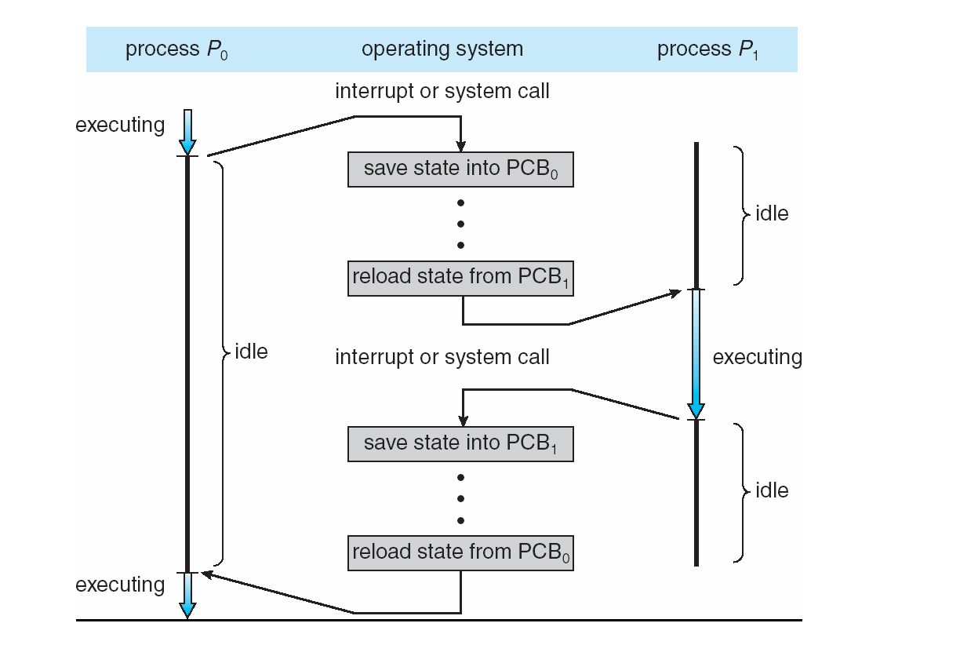
Last lecture …
Context Switching

Slide 4
Muddiest points
Xv6 code for context switching
Process lifecycle
CPU mode switching in context switching
What is inside PCB
Switching register sets in context switching
the code plus the diagram side by side
Determining when a context switch is actually required - if it's needed between each individual process regardless of user/kernel bit
monotlithic vs microkernel
Pros and cons
What a microkernel OS would look like in practice
the two tophat questions we all got wrong about immediately performing instructions in priviledged/non-priviledged mode
How long the context switching takes on average compared to the processes themselves.

Slide 5
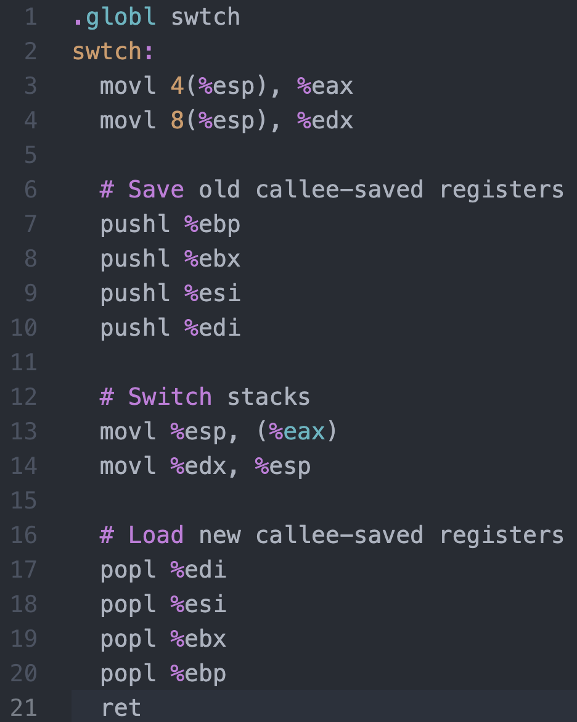




Context Switching in Xv6
%eax
%edx
context
Return address
PCB of Process${ P}_{0}$
%esp
%eip
Stack of Process${ P}_{0}$
Return address
Return address
CPU
context
PCB of Process${ P}_{1}$
Stack of Process${ P}_{1}$
Memory

Slide 6
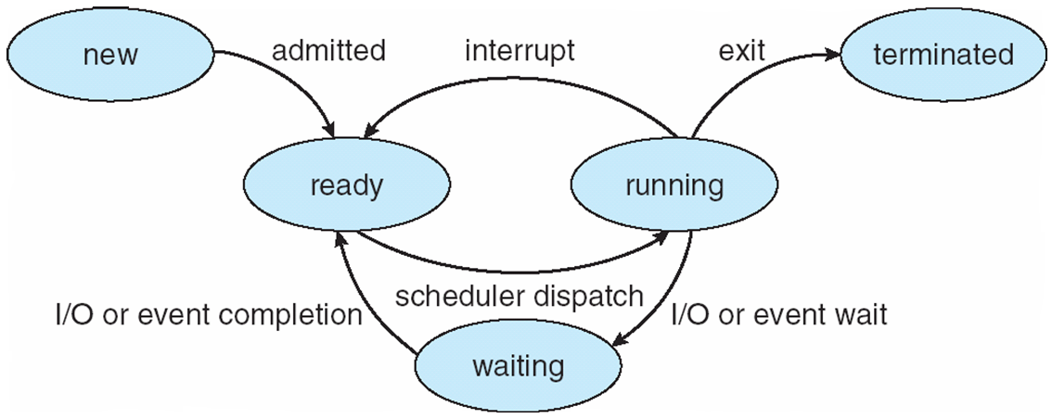
Process Lifecycle

Slide 7
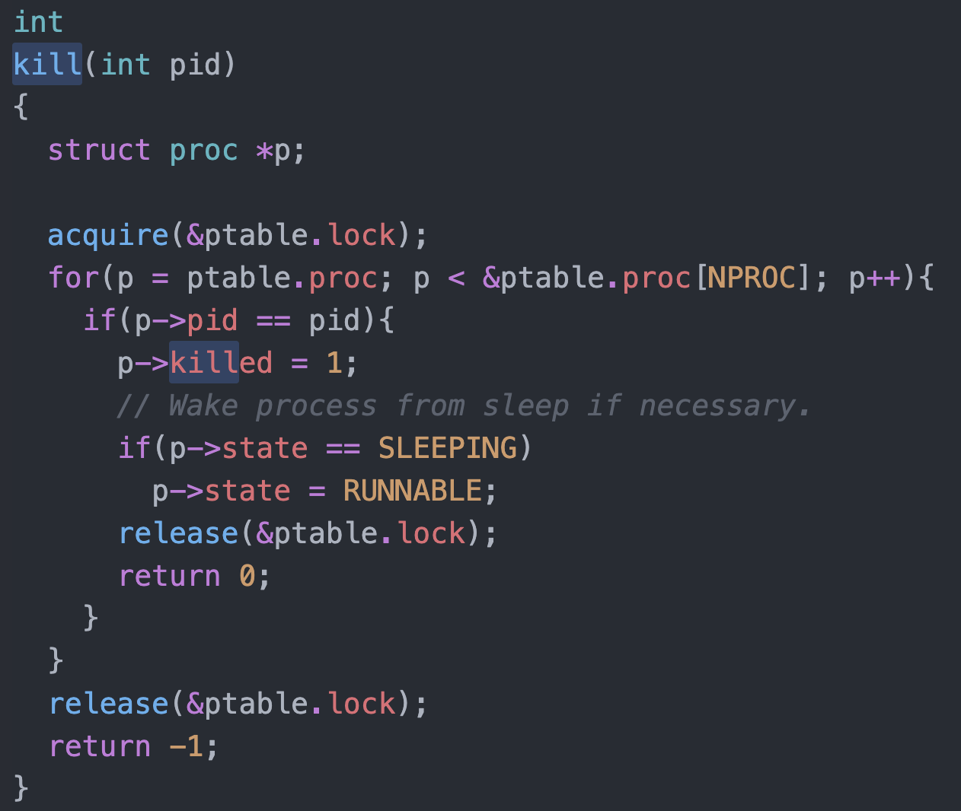
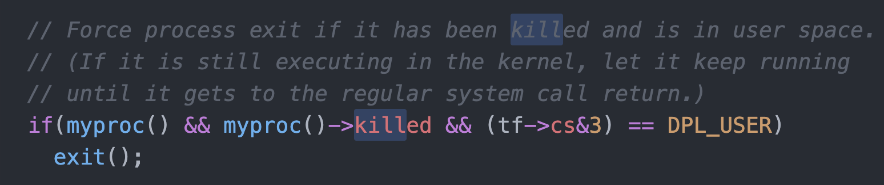
Killing a waiting process

Slide 8
Process Scheduling
Maximize CPU use, quickly switch processes onto CPU for time sharing
Process scheduler selects among available processes for next execution on CPU
Maintains scheduling queues of processes
Job queue – set of all processes in the system
Ready queue – set of all processes residing in main memory, ready and waiting to execute
Device queues – set of processes waiting for an I/O device
Processes migrate among the various queues

Slide 9
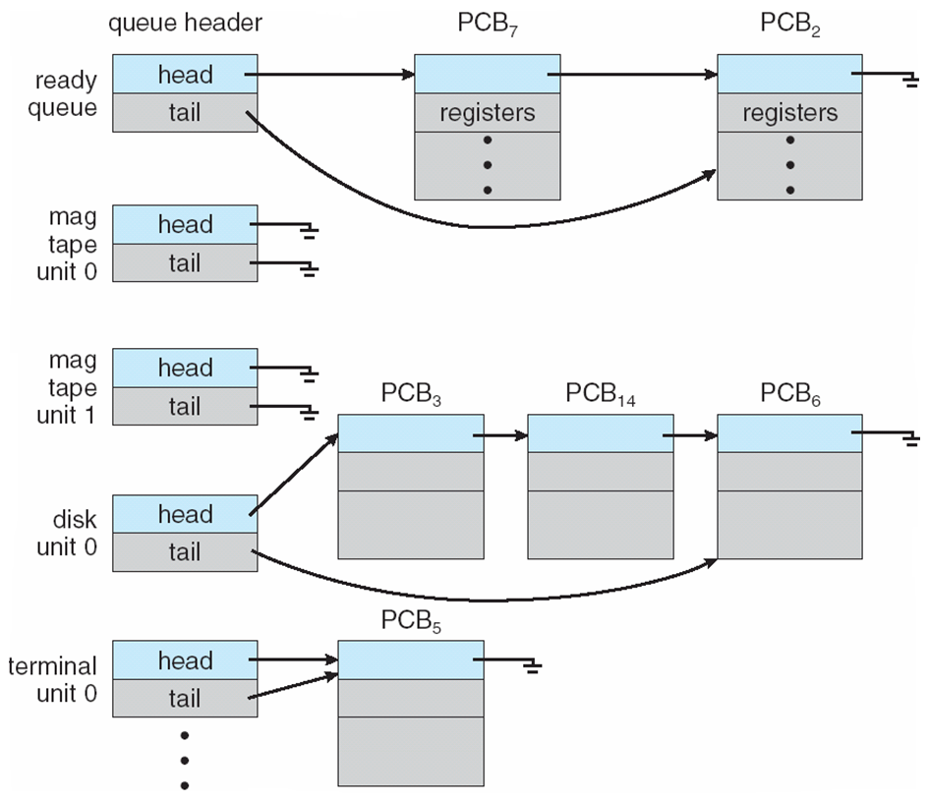
Ready Queue And Various I/O Device Queues

Slide 10
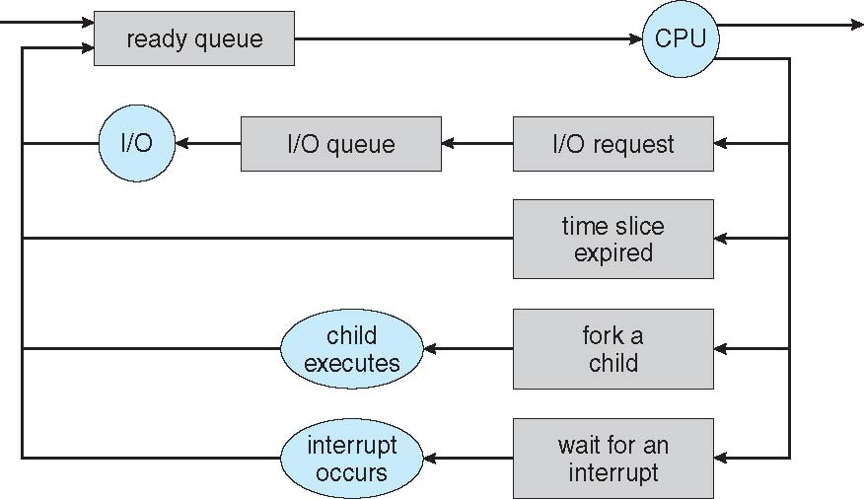
Representation of Process Scheduling
Queueing diagram represents queues, resources, flows

Slide 11
Schedulers
Short-term scheduler (or CPU scheduler) – selects which process should be executed next and allocates CPU
invoked frequently (milliseconds) ⇒ (must be fast)
Long-term scheduler (or job scheduler) – selects which processes should be brought into the ready queue
invoked infrequently (seconds, minutes) ⇒ (may be slow)
controls the degree of multiprogramming
Processes can be described as either:
I/O-bound process – spends more time doing I/O than computations, many short CPU bursts
CPU-bound process – spends more time doing computations; few very long CPU bursts
Long-term scheduler strives for good process mix

Slide 12
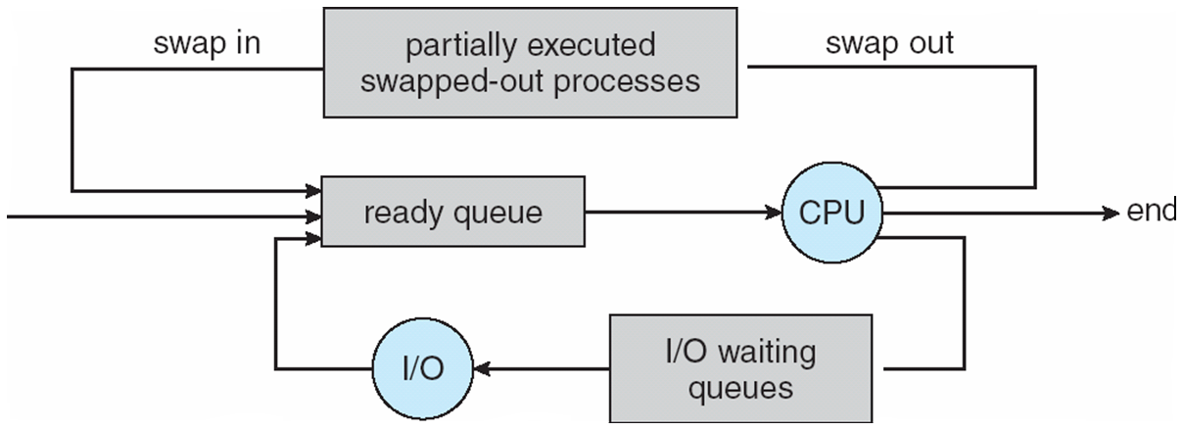
Addition of Medium Term Scheduling
Medium-term scheduler can be added if degree of multiple programming needs to decrease
Remove process from memory, store on disk, bring back in from disk to continue execution: swapping

Slide 13
Process Creation
Parent process creates children processes, which, in turn create other processes, forming a tree of processes
Generally, process identified and managed via a process identifier (pid)
Resource sharing options
Parent and children share all resources
Children share subset of parent’s resources
Parent and child share no resources
Execution options
Parent and children execute concurrently
Parent waits until children terminate

Slide 14
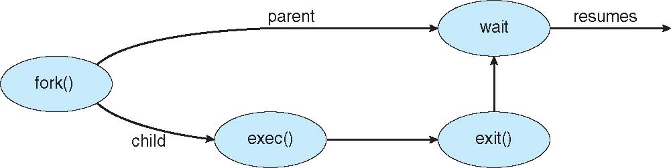
Process Creation (Cont.)
Address space
Child duplicate of parent
Child has a program loaded into it
UNIX examples
fork() system call creates new process
exec() system call used after a fork() to replace the process’ memory space with a new program

Slide 15
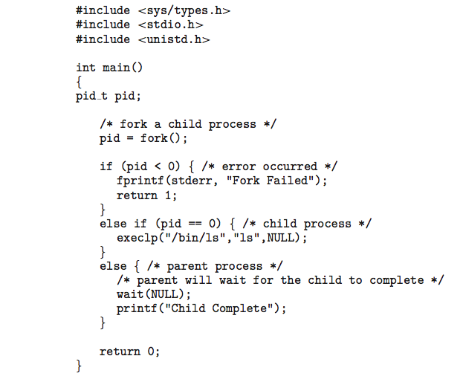
C Program Forking Separate Process

Slide 16
Process Termination
Process executes last statement and then asks the operating system to delete it using the exit() system call.
Returns status data from child to parent (via wait())
Process’ resources are deallocated by operating system
Parent may terminate the execution of children processes using the abort() system call. Some reasons for doing so:
Child has exceeded allocated resources
Task assigned to child is no longer required
The parent is exiting and the operating systems does not allow a child to continue if its parent terminates

Slide 17
Process Termination
Some operating systems do not allow a child to exist if its parent has terminated. If a process terminates, then all its children must also be terminated.
cascading termination. All children, grandchildren, etc. are terminated.
The termination is initiated by the operating system.
The parent process may wait for termination of a child process by using the wait()system call. The call returns status information and the pid of the terminated process
pid = wait(&status);
If no parent waiting (did not invoke wait()) process is a zombie
If parent terminated without invoking wait , process is an orphan

