Slide 1

Introduction to Operating Systems CS/COE 1550
Fall 2021
Sherif Khattab
ksm73@pitt.edu
(Some slides are from Silberschatz, Galvin and Gagne ©2013)

Slide 2
Announcements
Upcoming deadlines:
Lab 1, Homework 1, Homework 2, Tophat questions: due on 2/8
Project 1: due on 2/19
Piazza is the main communication mechanism with the teaching team
Slack is for student-to-student communication
SheInnovates: Starting 2/5
Pitt’s only all-women hackathon
http://sheinnovates.us/
Job Talk: 2/5 at 1:00 pm
https://pitt.co1.qualtrics.com/jfe/form/SV_391YsRaJ4mPBUX3

Slide 3
Last Lecture …
Spinlocks
How to use
How to implement
Semaphores
Overview

Slide 4
Muddiest Points
Threads vs. Processes
how exactly the semaphore code structure makes it superior to spinlock
why semaphores have an empty while loop but aren't considered to be busy waiting
things are becoming more and more difficult and abstract...
how to map what we have learned today to the project
The differences in implementation of spinlock with test & set versus atomic swap
What is inside Test and Set
Spinlock implementation. I think it is just hard for me to visualize.
blocking vs busy waiting
Usage of locks
identifying critical regions
Where the memory that the critical sections deal with is stored
bounded buffer problem
"No assumptions about speed of CPU" in critical region problem
The last Tophat question:
In busy waiting, what happens when process A tries to access a critical section while process B is already in the critical section?

Slide 5
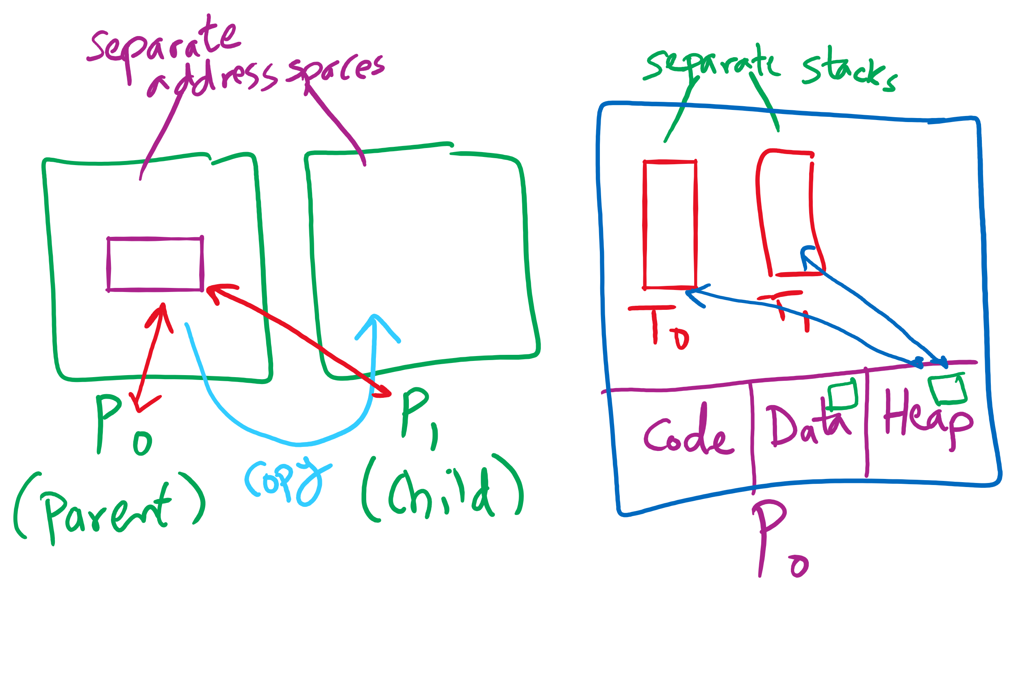
Process vs. Thread

Slide 6
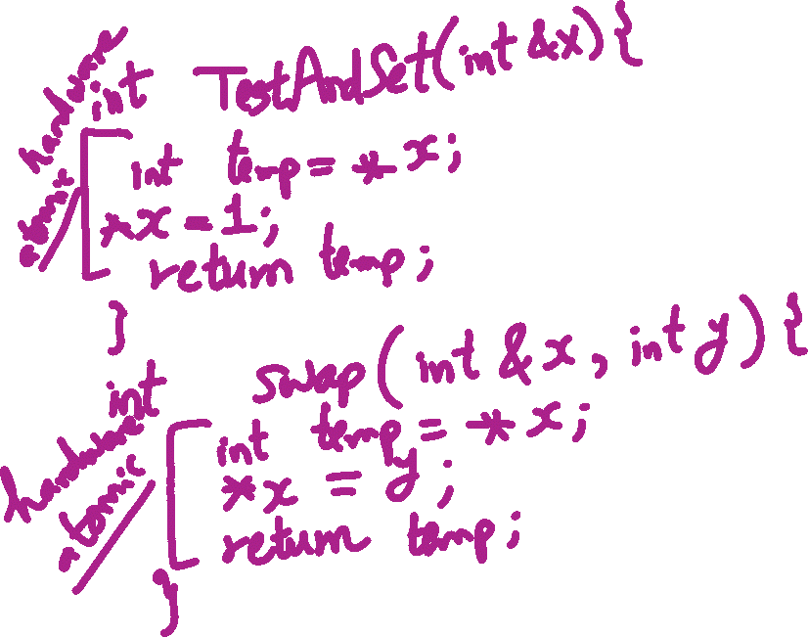
TestAndSet vs. Swap

Slide 7
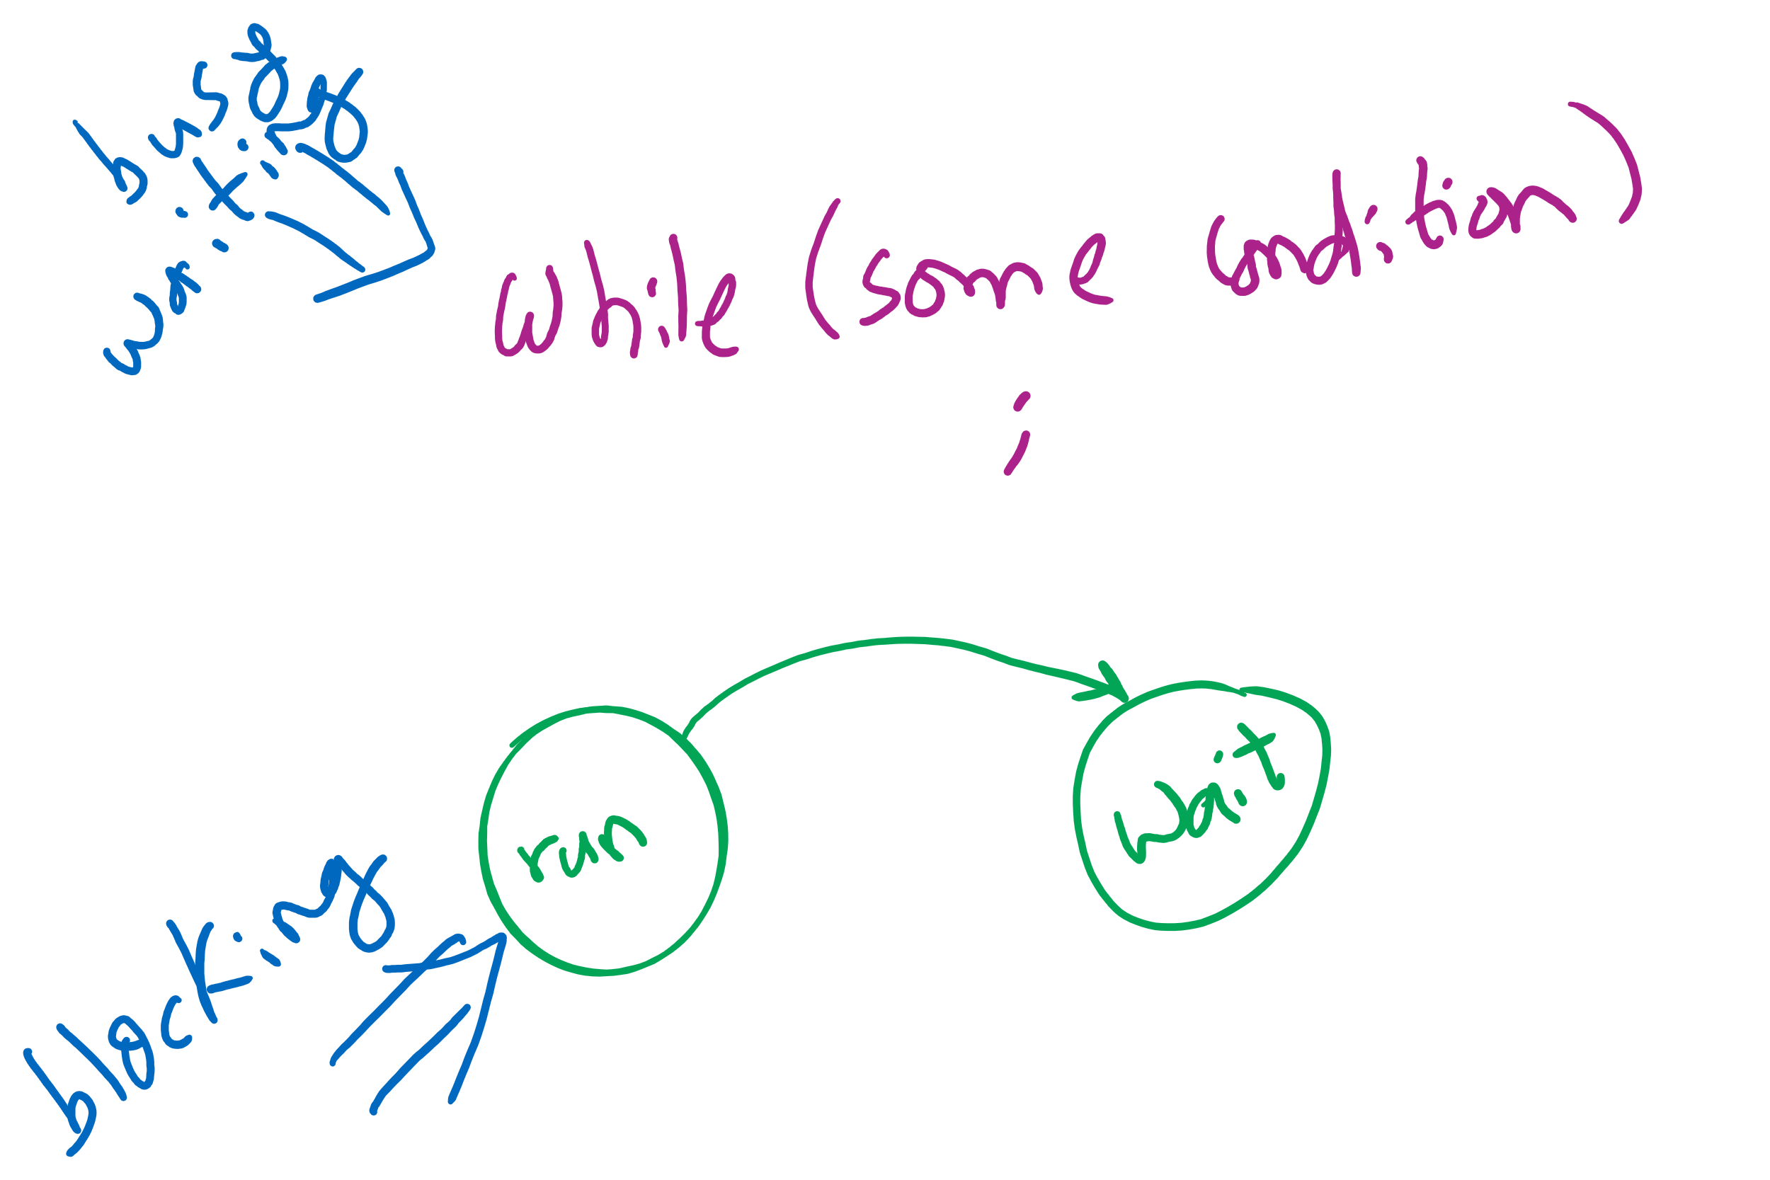
Busy waiting vs. Blocking

Slide 8
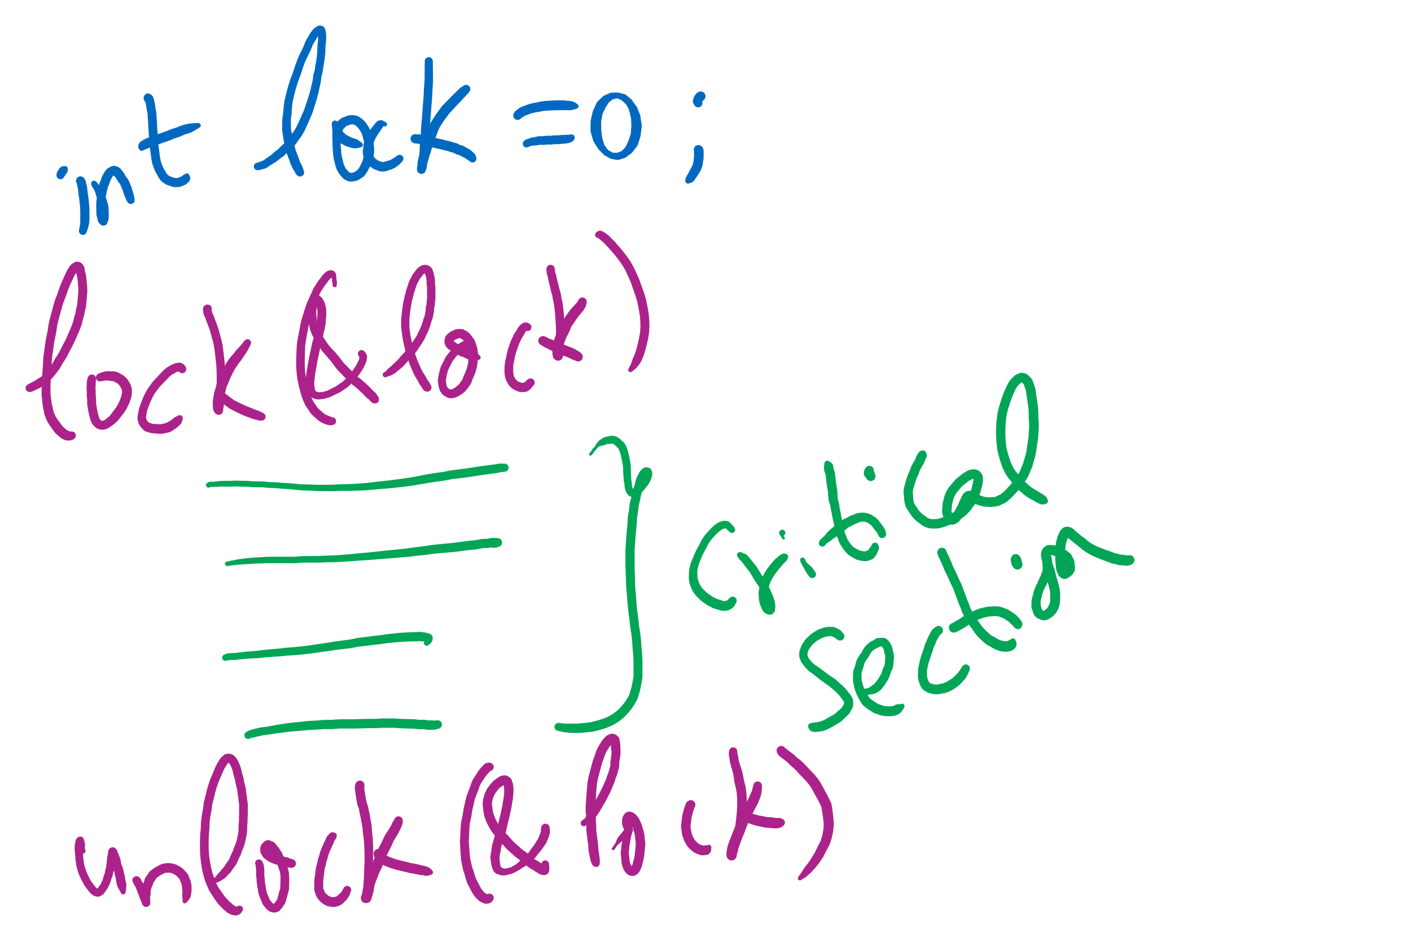
Lock Usage

Slide 9
Benefits of Orphan Processes
Allow a long-running job to continue running even after session (e.g., ssh connection) ends.
The nohup command does that
Create deamon processes
Long-running background processes adopted by the init process.

Slide 10
Today’s Agenda …
Spinlock problems
Semaphore
Usage
Implementation

Slide 11
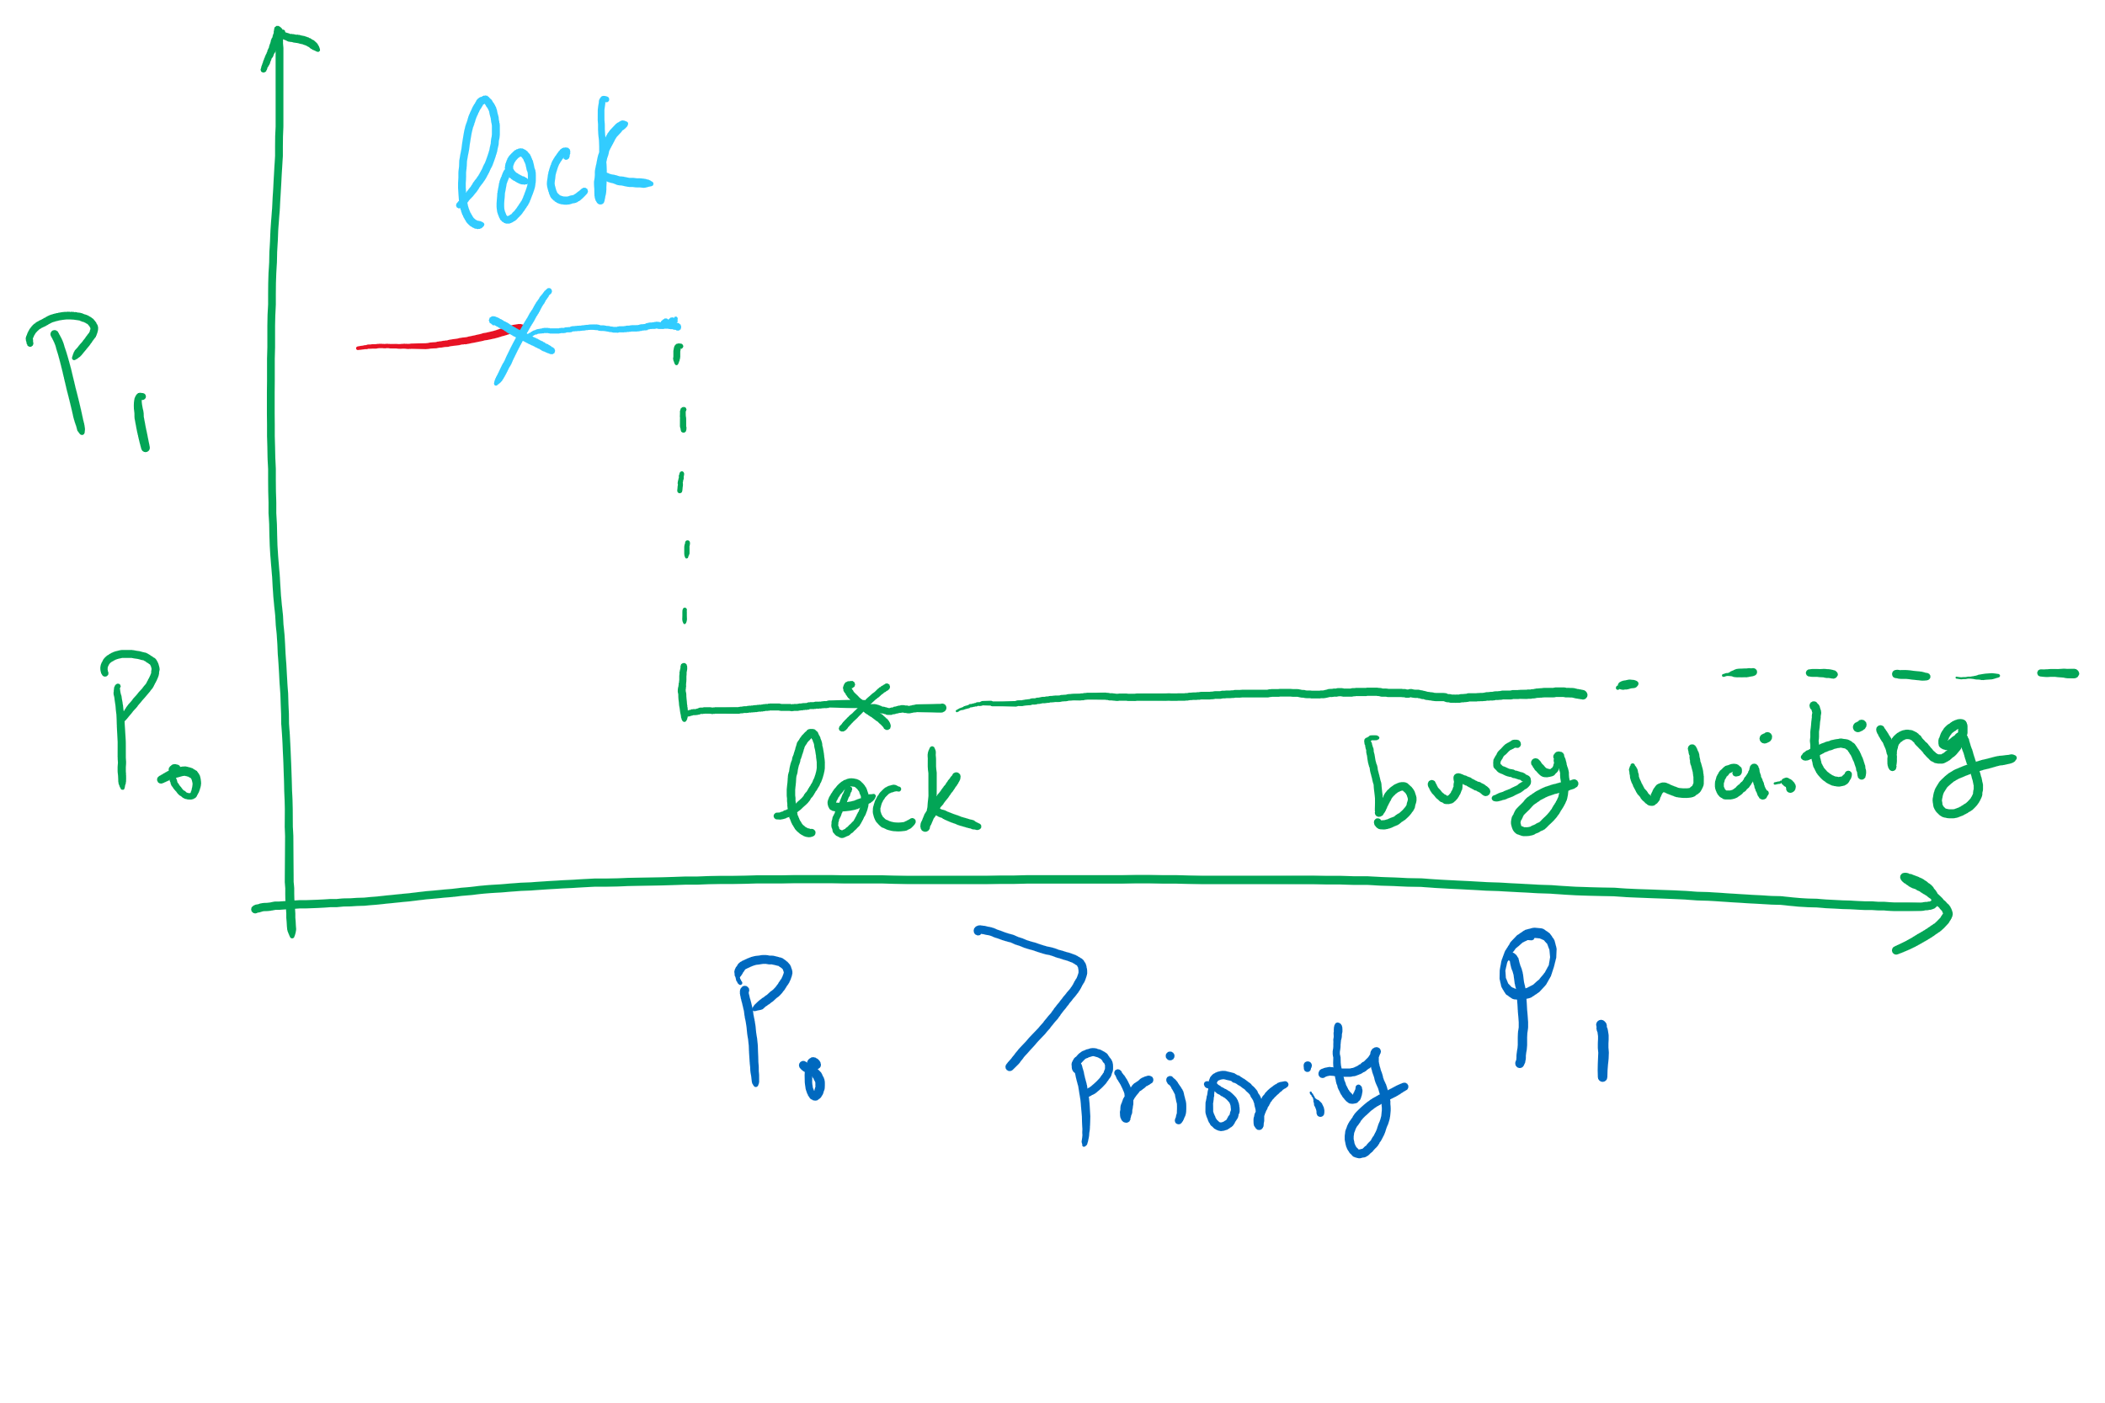


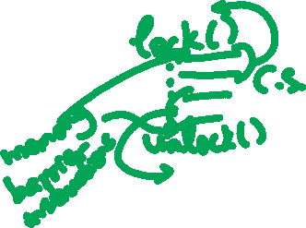
Spinlock Problems
Problem: wastes CPU time
Would be better to allow processes to sleep while they wait to execute their critical sections
Problem: priority inversion (higher priority process waits for lower priority process)
Problem: compiler and/or hardware instruction reordering

Slide 12
Critical sections using semaphores
Define a data structure called Semaphore
Details hidden from processes
Code for individual process is simple
Shared variables
Semaphore sem;
Code for process P_{i}
while (1) {
// non-critical section
down(sem);
// critical section
up(sem);
// non-critical section
}

Slide 13
Semaphores for general synchronization
We want to execute B in P1 only after A executes in P0
Use a semaphore initialized to 0
Use up() to notify P1 at the appropriate time
Shared variables
// flag initialized to 0
Semaphore flag(0);
Process P₀
.
.
.
// Execute code for A
flag.up ();
Process P₁
.
.
.
flag.down ();
// Execute code for B

Slide 14
Types of semaphores
Two different types of semaphores
Counting semaphores
Binary semaphores
Counting semaphore
Value can range over an unrestricted range
Binary semaphore
Only two values possible
1 means the semaphore is available
0 means a process has acquired the semaphore
May be simpler to implement
Possible to implement one type using the other

Slide 15
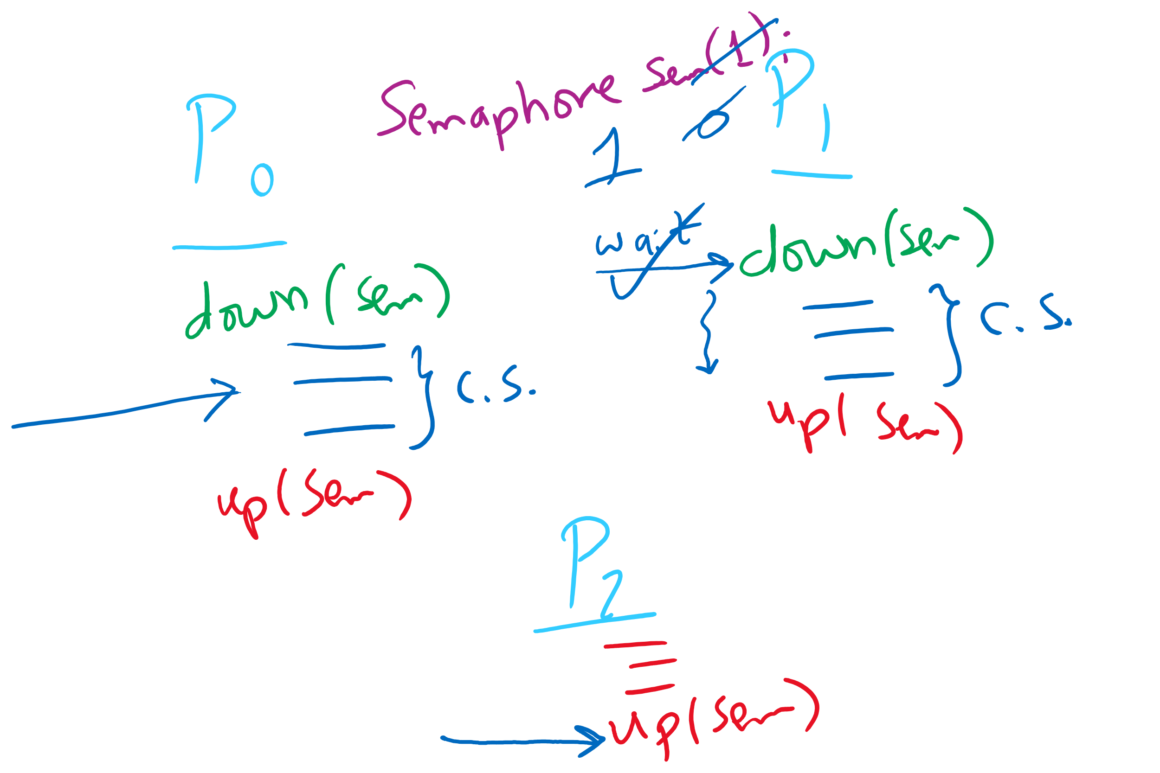
Semaphore Usage Problem: Compromising Mutual Exclusion
Any process can up() the semaphore
Solution: A Mutex can be up()’d only by the same process that down()’d it

Slide 16
Semaphore Usage Problem: Deadlock and Satrvation
Deadlock: two or more processes are waiting indefinitely for an event that can only be caused by a waiting process
P0 gets A, needs B
P1 gets B, needs A
Each process waiting for the other to signal
Starvation: indefinite blocking
Process is never removed from the semaphore queue in which its suspended
May be caused by ordering in queues (priority)
Shared variables
Semaphore A(1),B(1);
Process P₀
A.down();
B.down();
.
.
.
B.up();
A.up();
Process P₁
B.down();
A.down();
.
.
.
A.up();
B.up();

Slide 17
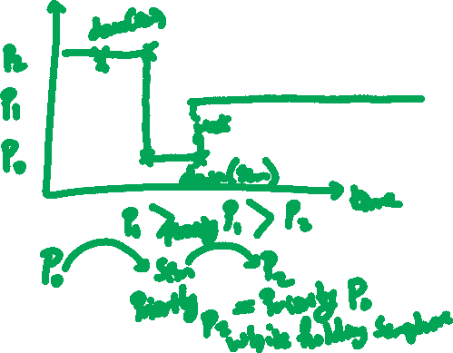
Semaphore Usage Problem: Priority Inversion
Priority inversion is still possible using semaphores
Slightly less likely
Needs at least three processes

Slide 18
Implementing semaphores with blocking
Assume two operations:
Sleep(): suspends current process
Wakeup(P): allows process P to resume execution
Semaphore data structure
Tracks value of semaphore
Keeps a list of processes waiting for the semaphore
Operations still atomic
Semaphore code
Semaphore::down ()
{
value -= 1;
if (value < 0) {
// add this process to pl
Sleep ();
}
}
Semaphore::up () {
Process P;
value += 1;
if (value <= 0) {
// remove a process P
// from pl
Wakeup (P);
}
}
Semaphore {
int value;
ProcessList pl;
void down ();
void up ();
};
How to protect these shared variables??

Slide 19
Spinlocks in Semaphores
Semaphore code
Semaphore::down ()
{
value -= 1;
if (value < 0) {
// add this process to pl
Sleep ();
}
}
Semaphore::up () {
Process P;
value += 1;
if (value <= 0) {
// remove a process P
// from pl
Wakeup (P);
}
}

Slide 20
Spinlocks are sometimes better than Semaphores
Multiple cores
Very (very) short waiting time to enter the critical section
< context-switching time
Few contending processes
Short critical section code

Slide 21
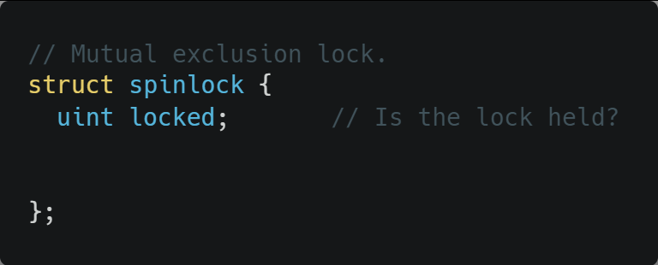
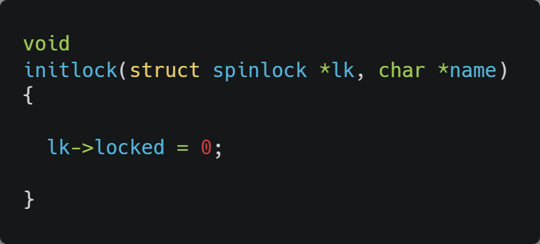
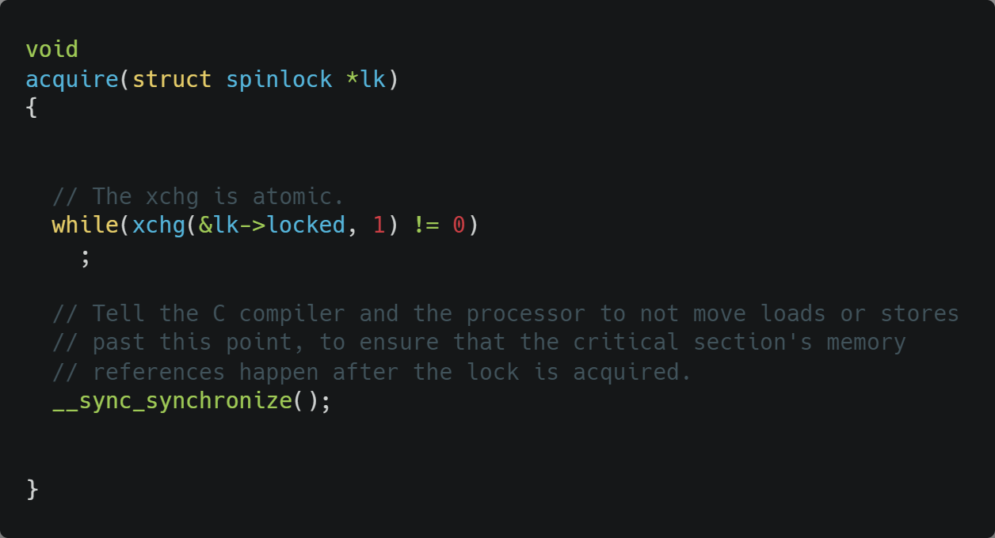
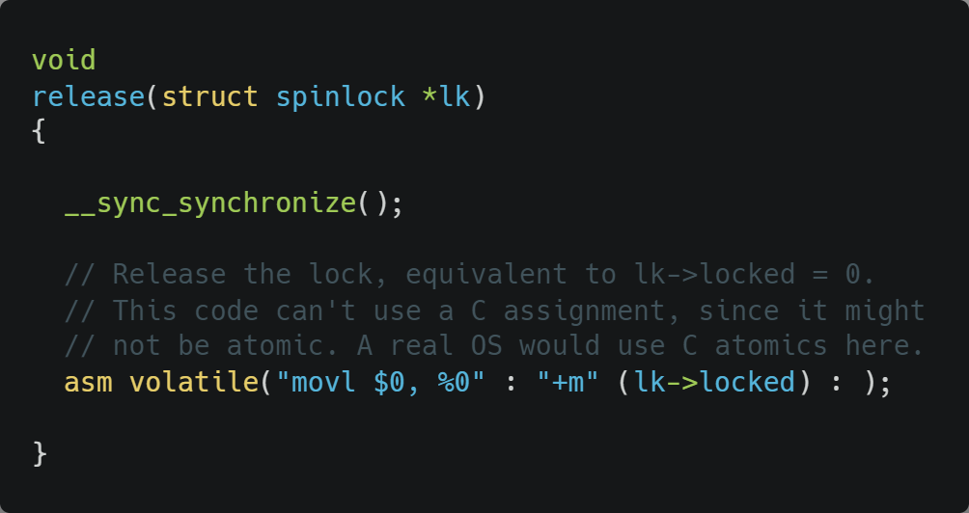
Xv6 Walkthrough
Spinlocks

