Slide 1

Introduction to Operating Systems CS/COE 1550
Fall 2021
Sherif Khattab
ksm73@pitt.edu
(Some slides are from Silberschatz, Galvin and Gagne ©2013)

Slide 2
Announcements
Upcoming deadlines:
Homework 3: due on 2/12
Tophat questions due one week after each lecture
Project 1: due on 2/19
VS Code
Please exit from Qemu using CTRL+a then x
In Project 1, you can use the list_first_entry macro to get the first node in the linked list of waiting tasks

Slide 3
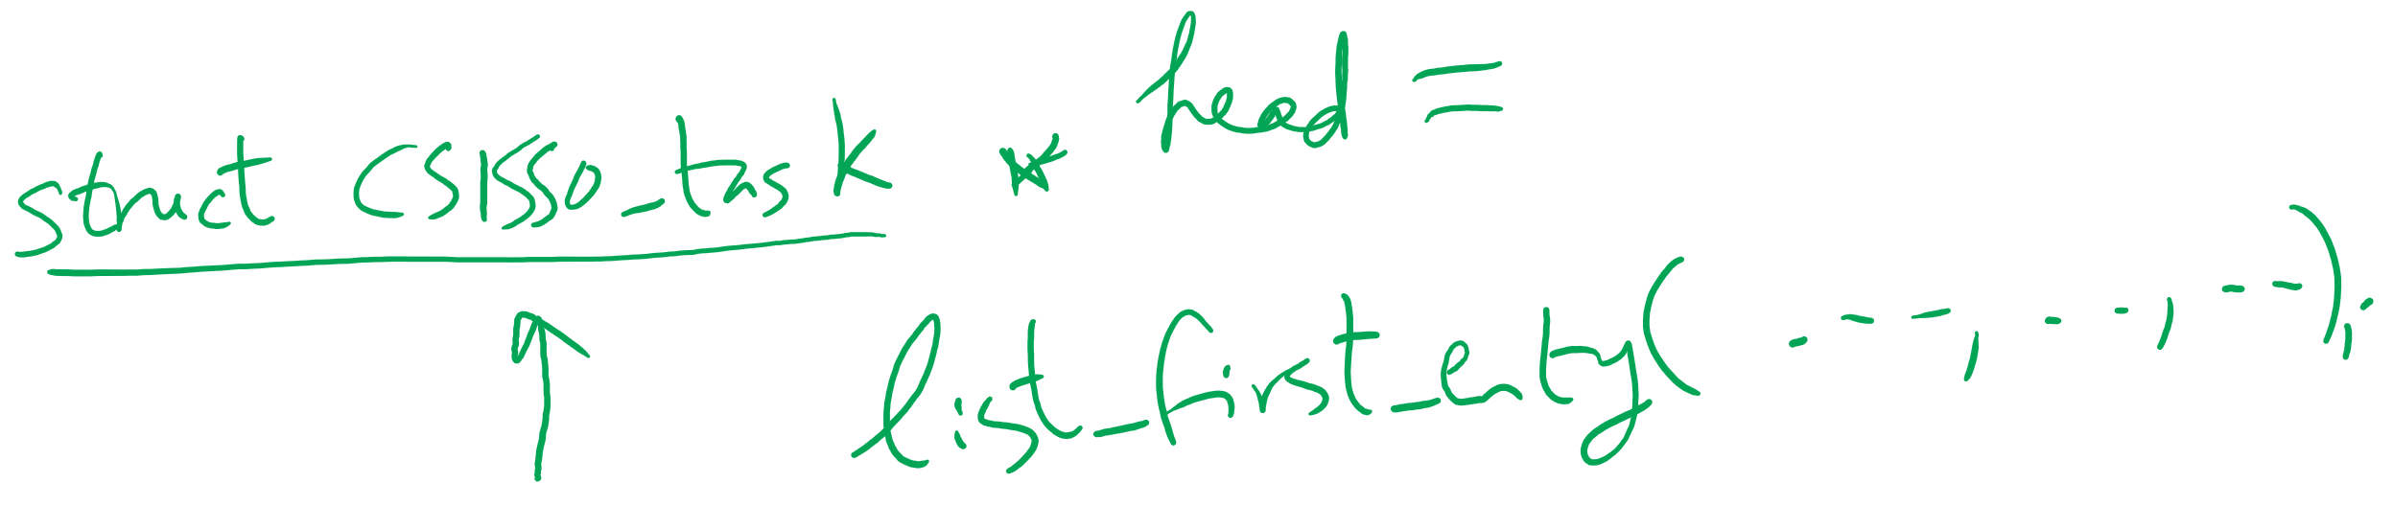
Getting the first entry in a list_head linked list

Slide 4
Last Lecture …
Classical Process Synchronization Problems
Bounded Buffer
Readers-Writers
Dining Philosophers
1 incorrect solution

Slide 5
Muddiest Points (1/3)
Readers Writers
Could we talk more about read write and how it relates to project 1?
When does the reader/writer problem stop? Will they just keep going if they don't block?
The intent of the Reader-Writer problem
how this is related to/differs from semaphores?
Why does the first reader need to down on the writing semaphore with the reader-writer problem
Bounded Buffer
Why the bounded buffer problem is a problem
what does in = (in +1) % n do
Dining Philosophers
How to apply the Dining Philosophers problem
how the dining philosophers problem could lead to a deadlock
How two processes can enter deadlock. I think I just need to really sit down and work it out.

Slide 6
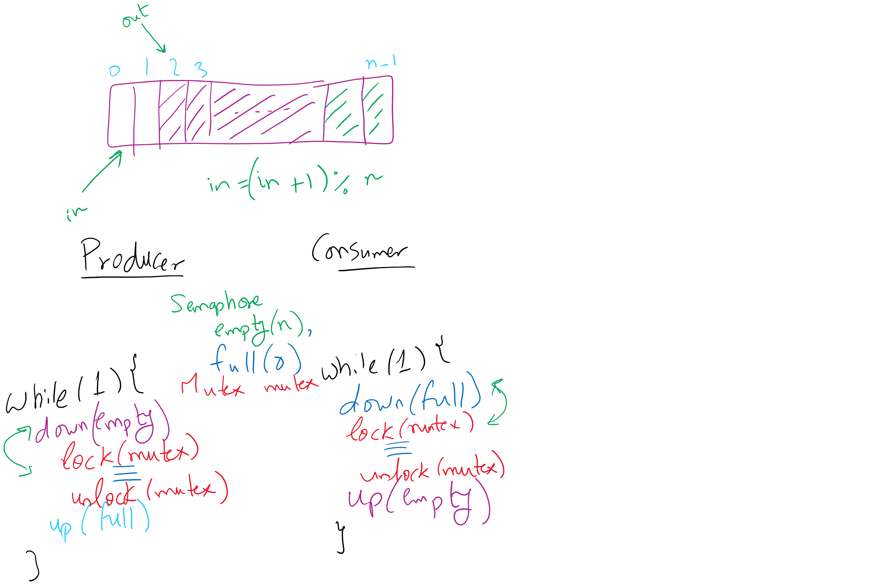
Bounded Buffer (Another rundown)

Slide 7
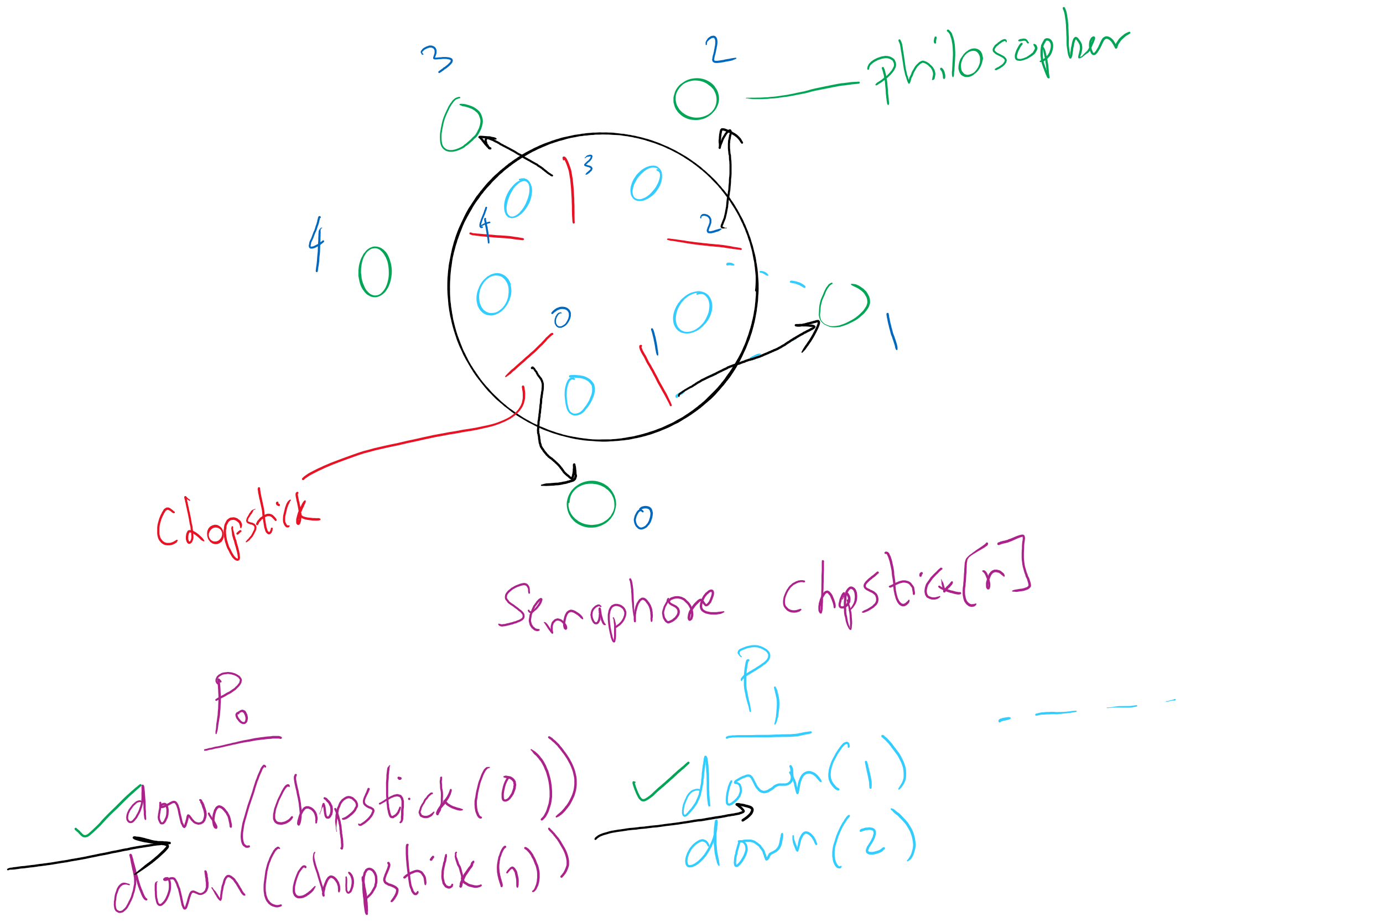
Deadlock in the first (incorrect) solution of Dining Philosophers

Slide 8
Muddiest Points (2/3)
Are condition variables data structures that have a shared variable inside of them?
other situations in bounded buffer / RW lock that lead to deadlocks
questions 6 and 7 on the homework
Could you provide a few more examples of problems that could be implemented to test semaphores? (or resources on where to find them)
How monitors differ from semaphores

Slide 9
Muddiest Points (3/3)
Project 1:
how to initialize the semaphore list when create semaphore and task list
How and where are RW locks used in project 1?

Slide 10
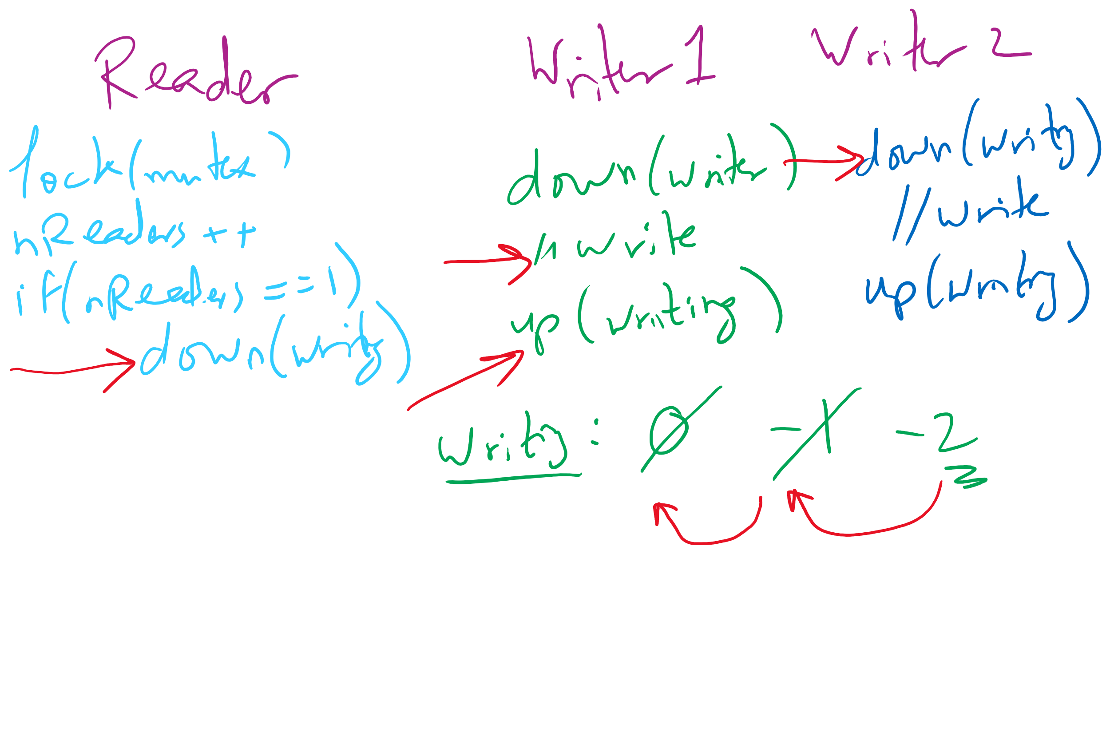
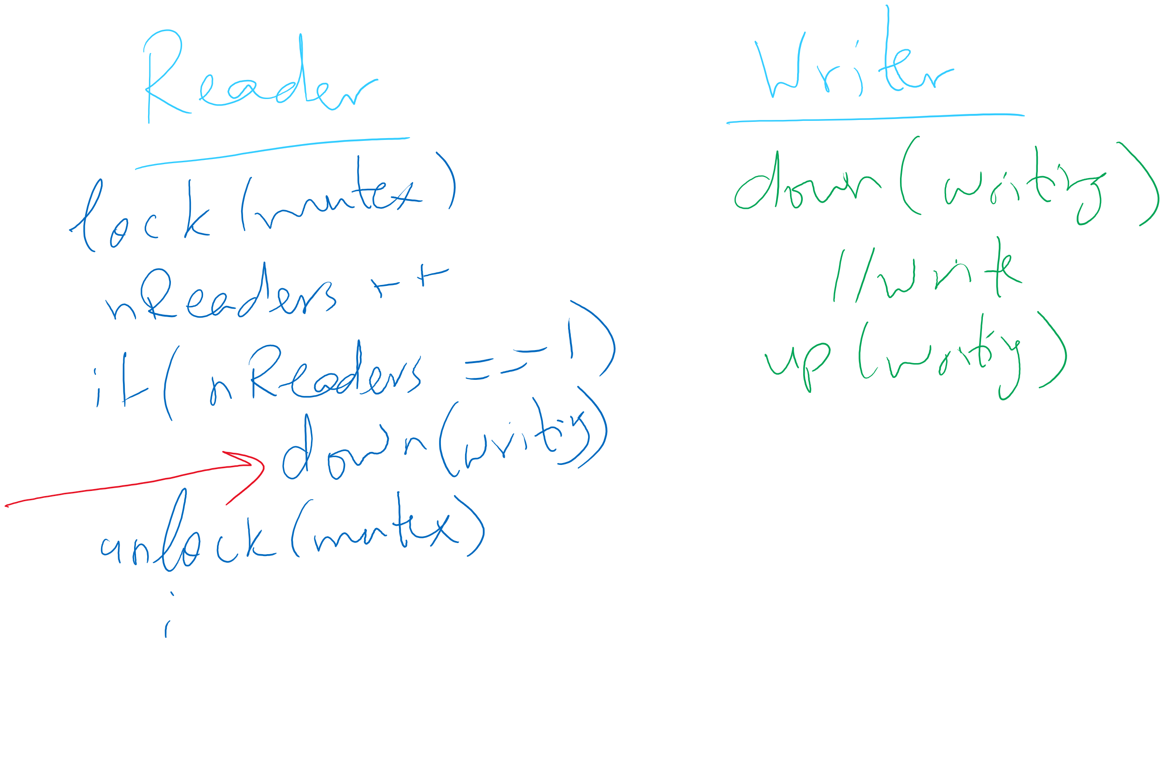
Readers Writers Scenarios

Slide 11
Today’s Agenda …
Classical Process Synchronization Problems
Dining Philosophers
correct solution
Sleepy Barber

Slide 12


Dining Philosophers
N philosophers around a table
All are hungry
All like to think
N chopsticks available
1 between each pair of philosophers
Philosophers need two chopsticks to eat
Philosophers alternate between eating and thinking
Goal: coordinate use of chopsticks

Slide 13
Dining Philosophers: solution 2
Use a semaphore for each chopstick
A hungry philosopher
Gets lower, then higher numbered chopstick
Eats
Puts down the chopsticks
Potential problems?
Deadlock
Fairness
Code for philosopher i
int i1,i2;
while(1) {
if (i != (n-1)) {
i1 = i;
i2 = i+1;
} else {
i1 = 0;
i2 = n-1;
}
chopstick[i1].down();
chopstick[i2].down();
// eat
chopstick[i1].up();
chopstick[i2].up();
// think
}
Shared variables
const int n;
// initialize to 1
Semaphore chopstick[n];

Slide 14
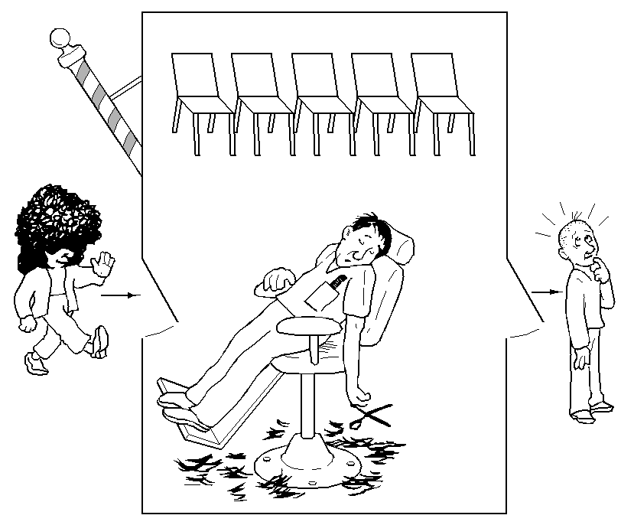
The Sleepy Barber Problem

Slide 15
Code for the Sleepy Barber Problem
#define CHAIRS 5
Semaphore customers=0;
Semaphore barbers=0;
Semaphore mutex=1;
int waiting=0;
void barber(void)
{
while(TRUE) {
// Sleep if no customers
customers.down();
// Decrement # of waiting people
mutex.down();
waiting -= 1;
// Wake up a customer to cut hair
barbers.up();
mutex.up();
// Do the haircut
cut_hair();
}
}
void customer(void)
{
mutex.down();
// If there is space in the chairs
if (waiting<CHAIRS) {
// Another customer is waiting
waiting++;
// Wake up the barber. This is
// saved up, so the barber doesn’t
// sleep if a customer is waiting
customers.up();
mutex.up();
// Sleep until the barber is ready
barbers.down();
get_haircut();
} else {
// Chairs full, leave the critical
// region
mutex.up ();
}
}

Slide 16
Monitor-based Solutions
Code Walkthrough at:
https://cs1550-2214.github.io/cs1550-code-handouts/ProcessSynchronization/Slides/

