Slide 1

Introduction to Operating Systems CS/COE 1550
Fall 2021
Sherif Khattab
ksm73@pitt.edu
(Some slides are from Silberschatz, Galvin and Gagne ©2013)

Slide 2
Announcements
Upcoming deadlines:
Project 4: 12/20 at 5:00 pm
Please check Canvas for the rest of the deadlines
Final Exam
In-person, paper-based, 110 minutes
Similar structure to the midterm
Non-cumulative
Study guide and practice exams
Date, time, and location as in PeopleSoft
Bonus opportunities
Bonus homework
Post-course test
OMET bonus (response rate >= 80%)
Currently at 17% (MW) and 48% (TuTh)

Slide 3
Muddiest Points (i-node)
inode indirection
so each process has an inode, but they're stored in a special part of the partition?
What are the inodes again, and the file system requires to know where the beginning is a lot of time. Where is that stored?
difference between index node and index block

Slide 4
Muddiest Points (Linked and File Allocation Table)
How can you tell which file is in each block for the file allocation table? Also can internal fragmentation still occur for both contiguous and linked allocation?
The array being used in linked allocation
The process of finding blocks in linked allocation
How FAT distinguishes the boundaries of different files?
Advantage of beginning vs end of block for mapping
in the FAT, what signifies the last block of a file?

Slide 5
Muddiest Points (Indexed Allocation)
Is transfer delay higher in indexed alloc?
When using index blocks, would there still be a 4 byte pointer to the next_block still?
calculating file size for indexed allocation
max file size calculation(why times file size at the end)
How is the index block accessed and updated when the file grows or shrinks

Slide 6
Muddiest Points (Misc. File Allocation)
contiguous allocation applications
Is contiguous allocation ever used in real world, or is it too inefficient in terms of speed?
Are the simpler filesystem approaches, contiguous for example, still useful when we have more optimized approaches?
Is the block system for read and writes and indexing strategies such as index blocks and FATs the same for SSDs?

Slide 7
RAIDs, RAIDs, and more RAIDs
Stripe
strip
strip
RAID 0
(Redundant Array of Inexpensive Disks
RAID 1
(Mirrored copies)
RAID 4
(Striped with parity)
RAID 5
(Parity rotates through disks)

Slide 8
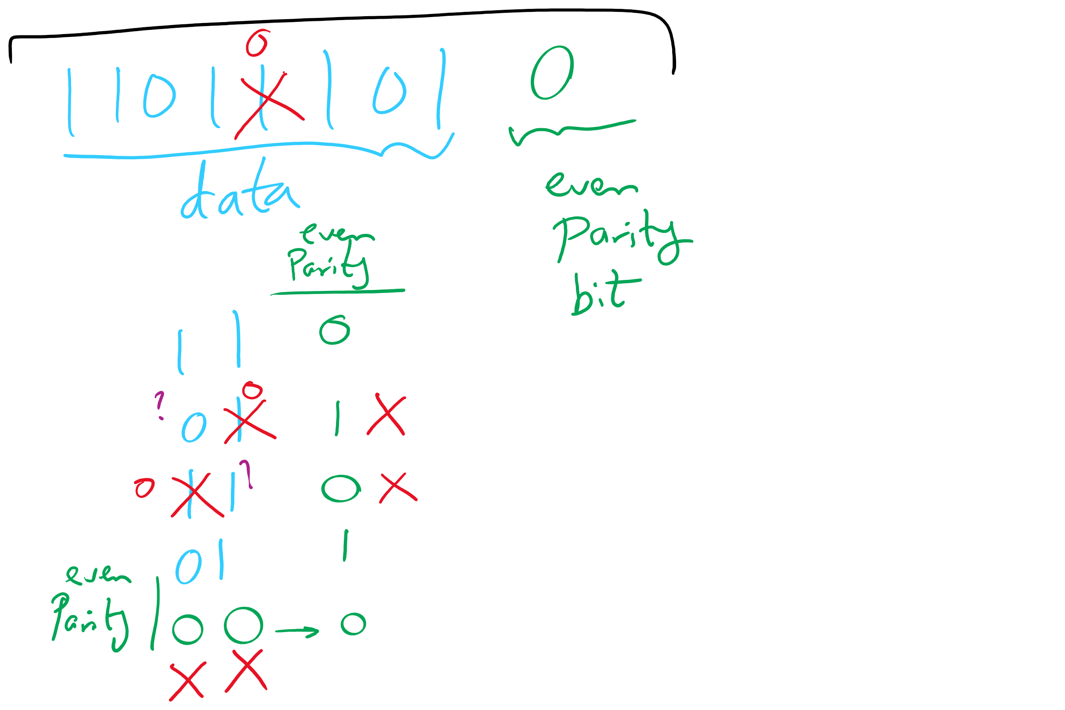
Parity Examples

Slide 9
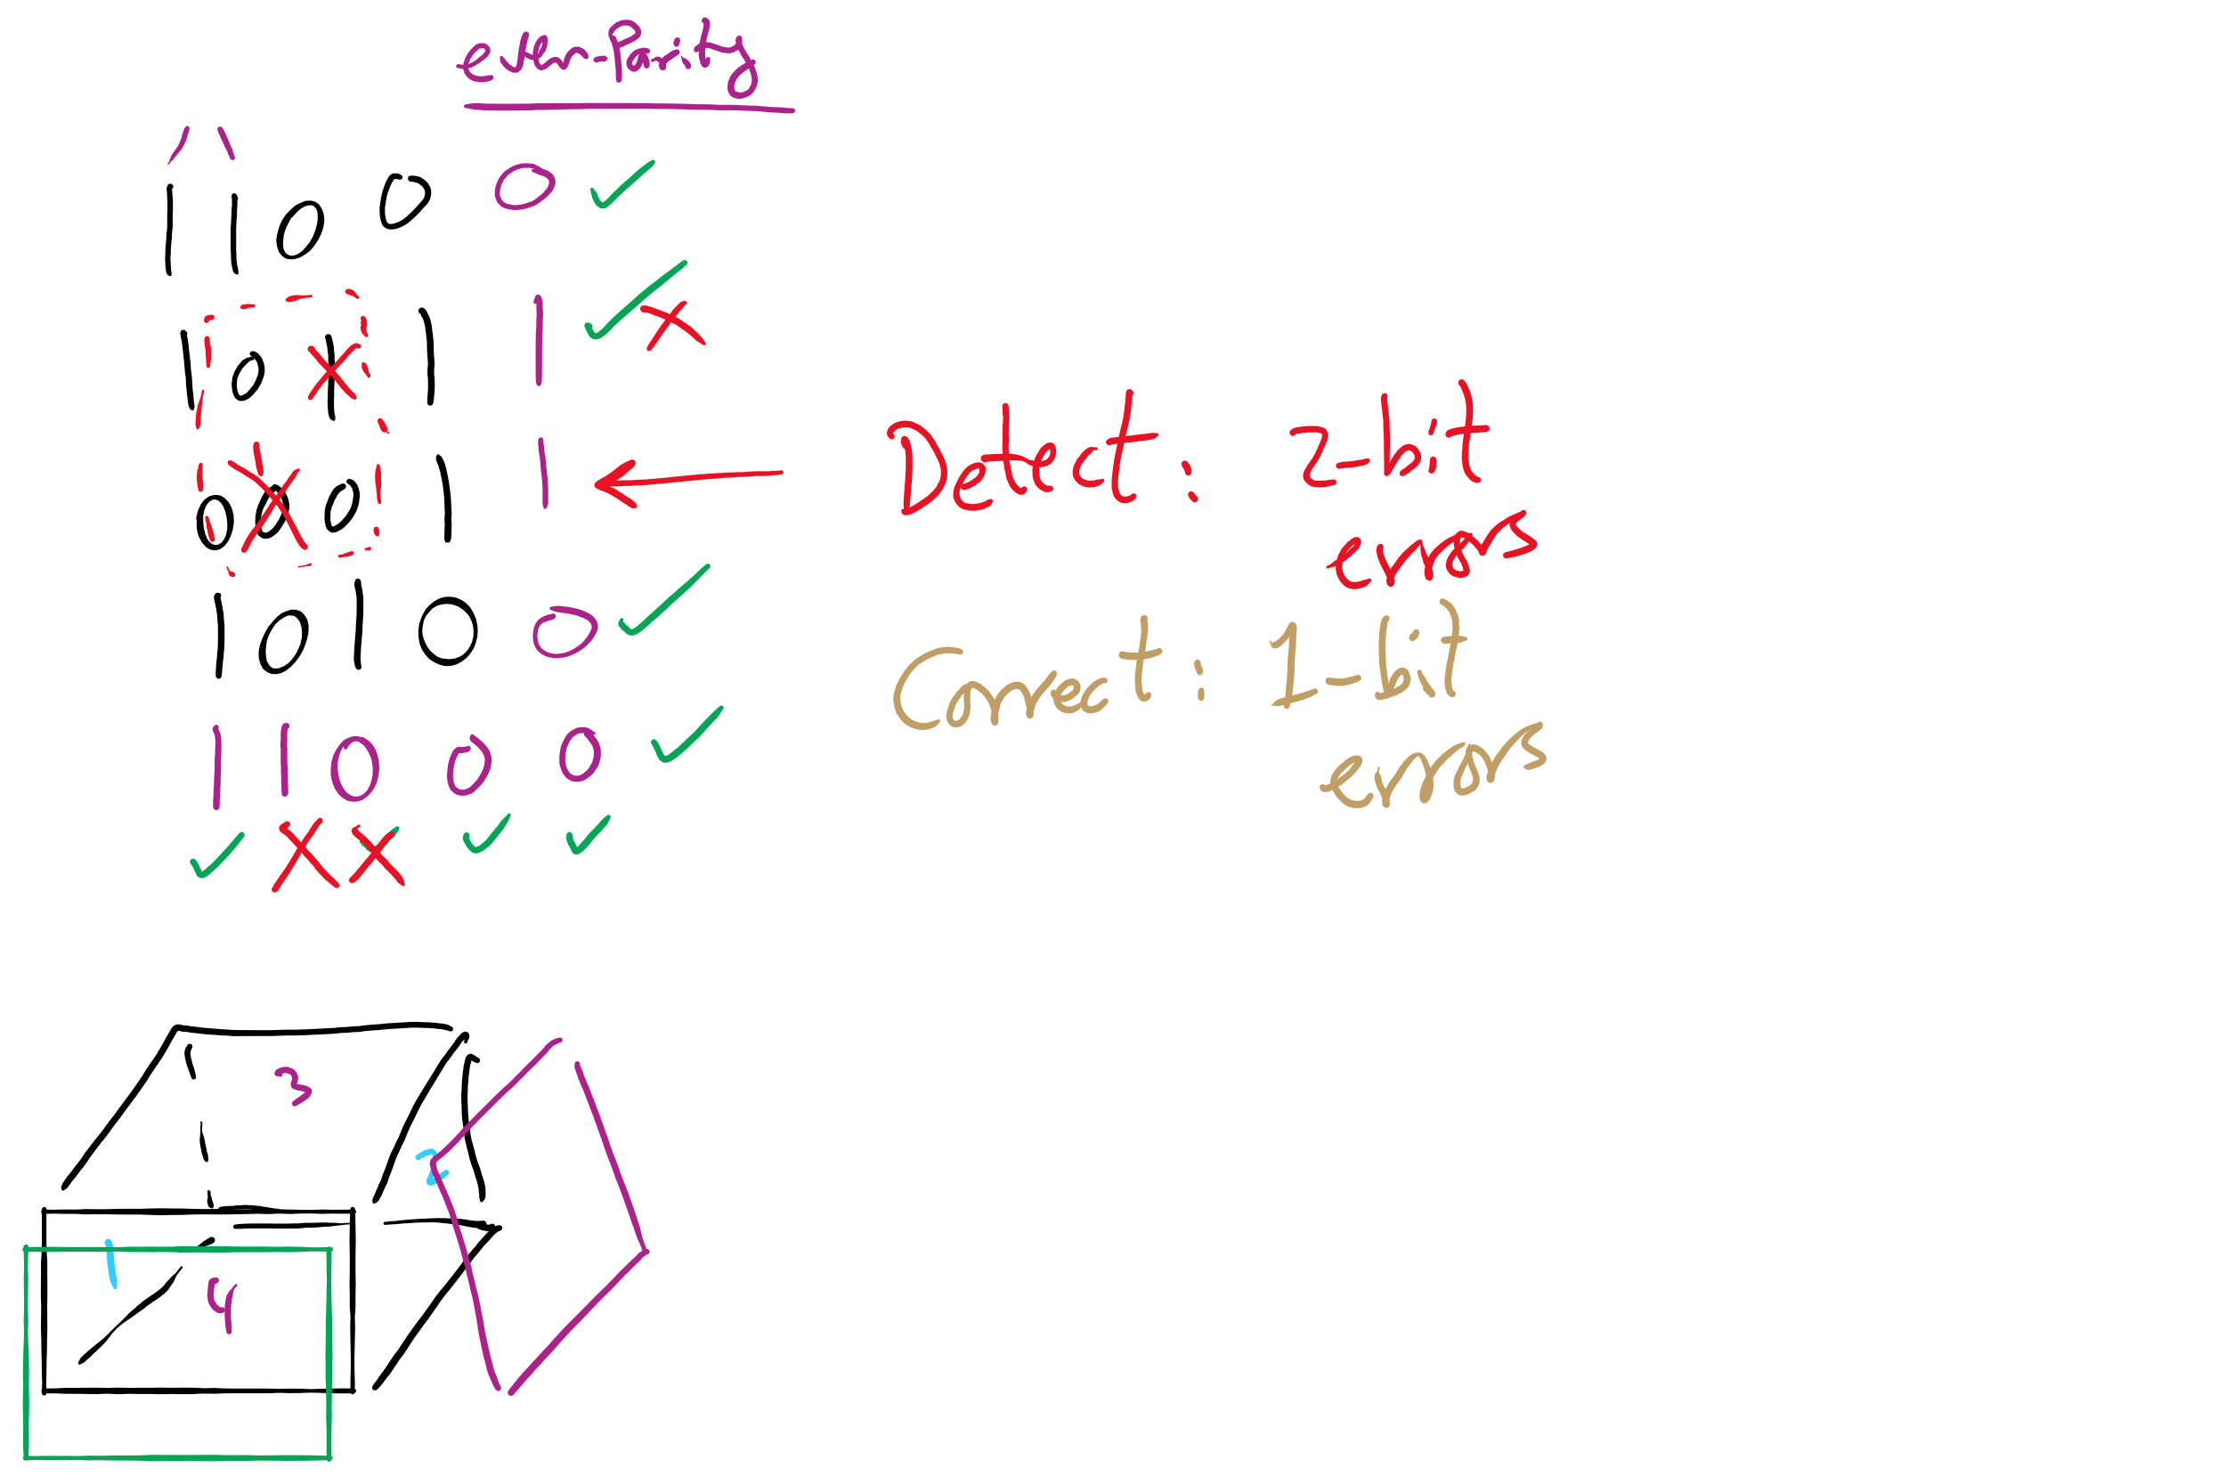
2-d parity

Slide 10
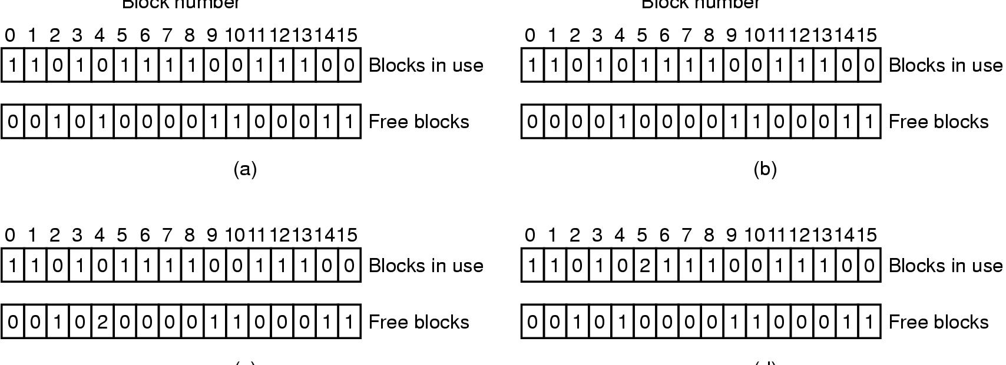
Checking the file system for consistency
Consistent
Missing (“lost”) block
Duplicate block in free list
Duplicate block in two files

Slide 11
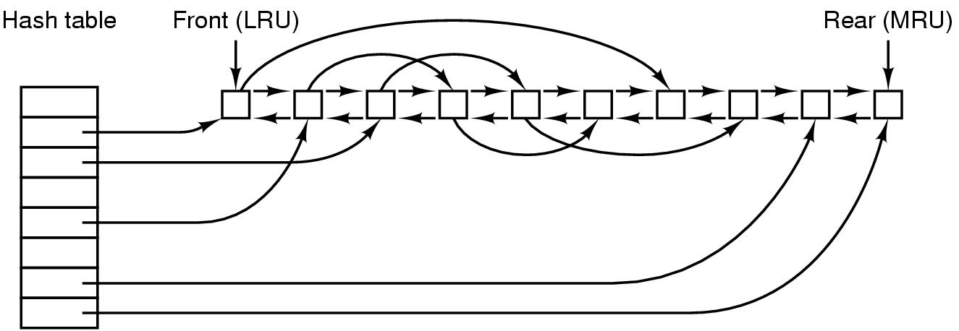
File block cache data structures

Slide 12
Muddiest Points (RAID)
Not important but RAID is a black box to me still. Looks like an easy google search tho
how much slower is raid 1
RAID, parity, and stripes
So a RAID is a physical object, not a method?
How we access multiple disks in parallel in RAID?
Why do we need to keep track of parity in RAID schemes? What advantages does that give us?

Slide 13
Muddiest Points (Parity)
confused about why parity is helpful in RAIDs, is it only for detecting errors (not preventing or fixing them)?
Doesn't parity end up taking a lot of space if it is able to recover from complex errors?
how does parity work

