Slide 1

Introduction to Operating Systems CS 1550
Spring 2022
Sherif Khattab
ksm73@pitt.edu
(Some slides are from Silberschatz, Galvin and Gagne ©2013)

Slide 2
Announcements
Upcoming deadlines:
Homework 10: due on 4/11
Project 3: due on 4/11
Lab 4: due on 4/15

Slide 3
Previous Lecture …
Indexed Allocation
Directory contents
Free block tracking
bitmap
linked list of free blocks

Slide 4
Muddiest Points (1/3)
Bitmapping for free blocks
It seems that directories have a limit to the number of files / subdirectories they contain based on the size of a disk block. Is / how is this limit overcome?
Everything
are the index nodes for the directories stored on the heap? is this different than the index nodes from the file allocation table?
Variable sized file name structures’ pros and cons
what exactly is an i-node and where is it stored?
Might need some recap on inode. So inode contains information for a specific file and block index is a block storing only the addresses of all the file block?

Slide 5
Muddiest Points (2/3)
a little confused about Fast File System indexing
For FFS, all the files will be kept in one directoriy (or many directories?) and then we adopt the direct pointers or one-level or multi-level pointers to point to their data based on their size?
Typically one directory per index block? What about a subdirectory in a parent directory? Would there be another block index (for the subdirectory) stored in the parent directory?
Can you explain why smaller page size leads to more page fault?
Linked allocation versus contiguous and when is it optimal to use linked

Slide 6
Muddiest Points (3/3)
how do we do midterm corrections
Top hat question about partition
Still a but confused on indexing for the Page Table Allocation
structure of a disk section

Slide 7
Problem of the Day – Part 1
How does a file system handle errors?
Answer: Defense in Depth
multiple layers of error detection/correction

Slide 8
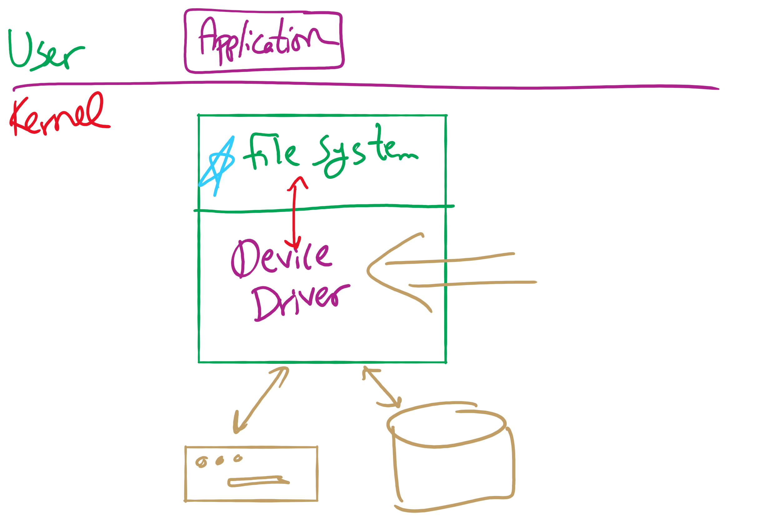
Software Stack

Slide 9
Device drivers
Device drivers go between device controllers and rest of OS
Drivers standardize interface to widely varied devices
Device drivers communicate with controllers over bus
Controllers communicate with devices themselves
User space
User program
Kernel space
Rest of the OS
Keyboard driver
Disk driver
Keyboard controller
Disk controller

Slide 10
Layers of I/O software
User-level I/O software & libraries
User
Device-independent OS software
Operating system (kernel)
Device drivers
Interrupt handlers
Hardware

Slide 11
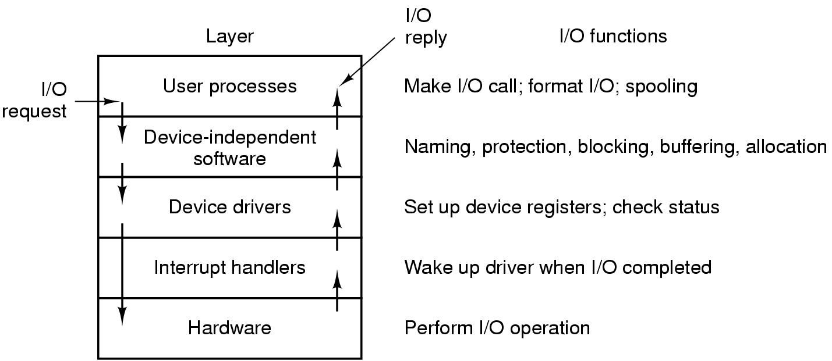
Anatomy of an I/O request

Slide 12
Device Driver goals
Device independence
Programs can access any I/O device
No need to specify device in advance
Uniform naming
Name of a file or device is a string or an integer
Doesn’t depend on the machine (underlying hardware)
Error handling
Done as close to the hardware as possible
Isolate from higher-level software
Synchronous vs. asynchronous transfers
Blocked transfers vs. interrupt-driven
Buffering
Data coming off a device cannot be stored in final destination
Sharable vs. dedicated devices

Slide 13
Disk drive structure
Data stored on surfaces
Up to two surfaces per platter
One or more platters per disk
Data in concentric tracks
Tracks broken into sectors
256B-1KB per sector
Cylinder: corresponding tracks on all surfaces
Data read and written by heads
Actuator moves heads
Heads move in unison
head
sector
platter
track
cylinder
surfaces
spindle
actuator

Slide 14
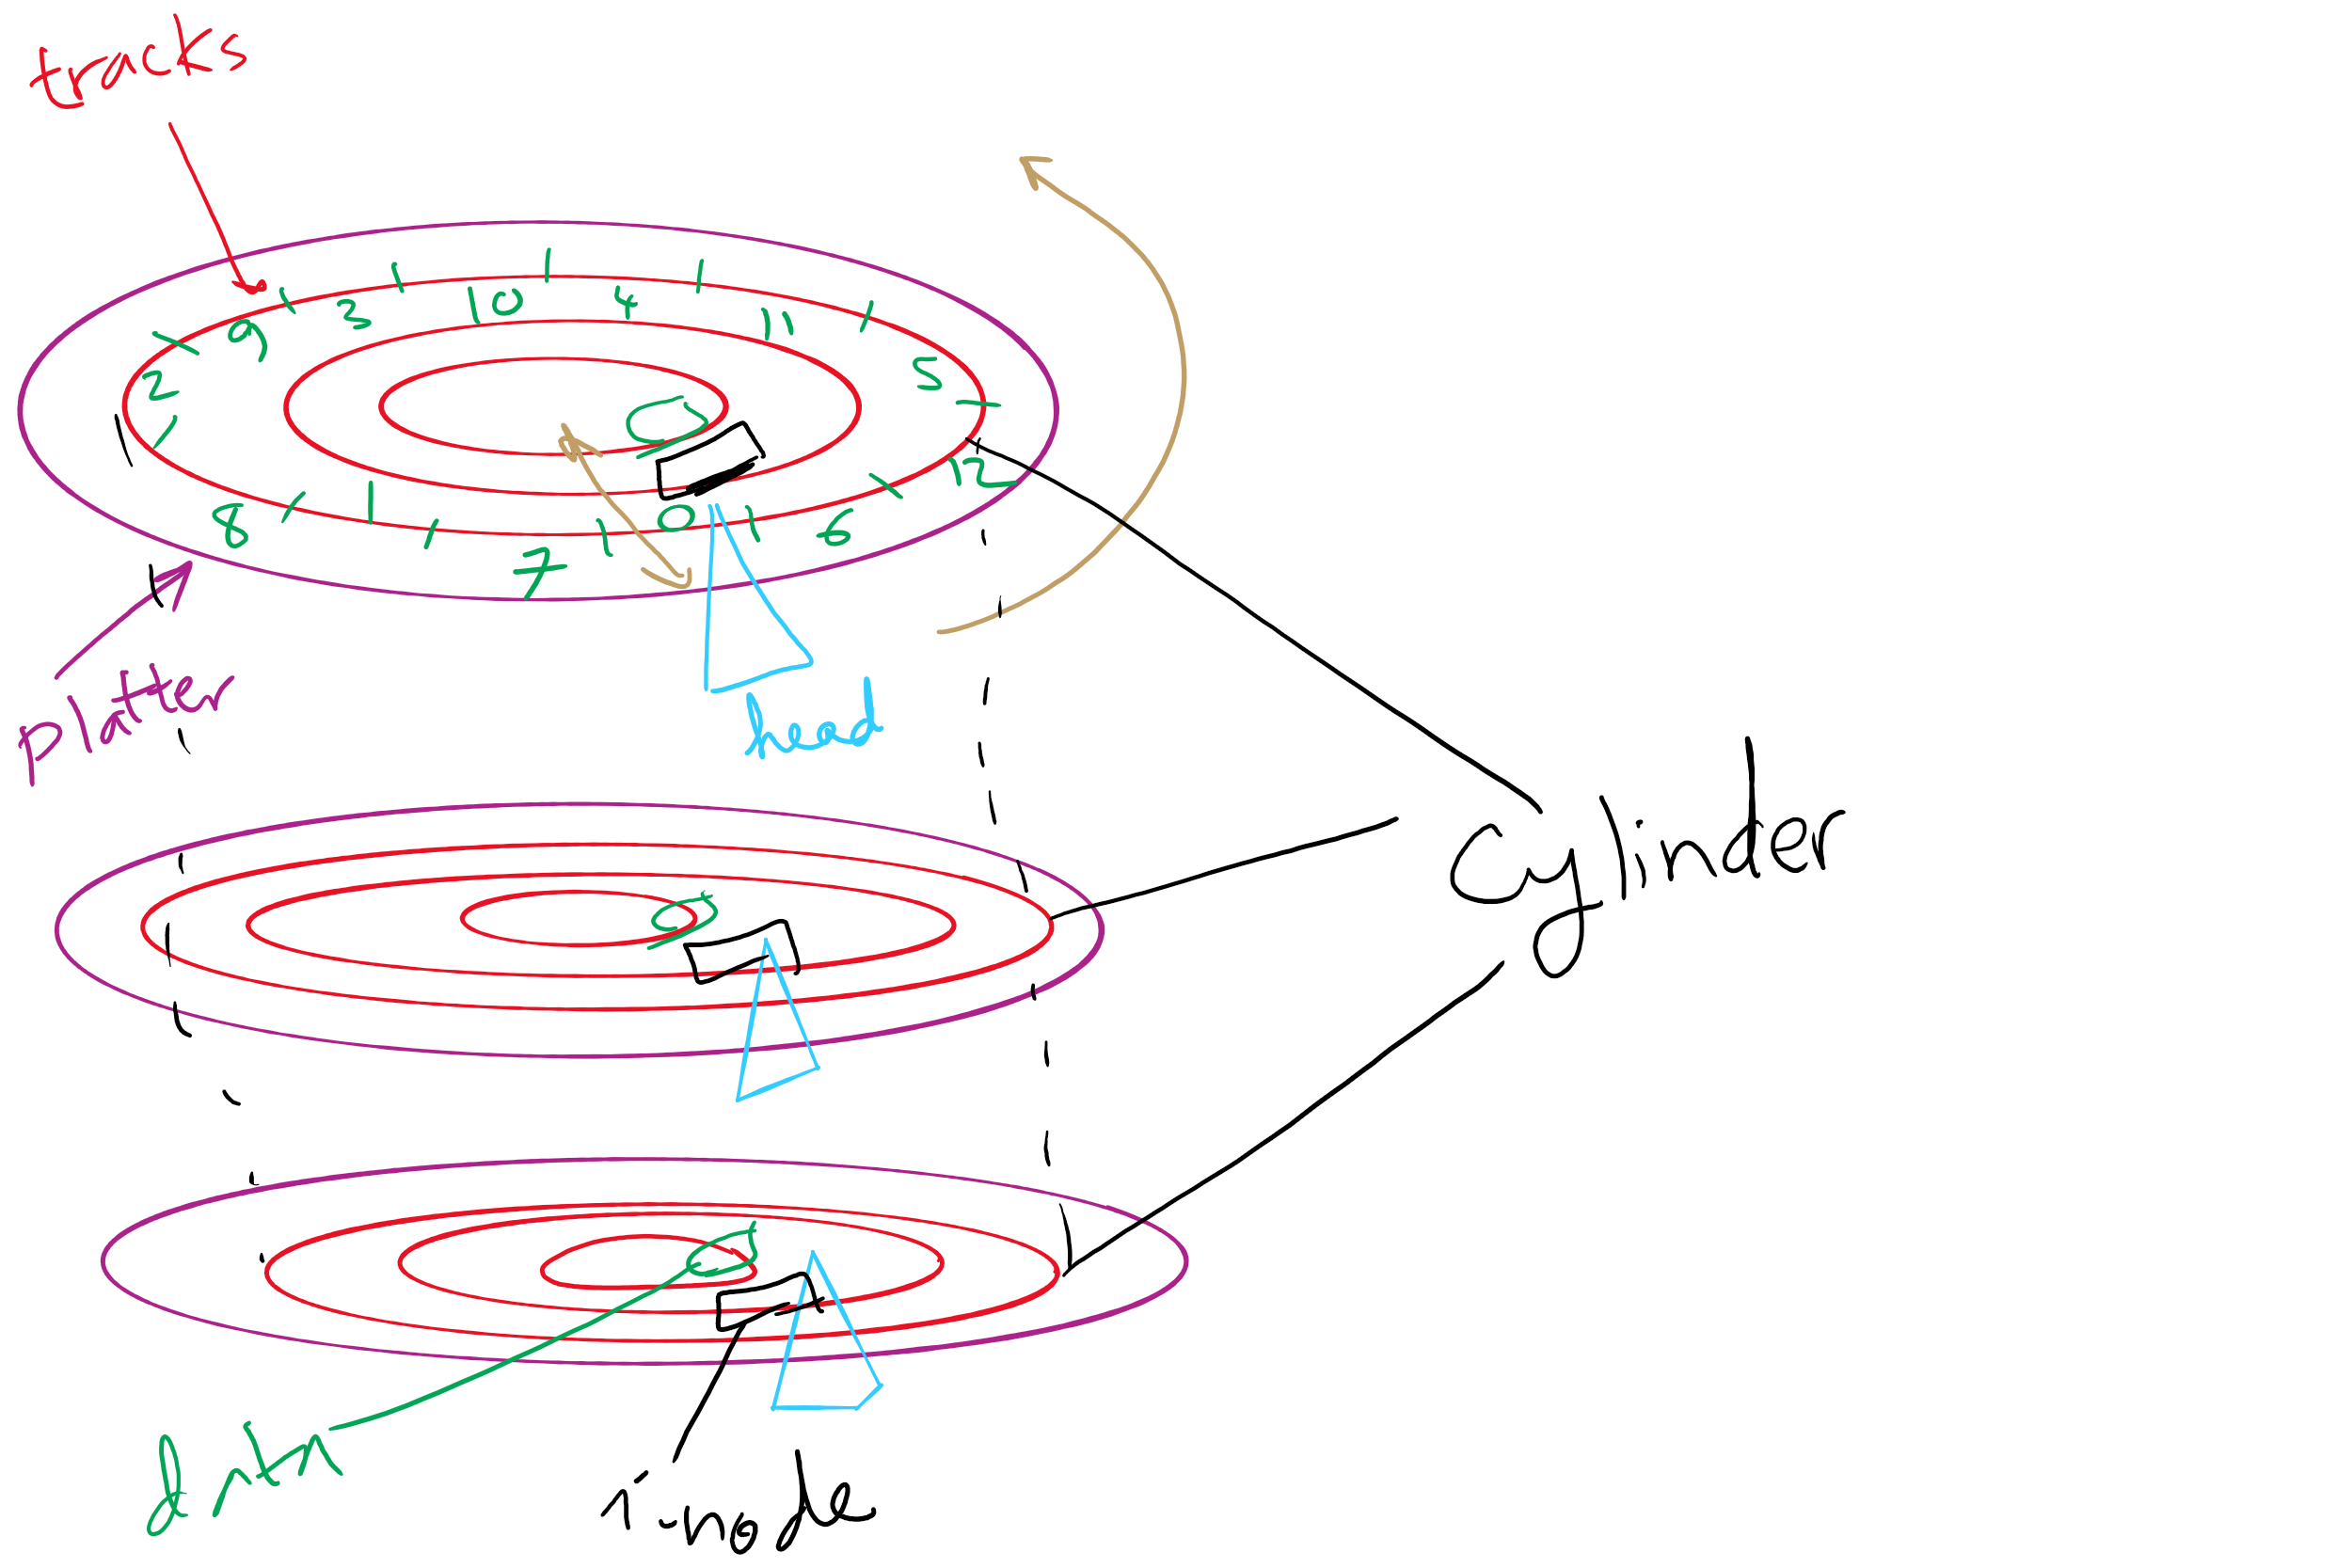
Disks, cylinders, cylinder groups

Slide 15
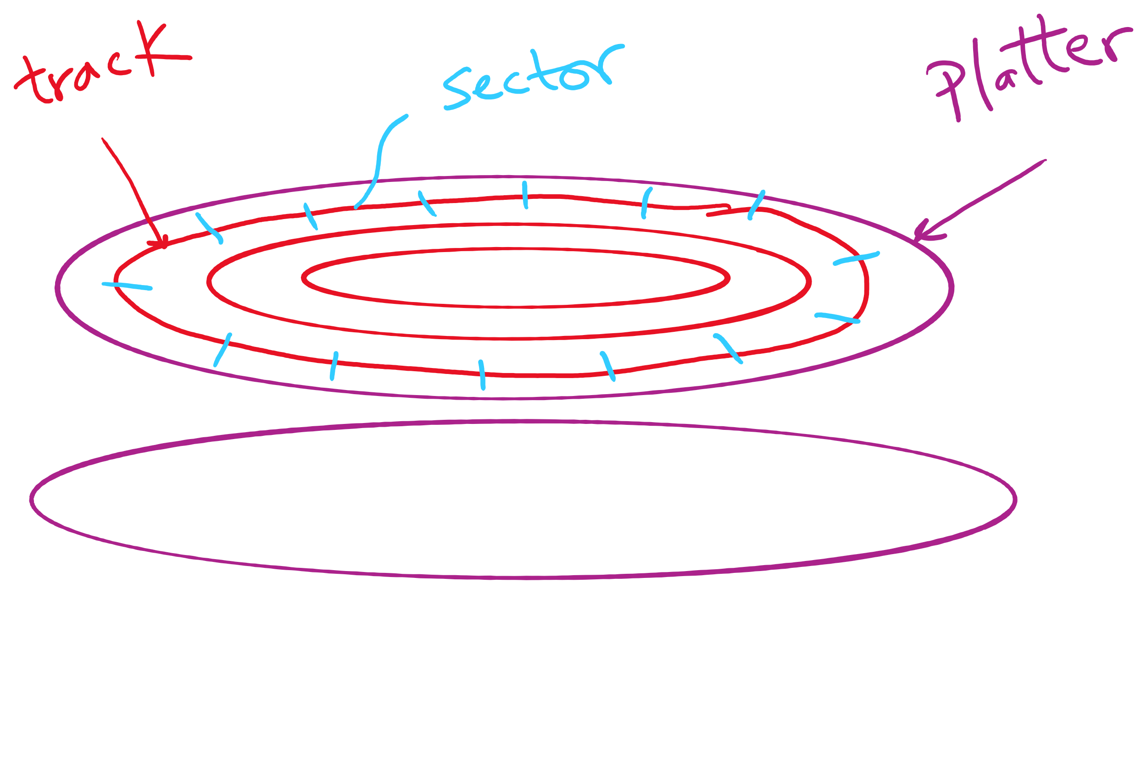
Disk Sector

Slide 16
What’s in a disk request?
Time required to read or write a disk block determined by 3 factors
Seek time
Rotational delay
Average delay = 1/2 rotation time
Example: rotate in 10ms, average rotation delay = 5ms
Actual transfer time
Transfer time = time to rotate over sector
Example: rotate in 10ms, 200 sectors/track => 10/200 ms = 0.05ms transfer time per sector
Seek time dominates, with rotation time close
Error checking is done by controllers

Slide 17
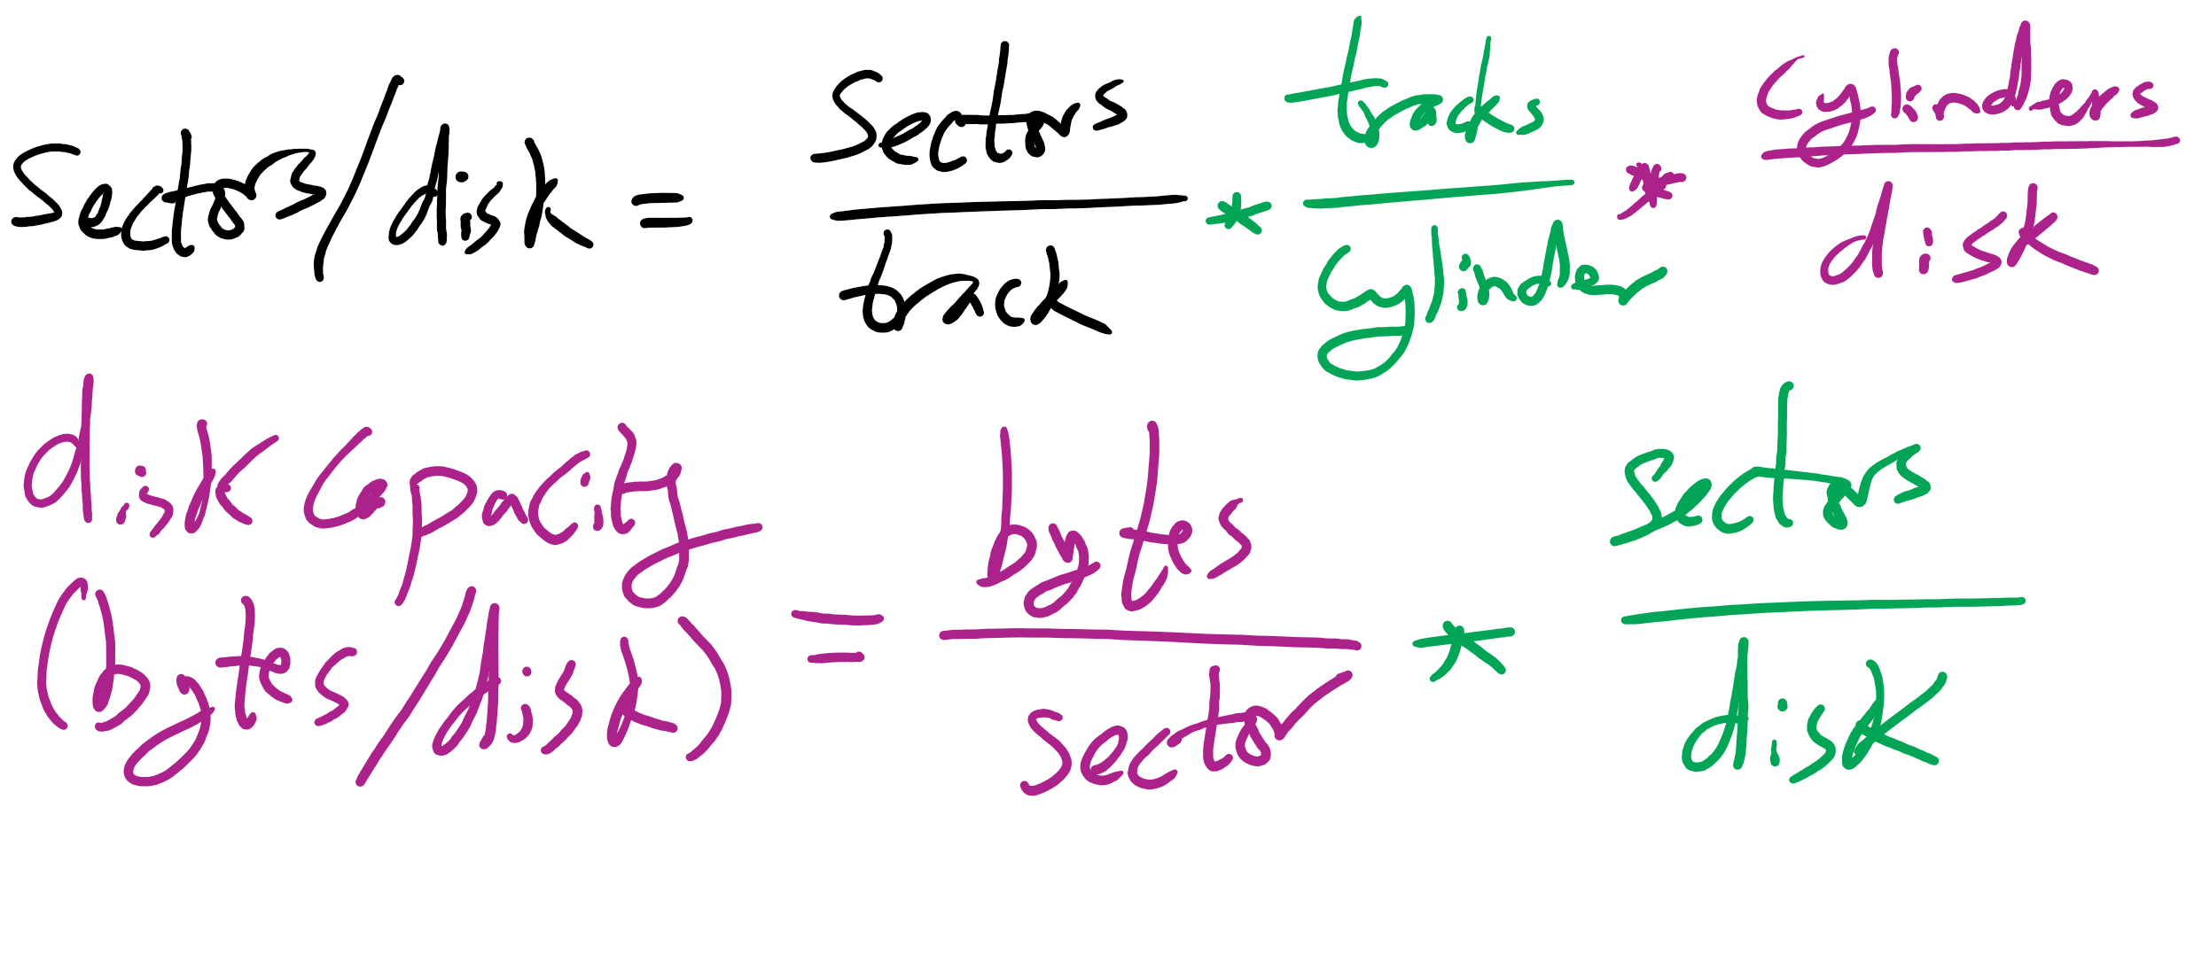
Disk drive specifics
 | IBM 360KB floppy | WD 18GB HD
Cylinders | 40 | 10601
Tracks per cylinder | 2 | 12
Sectors per track | 9 | 281 (average)
Sectors per disk | 720 | 35742000
Bytes per sector | 512 | 512
Capacity | 360 KB | 18.3 GB
Seek time (minimum) | 6 ms | 0.8 ms
Seek time (average) | 77 ms | 6.9 ms
Rotation time | 200 ms | 8.33 ms
Spinup time | 250 ms | 20 sec
Sector transfer time | 22 ms | 17 μsec

Slide 18
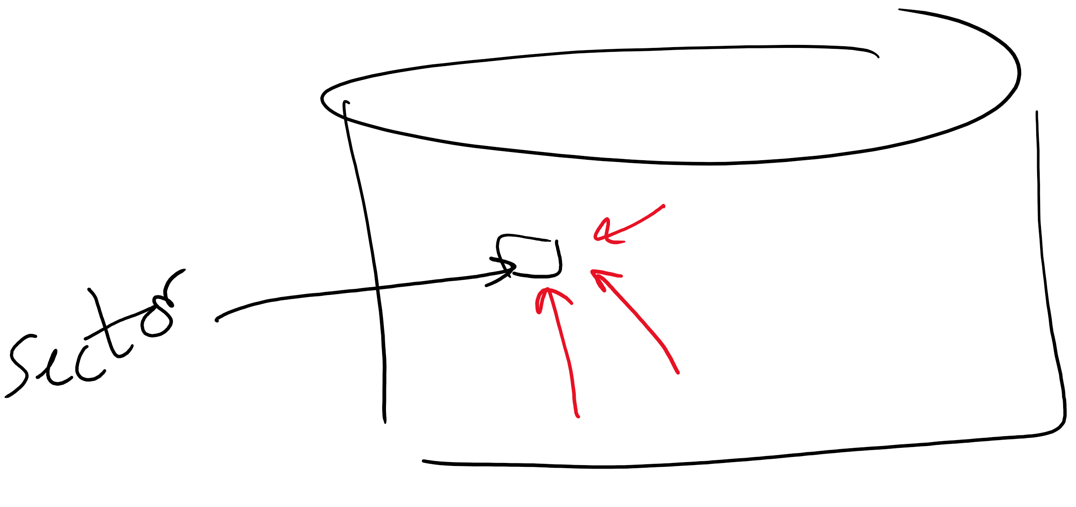
Structure of a disk sector
Preamble contains information about the sector
Sector number & location information
Data is usually 256, 512, or 1024 bytes
ECC (Error Correcting Code) is used to detect & correct minor errors in the data
Preamble
Data
ECC

Slide 19
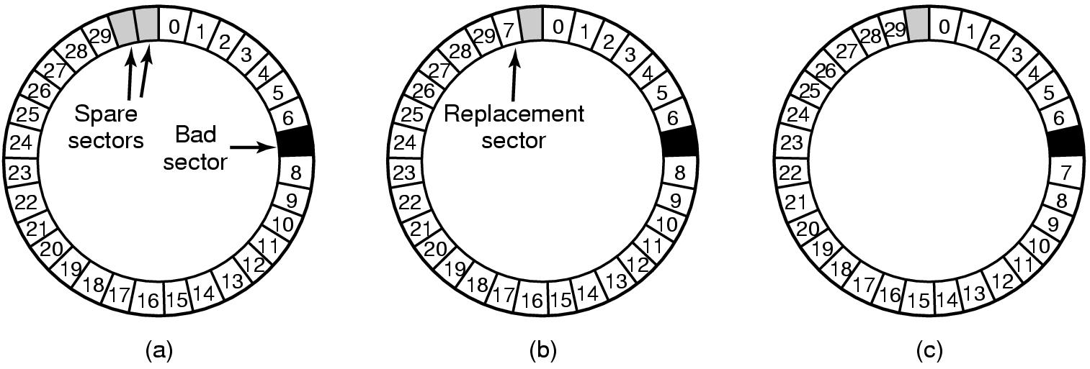
When good disks go bad…
Disks have defects
In 3M+ sectors, this isn’t surprising!
ECC helps with errors, but sometimes this isn’t enough
Disks keep spare sectors (normally unused) and remap bad sectors into these spares
If there’s time, the whole track could be reordered…

Slide 20
RAIDs, RAIDs, and more RAIDs
Stripe
strip
strip
RAID 0
(Redundant Array of Inexpensive Disks
RAID 1
(Mirrored copies)
RAID 4
(Striped with parity)
RAID 5
(Parity rotates through disks)

Slide 21
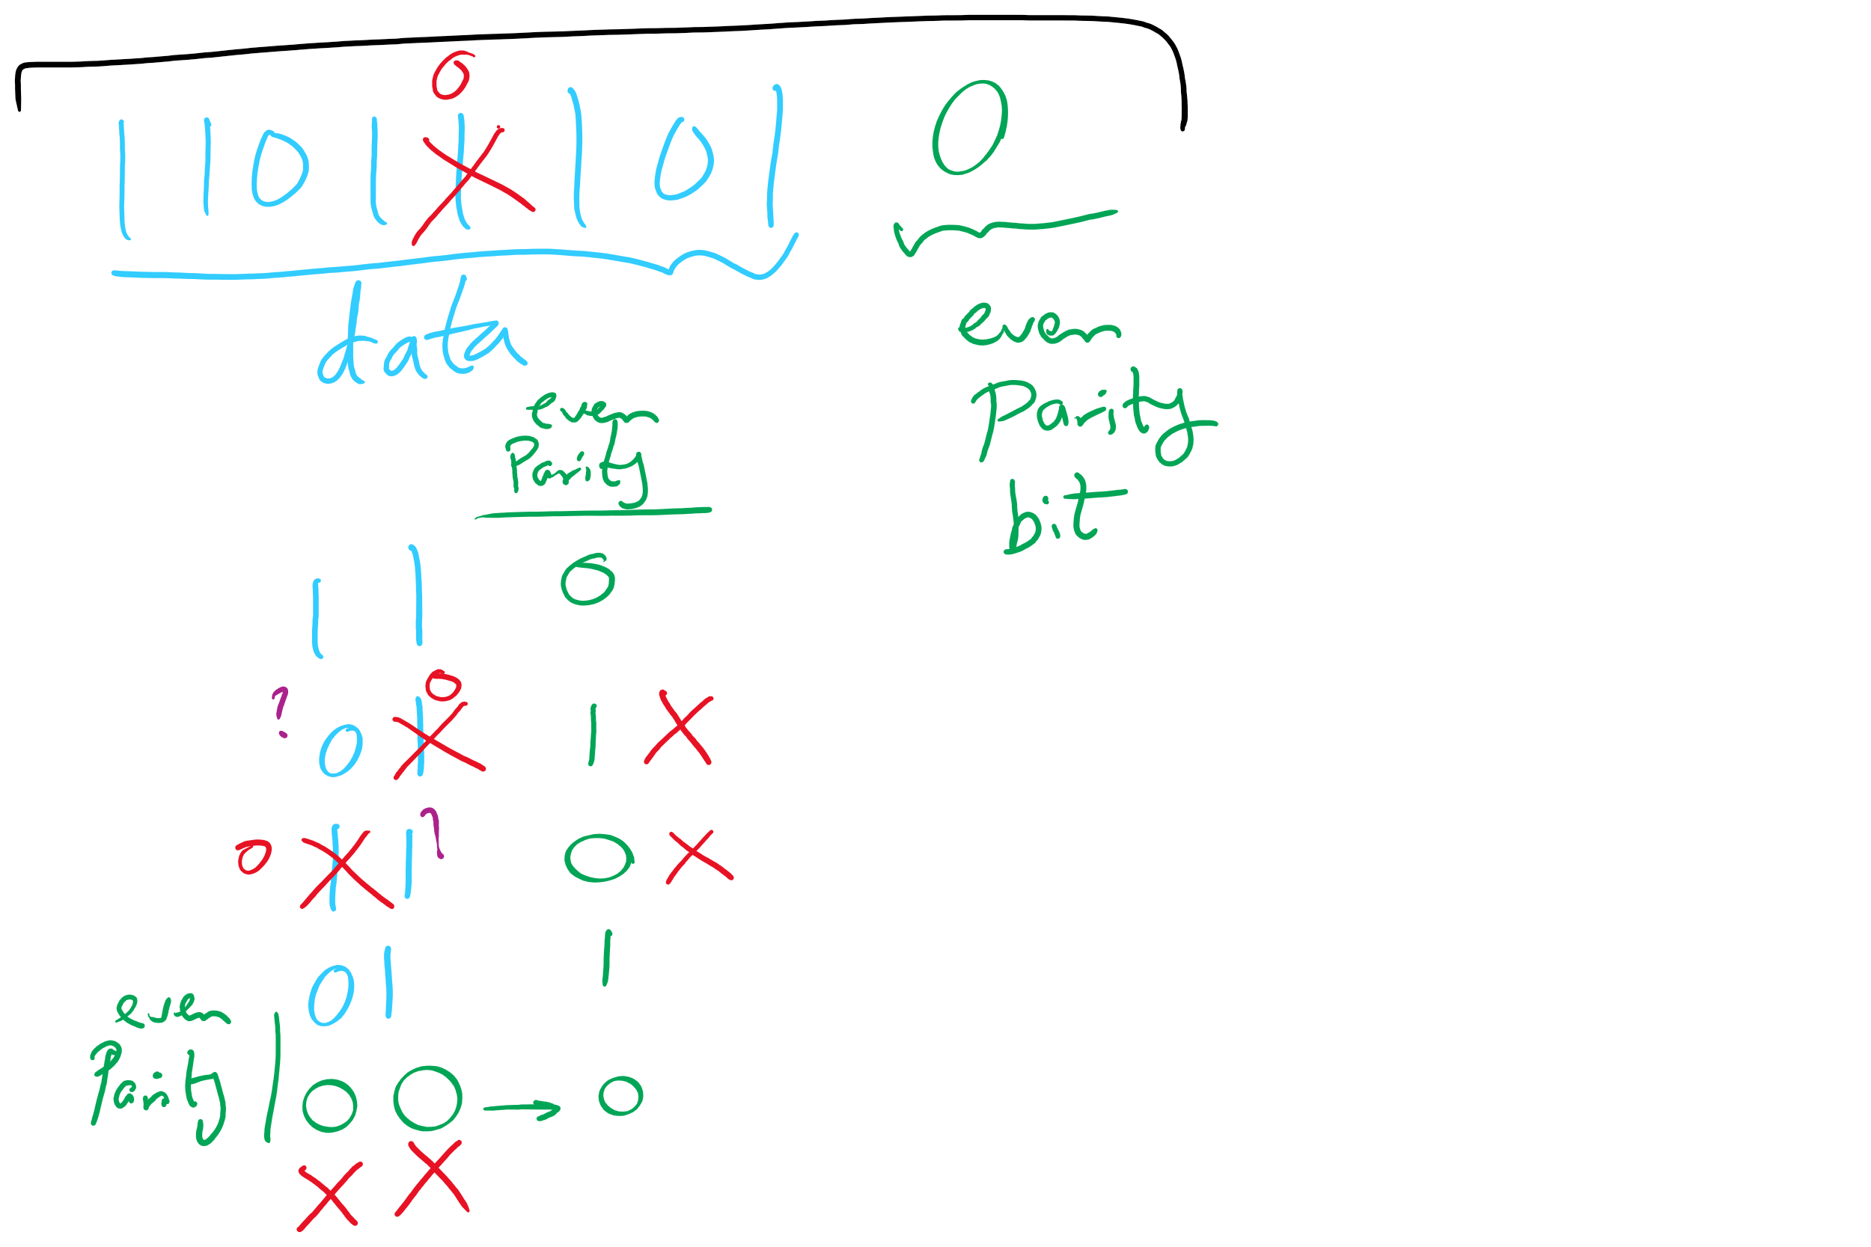
Parity Examples

Slide 22
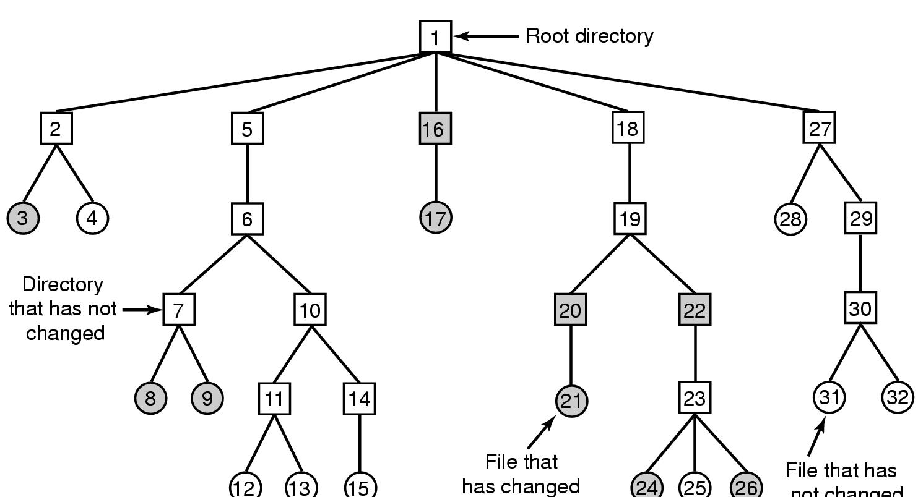
Backing up a file system
A file system to be dumped
Squares are directories, circles are files
Shaded items, modified since last dump
Each directory & file labeled by i-node number
File that has
not changed

Slide 23
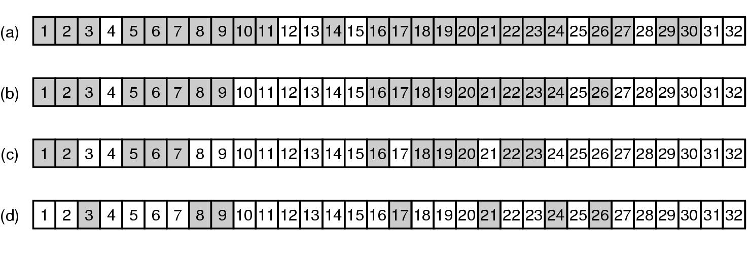
Bitmaps used in a file system dump

Slide 24
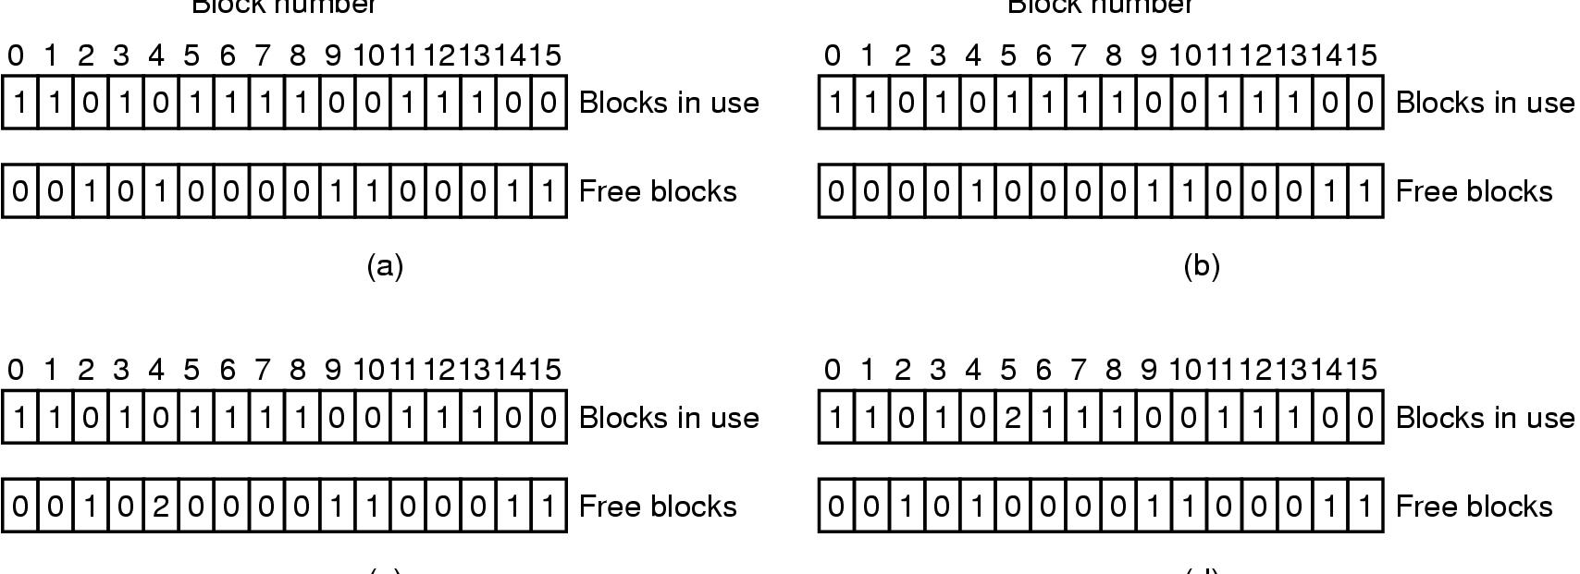
Checking the file system for consistency
Consistent
Missing (“lost”) block
Duplicate block in free list
Duplicate block in two files

Slide 25
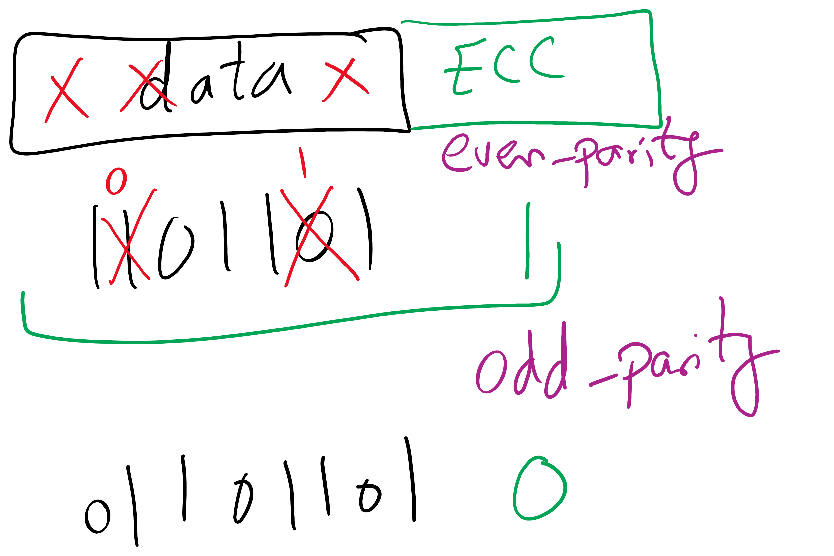
1-d parity

Slide 26
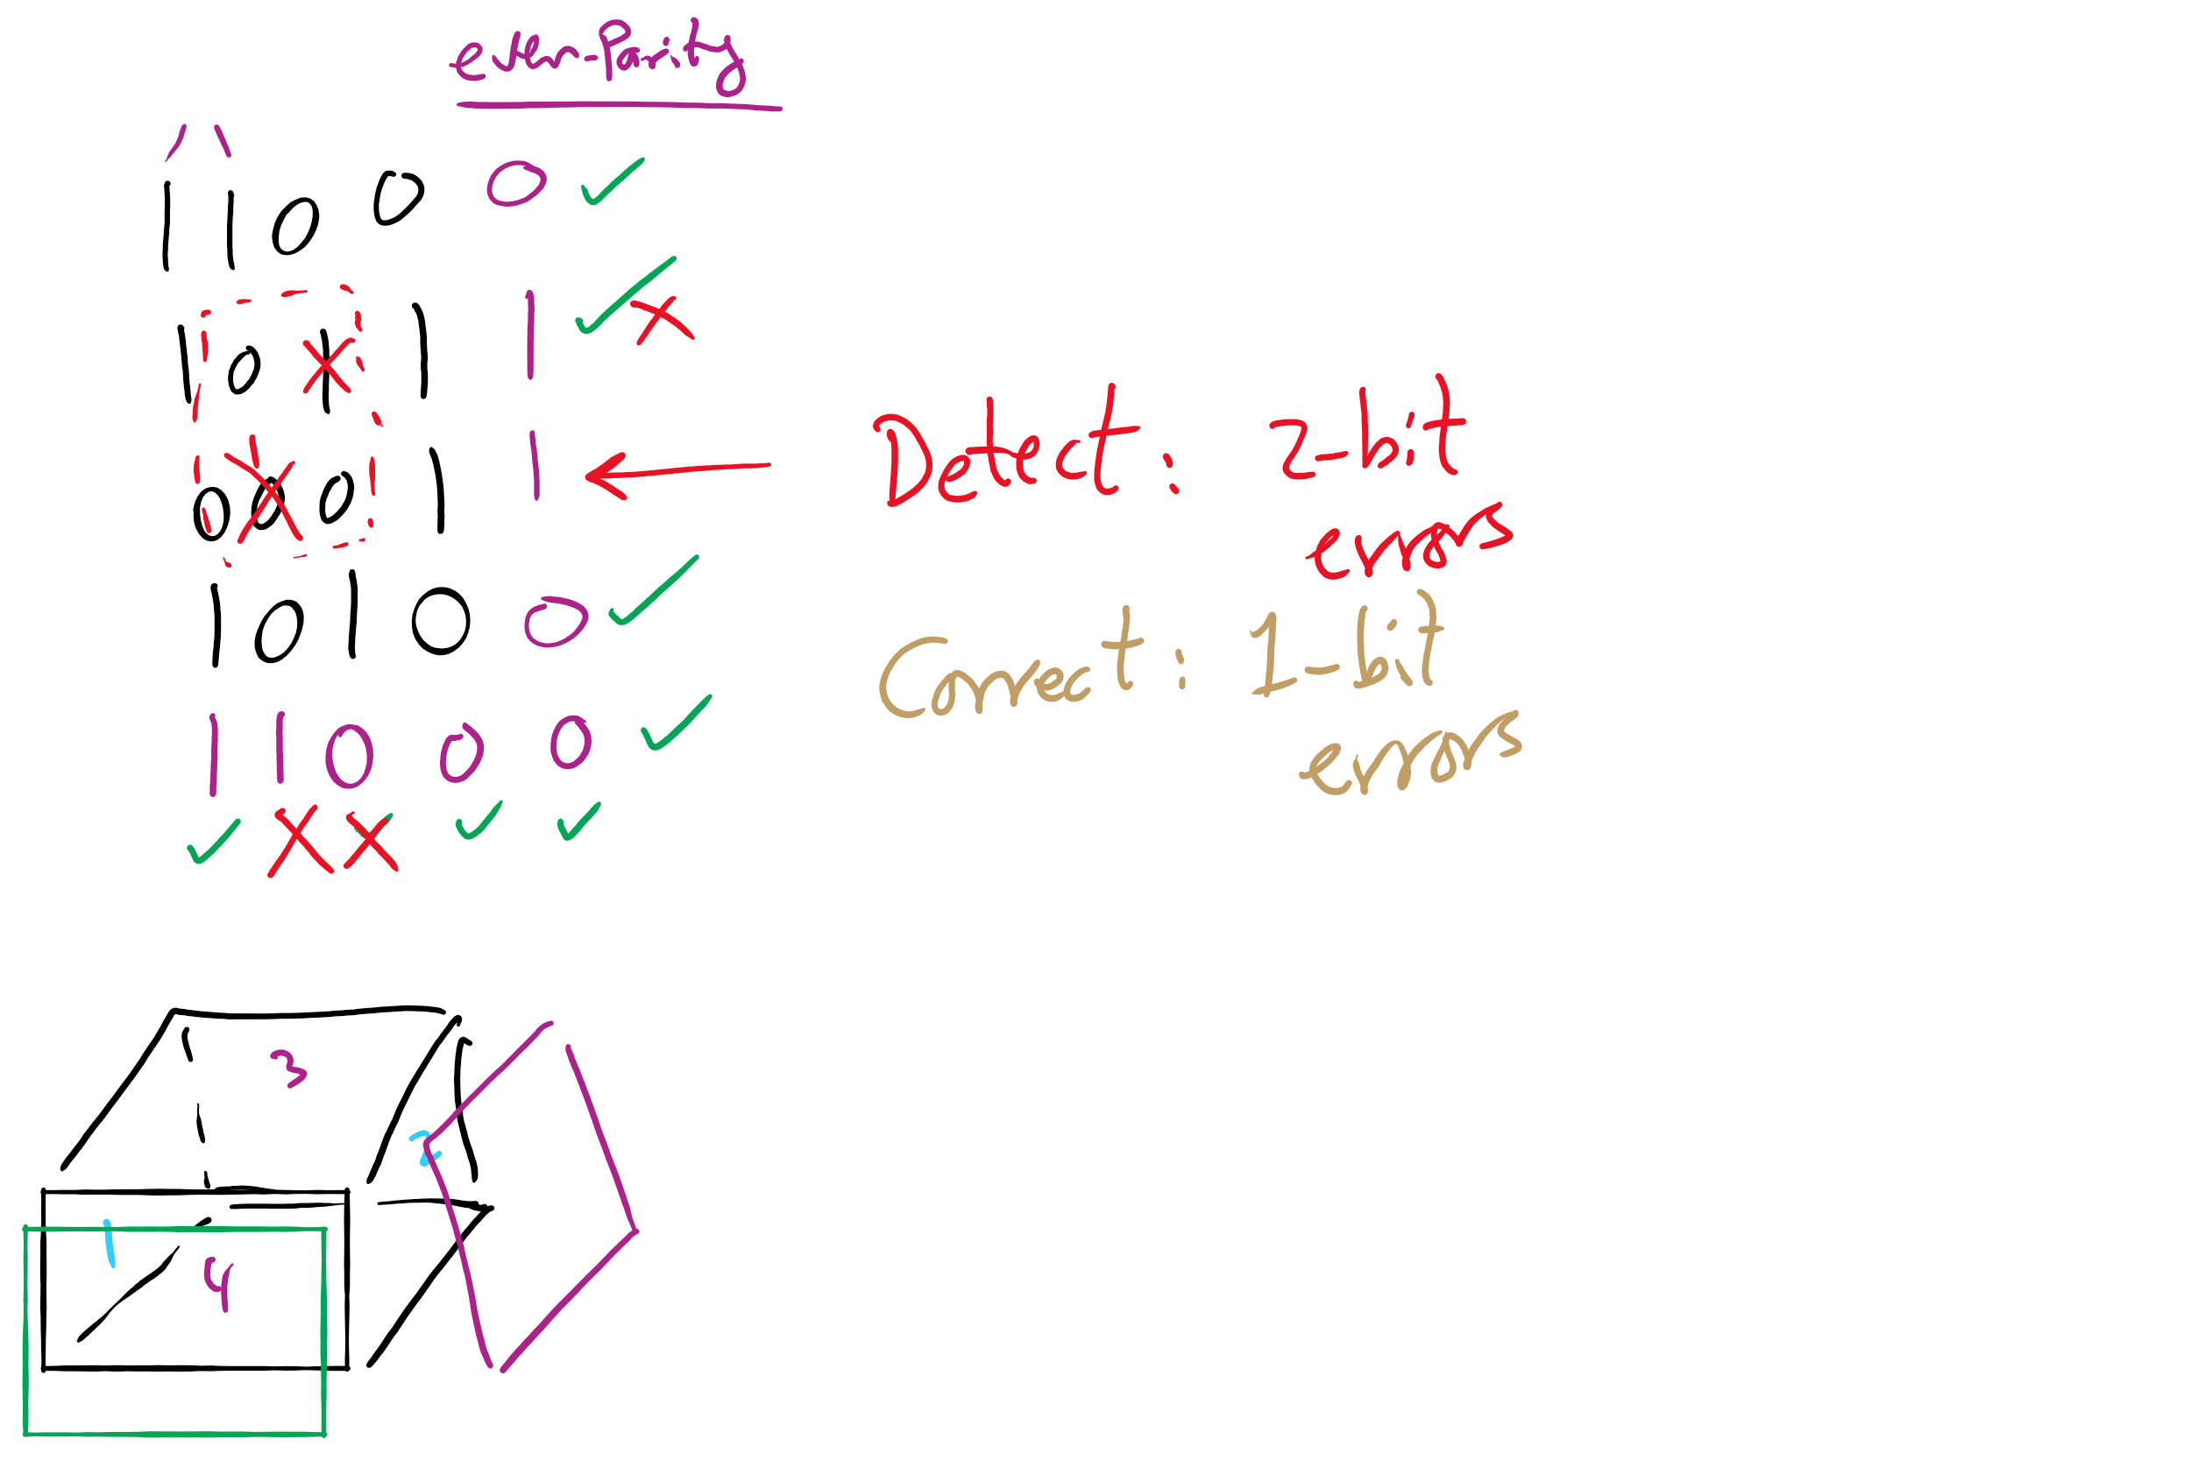
2-d parity

Slide 27
Problem of the Day – Part 2
How does a file system hide disk access delays?
Answer: Caching

Slide 28
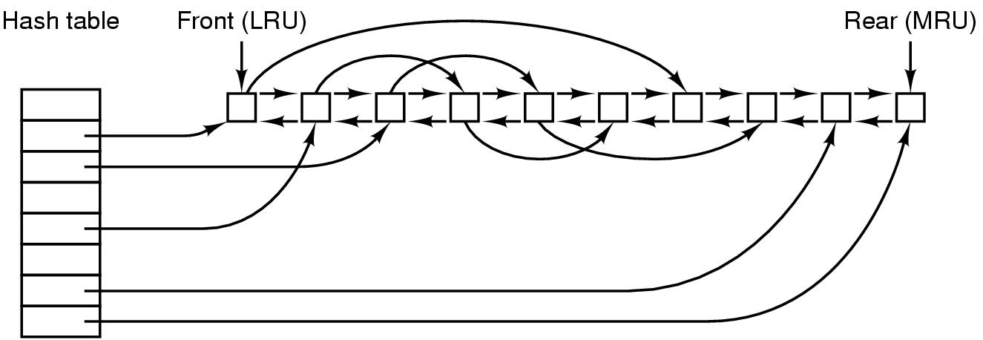
File block cache data structures

Slide 29
Log-structured file systems
Trends in disk & memory
Faster CPUs
Larger memories
Result
More memory -> disk caches can also be larger
Increasing number of read requests can come from cache
Thus, most disk accesses will be writes
LFS structures entire disk as a log
All writes initially buffered in memory
Periodically write these to the end of the disk log
When file opened, locate i-node, then find blocks
Issue: what happens when blocks are deleted?

Slide 30
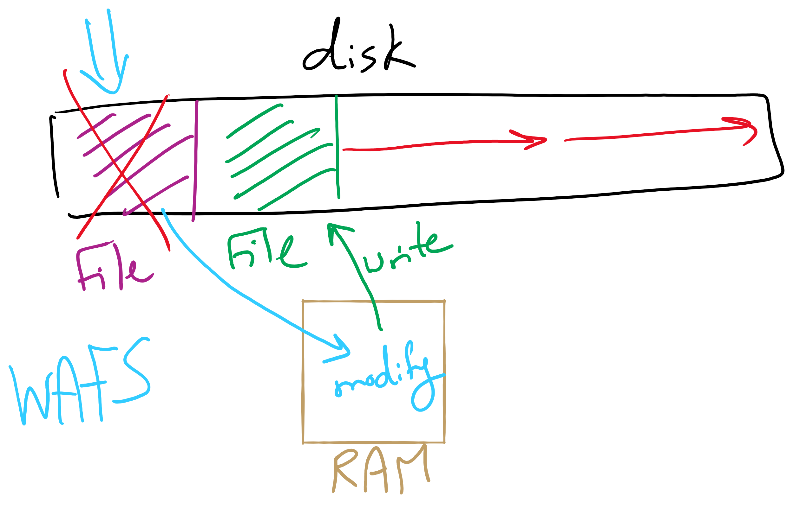
Log Structured File System

Slide 31
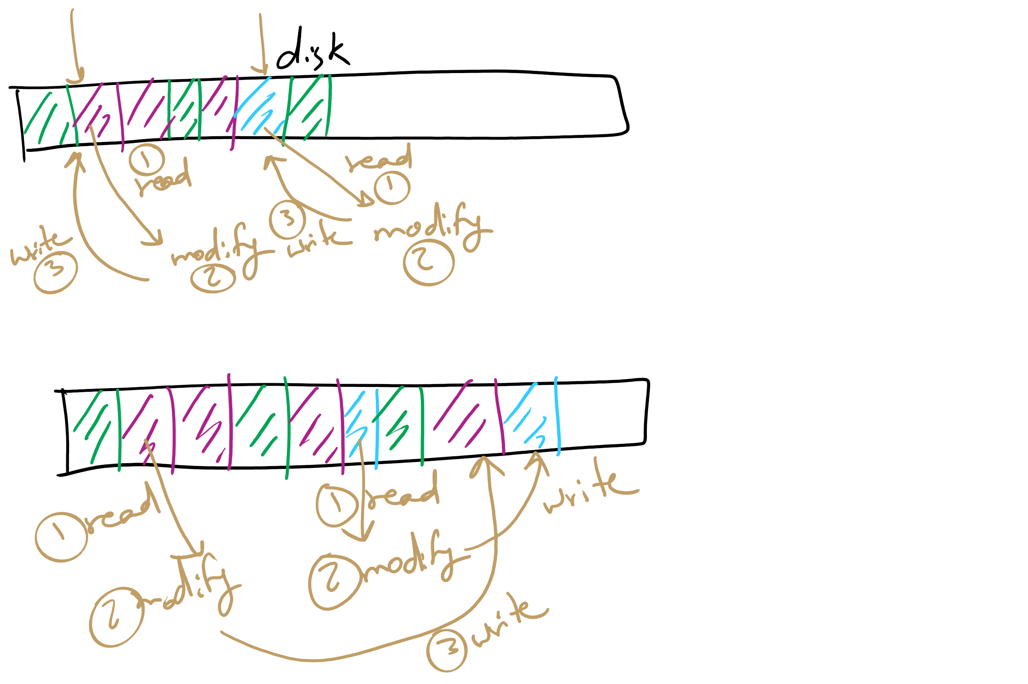
Log Structured File System

Slide 32
How are I/O devices connected?
Single-bus
All memory accesses go over a shared bus
I/O and RAM accesses compete for bandwidth
Dual-bus
RAM access over high-speed bus
I/O access over lower-speed bus
Less competition
More hardware (more expensive…)
CPU
Memory
I/O
CPU
Memory
I/O
This port allows I/O devices access into memory

Slide 33
Programmed I/O example: printing a page
User
Printed page
Printed page
Printed page
ABCD EFGH
ABCD EFGH
ABCD EFGH
A
AB
Kernel
ABCD EFGH
ABCD EFGH

Slide 34
Polling
copy_from_user (buffer, p, count); // copy into kernel buffer
for (j = 0; j < count; j++) { // loop for each char
while (*printer_status_reg != READY)
; // wait for printer to be ready
*printer_data_reg = p[j]; // output a single character
}
return_to_user();

Slide 35
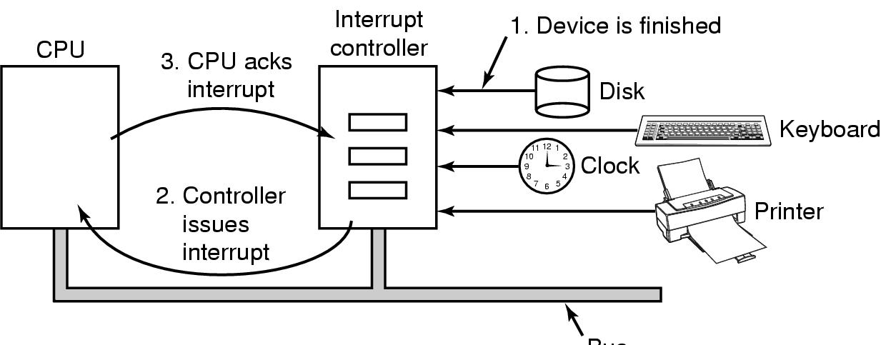
Hardware’s view of interrupts
Bus

Slide 36
Interrupt-driven I/O
copy_from_user (buffer, p, count);
j = 0;
enable_interrupts();
while (*printer_status_reg != READY)
;
*printer_data_reg = p[0];
scheduler(); // and block user
Code run by system call
if (count == 0) {
unblock_user();
} else {
j++;
*printer_data_reg = p[j];
count--;
}
acknowledge_interrupt();
return_from_interrupt();
Code run at interrupt time
(Interrupt handler)

Slide 37
What happens on an interrupt
Set up stack for interrupt service procedure
Ack interrupt controller, reenable interrupts
Copy registers from where saved
Run service procedure
(optional) Pick a new process to run next
Set up MMU context for process to run next
Load new process' registers
Start running the new process

Slide 38
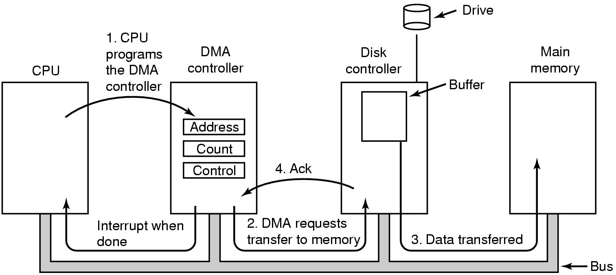
Direct Memory Access (DMA) operation

Slide 39
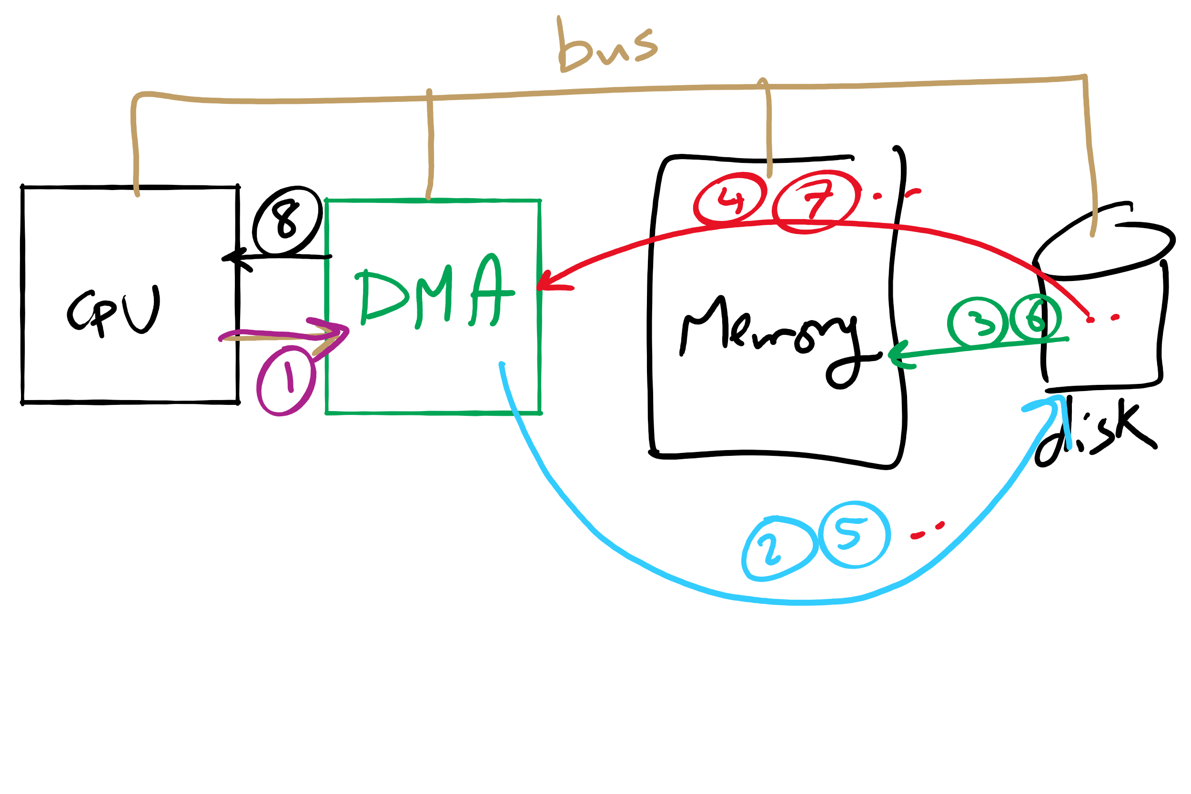
DMA

Slide 40
I/O using DMA
copy_from_user (buffer, p, count);
set_up_DMA_controller();
scheduler(); // and block user
Code run by system call
acknowledge_interrupt();
unblock_user();
return_from_interrupt();
Code run at interrupt time

