Slide 1

Introduction to Operating Systems CS/COE 1550
Spring 2022
Sherif Khattab
ksm73@pitt.edu
(Some slides are from Silberschatz, Galvin and Gagne ©2013)

Slide 2
Announcements
Homework 1 is due next Monday at 11:59 pm
Lab 1 is due on 2/4 at 11:59 pm
Distributed using GitHub Classroom
Explained in this week’s recitations
TA Office hours available on the syllabus page
Project 1 will be up on Canvas this Friday
Docker images are available on Canvas

Slide 3
Muddiest Points
the while(1) loop in the spinlocks example (just a placeholder I assume?)
It would be helpful to have a step-by-step written out representation of Context Switching in Xv6 to accompany the graphic
Why only certain registers were pushed/popped in the context switches. Is it just because these are the only registers the processes could be using?
How can hardware be directly accessed by user tasks, like the first two options in the spin lock slide? My thought was that something like an atomic swap would need hard wiring, not software
Are race condition prevention methods implemented by the programmer or the operating system?
What exactly is a critical region again?
Are context switching done by the kernel?

Slide 4
Agenda
Busy Waiting Problem
Why does it happen?
What are its implications?
How to solve it?
Sempahores

Slide 5
Today’s problem: Busy Waiting
A process that is trying to acquire a locked spinlock is running!
It continuously checks:
can I get the lock? No, lock is held by another process
can I get the lock? No, lock is held by another process
…
This continuous check is called spinning or busy waiting
But what is wrong with that?
Busy waiting wastes CPU cycles
on a single-core system it delays the process that is holding the lock from releasing it

Slide 6
Today’s problem: Busy Waiting
While P1 is in the critical region, P2 is busy waiting
Shared Data
Spinlock lk;
int x;
Process P1
lock(lk);
//critical region (e.g., x++)
unlock(lk);
Process P2
lock(lk);
//critical region (e.g., x++)
unlock(lk);

Slide 7
But why?
Why does busy waiting happen with spinlocks?

Slide 8
Atomic TestAndSet
TestAndSet is an atomic instruction
Works for single-core and multi-core Symmetric Multi-Processing (SMP)
int TestAndSet(int &x){
lock memory access to x
int temp = *x;
*x = 1;
unlock memory access to x
return temp;
}

Slide 9
Spinlock implementation using TestAndSet
Single shared variable: lock
Works for any number of processes
int lock = 0;
Lock(){
while (TestAndSet(&lock))
;
}
Unlock(){
lock = 0;
}

Slide 10
Atomic Swap
Swap is an atomic instruction
Works for single-core and multi-core Symmetric Multi-Processing (SMP)
int Swap(int &x, int y){
lock memory access to x
int temp = *x;
*x = y;
unlock memory access to x
return temp;
}

Slide 11
Spinlock implementation using Swap
Single shared variable: lock
Works for any number of processes
int lock = 0;
Lock(){
while (Swap(&lock, 1))
;
}
Unlock(){
lock = 0;
}

Slide 12
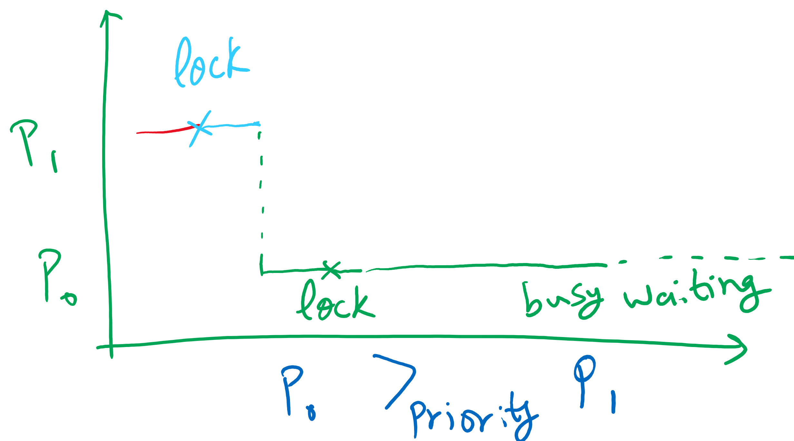
Implication of Busy Waiting
Subproblem: priority inversion (higher priority process busy waits for lower priority process)

Slide 13
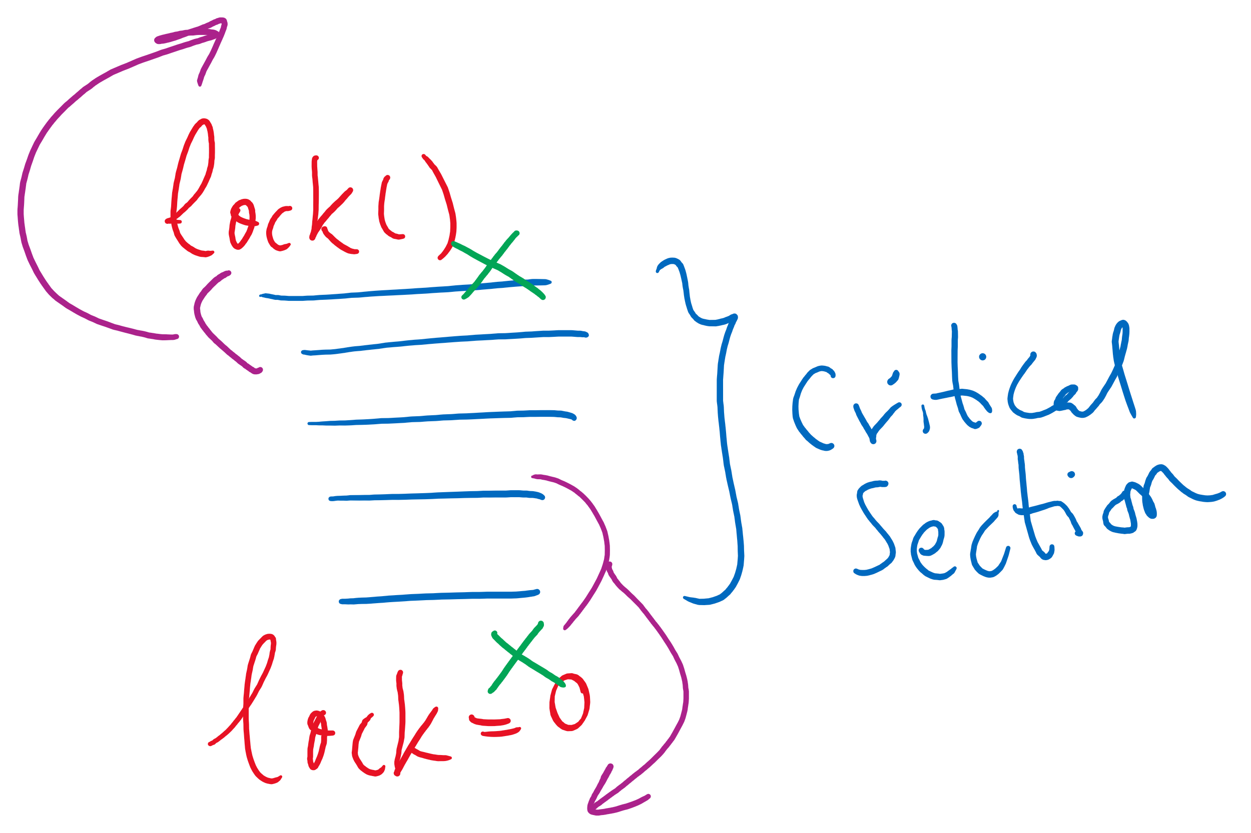
Implementation Detail
compiler and/or hardware may reorder instructions

Slide 14
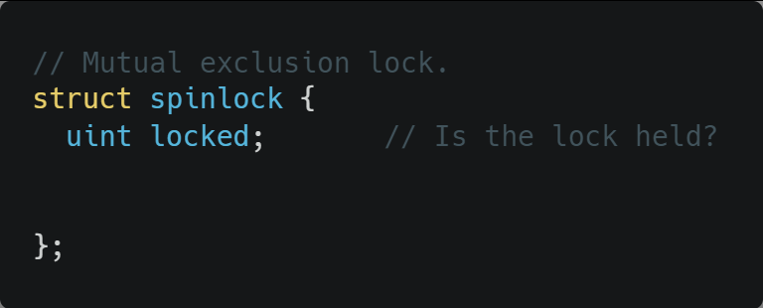
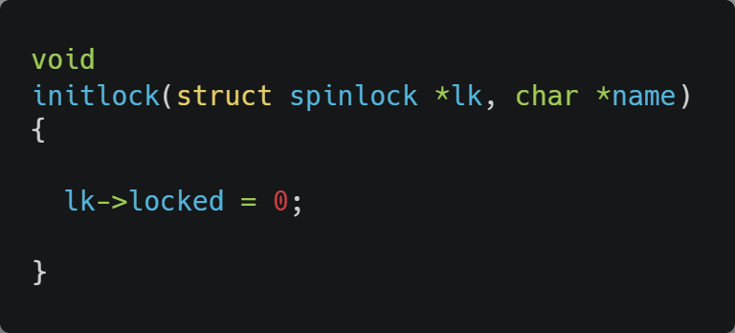
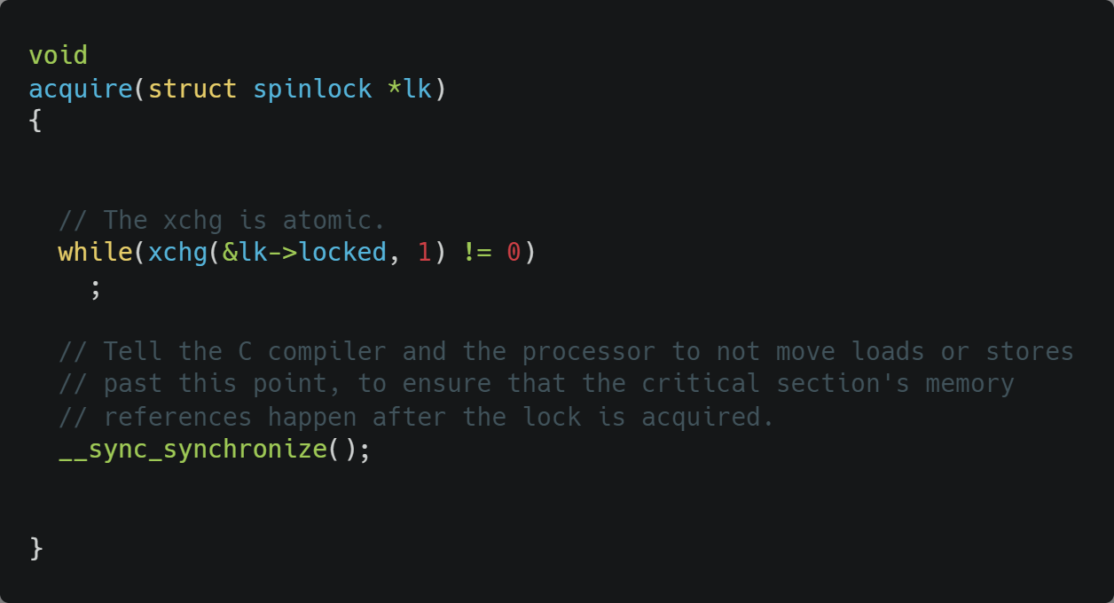
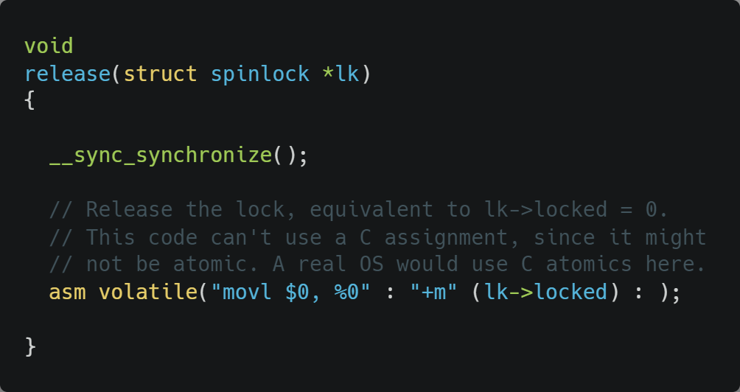
Xv6 Walkthrough
Spinlocks
__sync_synchronize() is a memory barrier instruction

Slide 15
Semaphores
Solution: use semaphores
Synchronization mechanism that doesn’t require busy waiting
Implementation
Semaphore S accessed by two atomic operations
Down(S): decrement the semaphore if > 0; block otherwise
Up(S): increment the semaphore and wakeup one blocked process if any
Down() is another name for P()
Up() is another name for V()

Slide 16
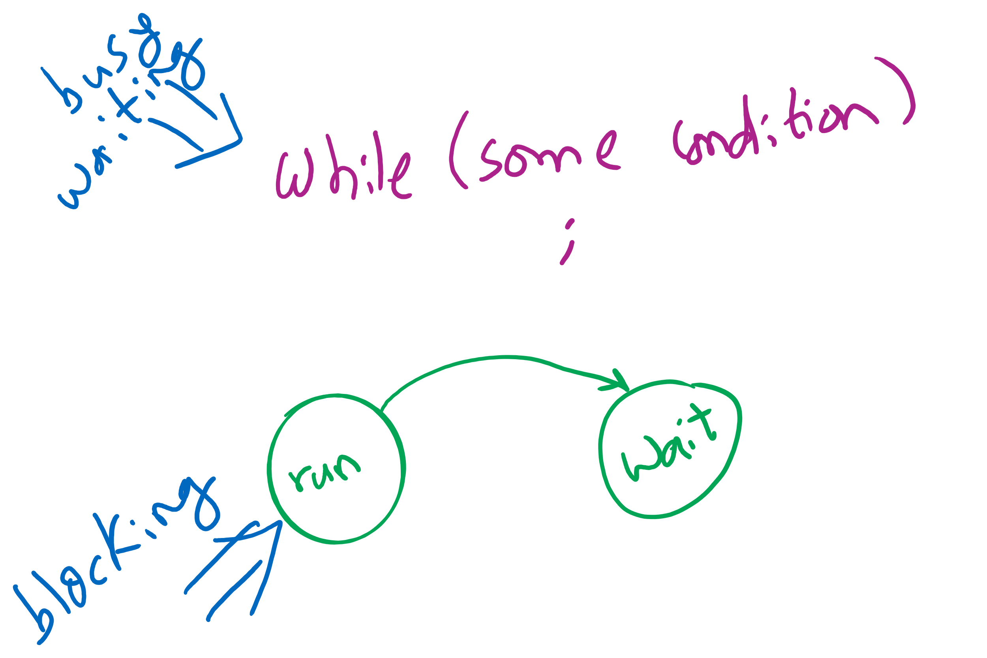
Busy waiting vs. Blocking
Blocking involves 2 context switches

Slide 17
Critical sections using semaphores
Shared variables
Semaphore sem(1);
Code for process P_{i}
while (1) {
// non-critical section
down(sem);
// critical section
up(sem);
// non-critical section
}

Slide 18
Types of semaphores
Two different types of semaphores
Counting semaphores
Binary semaphores
Counting semaphore
Value can range over an unrestricted range
Binary semaphore
Only two values possible
1 means the semaphore is available
0 means a process has acquired the semaphore
May be simpler to implement
Possible to implement one type using the other

Slide 19
Semaphore Implementation
But how do semaphores avoid busy waiting?

Slide 20
Implementing semaphores with blocking
Assume two operations:
Sleep(): suspends current process
Wakeup(P): allows process P to resume execution
Semaphore data structure
Tracks value of semaphore
Keeps a list of processes waiting for the semaphore
down ()
{
value -= 1;
if (value < 0) {
// add this process to pl
Sleep ();
}
}
up () {
Process P;
value += 1;
if (value <= 0) {
// remove a process P
// from pl
Wakeup (P);
}
}
struct Semaphore {
int value;
ProcessList pl;
};
How to protect these shared variables??

Slide 21
Spinlocks in Semaphores
down ()
{
value -= 1;
if (value < 0) {
// add this process to pl
Sleep ();
}
}
up () {
Process P;
value += 1;
if (value <= 0) {
// remove a process P
// from pl
Wakeup (P);
}
}
struct Semaphore {
int value;
ProcessList pl;
};

Slide 22
Spinlocks are sometimes better than Semaphores
Very (very) short waiting time to enter the critical section < the 2 context switches needed for blocking
Multi-core
so that the spinlock can be unlocked while the process is busy waiting
Few contending processes for the critical section
Short critical section code

Slide 23
Why do we need Synchronization?
Each process operates sequentially
All is fine until processes want to share data
Exchange data between multiple processes
Allow processes to navigate critical regions
Maintain proper sequencing of actions in multiple processes
These issues apply to threads as well
Threads can share data easily (same address space)
Other two issues apply to threads

Slide 24
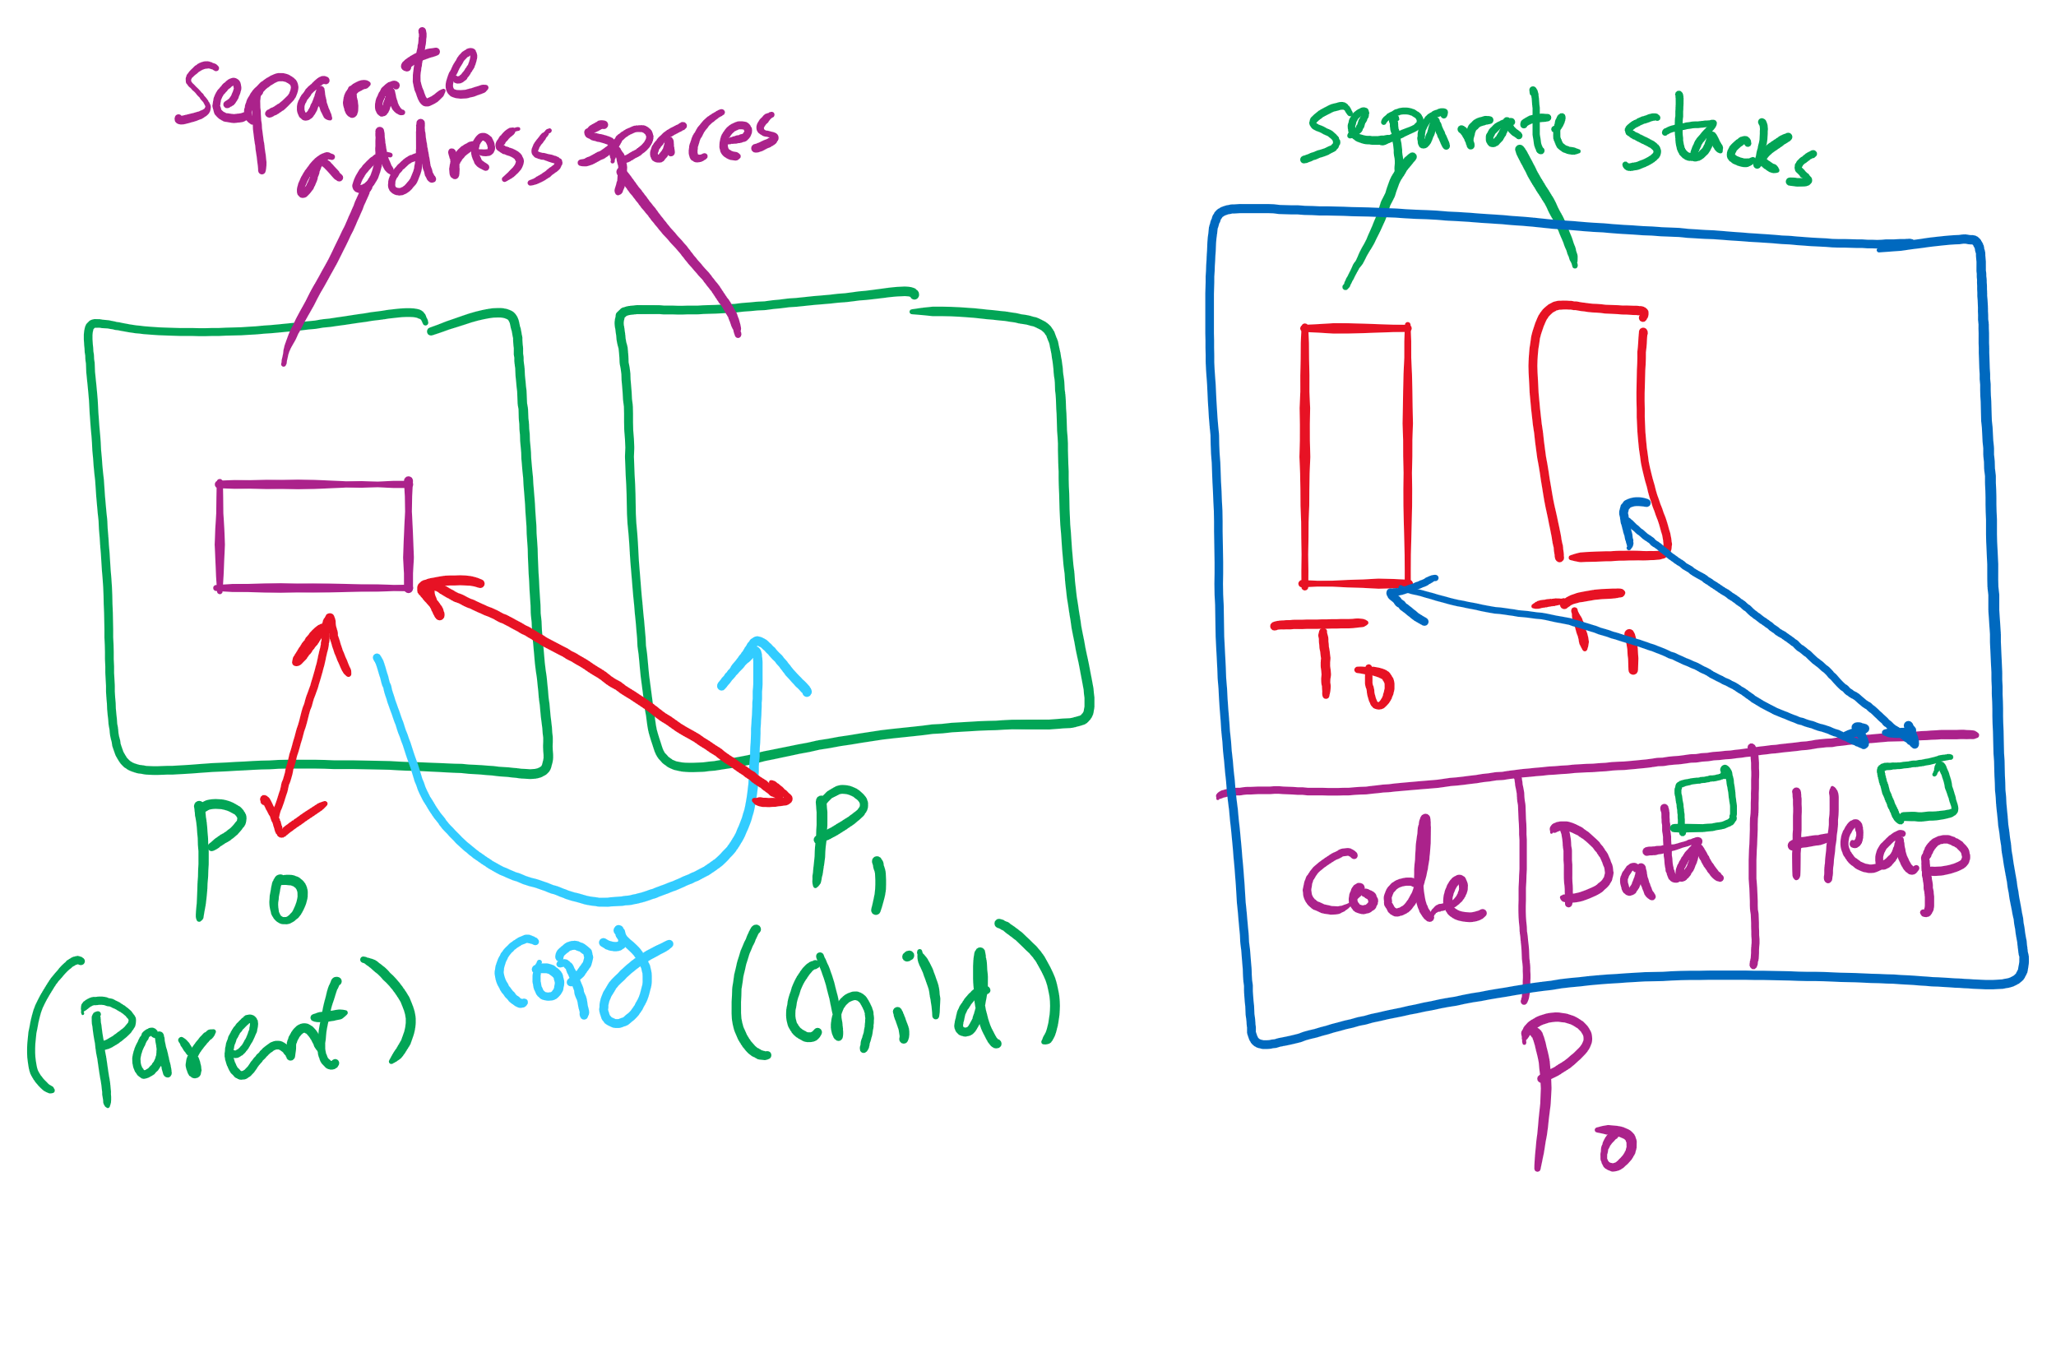
Process vs. Thread

Slide 25
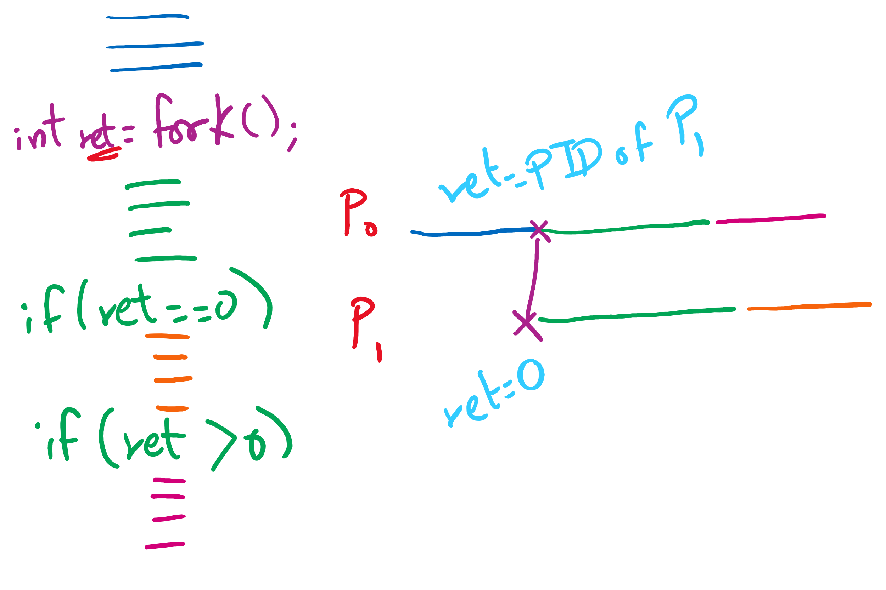
fork() tracing

Slide 26
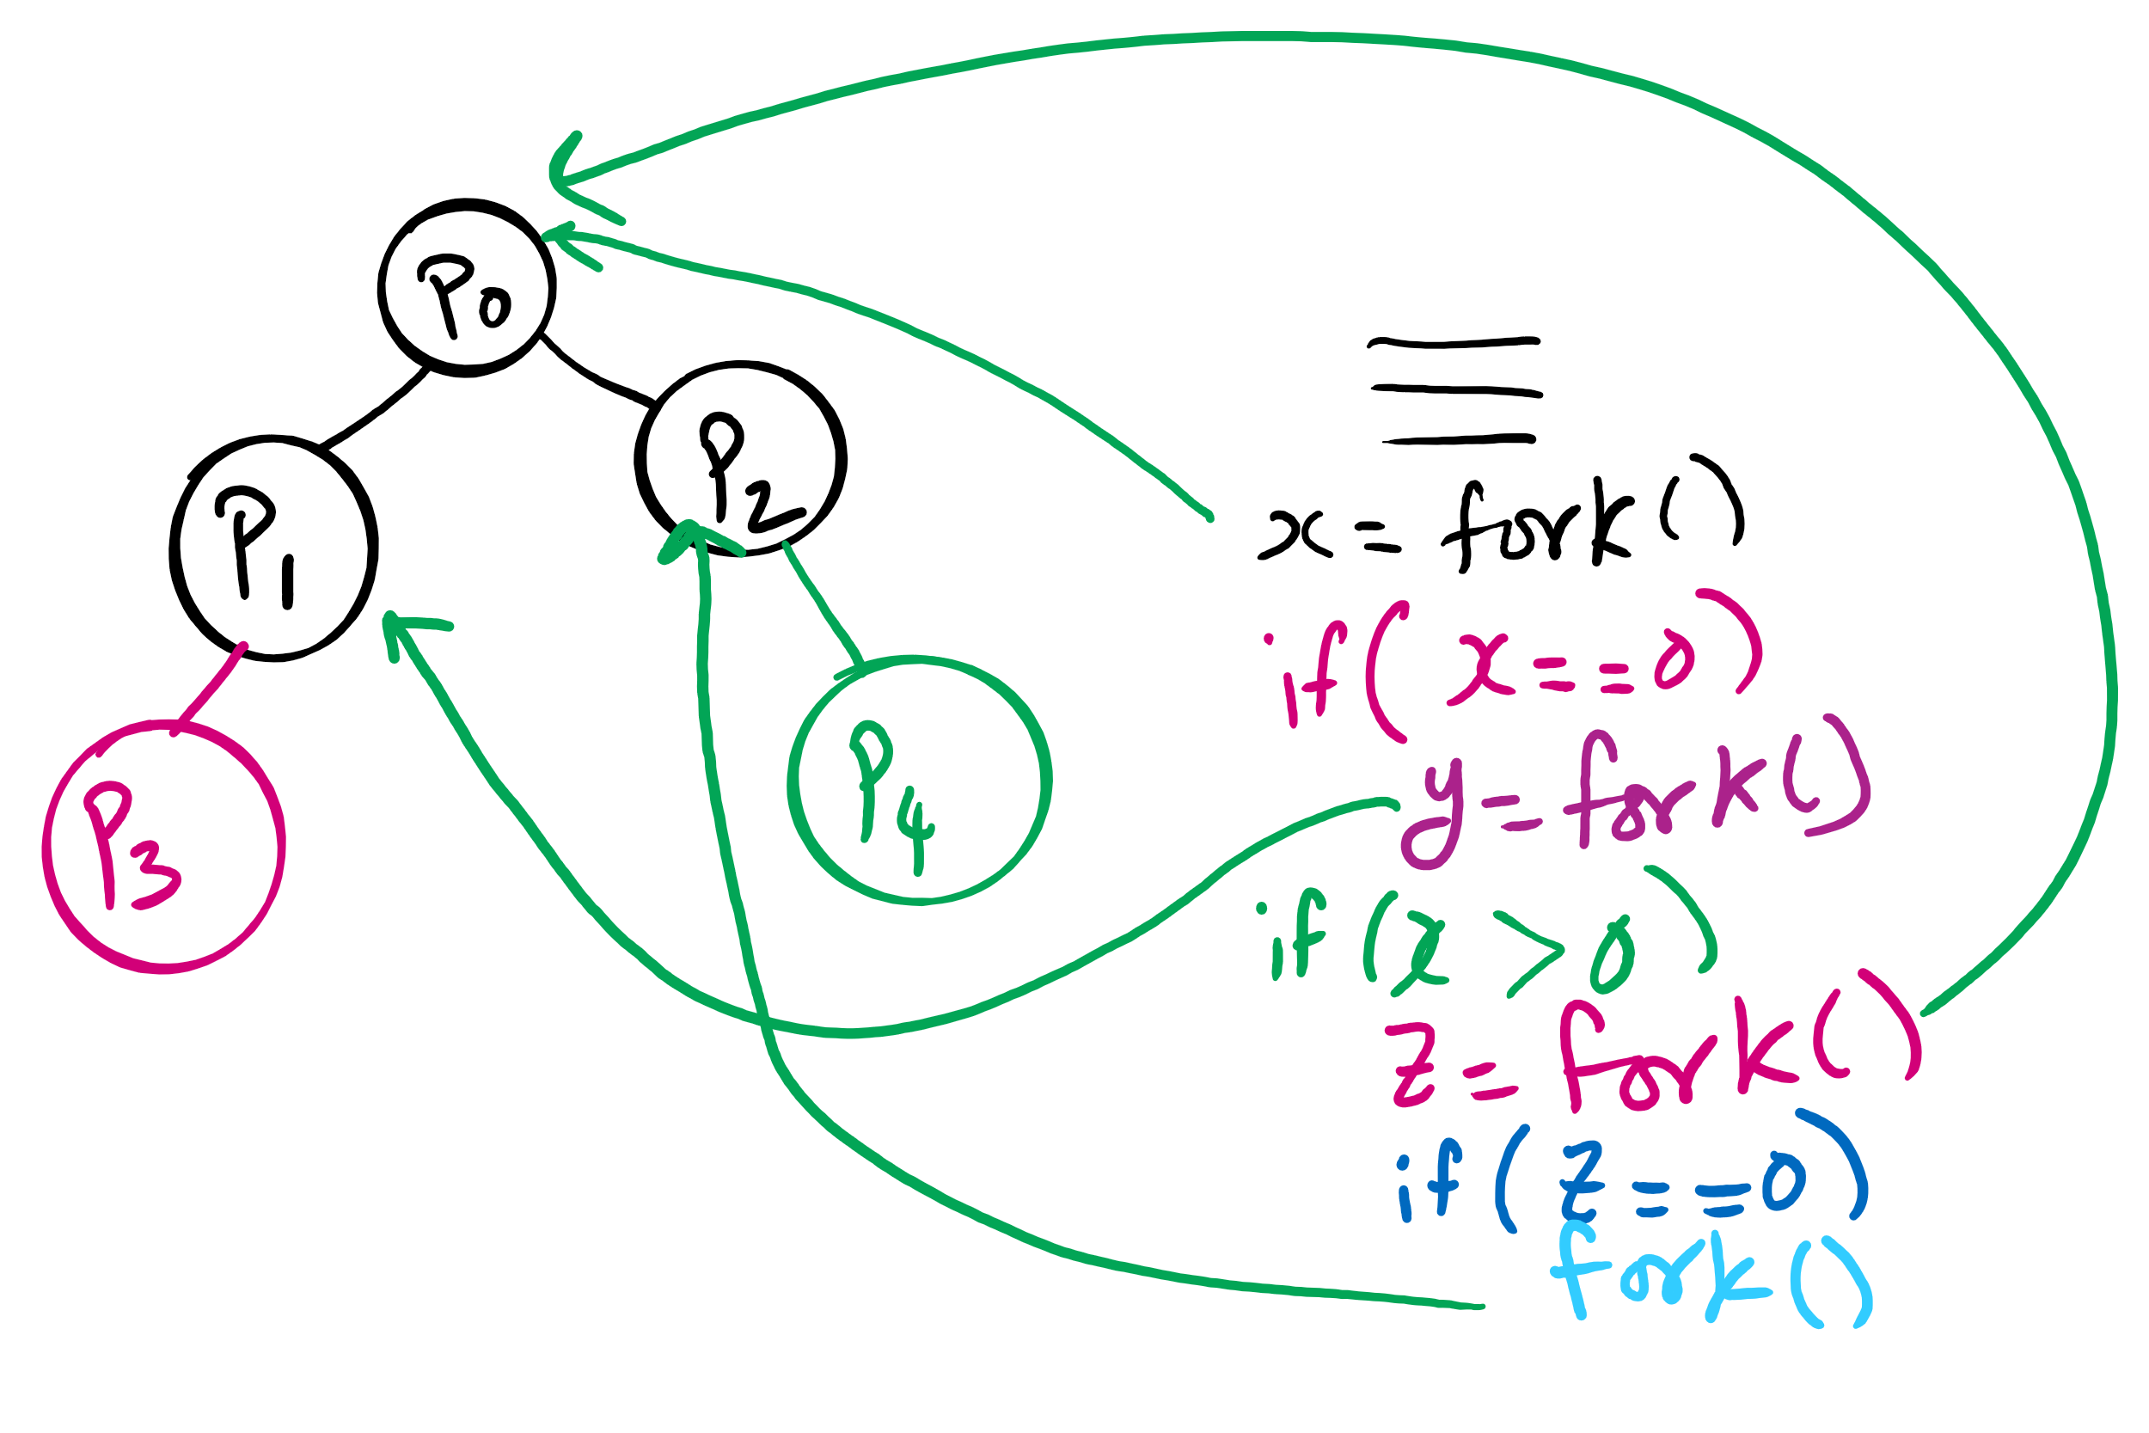
fork()’s of fork()’s

Slide 27
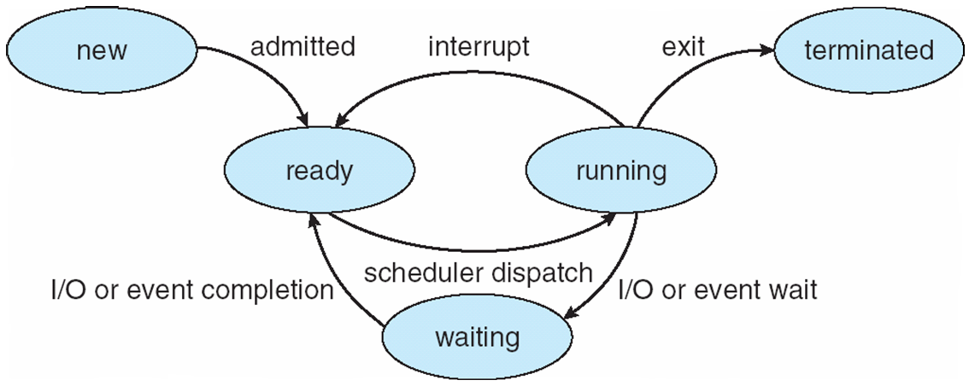
Process Lifecycle (AKA Process States)

Slide 28
Process Termination
Via exit() or abort() syscalls
The parent process may wait for termination of a child process by using the wait()system call.The call returns status information and the pid of the terminated process
pid = wait(&status);
When a process terminates
If no parent waiting (did not invoke wait()) process is a zombie
If parent terminated without invoking wait , process is an orphan
adopted by the init process

Slide 29
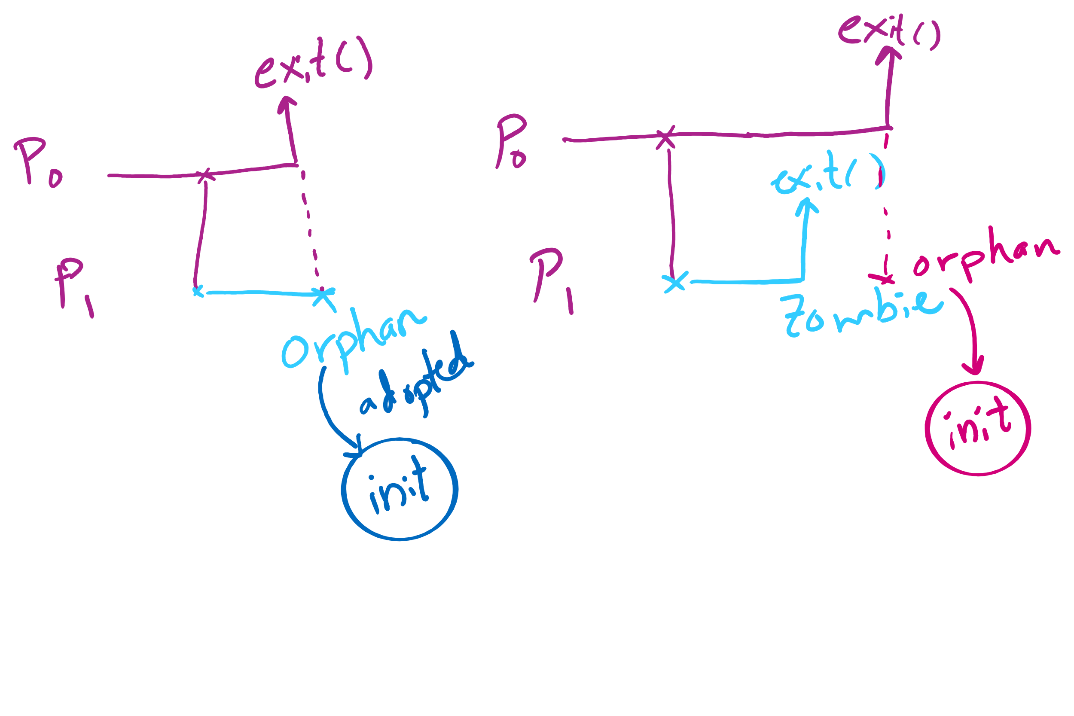
Orphan vs. Zombie Processes

Slide 30
Benefits of Orphan Processes
Allow a long-running job to continue running even after session (e.g., ssh connection) ends.
The nohup command does that
Create daemon processes
Long-running background processes adopted by the init process.

Slide 31
Xv6 Code Walkthrough
fork()
exit()
wait()

Slide 32
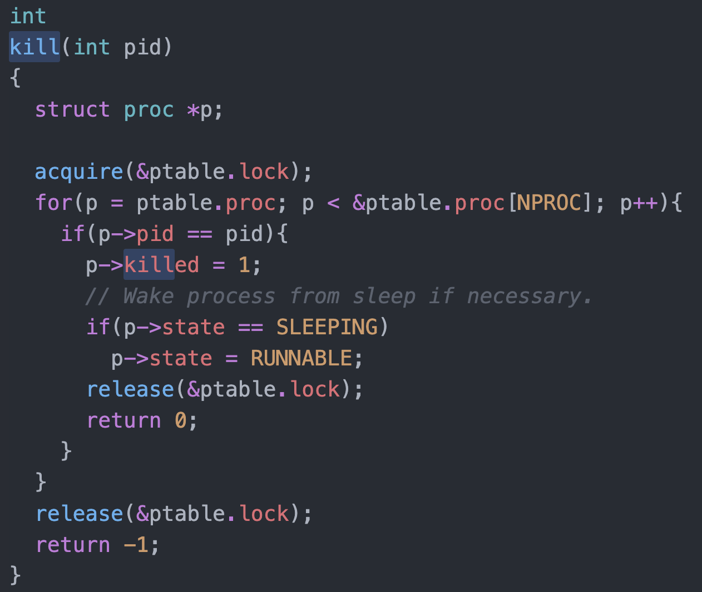
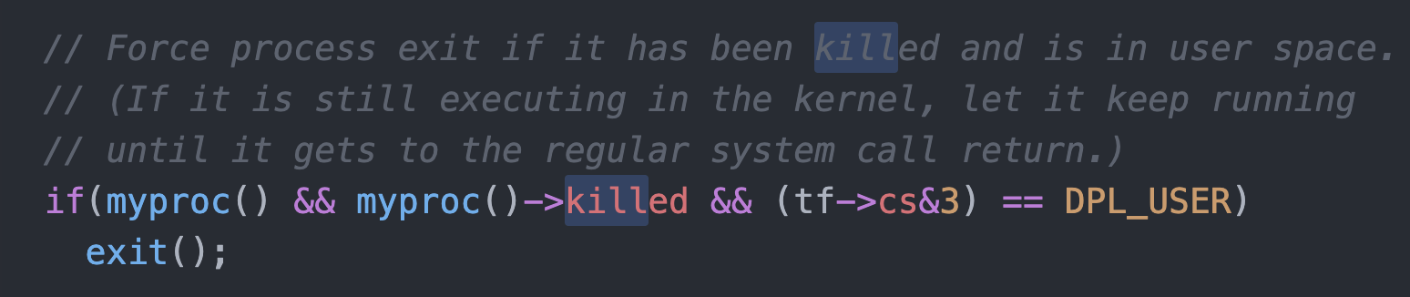
Killing a waiting process

