Slide 1

Introduction to Operating Systems CS/COE 1550
Spring 2022
Sherif Khattab
ksm73@pitt.edu
(Some slides are from Silberschatz, Galvin and Gagne ©2013)

Slide 2
Announcements
Upcoming deadlines:
Homework 3: due on 10/1
Please make good use of the office hours of the entire teaching team. We are all here to help you.

Slide 3
Last Lecture …
Semaphore Implementation
Monitors and Condition Variables

Slide 4
Condition variables in monitors
Problem: how can a process wait inside a monitor?
Can’t simply sleep: there’s no way for anyone else to enter
Solution: use a condition variable
Condition variables support two operations
Wait(): suspend this process until signaled
Signal(): wake up exactly one process waiting on this condition variable
If no process is waiting, signal has no effect
Signals on condition variables aren’t “saved up”
Different from semaphores!
Condition variables are only usable within monitors
Process must be in monitor to signal on a condition variable

Slide 5
Locks & condition variables
Monitors require native language support
What if native support is not there (e.g., in C)?
Provide monitor support using special data types and procedures
Locks (Acquire(), Release())
Condition variables (Wait(), Signal())
Lock usage
Acquiring a lock == entering a monitor
Releasing a lock == leaving a monitor
Condition variable usage
Each condition variable is associated with exactly one lock
Lock must be held to use condition variable
Waiting on a condition variable releases the lock implicitly and reacquires the lock upon returning

Slide 6
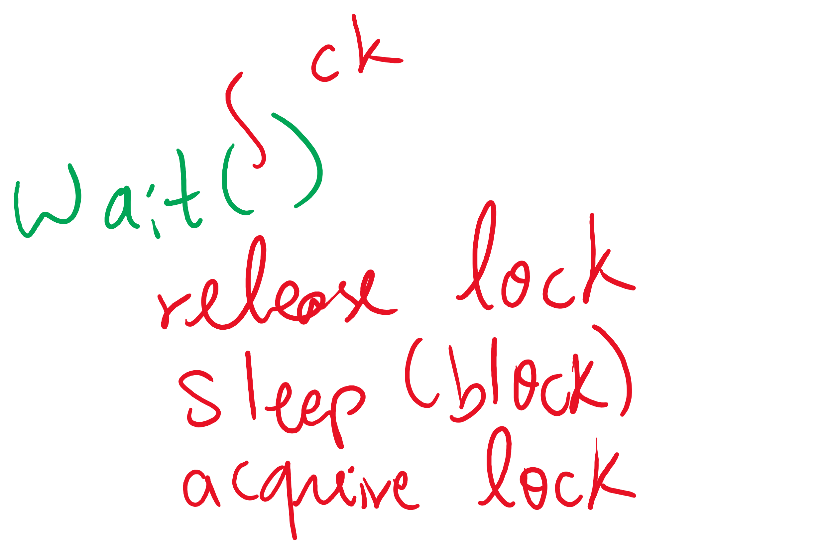


The three steps of the wait() operation

Slide 7
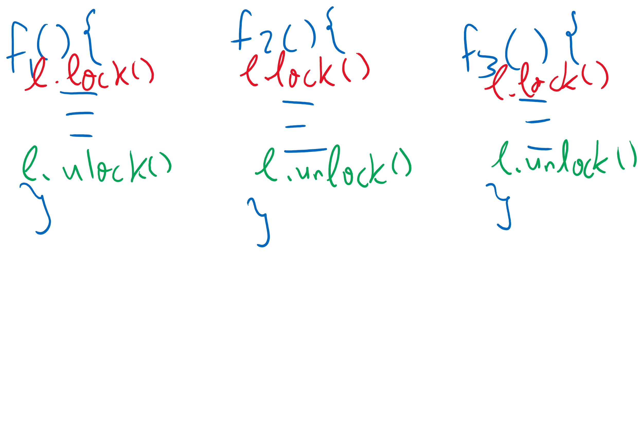
Adding Monitors in C

Slide 8
Monitor semantics
Question: which process gets the monitor after Signal()?
Problem: P signals on condition variable X, waking Q
Both can’t be active in the monitor at the same time
Which one continues first?
Mesa semantics
Signaling process (P) continues first
Q resumes when P leaves the monitor
Seems more logical: why suspend P when it signals?
Hoare semantics
Awakened process (Q) continues first
P resumes when Q leaves the monitor
May be better: condition that Q wanted may no longer hold when P leaves the monitor

Slide 9
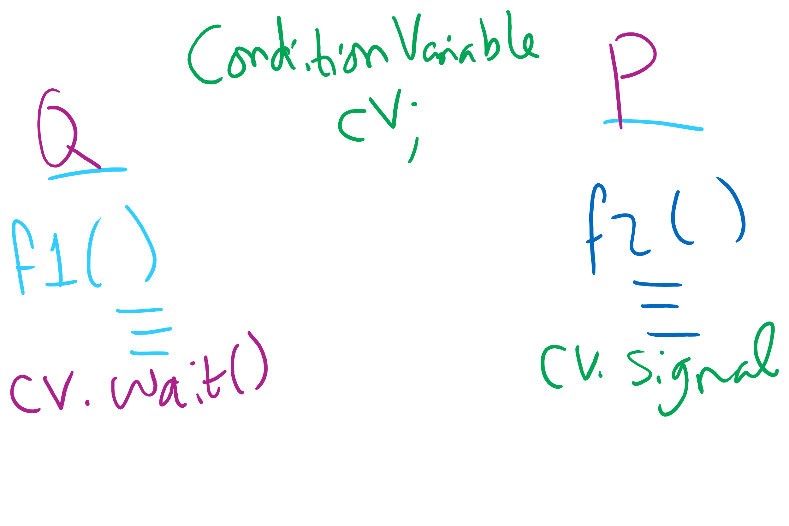
Signaling and Signaled Processes

Slide 10
Condition Variables wait()
Use a while loop around the wait()
While(some condition)
condvar.wait();
Why??
Think Mesa semantics!
Spurious wakeups

Slide 11
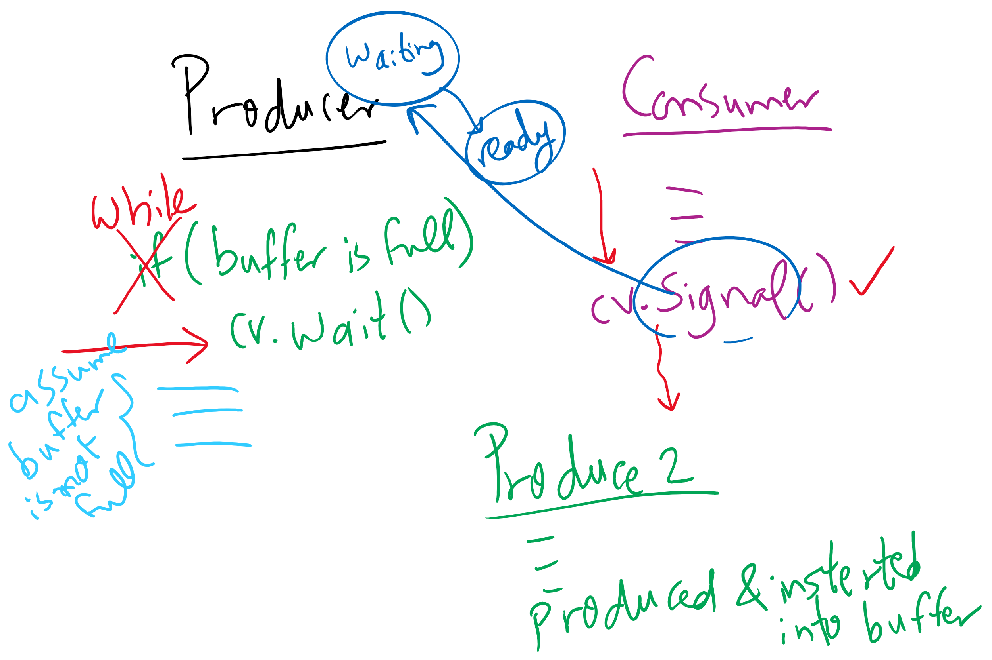
Using while instead of if with wait()

Slide 12
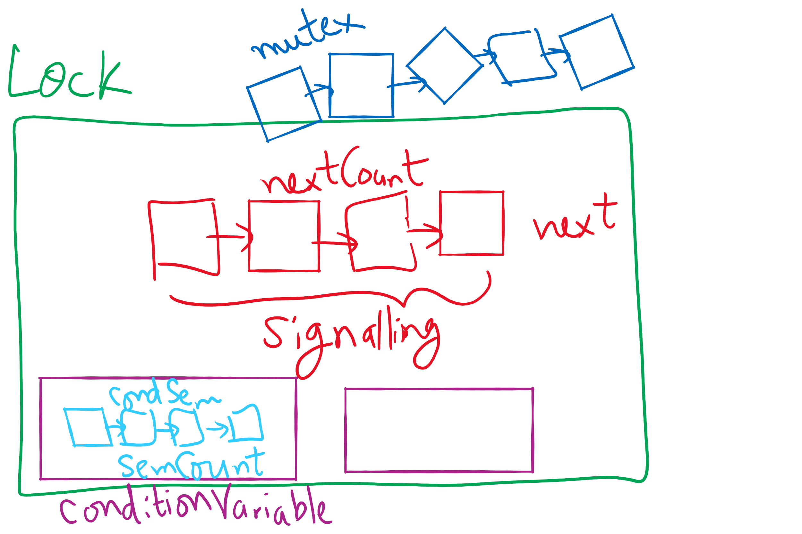
Lock and Condition Variable Implementation

Slide 13
Implementing locks with semaphores
Use mutex to ensure exclusion within the lock bounds
Use next to give lock to processes with a higher priority (why?)
nextCount indicates whether there are any higher priority waiters
class Lock {
Semaphore mutex(1);
Semaphore next(0);
int nextCount = 0;
};
Lock::Acquire()
{
mutex.down();
}
Lock::Release()
{
if (nextCount > 0)
next.up();
else
mutex.up();
}

Slide 14
Implementing condition variables
Are these Hoare or Mesa semantics?
Can there be multiple condition variables for a single Lock?
class Condition {
Lock *lock;
Semaphore condSem(0);
int semCount = 0;
};
Condition::Signal ()
{
if (semCount > 0) {
lock->nextCount += 1;
condSem.up ();
lock->next.down ();
lock->nextCount -= 1;
}
}
Condition::Wait ()
{
semCount += 1;
if (lock->nextCount > 0)
lock->next.up();
else
lock->mutex.up();
condSem.down ();
semCount -= 1;
}

