Slide 1

Introduction to Operating Systems CS/COE 1550
Fall 2021
Sherif Khattab
ksm73@pitt.edu
(Some slides are from Silberschatz, Galvin and Gagne ©2013)

Slide 2
Announcements
Homework 2 is due this Friday at 11:59 pm
Lab 1 is due on 9/20 at 11:59 pm
Using GitHub Classroom
Explained in last week’s recitation
TA Office hours available on the syllabus page
Project 1 is up on Canvas
Docker images are available on Canvas
Tophat questions of the previous two lectures are assigned as homework

Slide 3
Anouncements
Michael G. Wells Competition
https://www.innovation.pitt.edu/michael-g-wells-competition/
Games 4 Social Impact Hackathon
https://www.games4socialimpact.pitt.edu/
Get (Re)involved on Campus
https://www.pitt.edu/pittwire/features-articles/get-reinvolved-campus

Slide 4
Last Lecture …
Context Switching
Process Creation using the fork() syscall

Slide 5
Muddiest Points
How the heap/code/static/stack memory of processes are switched/kept track of.
Can you explain again how hardware contains multiple sets of registers to facilitate context switches?
Always have trouble drawing the forking diagrams
Do two processes ever actually run at the same time or are they really just switching so rapidly that it appears that they do
Is there a priority with which processes waiting longer are chosen first or is it just the first process seen that gets executed?
Is there a limit to how many PCBs a single CPU core can have?
the last question: it is possible for a cpu to execute process in non-privileged mode immediately after privileged mode?
Is a process that has 5 states and cannot skip the next states the most optimal way that was figured out by the programmers? What other way did they try when they were building the operating system?
If parent have a variable. If its fork() child change it, does parent variable changed?
why does the scheduler point to the context of the scheduler instead of a 'proc' struct (if the scheduler is a process like any other)
What happens to an orphan process? Does it just stay alive and take up resources?

Slide 6
Muddiest points
When a child process calls fork, is it assigned a new pid, and is that reflected in its parent process?
Fork, and all the pcb and how it switches. Even though you said you’d never ask about it
short term vs long term scheduling purposes
Does the medium term scheduler conflict with the long term scheduler? (with swapping in and out)
forking multiple times / do all processes have a common parent if you travel backwards far enough?
the animation was a bit confusing, I was lost while trying to follow along and not sure which are things to focus on and relevant for this class
Can you make a high-level list for the steps of context switching?
what does myproc() return: is it just a pointer to the current proc?
How do you tell if a parent and child are executing concurrently, or if the parent waits until the child terminates.
Can you explain how a parent process uses wait()
if you call fork() twice in a row so that each process forks again, does each process have a completely separate Id that you can track?
Does the init process ever wait on collected orphans to clear away zombies?
Was confused about the return value == 0 in the fork diagram tree

Slide 7
Why do we need Synchronization?
Each process operates sequentially
All is fine until processes want to share data
Exchange data between multiple processes
Allow processes to navigate critical regions
Maintain proper sequencing of actions in multiple processes
These issues apply to threads as well
Threads can share data easily (same address space)
Other two issues apply to threads

Slide 8
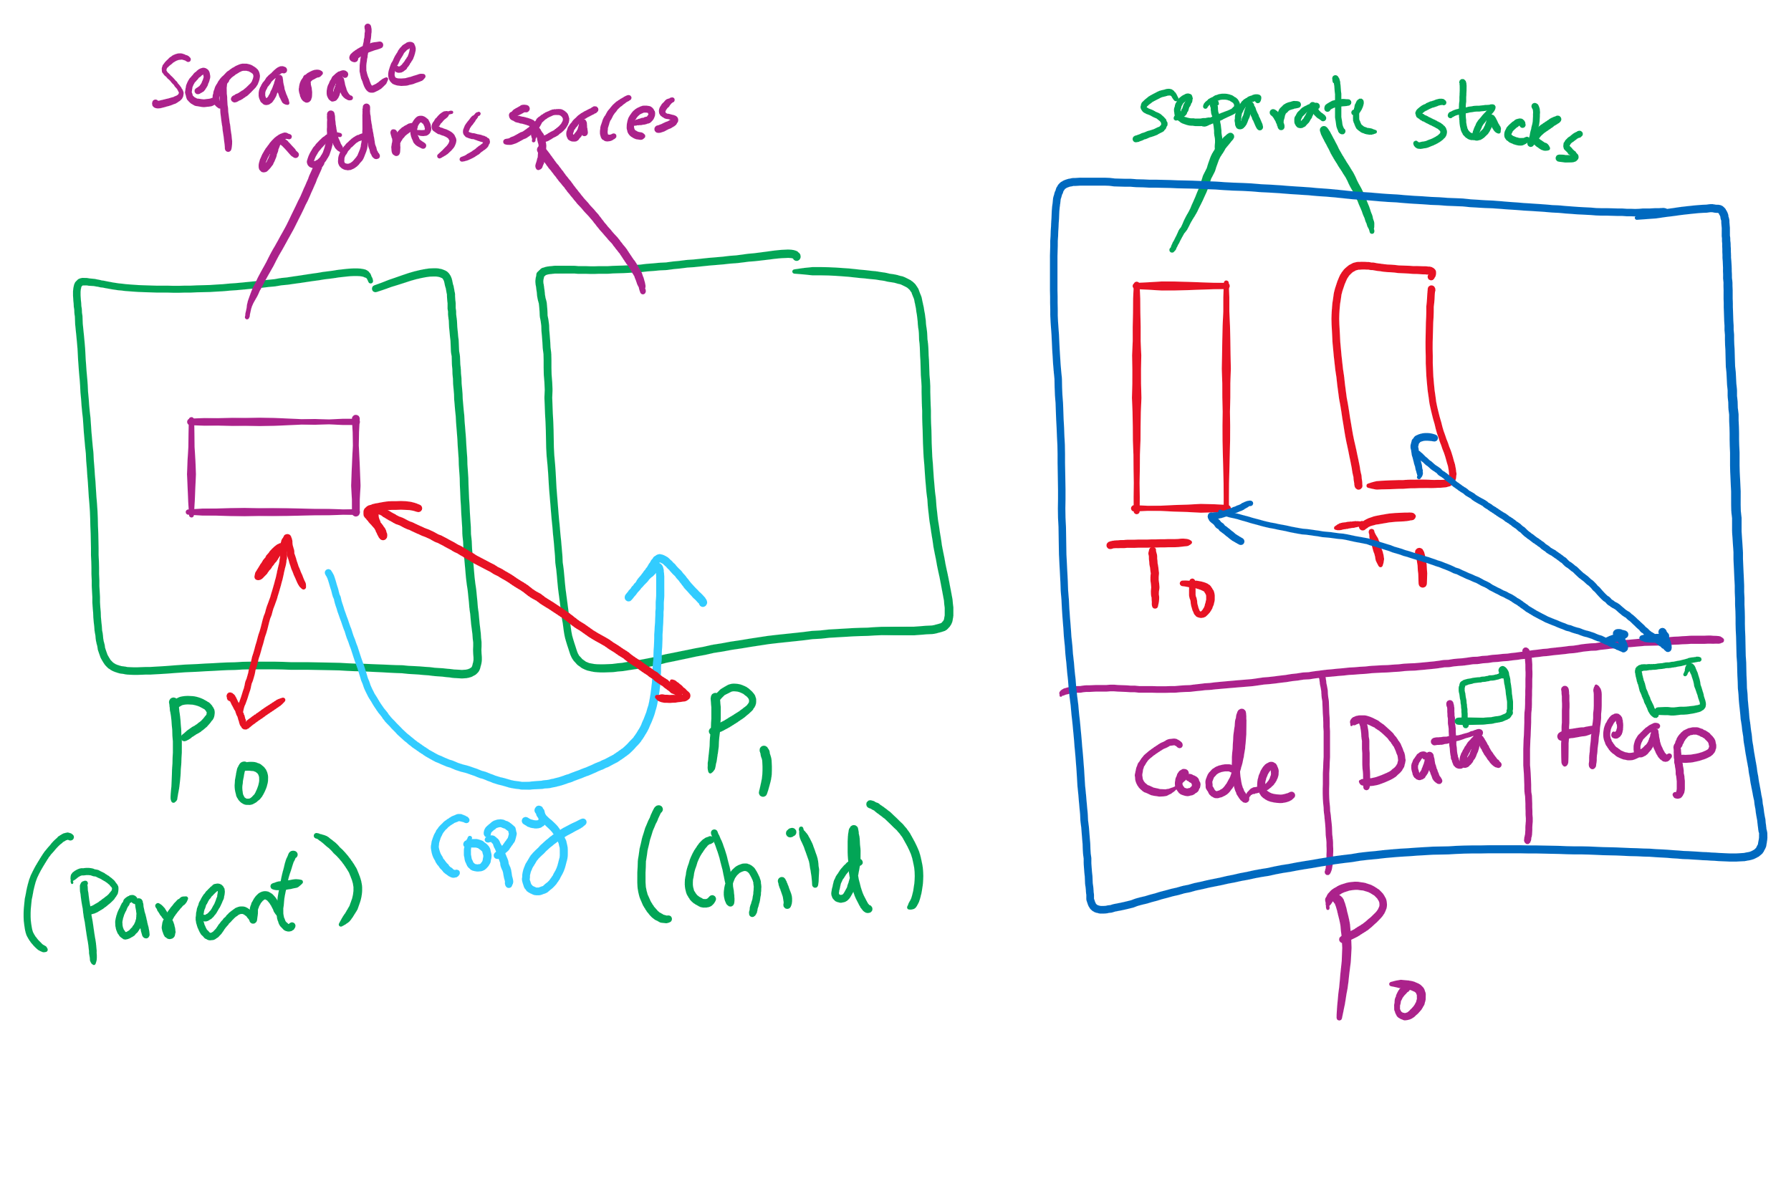
Process vs. Thread

Slide 9
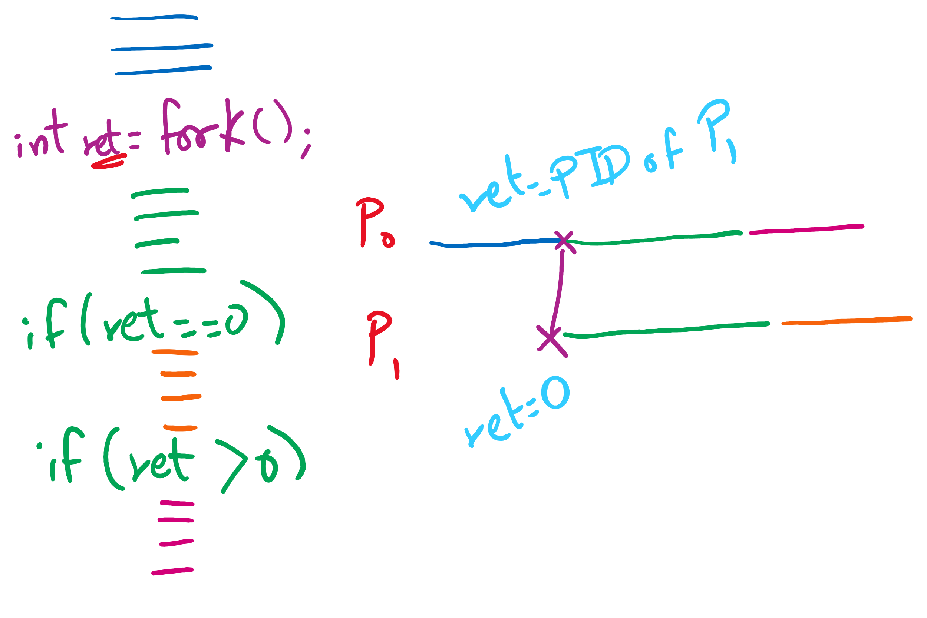
fork() tracing

Slide 10
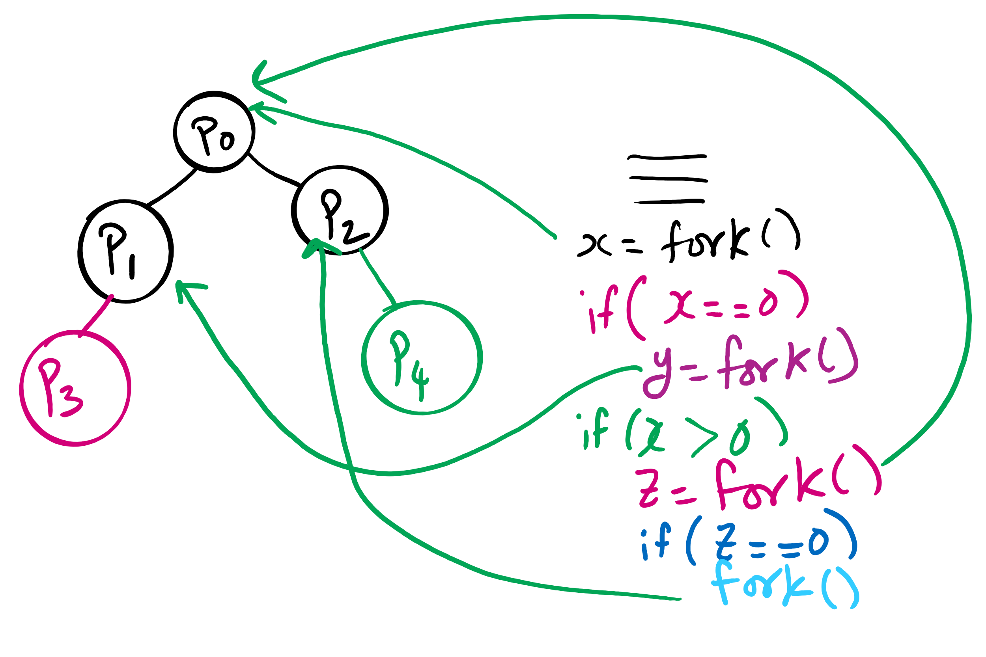
fork()’s of fork()’s

Slide 11
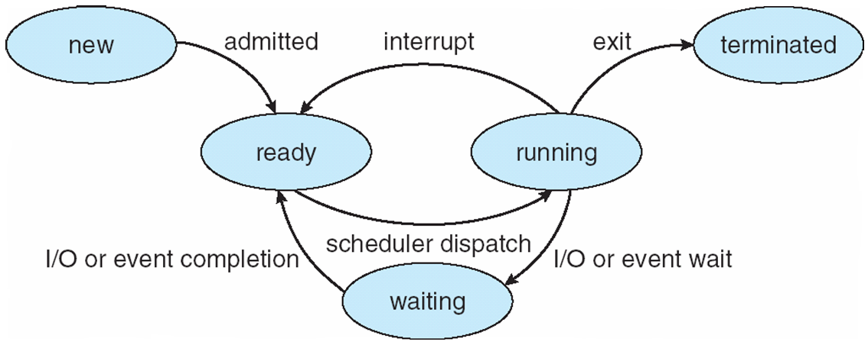
Process Lifecycle (AKA Process States)

Slide 12
Process Termination
Via exit() or abort() syscalls
The parent process may wait for termination of a child process by using the wait()system call.The call returns status information and the pid of the terminated process
pid = wait(&status);
When a process terminates
If no parent waiting (did not invoke wait()) process is a zombie
If parent terminated without invoking wait , process is an orphan
adopted by the init process

Slide 13
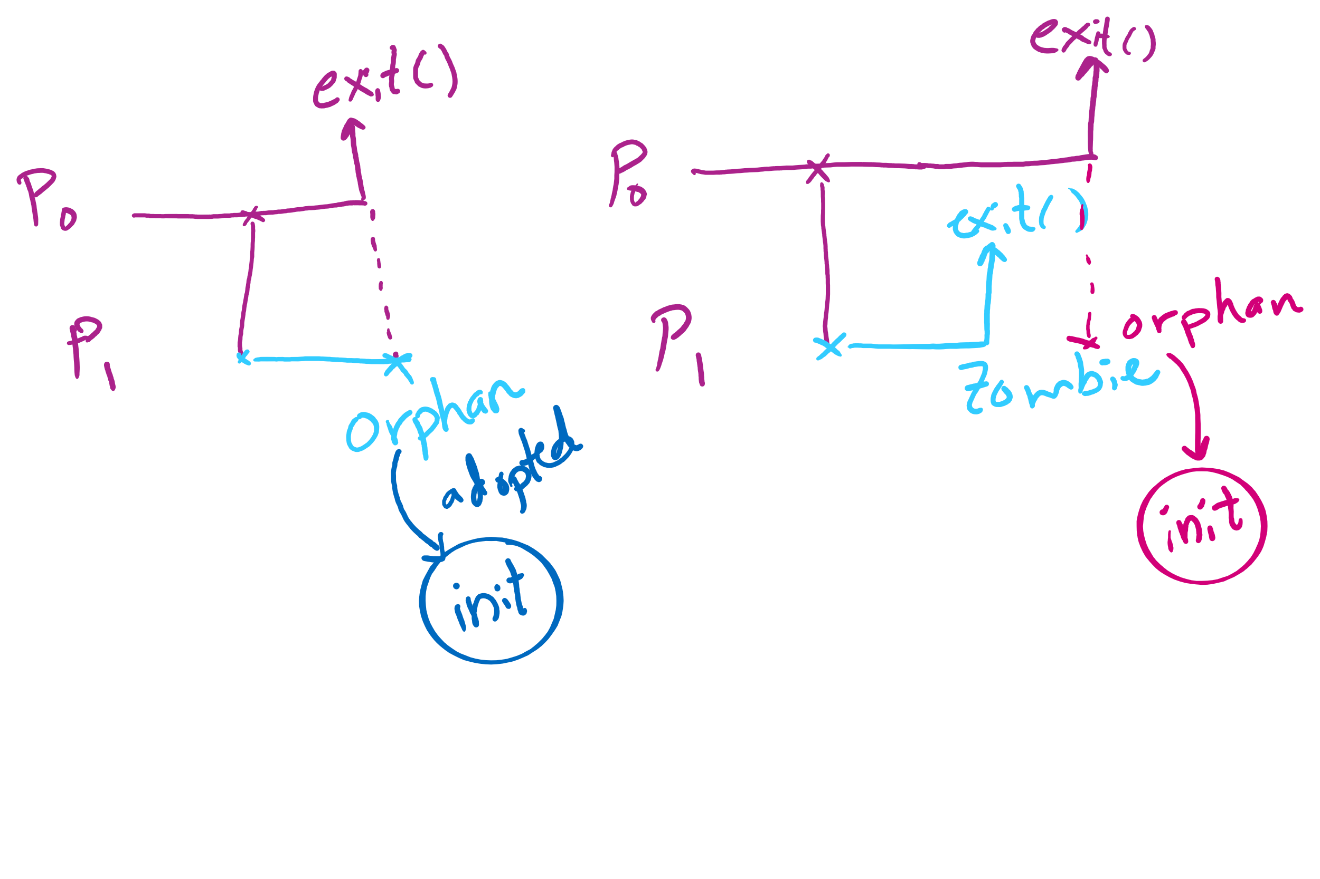
Orphan vs. Zombie Processes

Slide 14
Benefits of Orphan Processes
Allow a long-running job to continue running even after session (e.g., ssh connection) ends.
The nohup command does that
Create daemon processes
Long-running background processes adopted by the init process.

Slide 15
Xv6 Code Walkthrough
fork()
exit()
wait()

Slide 16
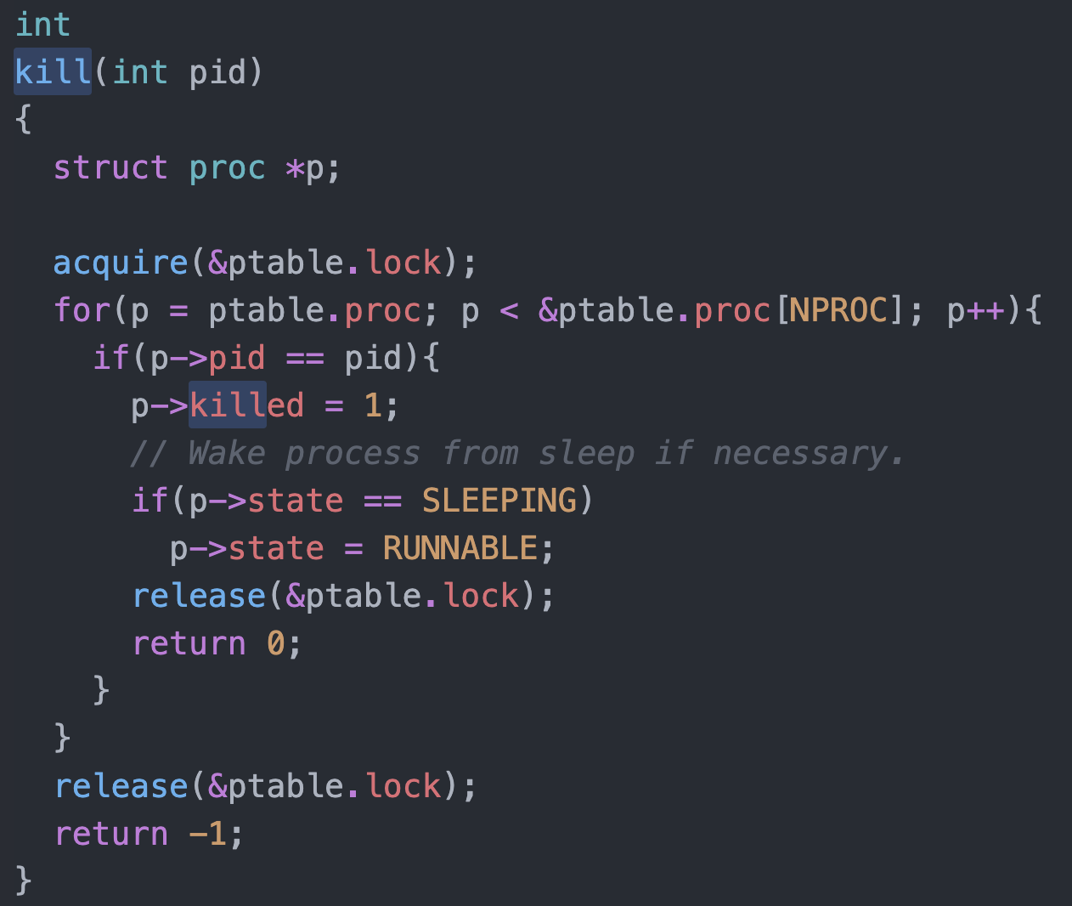
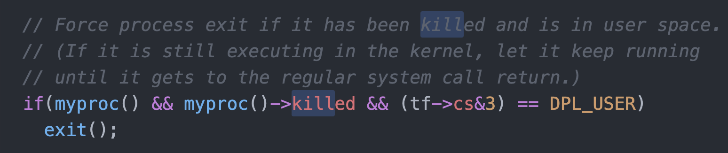
Killing a waiting process

Slide 17
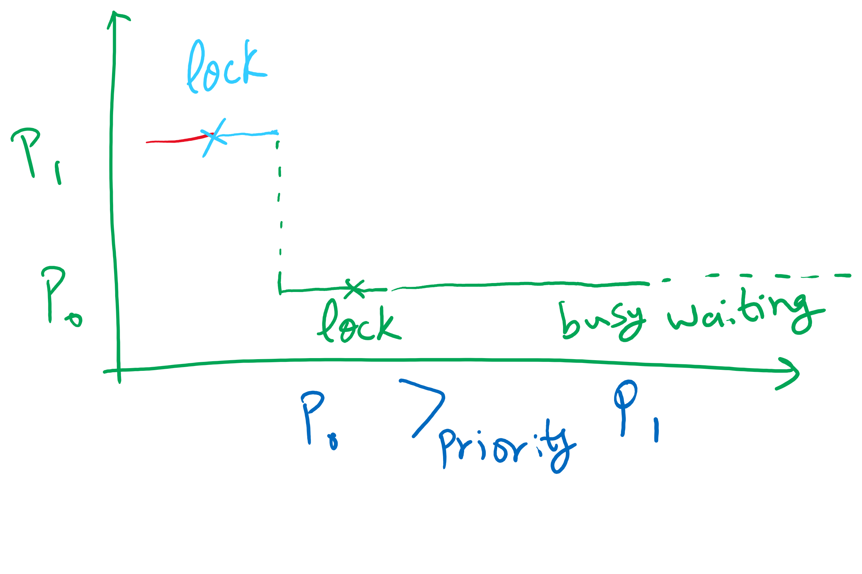
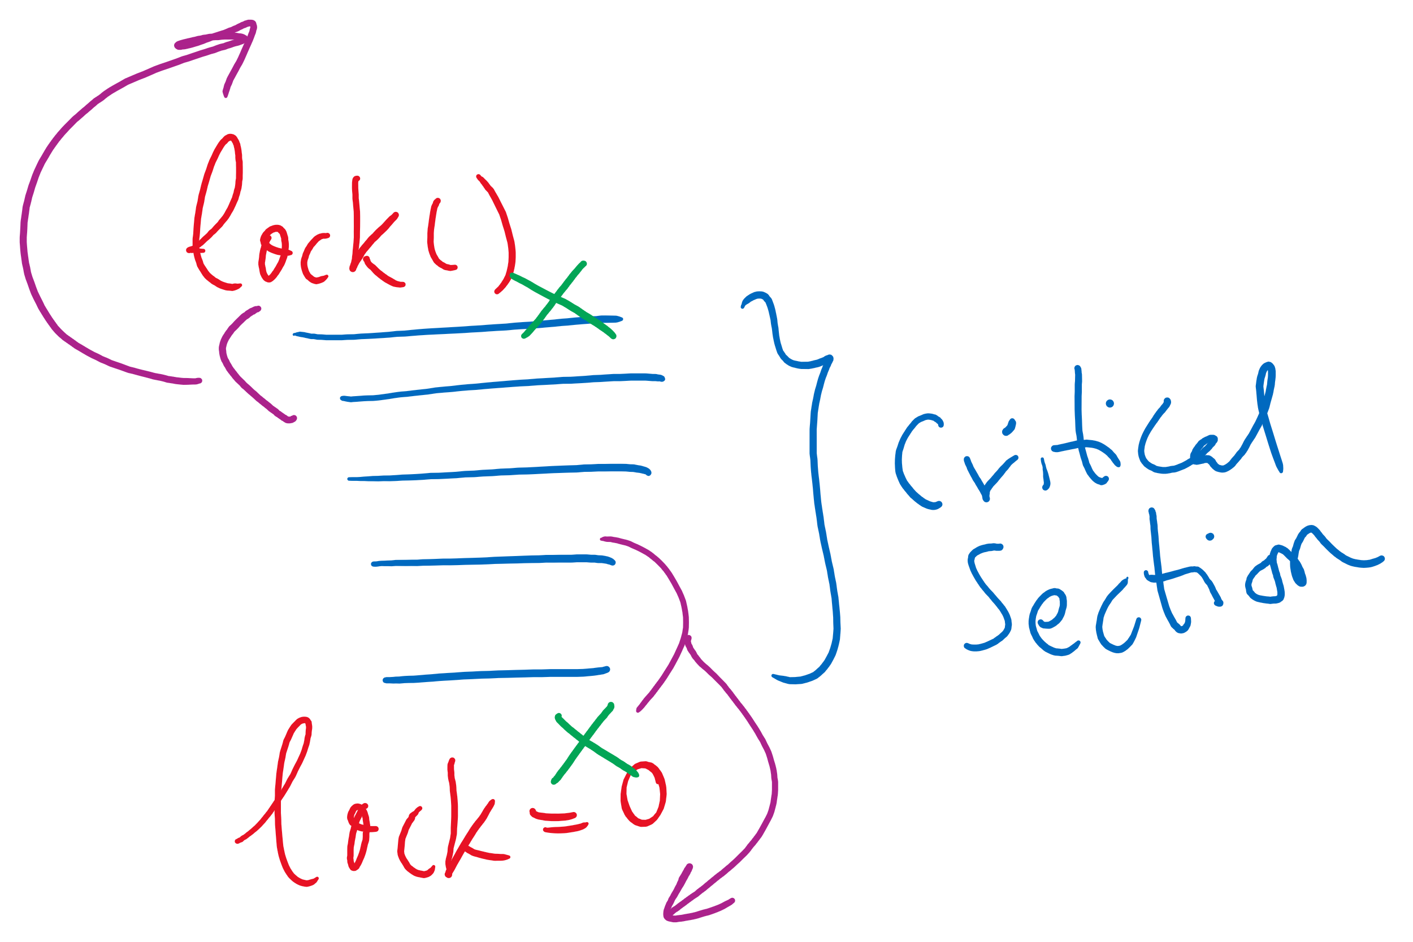


Implications of Busy Waiting
Subproblem: priority inversion (higher priority process waits for lower priority process)
Subproblem 2: compiler and/or hardware instruction reordering

Slide 18
Semaphores for general synchronization
We want to execute B in P1 only after A executes in P0
Use a semaphore initialized to 0
Use up() to notify P1 at the appropriate time
Shared variables
// flag initialized to 0
Semaphore flag(0);
Process P₀
.
.
.
// Execute code for A
flag.up ();
Process P₁
.
.
.
flag.down ();
// Execute code for B

Slide 19
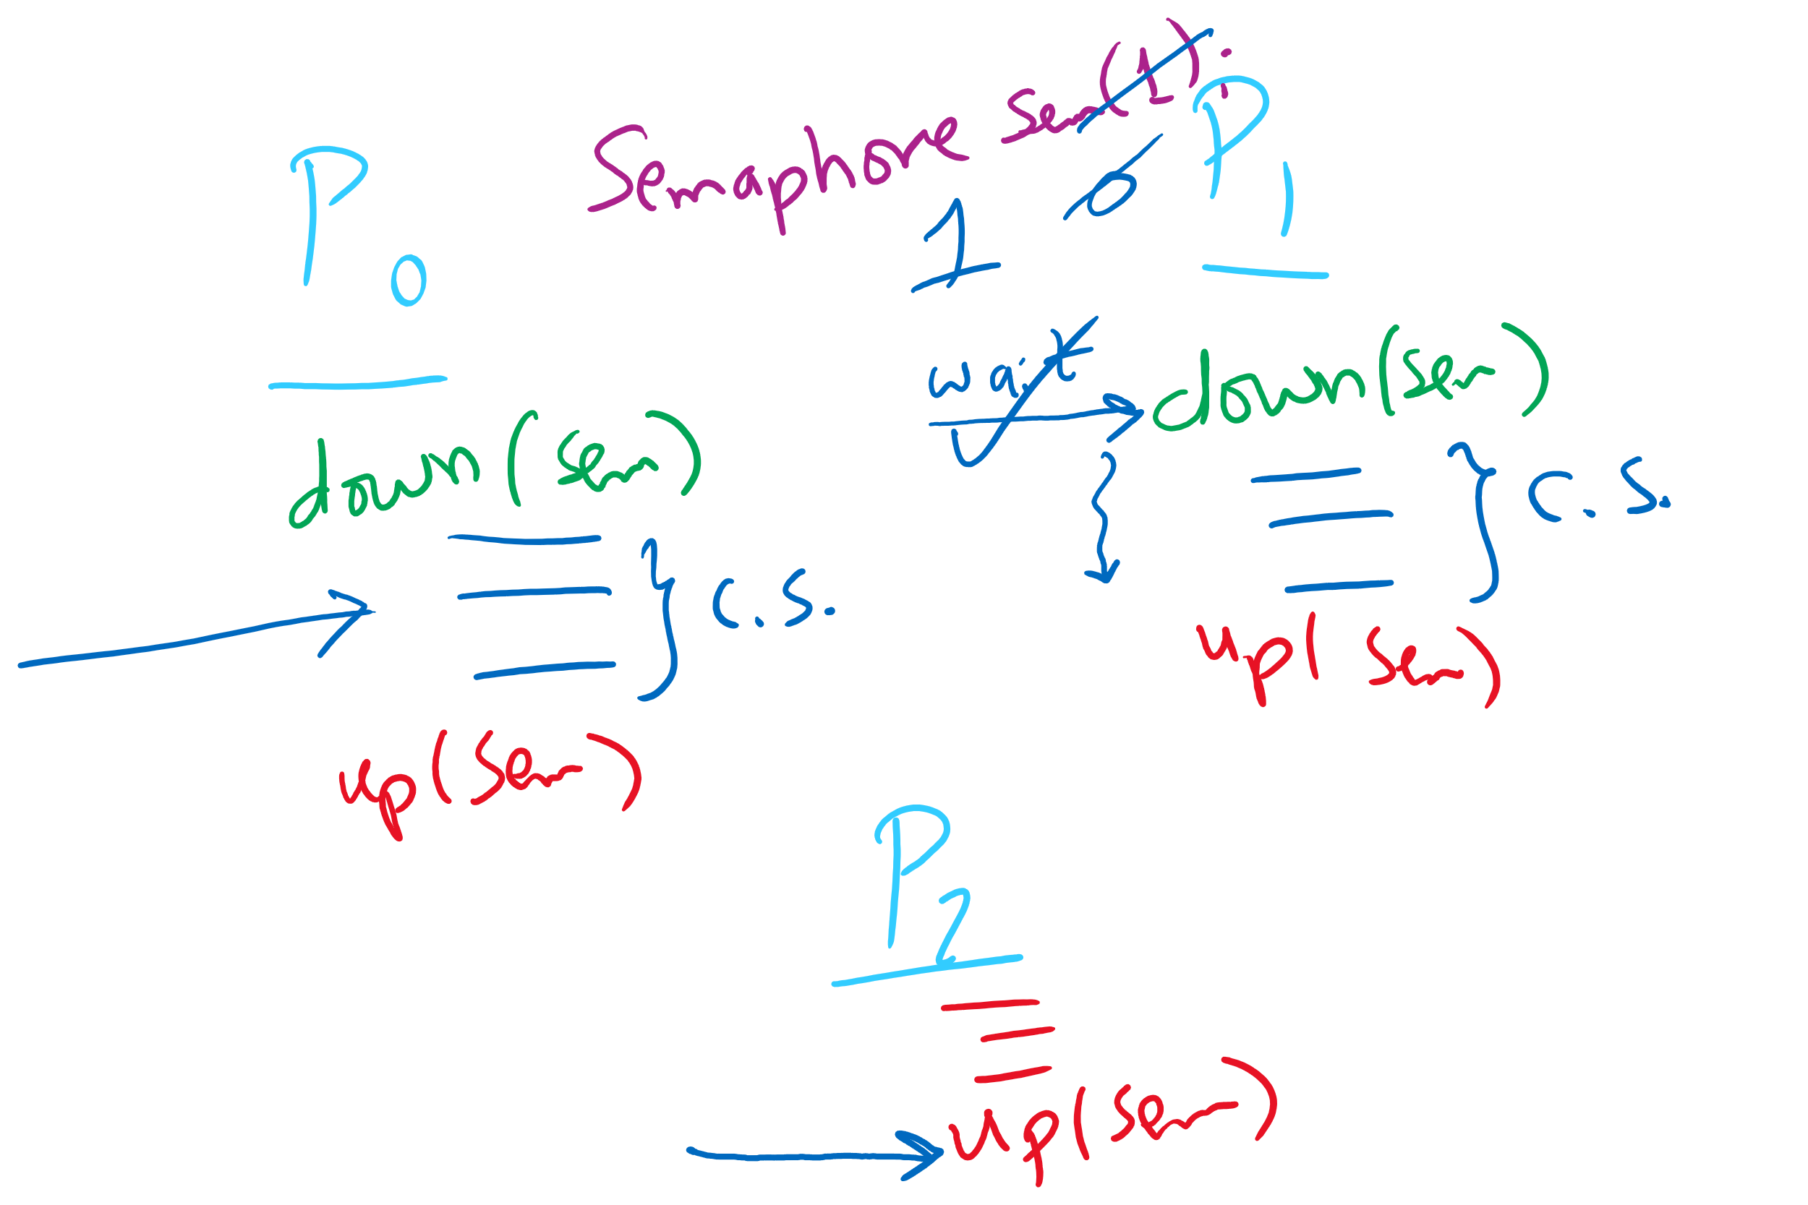
Semaphore Usage Problem: Compromising Mutual Exclusion
Any process can up() the semaphore
Solution: A Mutex can be up()’d only by the same process that down()’d it

Slide 20
Semaphore Usage Problem: Deadlock and Starvation
Deadlock: two or more processes are waiting indefinitely for an event that can only be caused by a waiting process
P0 gets A, needs B
P1 gets B, needs A
Each process waiting for the other to signal
Starvation: indefinite blocking
Process is never removed from the semaphore queue in which its suspended
May be caused by ordering in queues (priority)
Shared variables
Semaphore A(1),B(1);
Process P₀
A.down();
B.down();
.
.
.
B.up();
A.up();
Process P₁
B.down();
A.down();
.
.
.
A.up();
B.up();

Slide 21
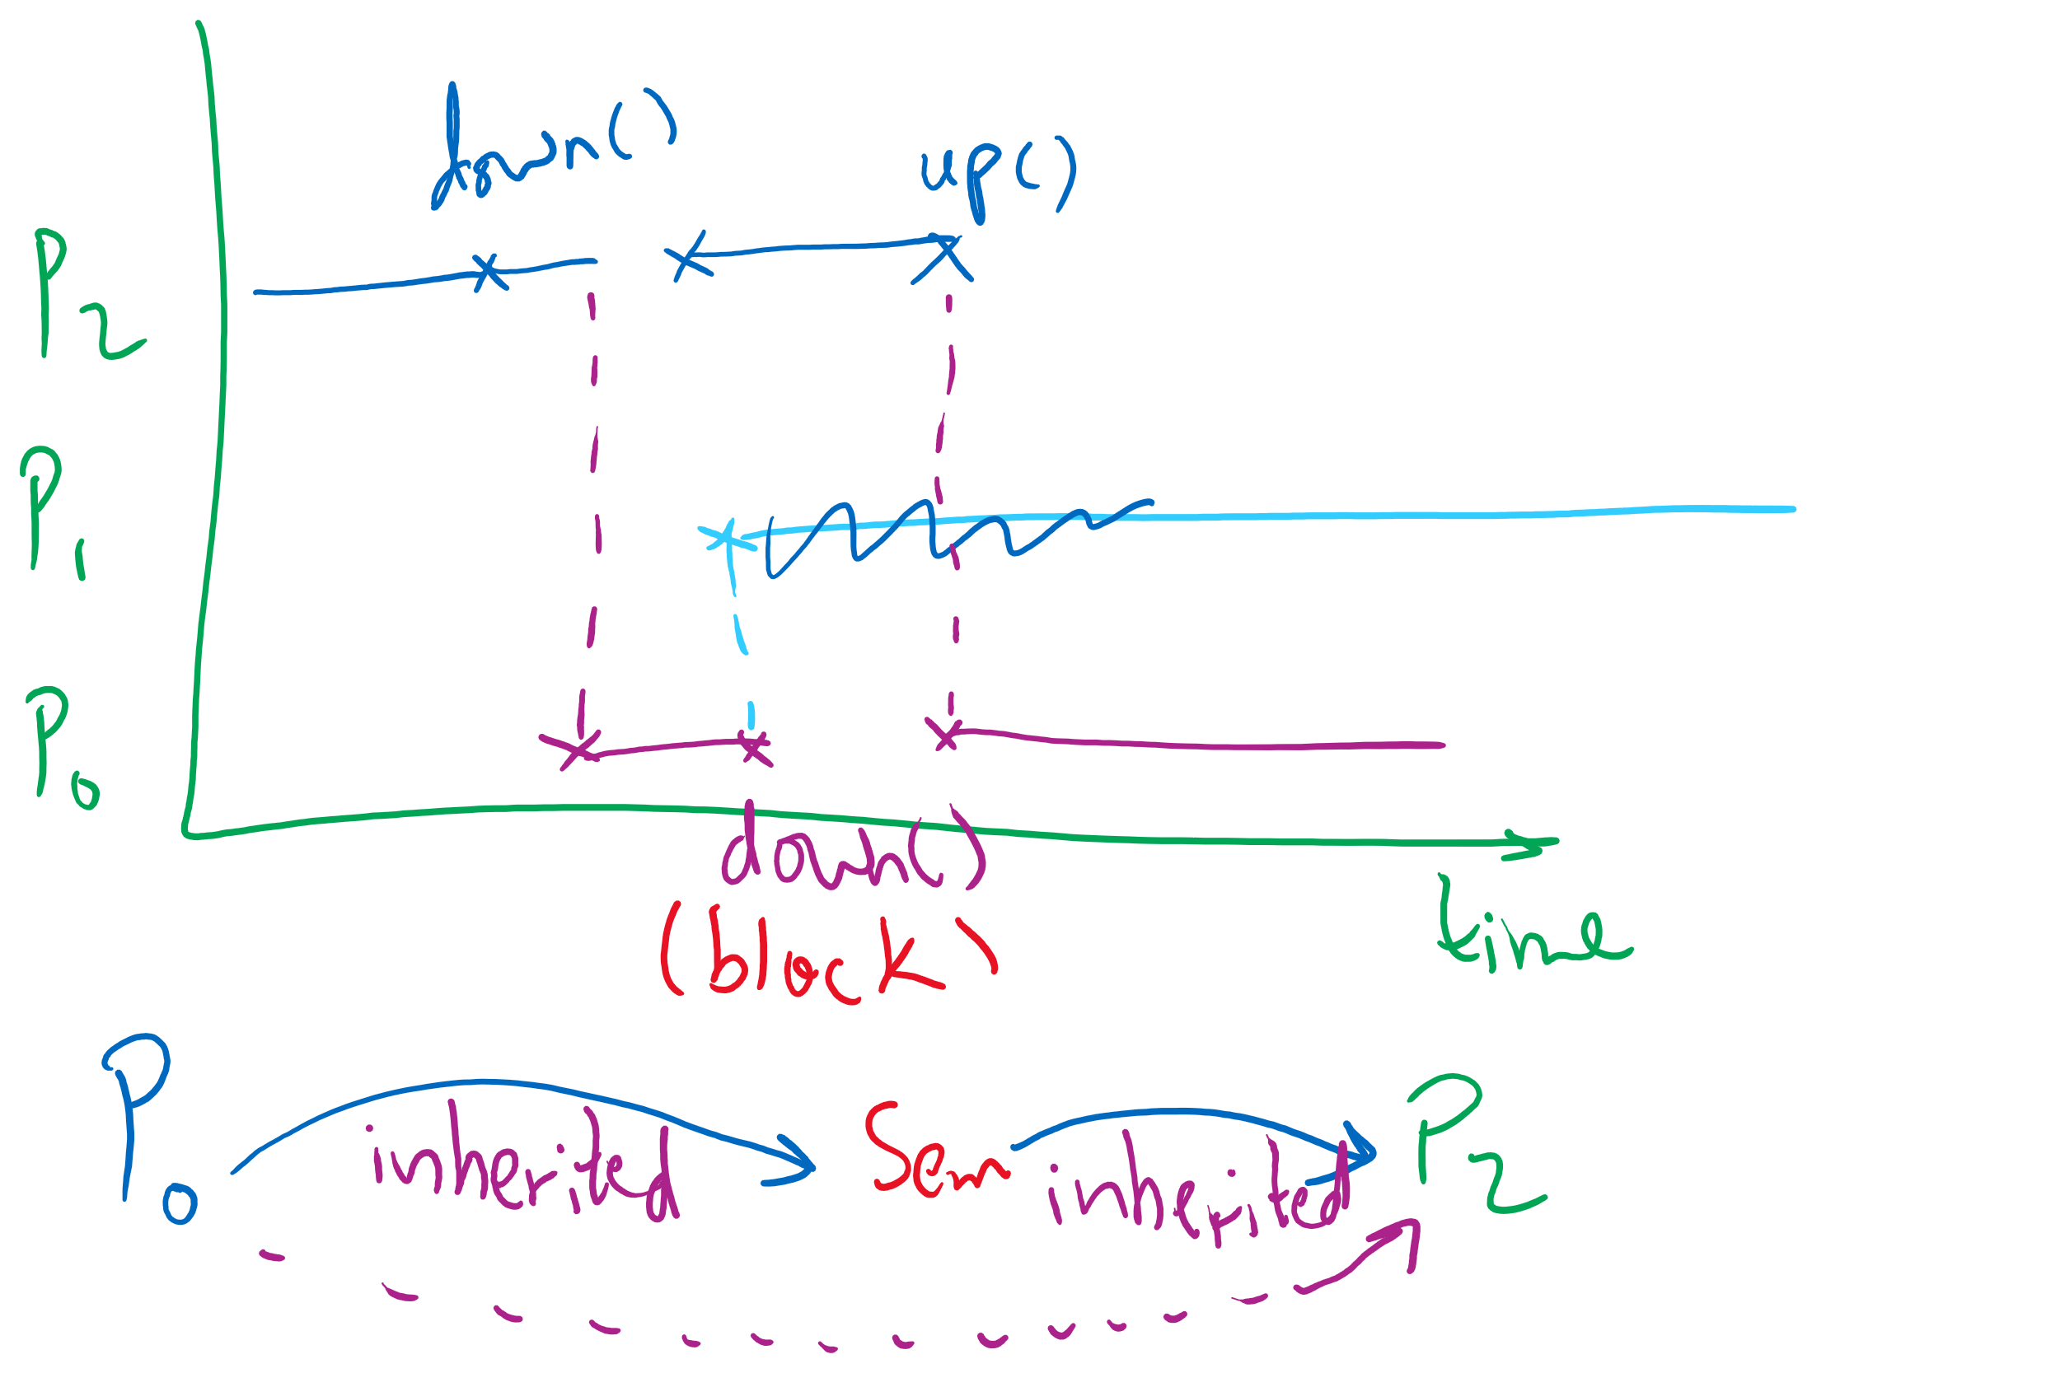
Semaphore Usage Problem: Priority Inversion
Priority inversion is still possible using semaphores
Slightly less likely
Needs at least three processes

