Slide 1

Introduction to Operating Systems CS/COE 1550
Fall 2021
Sherif Khattab
ksm73@pitt.edu
(Some slides are from Silberschatz, Galvin and Gagne ©2013)

Slide 2
Announcements
Upcoming deadlines:
Project 2: due on 10/22

Slide 3
Last Lecture …
Deadlock
Modeling using Resource Allocation Graph
Four conditions of deadlock
Deadlock detection

Slide 4
Muddiest Points
does this same algorithm for sleeping barber work if there are multiple barbers/barber chairs?
when you say that UNIX/Windows ignore deadlocks, do you mean within the OS itself or for handling application deadlocks? i.e., is there a chance that Windows itself will just deadlock without me running any faulty programs?
what does a deadlock on windows look like to a user
Livelock
What is a livelock
livelocks and how we identify them compared to deadlocks
Can a livelock be solved with some adaptive code that recognizes it is in a live lock and fix itself through the various restarts
which is worse: livelock or deadlock?
How to stop a deadlock
How to reverse a deadlock

Slide 5
Muddiest Points (contd.)
Is detecting deadlocks that costly that programs wouldn't want to even do so?
Deadlock avoidance vs deadlock prevention
How high is the cost of prevention for deadlocks?
Does a circle anywhere in an R.A.G always mean there’s a deadlick
Is manual ( drawing on paper) is best way of checking for deadlocks in real life applications, or usually there is some code implementation that does the checks?
i still struggle to identify a possible deadlock situation by looking at code
Can we predict frequency of deadlocks?

Slide 6
Muddiest Points (contd.)
recap why deadlock detection has n^3 runtime not n^2
the l1, l2 l3 ... in the resource trajectory graph
Deadlock detection algorithms are expensive, shouldn't we just enforce a global ordering of resource requests?
How much does deadlock detection impact performance (what factors does its impact depend on)?

Slide 7
Detecting deadlocks using graphs
Process holdings and requests in the table and in the graph (they’re equivalent)
Graph contains a cycle => deadlock!
Easy to pick out by looking at it (in this case)
Need to mechanically detect deadlock
Not all processes are deadlocked (A, C, F not in deadlock)
R
A
B
Process | Holds | Wants
A | R | S
B |  | T
C |  | S
D | U | S,T
E | T | V
F | W | S
G | V | U
C
S
D
T
E
F
U
V
W
G

Slide 8
Deadlock detection algorithm
General idea: try to find cycles in the resource allocation graph
Algorithm: depth-first search at each node
Mark arcs as they’re traversed
Build list of visited nodes
If node to be added is already on the list, a cycle exists!
Cycle == deadlock
Assuming one instance of each resource type
For each node N in the graph {
Set L = empty list
unmark all arcs
Traverse (N,L)
}
If no deadlock reported by now, there isn’t any
define Traverse (C,L) {
If C in L, report deadlock!
Add C to L
For each unmarked arc from C {
Mark the arc
Set A = arc destination
/* NOTE: L is a
local variable */
Traverse (A,L)
}
}

Slide 9
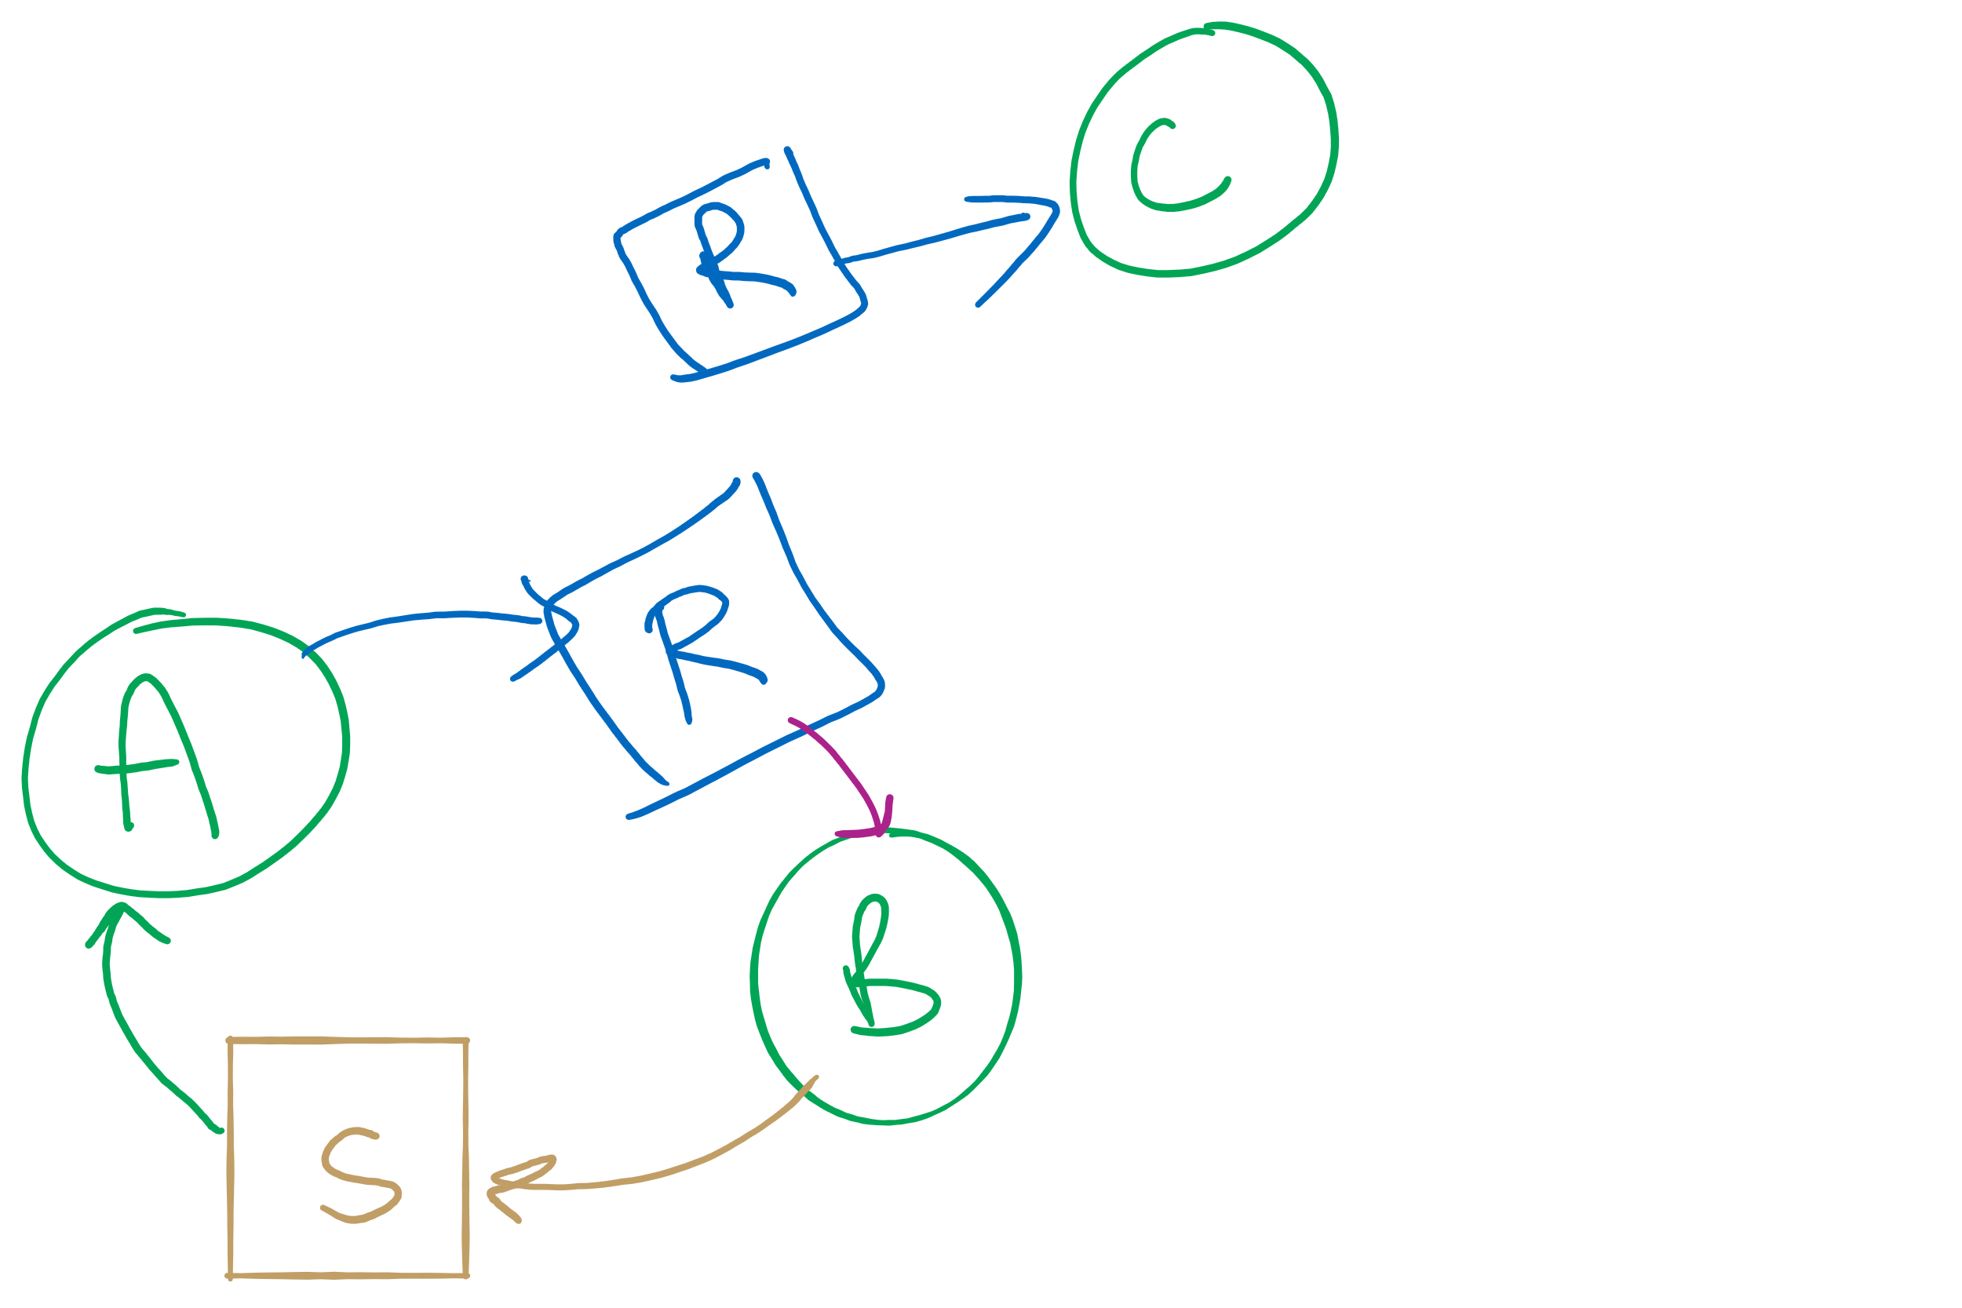
Resources with multiple instances
Previous algorithm only works if there’s one instance of each resource
If there are multiple instances of each resource, we need a different method
Track current usage and requests for each process
To detect deadlock, try to find a scenario where all processes can finish
If no such scenario exists, we have deadlock

Slide 10
Deadlock detection algorithm
 | A | B | C | D
Avail | 2 | 3 | 0 | 1
current=avail;
for (j = 0; j < N; j++) {
for (k=0; k<N; k++) {
if (finished[k])
continue;
if (want[k] <= current) {
finished[k] = 1;
current += hold[k];
break;
}
}
if (k==N) { //reached end of loop
printf “Deadlock!\n”;
// finished[k]==0 means process is in
// the deadlock
break;
}
}
Process | A | B | C | D
1 | 0 | 3 | 0 | 0
2 | 1 | 0 | 1 | 1
3 | 0 | 2 | 1 | 0
4 | 2 | 2 | 3 | 0
Hold
Process | A | B | C | D
1 | 3 | 2 | 1 | 0
2 | 2 | 2 | 0 | 0
3 | 3 | 5 | 3 | 1
4 | 0 | 4 | 1 | 1
Want
Note: want[j], hold[j], current, avail are arrays!

Slide 11


Deadlock detection algorithm
current=avail;
for (j = 0; j < N; j++) {
for (k=0; k<N; k++) {
if (finished[k])
continue;
if (want[k] <= current) {
finished[k] = 1;
current += hold[k];
break;
}
}
if (k==N) {
printf “Deadlock!\n”;
// finished[k]==0 means process is in
// the deadlock
break;
}
}
 | A | B | C | D
Avail | 2 | 3 | 0 | 1
Process | A | B | C | D
1 | 0 | 3 | 0 | 0
2 | 1 | 0 | 1 | 1
3 | 0 | 2 | 1 | 0
4 | 2 | 2 | 3 | 0
Hold
Process | A | B | C | D
1 | 3 | 2 | 1 | 0
2 | 2 | 2 | 0 | 0
3 | 3 | 5 | 3 | 1
4 | 0 | 4 | 1 | 1
Want
Note: want[j], hold[j], current, avail are arrays!

Slide 12



Deadlock detection algorithm
current=avail;
for (j = 0; j < N; j++) {
for (k=0; k<N; k++) {
if (finished[k])
continue;
if (want[k] <= current) {
finished[k] = 1;
current += hold[k];
break;
}
}
if (k==N) {
printf “Deadlock!\n”;
// finished[k]==0 means process is in
// the deadlock
break;
}
}
 | A | B | C | D
current | 2 | 3 | 0 | 1
Process | A | B | C | D
1 | 0 | 3 | 0 | 0
2 | 1 | 0 | 1 | 1
3 | 0 | 2 | 1 | 0
4 | 2 | 2 | 3 | 0
Hold
Process | A | B | C | D
1 | 3 | 2 | 1 | 0
2 | 2 | 2 | 0 | 0
3 | 3 | 5 | 3 | 1
4 | 0 | 4 | 1 | 1
Want
Note: want[j], hold[j], current, avail are arrays!

Slide 13


Deadlock detection algorithm
current=avail;
for (j = 0; j < N; j++) {
for (k=0; k<N; k++) {
if (finished[k])
continue;
if (want[k] <= current) {
finished[k] = 1;
current += hold[k];
break;
}
}
if (k==N) {
printf “Deadlock!\n”;
// finished[k]==0 means process is in
// the deadlock
break;
}
}
 | A | B | C | D
current | 2 | 3 | 0 | 1
Process | A | B | C | D
1 | 0 | 3 | 0 | 0
2 | 1 | 0 | 1 | 1
3 | 0 | 2 | 1 | 0
4 | 2 | 2 | 3 | 0
Hold
Process | A | B | C | D
1 | 3 | 2 | 1 | 0
2 | 2 | 2 | 0 | 0
3 | 3 | 5 | 3 | 1
4 | 0 | 4 | 1 | 1
Want
Note: want[j], hold[j], current, avail are arrays!

Slide 14

Deadlock detection algorithm
current=avail;
for (j = 0; j < N; j++) {
for (k=0; k<N; k++) {
if (finished[k])
continue;
if (want[k] <= current) {
finished[k] = 1;
current += hold[k];
break;
}
}
if (k==N) {
printf “Deadlock!\n”;
// finished[k]==0 means process is in
// the deadlock
break;
}
}
 | A | B | C | D
current | 3 | 3 | 1 | 2
Process | A | B | C | D
1 | 0 | 3 | 0 | 0
2 | 1 | 0 | 1 | 1
3 | 0 | 2 | 1 | 0
4 | 2 | 2 | 3 | 0
Hold
Process | A | B | C | D
1 | 3 | 2 | 1 | 0
2 | 2 | 2 | 0 | 0
3 | 3 | 5 | 3 | 1
4 | 0 | 4 | 1 | 1
Want
Note: want[j], hold[j], current, avail are arrays!

Slide 15

Deadlock detection algorithm
current=avail;
for (j = 0; j < N; j++) {
for (k=0; k<N; k++) {
if (finished[k])
continue;
if (want[k] <= current) {
finished[k] = 1;
current += hold[k];
break;
}
}
if (k==N) {
printf “Deadlock!\n”;
// finished[k]==0 means process is in
// the deadlock
break;
}
}
 | A | B | C | D
current | 3 | 3 | 1 | 2
Process | A | B | C | D
1 | 0 | 3 | 0 | 0
2 | 1 | 0 | 1 | 1
3 | 0 | 2 | 1 | 0
4 | 2 | 2 | 3 | 0
Hold
Process | A | B | C | D
1 | 3 | 2 | 1 | 0
2 | 2 | 2 | 0 | 0
3 | 3 | 5 | 3 | 1
4 | 0 | 4 | 1 | 1
Want
Note: want[j], hold[j], current, avail are arrays!

Slide 16


Deadlock detection algorithm
current=avail;
for (j = 0; j < N; j++) {
for (k=0; k<N; k++) {
if (finished[k])
continue;
if (want[k] <= current) {
finished[k] = 1;
current += hold[k];
break;
}
}
if (k==N) {
printf “Deadlock!\n”;
// finished[k]==0 means process is in
// the deadlock
break;
}
}
 | A | B | C | D
current | 3 | 3 | 1 | 2
Process | A | B | C | D
1 | 0 | 3 | 0 | 0
2 | 1 | 0 | 1 | 1
3 | 0 | 2 | 1 | 0
4 | 2 | 2 | 3 | 0
Hold
Process | A | B | C | D
1 | 3 | 2 | 1 | 0
2 | 2 | 2 | 0 | 0
3 | 3 | 5 | 3 | 1
4 | 0 | 4 | 1 | 1
Want
Note: want[j], hold[j], current, avail are arrays!

Slide 17



Deadlock detection algorithm
current=avail;
for (j = 0; j < N; j++) {
for (k=0; k<N; k++) {
if (finished[k])
continue;
if (want[k] <= current) {
finished[k] = 1;
current += hold[k];
break;
}
}
if (k==N) {
printf “Deadlock!\n”;
// finished[k]==0 means process is in
// the deadlock
break;
}
}
 | A | B | C | D
current | 3 | 3 | 1 | 2
Process | A | B | C | D
1 | 0 | 3 | 0 | 0
2 | 1 | 0 | 1 | 1
3 | 0 | 2 | 1 | 0
4 | 2 | 2 | 3 | 0
Hold
Process | A | B | C | D
1 | 3 | 2 | 1 | 0
2 | 2 | 2 | 0 | 0
3 | 3 | 5 | 3 | 1
4 | 0 | 4 | 1 | 1
Want
Note: want[j], hold[j], current, avail are arrays!

Slide 18


Deadlock detection algorithm
current=avail;
for (j = 0; j < N; j++) {
for (k=0; k<N; k++) {
if (finished[k])
continue;
if (want[k] <= current) {
finished[k] = 1;
current += hold[k];
break;
}
}
if (k==N) {
printf “Deadlock!\n”;
// finished[k]==0 means process is in
// the deadlock
break;
}
}
 | A | B | C | D
current | 3 | 6 | 1 | 2
Process | A | B | C | D
1 | 0 | 3 | 0 | 0
2 | 1 | 0 | 1 | 1
3 | 0 | 2 | 1 | 0
4 | 2 | 2 | 3 | 0
Hold
Process | A | B | C | D
1 | 3 | 2 | 1 | 0
2 | 2 | 2 | 0 | 0
3 | 3 | 5 | 3 | 1
4 | 0 | 4 | 1 | 1
Want
Note: want[j], hold[j], current, avail are arrays!

Slide 19




Deadlock detection algorithm
current=avail;
for (j = 0; j < N; j++) {
for (k=0; k<N; k++) {
if (finished[k])
continue;
if (want[k] <= current) {
finished[k] = 1;
current += hold[k];
break;
}
}
if (k==N) {
printf “Deadlock!\n”;
// finished[k]==0 means process is in
// the deadlock
break;
}
}
 | A | B | C | D
current | 3 | 6 | 1 | 2
Process | A | B | C | D
1 | 0 | 3 | 0 | 0
2 | 1 | 0 | 1 | 1
3 | 0 | 2 | 1 | 0
4 | 2 | 2 | 3 | 0
Hold
Process | A | B | C | D
1 | 3 | 2 | 1 | 0
2 | 2 | 2 | 0 | 0
3 | 3 | 5 | 3 | 1
4 | 0 | 4 | 1 | 1
Want
Note: want[j], hold[j], current, avail are arrays!

Slide 20


Deadlock detection algorithm
current=avail;
for (j = 0; j < N; j++) {
for (k=0; k<N; k++) {
if (finished[k])
continue;
if (want[k] <= current) {
finished[k] = 1;
current += hold[k];
break;
}
}
if (k==N) {
printf “Deadlock!\n”;
// finished[k]==0 means process is in
// the deadlock
break;
}
}
 | A | B | C | D
current | 5 | 8 | 4 | 2
Process | A | B | C | D
1 | 0 | 3 | 0 | 0
2 | 1 | 0 | 1 | 1
3 | 0 | 2 | 1 | 0
4 | 2 | 2 | 3 | 0
Hold
Process | A | B | C | D
1 | 3 | 2 | 1 | 0
2 | 2 | 2 | 0 | 0
3 | 3 | 5 | 3 | 1
4 | 0 | 4 | 1 | 1
Want
Note: want[j], hold[j], current, avail are arrays!

Slide 21






Deadlock detection algorithm
current=avail;
for (j = 0; j < N; j++) {
for (k=0; k<N; k++) {
if (finished[k])
continue;
if (want[k] <= current) {
finished[k] = 1;
current += hold[k];
break;
}
}
if (k==N) {
printf “Deadlock!\n”;
// finished[k]==0 means process is in
// the deadlock
break;
}
}
 | A | B | C | D
current | 5 | 8 | 4 | 2
Process | A | B | C | D
1 | 0 | 3 | 0 | 0
2 | 1 | 0 | 1 | 1
3 | 0 | 2 | 1 | 0
4 | 2 | 2 | 3 | 0
Hold
Process | A | B | C | D
1 | 3 | 2 | 1 | 0
2 | 2 | 2 | 0 | 0
3 | 3 | 5 | 3 | 1
4 | 0 | 4 | 1 | 1
Want
Note: want[j], hold[j], current, avail are arrays!

Slide 22


Deadlock detection algorithm
current=avail;
for (j = 0; j < N; j++) {
for (k=0; k<N; k++) {
if (finished[k])
continue;
if (want[k] <= current) {
finished[k] = 1;
current += hold[k];
break;
}
}
if (k==N) {
printf “Deadlock!\n”;
// finished[k]==0 means process is in
// the deadlock
break;
}
}
 | A | B | C | D
current | 5 | 10 | 5 | 2
Process | A | B | C | D
1 | 0 | 3 | 0 | 0
2 | 1 | 0 | 1 | 1
3 | 0 | 2 | 1 | 0
4 | 2 | 2 | 3 | 0
Hold
Process | A | B | C | D
1 | 3 | 2 | 1 | 0
2 | 2 | 2 | 0 | 0
3 | 3 | 5 | 3 | 1
4 | 0 | 4 | 1 | 1
Want
Note: want[j], hold[j], current, avail are arrays!

Slide 23





Deadlock detection algorithm
current=avail;
for (j = 0; j < N; j++) {
for (k=0; k<N; k++) {
if (finished[k])
continue;
if (want[k] <= current) {
finished[k] = 1;
current += hold[k];
break;
}
}
if (k==N) {
printf “Deadlock!\n”;
// finished[k]==0 means process is in
// the deadlock
break;
}
}
 | A | B | C | D
current | 5 | 10 | 5 | 2
Process | A | B | C | D
1 | 0 | 3 | 0 | 0
2 | 1 | 0 | 1 | 1
3 | 0 | 2 | 1 | 0
4 | 2 | 2 | 3 | 0
Hold
Process | A | B | C | D
1 | 3 | 2 | 1 | 0
2 | 2 | 2 | 0 | 0
3 | 3 | 5 | 3 | 1
4 | 0 | 4 | 1 | 1
Want
Note: want[j], hold[j], current, avail are arrays!

Slide 24
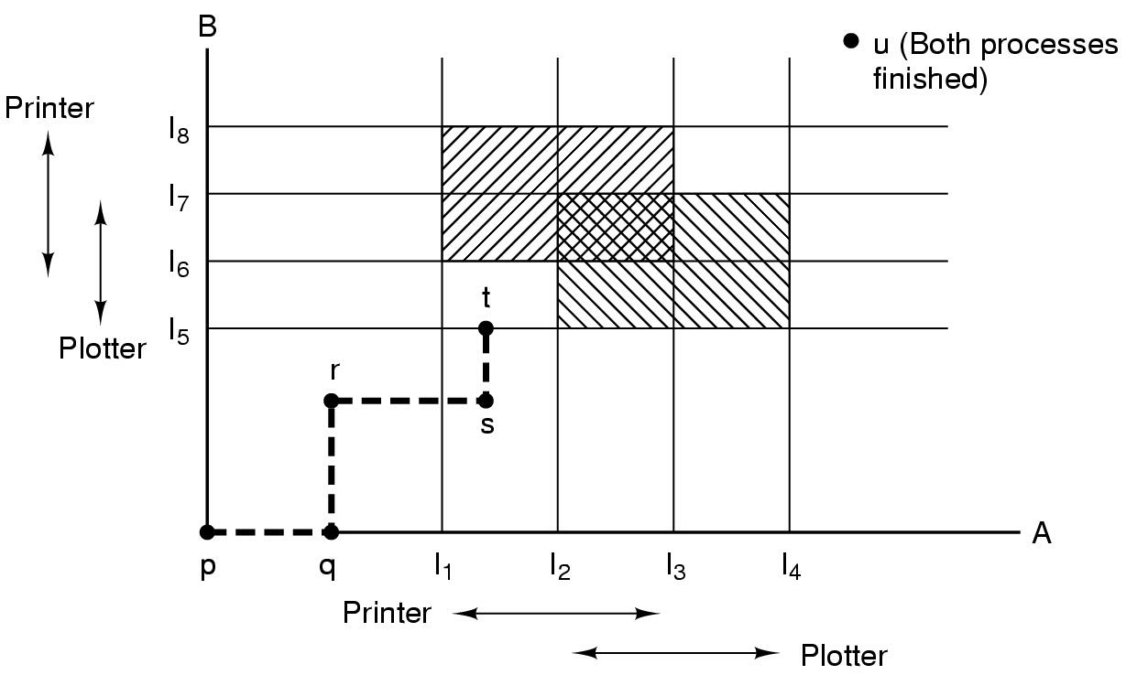
Resource trajectories
Two process resource trajectories

Slide 25

Resource trajectories
Two process resource trajectories

Slide 26


Resource trajectories
Two process resource trajectories

Slide 27



Resource trajectories
Two process resource trajectories

Slide 28

Resource trajectories
Two process resource trajectories

Slide 29

Resource trajectories
Two process resource trajectories

Slide 30

Resource trajectories
Two process resource trajectories

Slide 31

Resource trajectories
Two process resource trajectories

Slide 32

Resource trajectories
Two process resource trajectories

Slide 33
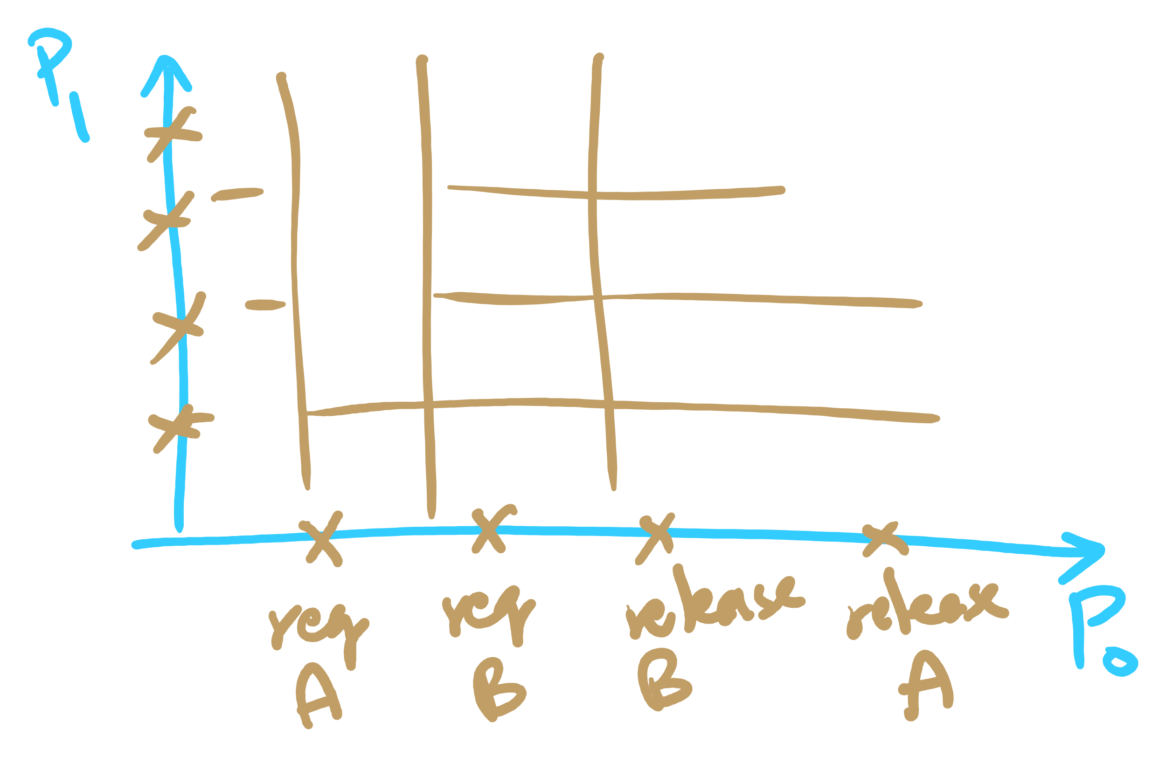
Resource Trajectories

Slide 34
Safe and unsafe states
 | Has | Max
A | 3 | 9
B | 2 | 4
C | 2 | 7
Free: 3
 | Has | Max
A | 3 | 9
B | 4 | 4
C | 2 | 7
Free: 1
 | Has | Max
A | 3 | 9
B | 0 | -
C | 2 | 7
Free: 5
 | Has | Max
A | 3 | 9
B | 0 | -
C | 7 | 7
Free: 0
 | Has | Max
A | 3 | 9
B | 0 | -
C | 0 | -
Free: 7
Demonstration that the first state is safe
 | Has | Max
A | 3 | 9
B | 2 | 4
C | 2 | 7
Free: 3
 | Has | Max
A | 4 | 9
B | 2 | 4
C | 2 | 7
Free: 2
 | Has | Max
A | 4 | 9
B | 4 | 4
C | 2 | 7
Free: 0
 | Has | Max
A | 4 | 9
B | 0 | -
C | 2 | 7
Free: 4
Demonstration that the second state is unsafe

Slide 35
Banker's Algorithm for a single resource
Bankers’ algorithm: before granting a request, ensure that a sequence exists that will allow all processes to complete
Use previous methods to find such a sequence
If a sequence exists, allow the requests
If there’s no such sequence, deny the request
Can be slow: must be done on each request!
 | Has | Max
A | 0 | 6
B | 0 | 5
C | 0 | 4
D | 0 | 7
Free: 10

Slide 36
Banker's Algorithm for a single resource
Bankers’ algorithm: before granting a request, ensure that a sequence exists that will allow all processes to complete
Use previous methods to find such a sequence
If a sequence exists, allow the requests
If there’s no such sequence, deny the request
Can be slow: must be done on each request!
 | Has | Max
A | 0 | 6
B | 0 | 5
C | 0 | 4
D | 0 | 7
Free: 10
 | Has | Max
A | 1 | 6
B | 1 | 5
C | 2 | 4
D | 4 | 7
Free: 2
Any sequence finishes

Slide 37
Banker's Algorithm for a single resource
Bankers’ algorithm: before granting a request, ensure that a sequence exists that will allow all processes to complete
Use previous methods to find such a sequence
If a sequence exists, allow the requests
If there’s no such sequence, deny the request
Can be slow: must be done on each request!
 | Has | Max
A | 0 | 6
B | 0 | 5
C | 0 | 4
D | 0 | 7
Free: 10
 | Has | Max
A | 1 | 6
B | 1 | 5
C | 2 | 4
D | 4 | 7
Free: 2
 | Has | Max
A | 1 | 6
B | 2 | 5
C | 2 | 4
D | 4 | 7
Free: 1
Any sequence finishes
C,B,A,D finishes

Slide 38
Banker's Algorithm for a single resource
Bankers’ algorithm: before granting a request, ensure that a sequence exists that will allow all processes to complete
Use previous methods to find such a sequence
If a sequence exists, allow the requests
If there’s no such sequence, deny the request
Can be slow: must be done on each request!
 | Has | Max
A | 0 | 6
B | 0 | 5
C | 0 | 4
D | 0 | 7
Free: 10
 | Has | Max
A | 1 | 6
B | 1 | 5
C | 2 | 4
D | 4 | 7
Free: 2
 | Has | Max
A | 1 | 6
B | 2 | 5
C | 2 | 4
D | 4 | 7
Free: 1
Any sequence finishes
C,B,A,D finishes
Deadlock (unsafe state)

Slide 39
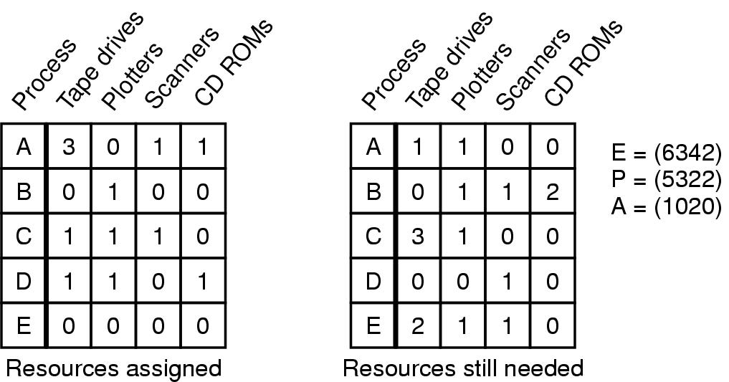
Banker's Algorithm for multiple resources
Example of banker's algorithm with multiple resources

Slide 40
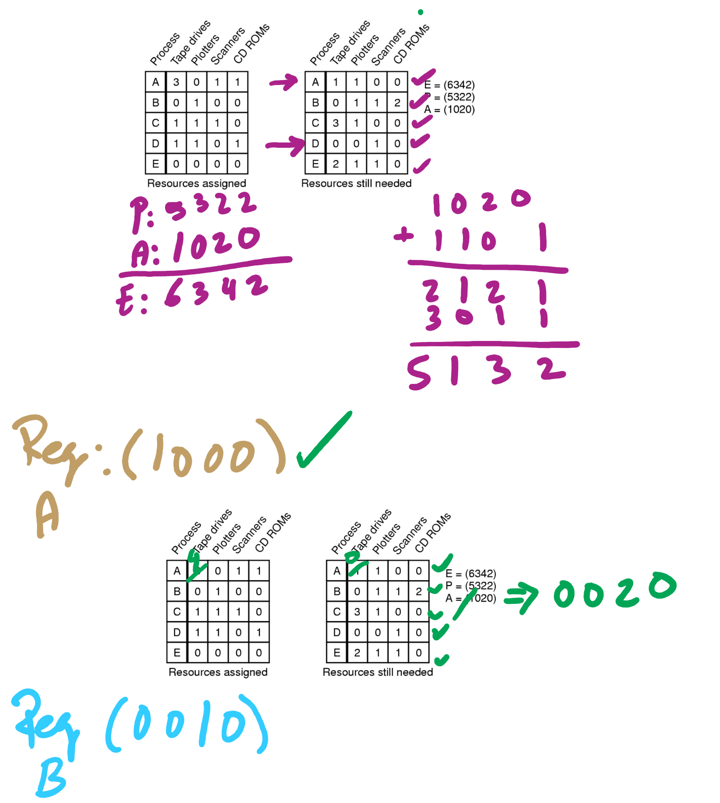
Banker’s Algorithm Example

Slide 41
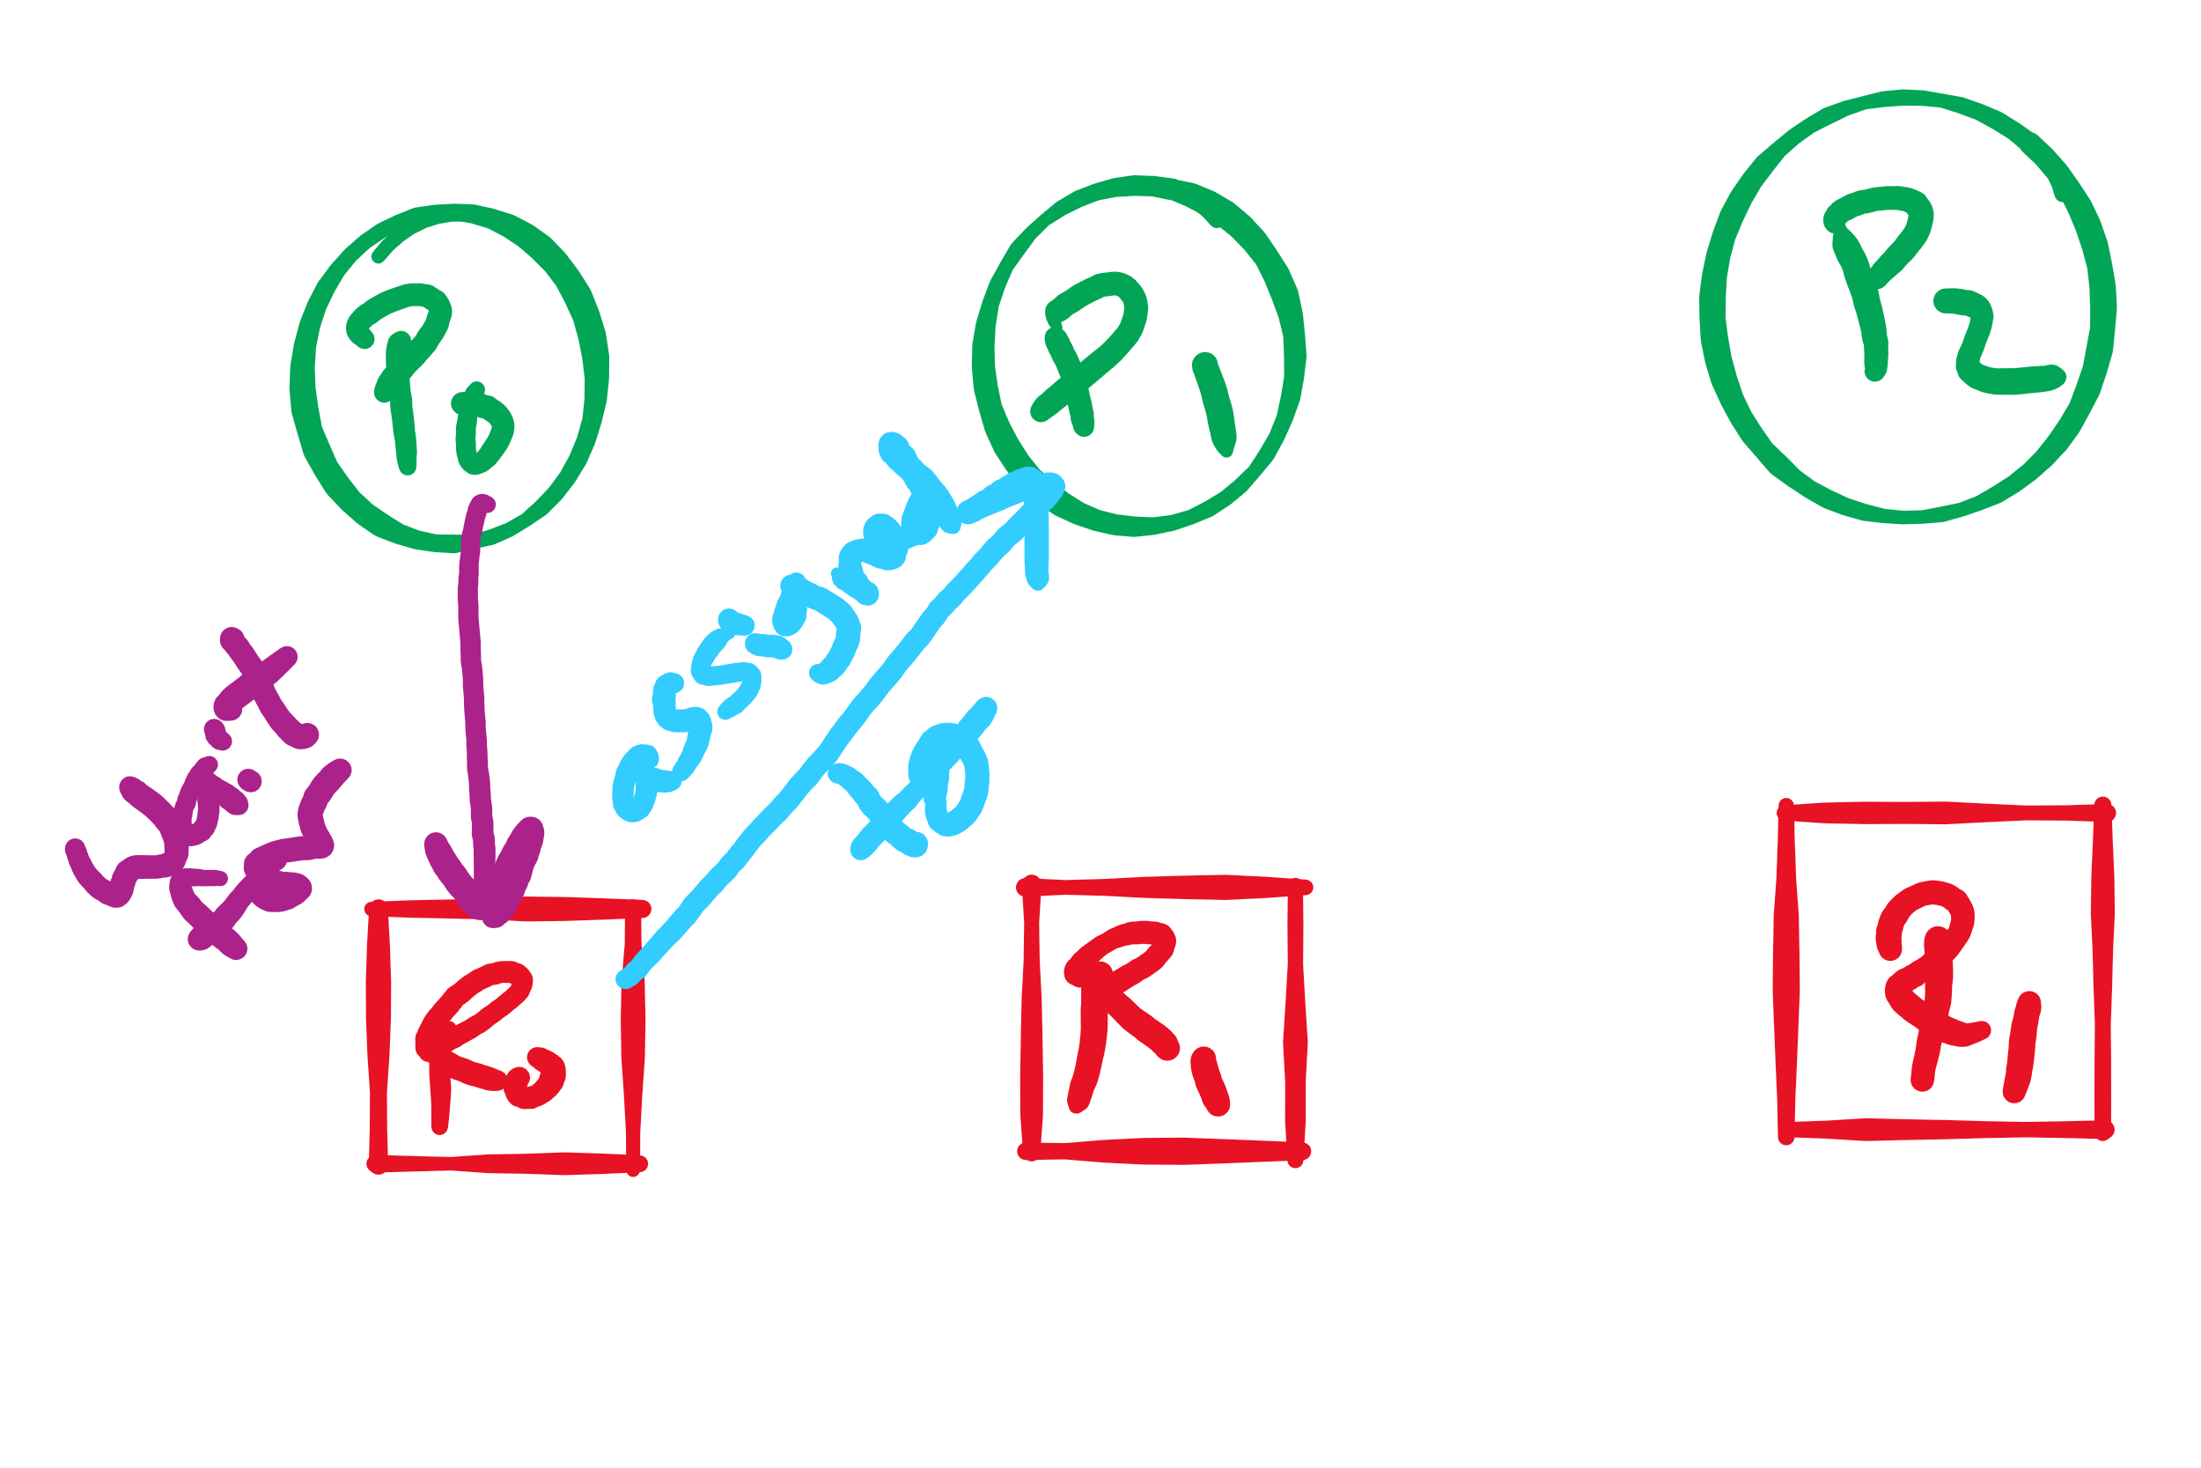
Arrows in Resource Allocation Graph

Slide 42
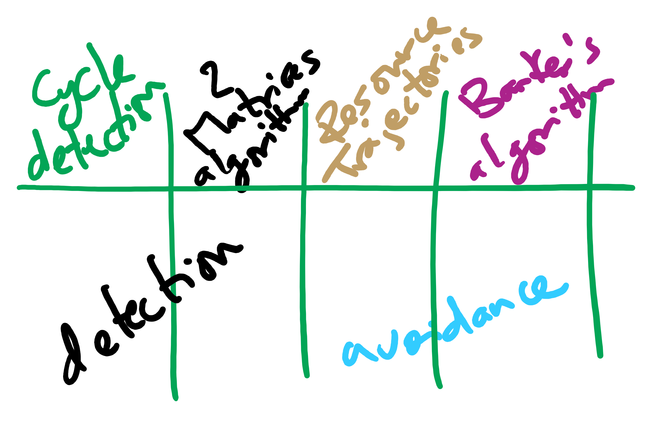
Deadlock Detection and Avoidance Algorithms

Slide 43
Preventing deadlock
Deadlock can be completely prevented!
Ensure that at least one of the conditions for deadlock never occurs
Mutual exclusion
Circular wait
Hold & wait
No preemption
Not always possible…

Slide 44
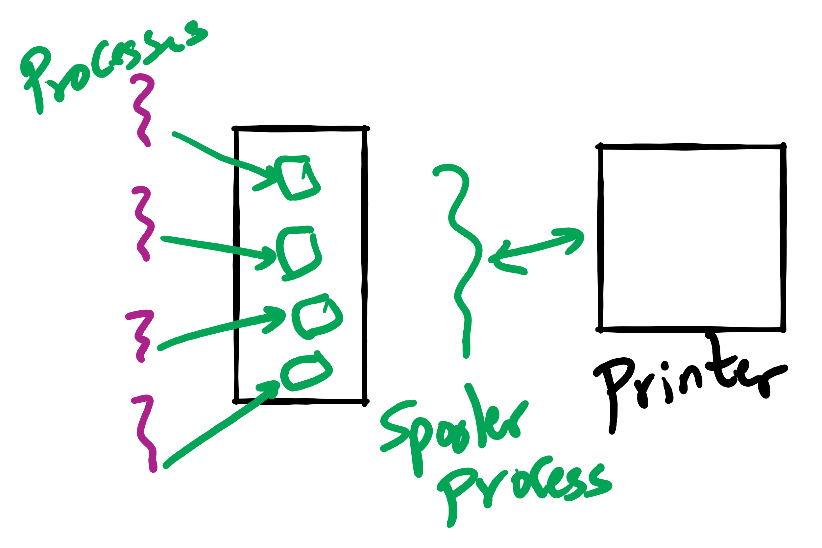
Eliminating mutual exclusion
Some devices (such as printer) can be spooled
Only the printer daemon uses printer resource
This eliminates deadlock for printer
Not all devices can be spooled
Principle:
Avoid assigning resource when not absolutely necessary
As few processes as possible actually claim the resource

Slide 45
Attacking “hold and wait”
Require processes to request resources before starting
A process never has to wait for what it needs
This can present problems
A process may not know required resources at start of run
This also ties up resources other processes could be using
Processes will tend to be conservative and request resources they might need
Variation: a process must give up all resources before making a new request
Process is then granted all prior resources as well as the new ones
Problem: what if someone grabs the resources in the meantime—how can the process save its state?

Slide 46
Attacking “no preemption”
This is not usually a viable option
Consider a process given the printer
Halfway through its job, take away the printer
Confusion ensues!
May work for some resources
Forcibly take away memory pages, suspending the process
Process may be able to resume with no ill effects

Slide 47
Attacking “circular wait”
Assign an order to resources
Always acquire resources in numerical order
Need not acquire them all at once!
Circular wait is prevented
A process holding resource n can’t wait for resource m if m < n
No way to complete a cycle
Place processes above the highest resource they hold and below any they’re requesting
All arrows point up!
D
C
B
A
1
2
3

Slide 48
Attacking “circular wait”
Assign an order to resources
Always acquire resources in numerical order
Need not acquire them all at once!
Circular wait is prevented
A process holding resource n can’t wait for resource m if m < n
No way to complete a cycle
Place processes above the highest resource they hold and below any they’re requesting
All arrows point up!
D
C
B
1
A
2
3

Slide 49
Attacking “circular wait”
Assign an order to resources
Always acquire resources in numerical order
Need not acquire them all at once!
Circular wait is prevented
A process holding resource n can’t wait for resource m if m < n
No way to complete a cycle
Place processes above the highest resource they hold and below any they’re requesting
All arrows point up!
D
C
2
B
1
A
3

Slide 50
Attacking “circular wait”
Assign an order to resources
Always acquire resources in numerical order
Need not acquire them all at once!
Circular wait is prevented
A process holding resource n can’t wait for resource m if m < n
No way to complete a cycle
Place processes above the highest resource they hold and below any they’re requesting
All arrows point up!
D
3
C
2
B
1
A

Slide 51
Deadlock prevention: summary
Mutual exclusion
Spool everything
Hold and wait
Request all resources initially
No preemption
Take resources away
Circular wait
Order resources numerically

Slide 52
Example: two-phase locking
Phase One
Process tries to lock all data it needs, one at a time
If needed data found locked, start over
(no real work done in phase one)
Phase Two
Perform updates
Release locks
Note similarity to requesting all resources at once
This is often used in databases
It avoids deadlock by eliminating the “hold-and-wait” deadlock condition

Slide 53
“Non-resource” deadlocks
Possible for two processes to deadlock
Each is waiting for the other to do some task
Can happen with semaphores
Each process required to do a down() on two semaphores (mutex and another)
If done in wrong order, deadlock results
Semaphores could be thought of as resources…

Slide 54
Starvation
Algorithm to allocate a resource
Give the resource to the shortest job first
Works great for multiple short jobs in a system
May cause long jobs to be postponed indefinitely
Even though not blocked
Solution
First-come, first-serve policy
Starvation can lead to deadlock
Process starved for resources can be holding resources
If those resources aren’t used and released in a timely fashion, shortage could lead to deadlock

