Slide 1

Introduction to Operating Systems CS/COE 1550
Fall 2021
Sherif Khattab
ksm73@pitt.edu
(Some slides are from Silberschatz, Galvin and Gagne ©2013)

Slide 2
Announcements
Upcoming deadlines:
10/25: Project 2 (extended deadline)
10/29: Homework 6
11/8: Lab 3

Slide 3
Last Lecture …
Deadlock prevention

Slide 4
Muddiest Points (Banker’s Algorithm)
what are the three steps of the bankers algorithm?
Could you go over the Bankers algorithm example again?
For the safe/unsafe algorithm, does that mean we need to know the resources that are available, keep track of the used ones, and also know how many each process will have in the future?
It seems like this detection algorithm has a lot of overhead. Are there any ways of reducing the time spent doing these checks
can we run the banker's algorithm or some alternative as a static analysis tool? like build this kind of check into the compiler or something instead of running it for each request during runtime
If a state is determined unsafe, does that always mean that the resource will not be allocated or is it possible to still allocate it and take the risk
What does the E, P and A stand for in the bankers algorithm
if bankers algorithm finds a valid path and grants the resource, can a deadlock still occur if a different path is followed than the one bankers algorithm found?
I'm a little confused on what the want and hold tables represent
Why is the runtime n^2 * n for the wait algorithm
What is the difference between wanted and max again?
Tracing bankers algorithms with multiple resource instances

Slide 5
Muddiest Points (Resource Trajectory)
the l1, l2 l3 ... in the resource trajectory graph
resource trajectory graphs with more than 2 resources
How to prevent a resource trajectory that would cause a deadlock

Slide 6
Muddiest Points (General Deadlock)
breaking circular wait seems almost always better than breaking hold and wait since breaking hold and wait requires you take all resources you need whereas breaking circular wait only makes you take some extra resources before you need them
Starvation vs deadlock
Which detection alg is fastest?
Where do deadlock detection algorithms exist? (Operating system or external application.) When do they run? Runtime or compile time? Also, how do deadlock avoidance algorithms interfere to make sure a program doesn’t deadlock? Are they integrated fully into the application?
how do we know what resources are available to use and the best way to choose who gets what resources
What is better practice, deadlock avoidance or deadlock detection?

Slide 7
Muddiest Points (Deadlock Prevention)
When checking a program to see it is free of deadlocks, you have to look for whether one of the four condtions is being broken somewhere?
Why do you only need to attack one of the 4 conditions to prevent deadlock?
How to know which deadlock prevention technique to use.
How spooling works
What exactly is spooling?
Spooling in applications
When is it appropriate to spool? How do you know?
How non-resource deadlocks occur
In regard to attacking "no preemption", how would you determine whether it's viable to take a resource away from a process?
how 2 phase locking avoids the hold and wait condition?

Slide 8
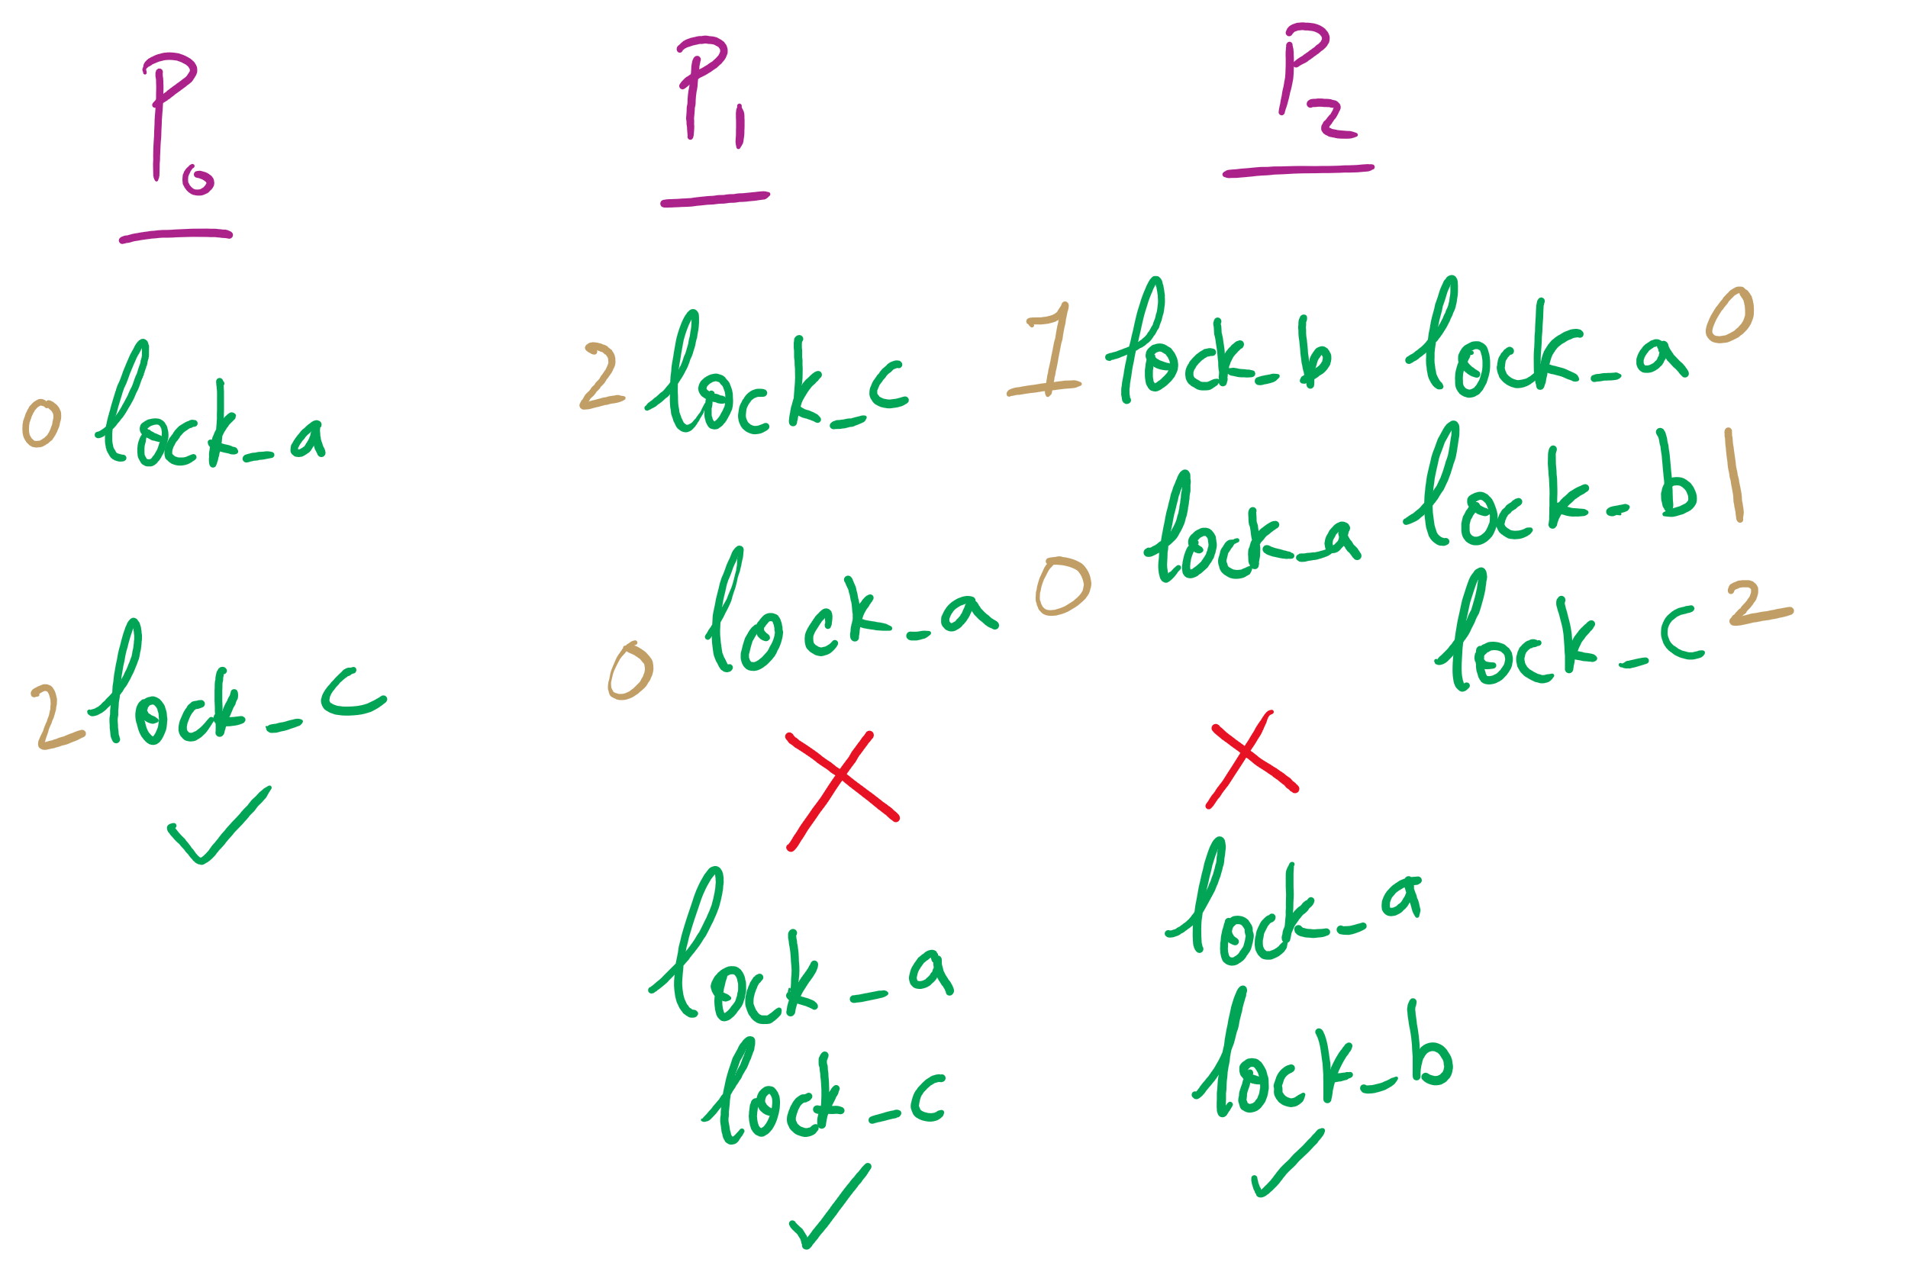
Attacking Circular Wait

Slide 9
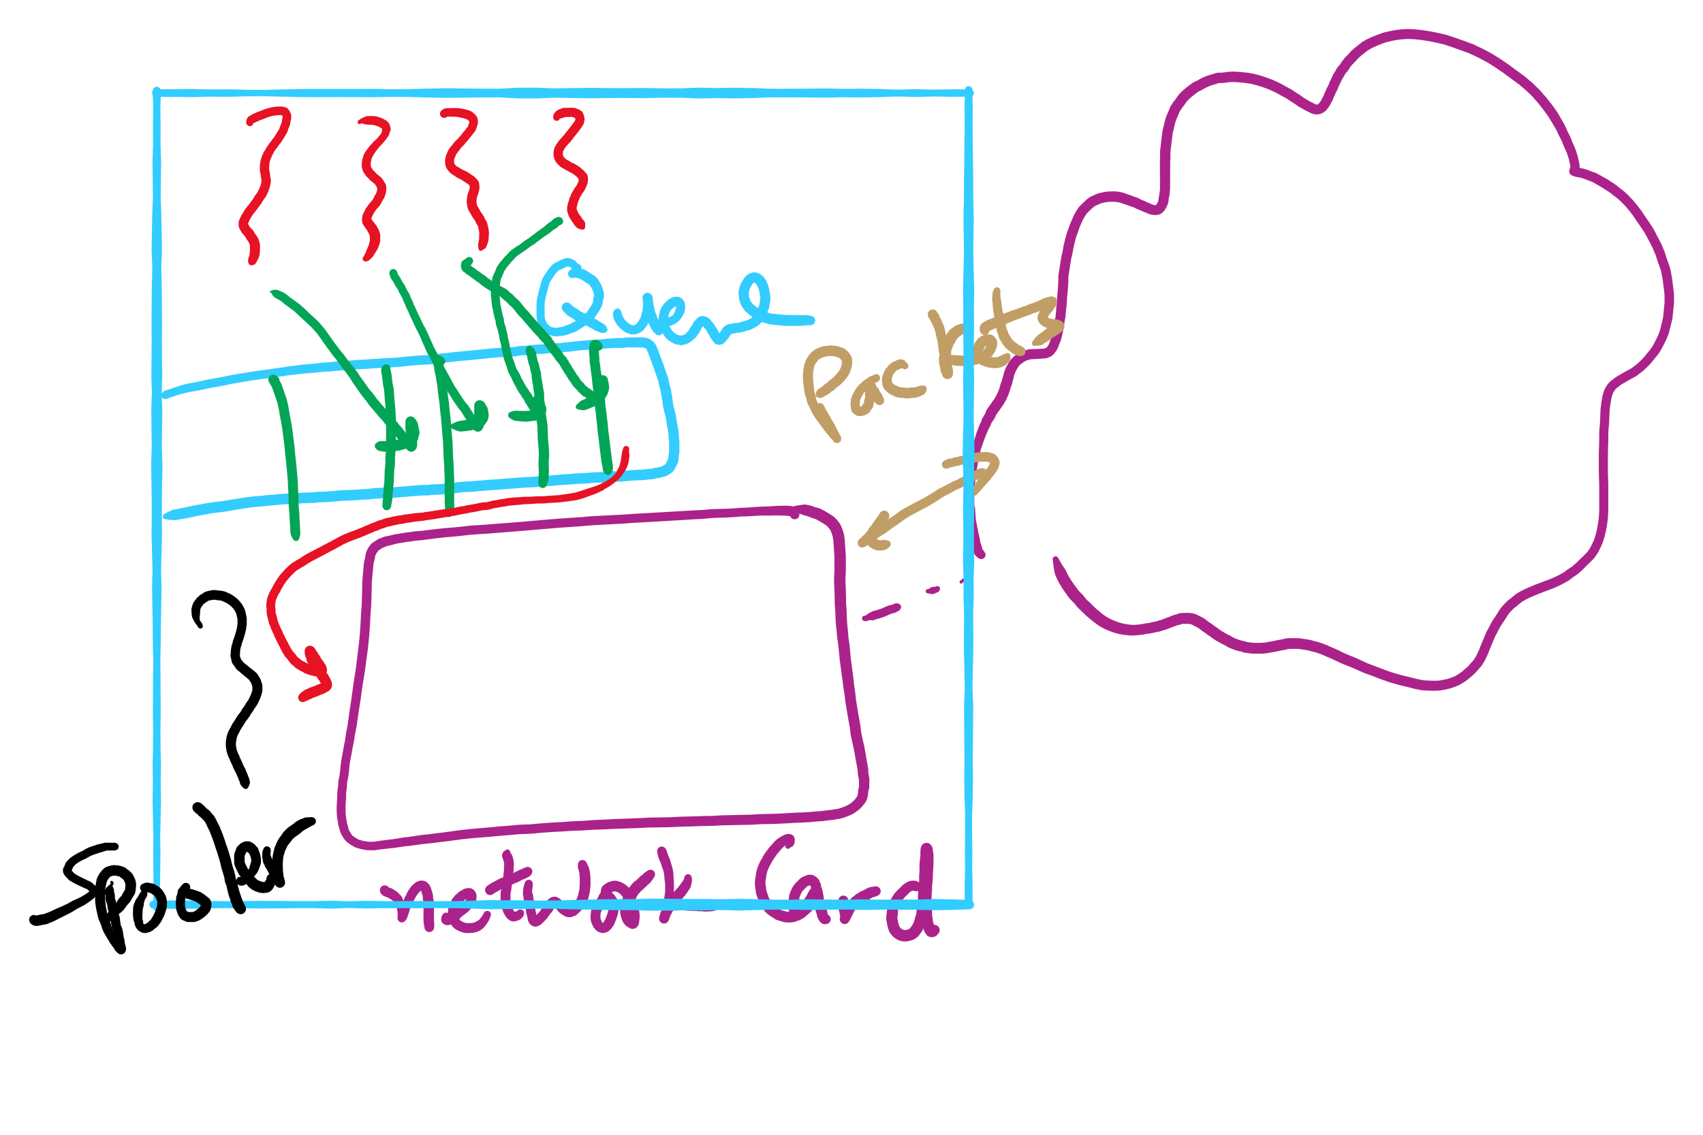
Spooling Example

Slide 10
Today …
CPU Scheduling

Slide 11
CPU Scheduling
Scheduling the processor among all ready processes
User-oriented criteria
Response Time: Elapsed time between the submission of a request and the receipt of a response
Turnaround Time: Elapsed time between the submission of a process to its completion
System-oriented criteria
Processor utilization
Throughput: number of process completed per unit time
Fairness

Slide 12
Short-Term Scheduler Dispatcher
The dispatcher is the module that gives control of the CPU to the process selected by the short-term scheduler
The functions of the dispatcher include:
Switching context
Switching to user mode
Jumping to the location in the user program to restart execution
The dispatch latency must be minimal

Slide 13





The CPU-I/O Cycle
Processes require alternate use of processor and I/O in a repetitive fashion
Each cycle consist of a CPU burst followed by an I/O burst
A process terminates on a CPU burst
CPU-bound processes have longer CPU bursts than I/O-bound processes

Slide 14
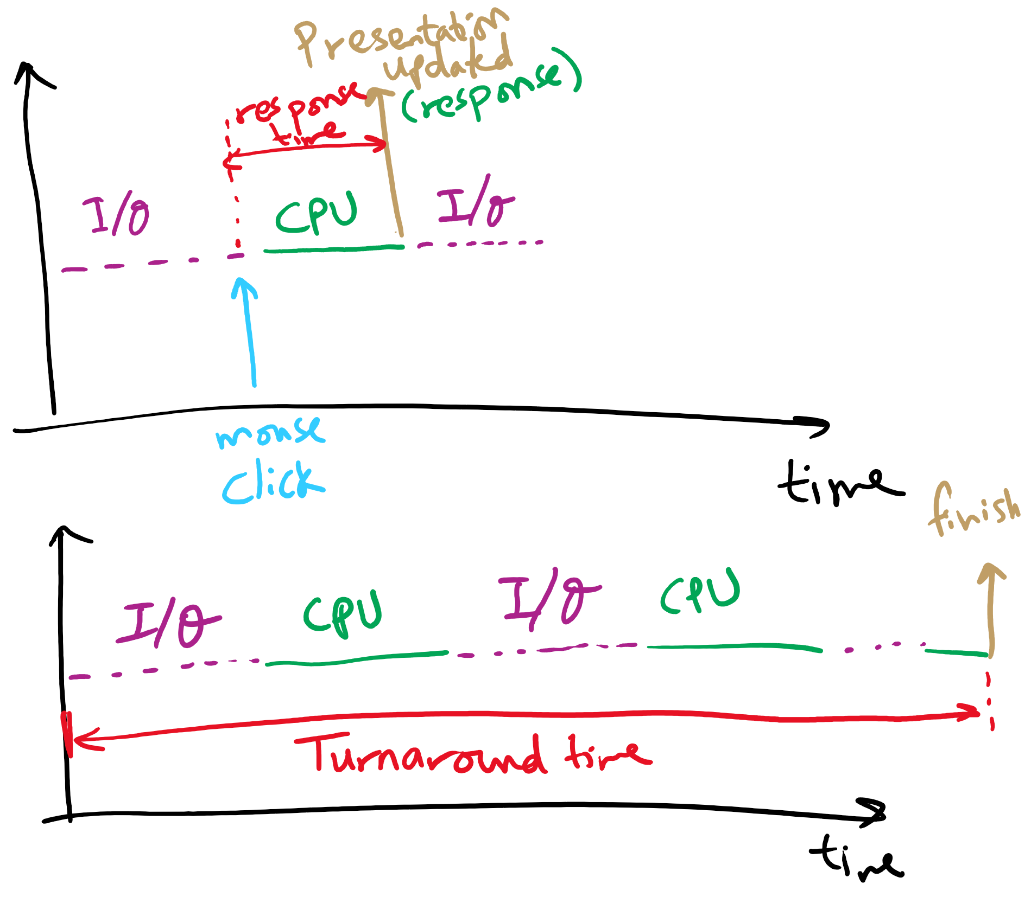
Response time vs. Turnaround time

Slide 15
Scheduling Algorithms
First-Come, First-Served Scheduling
Shortest-Job-First Scheduling
Also referred to as Shortest Process Next
Priority Scheduling
Round-Robin Scheduling
Multilevel Queue Scheduling
Multilevel Feedback Queue Scheduling

Slide 16
Characterization of Scheduling Policies
The selection function determines which ready process is selected next for execution
The decision mode specifies the instants in time the selection function is exercised
Nonpreemptive
Once a process is in the running state, it will continue until it terminates or blocks for an I/O
Preemptive
Currently running process may be interrupted and moved to the Ready state by the OS
Prevents one process from monopolizing the processor

Slide 17
Process Mix Example
Process
Arrival Time
Service Time
1
0
3
2
2
6
3
4
4
4
6
5
5
8
2
Service time = total processor time needed in one (CPU-I/O) cycle
Jobs with long service time are CPU-bound jobs and are referred
to as “long jobs”

Slide 18







First Come First Served (FCFS)
Selection function: the process that has been waiting the longest in the ready queue (hence, FCFS)
Decision mode: non-preemptive
a process runs until it blocks for an I/O
Process
Arrival Time
Service Time
1
0
3
2
2
6
3
4
4
4
6
5
5
8
2

Slide 19
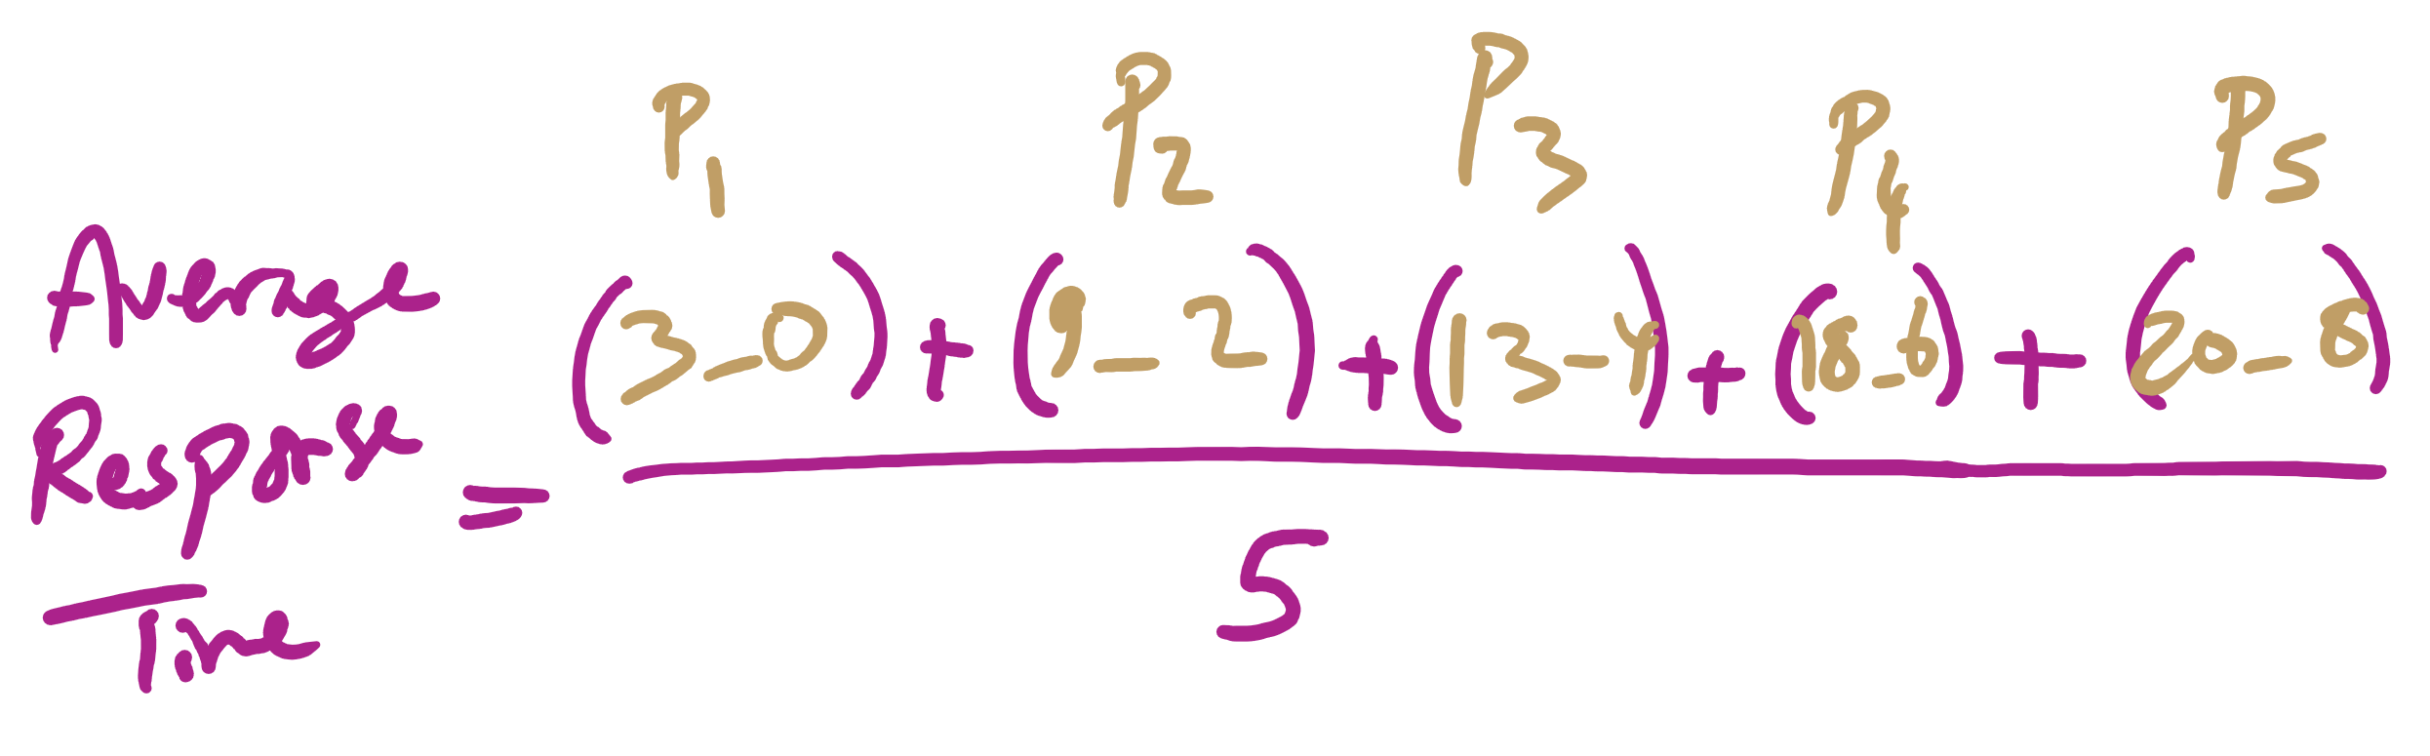
Average Response Time

Slide 20
FCFS drawbacks
Favours CPU-bound processes
CPU-bound processes monopolize the processor
I/O-bound processes have to wait until completion of CPU-bound process
I/O-bound processes may have to wait even after their I/Os are completed (poor device utilization)
Convoy effect
Better I/O device utilization could be achieved if I/O bound processes had higher priority

Slide 21
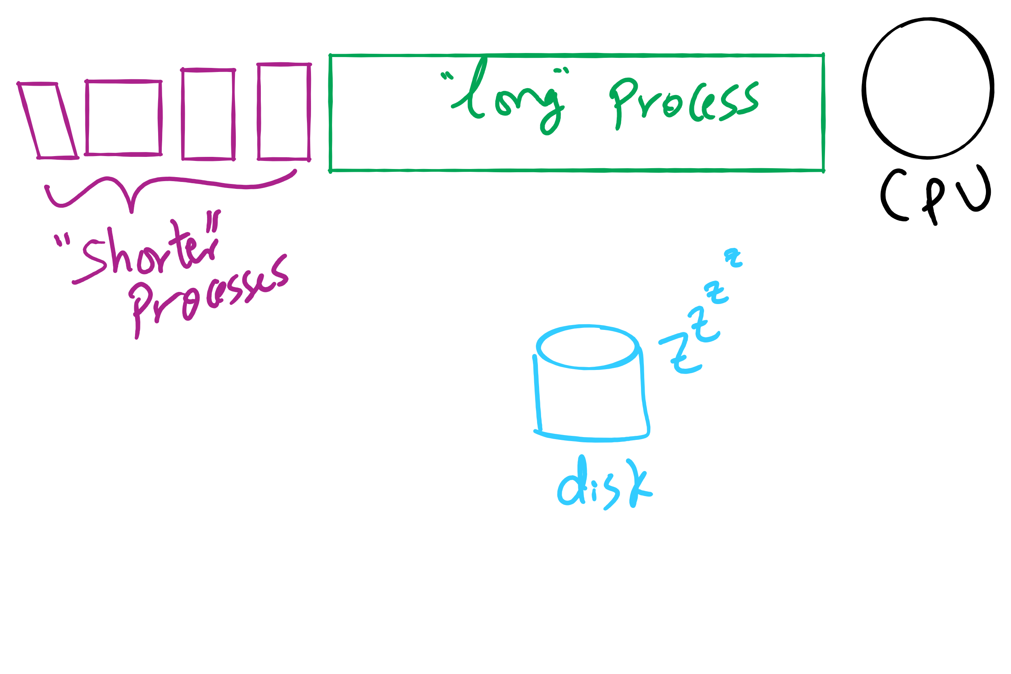
Convoy Effect

Slide 22











Shortest Job First (Shortest Process Next)
Selection function: the process with the shortest expected CPU burst time
I/O-bound processes will be selected first
Decision mode: non-preemptive
The required processing time, i.e., the CPU burst time, must be estimated for each process
Process
Arrival Time
Service Time
1
0
3
2
2
6
3
4
4
4
6
5
5
8
2

Slide 23
SJF / SPN Critique
Possibility of starvation for longer processes
Lack of preemption is not suitable in a time sharing environment
SJF/SPN implicitly incorporates priorities
Shortest jobs are given preference
CPU bound processes have lower priority, but a process doing no I/O could still monopolize the CPU if it is the first to enter the system

Slide 24
Priorities
Implemented by having multiple ready queues to represent each level of priority
Scheduler selects the process of a higher priority over one of lower priority
Lower-priority may suffer starvation
To alleviate starvation allow dynamic priorities
The priority of a process changes based on its age or execution history

Slide 25
Round-Robin
Selection function: same as FCFS
Decision mode: pre-emptive
a process is allowed to run until the time slice period (quantum, typically from 10 to 100 ms) has expired
a clock interrupt occurs and the running process is put on the ready queue
Process
Arrival Time
Service Time
1
0
3
2
2
6
3
4
4
4
6
5
5
8
2

Slide 26

Round-Robin
Selection function: same as FCFS
Decision mode: pre-emptive
a process is allowed to run until the time slice period (quantum, typically from 10 to 100 ms) has expired
a clock interrupt occurs and the running process is put on the ready queue
Process
Arrival Time
Service Time
1
0
3
2
2
6
3
4
4
4
6
5
5
8
2

Slide 27

Round-Robin
Selection function: same as FCFS
Decision mode: pre-emptive
a process is allowed to run until the time slice period (quantum, typically from 10 to 100 ms) has expired
a clock interrupt occurs and the running process is put on the ready queue
Process
Arrival Time
Service Time
1
0
3
2
2
6
3
4
4
4
6
5
5
8
2

Slide 28

Round-Robin
Selection function: same as FCFS
Decision mode: pre-emptive
a process is allowed to run until the time slice period (quantum, typically from 10 to 100 ms) has expired
a clock interrupt occurs and the running process is put on the ready queue
Process
Arrival Time
Service Time
1
0
3
2
2
6
3
4
4
4
6
5
5
8
2

Slide 29


Round-Robin
Selection function: same as FCFS
Decision mode: pre-emptive
a process is allowed to run until the time slice period (quantum, typically from 10 to 100 ms) has expired
a clock interrupt occurs and the running process is put on the ready queue
Process
Arrival Time
Service Time
1
0
3
2
2
6
3
4
4
4
6
5
5
8
2

Slide 30

Round-Robin
Selection function: same as FCFS
Decision mode: pre-emptive
a process is allowed to run until the time slice period (quantum, typically from 10 to 100 ms) has expired
a clock interrupt occurs and the running process is put on the ready queue
Process
Arrival Time
Service Time
1
0
3
2
2
6
3
4
4
4
6
5
5
8
2

Slide 31

Round-Robin
Selection function: same as FCFS
Decision mode: pre-emptive
a process is allowed to run until the time slice period (quantum, typically from 10 to 100 ms) has expired
a clock interrupt occurs and the running process is put on the ready queue
Process
Arrival Time
Service Time
1
0
3
2
2
6
3
4
4
4
6
5
5
8
2

Slide 32

Round-Robin
Selection function: same as FCFS
Decision mode: pre-emptive
a process is allowed to run until the time slice period (quantum, typically from 10 to 100 ms) has expired
a clock interrupt occurs and the running process is put on the ready queue
Process
Arrival Time
Service Time
1
0
3
2
2
6
3
4
4
4
6
5
5
8
2

Slide 33


Round-Robin
Selection function: same as FCFS
Decision mode: pre-emptive
a process is allowed to run until the time slice period (quantum, typically from 10 to 100 ms) has expired
a clock interrupt occurs and the running process is put on the ready queue
Process
Arrival Time
Service Time
1
0
3
2
2
6
3
4
4
4
6
5
5
8
2

Slide 34

Round-Robin
Selection function: same as FCFS
Decision mode: pre-emptive
a process is allowed to run until the time slice period (quantum, typically from 10 to 100 ms) has expired
a clock interrupt occurs and the running process is put on the ready queue
Process
Arrival Time
Service Time
1
0
3
2
2
6
3
4
4
4
6
5
5
8
2

Slide 35


Round-Robin
Selection function: same as FCFS
Decision mode: pre-emptive
a process is allowed to run until the time slice period (quantum, typically from 10 to 100 ms) has expired
a clock interrupt occurs and the running process is put on the ready queue
Process
Arrival Time
Service Time
1
0
3
2
2
6
3
4
4
4
6
5
5
8
2

Slide 36


Round-Robin
Selection function: same as FCFS
Decision mode: pre-emptive
a process is allowed to run until the time slice period (quantum, typically from 10 to 100 ms) has expired
a clock interrupt occurs and the running process is put on the ready queue
Process
Arrival Time
Service Time
1
0
3
2
2
6
3
4
4
4
6
5
5
8
2

Slide 37

Round-Robin
Selection function: same as FCFS
Decision mode: pre-emptive
a process is allowed to run until the time slice period (quantum, typically from 10 to 100 ms) has expired
a clock interrupt occurs and the running process is put on the ready queue
Process
Arrival Time
Service Time
1
0
3
2
2
6
3
4
4
4
6
5
5
8
2

Slide 38

Round-Robin
Selection function: same as FCFS
Decision mode: pre-emptive
a process is allowed to run until the time slice period (quantum, typically from 10 to 100 ms) has expired
a clock interrupt occurs and the running process is put on the ready queue
Process
Arrival Time
Service Time
1
0
3
2
2
6
3
4
4
4
6
5
5
8
2

Slide 39


Round-Robin
Selection function: same as FCFS
Decision mode: pre-emptive
a process is allowed to run until the time slice period (quantum, typically from 10 to 100 ms) has expired
a clock interrupt occurs and the running process is put on the ready queue
Process
Arrival Time
Service Time
1
0
3
2
2
6
3
4
4
4
6
5
5
8
2

Slide 40

Round-Robin
Selection function: same as FCFS
Decision mode: pre-emptive
a process is allowed to run until the time slice period (quantum, typically from 10 to 100 ms) has expired
a clock interrupt occurs and the running process is put on the ready queue
Process
Arrival Time
Service Time
1
0
3
2
2
6
3
4
4
4
6
5
5
8
2

Slide 41

Round-Robin
Selection function: same as FCFS
Decision mode: pre-emptive
a process is allowed to run until the time slice period (quantum, typically from 10 to 100 ms) has expired
a clock interrupt occurs and the running process is put on the ready queue
Process
Arrival Time
Service Time
1
0
3
2
2
6
3
4
4
4
6
5
5
8
2

Slide 42


Round-Robin
Selection function: same as FCFS
Decision mode: pre-emptive
a process is allowed to run until the time slice period (quantum, typically from 10 to 100 ms) has expired
a clock interrupt occurs and the running process is put on the ready queue
Process
Arrival Time
Service Time
1
0
3
2
2
6
3
4
4
4
6
5
5
8
2

Slide 43

Round-Robin
Selection function: same as FCFS
Decision mode: pre-emptive
a process is allowed to run until the time slice period (quantum, typically from 10 to 100 ms) has expired
a clock interrupt occurs and the running process is put on the ready queue
Process
Arrival Time
Service Time
1
0
3
2
2
6
3
4
4
4
6
5
5
8
2

