Slide 1

Introduction to Operating Systems CS/COE 1550
Fall 2021
Sherif Khattab
ksm73@pitt.edu
(Some slides are from Silberschatz, Galvin and Gagne ©2013)

Slide 2
Announcements
Upcoming deadlines:
11/5: Homework 7 and Quiz 2
11/8: Lab 3
11/19: Project 3

Slide 3
Last Lecture …
Memory sharing
Fixed partitions
Memory protection
Base and Limit registers

Slide 4
Muddiest Points (Scheduling Algorithms)
Multi-level Feedback Queues
Does a process in the lower queues of the multilevel feedback waste the extra time if it is not required max For example if a process has 2 time slots left to run but in that queue it runs for 4, what happens to the last 2 time slots?
Multilevel feedback scheduler seems like a great solution, but how hard is it to implement?
Round robin
Quantum versus time slice
when using round robin how do you determine how long the time slice should we use to get most efficient ratio including context switch overhead
What is the benefit of using a time slice
when to switch in round robin
is priority scheduling preemptive?
SJF
How are ties broken in SJF/SPN?
When do we ever know the expected service time of a process?
example of cpu burst estimation
What are the important differences between preemptive and non-preemptive versions of shortest job first?
How is FCFS a fair scheduling algorithm?

Slide 5
Muddiest Points (General CPU Scheduling)
Difference between dispatcher and scheduler? Also for studying purposes, will the final be cumulative?
Difference between non preemptive and preemptive
do you need preemption for there to be a time slice
are there any differences between preemptive and non-preemptive other than time slices?
the strengths and weaknesses of the scheduling techniques discussed so far
Honestly I’d like a table or easy to view breakdown of each method fro schedule. I feel we rushed through them

Slide 6
Muddiest Points (Memory)
Within an embedded device, if the OS and any programs are stored in RAM, what happens if the device loses power?

Slide 7
Today …
Paging and virtual memory
Page replacement algorithms

Slide 8
Base and limit registers
Special CPU registers: base & limit
Access to the registers limited to kernel (privileged) mode
Registers contain
Base: start of the process’s memory partition
Limit: length of the process’s memory partition
Address generation
Physical address: location in actual memory
Logical address: location from the process’s point of view
Physical address = base + logical address
Logical address larger than limit => error
0xFFFF
0x2000
Limit
Process partition
Base
0x9000
OS
0
Logical address: 0x1204 Physical address: 0x1204+0x9000 = 0xa204

Slide 9
Virtual memory
Basic idea: allow the OS to hand out more memory than exists on the system
Keep recently used stuff in physical memory
Move less recently used stuff to disk
Keep all of this hidden from processes
Processes still see an address space from 0 – max address
Movement of information to and from disk handled by the OS without process help
Virtual memory (VM) especially helpful in multiprogrammed system
CPU schedules process B while process A waits for its memory to be retrieved from disk

Slide 10
Virtual and physical addresses
Program uses virtual addresses
Addresses local to the process
Hardware translates virtual address to physical address
Translation done by the Memory Management Unit
Usually on the same chip as the CPU
Only physical addresses leave the CPU/MMU chip
Physical memory indexed by physical addresses
CPU chip
CPU
MMU
Virtual addresses from CPU to MMU
Memory
Physical addresses on bus, in memory
Disk controller

Slide 11
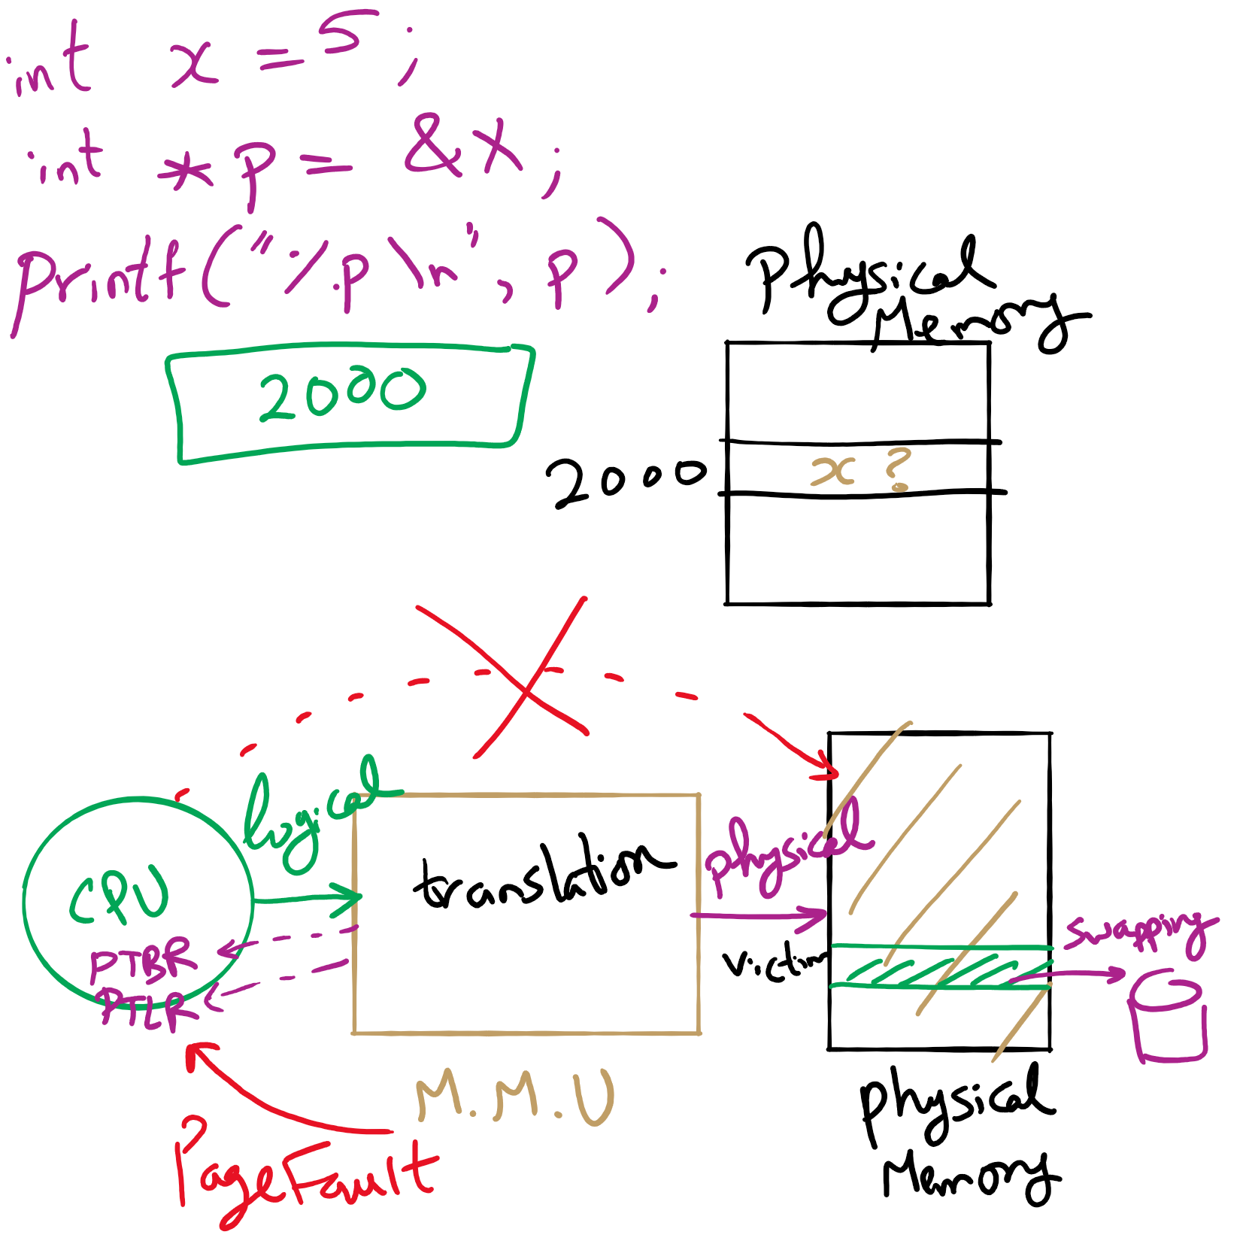
Address Translation

Slide 12
Paging and page tables
Virtual addresses mapped to physical addresses
Unit of mapping is called a page
All addresses in the same virtual page are in the same physical page
Page table entry (PTE) contains translation for a single page
Table translates virtual page number to physical page number
Not all virtual memory has a physical page
Not every physical page need be used
Example:
64 KB virtual memory
32 KB physical memory
60–64K
-
56–60K
-
52–56K
-
48–52K
6
44–48K
5
40–44K
1
36–40K
-
32–36K
-
28–32K
3
28–32K
24–28K
-
24–28K
20–24K
-
20–24K
16–20K
0
16–20K
12–16K
-
12–16K
8–12K
-
8–12K
4–8K
4
4–8K
0–4K
7
0–4K
Virtual address space
Physical memory

Slide 13
What’s in a page table entry?
Each entry in the page table contains
Valid bit: set if this logical page number has a corresponding physical frame in memory
If not valid, remainder of PTE is irrelevant
Page frame number: page in physical memory
Referenced bit: set if data on the page has been accessed
Dirty (modified) bit :set if data on the page has been modified
Protection information
Protection
D
R
V
Page frame number
Dirty bit
Referenced bit
Valid bit

Slide 14
Implementing page tables in hardware
Page table resides in main (physical) memory
CPU uses special registers for paging
Page table base register (PTBR) points to the page table
Page table length register (PTLR) contains length of page table: restricts maximum legal logical address
Translating an address requires two memory accesses
First access reads page table entry (PTE)
Second access reads the data / instruction from memory
Reduce number of memory accesses
Can’t avoid second access (we need the value from memory)
Eliminate first access by keeping a hardware cache (called a translation lookaside buffer or TLB) of recently used page table entries

Slide 15
Page replacement algorithms
Page fault forces a choice
No room for new page (steady state)
Which page must be removed to make room for an incoming page?
How is a page removed from physical memory?
If the page is unmodified, simply overwrite it: a copy already exists on disk
If the page has been modified, it must be written back to disk: prefer unmodified pages?
Better not to choose an often used page
It’ll probably need to be brought back in soon

Slide 16
Optimal page replacement algorithm
What’s the best we can possibly do?
Assume perfect knowledge of the future
Not realizable in practice (usually)
Useful for comparison: if another algorithm is within 5% of optimal, not much more can be done…
Algorithm: replace the page that will be used furthest in the future
Only works if we know the whole sequence!
Can be approximated by running the program twice
Once to generate the reference trace
Once (or more) to apply the optimal algorithm
Nice, but not achievable in real systems!

Slide 17
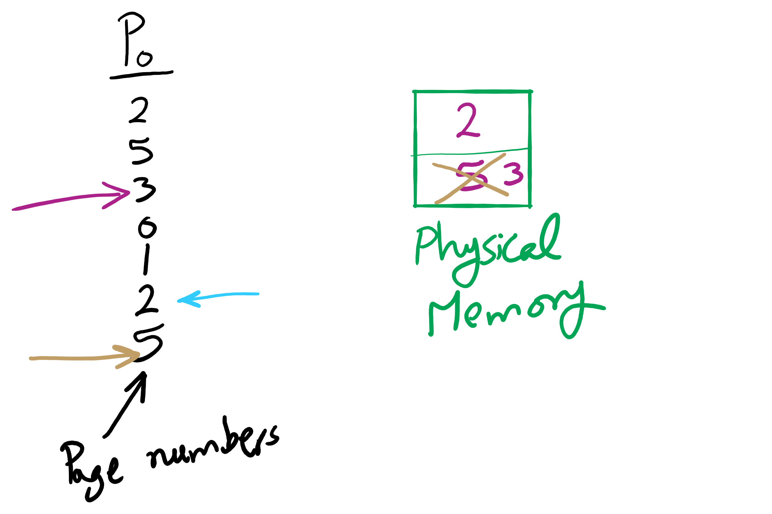
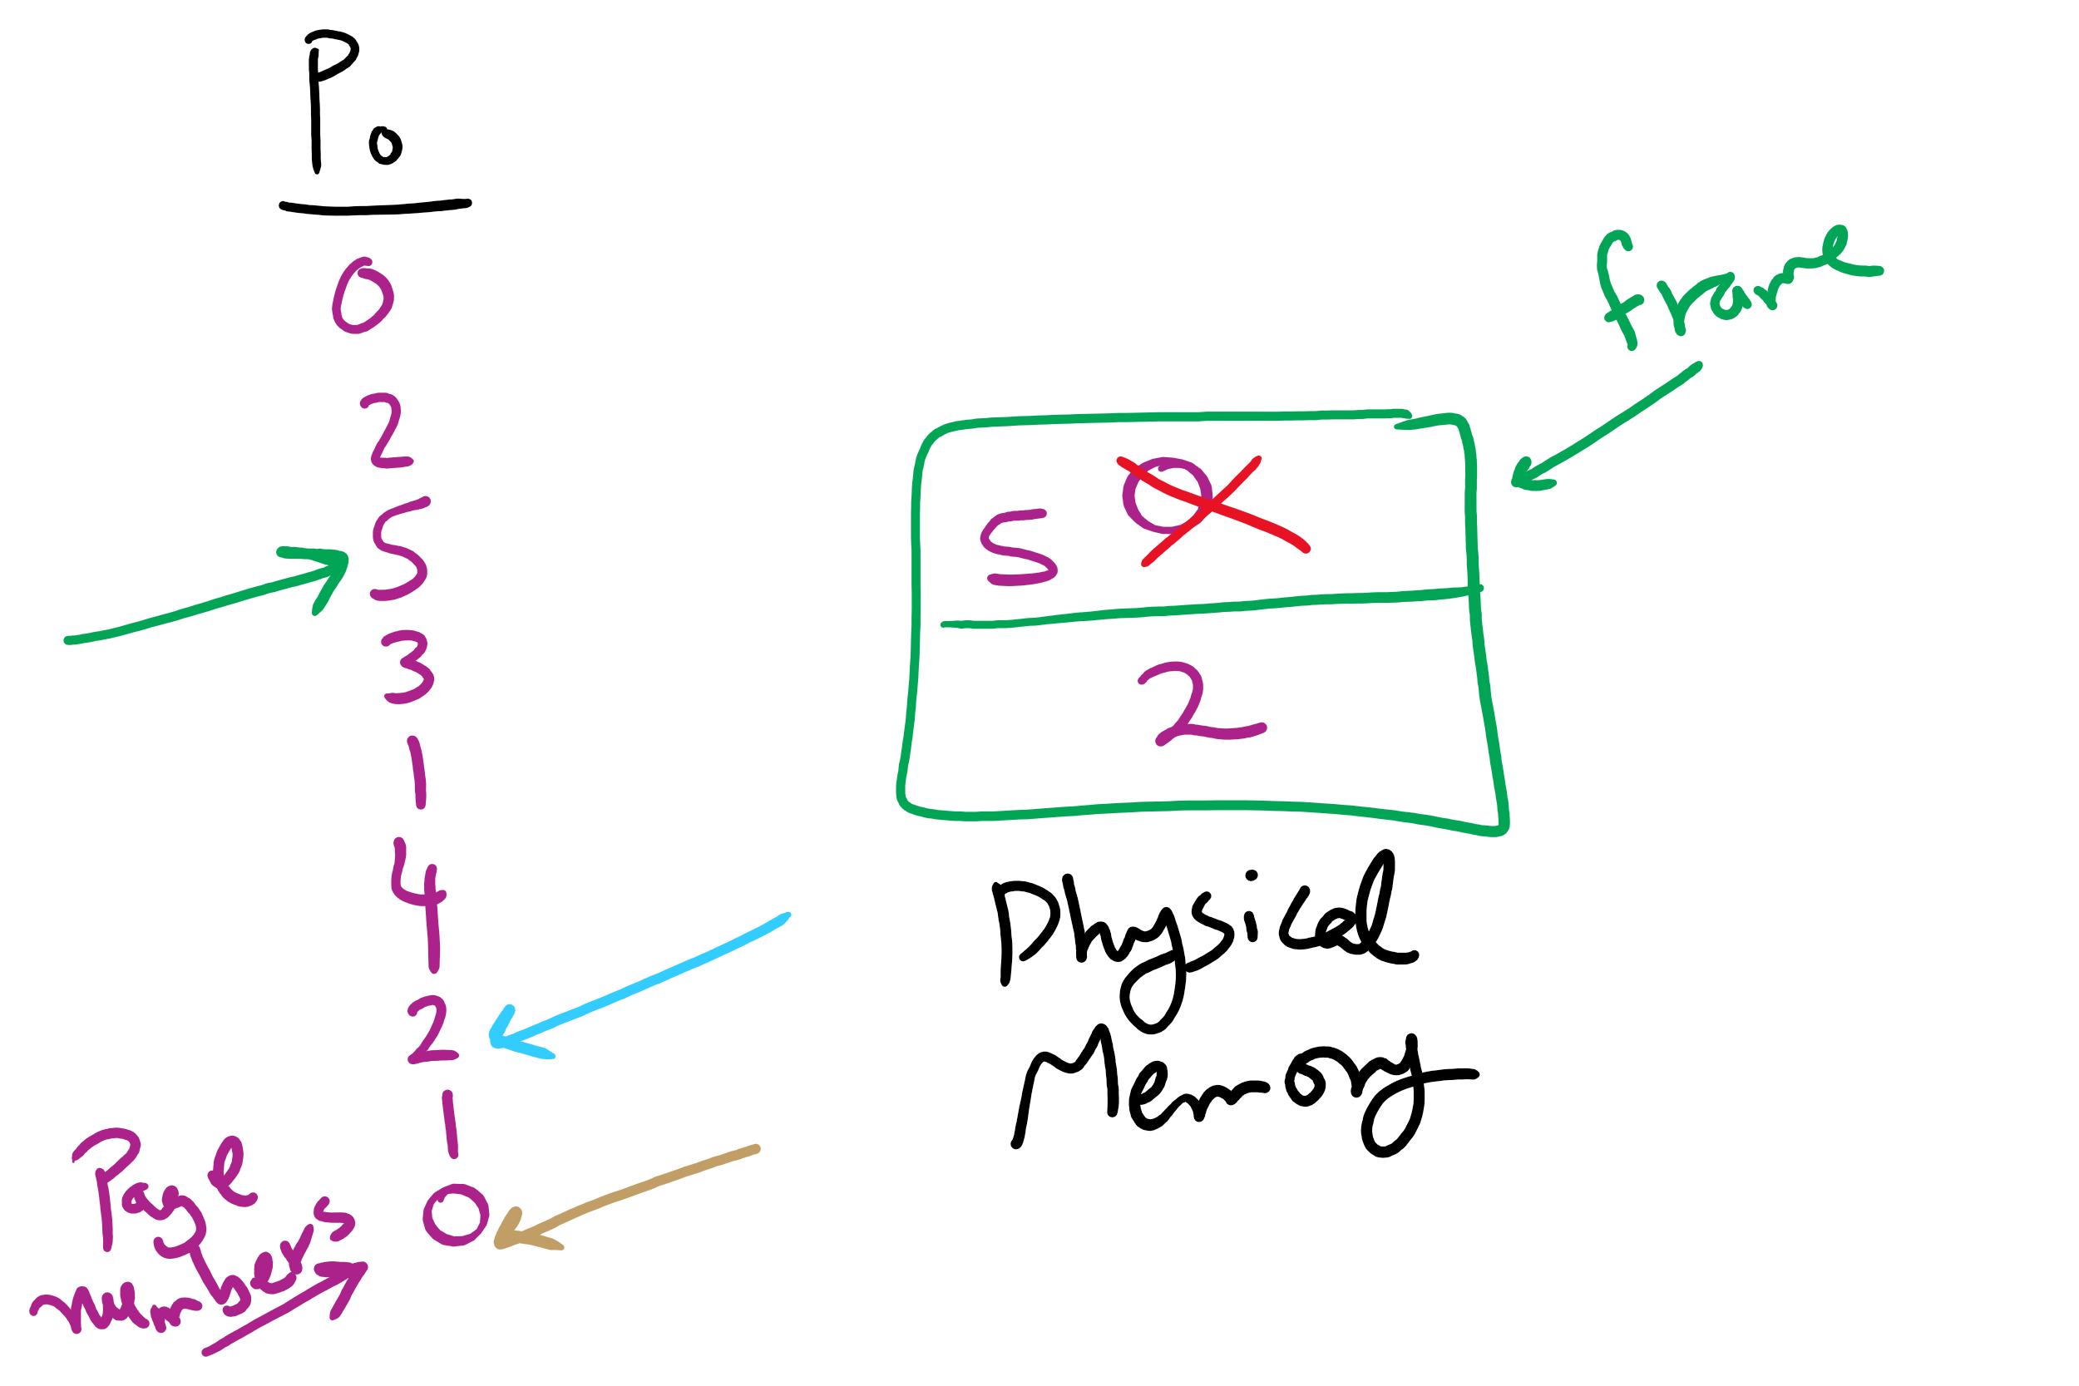
OPT Examples

Slide 18
Not-recently-used (NRU) algorithm
Each page has reference bit and dirty bit
Bits are set when page is referenced and/or modified
Pages are classified into four classes
0: not referenced, not dirty
1: not referenced, dirty
2: referenced, not dirty
3: referenced, dirty
Clear reference bit for all pages periodically
Can’t clear dirty bit: needed to indicate which pages need to be flushed to disk
Class 1 contains dirty pages where reference bit has been cleared
Algorithm: remove a page from the lowest non-empty class
Select a page at random from that class
Easy to understand and implement
Performance adequate (though not optimal)

Slide 19
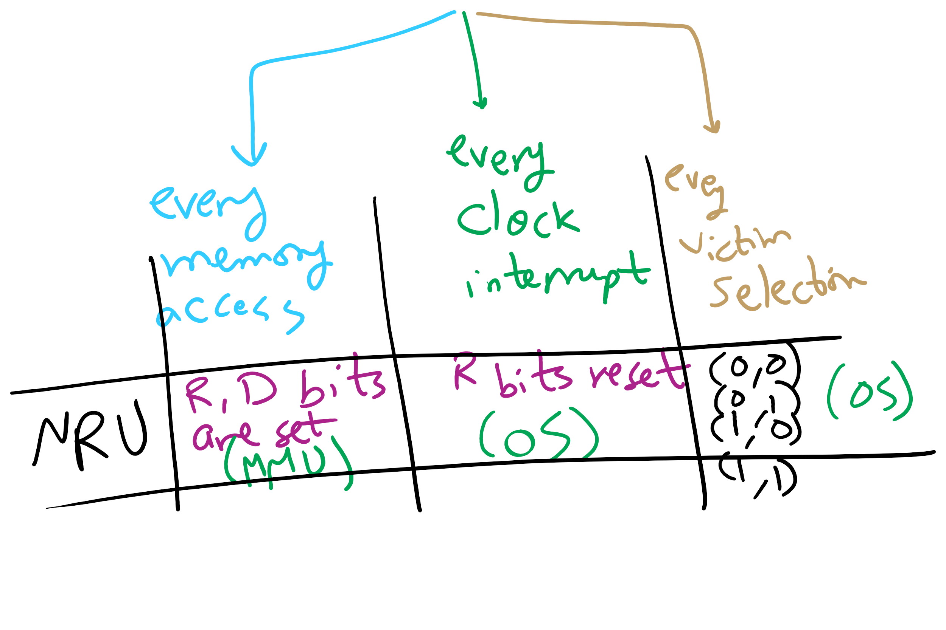
NRU Operation

