Slide 1

Introduction to Operating Systems CS/COE 1550
Spring 2022
Sherif Khattab
ksm73@pitt.edu
(Some slides are from Silberschatz, Galvin and Gagne ©2013)

Slide 2
Announcements
Upcoming deadlines
Homework 1 is due today at 11:59 pm
Homework 2 is due next Monday at 11:59 pm
Lab 1 is due on 2/4 at 11:59 pm
Project 1 is due on 2/18 at 11:59 pm
TA Office hours available on the syllabus page

Slide 3
Previous Lecture …
Busy waiting problem and how to solve it using semaphores

Slide 4
Muddiest Points
a little confused on the relationship between semaphores and spinlocks
what’s the advantage between a binary semaphore and a spinlock if a binary semaphore can only be for one process?
What happens to each process with each up() and down() for multiple processes with varying priorities? Another walkthrough basically
could you further explain how the semaphores with spinlocks still are able to keep their benefits?
What is the point of having semaphores if you are going to tie them with spinlocks? Does that not defeat the benefits of using a semaphore?
By introducing a spinlock within our semaphore implementation, doesn't that bring up the issue of busy waiting? Or is this not an issue because the critical section is a relatively small block of code?
what is the different between swap and test&set?
Do Semaphores have the same issue with reordering instructions that spinlocks have?

Slide 5
Muddiest Points (2/3)
where the lock() and unlock() go in the pseudo code of the spinlock in semaphores example
How to stop the up/down from breaking (the if else thing you brought up at the end)
for the process list I am assuming we would use some sort of priority queue to sort the processes for the ProcessList?
How a spinlock is implemented in a semaphore
I think the functional difference between blocking and waiting. As in, what is actually happening while a process is infinite looping and awaiting a lock? Since it's not "blocked", does that mean that it prevents other processes from running, or can it be context switched out like any normal process?
which implementation is most commonly used for semaphores
difference between counting and binary semaphore (why counting would be used)
can the semaphore be > 0, and if so what does that mean?
How are spinlocks implemented in hardware? Are they the only locking mechanism implemented in hardware?

Slide 6
Muddiest Points (3/3)
How process states are switched/clarification on ready/waiting/running
What does the comment above the line of assembly code mean?
I'm curious about memory barriers. could you talk more about how to use _sync_synchronize() and how it works?
Where exactly the code blocks
from the tophat question: why can down move a process into ready
When/why is reordering instructions in a critical section beneficial?
Today, We heard "Block" a lot but it has the same meaning
Implementation of mutex vs standard semaphore
When would you know to use a spinlock instead of a semaphore?
Why two context switches in semaphore
What is/makes an operation atomic?

Slide 7
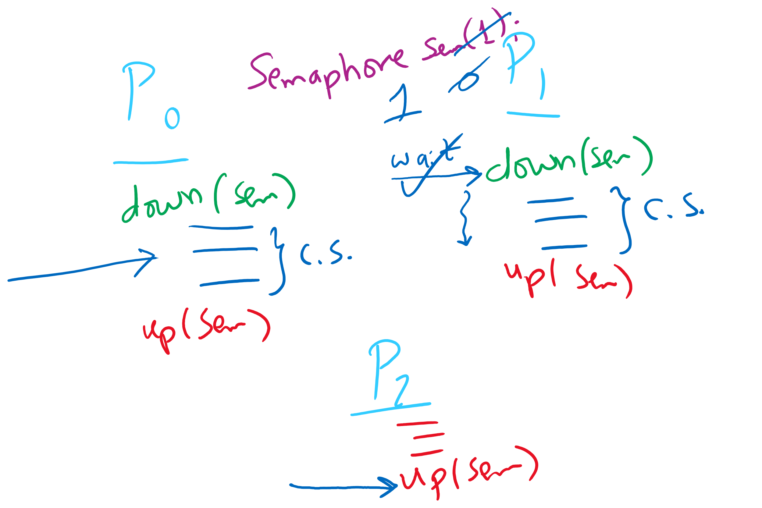
Semaphore Usage Problem: Compromising Mutual Exclusion
Any process can up() the semaphore
Solution: A Mutex can be up()’d only by the same process that down()’d it

Slide 8
Semaphore Usage Problem: Deadlock and Starvation
Deadlock: two or more processes are waiting indefinitely for an event that can only be caused by a waiting process
P0 gets A, needs B
P1 gets B, needs A
Each process waiting for the other to signal
Starvation: indefinite blocking
Process is never removed from the semaphore queue in which its suspended
May be caused by ordering in queues (priority)
Shared variables
Semaphore A(1),B(1);
Process P₀
A.down();
B.down();
.
.
.
B.up();
A.up();
Process P₁
B.down();
A.down();
.
.
.
A.up();
B.up();

Slide 9
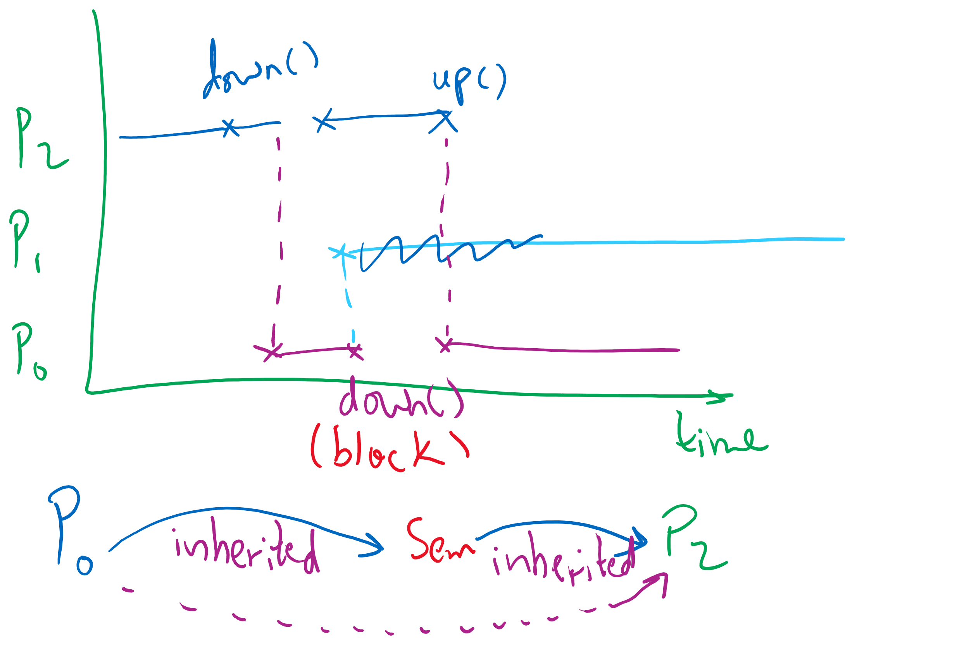
Semaphore Usage Problem: Priority Inversion
Priority inversion is still possible using semaphores
Slightly less likely
Needs at least three processes

Slide 10
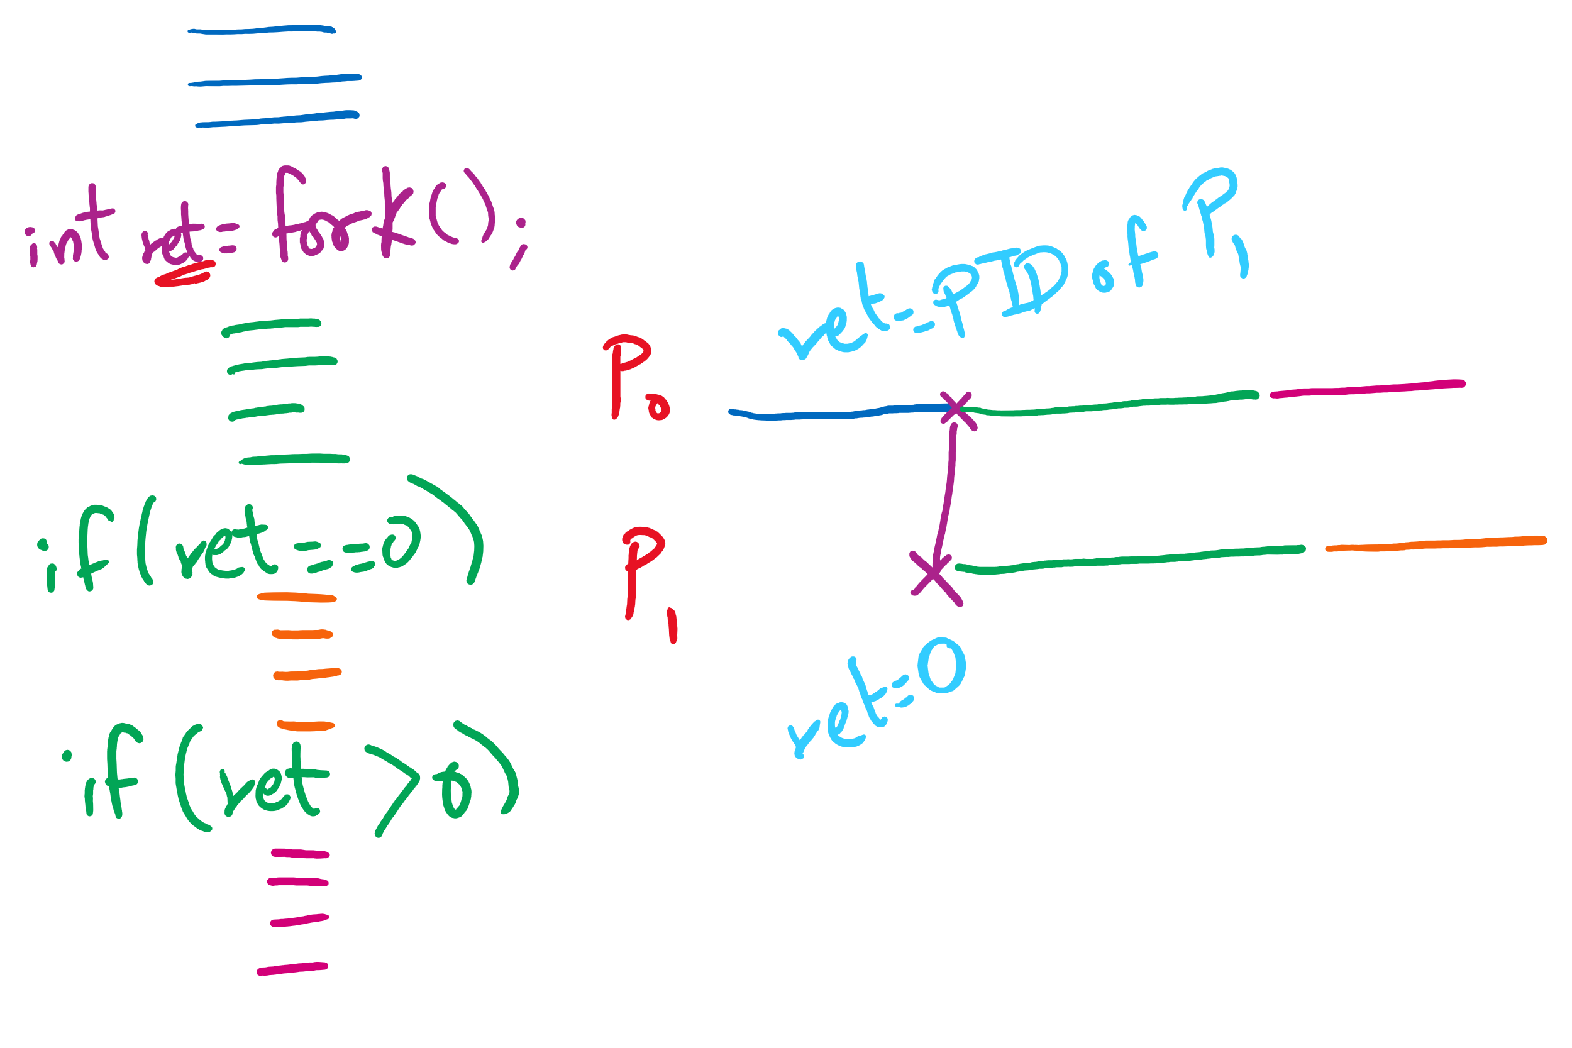
fork() tracing

Slide 11
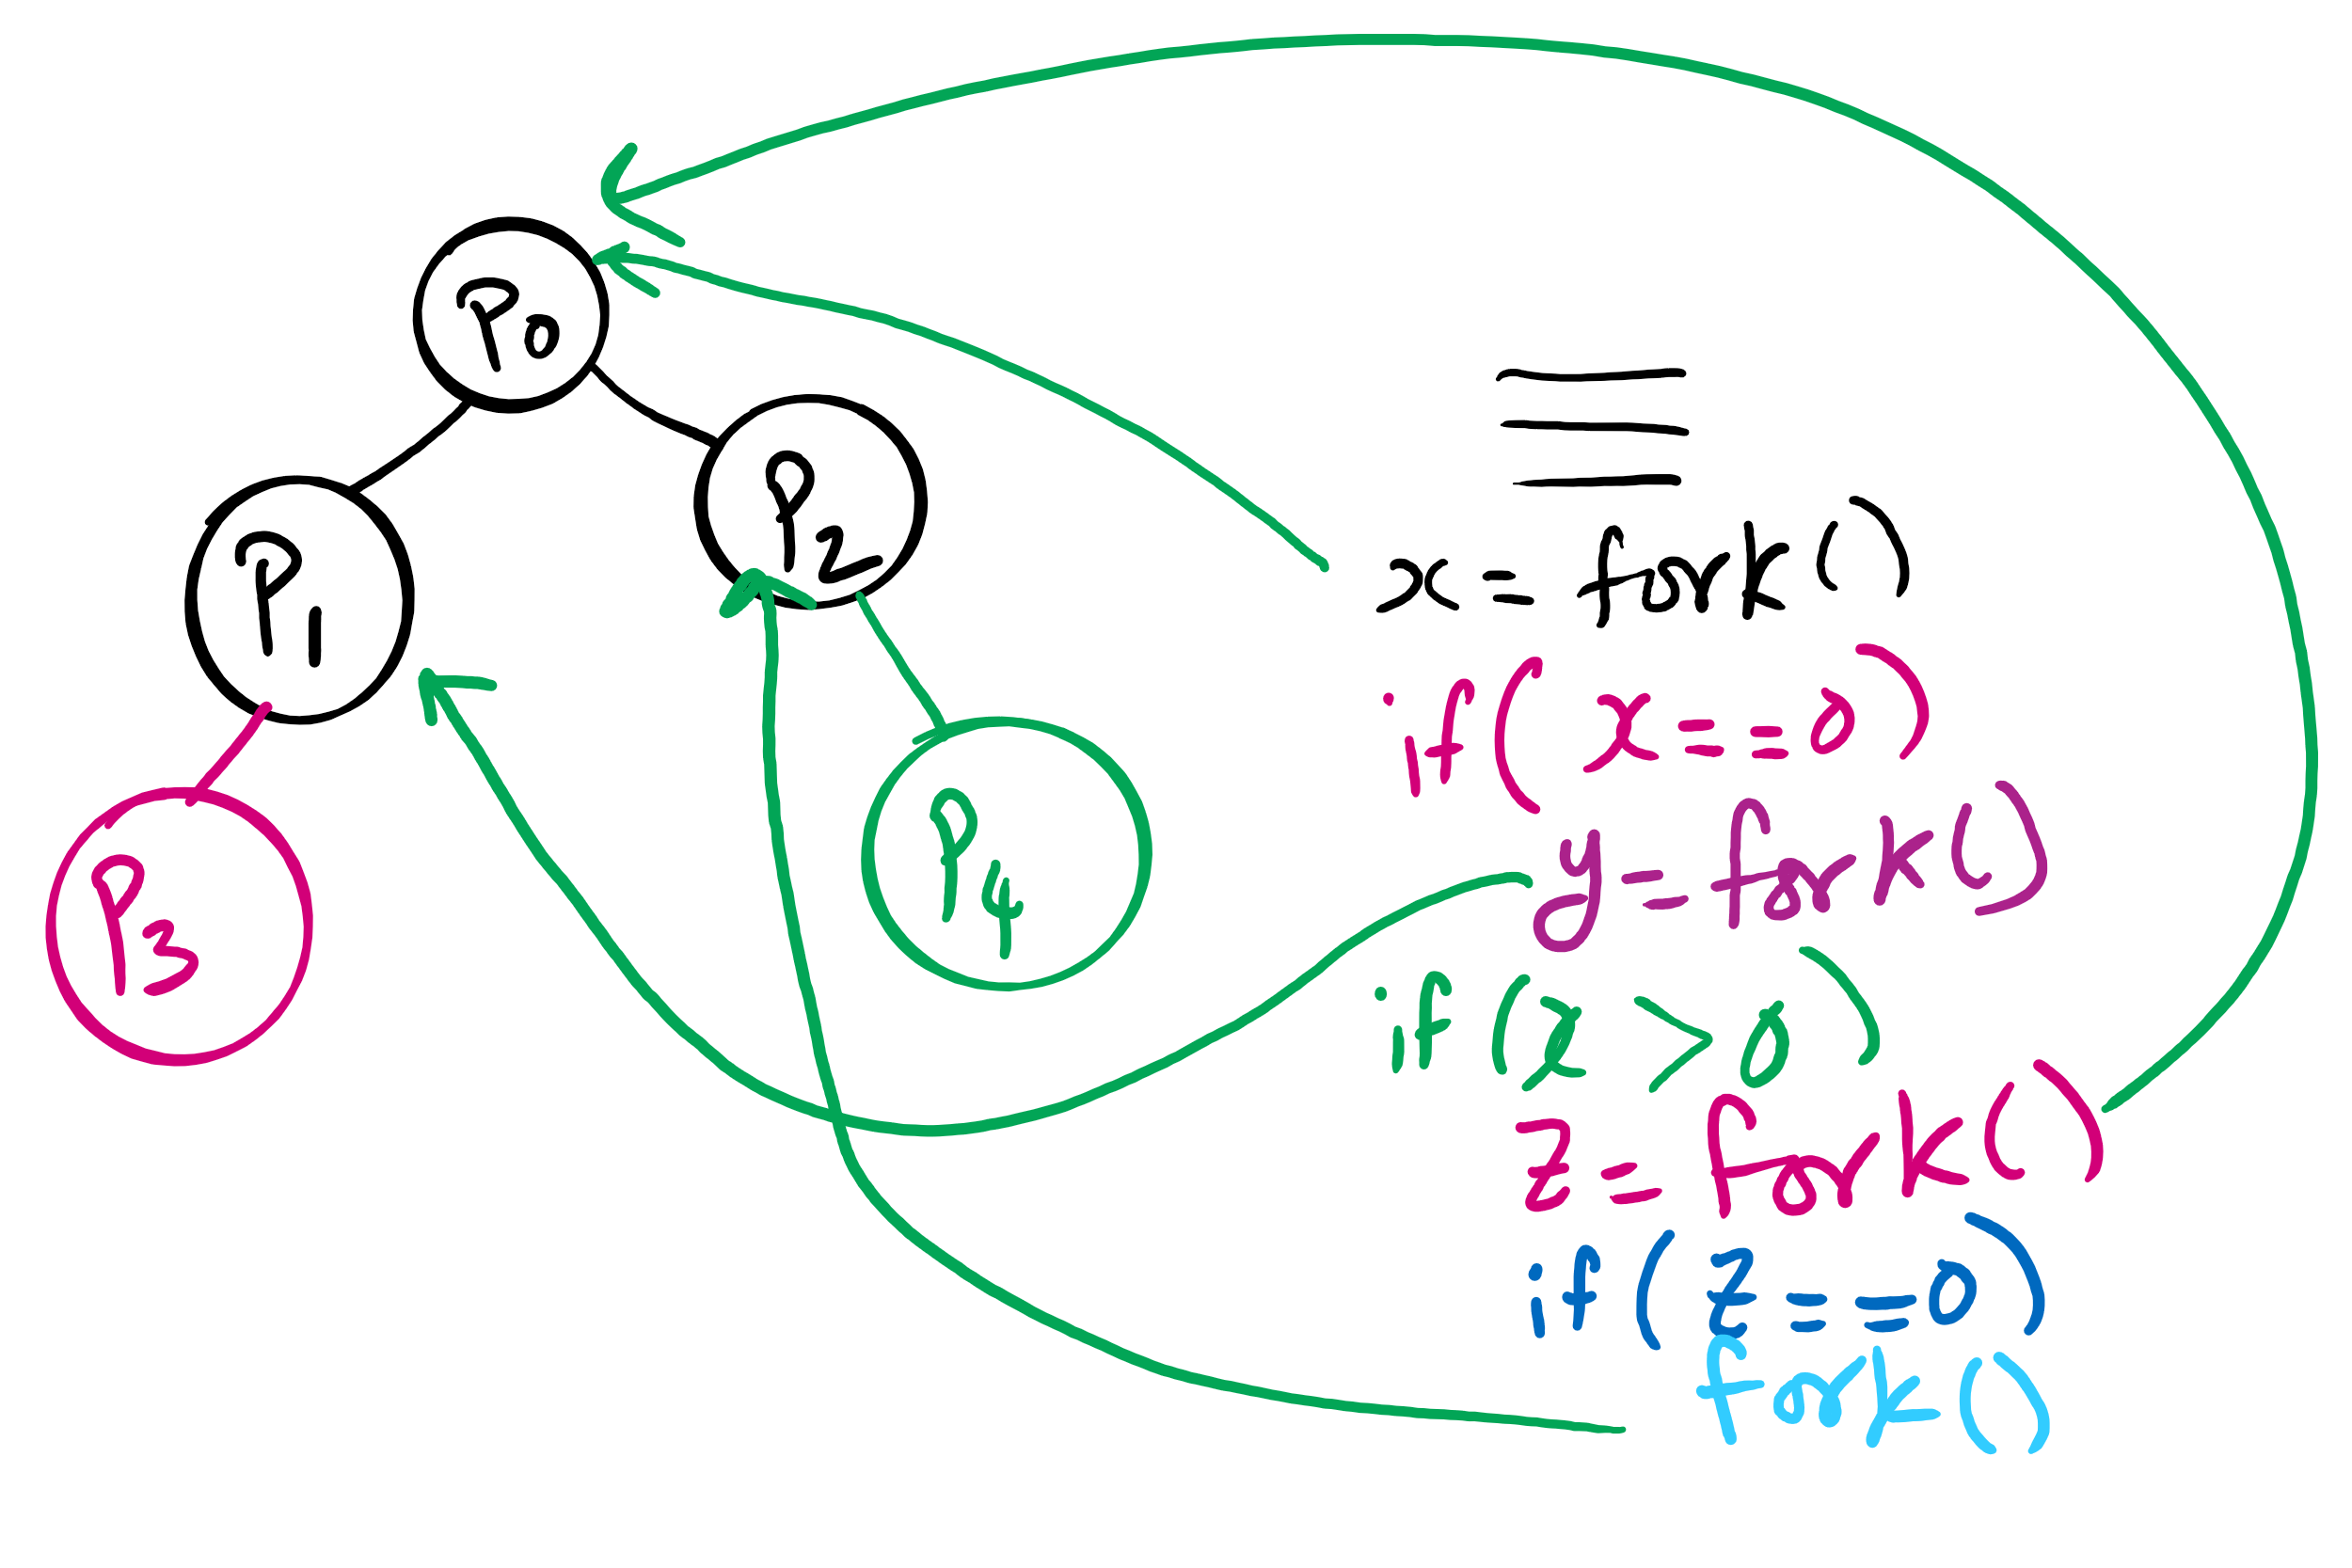
fork()’s of fork()’s

Slide 12
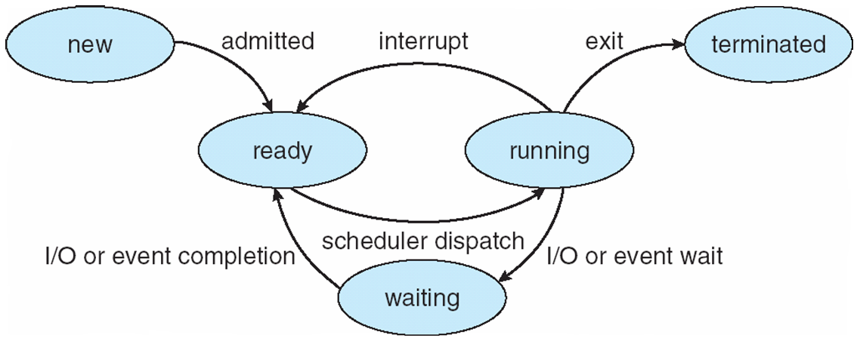
Process Lifecycle (AKA Process States)

Slide 13
Process Termination
Via exit() or abort() syscalls
The parent process may wait for termination of a child process by using the wait()system call.The call returns status information and the pid of the terminated process
pid = wait(&status);
When a process terminates
If no parent waiting (did not invoke wait()) process is a zombie
If parent terminated without invoking wait , process is an orphan
adopted by the init process

Slide 14
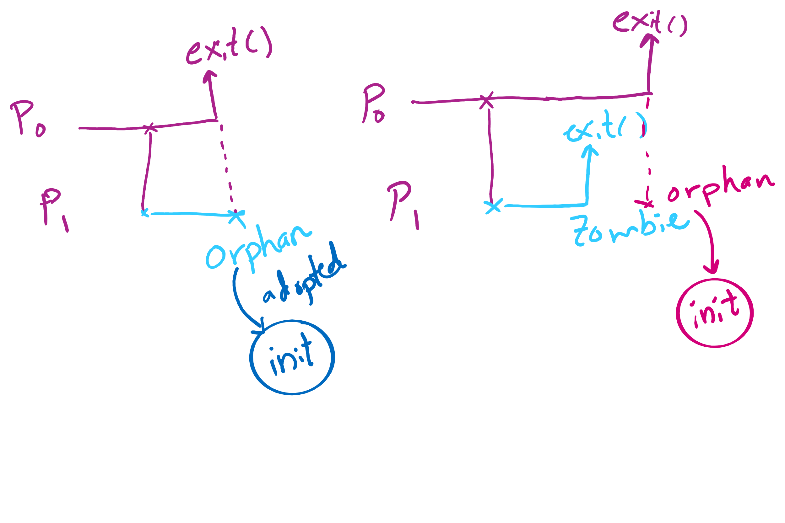
Orphan vs. Zombie Processes

Slide 15
Benefits of Orphan Processes
Allow a long-running job to continue running even after session (e.g., ssh connection) ends.
The nohup command does that
Create daemon processes
Long-running background processes adopted by the init process.

Slide 16
Xv6 Code Walkthrough
fork()
exit()
wait()

Slide 17
Process Lifecycle (AKA Process States)

Slide 18
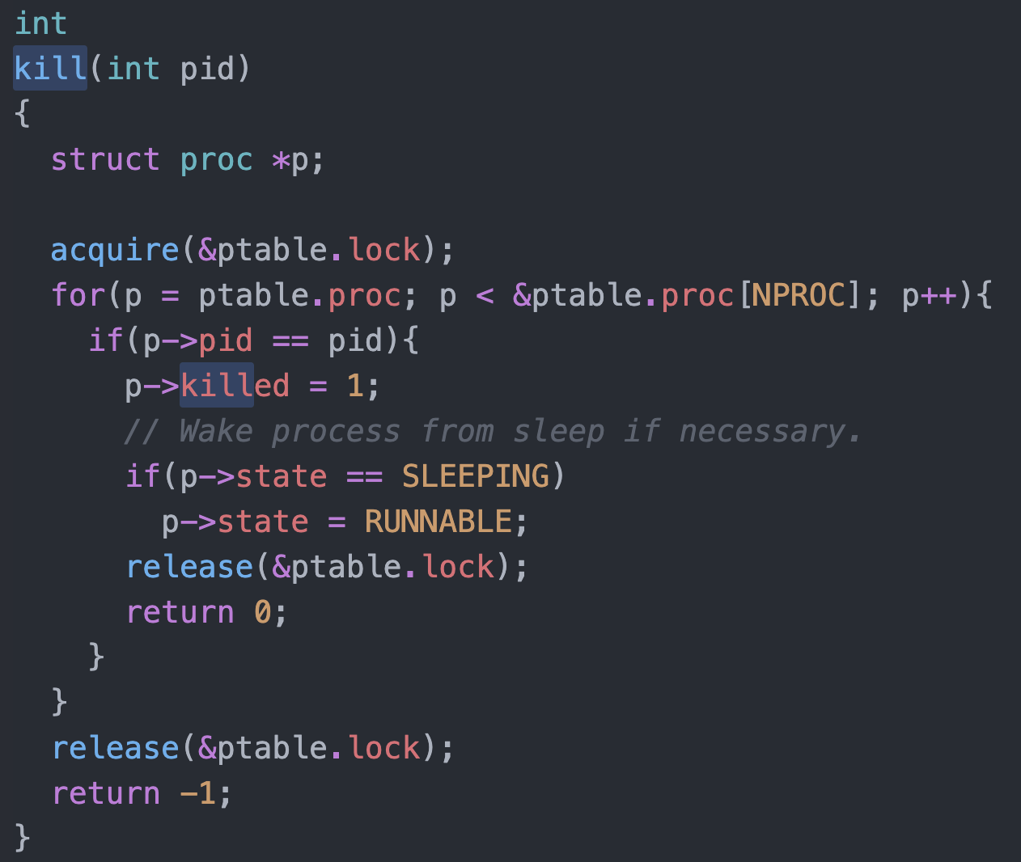
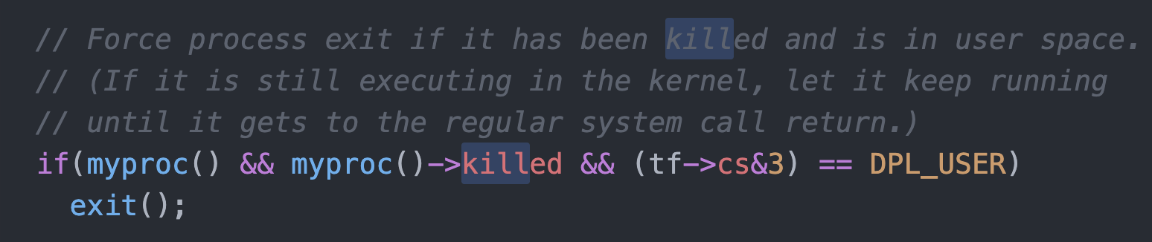
Killing a waiting process

Slide 19
Thread Synchronization
Synchronization issues apply to threads as well
Threads can share data easily (same address space)
Other two issues apply to threads

Slide 20
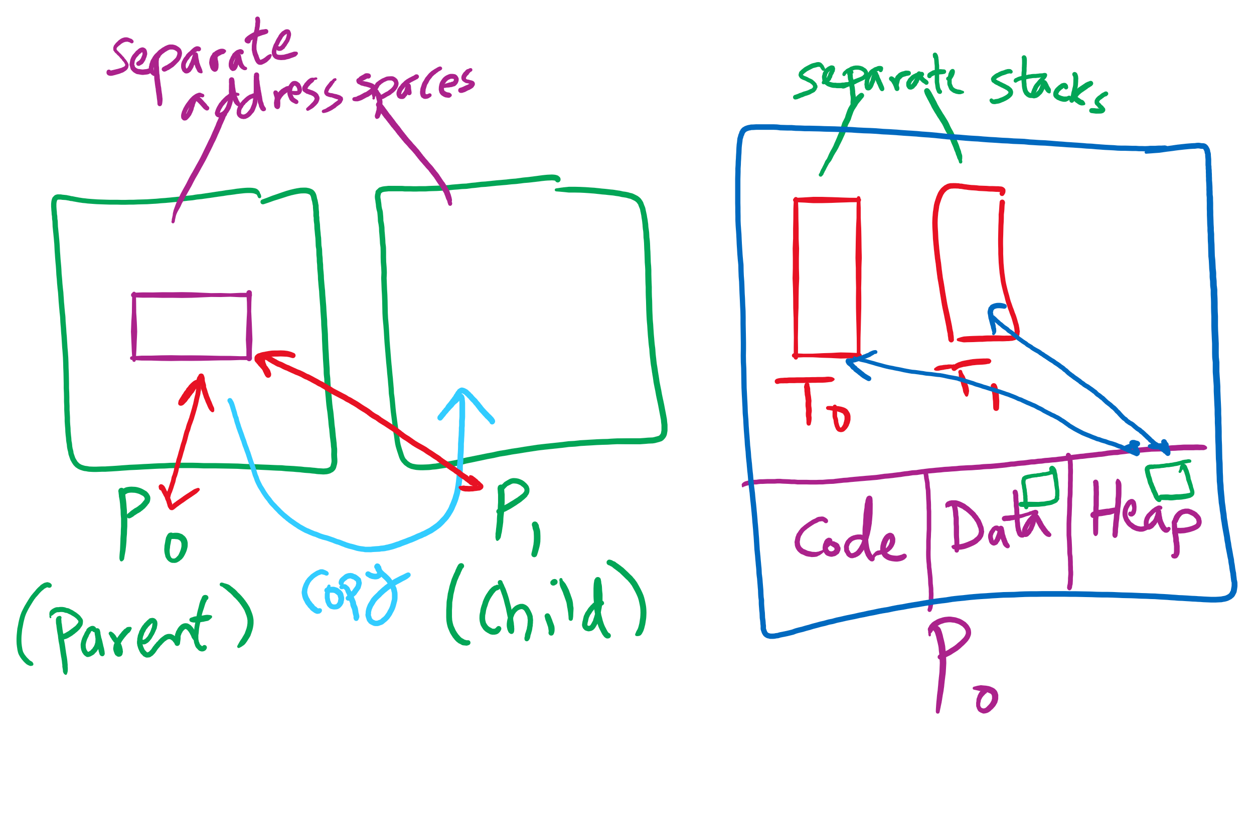
Process vs. Thread

Slide 21
Why do we need Synchronization?
Each process operates sequentially
All is fine until processes want to share data
Exchange data between multiple processes
Allow processes to navigate critical regions
Maintain proper sequencing of actions in multiple processes

Slide 22
Semaphores for general synchronization
We want to execute B in P1 only after A executes in P0
Use a semaphore initialized to 0
Use up() to notify P1 at the appropriate time
Shared variables
// flag initialized to 0
Semaphore flag(0);
Process P₀
.
.
.
// Execute code for A
flag.up ();
Process P₁
.
.
.
flag.down ();
// Execute code for B

