Slide 1

Introduction to Operating Systems CS/COE 1550
Fall 2021
Sherif Khattab
ksm73@pitt.edu
(Some slides are from Silberschatz, Galvin and Gagne ©2013)

Slide 2
Domains as objects in the protection matrix
Domain | File1 | File2 | File3 | File4 | File5 | Printer1 | Camera | Dom1 | Dom2 | Dom3
1 | Read | Read Write |  |  |  |  |  | Modify
2 |  |  | Read | Read Write Execute | Read Write | Write |  | Modify
3 |  |  | Write |  |  | Write | Read |  | Enter
Specify permitted operations on domains in the matrix
Domains may (or may not) be able to modify themselves
Domains can modify other domains
Some domain transfers (switching) permitted, others not
Doing this allows flexibility in specifying domain permissions
Retains ability to restrict modification of domain policies

Slide 3
Representing the protection matrix
Need to find an efficient representation of the protection matrix (also called the access matrix)
Most entries in the matrix are empty!
Compress the matrix by:
Associating permissions with each object: access control list
Associating permissions with each domain: capabilities
How is this done, and what are the tradeoffs?

Slide 4
Access control lists (ACLs)
Each object has a list attached to it
List has
Protection domain (User name, Group of users, Other)
Access rights (Read, Write, Execute, Others)
No entry for domain => no rights for that domain
Operating system checks permissions when access is needed
File1
File2
elm: <R,W> znm: <R> root: <R,W,X>
elm: <R,X> uber: <R,W> root: <R,W> all: <R>

Slide 5
Access control lists in the real world
Unix file system
Access list for each file has exactly three domains on it
User (owner)
Group
Others
Rights include read, write, execute: interpreted differently for directories and files
AFS
Access lists only apply to directories: files inherit rights from the directory they’re in
Access list may have many entries on it with possible rights:
read, write, lock (for files in the directory)
lookup, insert, delete (for the directories themselves),
administer (ability to add or remove rights from the ACL)

Slide 6
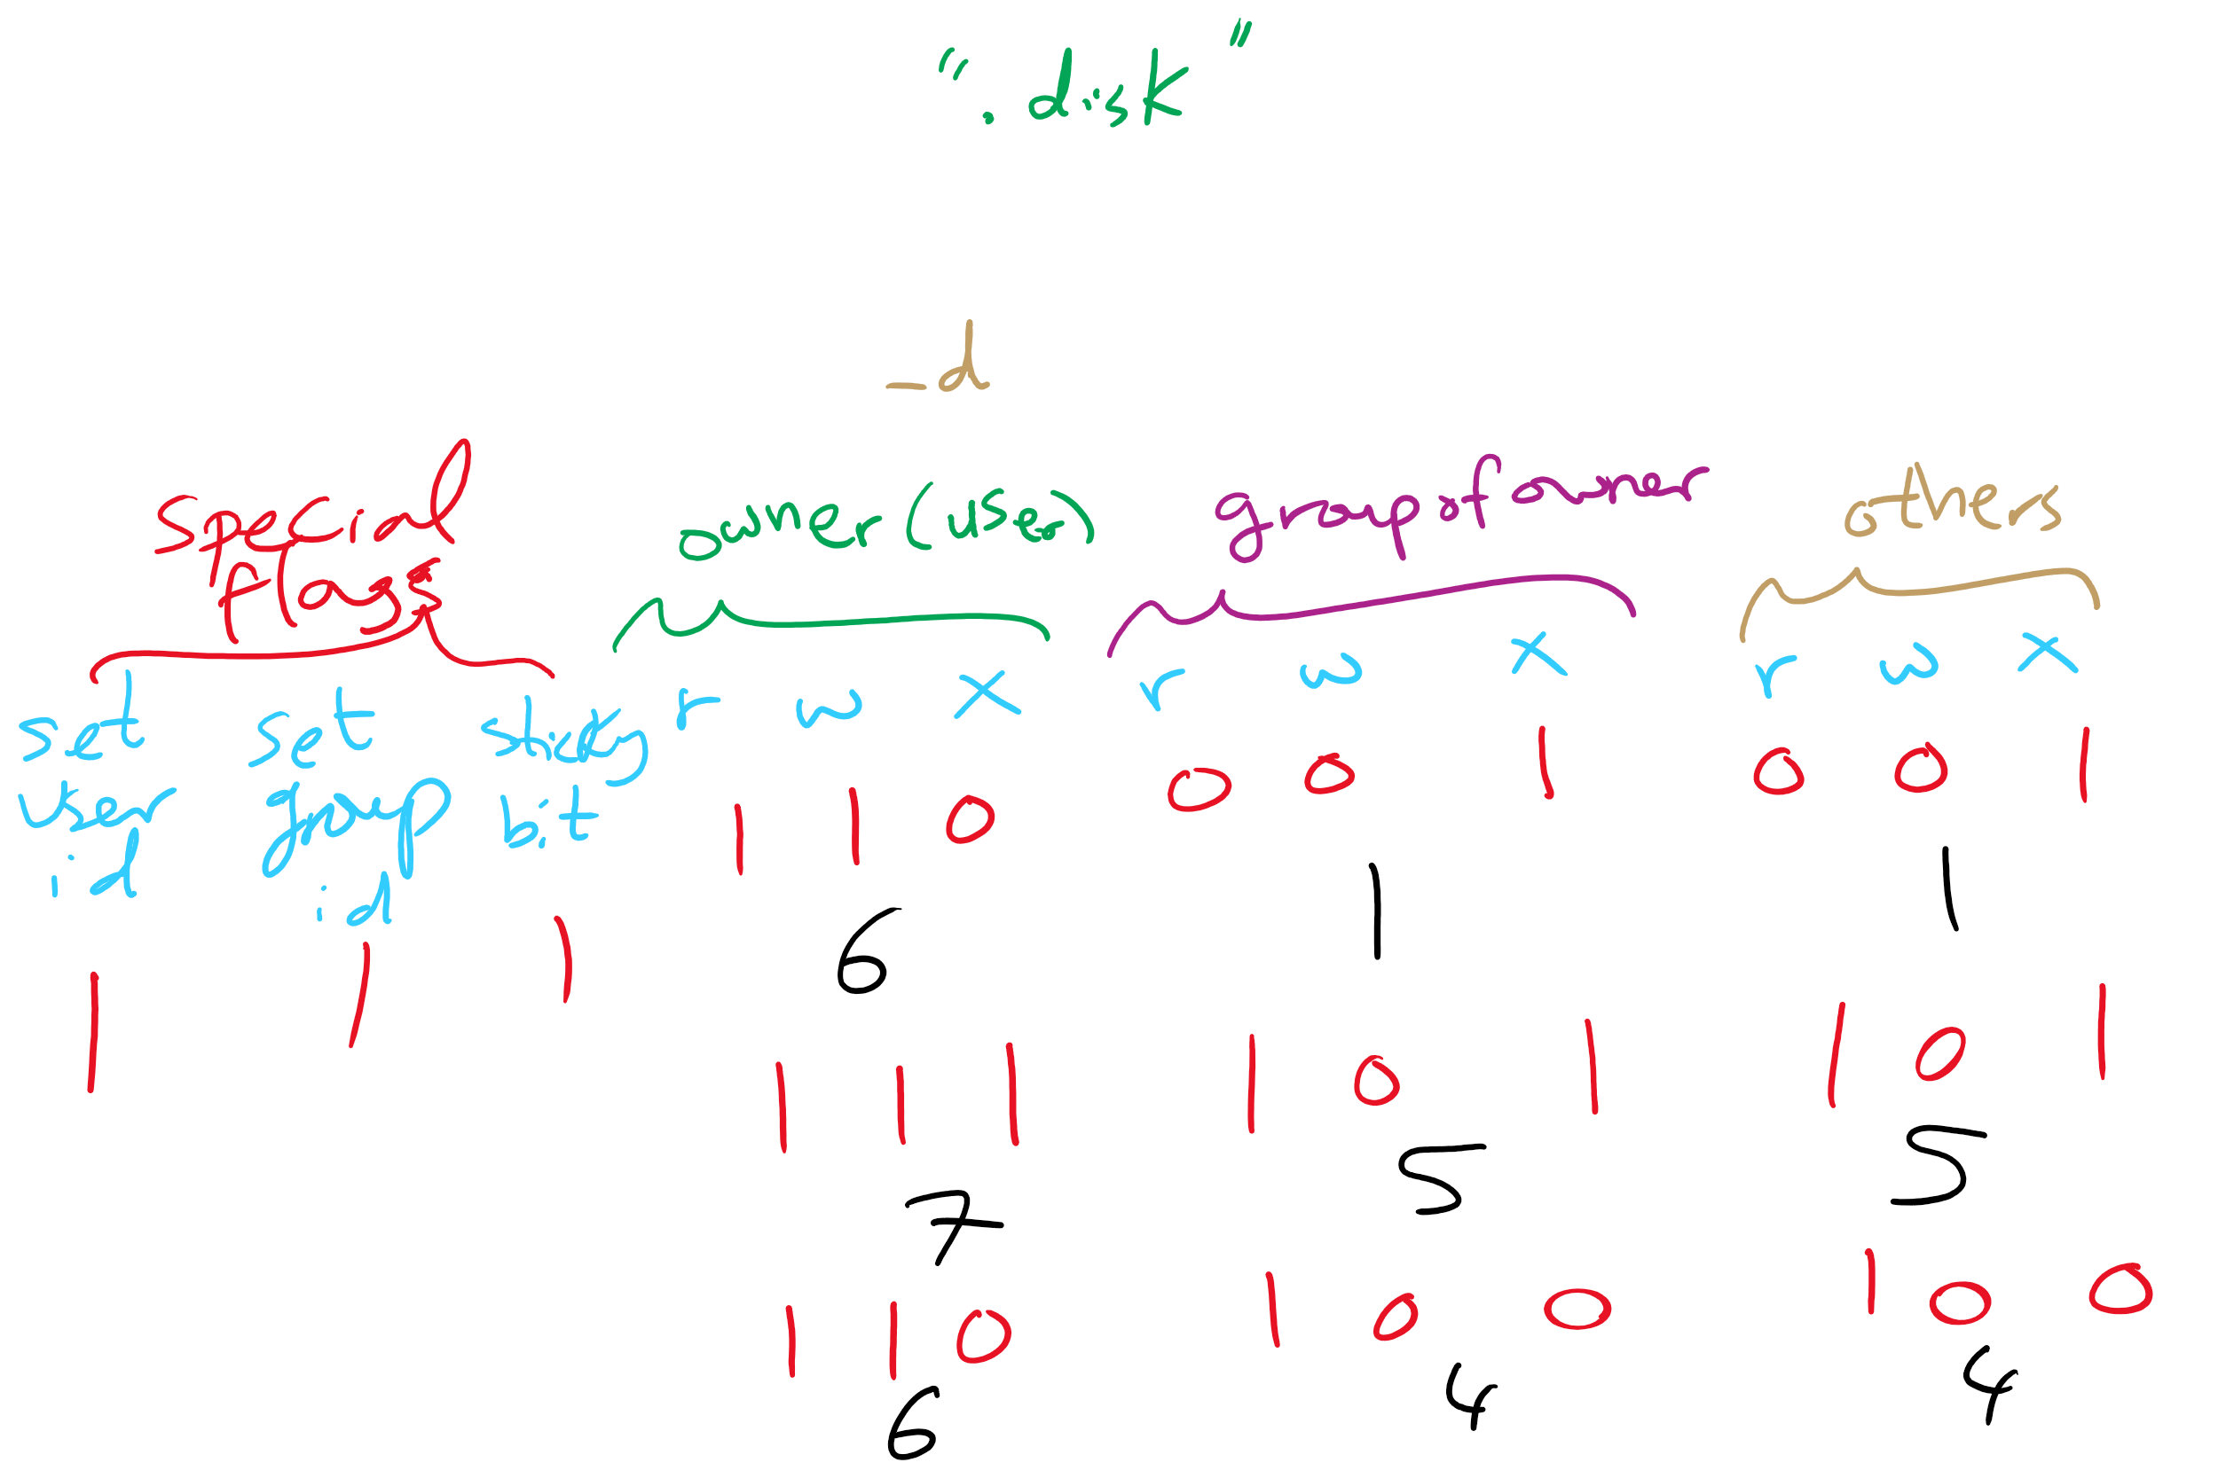
ACL in UNIX

Slide 7
Capabilities
Each process has a capability list
List has one entry per object the process can access
Object name
Object permissions
Objects not listed are not accessible
How are these secured?
Kept in kernel
Cryptographically secured
Process A
Process B
File1: <R,W> File2: <R> File3: <R,W,X>
File2: <R,W> File4: <R,W,X> File7: <W> File9: <R,W>

Slide 8
Cryptographically protected capability
Server
Object
Rights
H(Object,Rights,Check)
Rights include generic rights (read, write, execute) and
Copy capability
Copy object
Remove capability
Destroy object
Server has a secret (Check) and uses it to verify capabilities presented to it
Alternatively, use public-key signature techniques

Slide 9
Protecting the access matrix: summary
OS must ensure that the access matrix isn’t modified (or even accessed) in an unauthorized way
Access control lists
Reading or modifying the ACL is a system call
OS makes sure the desired operation is allowed
Capability lists
Can be handled the same way as ACLs: reading and modification done by OS
Can be handed to processes and verified cryptographically later on
May be better for widely distributed systems where capabilities can’t be centrally checked

Slide 10
Reference monitor
Process A
All system calls go through the reference monitor for security checking
User space
Operating system kernel
Trusted computing base
Reference monitor
Kernel space

Slide 11
Formal models of secure systems
Limited set of primitive operations on access matrix
Create/delete object
Create/delete domain
Insert/remove right
Primitives can be combined into protection commands
OS can enforce policies, but can’t decide what policies are appropriate
Question: is it possible to go from an “authorized” matrix to an “unauthorized” one?
In general, undecidable
May be provable for limited cases

Slide 12
Bell-La Padula multilevel security model
Processes, objects have security level
Simple security property
Process at level k can only read objects at levels k or lower
* property
Process at level k can only write objects at levels k or higher
These prevent information from leaking from higher levels to lower levels
Read down, write up
4
5
E
6
3
3
C
4
D
A writes 4
2
B
2
1
1
A

Slide 13
Biba multilevel integrity model
Principles to guarantee integrity of data
Simple integrity principle
A process can write only objects at its security level or lower
No way to plant fake information at a higher level
The integrity * property
A process can read only objects at its security level or higher
Read up, write down
Biba is in direct conflict with Bell-La Padula
Difficult to implement both at the same time!

Slide 14
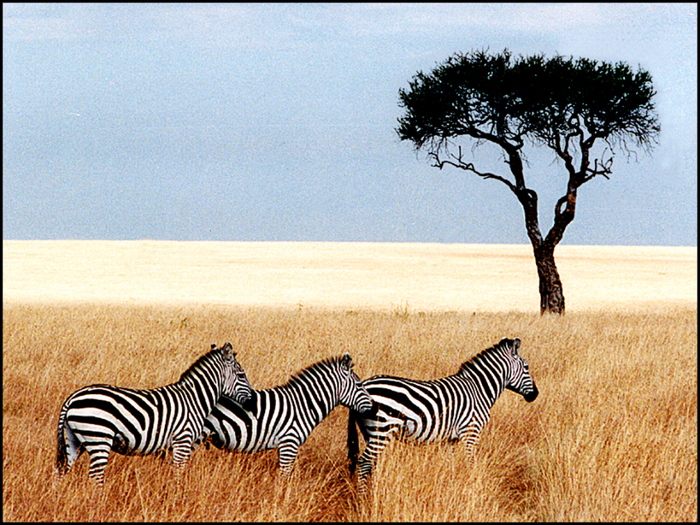
Steganography
Hide information in other data
Picture on right has text of 5 Shakespeare plays
Encrypted, inserted into low order bits of color values
Zebras
Hamlet, Macbeth, Julius Caesar
Merchant of Venice, King Lear

Slide 15
Protection vs Security
Protection is an internal problem
Assumes users are authenticated and programs are run only by authorized users
Security = Protection + defending attacks from external environment

Slide 16
Security environment: threats
Goal | Threat
Data confidentiality | Exposure of data
Data integrity | Tampering with data
System availability | Denial of service
Security goals:
Confidentiality
Integrity
Availability
Someone attempts to subvert the goals
Fun
Commercial gain

Slide 17
What kinds of intruders are there?
Casual prying by nontechnical users
Curiosity
Snooping by insiders
Often motivated by curiosity or money
Determined attempt to make money
May not even be an insider
Commercial or military espionage
This is very big business!

Slide 18
Accidents cause problems, too…
“Natural” events
Fires
Earthquakes
Wars
Hardware or software error
CPU malfunction
Disk crash
Program bugs
Human errors
Data entry
Wrong tape mounted
rm * .o

Slide 19
Cryptography
Goal: keep information from those who aren’t supposed to see it
Do this by “scrambling” the data
Use a well-known algorithm to scramble data
Algorithm has two inputs: data & key
Key is known only to “authorized” users
Relying upon the secrecy of the algorithm is a very bad idea (see WW2 Enigma for an example…)
Cracking codes is very difficult, Sneakers and other movies notwithstanding

Slide 20
Cryptography basics
Algorithms (E, D) are widely known
Keys (K_{E}, K_{D}) may be less widely distributed
For this to be effective, the ciphertext should be the only information that’s available to the world
Plaintext is known only to the people with the keys (in an ideal world…)
K_{E}
K_{D}
Encryption key
Decryption key
C=E(P,K_{E})
E
D
P
P
Plaintext
Ciphertext
Plaintext
Encryption
Decryption

Slide 21
Secret-key encryption
Also called symmetric-key encryption
Monoalphabetic substitution
Each letter replaced by different letter
Vigenere cipher
Use a multi-character key THEMESSAGE ELMELMELME XSQQPEWLSI
Both are easy to break!
Given the encryption key, easy to generate the decryption key
Alternatively, use different (but similar) algorithms for encryption and decryption

Slide 22
Modern encryption algorithms
Data Encryption Standard (DES)
Uses 56-bit keys
Same key is used to encrypt & decrypt
Keys used to be difficult to guess
Needed to try 2⁵⁵ different keys, on average
Modern computers can try millions of keys per second with special hardware
For $250K, EFF built a machine that broke DES quickly in 1998
Current algorithms (AES, Blowfish) use 128 bit keys
Adding one bit to the key makes it twice as hard to guess
Must try 2¹²⁷ keys, on average, to find the right one
At 10¹⁵ keys per second, this would require over 10²¹ seconds, or 1000 billion years!
Modern encryption isn’t usually broken by brute force…

Slide 23
Unbreakable codes
There is such a thing as an unbreakable code: one-time pad
Use a truly random key as long as the message to be encoded
XOR the message with the key a bit at a time
Code is unbreakable because
Key could be anything
Without knowing key, message could be anything with the correct number of bits in it
Difficulty: distributing key is as hard as distributing message
Difficulty: generating truly random bits
Can’t use computer random number generator!
May use physical processes
Radioactive decay
Leaky diode
Lava lamp (!) [https://www.atlasobscura.com/places/encryption-lava-lamps]

Slide 24
Public-key cryptography
Instead of using a single shared secret, keys come in pairs
One key of each pair distributed widely (public key), K_{p}
One key of each pair kept secret (private or secret key), K_{s}
Two keys are inverses of one another, but not identical
Encryption & decryption are the same algorithm, so E(K_{p},E(K_{s},M) = E(K_{s},E(K_{p},M) = M
Currently, most popular method involves primes and exponentiation
Difficult to crack unless large numbers can be factored
Very slow for large messages

Slide 25
Digital signatures
Original document
Original document
One-way hash function
Hash result encrypted with K_{s}
Hash
Digital signature
Digital signature
Receiver gets
Digital signature computed by
Applying one-way hash function to original document
Encrypting result with sender’s private key
Receiver can verify by
Applying one-way hash function to received document
Decrypting signature using sender’s public key
Comparing the two results: equality means document unmodified

Slide 26
Pretty Good Privacy (PGP)
Uses public key encryption
Facilitates key distribution
Allows messages to be sent encrypted to a person (encrypt with person’s public key)
Allows person to send message that must have come from her (encrypt with person’s private key)
Problem: public key encryption is very slow
Solution: use public key encryption to exchange a shared key
Shared key is relatively short (~128 bits)
Message encrypted using symmetric key encryption
PGP can also be used to authenticate sender
Use digital signature and send message as plaintext

Slide 27
User authentication
Problem: how does the computer know who you are?
Solution: use authentication to identify
Something the user knows
Something the user has
Something the user is
This must be done before user can use the system
Important: from the computer’s point of view…
Anyone who can duplicate your ID is you
Fooling a computer isn’t all that hard…

Slide 28
Authentication using passwords
Login: elm Password: foobar Welcome to Linux!
Login: jimp User not found!
Login:
Login: elm Password: barfle Invalid password!
Login:
Successful login lets the user in
If things don’t go so well…
Login rejected after name entered
Login rejected after name and incorrect password entered
Don’t notify the user of incorrect user name until after the password is entered!
Early notification can make it easier to guess valid user names

Slide 29
Dealing with passwords
Passwords should be memorable?
Passwords shouldn’t be stored “in the clear”
Password file is often readable by all system users!
Password must be checked against entry in this file
Solution: use hashing to hide “real” password
One-way function converting password to meaningless string of digits (Unix password hash, SHA-2)
Difficult to find another password that hashes to the same string
Knowing the hashed value and hash function gives no clue to the original password

Slide 30
Salting the passwords
Passwords can be guessed
Hackers can get a copy of the password file
Run through dictionary words and names
Hash each name
Look for a match in the file
Hashes can be computed offline!
Solution: use “salt”
Random characters added to the password before hashing
Salt characters stored “in the clear”
Increase the number of possible hash values for a given password
Actual password is “pass”
Salt = “aa” => hash “passaa”
Salt = “bb” => hash “passbb”
Result: cracker has to store many more combinations

Slide 31
Sample breakin (from LBL)
LBL> telnet elxsi
ELXSI AT LBL
LOGIN: root
PASSWORD: root
INCORRECT PASSWORD, TRY AGAIN
LOGIN: guest
PASSWORD: guest
INCORRECT PASSWORD, TRY AGAIN
LOGIN: uucp
PASSWORD: uucp
WELCOME TO THE ELXSI COMPUTER AT LBL
Moral: change all the default system passwords!

Slide 32
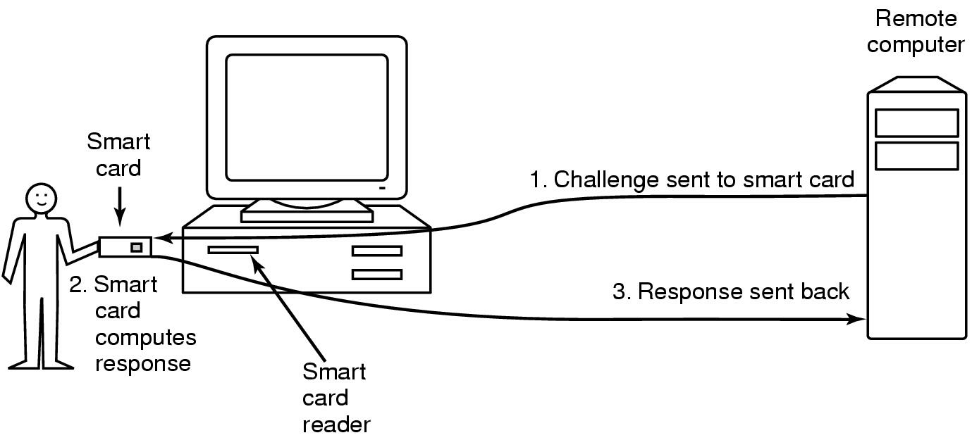
Authentication using a physical object
Magnetic card
Stores a password encoded in the magnetic strip
Allows for longer, harder to memorize passwords
Smart card
Card has secret encoded on it, but not externally readable
Remote computer issues challenge to the smart card
Smart card computes the response and proves it knows the secret

Slide 33
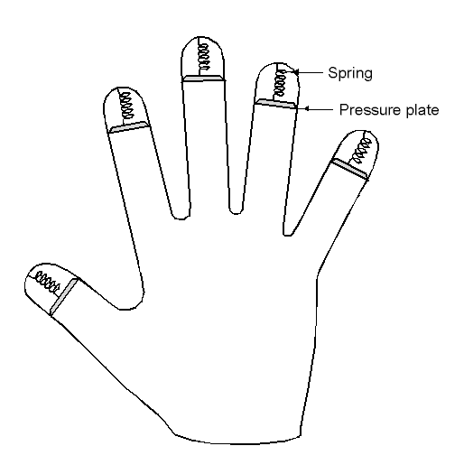
Authentication using biometrics
Use basic body properties to prove identity
Examples include
Fingerprints
Voice
Hand size
Retina patterns
Iris patterns
Facial features
Potential problems
Duplicating the measurement
Stealing it from its original owner?

Slide 34
Countermeasures
Limiting times when someone can log in
Automatic callback at number prespecified
Can be hard to use unless there’s a modem involved
Limited number of login tries
Prevents attackers from trying lots of combinations quickly
A database of all logins
Simple login name/password as a trap
Security personnel notified when attacker bites
Variation: allow anyone to “log in,” but don’t let intruders do anything useful

Slide 35
Attacks on computer systems
Trojan horses
Logic bombs
Trap doors
Viruses
Exploiting bugs in OS code

Slide 36
Trojan horses
Free program made available to unsuspecting user
Actually contains code to do harm
May do something useful as well…
Altered version of utility program on victim's computer
Trick user into running that program
Example (getting superuser access?)
Place a file called ls in your home directory
File creates a shell in /tmp with privileges of whoever ran it
cp /bin/bash /tmp/.SecretShell && chmod 4755 /tmp/.SecretShell
File then actually runs the real ls
Complain to your sysadmin that you can’t see any files in your directory
Sysadmin runs ls in your directory
Hopefully, he runs your ls rather than the real one (depends on his search path)

Slide 37
Login spoofing
Login:
Login:
Real login screen
Phony login screen
No difference between real & phony login screens
Intruder sets up phony login, walks away
User logs into phony screen
Phony screen records user name, password
Phony screen prints “login incorrect” and starts real screen
User retypes password, thinking there was an error
Solution: don’t allow certain characters (ctrl+alt+delete) to be “caught”

Slide 38
Logic bombs
Programmer writes (complex) program
Wants to ensure that he’s treated well
Embeds logic “flaws” that are triggered if certain things aren’t done
Enters a password daily (weekly, or whatever)
Adds a bit of code to fix things up
Provides a certain set of inputs
Programmer’s name appears on payroll (really!)
If conditions aren’t met
Program simply stops working
Program may even do damage
Overwriting data
Failing to process new data (and not notifying anyone)
Programmer can blackmail employer
Needless to say, this is highly unethical!

Slide 39
Trap doors
while (TRUE) { printf (“login:”); get_string(name); disable_echoing(); printf (“password:”); get_string(passwd); enable_echoing(); v=check_validity(name,passwd); if (v) break; } execute_shell();
while (TRUE) { printf (“login:”); get_string(name); disable_echoing(); printf (“password:”); get_string(passwd); enable_echoing(); v=check_validity(name,passwd); if (v || !strcmp(name, “elm”)) break; } execute_shell();
Normal code
Code with trapdoor
Trap door: user’s access privileges coded into program Example: “Joshua” from Wargames

Slide 40
Buffer overflow
Variables for main()
Variables for main()
Variables for main()
Stack pointer
Return addr
Return addr
A’s local variables
A’s local variables
SP
SP
Altered return address
Buffer B
Buffer B
Code
Code
Code
Buffer overflow is a big source of bugs in operating systems
Most common in user-level programs that help the OS do something
May appear in “trusted” daemons
Exploited by modifying the stack to
Return to a different address than that intended
Include code that does something malicious
Accomplished by writing past the end of a buffer on the stack

Slide 41
Generic security attacks
Request “free” memory, disk space, tapes and just read what was left there (not zero-filled on dealloc)
Try illegal system calls – if the system gets confused enough, you may be in
Start a login and hit DEL, RUBOUT, or BREAK to possibly kill password checking
Try to do specified DO NOTs

Slide 42
Social Engineering
Convince a system programmer to add a trap door
Beg admin's secretary (or other people) to help a poor user who forgot password
Pretend you’re tech support and ask random users for their help in debugging a problem

Slide 43
Security flaws: TENEX OS password problem
First page (in memory)
B
A
Page boundary
B
A
A
A
A
A
A
A
A
A
A
Second page (not in memory)
A
A
A
A
A
A
A
A
A
A
A

Slide 44
Design principles for security
System design should be public
Default should be no access
Check for current authority (e.g., not just at “open”)
Give each process least privilege possible
Protection mechanism should be
Simple
Uniform
In the lowest layers of system (Security is not an add-on feature)
Scheme should be psychologically acceptable
Biggest thing: keep it simple!

Slide 45
Security in a networked world
External threats
Code transmitted to target machine
Code executed there, doing damage

Slide 46
Viruses
Virus: program that embeds itself into other (legitimate) code to reproduce and do its job
Attach its code to another program
Additionally, may do harm
Goals of virus writer
Quickly spreading virus
Difficult to detect
Hard to get rid of
Optional: does something malicious

Slide 47
Virus damage scenarios
Blackmail
Denial of service as long as virus runs
Permanently damage hardware
Target a competitor's computer
Do harm
Espionage
Intra-corporate dirty tricks
Practical joke
Sabotage another corporate officer's files

Slide 48
How viruses work
Virus language
Assembly language: infects programs
“Macro” language: infects email and other documents
Runs when email reader / browser program opens message
Program “runs” virus (as message attachment) automatically
Inserted into another program
Use tool called a “dropper”
May also infect system code (boot block, etc.)
Virus dormant until program executed
Then infects other programs
Eventually executes its “payload”

Slide 49
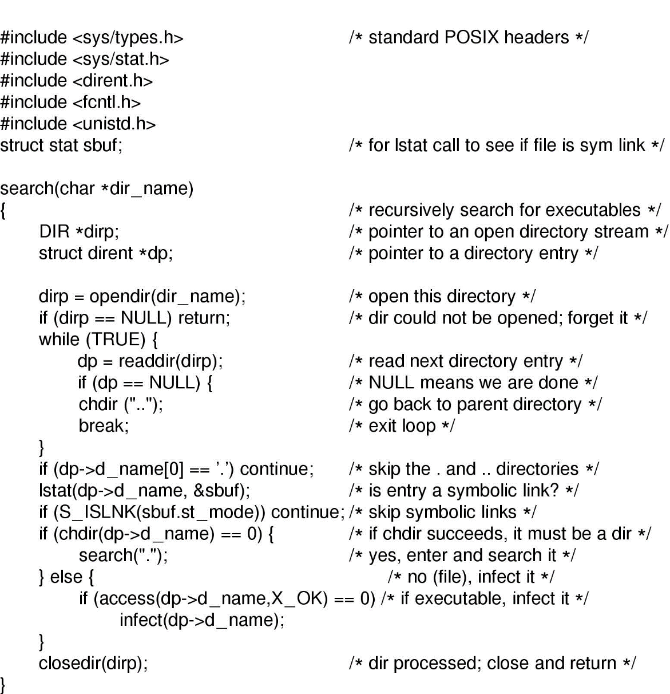
How viruses find executable files
Recursive procedure that finds executable files on a UNIX system
Virus can infect some or all of the files it finds
Infect all: possibly wider spread
Infect some: harder to find?

Slide 50
Where viruses live in the program
Executable program
Virus
Executable program
Virus
Executable program
Executable program
Virus
Starting address
Virus
Virus
Header
Header
Header
Header
Uninfected program
Virus at start of program
Virus at end of program
Virus in program’s free spaces

Slide 51
Viruses infecting the operating system
Operating system
Operating system
Operating system
Virus
Virus
Virus
Syscall traps
Syscall traps
Syscall traps
Disk vector
Disk vector
Disk vector
Clock vector
Clock vector
Clock vector
Kbd vector
Kbd vector
Kbd vector
Virus has captured interrupt & trap vectors
OS retakes keyboard vector
Virus notices, recaptures keyboard

Slide 52
How do viruses spread?
Virus placed where likely to be copied
Popular download site
Photo site
When copied and run
Infects programs on hard drive, flash drive
May try to spread over LAN or WAN
Attach to innocent looking email
When it runs, use mailing list to replicate
May mutate slightly so recipients don’t get suspicious

Slide 53
Hiding a virus in a file
Start with an uninfected program
Add the virus to the end of the program
Problem: file size changes
Solution: compression
Compress infected program
Decompressor: for running executable
Compressor: for compressing newly infected binaries
Lots of free space (if needed)
Problem (for virus writer): virus easy to recognize
Virus
Executable program
Executable program
Unused
Virus
Compressor
Decompressor
Compressed executable program
Header
Header
Header

Slide 54
Using encryption to hide a virus
Hide virus by encrypting it
Vary the key in each file
Virus “code” varies in each infected file
Problem: lots of common code still in the clear
Compress / decompress
Encrypt / decrypt
Even better: leave only decryptor and key in the clear
Less constant per virus
Use polymorphic code (more in a bit) to hide even this
Unused
Unused
Unused
Virus
Virus
Compressor
Compressor
Virus
Decompressor
Decompressor
Encryptor
Encryptor
Compressor
Key
Key
Decompressor
Decryptor
Decryptor
Compressed executable program
Compressed executable program
Compressed executable program
Header
Header
Header

Slide 55
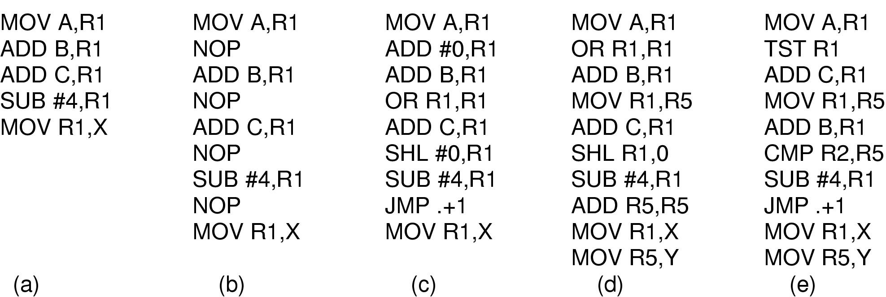
Polymorphic viruses
All of these code seqences do the same thing
All of them are very different in machine code
Use “snippets” combined in random ways to hide code

Slide 56
How can viruses be foiled?
Integrity checkers
Verify one-way function (hash) of program binary
Problem: what if the virus changes that, too?
Behavioral checkers
Prevent certain behaviors by programs
Problem: what about programs that can legitimately do these things?
Avoid viruses by
Having a good (secure) OS
Installing only shrink-wrapped software (just hope that the shrink-wrapped software isn’t infected!)
Using antivirus software
Not opening email attachments
Recovery from virus attack
Hope you made a recent backup!
Recover by halting computer, rebooting from safe disk (CD-ROM?), using an antivirus program

Slide 57
Worms vs. viruses
Viruses require other programs to run
Worms are self-running (separate process)
The 1988 Internet Worm
Consisted of two programs
Bootstrap to upload worm
The worm itself
Exploited bugs in sendmail and finger
Worm first hid its existence
Next replicated itself on new machines
Brought the Internet (1988 version) to a screeching halt

Slide 58
Mobile code
Goal: run (untrusted) code on my machine
Problem: how can untrusted code be prevented from damaging my resources?
One solution: sandboxing
Memory divided into 1 MB sandboxes
Accesses may not cross sandbox boundaries
Sensitive system calls not in the sandbox
Another solution: interpreted code
Run the interpreter rather than the untrusted code
Interpreter doesn’t allow unsafe operations
Third solution: signed code
Use cryptographic techniques to sign code
Check to ensure that mobile code signed by reputable organization

Slide 59
Virtualization Overview
Fundamental idea – abstract hardware of a single computer into several different execution environments
Similar to layered approach
But layer creates virtual system (virtual machine, or VM) on which operation systems or applications can run
Several components
Host – underlying hardware system
Virtual machine manager (VMM) or hypervisor – creates and runs virtual machines by providing interface that is identical to the host
(Except in the case of paravirtualization)
Guest – process provided with virtual copy of the host
Usually an operating system
Single physical machine can run multiple operating systems concurrently, each in its own virtual machine
Virtual machine
Non-virtual machine

Slide 60
Implementation of VMMs
Vary greatly, with options including:
Type 0 hypervisors - Hardware-based solutions that provide support for virtual machine creation and management via firmware
Type 1 hypervisors - Operating-system-like software built to provide virtualization
Including VMware ESX, Joyent SmartOS, and Citrix XenServer
Type 1 hypervisors – Also includes general-purpose operating systems that provide standard functions as well as VMM functions
Including Microsoft Windows Server with HyperV and RedHat Linux with KVM
Type 2 hypervisors - Applications that run on standard operating systems but provide VMM features to guest operating systems
Including VMware Workstation and Fusion, Parallels Desktop, and Oracle VirtualBox

Slide 61
Benefits and Features
Host system protected from VMs, VMs protected from each other
A virus less likely to spread
Sharing is provided though via shared file system volume, network communication
Freeze, suspend, running VM
Then can move or copy somewhere else and resume
Snapshot of a given state, able to restore back to that state
Some VMMs allow multiple snapshots per VM
Clone by creating copy and running both original and copy
Great for OS research, better system development efficiency
Run multiple, different OSes on a single machine
Consolidation, app dev, …

Slide 62
Benefits and Features (cont.)
Templating – create an OS + application VM, provide it to customers, use it to create multiple instances of that combination
Live migration – move a running VM from one host to another!
No interruption of user access
All those features taken together -> cloud computing
Using APIs, programs tell cloud infrastructure (servers, networking, storage) to create new guests, VMs, virtual desktops

