Slide 1

Introduction to Operating Systems CS/COE 1550
Fall 2021
Sherif Khattab
ksm73@pitt.edu
(Some slides are from Silberschatz, Galvin and Gagne ©2013)

Slide 2
Announcements
Upcoming deadlines:
Quiz 1 and Homework 4: due 10/8
Lab 2: due on 10/18
Project 2: due on 10/22
Midterm Exam next week
10/13 for MW section and 10/14 for TuTh section
In-class, in-person, paper, closed book

Slide 3
Last Lecture …
Semaphore-based solution to the Producers-Consumers Problem

Slide 4
Muddiest Points

Slide 5
Readers-writers problem
Shared variables
int nreaders;
Semaphore mutex(1), writing(1);
Reader process
…
mutex.down();
nreaders += 1;
if (nreaders == 1) // wait if
writing.down(); // 1st reader
mutex.up();
// Read some stuff
mutex.down();
nreaders -= 1;
if (nreaders == 0) // signal if
writing.up(); // last reader
mutex.up();
…
Writer process
…
writing.down();
// Write some stuff
writing.up();
…

Slide 6
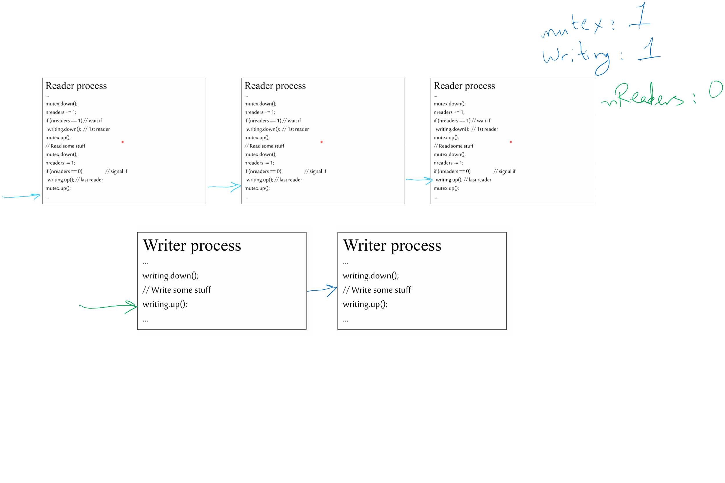
Tracing the solution

Slide 7
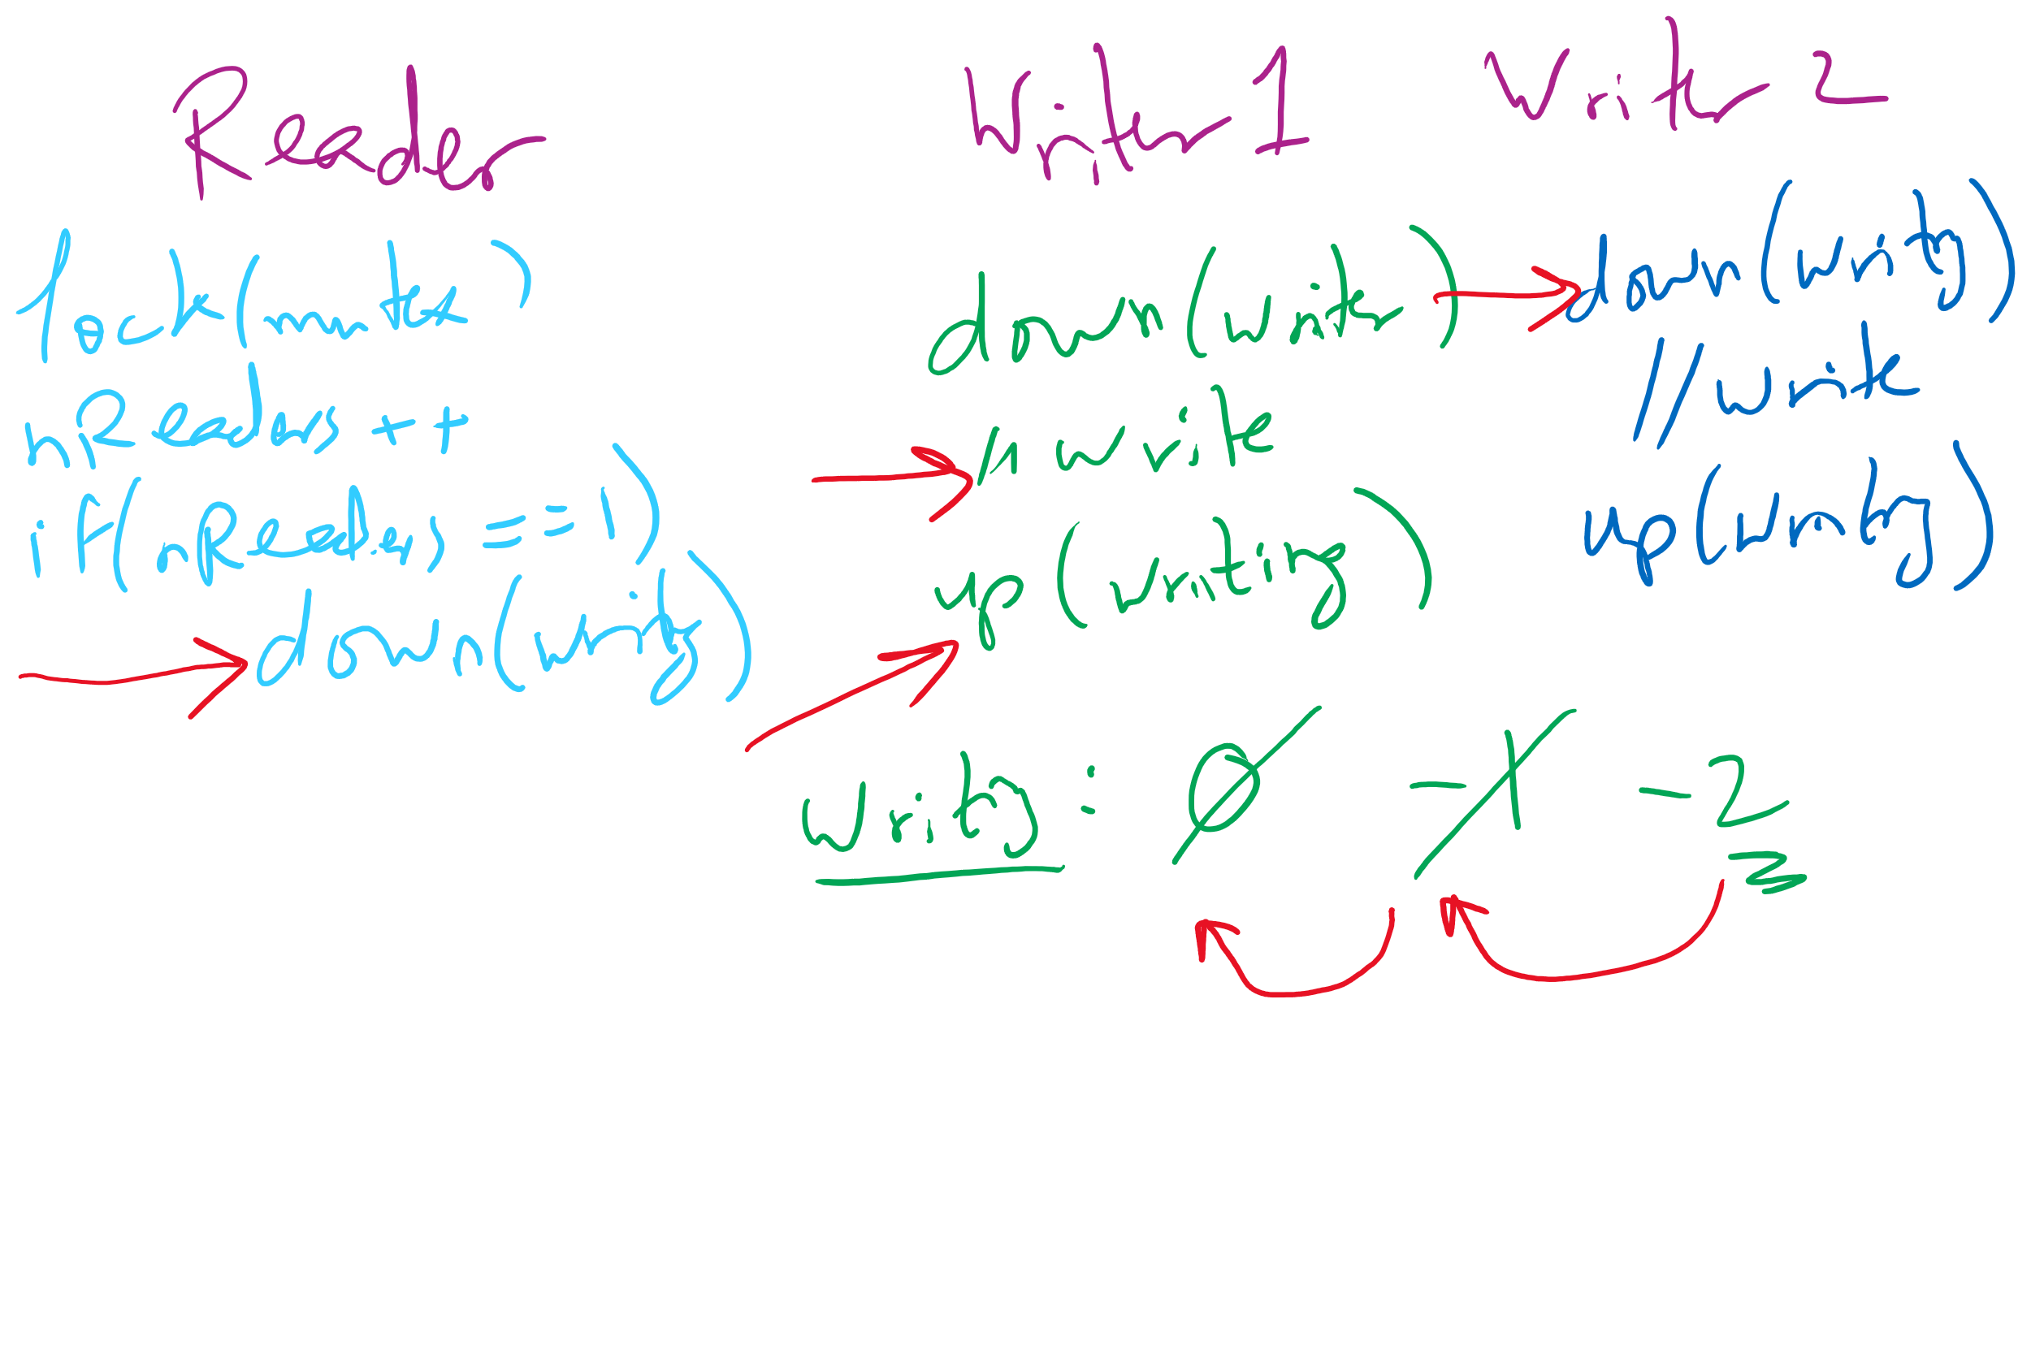
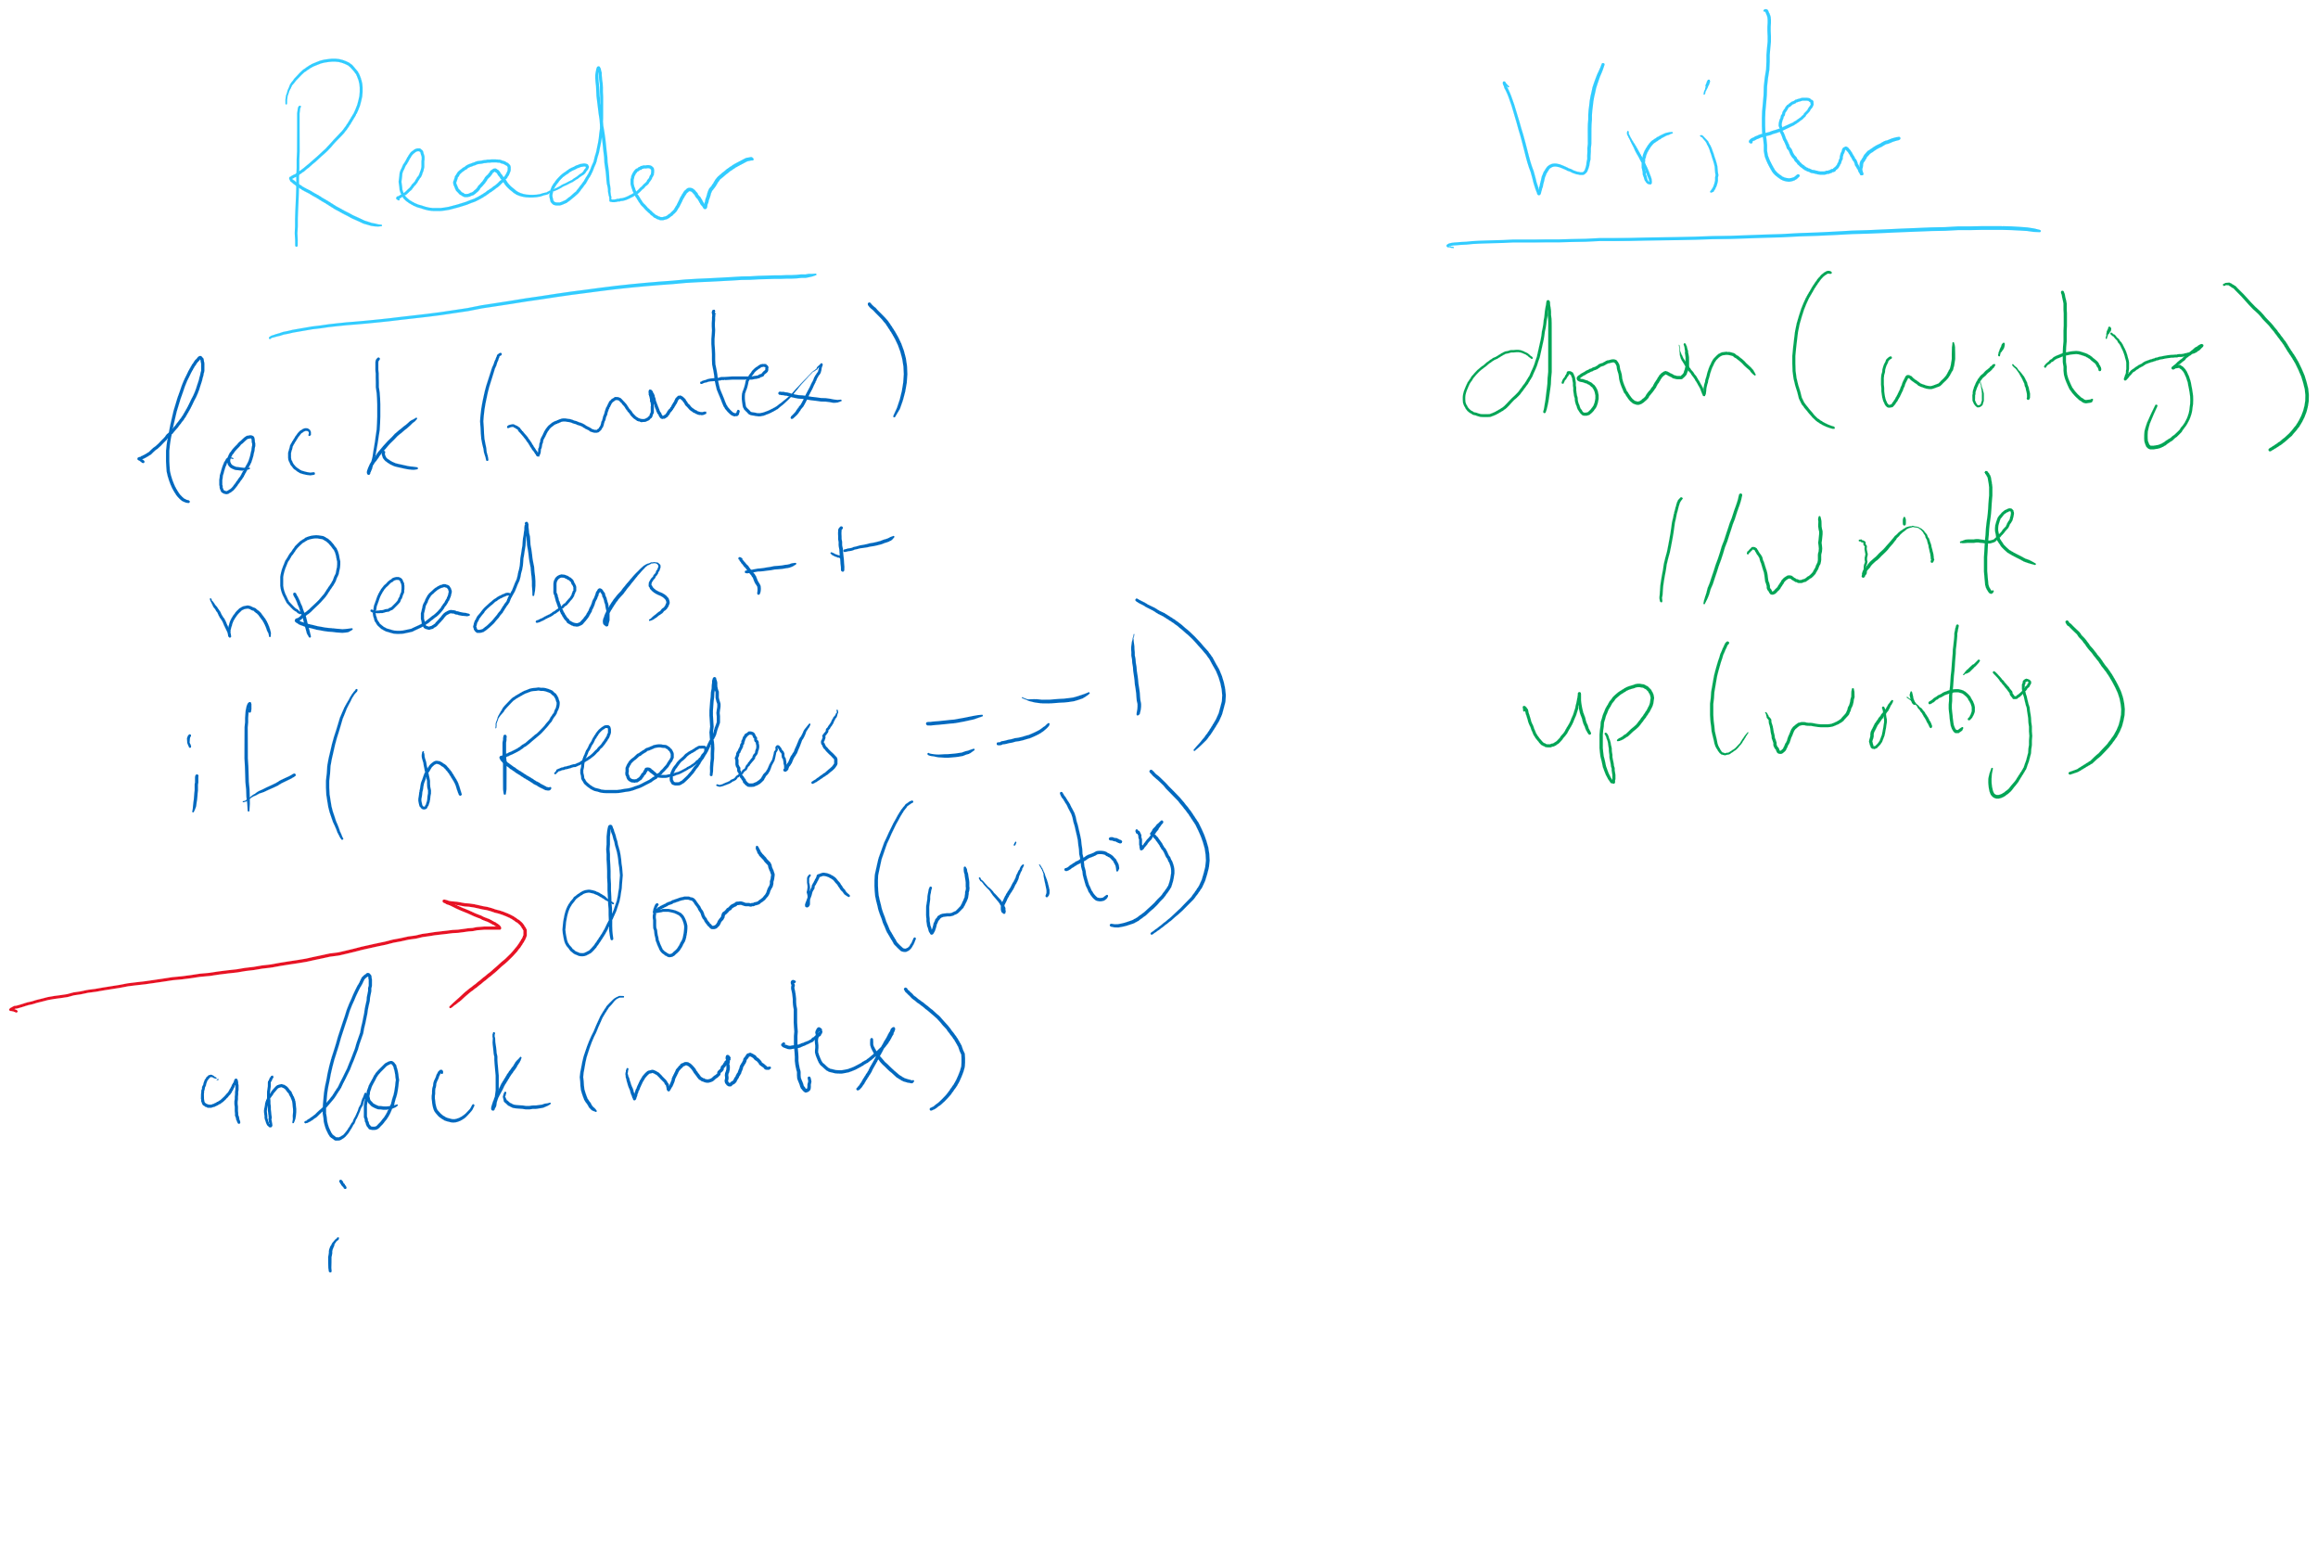
Readers Writers Scenarios

Slide 8


Dining Philosophers
N philosophers around a table
All are hungry
All like to think
N chopsticks available
1 between each pair of philosophers
Philosophers need two chopsticks to eat
Philosophers alternate between eating and thinking
Goal: coordinate use of chopsticks

Slide 9
Dining Philosophers: solution 1
Use a semaphore for each chopstick
A hungry philosopher
Gets the chopstick to his right
Gets the chopstick to his left
Eats
Puts down the chopsticks
Potential problems?
Deadlock
Fairness
Shared variables
const int n;
// initialize to 1
Semaphore chopstick[n];
Code for philosopher i
while(1) {
chopstick[i].down();
chopstick[(i+1)%n].down();
// eat
chopstick[i].up();
chopstick[(i+1)%n].up();
// think
}

Slide 10
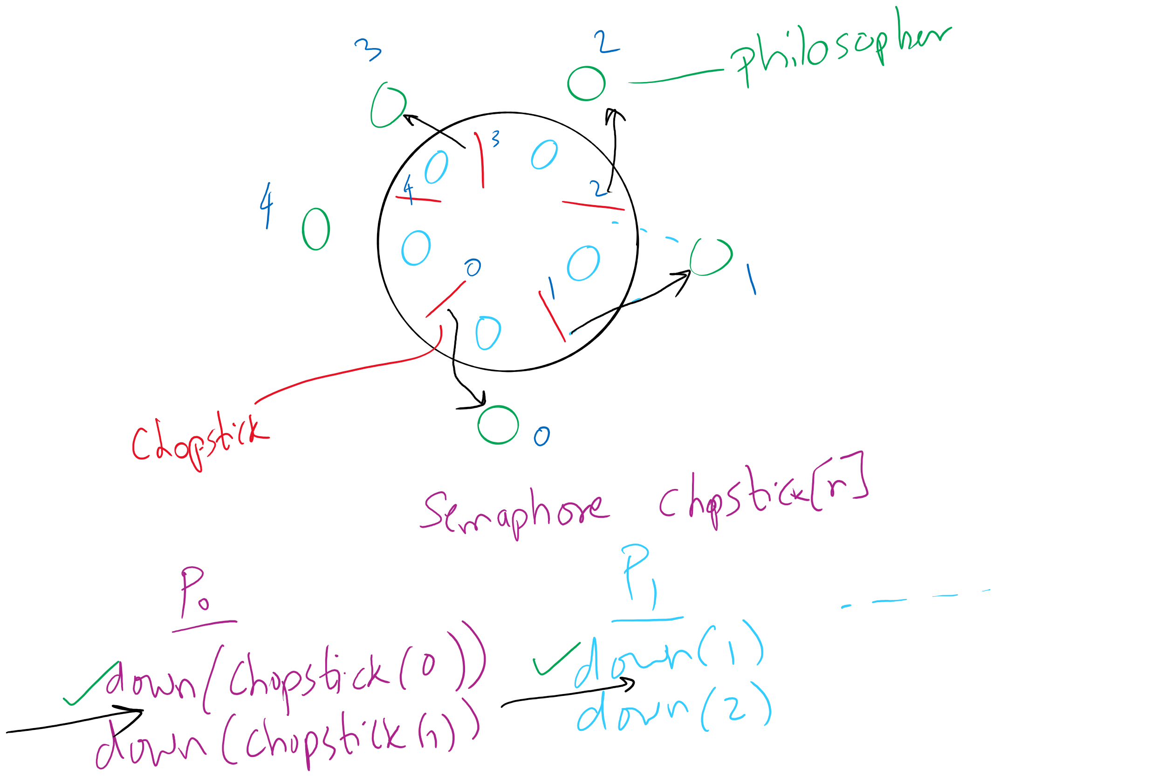
Deadlock in the first (incorrect) solution of Dining Philosophers

Slide 11
Dining Philosophers: solution 2
Use a semaphore for each chopstick
A hungry philosopher
Gets lower, then higher numbered chopstick
Eats
Puts down the chopsticks
Potential problems?
Deadlock
Fairness
Code for philosopher i
int i1,i2;
while(1) {
if (i != (n-1)) {
i1 = i;
i2 = i+1;
} else {
i1 = 0;
i2 = n-1;
}
chopstick[i1].down();
chopstick[i2].down();
// eat
chopstick[i1].up();
chopstick[i2].up();
// think
}
Shared variables
const int n;
// initialize to 1
Semaphore chopstick[n];

Slide 12
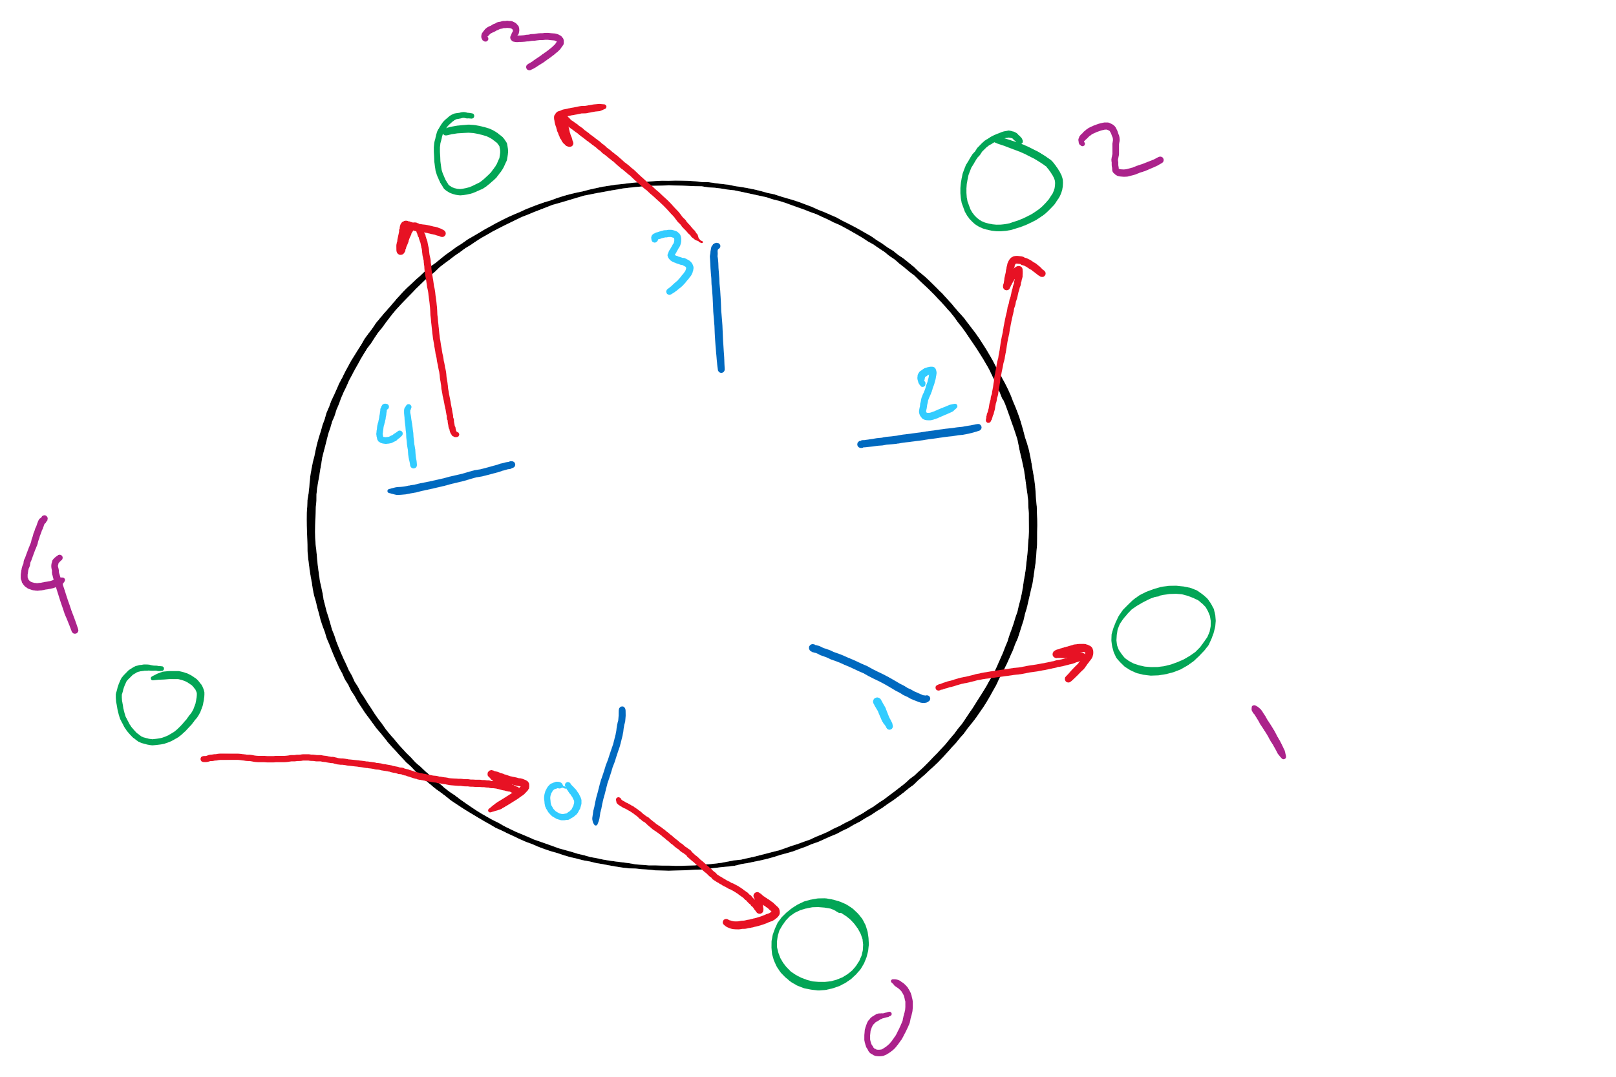
Dining Philosophers Solution

Slide 13
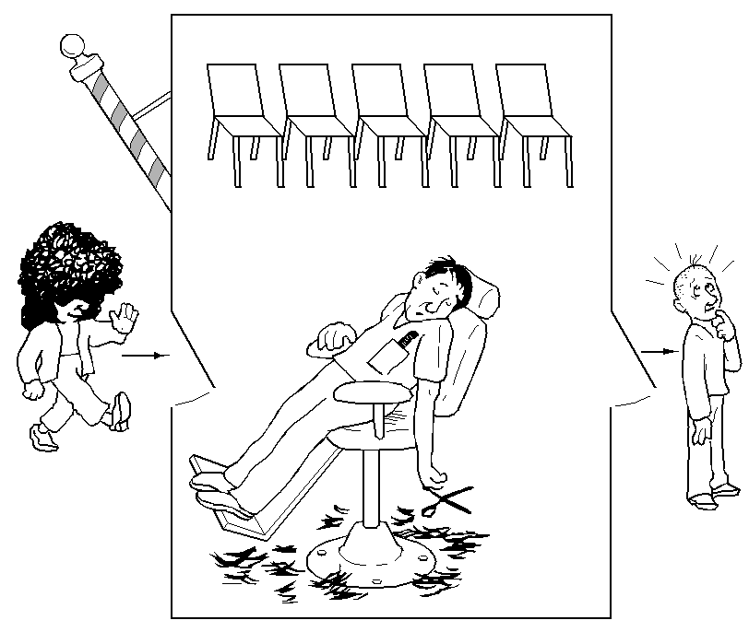
The Sleepy Barber Problem

Slide 14
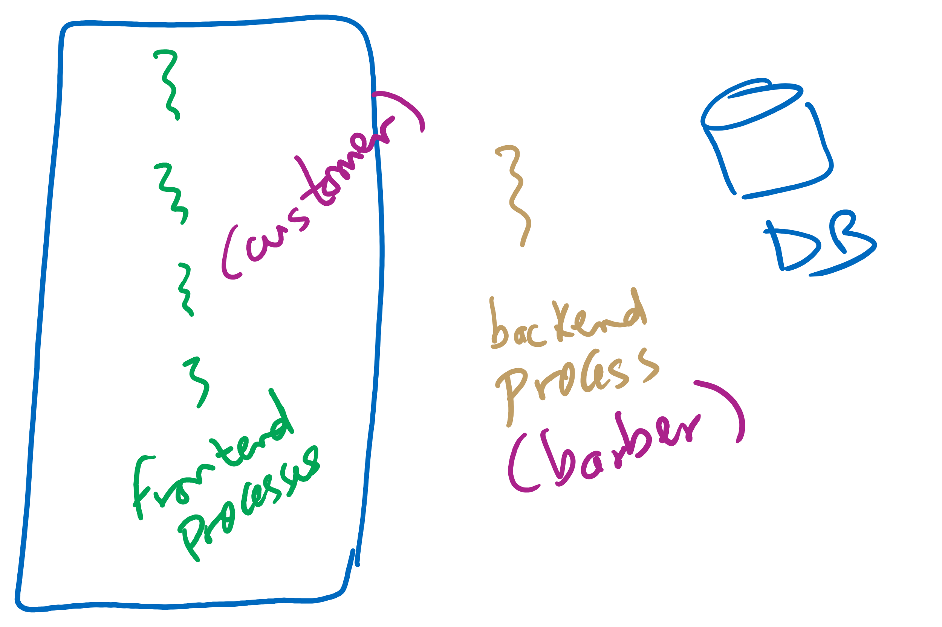
Sleepy Barber Real-life Example

Slide 15
Code for the Sleepy Barber Problem
#define CHAIRS 5
Semaphore customers=0;
Semaphore barbers=0;
Semaphore mutex=1;
int waiting=0;
void barber(void)
{
while(TRUE) {
// Sleep if no customers
customers.down();
// Decrement # of waiting people
mutex.down();
waiting -= 1;
// Wake up a customer to cut hair
barbers.up();
mutex.up();
// Do the haircut
cut_hair();
}
}
void customer(void)
{
mutex.down();
// If there is space in the chairs
if (waiting<CHAIRS) {
// Another customer is waiting
waiting++;
// Wake up the barber. This is
// saved up, so the barber doesn’t
// sleep if a customer is waiting
customers.up();
mutex.up();
// Sleep until the barber is ready
barbers.down();
get_haircut();
} else {
// Chairs full, leave the critical
// region
mutex.up ();
}
}

