Slide 1

Introduction to Operating Systems CS/COE 1550
Fall 2021
Sherif Khattab
ksm73@pitt.edu
(Some slides are from Silberschatz, Galvin and Gagne ©2013)

Slide 2
Announcements
Upcoming deadlines:
Lab 2: due on 10/18
Project 2: due on 10/22

Slide 3
Last Lecture …
Monitor-based solution for classical synchronization problems
Bound Buffer
Readers Writers
Dining Philosophers

Slide 4
Muddiest Points (General)
Benefits of using a monitor to solve these problems as opposed to semaphores
Monitor implementations are intuitive. Is the only drawback having to write the class?
So after a condition variable calls wait(&lock), the process is placed in the condSem inside the monitor?

Slide 5
Muddiest Points (Dining Philosophers)
why set a philosopher's state to hungry at the beginning up pickup?
what is stopping us from using one semaphore per philosopher (like the monitor solution) instead of per-chopstick in the semaphore based solution? I guess we wouldn't get the signaling functionality and state encapsulation but it seems like it should be possible
How does the monitor/condition variable solution of the dining philosphers problem prevent deadlock, isn't philosopher n-1 a special case here?
Why not use a version of philosophers where we track the sticks with a list instead of using only philosophers
how does the code implementation for dining philosophers prevent starvation?

Slide 6
Muddiest Points (Sleepy Barber)
Can ticketTurn in Sleepy Barber be greater than the customer's ticket number?
How the separate barber and customer classes would interact
why we need fifo for sleepy barber
Sleepy barber condition variable implementation... is starvation possible?
broadcasting in the sleepy barber problem
Why we have a separate class for the barber?

Slide 7
Monitor-based Solutions
Code Walkthrough at:
https://cs1550-2214.github.io/cs1550-code-handouts/ProcessSynchronization/Slides/

Slide 8
Today … Deadlocks
Definition
Resource Allocation Graph
Why do deadlocks occur?
Dealing with deadlocks
Ignoring them: ostrich algorithm
Detecting & recovering from deadlock
Avoiding deadlock
Preventing deadlock

Slide 9
What is a deadlock?
Formal definition: “A set of processes is deadlocked if each process in the set is waiting for an event that only another process in the set can cause.”
Usually, the event is release of a currently held resource
In deadlock, none of the processes can
Run
Release resources
Be awakened

Slide 10
Four conditions for deadlock
Mutual exclusion
Each resource is assigned to at most one process
Hold and wait
A process holding resources can request more resources
No preemption
Previously granted resources cannot be forcibly taken away
Circular wait
There must be a circular chain of 2 or more processes where each is waiting for a resource held by the next member of the chain

Slide 11
Resource allocation graphs
Resource allocation modeled by directed graphs
Example 1:
Resource R assigned to process A
Example 2:
Process B is requesting / waiting for resource S
Example 3:
Process C holds T, waiting for U
Process D holds U, waiting for T
C and D are in deadlock!
A
R
B
S
T
C
D
U

Slide 12
Getting into deadlock
A
B
C
Acquire R
Acquire S
Release R
Release S
Acquire S
Acquire T
Release S
Release T
Acquire T
Acquire R
Release T
Release R
A
B
C
A
B
C
A
B
C
R
S
T
R
S
T
R
S
T
Acquire R
Acquire S
Acquire T
A
B
C
A
B
C
A
B
C
R
S
T
R
S
T
R
S
T
Deadlock!
Acquire S
Acquire T
Acquire R

Slide 13
Not getting into deadlock…
Many situations may result in deadlock (but don’t have to)
In previous example, A could release R before C requests R, resulting in no deadlock
Can we always get out of it this way?
Find ways to:
Detect deadlock and reverse it
Stop it from happening in the first place

Slide 14
The Ostrich Algorithm
Pretend there’s no problem
Reasonable if
Deadlocks occur very rarely
Cost of prevention is high
UNIX and Windows take this approach
Resources (memory, CPU, disk space) are plentiful
Deadlocks over such resources rarely occur
Deadlocks typically handled by rebooting
Trade off between convenience and correctness

Slide 15
Detecting deadlocks using graphs
Process holdings and requests in the table and in the graph (they’re equivalent)
Graph contains a cycle => deadlock!
Easy to pick out by looking at it (in this case)
Need to mechanically detect deadlock
Not all processes are deadlocked (A, C, F not in deadlock)
R
A
B
Process | Holds | Wants
A | R | S
B |  | T
C |  | S
D | U | S,T
E | T | V
F | W | S
G | V | U
C
S
D
T
E
F
U
V
W
G

Slide 16
Deadlock detection algorithm
General idea: try to find cycles in the resource allocation graph
Algorithm: depth-first search at each node
Mark arcs as they’re traversed
Build list of visited nodes
If node to be added is already on the list, a cycle exists!
Cycle == deadlock
Assuming one instance of each resource type
For each node N in the graph {
Set L = empty list
unmark all arcs
Traverse (N,L)
}
If no deadlock reported by now, there isn’t any
define Traverse (C,L) {
If C in L, report deadlock!
Add C to L
For each unmarked arc from C {
Mark the arc
Set A = arc destination
/* NOTE: L is a
local variable */
Traverse (A,L)
}
}

Slide 17
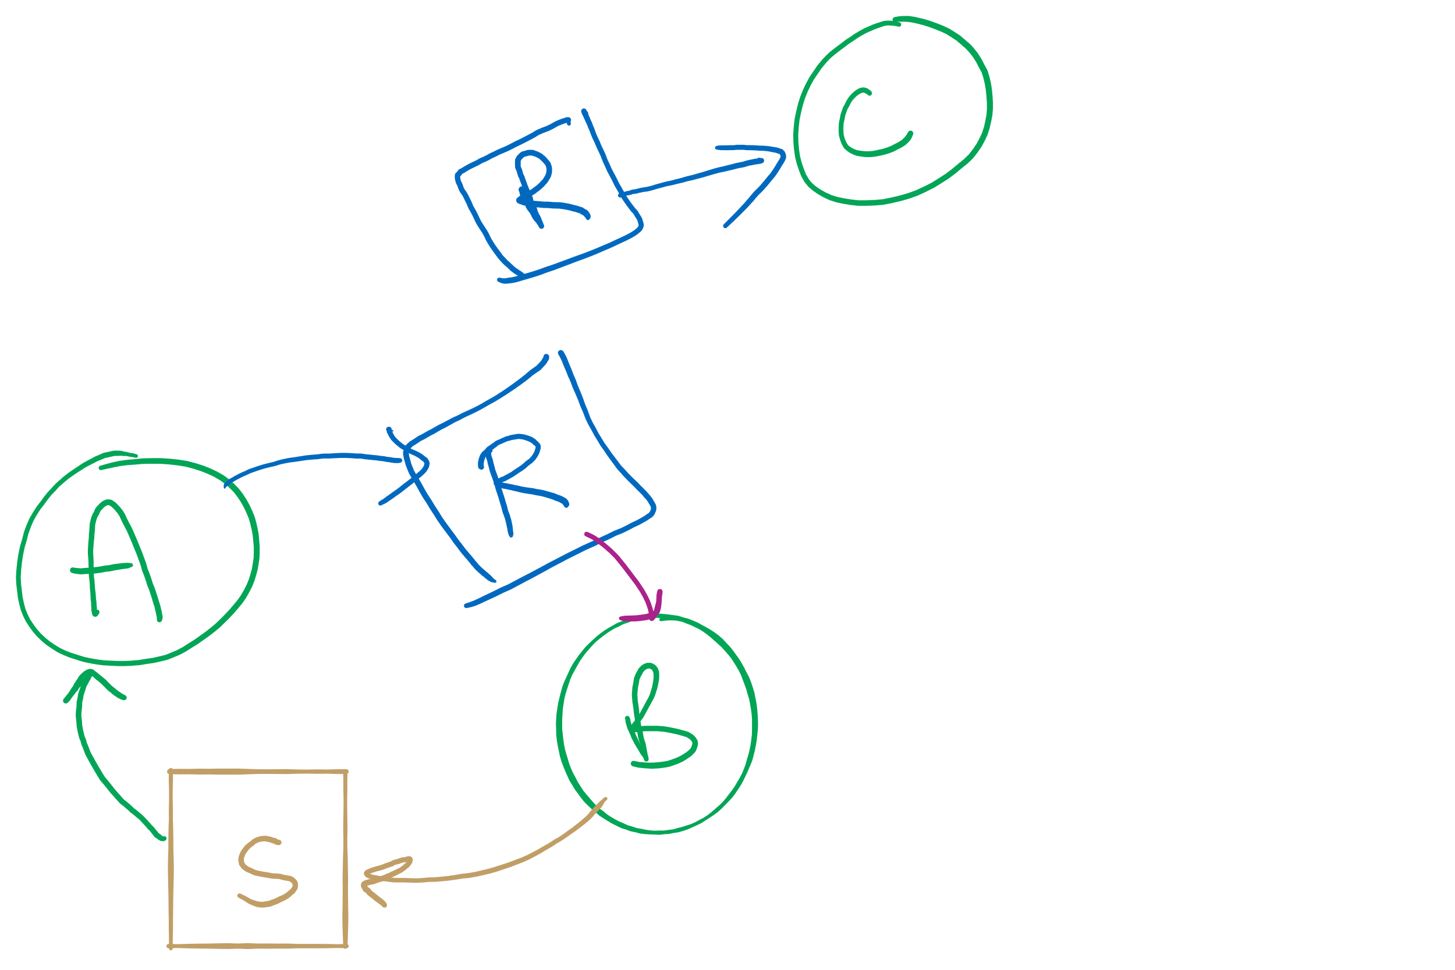
Resources with multiple instances
Previous algorithm only works if there’s one instance of each resource
If there are multiple instances of each resource, we need a different method
Track current usage and requests for each process
To detect deadlock, try to find a scenario where all processes can finish
If no such scenario exists, we have deadlock

Slide 18
Deadlock detection algorithm
 | A | B | C | D
Avail | 2 | 3 | 0 | 1
current=avail;
for (j = 0; j < N; j++) {
for (k=0; k<N; k++) {
if (finished[k])
continue;
if (want[k] <= current) {
finished[k] = 1;
current += hold[k];
break;
}
}
if (k==N) { //reached end of loop
printf “Deadlock!\n”;
// finished[k]==0 means process is in
// the deadlock
break;
}
}
Process | A | B | C | D
1 | 0 | 3 | 0 | 0
2 | 1 | 0 | 1 | 1
3 | 0 | 2 | 1 | 0
4 | 2 | 2 | 3 | 0
Hold
Process | A | B | C | D
1 | 3 | 2 | 1 | 0
2 | 2 | 2 | 0 | 0
3 | 3 | 5 | 3 | 1
4 | 0 | 4 | 1 | 1
Want
Note: want[j], hold[j], current, avail are arrays!

Slide 19


Deadlock detection algorithm
current=avail;
for (j = 0; j < N; j++) {
for (k=0; k<N; k++) {
if (finished[k])
continue;
if (want[k] <= current) {
finished[k] = 1;
current += hold[k];
break;
}
}
if (k==N) {
printf “Deadlock!\n”;
// finished[k]==0 means process is in
// the deadlock
break;
}
}
 | A | B | C | D
Avail | 2 | 3 | 0 | 1
Process | A | B | C | D
1 | 0 | 3 | 0 | 0
2 | 1 | 0 | 1 | 1
3 | 0 | 2 | 1 | 0
4 | 2 | 2 | 3 | 0
Hold
Process | A | B | C | D
1 | 3 | 2 | 1 | 0
2 | 2 | 2 | 0 | 0
3 | 3 | 5 | 3 | 1
4 | 0 | 4 | 1 | 1
Want
Note: want[j], hold[j], current, avail are arrays!

Slide 20



Deadlock detection algorithm
current=avail;
for (j = 0; j < N; j++) {
for (k=0; k<N; k++) {
if (finished[k])
continue;
if (want[k] <= current) {
finished[k] = 1;
current += hold[k];
break;
}
}
if (k==N) {
printf “Deadlock!\n”;
// finished[k]==0 means process is in
// the deadlock
break;
}
}
 | A | B | C | D
current | 2 | 3 | 0 | 1
Process | A | B | C | D
1 | 0 | 3 | 0 | 0
2 | 1 | 0 | 1 | 1
3 | 0 | 2 | 1 | 0
4 | 2 | 2 | 3 | 0
Hold
Process | A | B | C | D
1 | 3 | 2 | 1 | 0
2 | 2 | 2 | 0 | 0
3 | 3 | 5 | 3 | 1
4 | 0 | 4 | 1 | 1
Want
Note: want[j], hold[j], current, avail are arrays!

Slide 21


Deadlock detection algorithm
current=avail;
for (j = 0; j < N; j++) {
for (k=0; k<N; k++) {
if (finished[k])
continue;
if (want[k] <= current) {
finished[k] = 1;
current += hold[k];
break;
}
}
if (k==N) {
printf “Deadlock!\n”;
// finished[k]==0 means process is in
// the deadlock
break;
}
}
 | A | B | C | D
current | 2 | 3 | 0 | 1
Process | A | B | C | D
1 | 0 | 3 | 0 | 0
2 | 1 | 0 | 1 | 1
3 | 0 | 2 | 1 | 0
4 | 2 | 2 | 3 | 0
Hold
Process | A | B | C | D
1 | 3 | 2 | 1 | 0
2 | 2 | 2 | 0 | 0
3 | 3 | 5 | 3 | 1
4 | 0 | 4 | 1 | 1
Want
Note: want[j], hold[j], current, avail are arrays!

Slide 22

Deadlock detection algorithm
current=avail;
for (j = 0; j < N; j++) {
for (k=0; k<N; k++) {
if (finished[k])
continue;
if (want[k] <= current) {
finished[k] = 1;
current += hold[k];
break;
}
}
if (k==N) {
printf “Deadlock!\n”;
// finished[k]==0 means process is in
// the deadlock
break;
}
}
 | A | B | C | D
current | 3 | 3 | 1 | 2
Process | A | B | C | D
1 | 0 | 3 | 0 | 0
2 | 1 | 0 | 1 | 1
3 | 0 | 2 | 1 | 0
4 | 2 | 2 | 3 | 0
Hold
Process | A | B | C | D
1 | 3 | 2 | 1 | 0
2 | 2 | 2 | 0 | 0
3 | 3 | 5 | 3 | 1
4 | 0 | 4 | 1 | 1
Want
Note: want[j], hold[j], current, avail are arrays!

Slide 23

Deadlock detection algorithm
current=avail;
for (j = 0; j < N; j++) {
for (k=0; k<N; k++) {
if (finished[k])
continue;
if (want[k] <= current) {
finished[k] = 1;
current += hold[k];
break;
}
}
if (k==N) {
printf “Deadlock!\n”;
// finished[k]==0 means process is in
// the deadlock
break;
}
}
 | A | B | C | D
current | 3 | 3 | 1 | 2
Process | A | B | C | D
1 | 0 | 3 | 0 | 0
2 | 1 | 0 | 1 | 1
3 | 0 | 2 | 1 | 0
4 | 2 | 2 | 3 | 0
Hold
Process | A | B | C | D
1 | 3 | 2 | 1 | 0
2 | 2 | 2 | 0 | 0
3 | 3 | 5 | 3 | 1
4 | 0 | 4 | 1 | 1
Want
Note: want[j], hold[j], current, avail are arrays!

Slide 24


Deadlock detection algorithm
current=avail;
for (j = 0; j < N; j++) {
for (k=0; k<N; k++) {
if (finished[k])
continue;
if (want[k] <= current) {
finished[k] = 1;
current += hold[k];
break;
}
}
if (k==N) {
printf “Deadlock!\n”;
// finished[k]==0 means process is in
// the deadlock
break;
}
}
 | A | B | C | D
current | 3 | 3 | 1 | 2
Process | A | B | C | D
1 | 0 | 3 | 0 | 0
2 | 1 | 0 | 1 | 1
3 | 0 | 2 | 1 | 0
4 | 2 | 2 | 3 | 0
Hold
Process | A | B | C | D
1 | 3 | 2 | 1 | 0
2 | 2 | 2 | 0 | 0
3 | 3 | 5 | 3 | 1
4 | 0 | 4 | 1 | 1
Want
Note: want[j], hold[j], current, avail are arrays!

Slide 25



Deadlock detection algorithm
current=avail;
for (j = 0; j < N; j++) {
for (k=0; k<N; k++) {
if (finished[k])
continue;
if (want[k] <= current) {
finished[k] = 1;
current += hold[k];
break;
}
}
if (k==N) {
printf “Deadlock!\n”;
// finished[k]==0 means process is in
// the deadlock
break;
}
}
 | A | B | C | D
current | 3 | 3 | 1 | 2
Process | A | B | C | D
1 | 0 | 3 | 0 | 0
2 | 1 | 0 | 1 | 1
3 | 0 | 2 | 1 | 0
4 | 2 | 2 | 3 | 0
Hold
Process | A | B | C | D
1 | 3 | 2 | 1 | 0
2 | 2 | 2 | 0 | 0
3 | 3 | 5 | 3 | 1
4 | 0 | 4 | 1 | 1
Want
Note: want[j], hold[j], current, avail are arrays!

Slide 26


Deadlock detection algorithm
current=avail;
for (j = 0; j < N; j++) {
for (k=0; k<N; k++) {
if (finished[k])
continue;
if (want[k] <= current) {
finished[k] = 1;
current += hold[k];
break;
}
}
if (k==N) {
printf “Deadlock!\n”;
// finished[k]==0 means process is in
// the deadlock
break;
}
}
 | A | B | C | D
current | 3 | 6 | 1 | 2
Process | A | B | C | D
1 | 0 | 3 | 0 | 0
2 | 1 | 0 | 1 | 1
3 | 0 | 2 | 1 | 0
4 | 2 | 2 | 3 | 0
Hold
Process | A | B | C | D
1 | 3 | 2 | 1 | 0
2 | 2 | 2 | 0 | 0
3 | 3 | 5 | 3 | 1
4 | 0 | 4 | 1 | 1
Want
Note: want[j], hold[j], current, avail are arrays!

Slide 27




Deadlock detection algorithm
current=avail;
for (j = 0; j < N; j++) {
for (k=0; k<N; k++) {
if (finished[k])
continue;
if (want[k] <= current) {
finished[k] = 1;
current += hold[k];
break;
}
}
if (k==N) {
printf “Deadlock!\n”;
// finished[k]==0 means process is in
// the deadlock
break;
}
}
 | A | B | C | D
current | 3 | 6 | 1 | 2
Process | A | B | C | D
1 | 0 | 3 | 0 | 0
2 | 1 | 0 | 1 | 1
3 | 0 | 2 | 1 | 0
4 | 2 | 2 | 3 | 0
Hold
Process | A | B | C | D
1 | 3 | 2 | 1 | 0
2 | 2 | 2 | 0 | 0
3 | 3 | 5 | 3 | 1
4 | 0 | 4 | 1 | 1
Want
Note: want[j], hold[j], current, avail are arrays!

Slide 28


Deadlock detection algorithm
current=avail;
for (j = 0; j < N; j++) {
for (k=0; k<N; k++) {
if (finished[k])
continue;
if (want[k] <= current) {
finished[k] = 1;
current += hold[k];
break;
}
}
if (k==N) {
printf “Deadlock!\n”;
// finished[k]==0 means process is in
// the deadlock
break;
}
}
 | A | B | C | D
current | 5 | 8 | 4 | 2
Process | A | B | C | D
1 | 0 | 3 | 0 | 0
2 | 1 | 0 | 1 | 1
3 | 0 | 2 | 1 | 0
4 | 2 | 2 | 3 | 0
Hold
Process | A | B | C | D
1 | 3 | 2 | 1 | 0
2 | 2 | 2 | 0 | 0
3 | 3 | 5 | 3 | 1
4 | 0 | 4 | 1 | 1
Want
Note: want[j], hold[j], current, avail are arrays!

Slide 29






Deadlock detection algorithm
current=avail;
for (j = 0; j < N; j++) {
for (k=0; k<N; k++) {
if (finished[k])
continue;
if (want[k] <= current) {
finished[k] = 1;
current += hold[k];
break;
}
}
if (k==N) {
printf “Deadlock!\n”;
// finished[k]==0 means process is in
// the deadlock
break;
}
}
 | A | B | C | D
current | 5 | 8 | 4 | 2
Process | A | B | C | D
1 | 0 | 3 | 0 | 0
2 | 1 | 0 | 1 | 1
3 | 0 | 2 | 1 | 0
4 | 2 | 2 | 3 | 0
Hold
Process | A | B | C | D
1 | 3 | 2 | 1 | 0
2 | 2 | 2 | 0 | 0
3 | 3 | 5 | 3 | 1
4 | 0 | 4 | 1 | 1
Want
Note: want[j], hold[j], current, avail are arrays!

Slide 30


Deadlock detection algorithm
current=avail;
for (j = 0; j < N; j++) {
for (k=0; k<N; k++) {
if (finished[k])
continue;
if (want[k] <= current) {
finished[k] = 1;
current += hold[k];
break;
}
}
if (k==N) {
printf “Deadlock!\n”;
// finished[k]==0 means process is in
// the deadlock
break;
}
}
 | A | B | C | D
current | 5 | 10 | 5 | 2
Process | A | B | C | D
1 | 0 | 3 | 0 | 0
2 | 1 | 0 | 1 | 1
3 | 0 | 2 | 1 | 0
4 | 2 | 2 | 3 | 0
Hold
Process | A | B | C | D
1 | 3 | 2 | 1 | 0
2 | 2 | 2 | 0 | 0
3 | 3 | 5 | 3 | 1
4 | 0 | 4 | 1 | 1
Want
Note: want[j], hold[j], current, avail are arrays!

Slide 31





Deadlock detection algorithm
current=avail;
for (j = 0; j < N; j++) {
for (k=0; k<N; k++) {
if (finished[k])
continue;
if (want[k] <= current) {
finished[k] = 1;
current += hold[k];
break;
}
}
if (k==N) {
printf “Deadlock!\n”;
// finished[k]==0 means process is in
// the deadlock
break;
}
}
 | A | B | C | D
current | 5 | 10 | 5 | 2
Process | A | B | C | D
1 | 0 | 3 | 0 | 0
2 | 1 | 0 | 1 | 1
3 | 0 | 2 | 1 | 0
4 | 2 | 2 | 3 | 0
Hold
Process | A | B | C | D
1 | 3 | 2 | 1 | 0
2 | 2 | 2 | 0 | 0
3 | 3 | 5 | 3 | 1
4 | 0 | 4 | 1 | 1
Want
Note: want[j], hold[j], current, avail are arrays!

