Slide 1

Introduction to Operating Systems CS/COE 1550
Fall 2021
Sherif Khattab
ksm73@pitt.edu
(Some slides are from Silberschatz, Galvin and Gagne ©2013)

Slide 2
Announcements
Upcoming deadlines:
10/22: Project 2

Slide 3
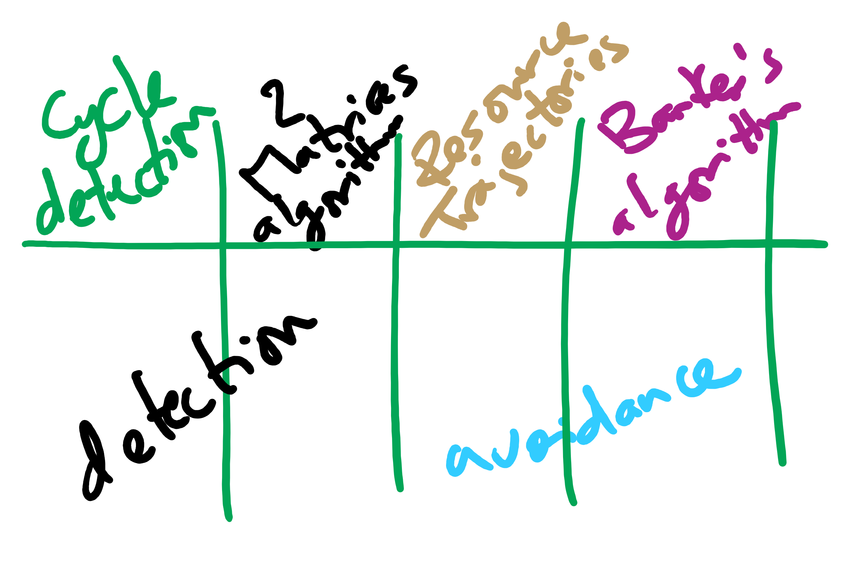
Last Lecture
Deadlock detection and avoidance

Slide 4
Muddiest Points (Banker’s Algorithm)
what are the three steps of the bankers algorithm?
Could you go over the Bankers algorithm example again?
For the safe/unsafe algorithm, does that mean we need to know the resources that are available, keep track of the used ones, and also know how many each process will have in the future?
It seems like this detection algorithm has a lot of overhead. Are there any ways of reducing the time spent doing these checks
can we run the banker's algorithm or some alternative as a static analysis tool? like build this kind of check into the compiler or something instead of running it for each request during runtime
If a state is determined unsafe, does that always mean that the resource will not be allocated or is it possible to still allocate it and take the risk
What does the E, P and A stand for in the bankers algorithm
if bankers algorithm finds a valid path and grants the resource, can a deadlock still occur if a different path is followed than the one bankers algorithm found?
I'm a little confused on what the want and hold tables represent
Why is the runtime n^2 * n for the wait algorithm
What is the difference between wanted and max again?
Tracing bankers algorithms with multiple resource instances

Slide 5
Muddiest Points (Resource Trajectory)
the l1, l2 l3 ... in the resource trajectory graph
resource trajectory graphs with more than 2 resources
How to prevent a resource trajectory that would cause a deadlock

Slide 6
Muddiest Points (General Deadlock)
breaking circular wait seems almost always better than breaking hold and wait since breaking hold and wait requires you take all resources you need whereas breaking circular wait only makes you take some extra resources before you need them
Starvation vs deadlock
Which detection alg is fastest?
Where do deadlock detection algorithms exist? (Operating system or external application.) When do they run? Runtime or compile time? Also, how do deadlock avoidance algorithms interfere to make sure a program doesn’t deadlock? Are they integrated fully into the application?
how do we know what resources are available to use and the best way to choose who gets what resources
What is better practice, deadlock avoidance or deadlock detection?

Slide 7
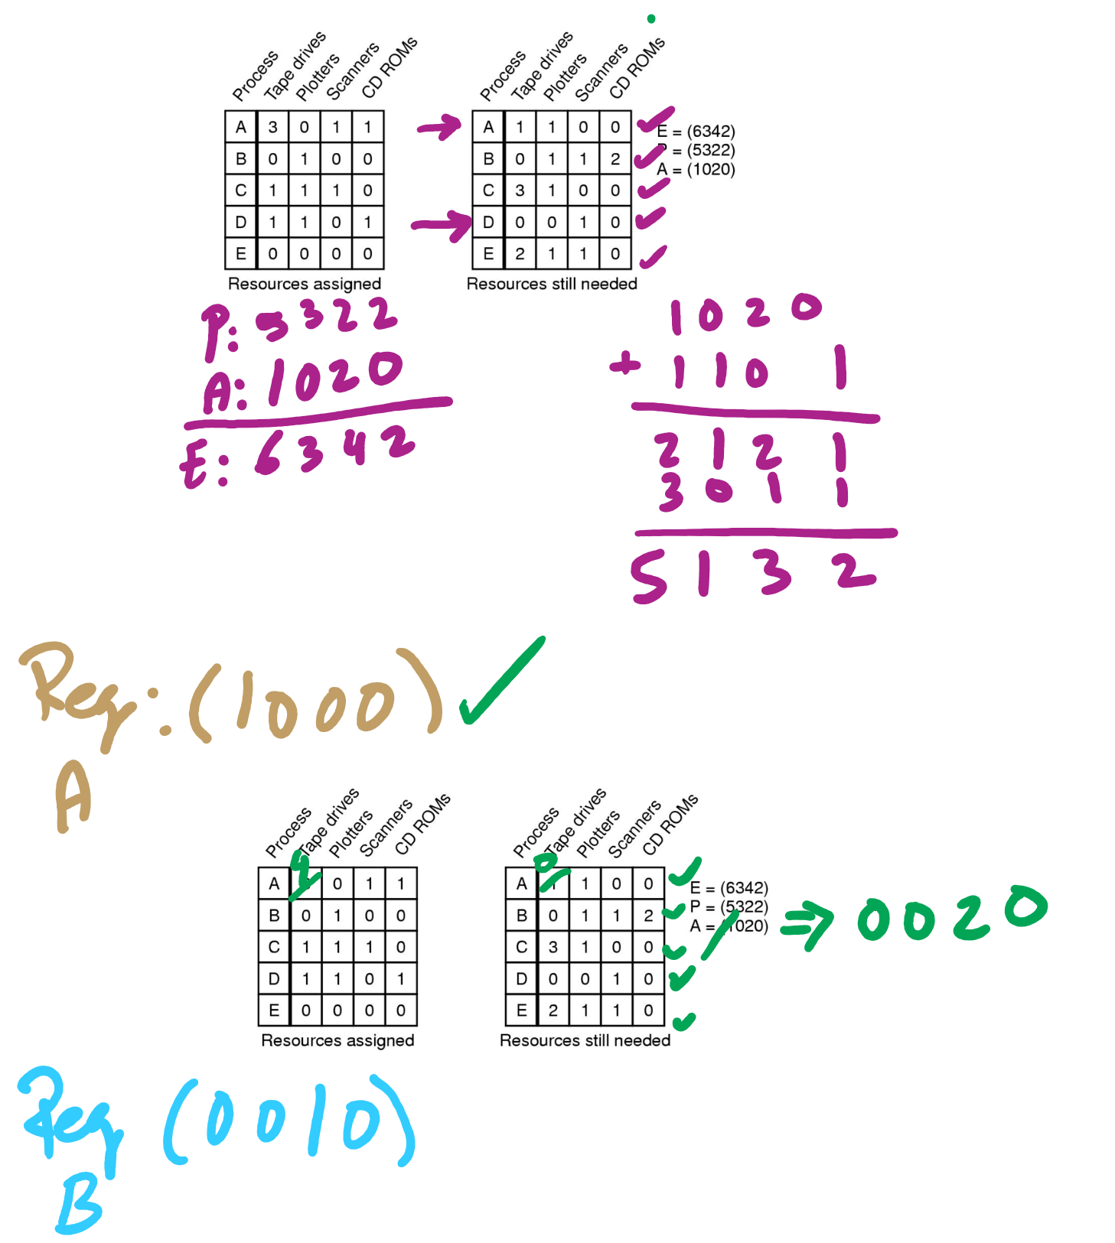
Banker’s Algorithm Example

Slide 8
Muddiest Points (General Deadlock, contd.)
Deadlock detection algorithms are expensive, shouldn't we just enforce a global ordering of resource requests?
How much does deadlock detection impact performance (what factors does its impact depend on)?
project 2 extension?

Slide 9
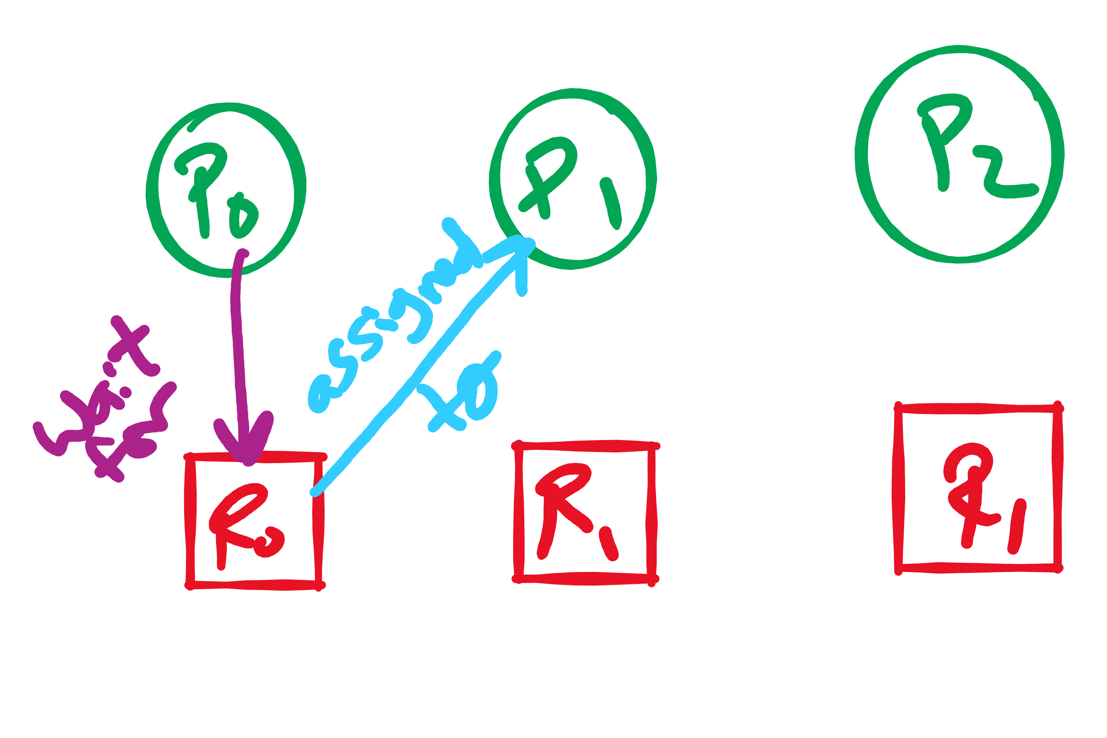
Arrows in Resource Allocation Graph

Slide 10
Preventing deadlock
Deadlock can be completely prevented!
Ensure that at least one of the conditions for deadlock never occurs
Mutual exclusion
Circular wait
Hold & wait
No preemption
Not always possible…

Slide 11
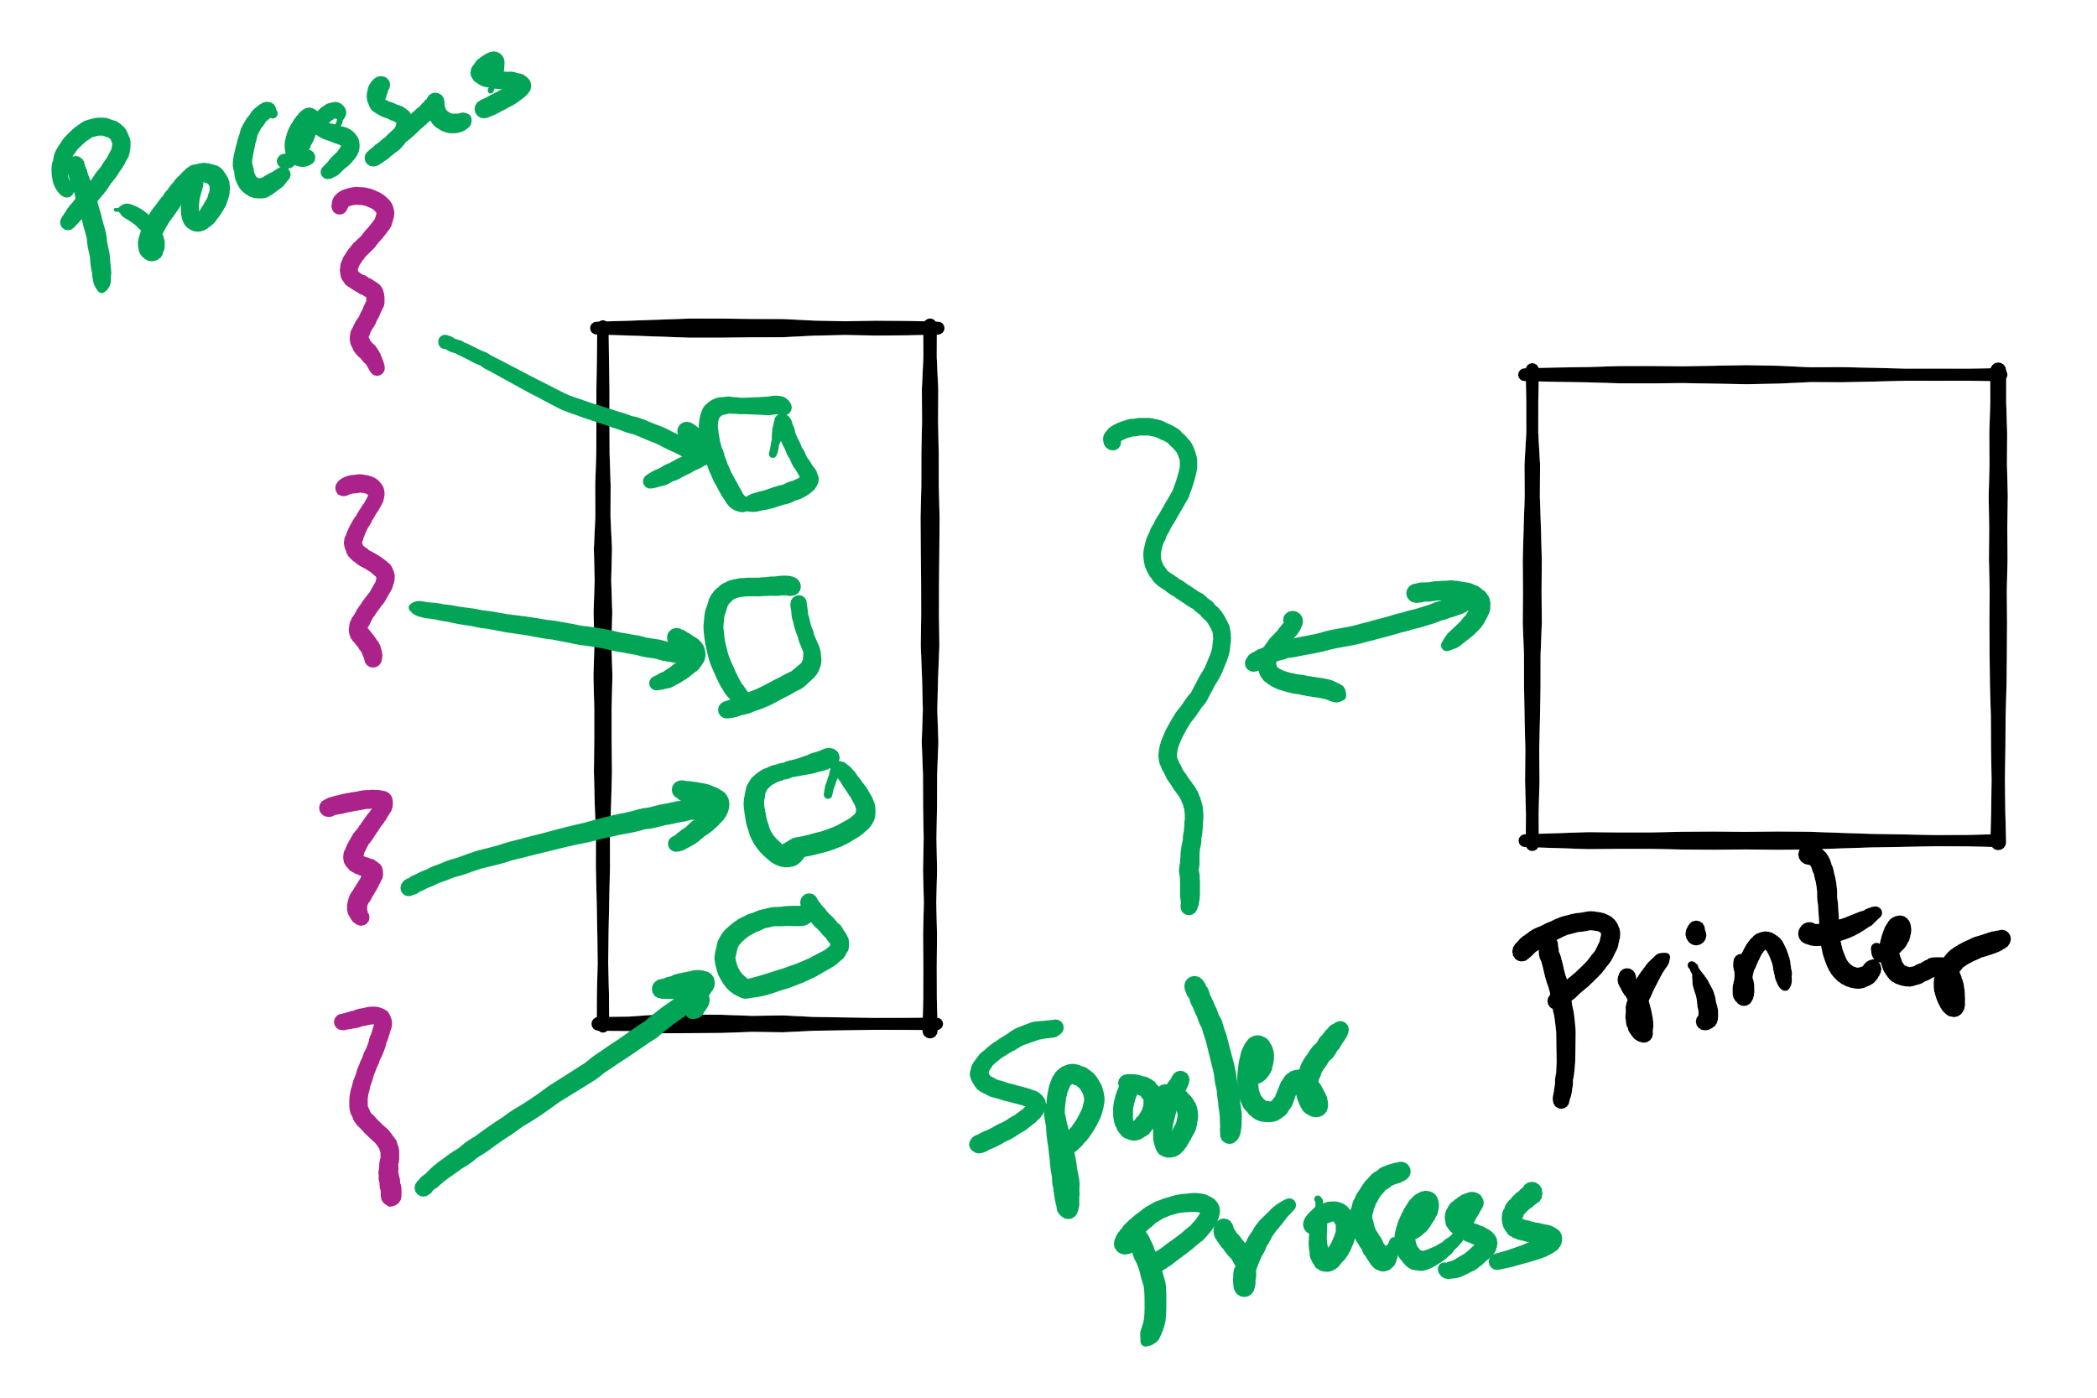
Eliminating mutual exclusion
Some devices (such as printer) can be spooled
Only the printer daemon uses printer resource
This eliminates deadlock for printer
Not all devices can be spooled
Principle:
Avoid assigning resource when not absolutely necessary
As few processes as possible actually claim the resource

Slide 12
Attacking “hold and wait”
Require processes to request resources before starting
A process never has to wait for what it needs
This can present problems
A process may not know required resources at start of run
This also ties up resources other processes could be using
Processes will tend to be conservative and request resources they might need
Variation: a process must give up all resources before making a new request
Process is then granted all prior resources as well as the new ones
Problem: what if someone grabs the resources in the meantime—how can the process save its state?

Slide 13
Attacking “no preemption”
This is not usually a viable option
Consider a process given the printer
Halfway through its job, take away the printer
Confusion ensues!
May work for some resources
Forcibly take away memory pages, suspending the process
Process may be able to resume with no ill effects

Slide 14
Attacking “circular wait”
Assign an order to resources
Always acquire resources in numerical order
Need not acquire them all at once!
Circular wait is prevented
A process holding resource n can’t wait for resource m if m < n
No way to complete a cycle
Place processes above the highest resource they hold and below any they’re requesting
All arrows point up!
D
C
B
A
1
2
3

Slide 15
Attacking “circular wait”
Assign an order to resources
Always acquire resources in numerical order
Need not acquire them all at once!
Circular wait is prevented
A process holding resource n can’t wait for resource m if m < n
No way to complete a cycle
Place processes above the highest resource they hold and below any they’re requesting
All arrows point up!
D
C
B
1
A
2
3

Slide 16
Attacking “circular wait”
Assign an order to resources
Always acquire resources in numerical order
Need not acquire them all at once!
Circular wait is prevented
A process holding resource n can’t wait for resource m if m < n
No way to complete a cycle
Place processes above the highest resource they hold and below any they’re requesting
All arrows point up!
D
C
2
B
1
A
3

Slide 17
Attacking “circular wait”
Assign an order to resources
Always acquire resources in numerical order
Need not acquire them all at once!
Circular wait is prevented
A process holding resource n can’t wait for resource m if m < n
No way to complete a cycle
Place processes above the highest resource they hold and below any they’re requesting
All arrows point up!
D
3
C
2
B
1
A

Slide 18
Deadlock prevention: summary
Mutual exclusion
Spool everything
Hold and wait
Request all resources initially
No preemption
Take resources away
Circular wait
Order resources numerically

Slide 19
Example: two-phase locking
Phase One
Process tries to lock all data it needs, one at a time
If needed data found locked, start over
(no real work done in phase one)
Phase Two
Perform updates
Release locks
Note similarity to requesting all resources at once
This is often used in databases
It avoids deadlock by eliminating the “hold-and-wait” deadlock condition

Slide 20
“Non-resource” deadlocks
Possible for two processes to deadlock
Each is waiting for the other to do some task
Can happen with semaphores
Each process required to do a down() on two semaphores (mutex and another)
If done in wrong order, deadlock results
Semaphores could be thought of as resources…

Slide 21
Starvation
Algorithm to allocate a resource
Give the resource to the shortest job first
Works great for multiple short jobs in a system
May cause long jobs to be postponed indefinitely
Even though not blocked
Solution
First-come, first-serve policy
Starvation can lead to deadlock
Process starved for resources can be holding resources
If those resources aren’t used and released in a timely fashion, shortage could lead to deadlock

