Slide 1

Introduction to Operating Systems CS/COE 1550
Fall 2021
Sherif Khattab
ksm73@pitt.edu
(Some slides are from Silberschatz, Galvin and Gagne ©2013)

Slide 2
Announcements
Upcoming deadlines:
10/25: Project 2 (extended deadline)
10/29: Homework 6
11/8: Lab 3

Slide 3
Previous Lecture …
CPU Scheduling Algorithms
FCFS
SJF
Priority
RR

Slide 4
Today …
More CPU Scheduling
Multi-level (Feedback) Queues
CPU-Burst length estimation
Memory Management

Slide 5
RR Time Quantum
Quantum must be substantially larger than the time required to handle the clock interrupt and dispatching
Quantum should be larger then the typical interaction
but not much larger, to avoid penalizing I/O bound processes

Slide 6
RR Time Quantum

Slide 7
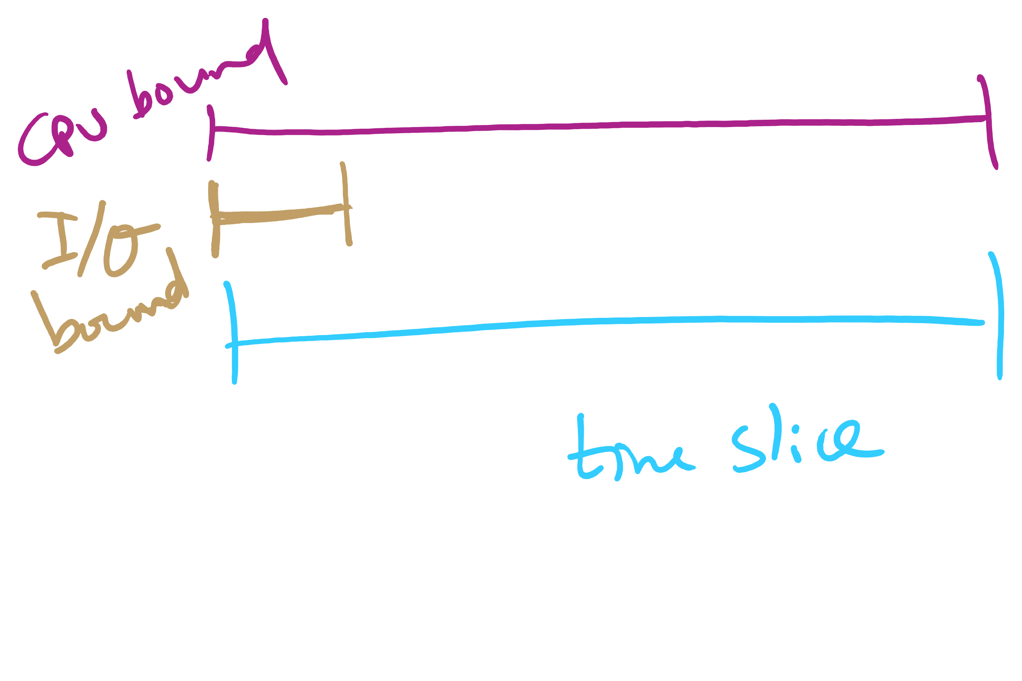
Quantum Length

Slide 8
Round Robin: critique
Still favors CPU-bound processes
An I/O bound process uses the CPU for a time less than the time quantum before it is blocked waiting for an I/O
A CPU-bound process runs for all its time slice and is put back into the ready queue
May unfairly get in front of blocked processes

Slide 9
Multilevel Feedback Scheduling
Preemptive scheduling with dynamic priorities
N ready to execute queues with decreasing priorities:
P(RQ₀) > P(RQ₁) > ... > P(RQ_{N-1})
Dispatcher selects a process for execution from RQ_{i} only if RQ_{i-1} to RQ₀ are empty

Slide 10
Multilevel Feedback Scheduling
New process are placed in RQ₀
After the first quantum, they are moved to RQ₁, and to RQ₂ after the second quantum, … and to RQ_{N-1} after the Nth quantum
I/O-bound processes remain in higher priority queues.
CPU-bound jobs drift downward.
Hence, long jobs may starve

Slide 11
Multiple Feedback Queues
Different RQs may have different quantum values

Slide 12
Time Quantum for feedback Scheduling
With a fixed quantum time, the turn-around time of longer processes can be high
To alleviate this problem, the time quantum can be increased based on the depth of the queue
Time quantum of RQ_{i} = 2^{i-1}
May still cause longer processes to suffer starvation.
Possible fix is to promote a process to higher queue after some time
Process
Arrival Time
Service Time
1
0
3
2
2
6
3
4
4
4
6
5
5
8
2

Slide 13

Time Quantum for feedback Scheduling
With a fixed quantum time, the turn-around time of longer processes can be high
To alleviate this problem, the time quantum can be increased based on the depth of the queue
Time quantum of RQ_{i} = 2^{i-1}
May still cause longer processes to suffer starvation.
Possible fix is to promote a process to higher queue after some time
Process
Arrival Time
Service Time
1
0
3
2
2
6
3
4
4
4
6
5
5
8
2

Slide 14

Time Quantum for feedback Scheduling
With a fixed quantum time, the turn-around time of longer processes can be high
To alleviate this problem, the time quantum can be increased based on the depth of the queue
Time quantum of RQ_{i} = 2^{i-1}
May still cause longer processes to suffer starvation.
Possible fix is to promote a process to higher queue after some time
Process
Arrival Time
Service Time
1
0
3
2
2
6
3
4
4
4
6
5
5
8
2

Slide 15

Time Quantum for feedback Scheduling
With a fixed quantum time, the turn-around time of longer processes can be high
To alleviate this problem, the time quantum can be increased based on the depth of the queue
Time quantum of RQ_{i} = 2^{i-1}
May still cause longer processes to suffer starvation.
Possible fix is to promote a process to higher queue after some time
Process
Arrival Time
Service Time
1
0
3
2
2
6
3
4
4
4
6
5
5
8
2

Slide 16

Time Quantum for feedback Scheduling
With a fixed quantum time, the turn-around time of longer processes can be high
To alleviate this problem, the time quantum can be increased based on the depth of the queue
Time quantum of RQ_{i} = 2^{i-1}
May still cause longer processes to suffer starvation.
Possible fix is to promote a process to higher queue after some time
Process
Arrival Time
Service Time
1
0
3
2
2
6
3
4
4
4
6
5
5
8
2

Slide 17

Time Quantum for feedback Scheduling
With a fixed quantum time, the turn-around time of longer processes can be high
To alleviate this problem, the time quantum can be increased based on the depth of the queue
Time quantum of RQ_{i} = 2^{i-1}
May still cause longer processes to suffer starvation.
Possible fix is to promote a process to higher queue after some time
Process
Arrival Time
Service Time
1
0
3
2
2
6
3
4
4
4
6
5
5
8
2

Slide 18


Time Quantum for feedback Scheduling
With a fixed quantum time, the turn-around time of longer processes can be high
To alleviate this problem, the time quantum can be increased based on the depth of the queue
Time quantum of RQ_{i} = 2^{i-1}
May still cause longer processes to suffer starvation.
Possible fix is to promote a process to higher queue after some time
Process
Arrival Time
Service Time
1
0
3
2
2
6
3
4
4
4
6
5
5
8
2

Slide 19


Time Quantum for feedback Scheduling
With a fixed quantum time, the turn-around time of longer processes can be high
To alleviate this problem, the time quantum can be increased based on the depth of the queue
Time quantum of RQ_{i} = 2^{i-1}
May still cause longer processes to suffer starvation.
Possible fix is to promote a process to higher queue after some time
Process
Arrival Time
Service Time
1
0
3
2
2
6
3
4
4
4
6
5
5
8
2

Slide 20

Time Quantum for feedback Scheduling
With a fixed quantum time, the turn-around time of longer processes can be high
To alleviate this problem, the time quantum can be increased based on the depth of the queue
Time quantum of RQ_{i} = 2^{i-1}
May still cause longer processes to suffer starvation.
Possible fix is to promote a process to higher queue after some time
Process
Arrival Time
Service Time
1
0
3
2
2
6
3
4
4
4
6
5
5
8
2

Slide 21

Time Quantum for feedback Scheduling
With a fixed quantum time, the turn-around time of longer processes can be high
To alleviate this problem, the time quantum can be increased based on the depth of the queue
Time quantum of RQ_{i} = 2^{i-1}
May still cause longer processes to suffer starvation.
Possible fix is to promote a process to higher queue after some time
Process
Arrival Time
Service Time
1
0
3
2
2
6
3
4
4
4
6
5
5
8
2

Slide 22

Time Quantum for feedback Scheduling
With a fixed quantum time, the turn-around time of longer processes can be high
To alleviate this problem, the time quantum can be increased based on the depth of the queue
Time quantum of RQ_{i} = 2^{i-1}
May still cause longer processes to suffer starvation.
Possible fix is to promote a process to higher queue after some time
Process
Arrival Time
Service Time
1
0
3
2
2
6
3
4
4
4
6
5
5
8
2

Slide 23

Time Quantum for feedback Scheduling
With a fixed quantum time, the turn-around time of longer processes can be high
To alleviate this problem, the time quantum can be increased based on the depth of the queue
Time quantum of RQ_{i} = 2^{i-1}
May still cause longer processes to suffer starvation.
Possible fix is to promote a process to higher queue after some time
Process
Arrival Time
Service Time
1
0
3
2
2
6
3
4
4
4
6
5
5
8
2

Slide 24

Time Quantum for feedback Scheduling
With a fixed quantum time, the turn-around time of longer processes can be high
To alleviate this problem, the time quantum can be increased based on the depth of the queue
Time quantum of RQ_{i} = 2^{i-1}
May still cause longer processes to suffer starvation.
Possible fix is to promote a process to higher queue after some time
Process
Arrival Time
Service Time
1
0
3
2
2
6
3
4
4
4
6
5
5
8
2

Slide 25

Time Quantum for feedback Scheduling
With a fixed quantum time, the turn-around time of longer processes can be high
To alleviate this problem, the time quantum can be increased based on the depth of the queue
Time quantum of RQ_{i} = 2^{i-1}
May still cause longer processes to suffer starvation.
Possible fix is to promote a process to higher queue after some time
Process
Arrival Time
Service Time
1
0
3
2
2
6
3
4
4
4
6
5
5
8
2

Slide 26
Algorithm Comparison
Which one is the best?
The answer depends on many factors:
the system workload (extremely variable)
hardware support for the dispatcher
relative importance of performance criteria (response time, CPU utilization, throughput...)
The evaluation method used (each has its limitations...)

Slide 27
Back to SJF: CPU Burst Estimation
Let T[i] be the execution time for the ith instance of this process: the actual duration of the ith CPU burst of this process
Let S[i] be the predicted value for the ith CPU burst of this process. The simplest choice is:
S[n+1] =(1/n)(T[1]+…+T[n])=(1/n) Σ{i=1 to n} T[i]
This can be more efficiently calculated as:
S[n+1] = (1/n) T[n] + ((n-1)/n) S[n]
This estimate, however, results in equal weight for each instance

Slide 28
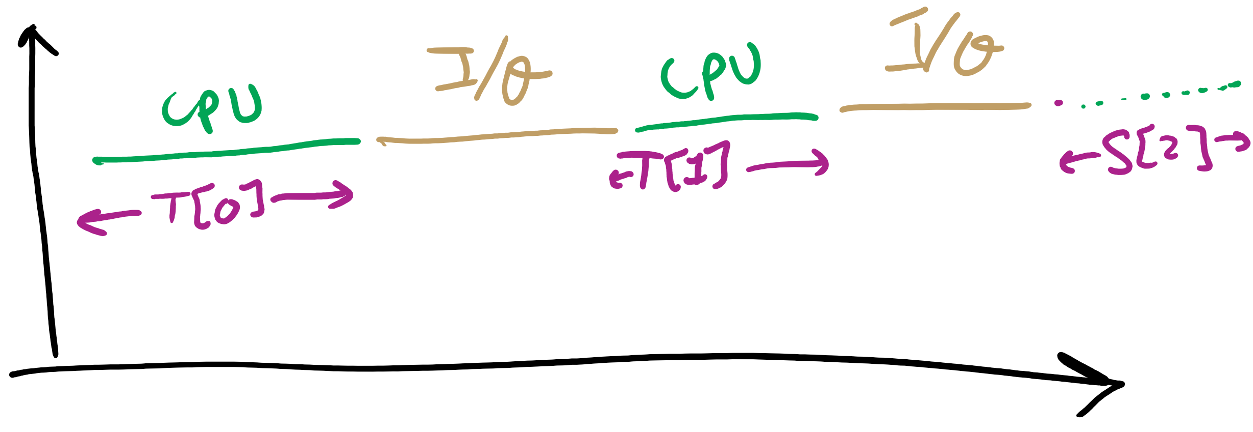
CPU Burst Estimation

Slide 29
Estimating the required CPU burst
Recent instances are more likely to better reflect future behavior
A common technique to factor the above observation into the estimate is to use exponential averaging :
S[n+1] = α T[n] + (1- α) S[n] ; 0 < α < 1

Slide 30
CPU burst Estimate (Exponential Average)
Recent instances have higher weights, whenever α > 1/n
Expanding the estimated value shows that the weights of past instances decrease exponentially
S[n+1] = α T[n] + (1- α) α T[n-1] + ... (1- α)^{i} α T[n-i] +
... + (1- α)^{n}S[1]
The predicted value of 1st instance, S[1], is usually set to 0 to give priority to new processes

Slide 31
Exponentially Decreasing Coefficients

Slide 32
Exponentially Decreasing Coefficients
S[1] = 0 to give high priority to new processes
Exponential averaging tracks changes in process behavior much faster than simple averaging

Slide 33
Memory management
Basic memory management
Swapping
Virtual memory
Page replacement algorithms
Modeling page replacement algorithms
Design issues for paging systems
Implementation issues
Segmentation

Slide 34
In an ideal world…
The ideal world has memory that is
Very large
Very fast
Non-volatile (doesn’t go away when power is turned off)
The real world has memory that is:
Very large
Very fast
Affordable!
Pick any two…
Memory management goal: make the real world look as much like the ideal world as possible

Slide 35
Memory hierarchy
What is the memory hierarchy?
Different levels of memory
Some are small & fast
Others are large & slow
What levels are usually included?
Cache: small amount of fast, expensive memory
L1 (level 1) cache: usually on the CPU chip
L2 & L3 cache: off-chip, made of SRAM
Main memory: medium-speed, medium price memory (DRAM)
Disk: many gigabytes of slow, cheap, non-volatile storage
Memory manager handles the memory hierarchy

Slide 36
Basic memory management
Components include
Operating system (perhaps with device drivers)
Single process
Goal: lay these out in memory
Memory protection may not be an issue (only one program)
Flexibility may still be useful (allow OS changes, etc.)
No swapping or paging
0xFFFF
0xFFFF
User program (RAM)
Operating system (ROM)
Device drivers (ROM)
User program (RAM)
User program (RAM)
Operating system (RAM)
Operating system (RAM)
0
0

Slide 37
Fixed partitions: multiple programs
Fixed memory partitions
Divide memory into fixed spaces
Assign a process to a space when it’s free
Mechanisms
Separate input queues for each partition
Single input queue: better ability to optimize CPU usage
Partition 4
900K
Partition 4
900K
Partition 3
700K
Partition 3
700K
Partition 2
600K
Partition 2
600K
Partition 1
500K
Partition 1
500K
100K
100K
OS
OS
0
0

Slide 38
How many programs is enough?
Several memory partitions (fixed or variable size)
Lots of processes wanting to use the CPU
Tradeoff
More processes utilize the CPU better
Fewer processes use less memory (cheaper!)
How many processes do we need to keep the CPU fully utilized?
This will help determine how much memory we need
Is this still relevant with memory costing $10/GB?

Slide 39
Modeling multiprogramming
More I/O wait means less processor utilization
At 20% I/O wait, 3–4 processes fully utilize CPU
At 80% I/O wait, even 10 processes aren’t enough
This means that the OS should have more processes if they’re I/O bound
More processes => memory management & protection more important!

Slide 40
Base and limit registers
Special CPU registers: base & limit
Access to the registers limited to kernel (privileged) mode
Registers contain
Base: start of the process’s memory partition
Limit: length of the process’s memory partition
Address generation
Physical address: location in actual memory
Logical address: location from the process’s point of view
Physical address = base + logical address
Logical address larger than limit => error
0xFFFF
0x2000
Limit
Process partition
Base
0x9000
OS
0
Logical address: 0x1204 Physical address: 0x1204+0x9000 = 0xa204

Slide 41
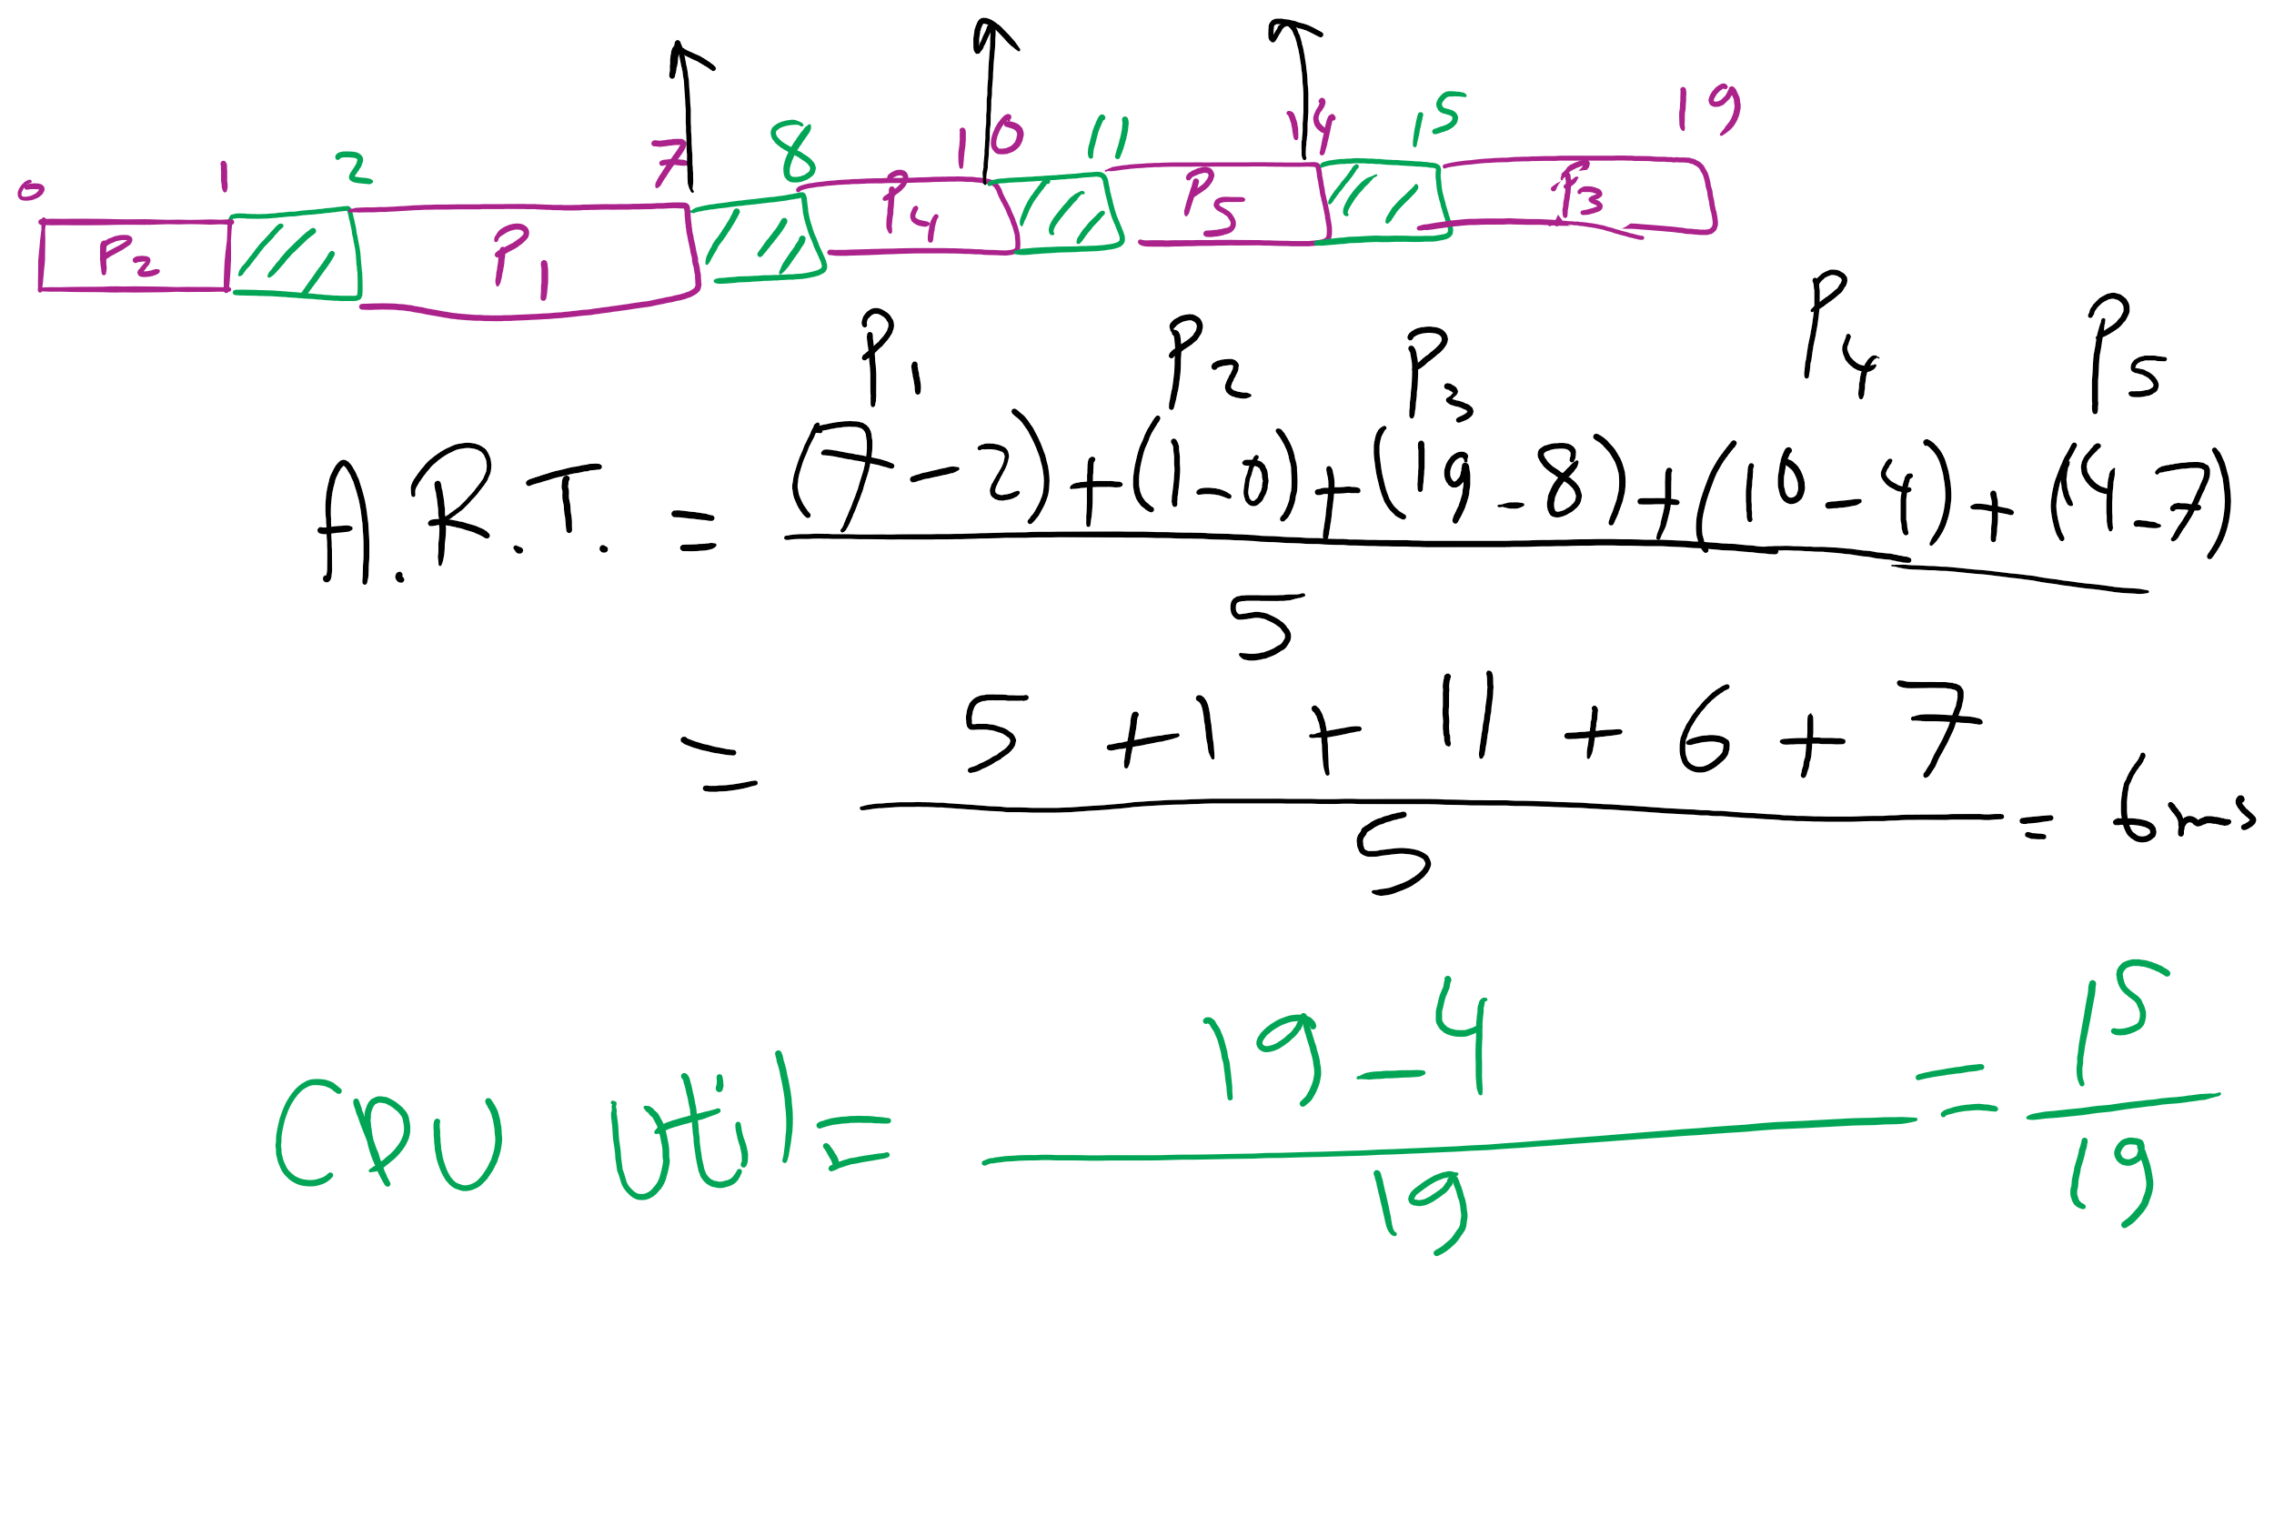
FCFS Problem in HW7

Slide 42
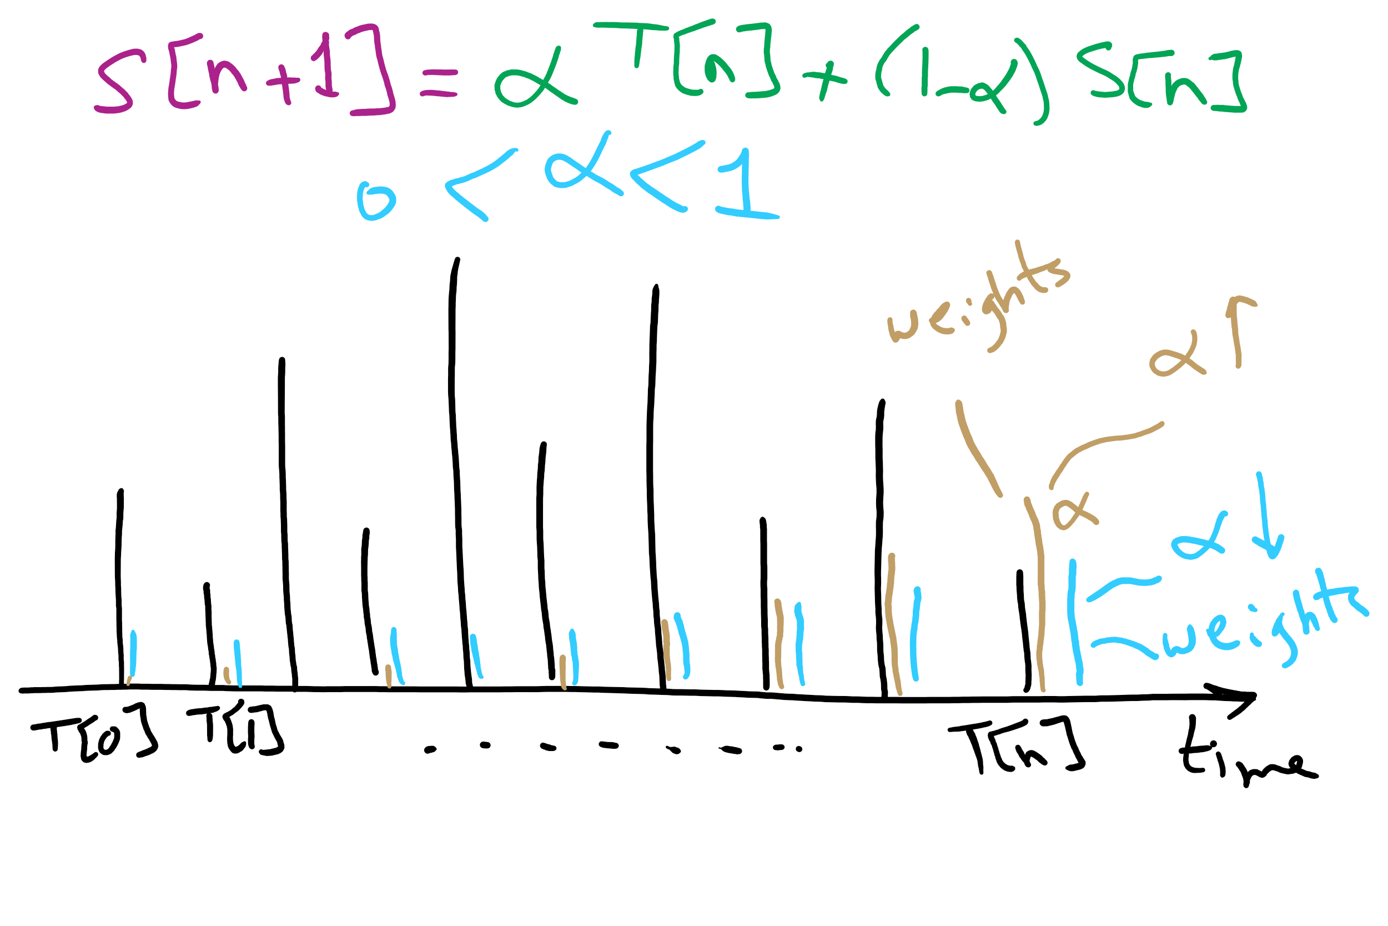
CPU Burst Estimation

Slide 43

Memory Management for Embedded Systems

Slide 44
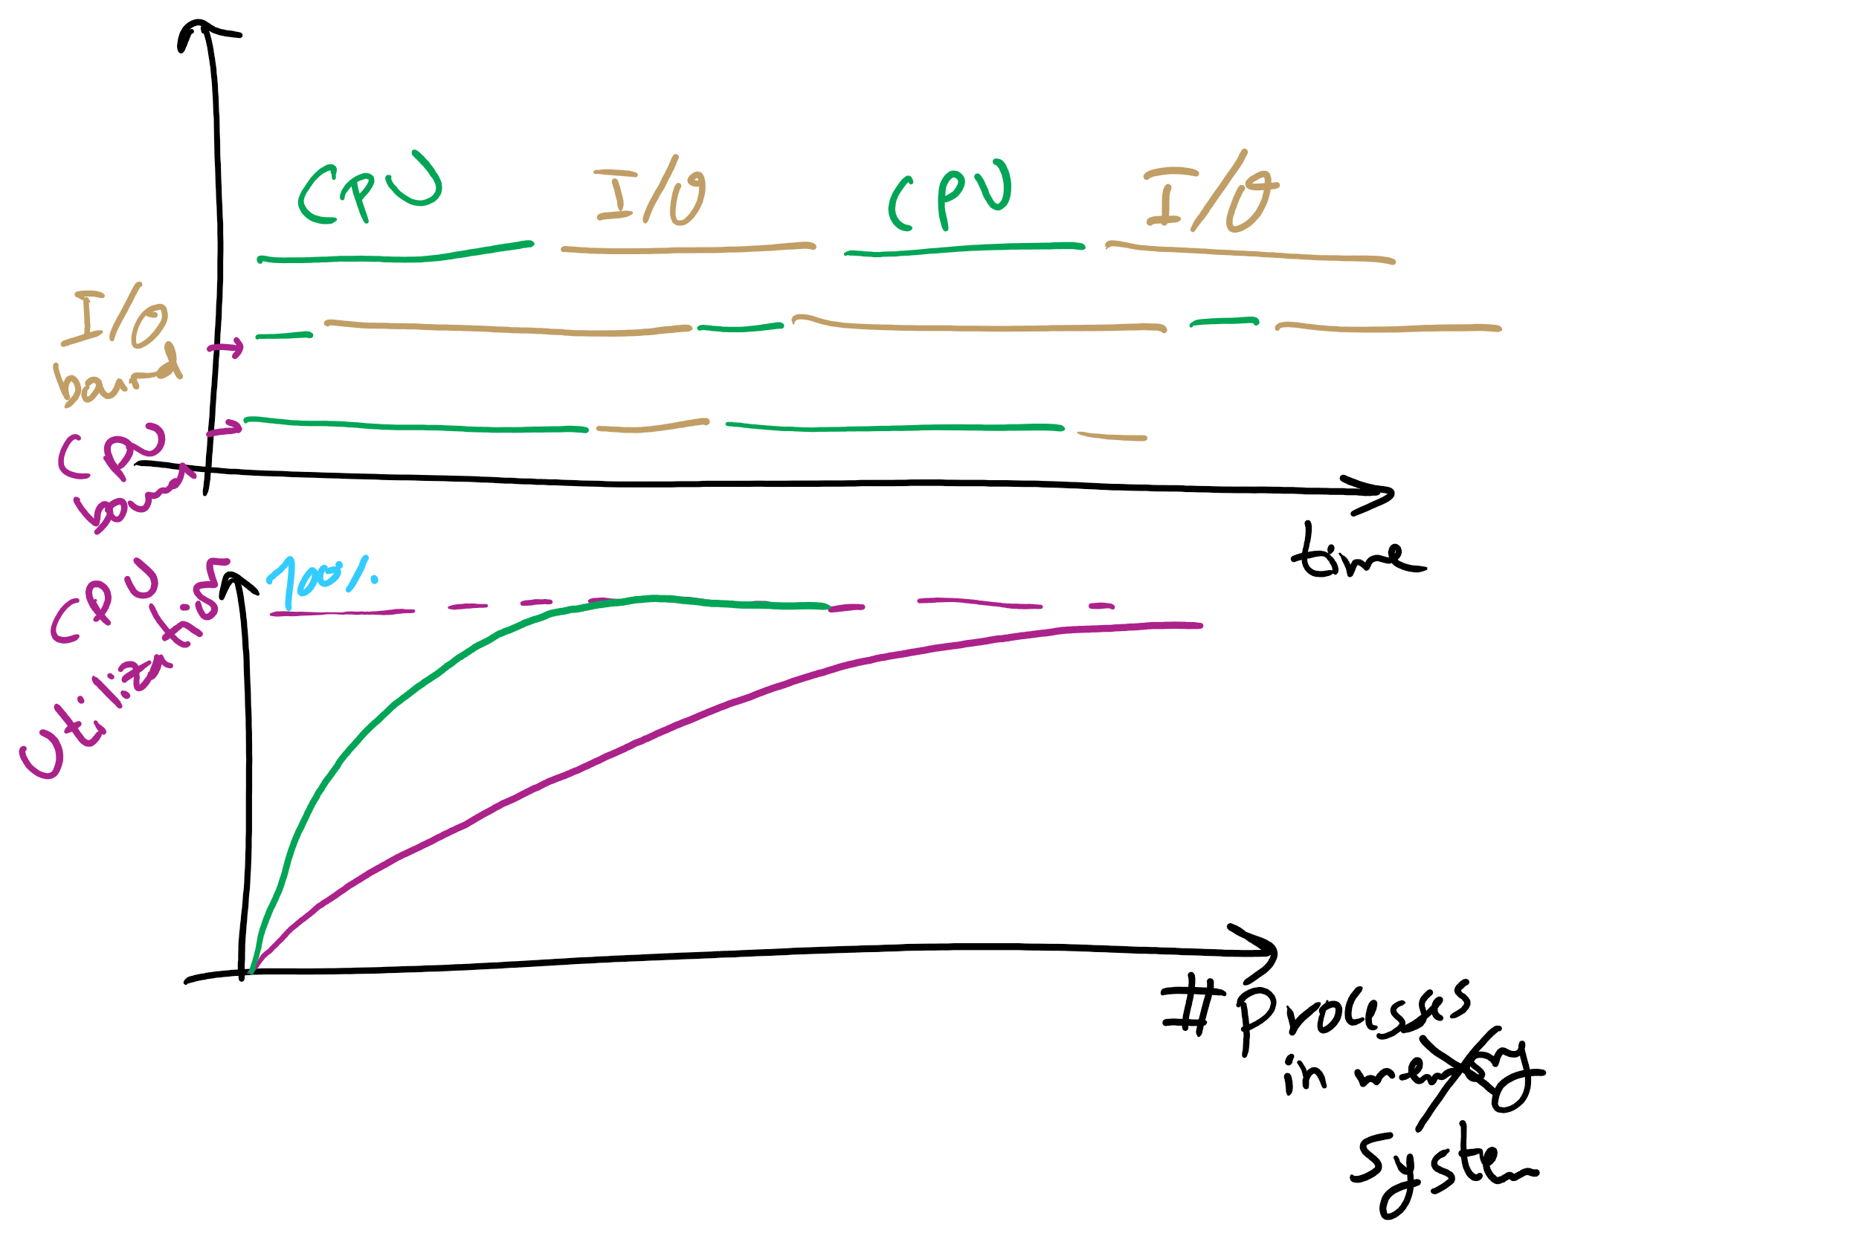
Why do we need more processes?

Slide 45
Today’s Agenda …
Virtual Memory
Page Replacement Algorithms

Slide 46
Base and limit registers
Special CPU registers: base & limit
Access to the registers limited to kernel (privileged) mode
Registers contain
Base: start of the process’s memory partition
Limit: length of the process’s memory partition
Address generation
Physical address: location in actual memory
Logical address: location from the process’s point of view
Physical address = base + logical address
Logical address larger than limit => error
0xFFFF
0x2000
Limit
Process partition
Base
0x9000
OS
0
Logical address: 0x1204 Physical address: 0x1204+0x9000 = 0xa204

