Slide 1

Introduction to Operating Systems CS/COE 1550
Fall 2021
Sherif Khattab
ksm73@pitt.edu
(Some slides are from Silberschatz, Galvin and Gagne ©2013)

Slide 2
Announcements
Upcoming deadlines:
11/12: Homework 8
11/19: Project 3

Slide 3
Previous lecture …
Manual tracing of page replacement algorithms
Belady’s anomayl

Slide 4
Muddiest Points (1/2)
Working Set
irc, in order to minimize the working set (and page faults), we need to try to make more local references instead of hopping around in memory. Is this done in userspace or in the kernel? If it's done in userspace, can you give a brief example with pseudocode
Review of application view vs os view for working set again
clarification on how working set clock varies from the original
Stack Algorithms
How the stack algorithm fixes Belady’s anomaly
Manual tracing of page-replacement algorithms
What are these tables used for? to evaluate page replacement algorithms for vulnerability to Belady's anomaly?

Slide 5
Muddiest Points (2/2)
Belady’s Anomaly
How was their MORE page faults when have more memory. I understand why nit less.
Why does Belady's anomaly occur in FIFO?
Project 3
I'm still a bit confused on the implementation of OPT
could we go over the page replacement algorithms list one more time
Why do we only write to disk on page eviction

Slide 6
Page replacement algorithms: summary
Algorithm | Comment
OPT (Optimal) | Not implementable, but useful as a benchmark
NRU (Not Recently Used) | Crude
FIFO (First-In, First Out) | Might throw out useful pages
Second chance | Big improvement over FIFO
Clock | Better implementation of second chance
LRU (Least Recently Used) | Excellent, but hard to implement exactly
NFU (Not Frequently Used) | Poor approximation to LRU
Aging | Good approximation to LRU, efficient to implement
Working Set | Somewhat expensive to implement
WSClock | Implementable version of Working Set

Slide 7
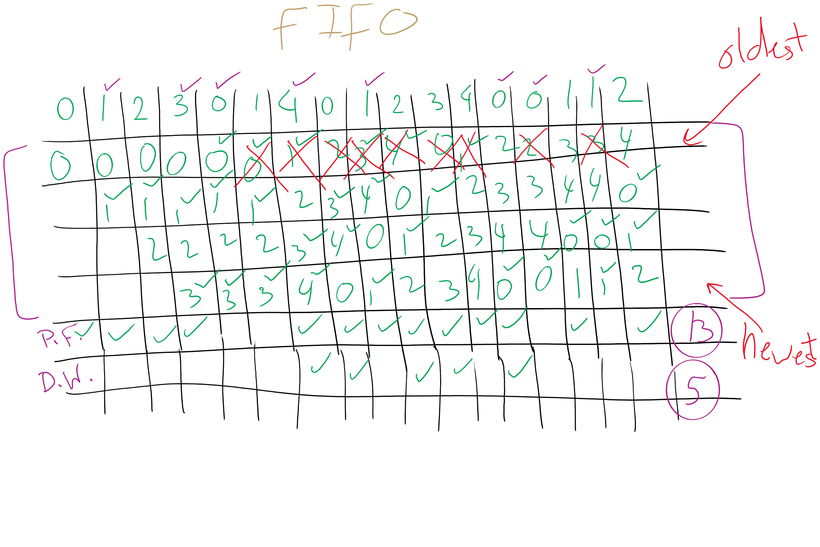
FIFO with 4 frames

Slide 8
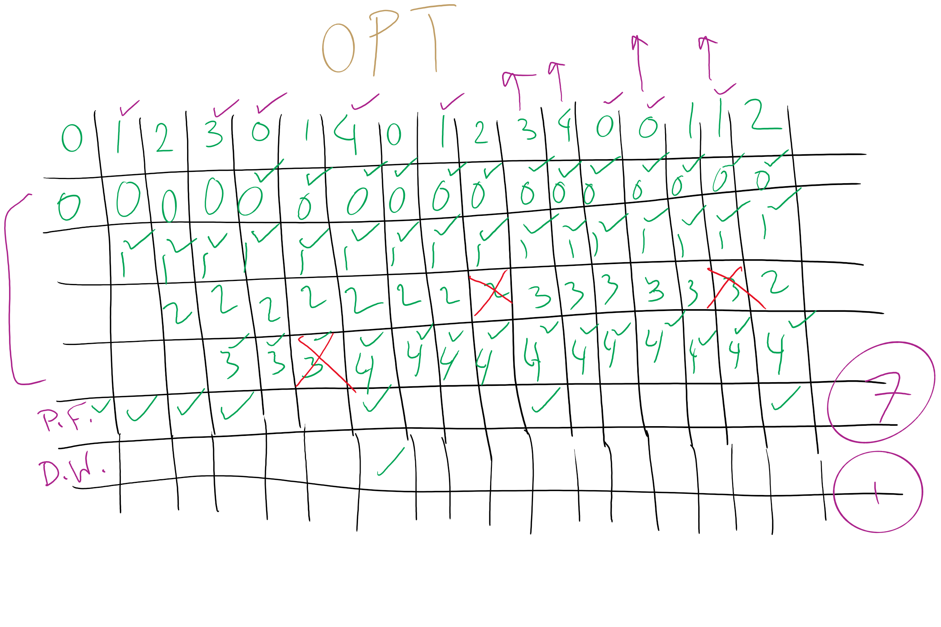
OPT

Slide 9
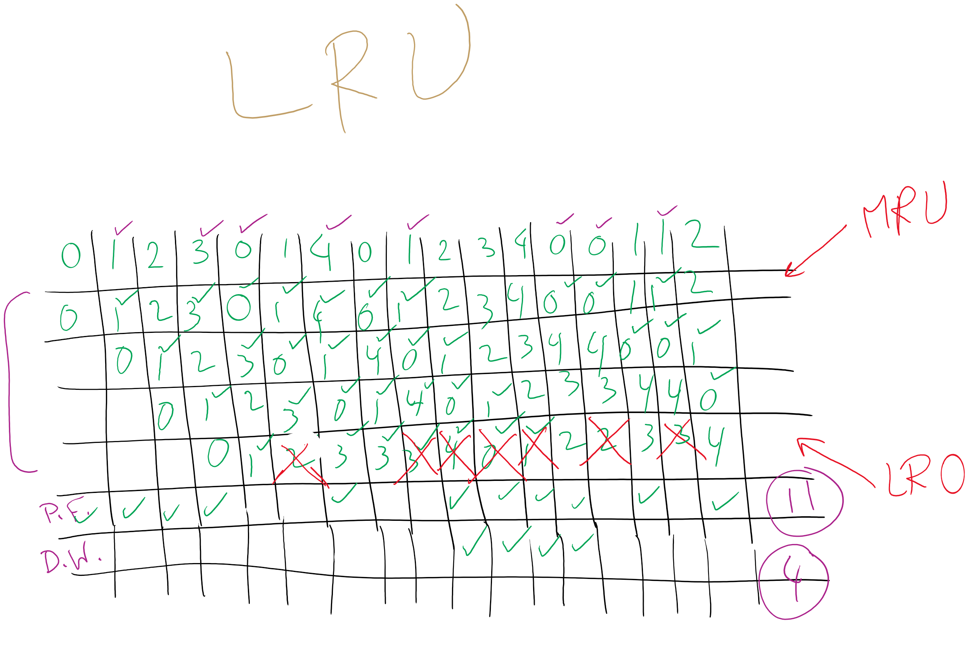
LRU

Slide 10
Mapping logical => physical address
Split address from CPU into two pieces
Page number (p)
Page offset (d)
Page number
Index into page table
Page table contains base address of page in physical memory
Page offset
Added to base address to get actual physical memory address
Page size = 2^{d} bytes
Example:
• 4 KB (=4096 byte) pages
• 32 bit logical addresses
2^{d} = 4096
d = 12
32-12 = 20 bits
12 bits
p
d
32 bit logical address

Slide 11
Address translation architecture
page number
Page frame number
Page frame number
page offset
0
CPU
p
d
f
d
1
. . .
0
f-1
1
f
. . .
f+1
p-1
f+2
p
f
. . .
p+1
physical memory
page table

Slide 12
Memory & paging structures
Physical memory
Page frame number
Page 0
6
Page 1
3
0
Page 1 (P1)
Page 2
4
1
Page 3
9
2
Page 4 (P0)
Page 4
2
3
Page 1 (P0)
Free
pages
4
Page 2 (P0)
Logical memory (P0)
Page table (P0)
5
6
Page 0 (P0)
Page 0
8
7
Page 1
0
8
Page 0 (P1)
9
Page 3 (P0)
Logical memory (P1)
Page table (P1)

Slide 13
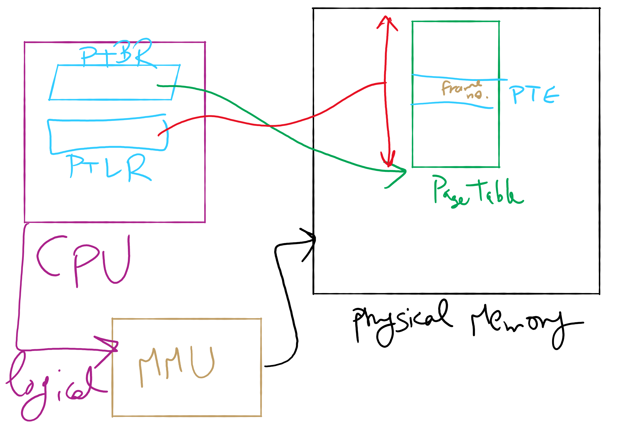
Address Translation Structures

Slide 14
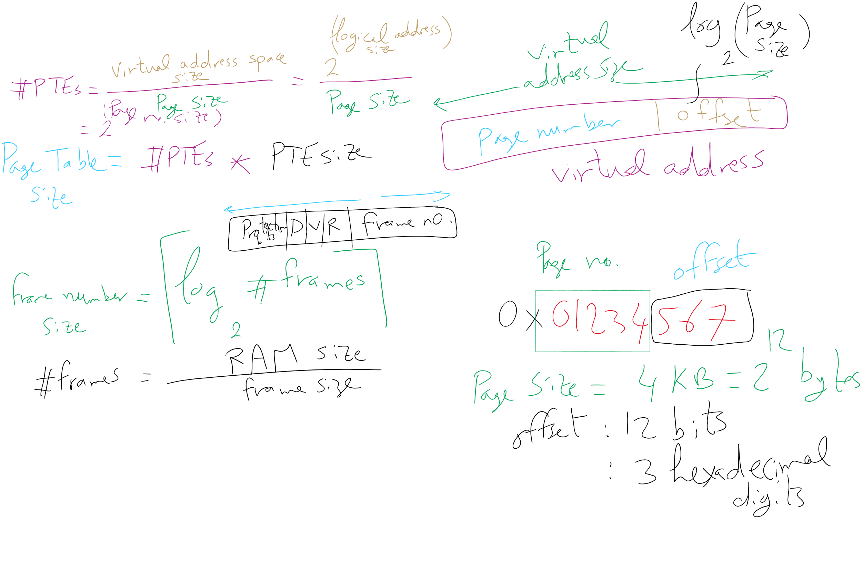
Address Translation Relations

Slide 15
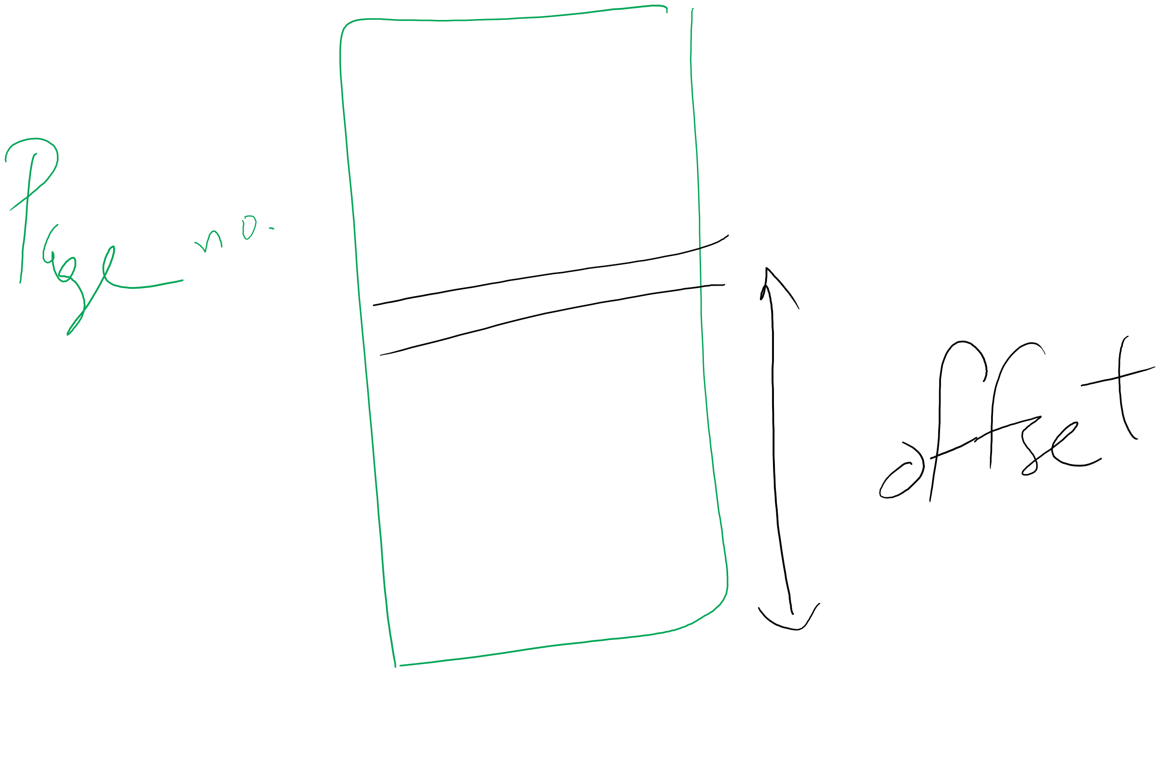
Page number vs. Offset

