Slide 1

Introduction to Operating Systems CS/COE 1550
Fall 2021
Sherif Khattab
ksm73@pitt.edu
(Some slides are from Silberschatz, Galvin and Gagne ©2013)

Slide 2
Announcements
Upcoming deadlines:
11/19: Homework 9
11/19: Project 3
Bonus opportunities
Bonus homework
Post-course test
OMET bonus (response rate >= 80%)

Slide 3
Previous Lecture …
2-level and inverted page table
TLB
Effective memory access time
Miscellaneous issues
Local vs global
Controlling memory allocation using page fault rate

Slide 4
Muddiest Points (Page Tables)
Is there any reason to use a TLB on a 1-level page table?
inverted page table.
how it differs from page table/multilevel page tables. and calculating its size, is that calculation different from a normal page table?
Inverted table / associative memory
why we need them
Are inverted tables used when space is more important than speed?
comparison between methodology of conventional and inverted page tables
Multi-level page table
Where is Second and Further Level Page Tables stored?
how to implement multi level page tables
How many levels are the page tables in modern systems?

Slide 5
Muddiest Points (Other Address Translation Issues)
use of EAT equation
Changing of frames between processes
Frame allocation through thrashing
how are frames taken from one process and given to another
Thresholds for page faults/allocation
What are important differences between pure and modified separation?

Slide 6
Muddiest Points (Project 3 and logistics)
for the p3 write up - can we just pick any trace file to run all the statistics on? it is not specified
Project 3 small extension?
Not having slides ahead of time makes it difficult to follow.

Slide 7
How big should a page be?
Smaller pages have advantages
Less internal fragmentation
Better fit for various data structures, code sections
Less unused physical memory (some pages have 20 useful bytes and the rest isn’t needed currently)
Larger pages are better because
Less overhead to keep track of them
Smaller page tables
TLB can point to more memory (same number of pages, but more memory per page)
Faster paging algorithms (fewer table entries to look through)
More efficient to transfer larger pages to and from disk

Slide 8
Separate I & D address spaces
One user address space for both data & code
Simpler
Code/data separation harder to enforce
More address space?
One address space for data, another for code
Code & data separated
More complex in hardware
Less flexible
CPU must handle instructions & data differently
Instructions
Data
2³²-1
Data
Data
Code
Code
0

Slide 9
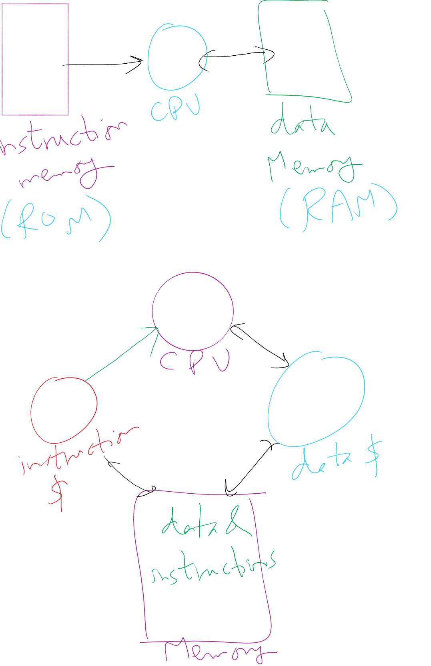
Separate I&D Address Spaces (Pure and modified)

Slide 10
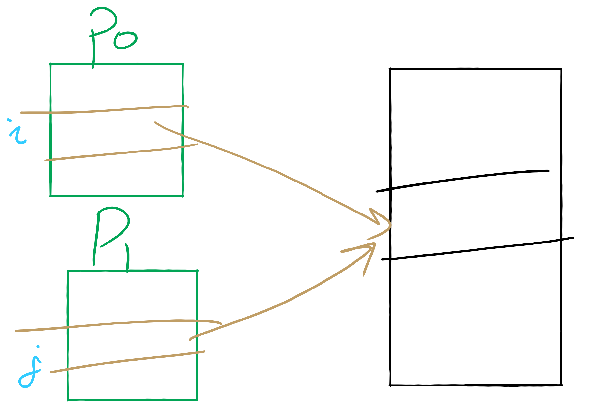
Sharing Pages

Slide 11
Sharing pages
Processes can share pages
Entries in page tables point to the same physical page frame
Easier to do with code: no problems with modification
Virtual addresses in different processes can be…
The same: easier to exchange pointers, keep data structures consistent
Different: may be easier to actually implement
Not a problem if there are only a few shared regions
Can be very difficult if many processes share regions with each other

Slide 12
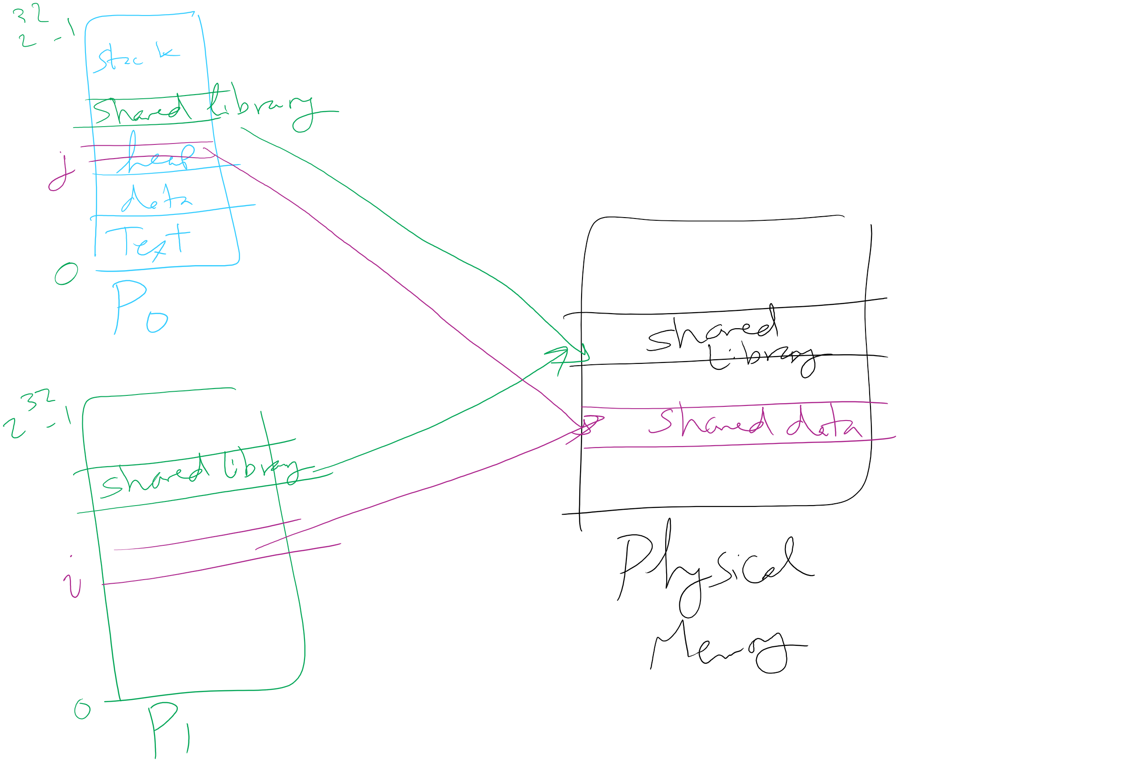
Page Sharing

Slide 13
Implementation issues
Four times when OS involved with paging
Process creation
Determine program size
Create page table
During process execution
Reset the MMU for new process
Flush the TLB (or reload it from saved state)
Page fault time
Determine virtual address causing fault
Swap target page out, needed page in
Process termination time
Release page table
Return pages to the free pool

Slide 14
How is a page fault handled?
Hardware causes a page fault
General registers saved (as on every exception)
OS determines which virtual page needed
Actual fault address in a special register
Address of faulting instruction in register
Page fault was in fetching instruction, or
Page fault was in fetching operands for instruction
OS must figure out which…
OS checks validity of address
Process killed if address was illegal
OS finds a place to put new page frame
If frame selected for replacement is dirty, write it out to disk
OS requests the new page from disk
Page tables updated
Faulting instruction backed up so it can be restarted
Faulting process scheduled
Registers restored
Program continues

Slide 15
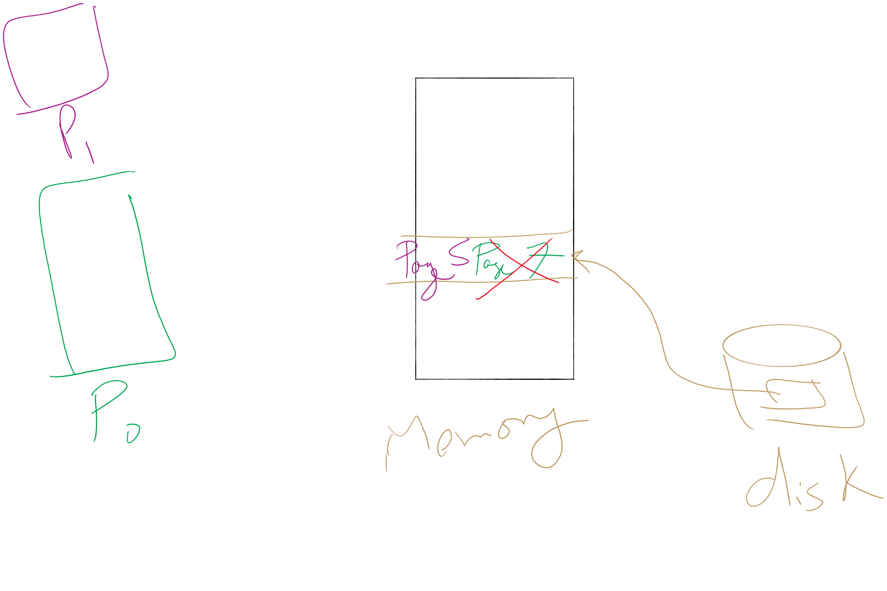
Page locking

Slide 16
Locking pages in memory
Virtual memory and I/O occasionally interact
P1 issues call for read from device into buffer
While it’s waiting for I/O, P2 runs
P2 has a page fault
P1’s I/O buffer might be chosen to be paged out
This can create a problem because an I/O device is going to write to the buffer on P1’s behalf
Solution: allow some pages to be locked into memory
Locked pages are immune from being replaced
Pages only stay locked for (relatively) short periods

Slide 17
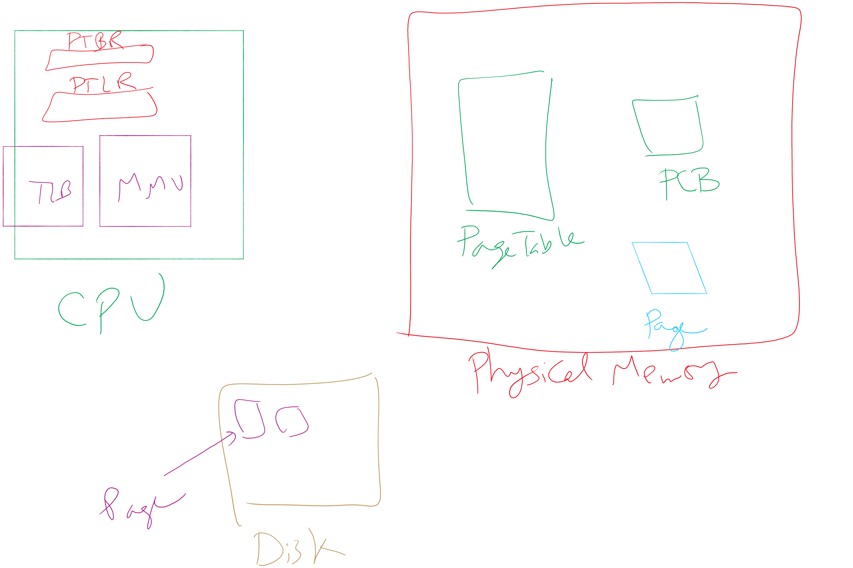
Map of MMU, TLB, Page Table, etc.

Slide 18
When are dirty pages written to disk?
On demand (when they’re replaced)
Fewest writes to disk
Slower: replacement takes twice as long (must wait for disk write and disk read)
Periodically (in the background)
Background process scans through page tables, writes out dirty pages that are pretty old
Background process also keeps a list of pages ready for replacement
Page faults handled faster: no need to find space on demand
Cleaner may use the same structures discussed earlier (clock, etc.)

Slide 19
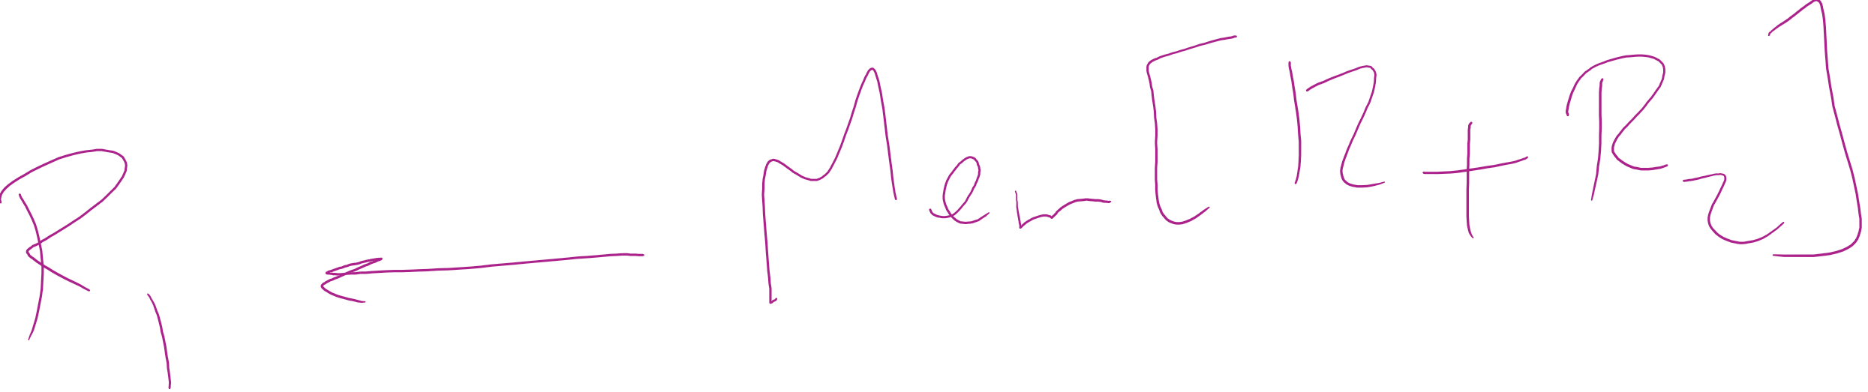
Backing up an instruction
Problem: page fault happens in the middle of instruction execution
Some changes may have already happened
Others may be waiting for VM to be fixed
Solution: undo all of the changes made by the instruction
Restart instruction from the beginning
This is easier on some architectures than others
Example: LW R1, 12(R2)
Page fault in fetching instruction: nothing to undo
Page fault in getting value at 12(R2): restart instruction

Slide 20
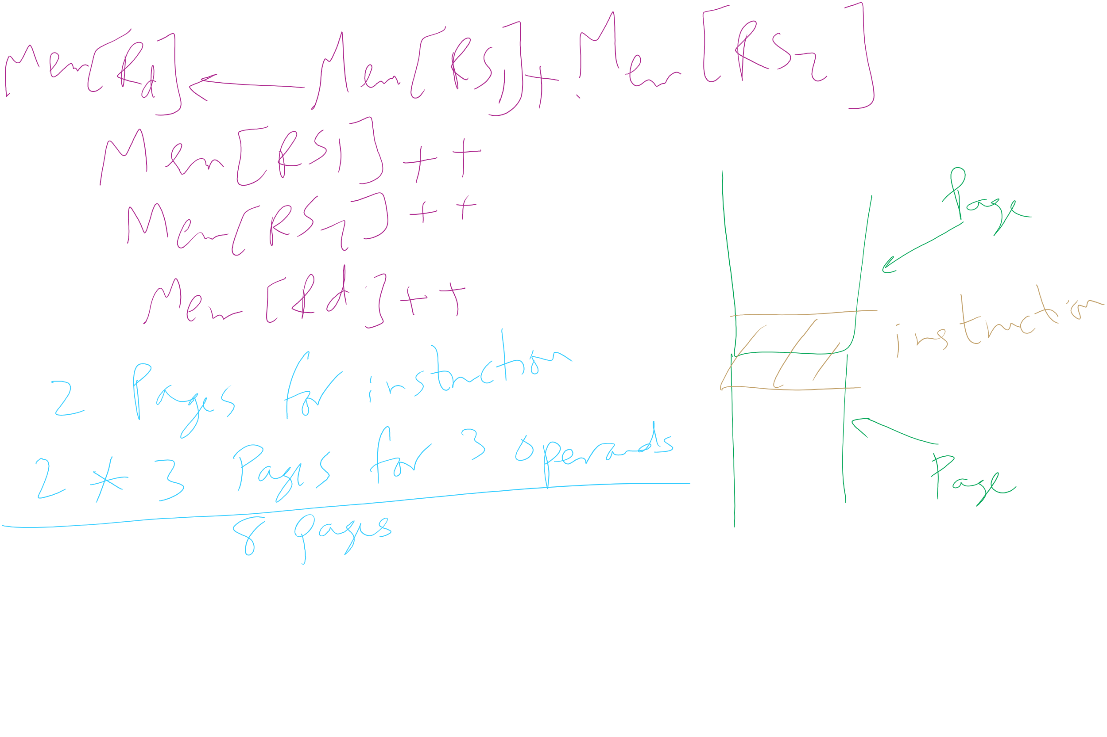
Minimum memory allocation to a process
Example: ADD (Rd)+,(Rs1)+,(Rs2)+
Page fault in writing to (Rd): may have to undo an awful lot…

Slide 21
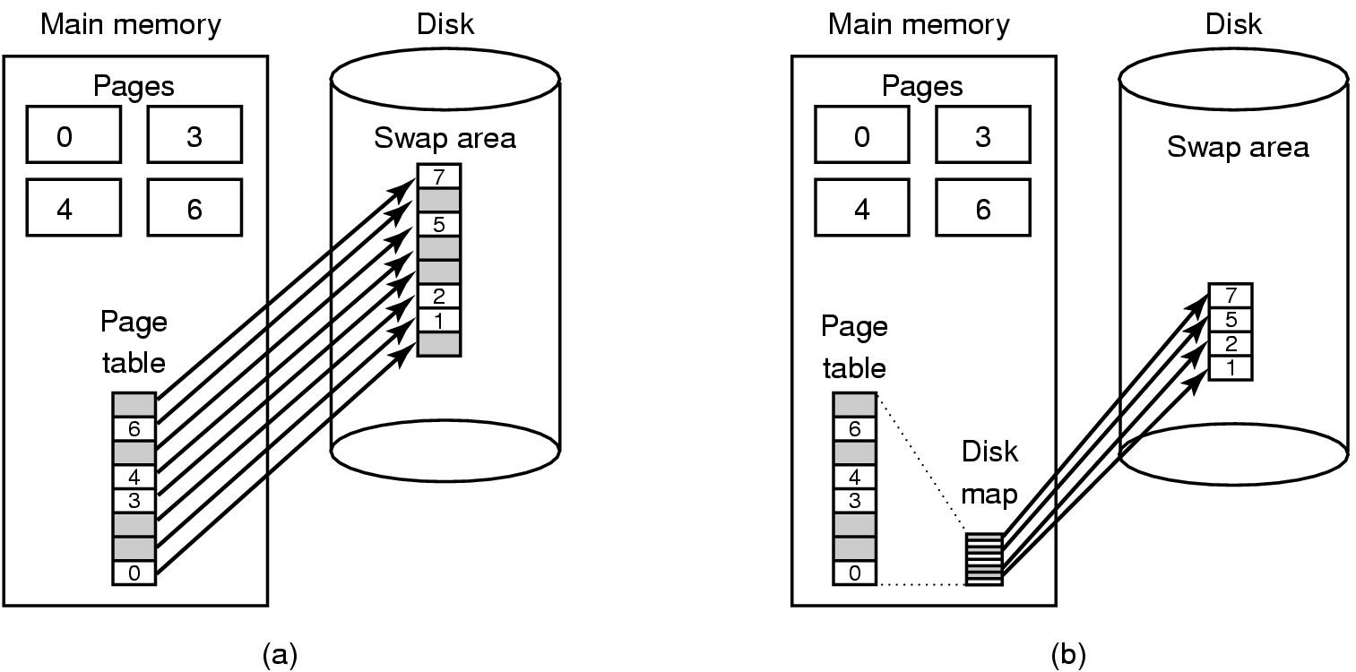
Storing pages on disk
Pages removed from memory are stored on disk
Where are they placed?
Static swap area: easier to code, less flexible
Dynamically allocated space: more flexible, harder to locate a page
Dynamic placement often uses a special file (managed by the file system) to hold pages
Need to keep track of which pages are where within the on-disk storage

Slide 22
Separating policy and mechanism
Mechanism for page replacement has to be in kernel
Modifying page tables
Reading and writing page table entries
Policy for deciding which pages to replace could be in user space
More flexibility
3. Request page
User process
External pager
4. Page arrives
User space
2. Page needed
5. Here is page!
Kernel space
Fault handler
MMU handler
1. Page fault
6. Map in page

Slide 23
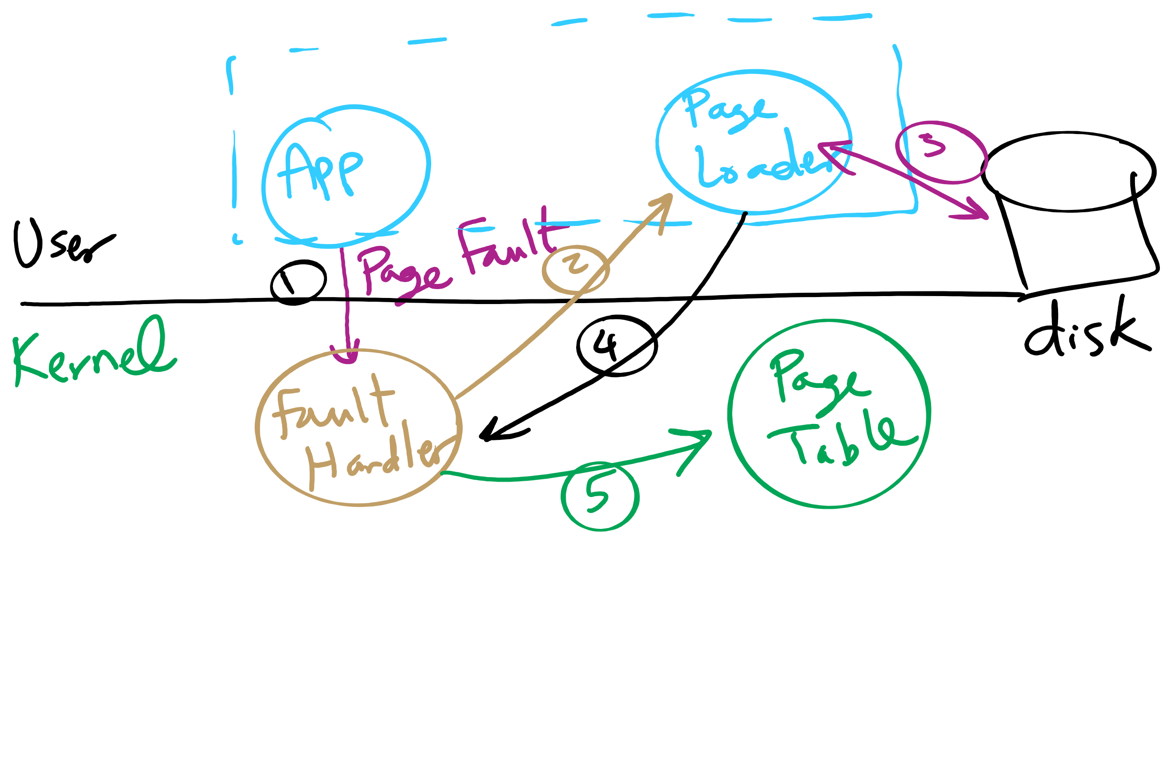
Separating Policy and Mechanism for Page Replacement

Slide 24
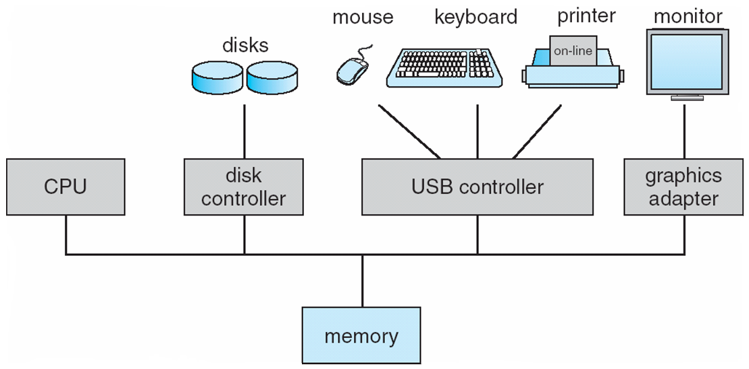
How complex is the OS’s job?
Let’s look at one of the resources managed by the OS: I/O devices

Slide 25
File system implementation issues
How are disks divided up into file systems?
How does the file system allocate blocks to files?
How are directories handled?
How does the file system manage free space?
How can the file system improve…
Performance?
Reliability?

Slide 26
Carving up the disk
Entire disk
Partition table
Master boot record
Partition 1
Partition 2
Partition 3
Partition 4
Boot block
Super block
Free space management
Index nodes
Files & directories

Slide 27
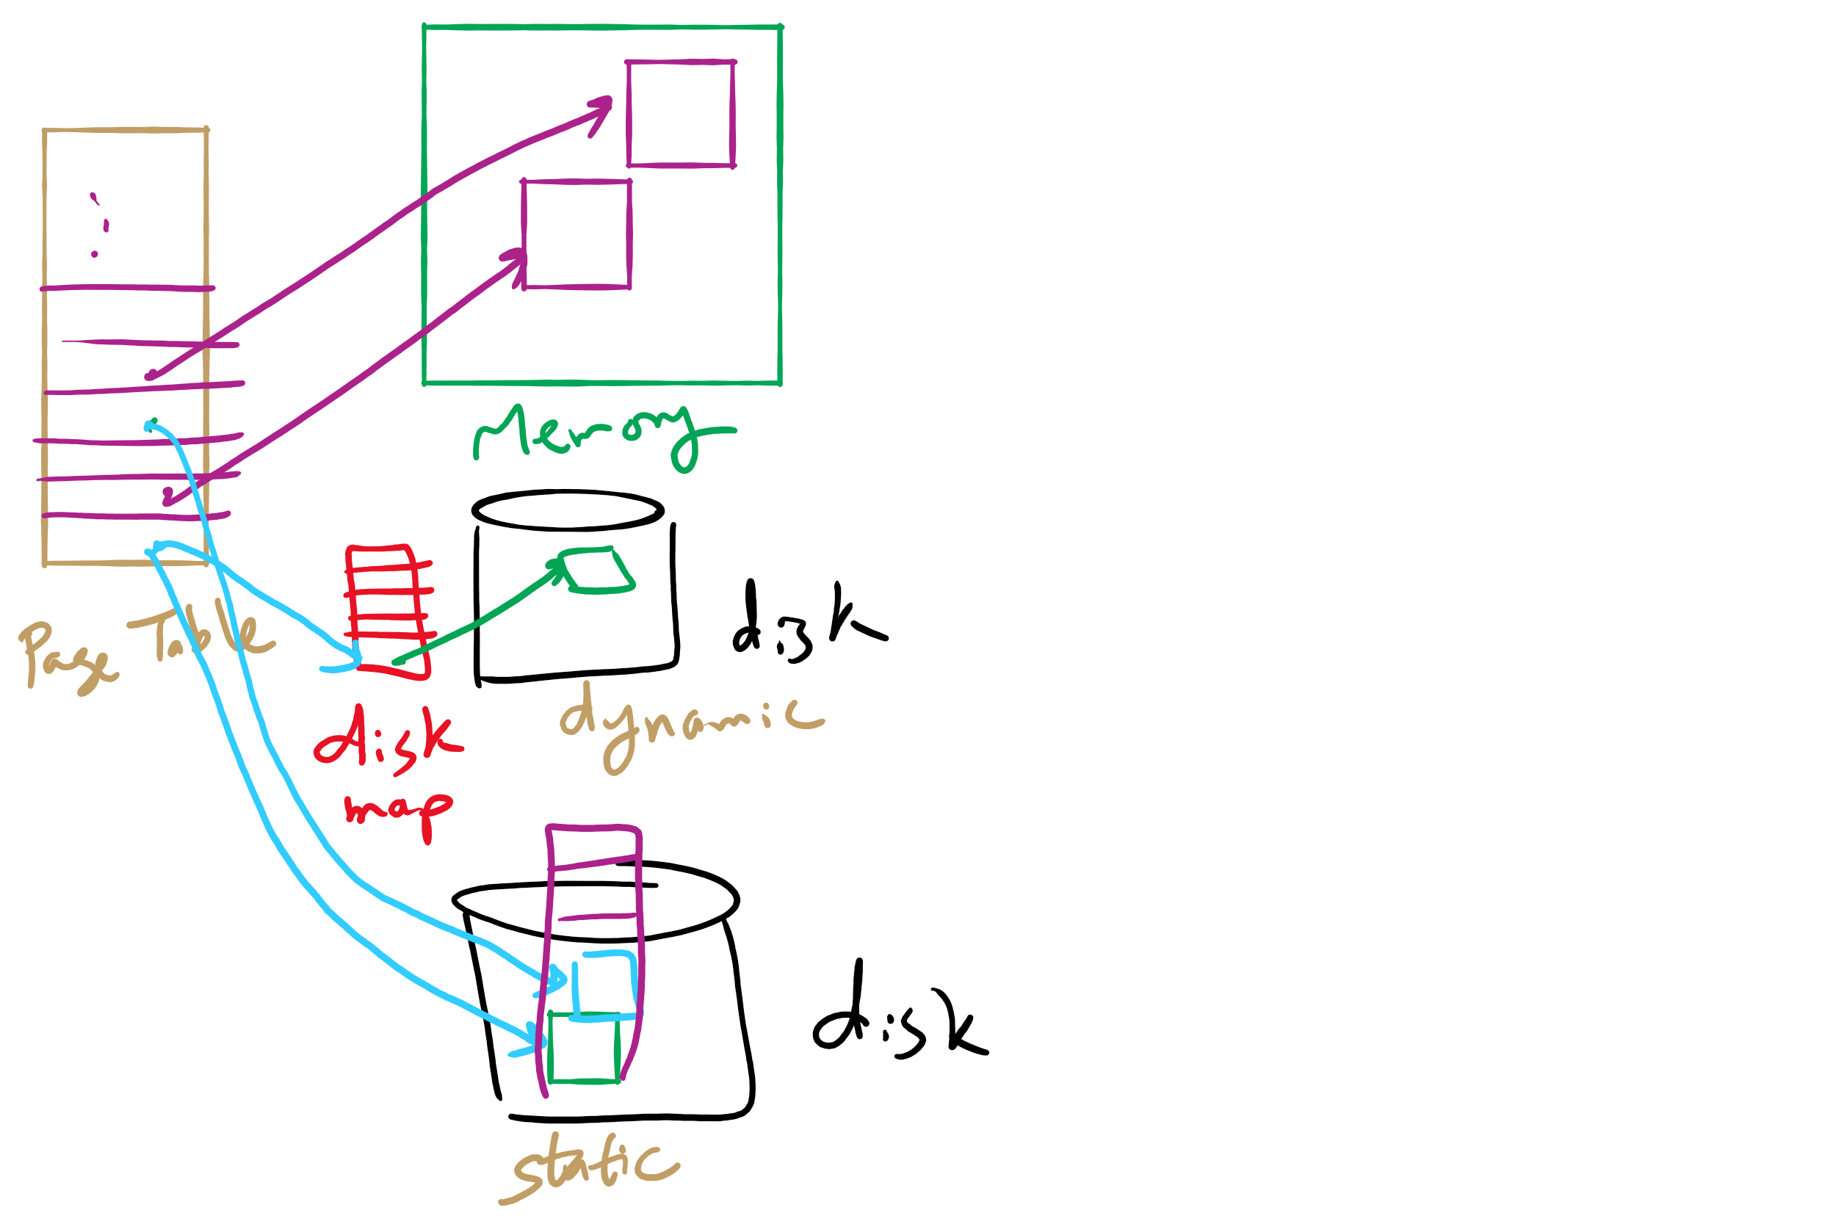
Disk Map

Slide 28
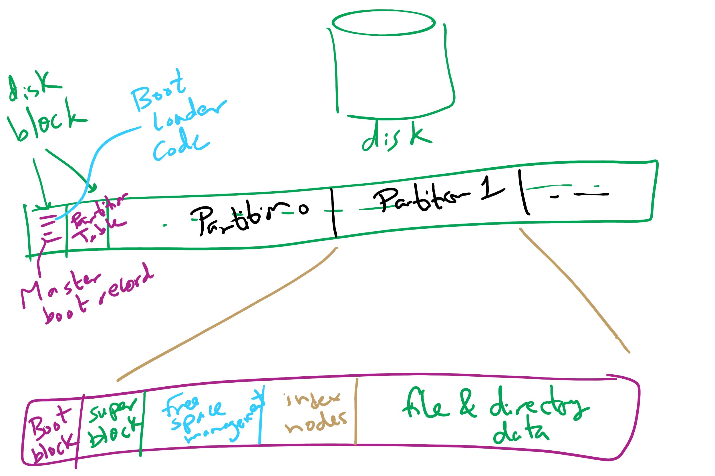
Carving Up a Disk

Slide 29
Contiguous allocation for file blocks
Contiguous allocation requires all blocks of a file to be consecutive on disk
Problem: deleting files leaves “holes”
Similar to memory allocation issues
Compacting the disk can be a very slow procedure…
A
B
C
D
E
F
A
Free
C
Free
E
F

