Slide 1

Introduction to Operating Systems CS/COE 1550
Fall 2021
Sherif Khattab
ksm73@pitt.edu
(Some slides are from Silberschatz, Galvin and Gagne ©2013)

Slide 2
Announcements
Upcoming deadlines:
11/29: Homework 10 and Lab 4
12/20: Project 4
Please check Canvas for the rest of the deadlines

Slide 3
Muddiest Points (Memory)
So the hardware receives a signal from the OS for an interrupt?
Page sharing
Instruction Restart
Where is the buffer for instruction completion? Also what were the disadvantages of large page sizes?
How the processor can "undo" or reset an instruction if the page changes?
How exactly are instructions backed up then restarted
How does the CPU know how to undo instructions?
Min allocation
when looking at the instruction set in the ADD example, why does each instruction take up (or have one foot in) 2 pages each instead of one or more than 2?
pure vs modified seperation
what do the different classes and different schools represent in the "students and chairs" analogy

Slide 4
Muddiest Points (File System)
Difference of master boot block of disk and boot block of a partition
How does the master boot block interact with each partition in a disk?
Why is it needed to put files and directory per partition
What is a partition

Slide 5
File system implementation issues
How are disks divided up into file systems?
How does the file system allocate blocks to files?
How are directories handled?
How does the file system manage free space?
How can the file system improve…
Performance?
Reliability?

Slide 6
Contiguous allocation
Data in each file is stored in consecutive blocks on disk
Simple & efficient indexing
Starting location (block #) on disk (start)
Length of the file in blocks (length)
Random access well-supported
Difficult to grow files
Must pre-allocate all needed space
Wasteful of storage if file isn’t using all of the space
Logical to physical mapping is easy blocknum = (pos / 1024) + start; offset_in_block = pos % 1024;
0
1
2
3
4
5
6
7
8
9
10
11
Start=5
Length=2902

Slide 7
Linked allocation
File is a linked list of disk blocks
Blocks may be scattered around the disk drive
Block contains both pointer to next block and data
Files may be as long as needed
New blocks are allocated as needed
Linked into list of blocks in file
Removed from list (bitmap) of free blocks
0
1
2
3
4
6
4
5
6
7
x
x
8
9
10
11
0
Start=9
End=4
Length=2902
Start=3
End=6
Length=1500

Slide 8
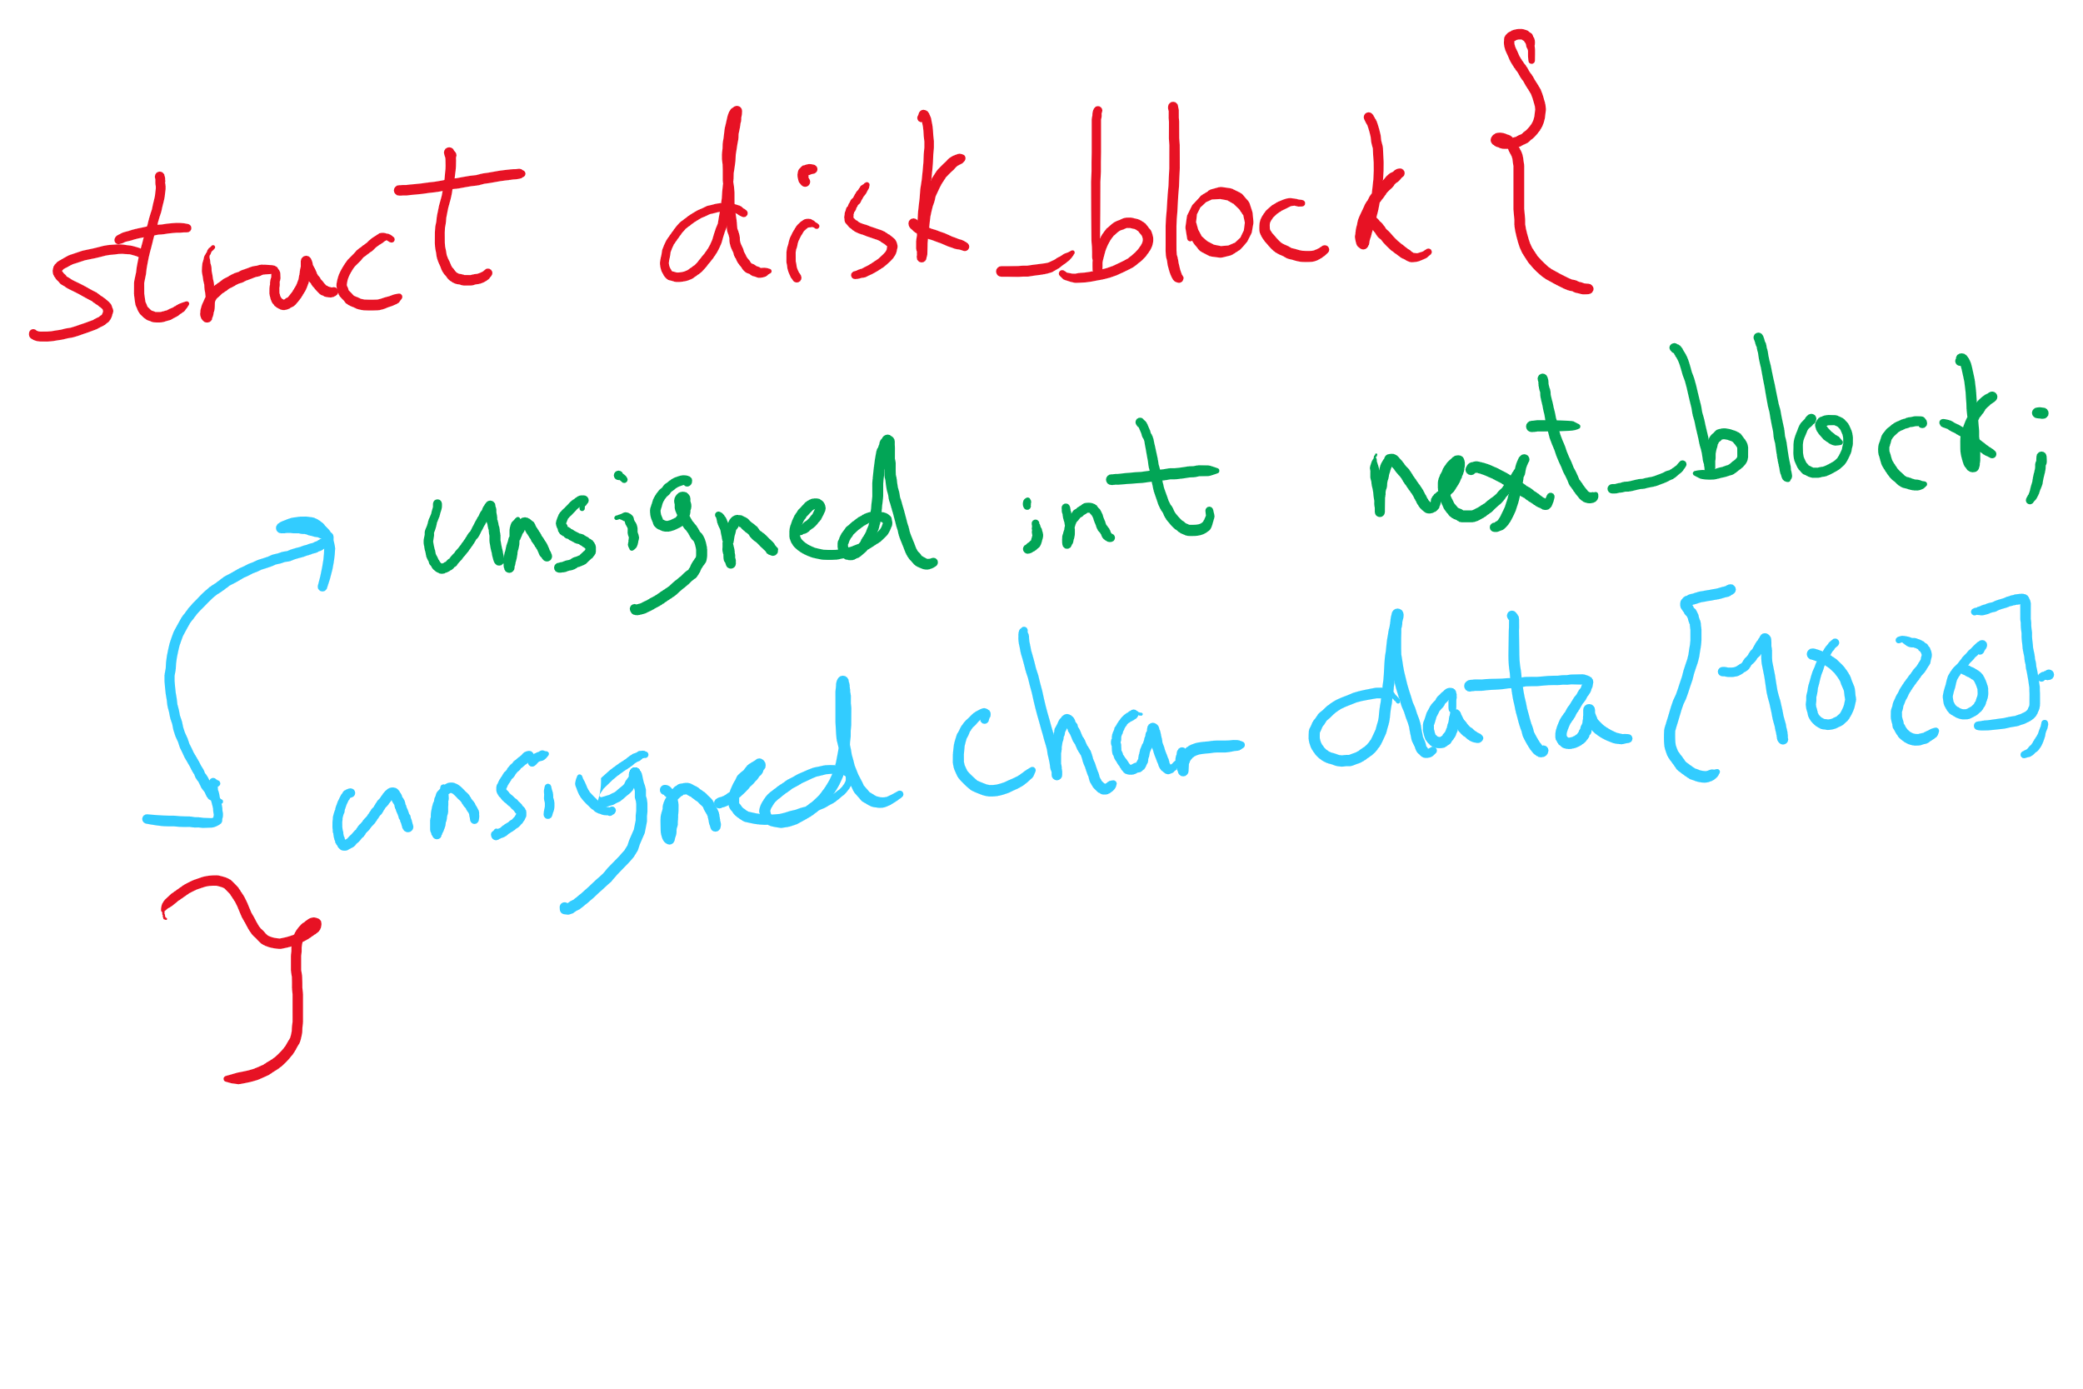
Data Structures for Linked Allocation

Slide 9
Finding blocks with linked allocation
Directory structure is simple
Starting address looked up from directory
Directory only keeps track of first block (not others)
No wasted blocks - all blocks can be used
Random access is difficult: must always start at first block!
Logical to physical mapping is done by block = start; offset_in_block = pos % 1020; for (j = 0; j < pos / 1020; j++) { block = block->next; }
Assumes that next pointer is stored at end of block
May require a long time for seek to random location in file

Slide 10
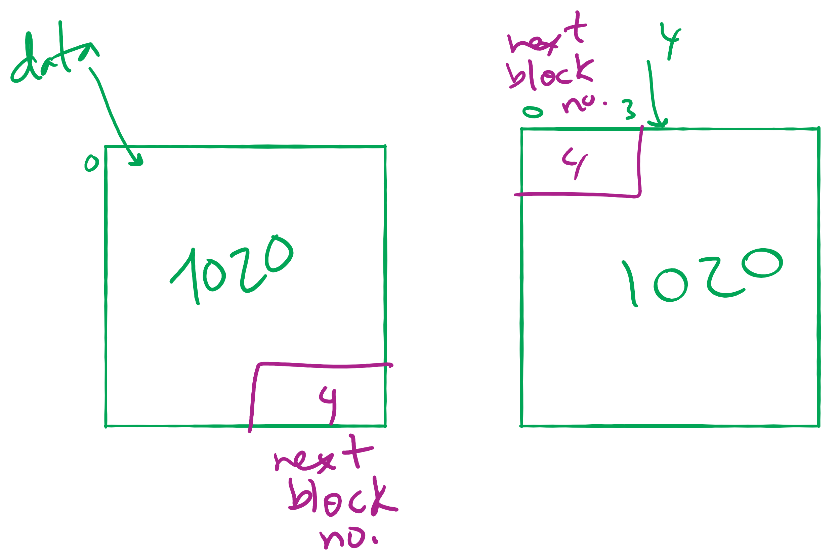
Offset Calculation

Slide 11
File Allocation Table (FAT)
Links on disk are slow
Keep linked list in memory
Advantage: faster
Disadvantages
Have to copy it to disk at some point
Have to keep in-memory and on-disk copy consistent
0
4
1
-1
2
-1
3
-2
4
-2
5
-1
6
3
B
7
-1
8
-1
9
0
A
10
-1
11
-1
12
-1
13
-1
14
-1
15
-1

Slide 12
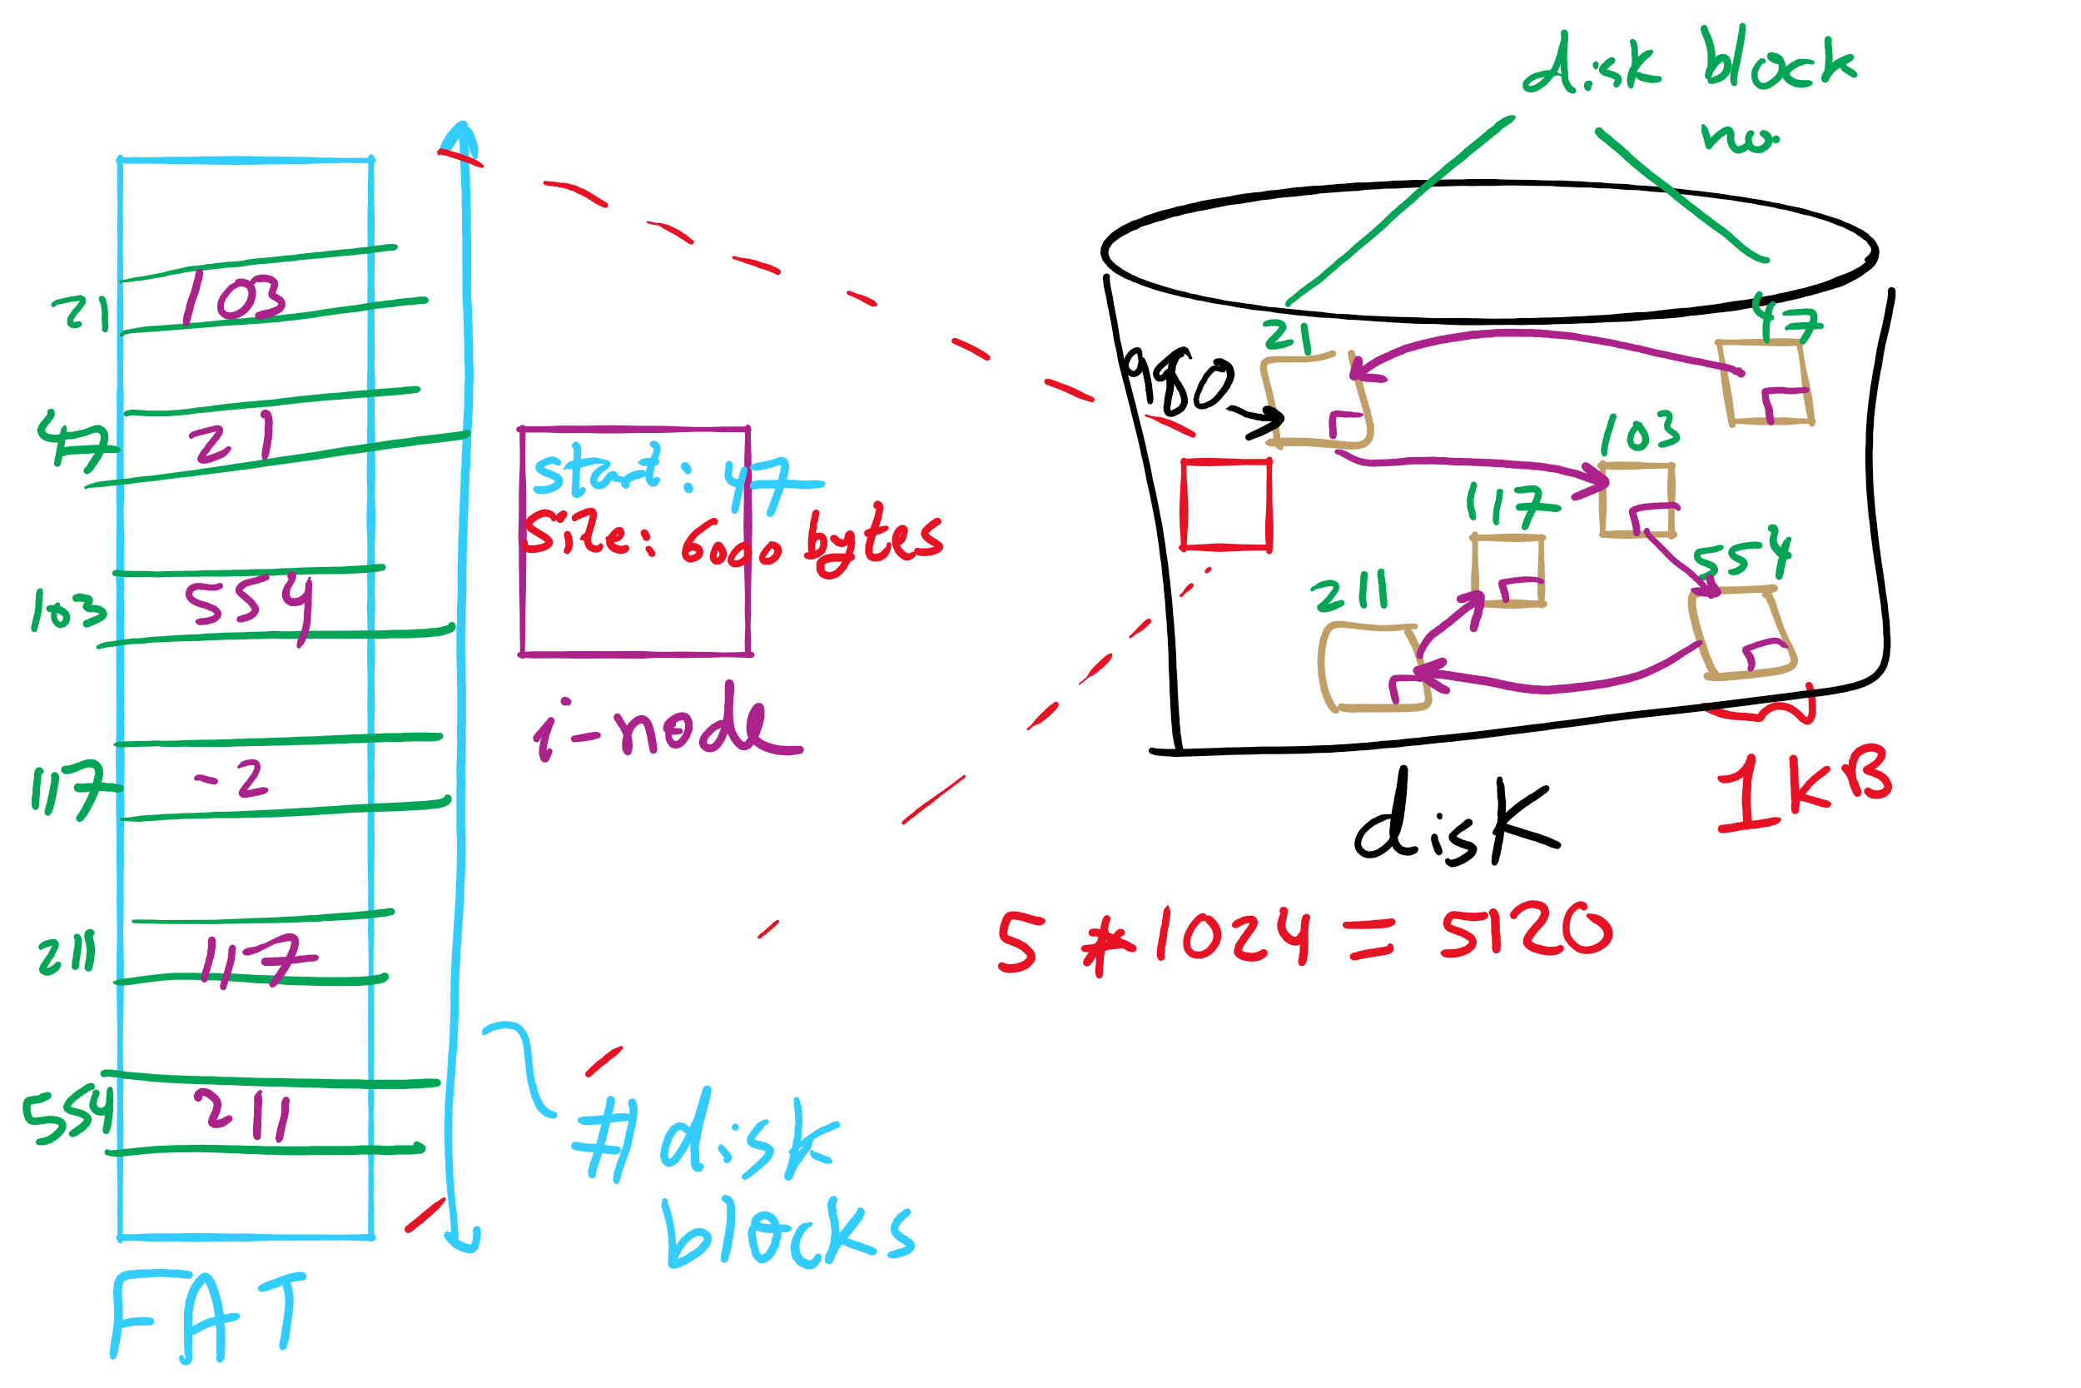
FAT Example

Slide 13
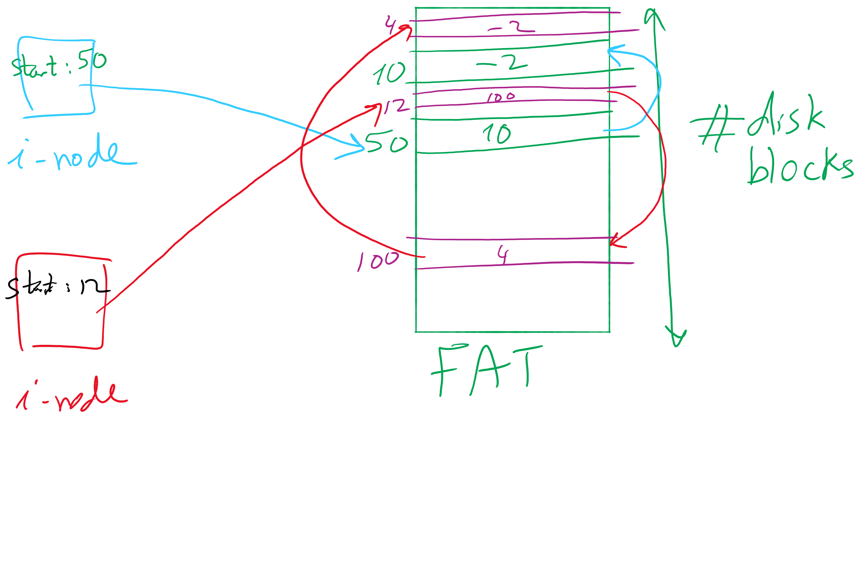
i-node and FAT

Slide 14
Using a block index for allocation
Store file block addresses in an array
Array itself is stored in a disk block
Directory has a pointer to this disk block
Non-existent blocks indicated by -1
Random access easy
Limit on file size?
Name index size
grades 4 4802
0
1
2
3
6
9
7
0
8
4
5
6
7
8
9
10
11

Slide 15
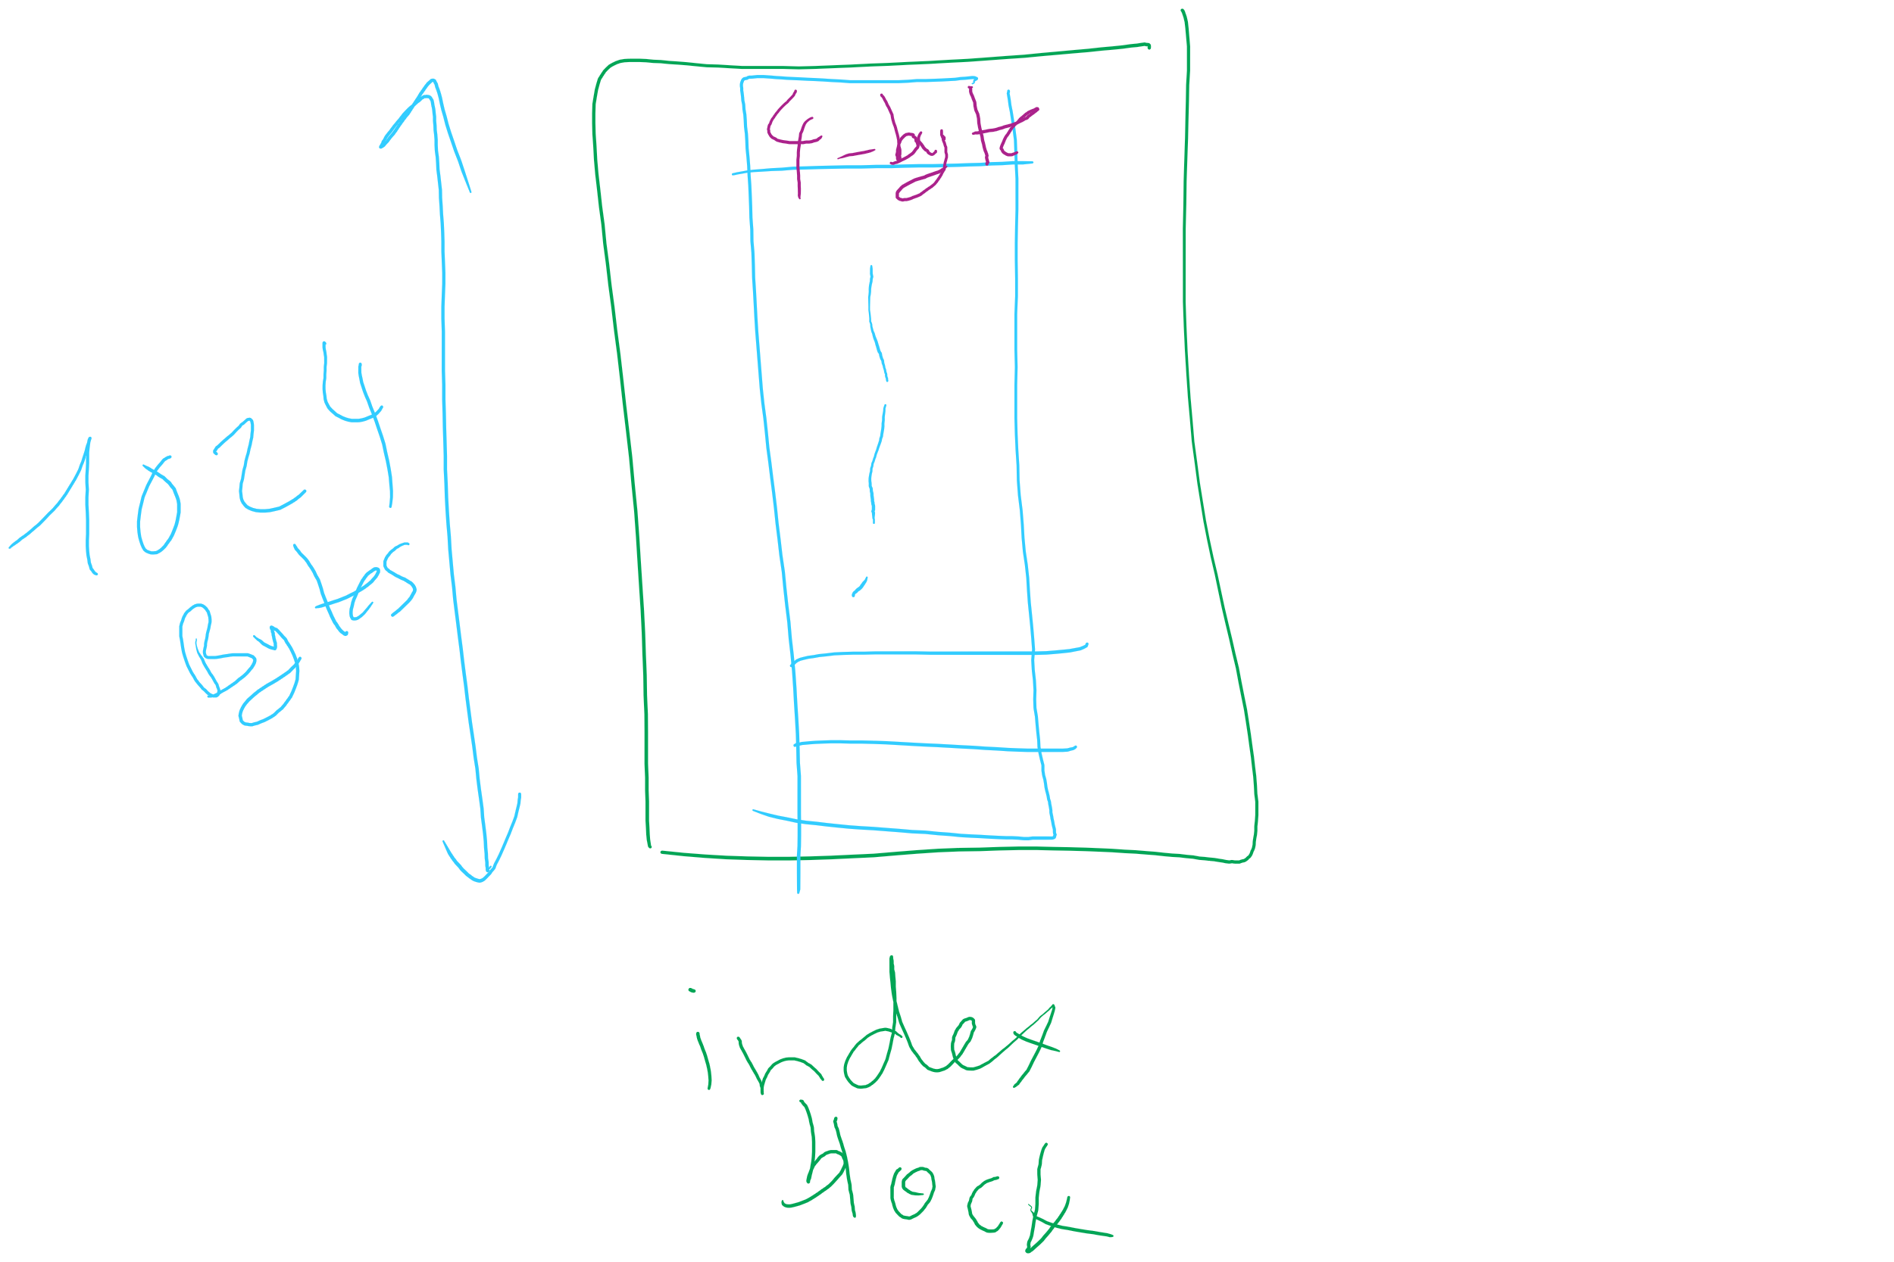
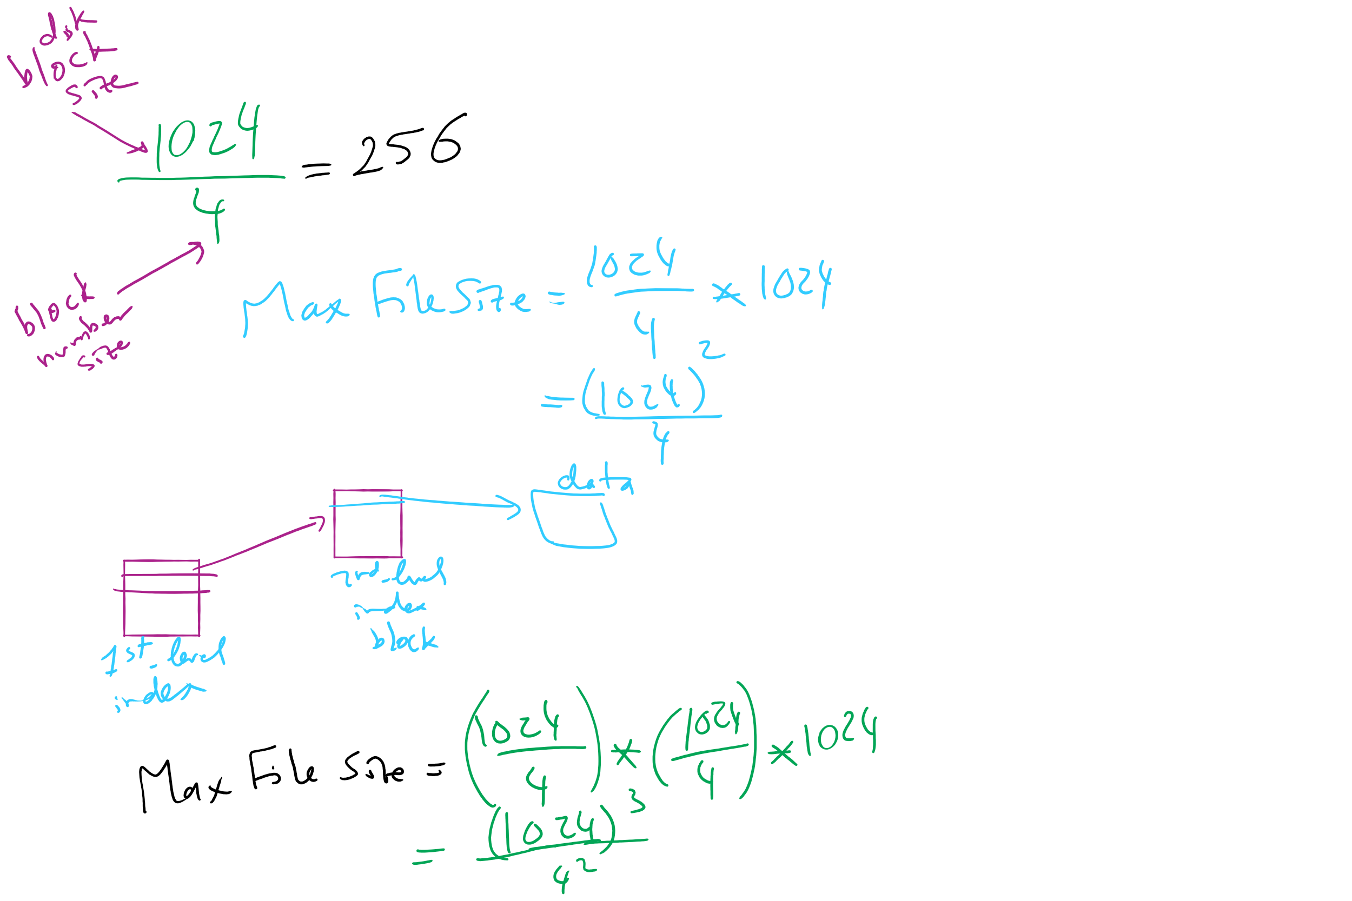
Max File Size for Indexed Allocation

Slide 16
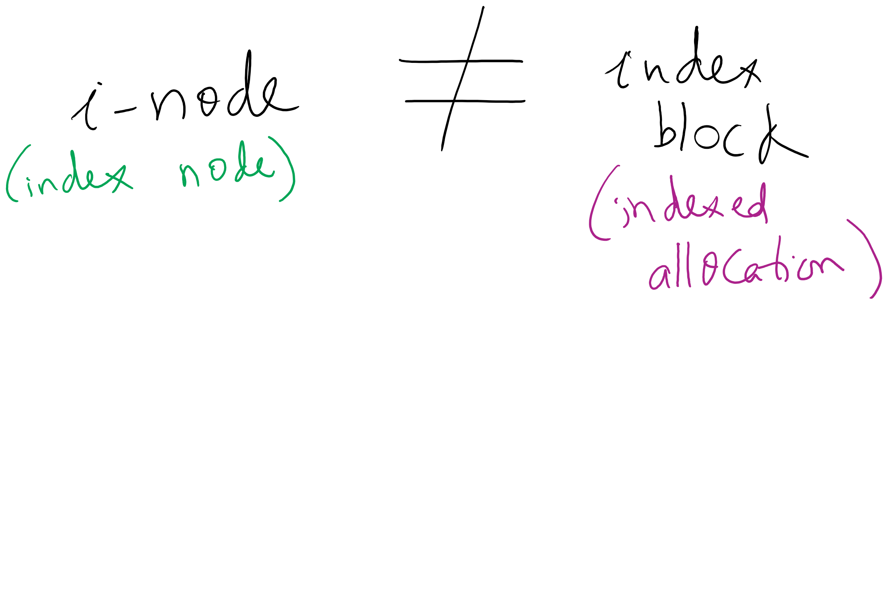
i-node vs index block

