Slide 1

Introduction to Operating Systems CS/COE 1550
Fall 2021
Sherif Khattab
ksm73@pitt.edu
(Some slides are from Silberschatz, Galvin and Gagne ©2013)

Slide 2
Announcements
Homework 2 is due this Friday at 11:59 pm
Lab 1 is due on 9/20 at 11:59 pm
Using GitHub Classroom
Explained in last week’s recitation
TA Office hours available on the syllabus page
Project 1 is up on Canvas
Docker images are available on Canvas
Tophat questions of this and the previous lectures are assigned as homework

Slide 3
Anouncements
Michael G. Wells Competition
https://www.innovation.pitt.edu/michael-g-wells-competition/
Games 4 Social Impact Hackathon
https://www.games4socialimpact.pitt.edu/
Get (Re)involved on Campus
https://www.pitt.edu/pittwire/features-articles/get-reinvolved-campus

Slide 4
Last Lecture …
Context Switching

Slide 5
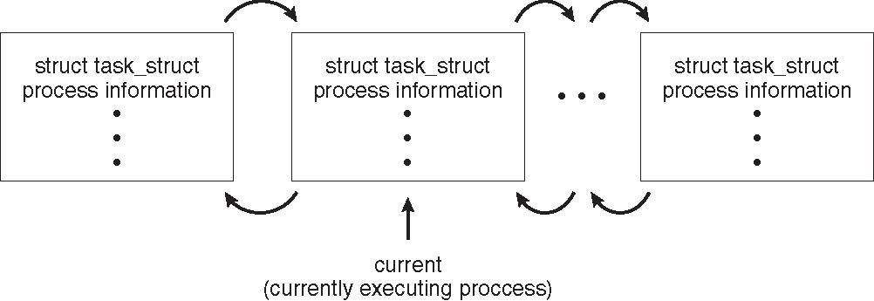
Process Representation in Linux
Represented by the C structure task_struct
pid_t pid; /* process identifier */ long state; /* state of the process */ unsigned int time_slice /* scheduling information */ struct task_struct *parent; /* this process’s parent */ struct list_head children; /* this process’s children */ struct files_struct *files; /* list of open files */ struct mm_struct *mm; /* address space of this process */

Slide 6
Xv6 Code Walkthrough
PCB and process table
context switching

Slide 7
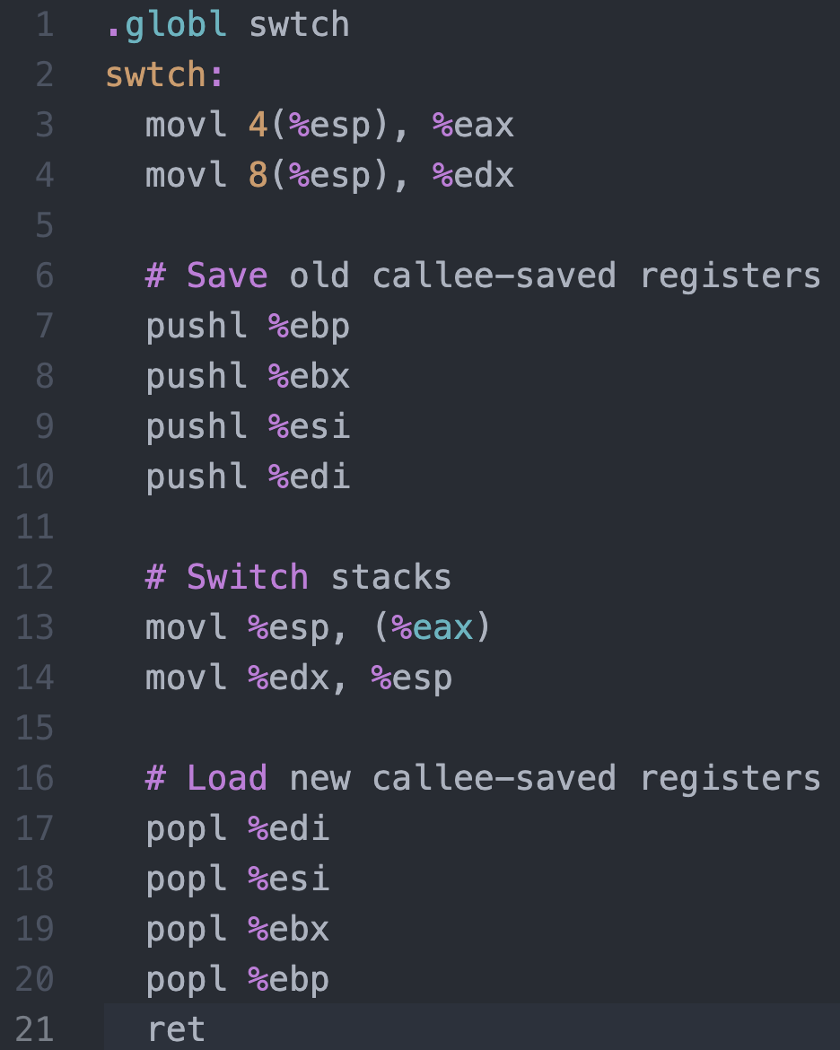
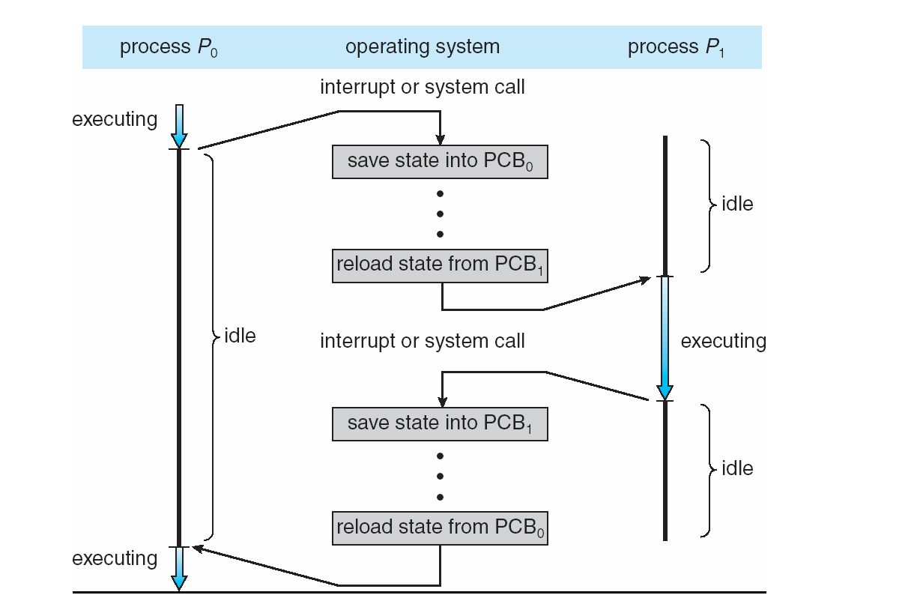




Context Switching in Xv6
%eax
%edx
context
PCB of Process${ P}_{0}$
Return address
%esp
%eip
Stack of Process${ P}_{0}$
Return address
Return address
CPU
context
PCB of Process${ P}_{1}$
Stack of Process${ P}_{1}$
Memory

Slide 8
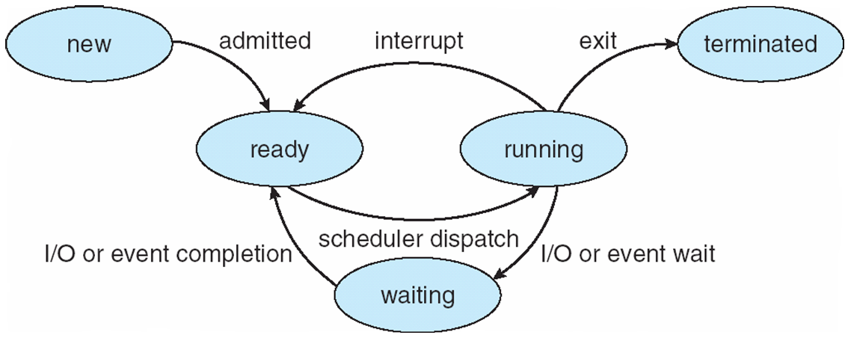
Process Lifecycle

Slide 9
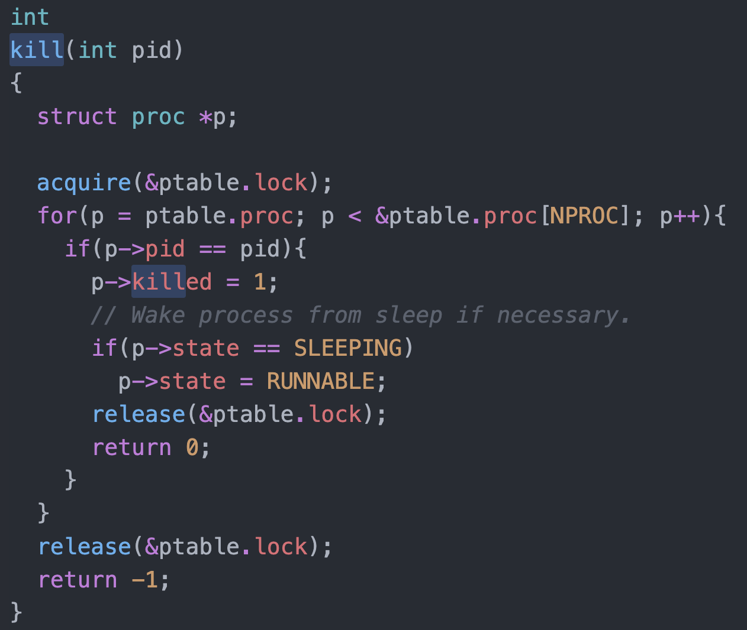
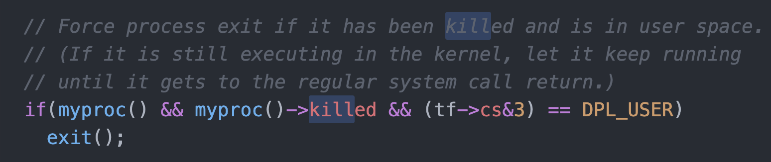
Killing a waiting process

Slide 10
Process Scheduling
Maximize CPU use, quickly switch processes onto CPU for time sharing
Process scheduler selects among available processes for next execution on CPU
Maintains scheduling queues of processes
Job queue – set of all processes in the system
Ready queue – set of all processes residing in main memory, ready and waiting to execute
Device queues – set of processes waiting for an I/O device
Processes migrate among the various queues

Slide 11
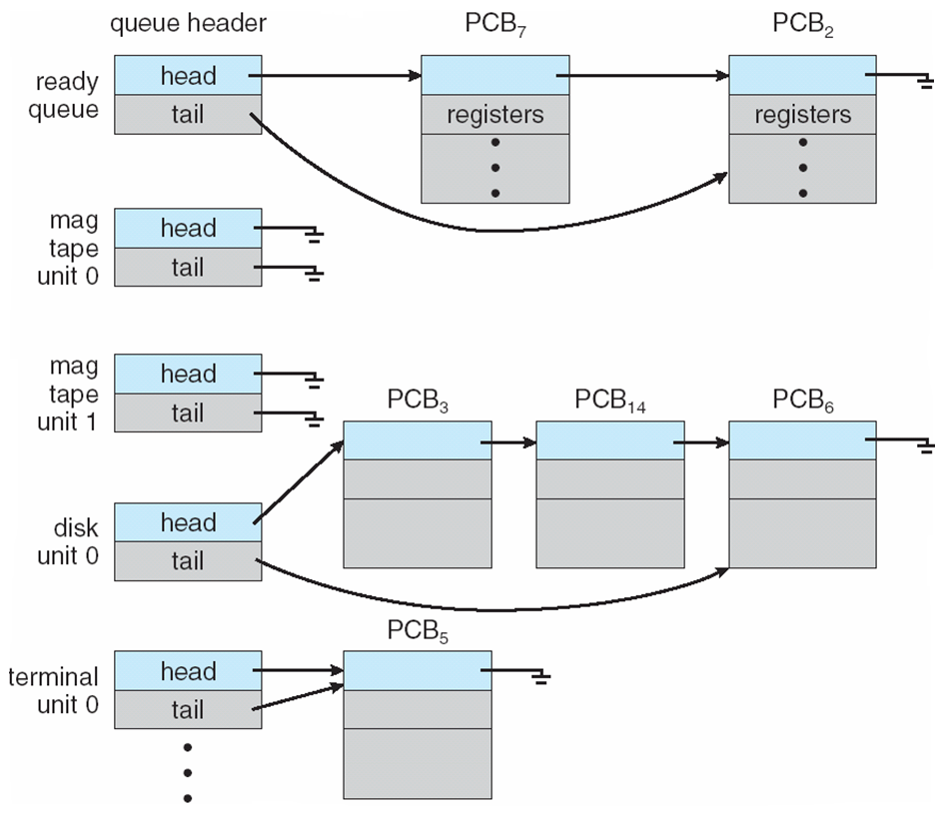
Ready Queue And Various I/O Device Queues

Slide 12
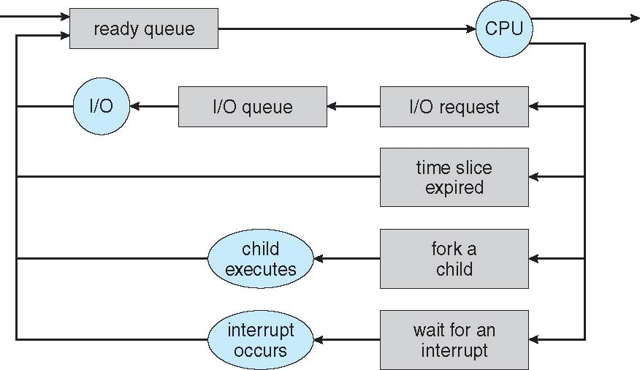
Representation of Process Scheduling
Queueing diagram represents queues, resources, flows

Slide 13
Schedulers
Short-term scheduler (or CPU scheduler) – selects which process should be executed next and allocates CPU
invoked frequently (milliseconds) ⇒ (must be fast)
Long-term scheduler (or job scheduler) – selects which processes should be brought into the ready queue
invoked infrequently (seconds, minutes) ⇒ (may be slow)
controls the degree of multiprogramming
Processes can be described as either:
I/O-bound process – spends more time doing I/O than computations, many short CPU bursts
CPU-bound process – spends more time doing computations; few very long CPU bursts
Long-term scheduler strives for good process mix

Slide 14
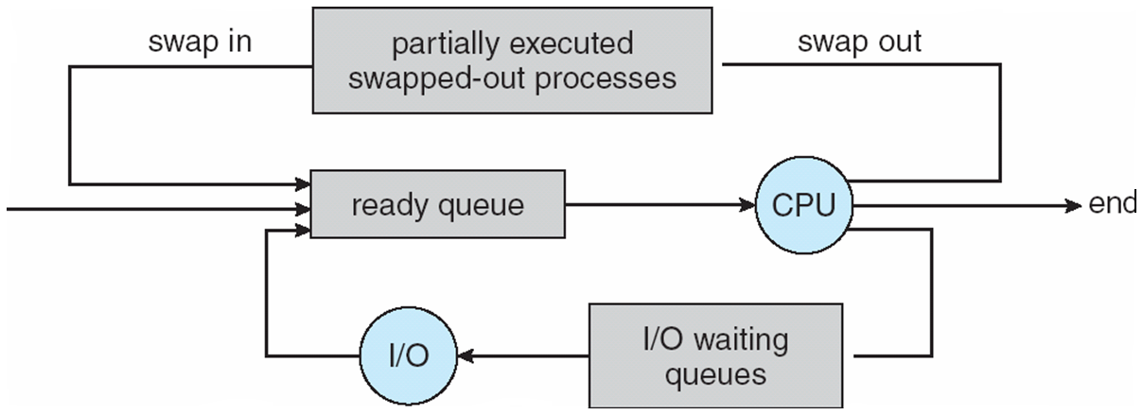
Addition of Medium Term Scheduling
Medium-term scheduler can be added if degree of multiple programming needs to decrease
Remove process from memory, store on disk, bring back in from disk to continue execution: swapping

Slide 15
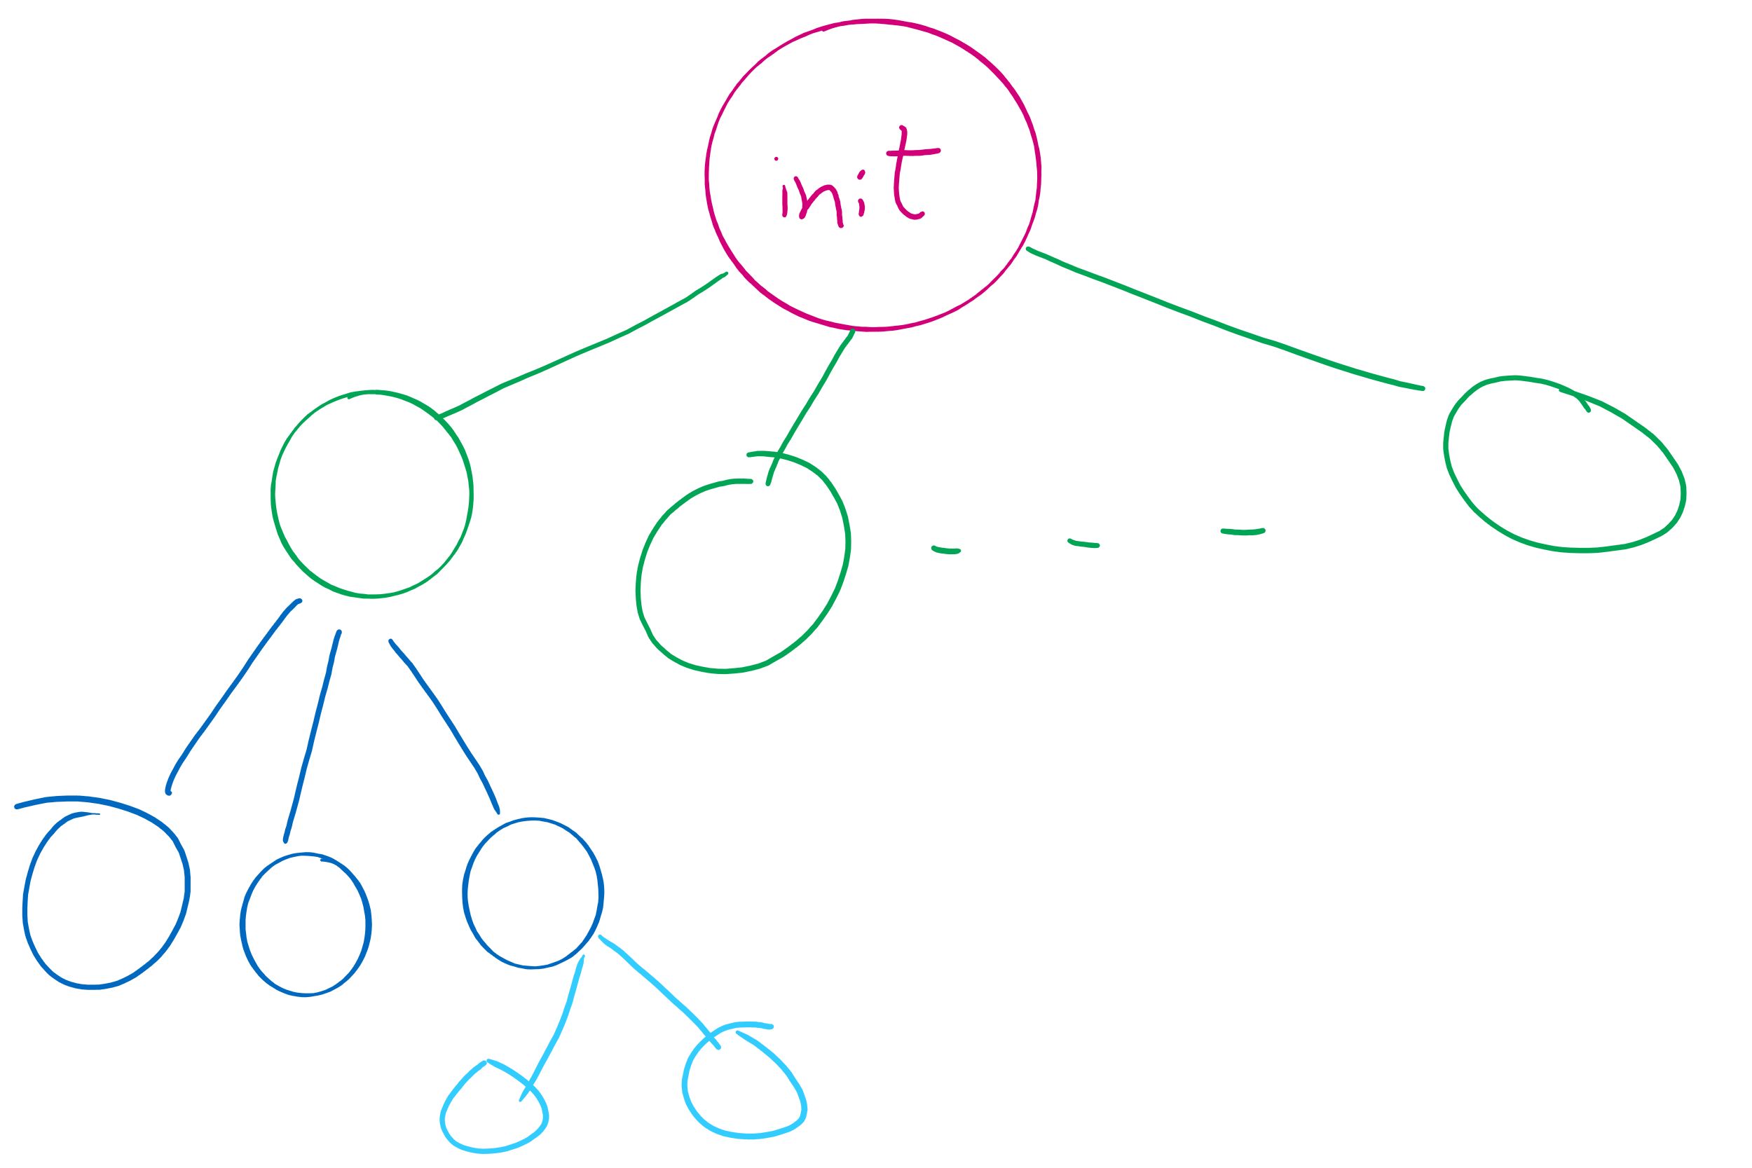
Process Creation
Parent process creates children processes, which, in turn create other processes, forming a tree of processes
Generally, process identified and managed via a process identifier (pid)

Slide 16
Process Creation (Cont.)
Resource sharing options
Parent and children share all resources
Children share subset of parent’s resources
Parent and child share no resources
Execution options
Parent and children execute concurrently
Parent waits until children terminate
Address space
Child duplicate of parent
Child has a program loaded into it

Slide 17
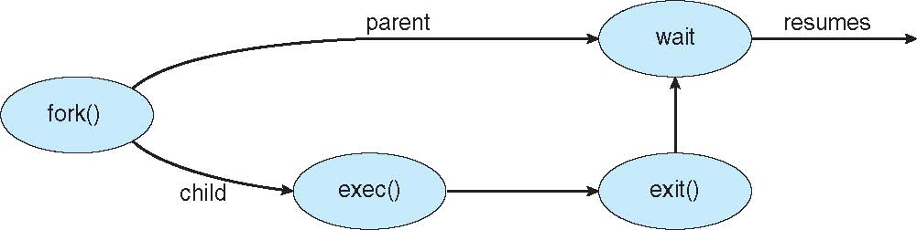
Process Creation (Cont.)
UNIX examples
fork() system call creates new process
exec() system call used after a fork() to replace the process’ memory space with a new program

Slide 18
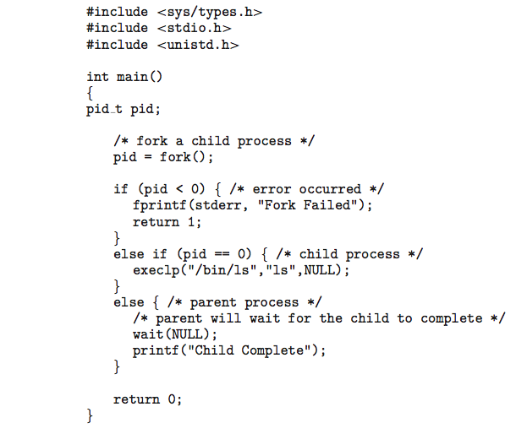
C Program Forking Separate Process

Slide 19
Process Termination
Process executes last statement and then asks the operating system to delete it using the exit() system call.
Returns status data from child to parent (via wait())
Process’ resources are deallocated by operating system
Parent may terminate the execution of children processes using the abort() system call. Some reasons for doing so:
Child has exceeded allocated resources
Task assigned to child is no longer required
The parent is exiting and the operating systems does not allow a child to continue if its parent terminates

