Slide 1

Introduction to Operating Systems CS/COE 1550
Fall 2021
Sherif Khattab
ksm73@pitt.edu
(Some slides are from Silberschatz, Galvin and Gagne ©2013)

Slide 2
Announcements
Homework 2 is due this Friday at 11:59 pm
Lab 1 is due on 9/20 at 11:59 pm
Using GitHub Classroom
Explained in last week’s recitation
TA Office hours available on the syllabus page
Project 1 is up on Canvas
Docker images are available on Canvas
Tophat questions of the previous two lectures are assigned as homework

Slide 3
Anouncements
Michael G. Wells Competition
https://www.innovation.pitt.edu/michael-g-wells-competition/
Games 4 Social Impact Hackathon
https://www.games4socialimpact.pitt.edu/
Get (Re)involved on Campus
https://www.pitt.edu/pittwire/features-articles/get-reinvolved-campus

Slide 4
Last Lecture …
Context Switching
Process Creation using the fork() syscall

Slide 5
Muddiest Points
How the heap/code/static/stack memory of processes are switched/kept track of.
Can you explain again how hardware contains multiple sets of registers to facilitate context switches?
Always have trouble drawing the forking diagrams
Do two processes ever actually run at the same time or are they really just switching so rapidly that it appears that they do
Is there a priority with which processes waiting longer are chosen first or is it just the first process seen that gets executed?
Is there a limit to how many PCBs a single CPU core can have?
the last question: it is possible for a cpu to execute process in non-privileged mode immediately after privileged mode?
Is a process that has 5 states and cannot skip the next states the most optimal way that was figured out by the programmers? What other way did they try when they were building the operating system?
If parent have a variable. If its fork() child change it, does parent variable changed?
why does the scheduler point to the context of the scheduler instead of a 'proc' struct (if the scheduler is a process like any other)
What happens to an orphan process? Does it just stay alive and take up resources?

Slide 6
Muddiest points
When a child process calls fork, is it assigned a new pid, and is that reflected in its parent process?
Fork, and all the pcb and how it switches. Even though you said you’d never ask about it
short term vs long term scheduling purposes
Does the medium term scheduler conflict with the long term scheduler? (with swapping in and out)
forking multiple times / do all processes have a common parent if you travel backwards far enough?
the animation was a bit confusing, I was lost while trying to follow along and not sure which are things to focus on and relevant for this class
Can you make a high-level list for the steps of context switching?
what does myproc() return: is it just a pointer to the current proc?
How do you tell if a parent and child are executing concurrently, or if the parent waits until the child terminates.
Can you explain how a parent process uses wait()
if you call fork() twice in a row so that each process forks again, does each process have a completely separate Id that you can track?
Does the init process ever wait on collected orphans to clear away zombies?
Was confused about the return value == 0 in the fork diagram tree

Slide 7
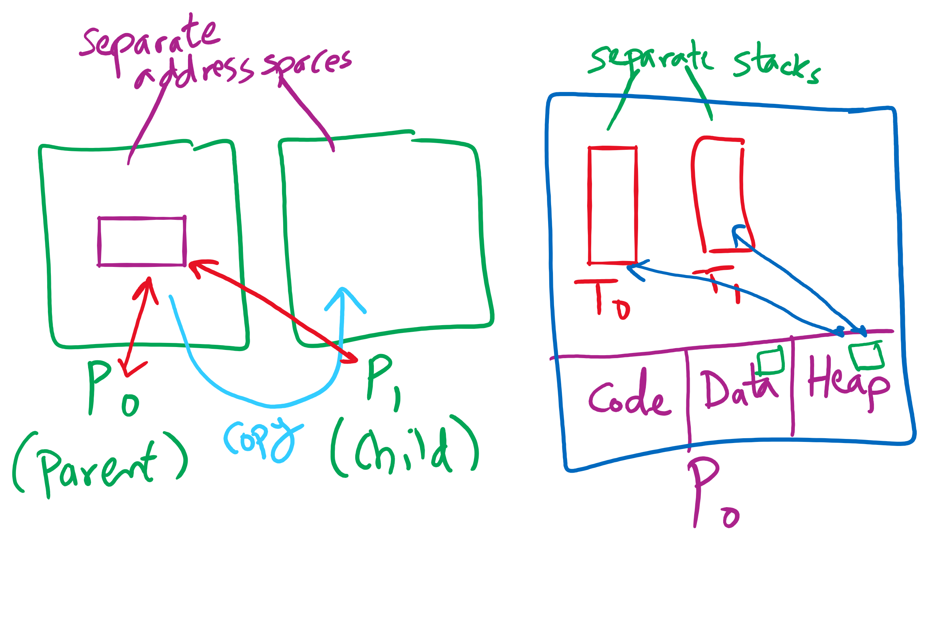
Process vs. Thread

Slide 8
Process Termination
Some operating systems do not allow a child to exist if its parent has terminated. If a process terminates, then all its children must also be terminated.
cascading termination. All children, grandchildren, etc. are terminated.
The termination is initiated by the operating system.
The parent process may wait for termination of a child process by using the wait()system call. The call returns status information and the pid of the terminated process
pid = wait(&status);
If no parent waiting (did not invoke wait()) process is a zombie
If parent terminated without invoking wait , process is an orphan

Slide 9
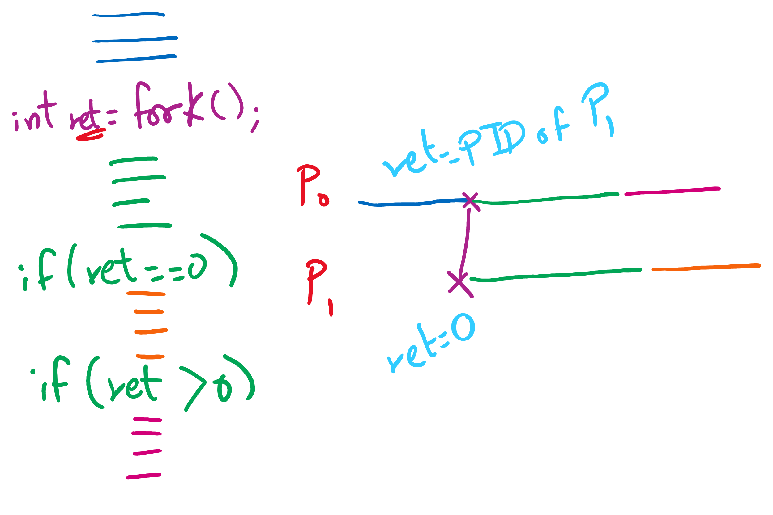
fork() tracing

Slide 10
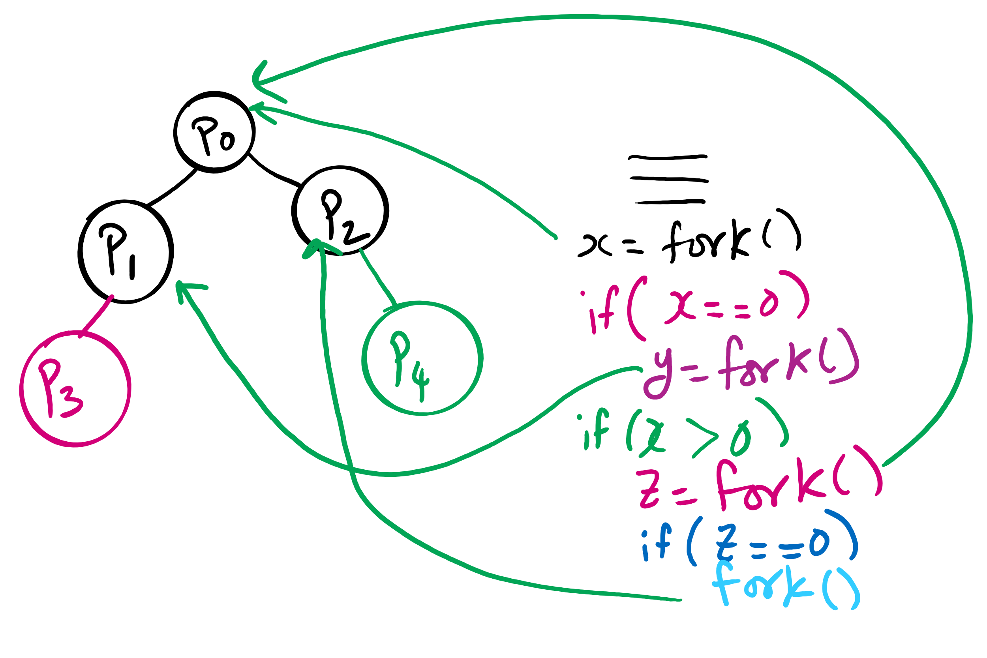
fork()’s of fork()’s

Slide 11
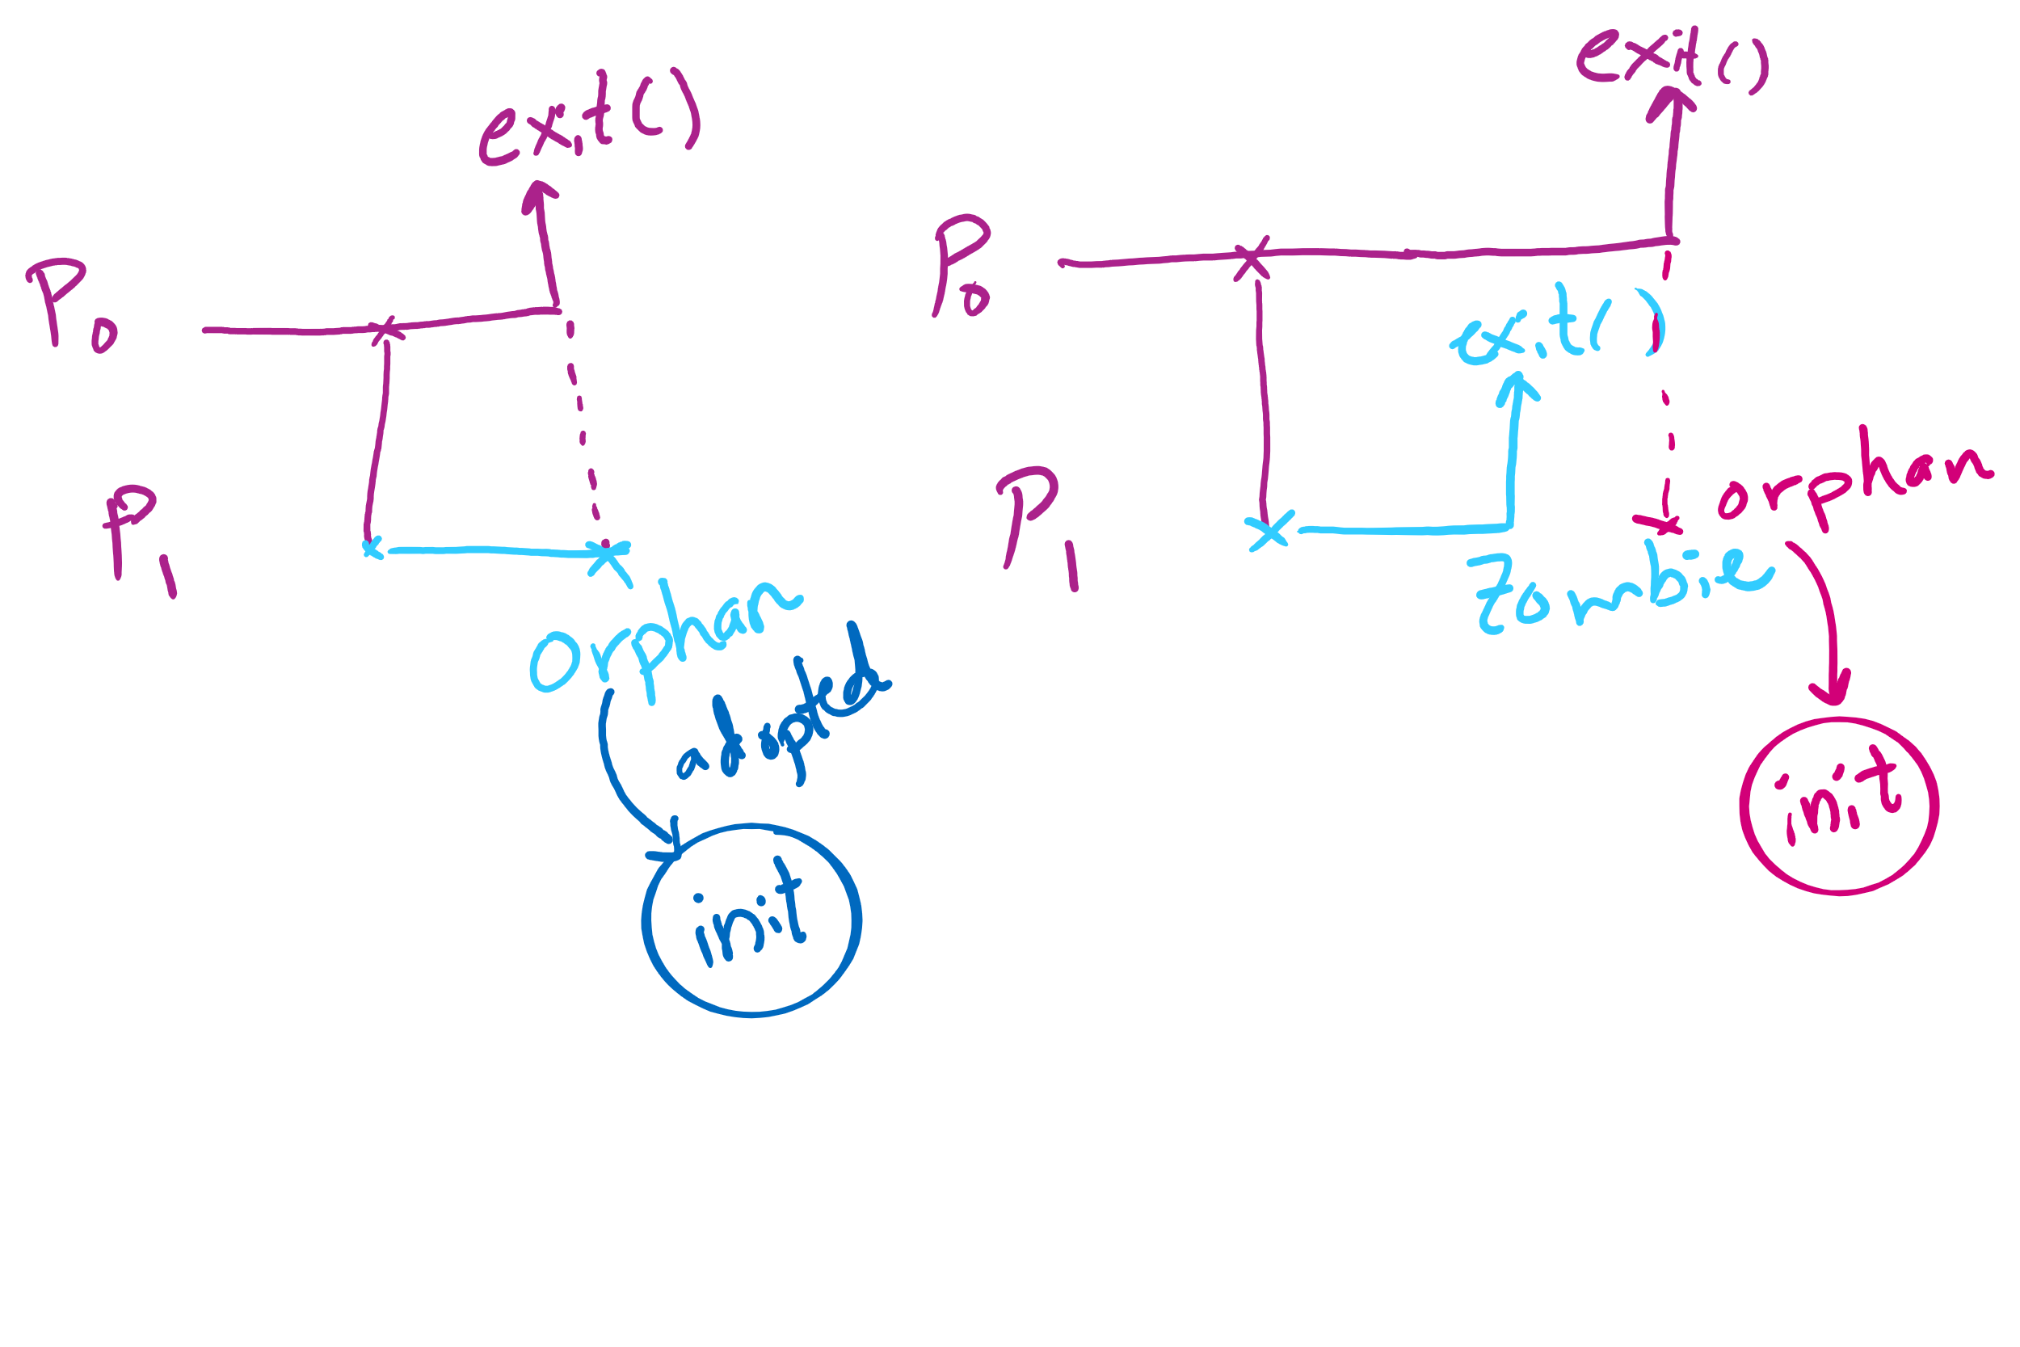
Orphan vs. Zombie Processes

Slide 12
Benefits of Orphan Processes
Allow a long-running job to continue running even after session (e.g., ssh connection) ends.
The nohup command does that
Create deamon processes
Long-running background processes adopted by the init process.

Slide 13
Xv6 Code Walkthrough
Context switching
Calling of the swtch routine
fork()
exit()
wait()

