Slide 1

Introduction to Operating Systems CS/COE 1550
Fall 2021
Sherif Khattab
ksm73@pitt.edu
(Some slides are from Silberschatz, Galvin and Gagne ©2013)

Slide 2
Announcements
Homework 2 is due next Friday at 11:59 pm
Lab 1 is due on 9/20 at 11:59 pm
Using GitHub Classroom
Explained in last week’s recitation
TA Office hours available on the syllabus page
Project 1 is up on Canvas
Docker images are available on Canvas
Tophat questions of Lecture 2 and Lecture 3 are assigned as homework

Slide 3
Anouncements
Michael G. Wells Competition
https://www.innovation.pitt.edu/michael-g-wells-competition/
Games 4 Social Impact Hackathon
https://www.games4socialimpact.pitt.edu/
Get (Re)involved on Campus
https://www.pitt.edu/pittwire/features-articles/get-reinvolved-campus

Slide 4
Last Lecture …
Tracing of forking programs
fork(), exit(), and wait()

Slide 5
Muddiest Points (1/2)
Threads vs. Processes
maybe I wasn't focusing at the time, but how does the thread works during fork
what's the purpose of threads, what creates them
what is the formal definition of threads
On a multi core system would there be a process to thread scheduler and a scheduler for each threads set of processes?
So a thread contains multiple stacks?
Are threads always a part of a single process?
Relationship between threads and processes? More specifically their similarities and differences?
In a thread, how are the heap and separate stacks related
Is there a time when the InitProcess should create a daemon rather than have another process create it and exit?

Slide 6
Muddiest Points (2/2)
Orphan vs Zombie Processes
benefits of a zombie process
walkthroughs are somewhat unclear, can you upload powerpoints on them?
Would appreciate another walkthrough of the Xv6 code
I was a bit lost on the explanation of copy-on-write
Can the XV6 "nextpid" variable overflow?
Xv6 exit()
Why use a tree paradigm for processes when you could just let creating parent processes have a process hook returned for listening to an exit status if they feel like it, let zombies be zombies, orphans be orphans who cares, and just clean up a process when it’s done.
How would context switching work with instruction memory? How do you know if the program counter register of the waking process is still the same?

Slide 7
Next ….
Spinlocks
How to use
How to implement
Semaphores
How to use
How to implement

Slide 8
Why do we need Synchronization?
Each process operates sequentially
All is fine until processes want to share data
Exchange data between multiple processes
Allow processes to navigate critical regions
Maintain proper sequencing of actions in multiple processes
These issues apply to threads as well
Threads can share data easily (same address space)
Other two issues apply to threads

Slide 9
Example: bounded buffer problem
Shared variables const int n; typedef … Item; Item buffer[n]; int in = 0, out = 0, counter = 0;
Atomic statements:
Counter += 1;
Counter -= 1;
Producer
Item pitm; while (1) { … produce an item into pitm … while (counter == n) ; buffer[in] = pitm; in = (in+1) % n;
counter += 1; }
Consumer
Item citm; while (1) { while (counter == 0) ; citm = buffer[out]; out = (out+1) % n;
counter -= 1;
… consume the item in citm … }

Slide 10
Problem: race conditions
Cooperating processes share storage (memory)
Both may read and write the shared memory
Problem: can’t guarantee that read followed by write is atomic
Ordering matters!
This can result in erroneous results!
We need to eliminate race conditions…
P1
P2
x=3
R1 <= x
R1 = R1+1
R1 => x
R3 <= x
R3 = R3+1
R3 => x
x=5
R1 <= x
R3 <= x
R3 = R3+1
R1 = R1+1
R1 => x
R3 => x
x=6!

Slide 11
Critical regions
Use critical regions to provide mutual exclusion and help fix race conditions
Four conditions to provide mutual exclusion
No two processes simultaneously in critical region
No assumptions made about speeds or numbers of CPUs
No process running outside its critical region may block another process
No process must wait forever to enter its critical region
A enters critical region
A leaves critical region
Process A
B enters critical region
B leaves critical region
B tries to enter critical region
Process B
B blocked
Time

Slide 12
Using Spinlocks
Spinlock lock;
Code for process P_{i}
While(1){
Lock(lock)
// critical section
Unlock(lock);
// remainder of code
}
}

Slide 13
Spinlock implementation (1/2)
Solution: use hardware
Several hardware methods
Test & set: test a variable and set it in one instruction
Atomic swap: switch register & memory in one instruction
Turn off interrupts: process won’t be switched out unless it asks to be suspended
Can be in user land

Slide 14
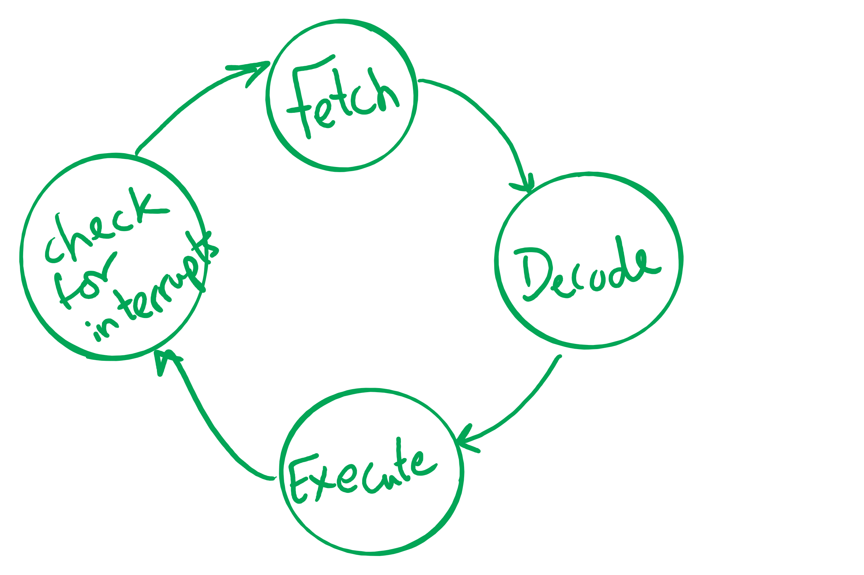
Atomic operations
If done in one instruction, then not interruptible

Slide 15
Spinlock implementation (2/2)
Single shared variable: lock
requires busy waiting, but code is much simple
Two versions
Test and set
Swap
Works for any number of processes
Possible problem with requirements
can lead to unbounded waiting
int lock = 0;
Lock(){
while (TestAndSet(lock))
;
}
Unlock(){
lock = 0;
}
Lock(){
while (Swap(lock,1) == 1)
;
}
Unlock(){
lock = 0;
}

Slide 16
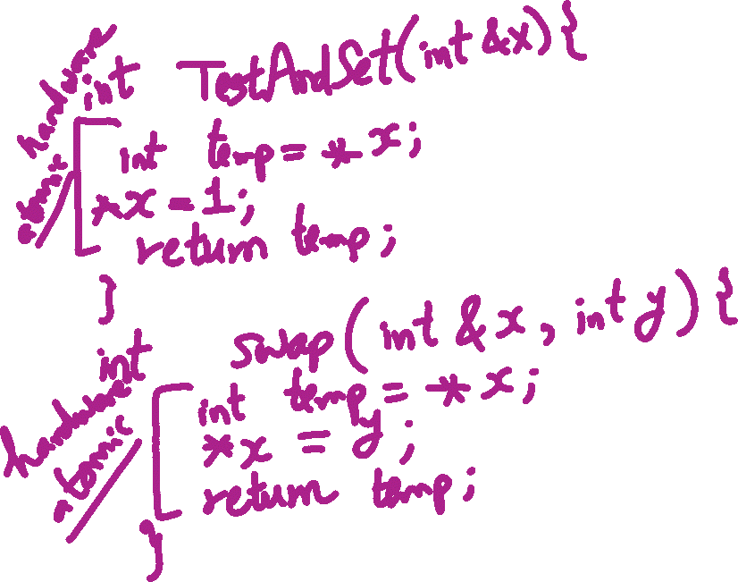
TestAndSet vs. Swap

Slide 17
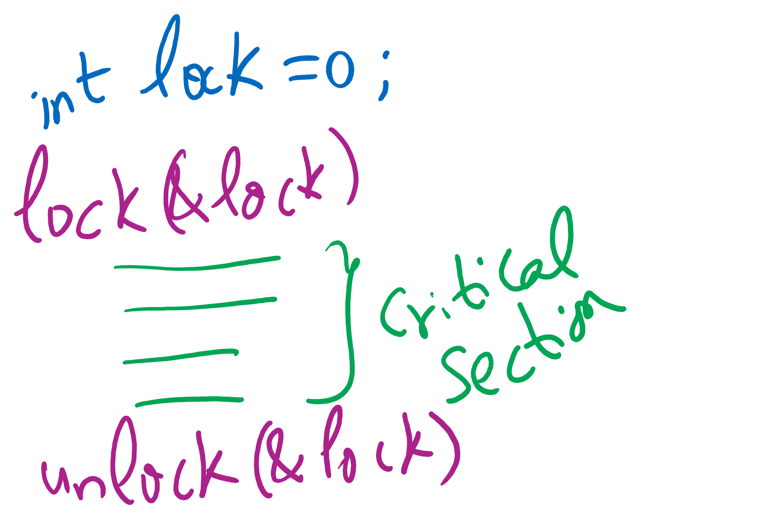
Lock Usage

