Slide 1

Introduction to Operating Systems CS/COE 1550
Fall 2021
Sherif Khattab
ksm73@pitt.edu
(Some slides are from Silberschatz, Galvin and Gagne ©2013)

Slide 2
Announcements
Homework 2 is due this Friday at 11:59 pm
Lab 1 is due on 9/20 at 11:59 pm
Project 1 due on 9/27 at 11:59 pm

Slide 3
Last Lecture …
Spinlocks
How to use
How to implement
Semaphores

Slide 4
Muddiest Points (1/3)
Spinlock
How spinlock is fully utilized and useful
are spinlocks ever better than semaphores, or only really useful as part of implementing semaphores?
can locks be called at the same time by 2 different processes?
is there a less busy approach to spinlock
how does swap work and why does it matter to have both lock and test & set as options
How the process unlocks if stuck in the loop, exactly
the condition of the while loop in the test/set code
does the spin lock use a whole time slice
What is the alternative to busy waiting fir the spinlock implementation?
How is TestAndSet implemented so that it can’t be interrupted?
What happens if two cores simultaneously lock the same region?

Slide 5
Muddiest Points (2/3)
Spinlock
The downsides of atomic operations
What would happen if the initial process called lock() twice in a row?
Are multiple processes waiting in the same while loop in spin locks
Is it the user code or author's code that is calling the lock and unlock for these critical regions? And... Are these critical regions only defined by lock and unlock?
Why would you not want to busy wait? Wouldn’t it be advantageous to have processes running/active in the background?
Does a process need to call unlock individually?
where does the implementation of spin locks/semaphore exist?
where does a process go when it is waiting to get into a spinlock? back into the queue?
During a spin lock, can the memory (not the instructions) be accessed by another process or is it also blocked by the lock?
how to indentify critical regions

Slide 6
Muddiest Points (3/3)
Semaphore
What is a semaphore
I know both are used for process synchronization but what is the difference between SpinLocks and Semaphores?
How are the values of semaphores checked?
How to eliminate busy waiting from Down()
Can I see a coding example of a semaphore?
I don’t see how semaphores are faster than spinlocks
How semaphores are just regular waiting and not busy waiting

Slide 7
Today’s Agenda …
Semaphores
How to use
How to implement
Monitors
How to use
How to implement
Classical Process Synchronization Problems
Bounded Buffer
Readers-Writers
Dining Philosophers

Slide 8
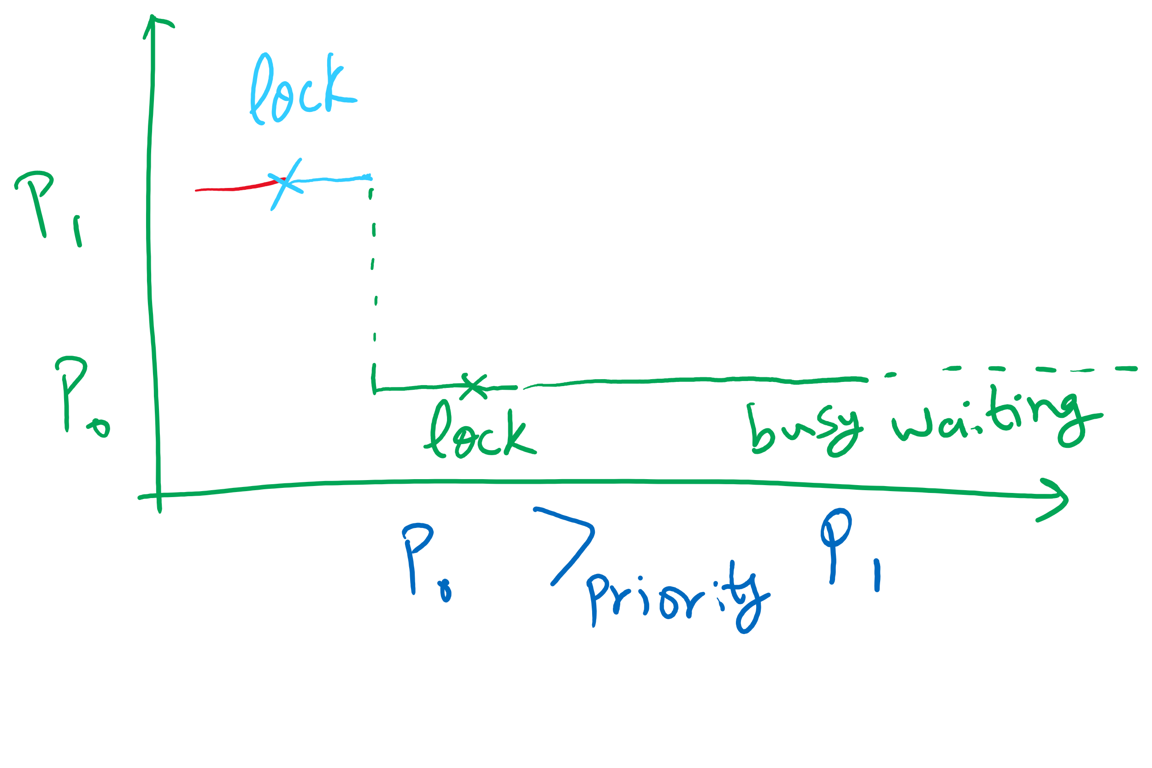
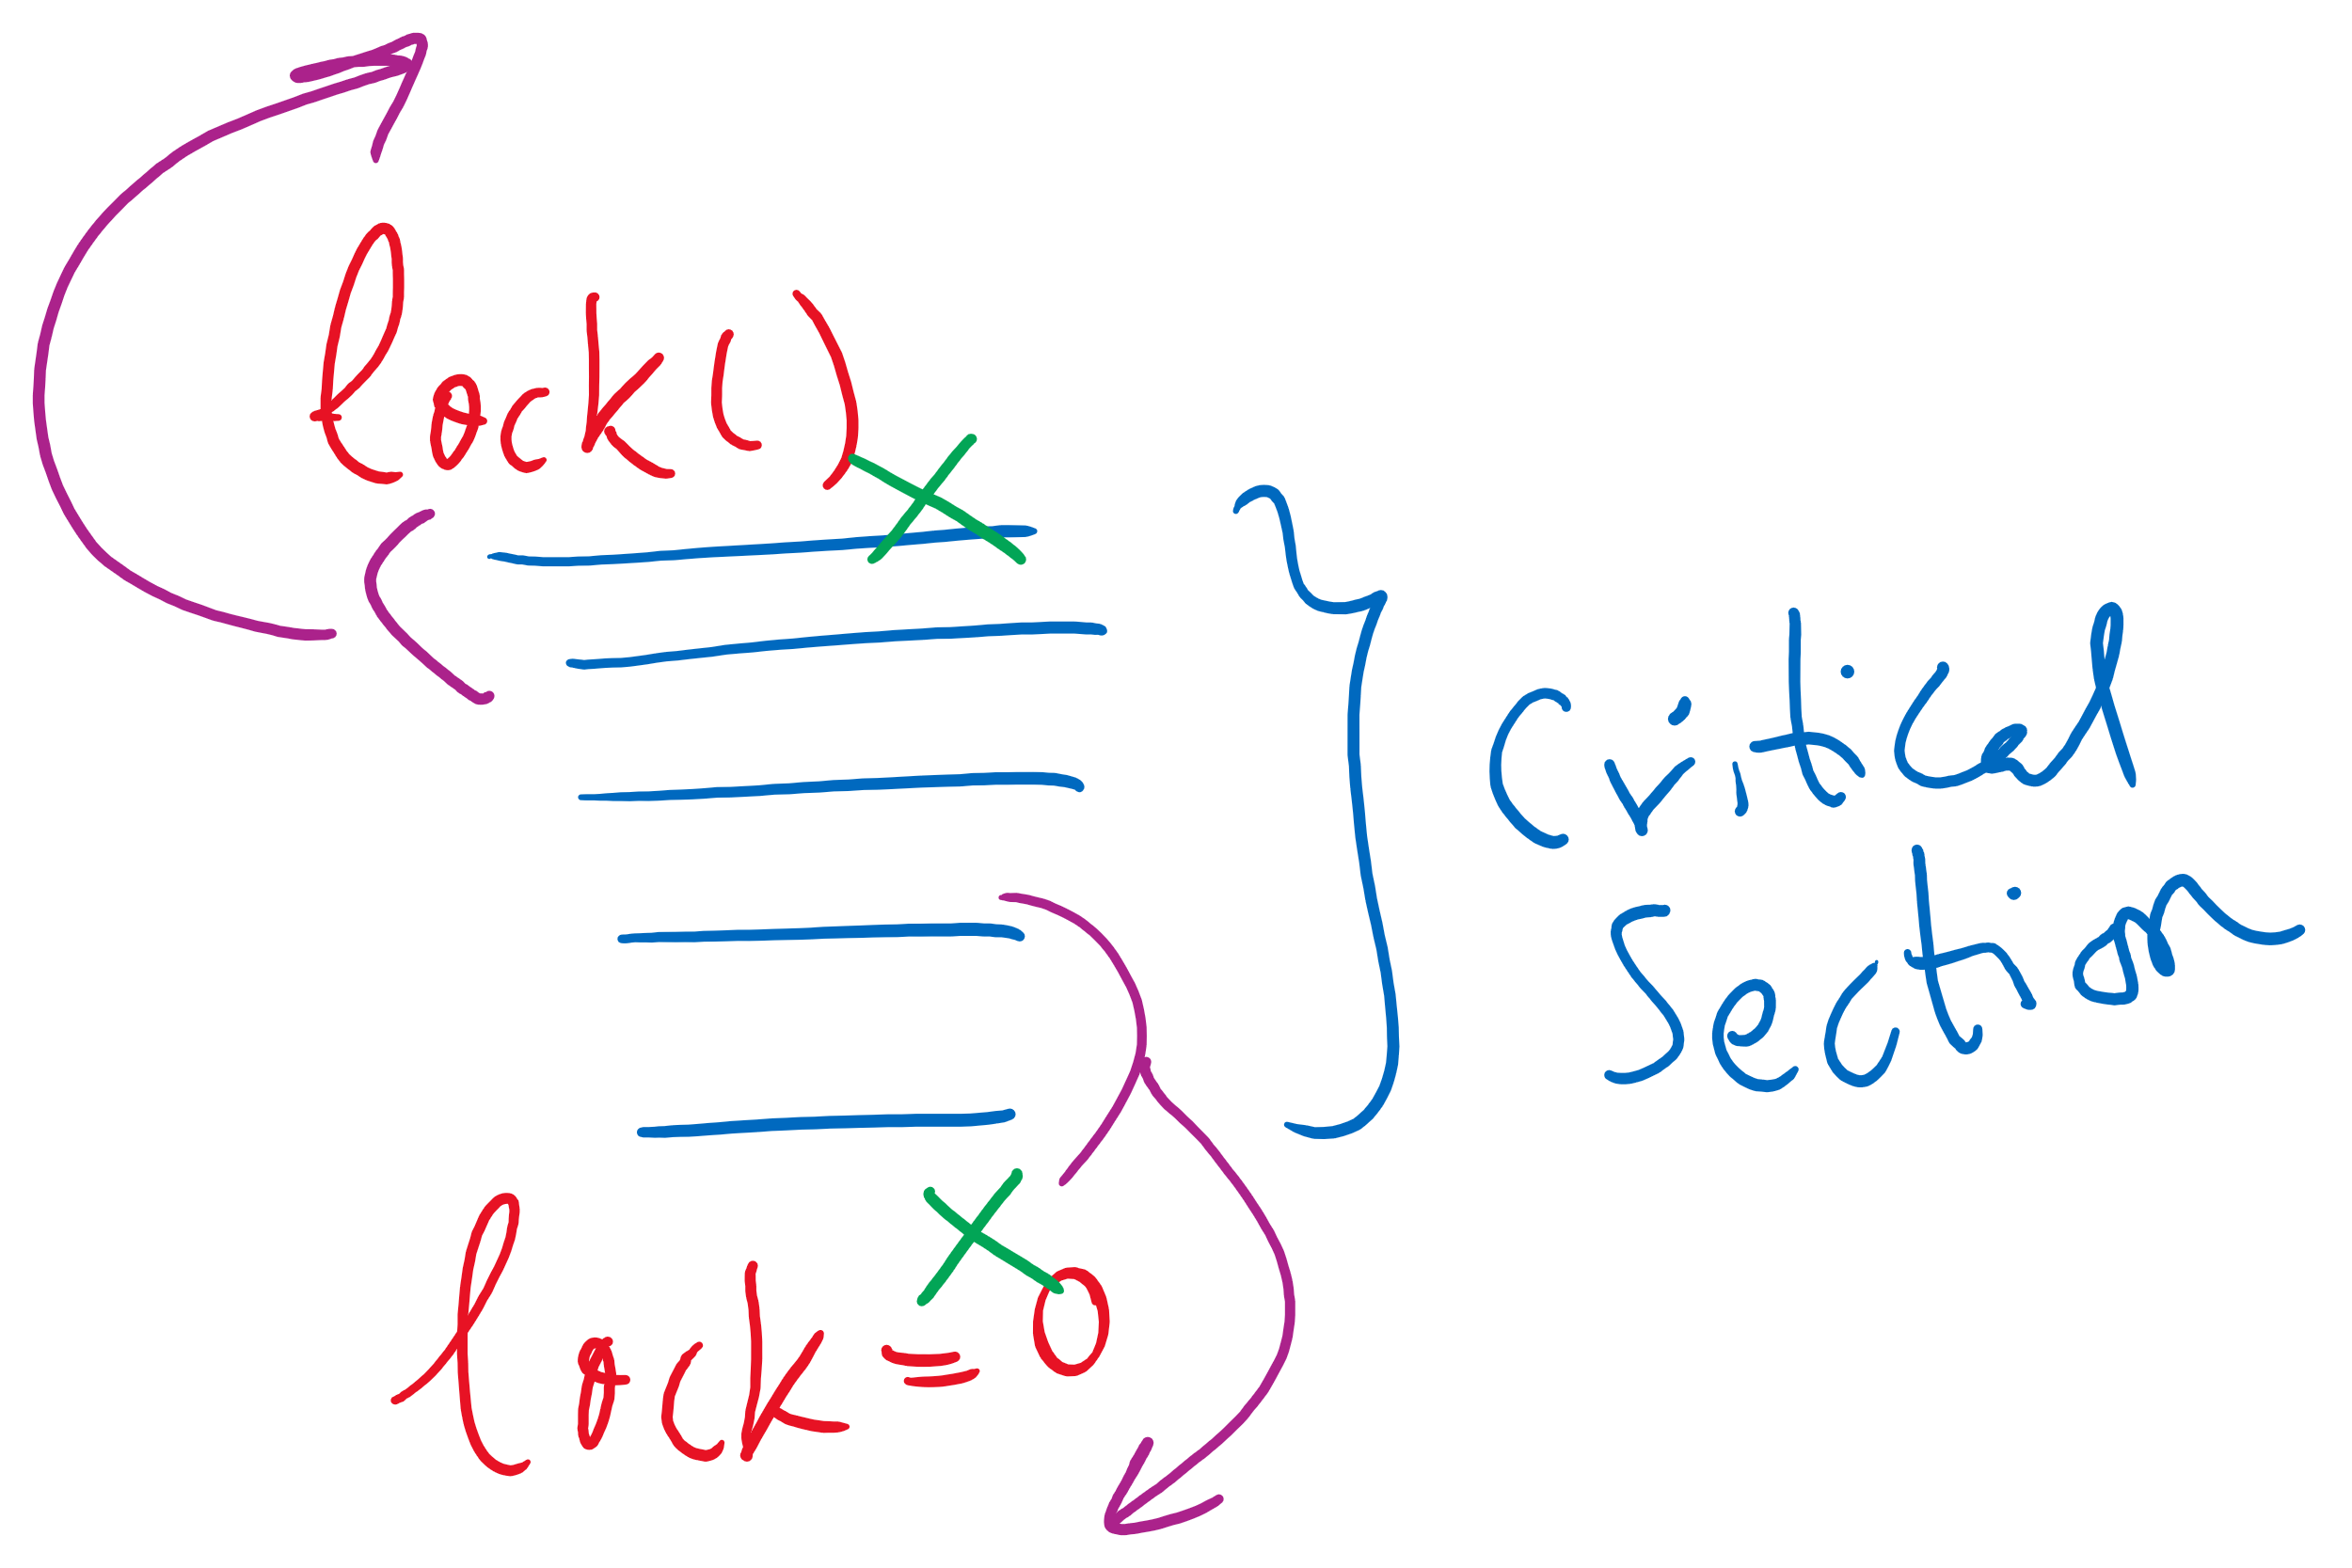


Spinlock Problems
Problem: wastes CPU time
Would be better to allow processes to sleep while they wait to execute their critical sections
Problem: priority inversion (higher priority process waits for lower priority process)
Problem: compiler and/or hardware instruction reordering

Slide 9
Semaphores
Solution: use semaphores
Synchronization mechanism that doesn’t require busy waiting
Implementation
Semaphore S accessed by two atomic operations
Down(S): while (S<=0) {}; S-= 1;
Up(S): S+=1;
Down() is another name for P()
Up() is another name for V()
Modify implementation to eliminate busy wait from Down()

Slide 10
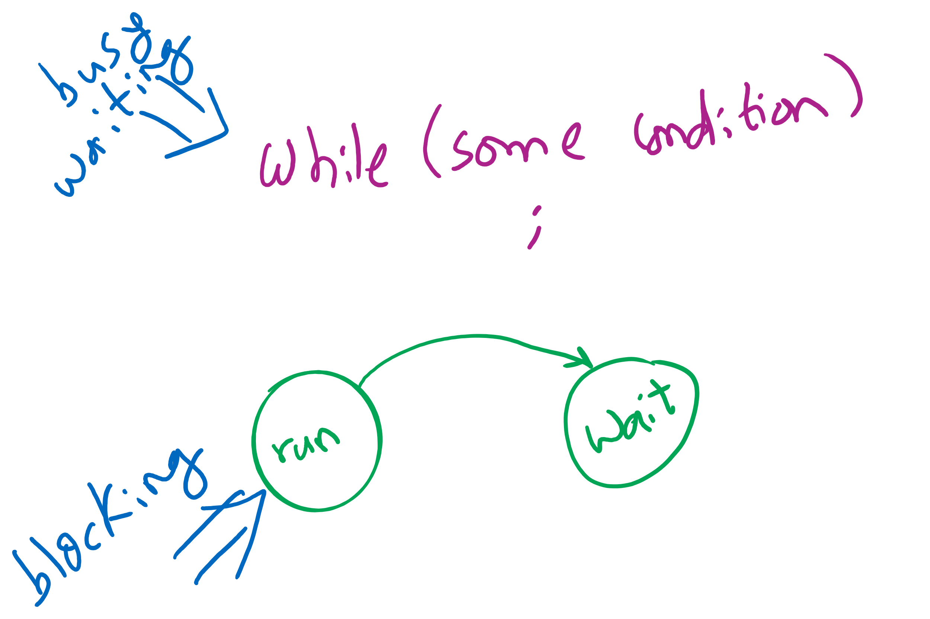
Busy waiting vs. Blocking

Slide 11
Critical sections using semaphores
Define a data structure called Semaphore
Details hidden from processes
Code for individual process is simple
Shared variables
Semaphore sem;
Code for process P_{i}
while (1) {
// non-critical section
down(sem);
// critical section
up(sem);
// non-critical section
}

Slide 12
Semaphores for general synchronization
We want to execute B in P1 only after A executes in P0
Use a semaphore initialized to 0
Use up() to notify P1 at the appropriate time
Shared variables
// flag initialized to 0
Semaphore flag(0);
Process P₀
.
.
.
// Execute code for A
flag.up ();
Process P₁
.
.
.
flag.down ();
// Execute code for B

Slide 13
Types of semaphores
Two different types of semaphores
Counting semaphores
Binary semaphores
Counting semaphore
Value can range over an unrestricted range
Binary semaphore
Only two values possible
1 means the semaphore is available
0 means a process has acquired the semaphore
May be simpler to implement
Possible to implement one type using the other

Slide 14
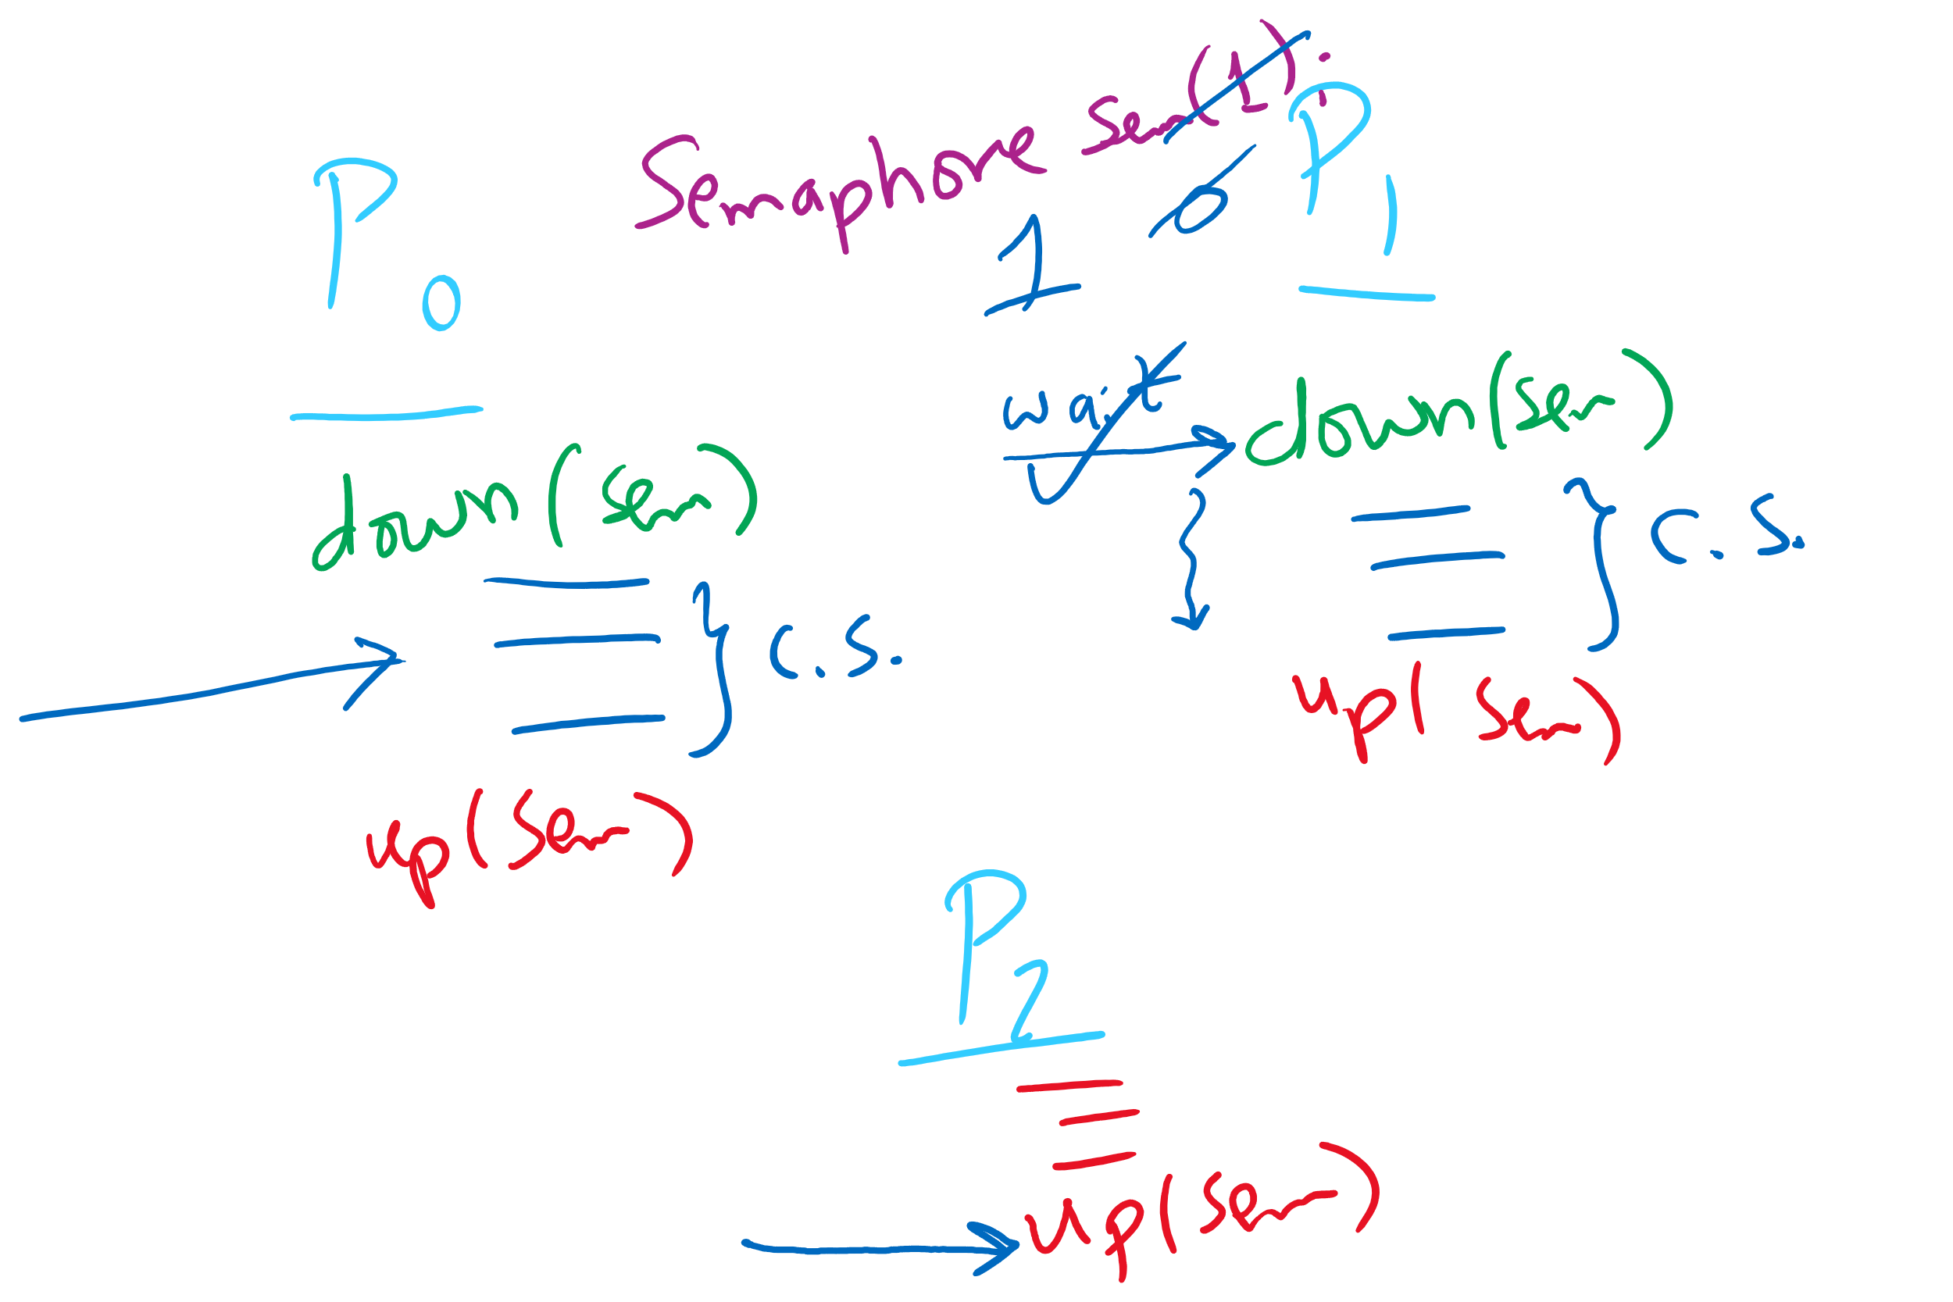
Semaphore Usage Problem: Compromising Mutual Exclusion
Any process can up() the semaphore
Solution: A Mutex can be up()’d only by the same process that down()’d it

Slide 15
Semaphore Usage Problem: Deadlock and Starvation
Deadlock: two or more processes are waiting indefinitely for an event that can only be caused by a waiting process
P0 gets A, needs B
P1 gets B, needs A
Each process waiting for the other to signal
Starvation: indefinite blocking
Process is never removed from the semaphore queue in which its suspended
May be caused by ordering in queues (priority)
Shared variables
Semaphore A(1),B(1);
Process P₀
A.down();
B.down();
.
.
.
B.up();
A.up();
Process P₁
B.down();
A.down();
.
.
.
A.up();
B.up();

Slide 16
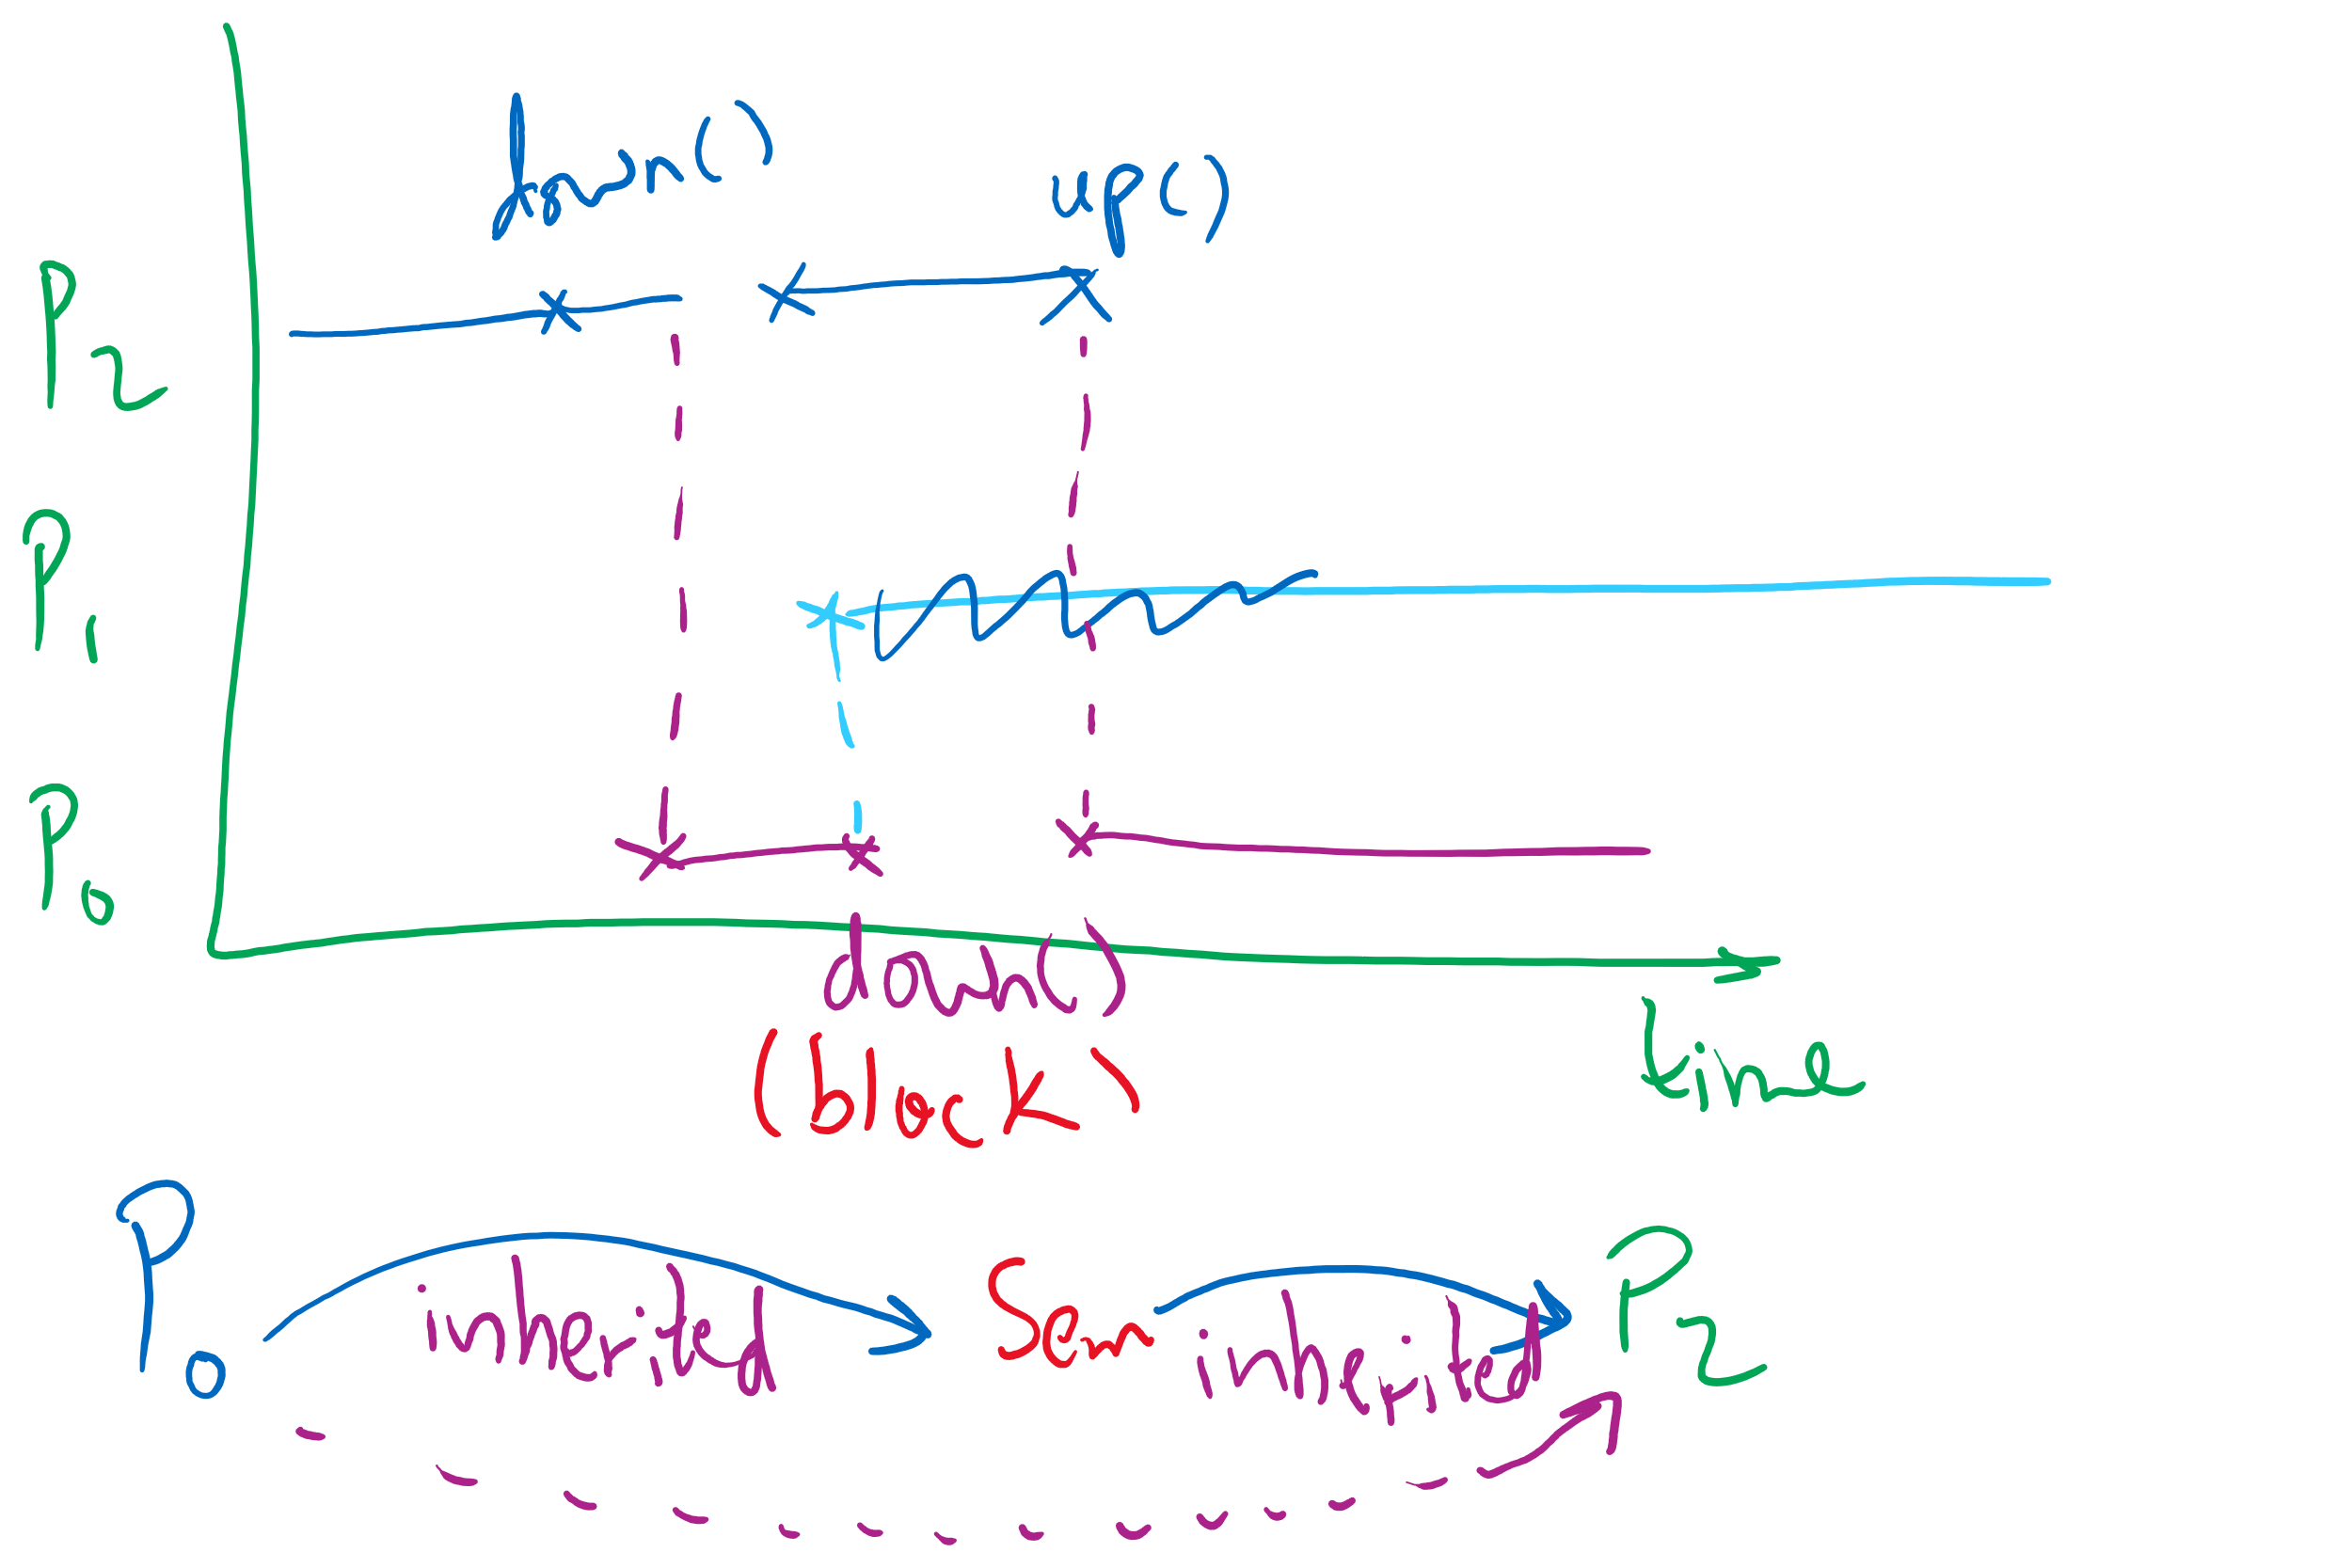
Semaphore Usage Problem: Priority Inversion
Priority inversion is still possible using semaphores
Slightly less likely
Needs at least three processes

