Slide 1

Introduction to Operating Systems CS/COE 1550
Fall 2021
Sherif Khattab
ksm73@pitt.edu
(Some slides are from Silberschatz, Galvin and Gagne ©2013)

Slide 2
Announcements
Upcoming deadlines:
Project 1: due on 9/27
Homework 3: due on 10/1

Slide 3
Last Lecture …
Semaphores
How to use
Semaphore problems

Slide 4
Muddiest Points (1/3)
still a bit unclear on why the priority inversion happens in that 3-process case
For semaphores down operation do this block the process, busy wait, or both?
the deadlock example
You said briefly at one point that only applies to threads. You brushed over that, maybe more details on what you mean
can you use both semaphores and spin locks in an application? or is it a pick one or the other mostly?
Question on semantics. If a process calls down when sem = 0, is that process blocked or would that itself be called blocks
What is the semaphore queue exactly? does it keep an order of the procs that get slept so we know what order (if no priority)/what procs in general need scheduled/ woken up?
Examples of starvation
how do you know which processes have higher priority and lower priority
How do binary semaphores handle more than 2 processes?
Are all mutexs binary semaphores?
How does a process know when to wake up from being blocked if it is not busy waiting?
Why do you need at least 3 process for priority inversion to happen in semaphore

Slide 5
Muddiest Points (2/3)
Semaphores vs Spinlocks
What is busy waiting
if the critical section is very small, could the spinlock be faster than a semaphore because of the context switch needed for the semaphore.
Why would we need to implement multiple semaphores?
binary semaphore vs spinlock
With spinlocks, busy waiting occurs and then moves on to the next process when the first process leaves the critical region.
With semaphores, a second process is blocked when a first process is already in the critical region. After that first process leaves the critical region, how does that blocked process get to the critical region?

Slide 6
Muddiest Points (3/3)
Binary Semaphore, Mutex, and Counting Semaphore
Can you make a Mutex that still tracks which processes used down() but also allows multiple specific processes to access the critical section?
in what cases would a binary semaphore be more useful than a counting semaphore?
Still a little confused on the semaphore usage problem. How does mutex solve compromising mutual exclusion
Why to use semaphores with non-binary values
do spinlocks and semaphores require all processes to access them correctly in order to guarantee mutual exclusion while mutexes just work?

Slide 7
Implementing semaphores with blocking
Assume two operations:
Sleep(): suspends current process
Wakeup(P): allows process P to resume execution
Semaphore data structure
Tracks value of semaphore
Keeps a list of processes waiting for the semaphore
Operations still atomic
Semaphore code
Semaphore::down ()
{
value -= 1;
if (value < 0) {
// add this process to pl
Sleep ();
}
}
Semaphore::up () {
Process P;
value += 1;
if (value <= 0) {
// remove a process P
// from pl
Wakeup (P);
}
}
Semaphore {
int value;
ProcessList pl;
void down ();
void up ();
};
How to protect these shared variables??

Slide 8
Spinlocks in Semaphores
Semaphore code
Semaphore::down ()
{
value -= 1;
if (value < 0) {
// add this process to pl
Sleep ();
}
}
Semaphore::up () {
Process P;
value += 1;
if (value <= 0) {
// remove a process P
// from pl
Wakeup (P);
}
}

Slide 9
Spinlocks are sometimes better than Semaphores
Multiple cores
Very (very) short waiting time to enter the critical section
< context-switching time
Few contending processes
Short critical section code

Slide 10
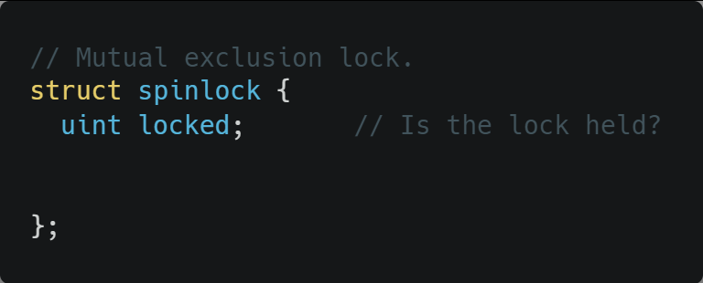
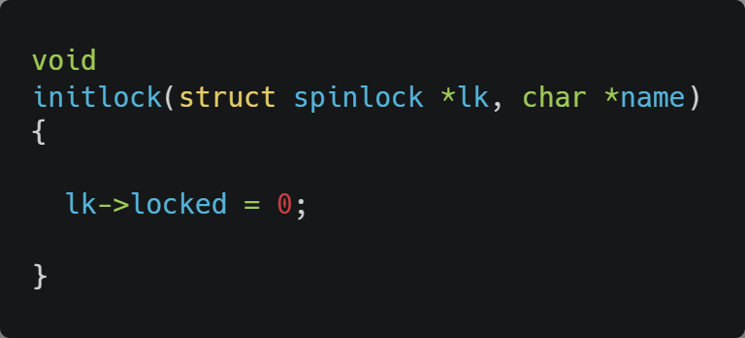
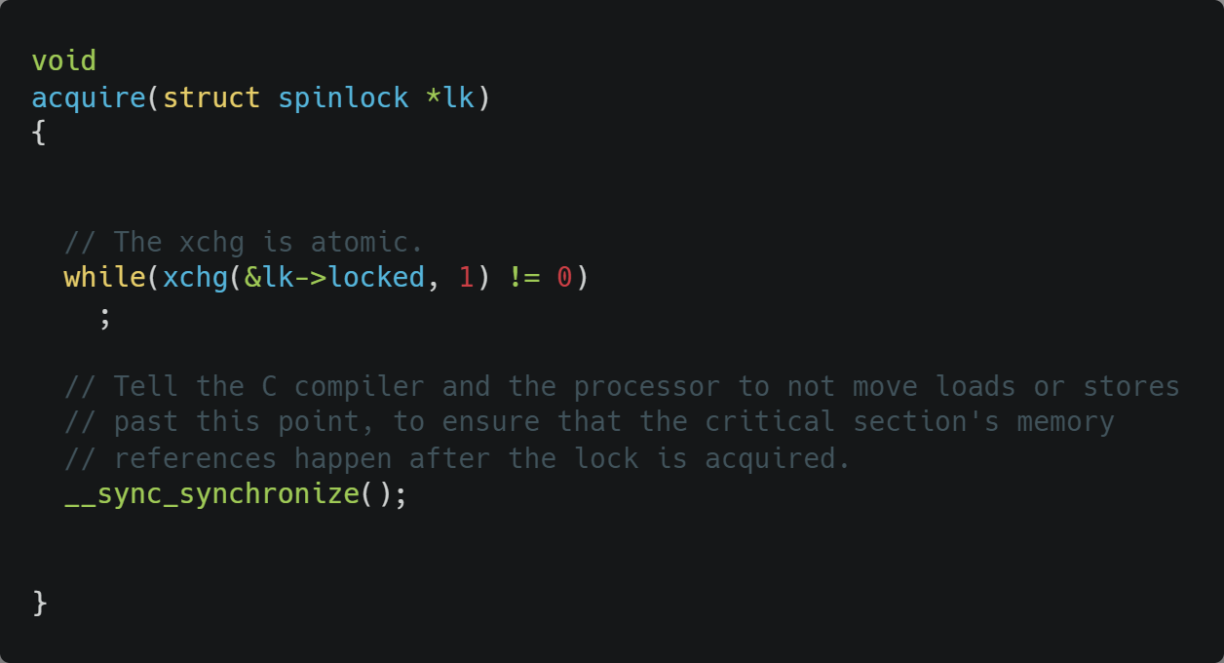
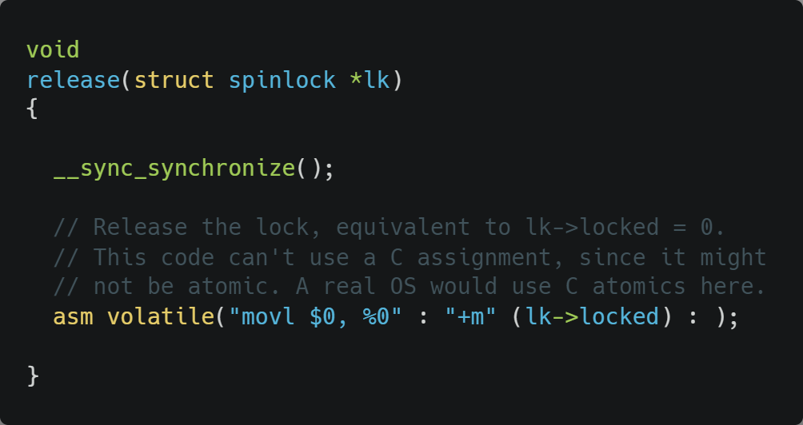
Xv6 Walkthrough
Spinlocks

Slide 11
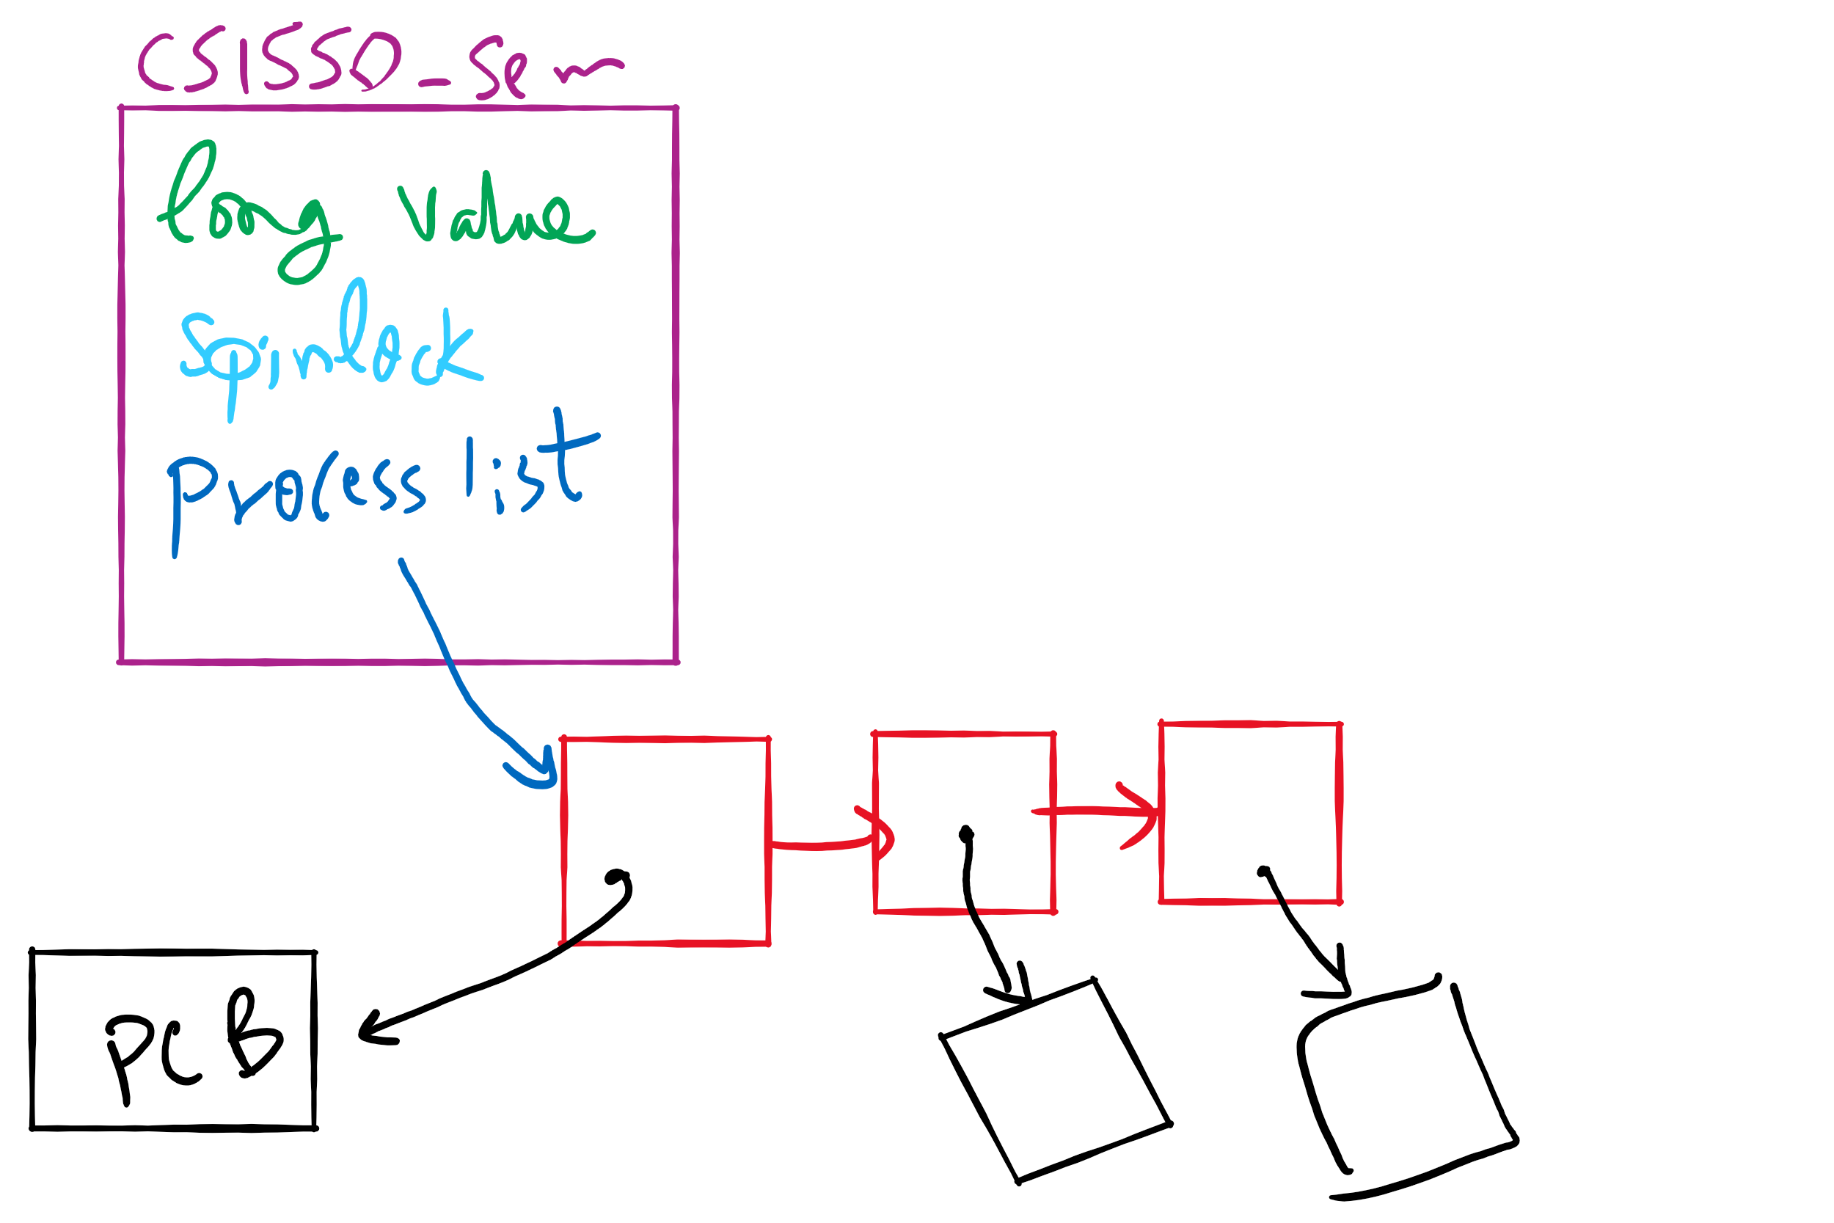
Semaphore Implementation in Project 1

Slide 12
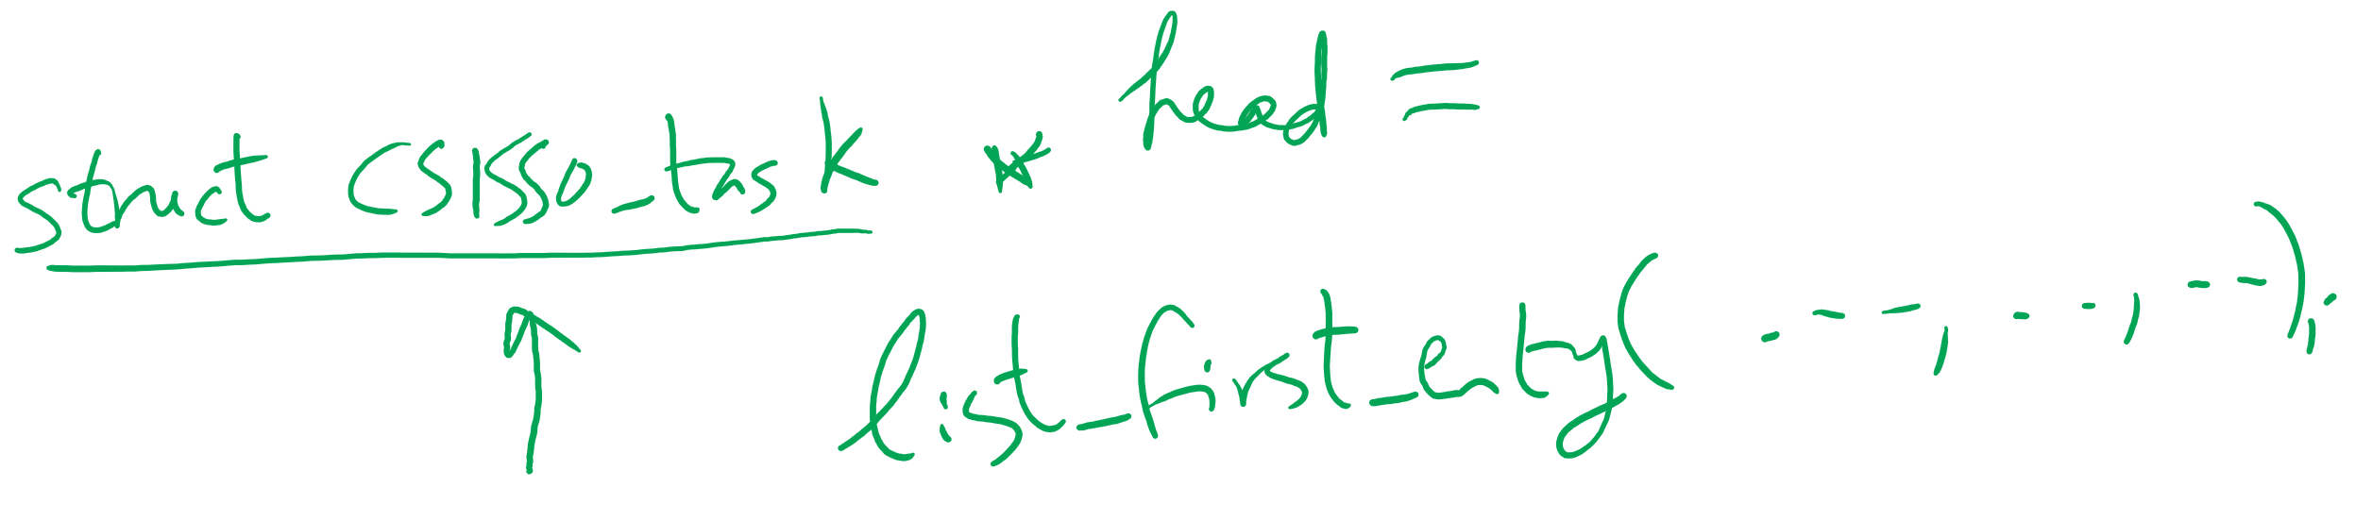
Getting the first entry in a list_head linked list

Slide 13
Monitors
A monitor is another kind of high-level synchronization primitive
One monitor has multiple entry points
Think multiple methods in a Java class
Only one process may be in the monitor at any time
Enforces mutual exclusion - less chance for programming errors
Monitors provided by high-level language
Variables belonging to monitor are protected from simultaneous access
Procedures in monitor are guaranteed to have mutual exclusion

Slide 14
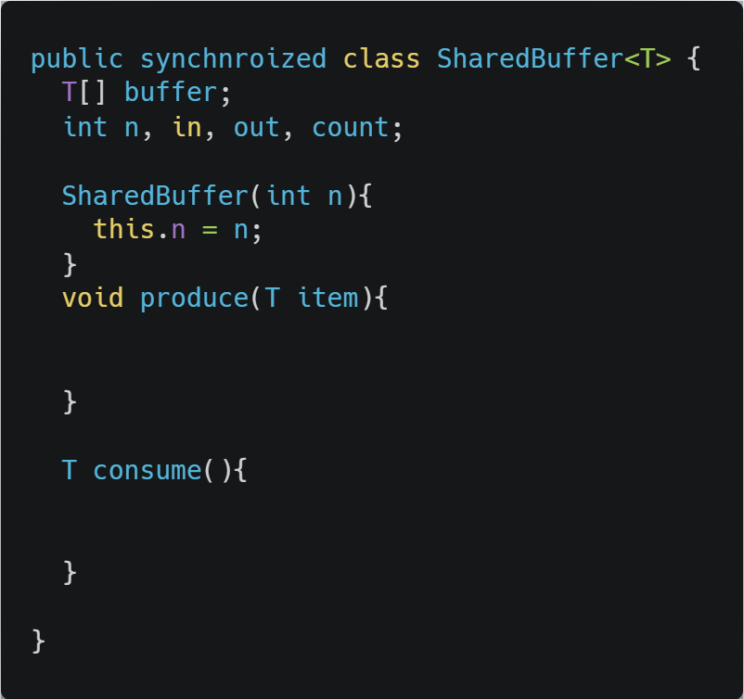
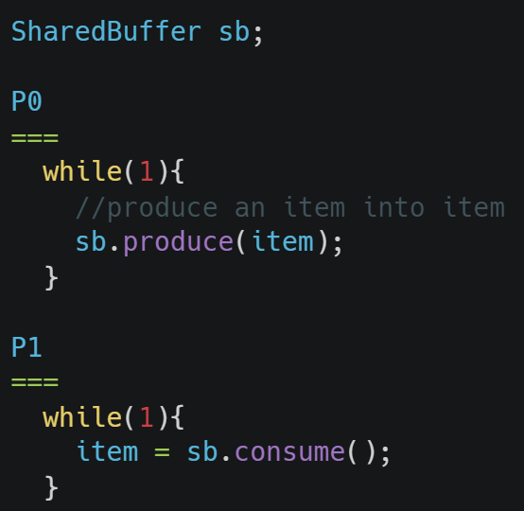
Monitor usage
Supported by Java
synchronized keyword
Only one process can be executing in either produce or consume at any time

Slide 15
Condition variables in monitors
Problem: how can a process wait inside a monitor?
Can’t simply sleep: there’s no way for anyone else to enter
Solution: use a condition variable
Condition variables support two operations
Wait(): suspend this process until signaled
Signal(): wake up exactly one process waiting on this condition variable
If no process is waiting, signal has no effect
Signals on condition variables aren’t “saved up”
Different from semaphores!
Condition variables are only usable within monitors
Process must be in monitor to signal on a condition variable

Slide 16
Locks & condition variables
Monitors require native language support
What if native support is not there (e.g., in C)?
Provide monitor support using special data types and procedures
Locks (Acquire(), Release())
Condition variables (Wait(), Signal())
Lock usage
Acquiring a lock == entering a monitor
Releasing a lock == leaving a monitor
Condition variable usage
Each condition variable is associated with exactly one lock
Lock must be held to use condition variable
Waiting on a condition variable releases the lock implicitly and reacquires the lock upon returning

