Slide 1

Introduction to Operating Systems CS/COE 1550
Spring 2022
Sherif Khattab
ksm73@pitt.edu
(Some slides are from Silberschatz, Galvin and Gagne ©2013)

Slide 2
Announcements
Homework 2 is due this Friday at 11:59 pm
Lab 1 is due on 9/20 at 11:59 pm
Using GitHub Classroom
Explained in last week’s recitation
TA Office hours available on the syllabus page
Project 1 is up on Canvas
Docker images are available on Canvas
Tophat questions of this and the previous lectures are assigned as homework

Slide 3
Spinlock implementation (2/2)
Single shared variable: lock
requires busy waiting, but code is simple
Two versions
Test and set
Swap
Works for any number of processes
Can lead to unbounded waiting
aka starvation
int lock = 0;
Lock(){
while (TestAndSet(lock))
;
}
Unlock(){
lock = 0;
}
Lock(){
while (Swap(lock,1) == 1)
;
}
Unlock(){
lock = 0;
}

Slide 4
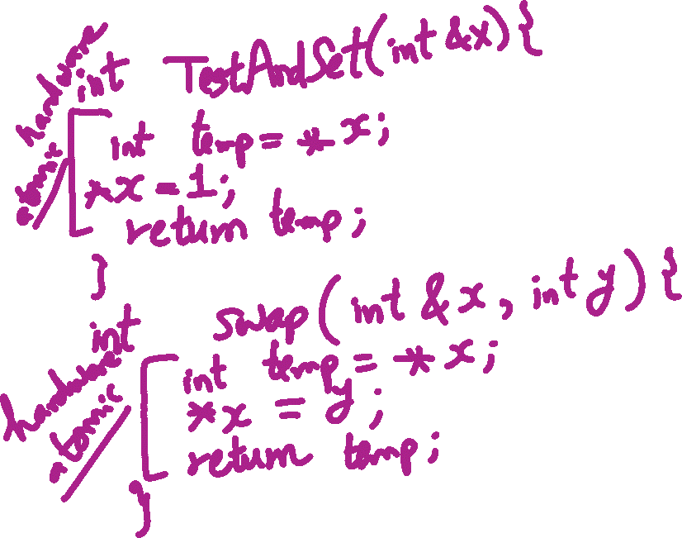
TestAndSet vs. Swap

Slide 5
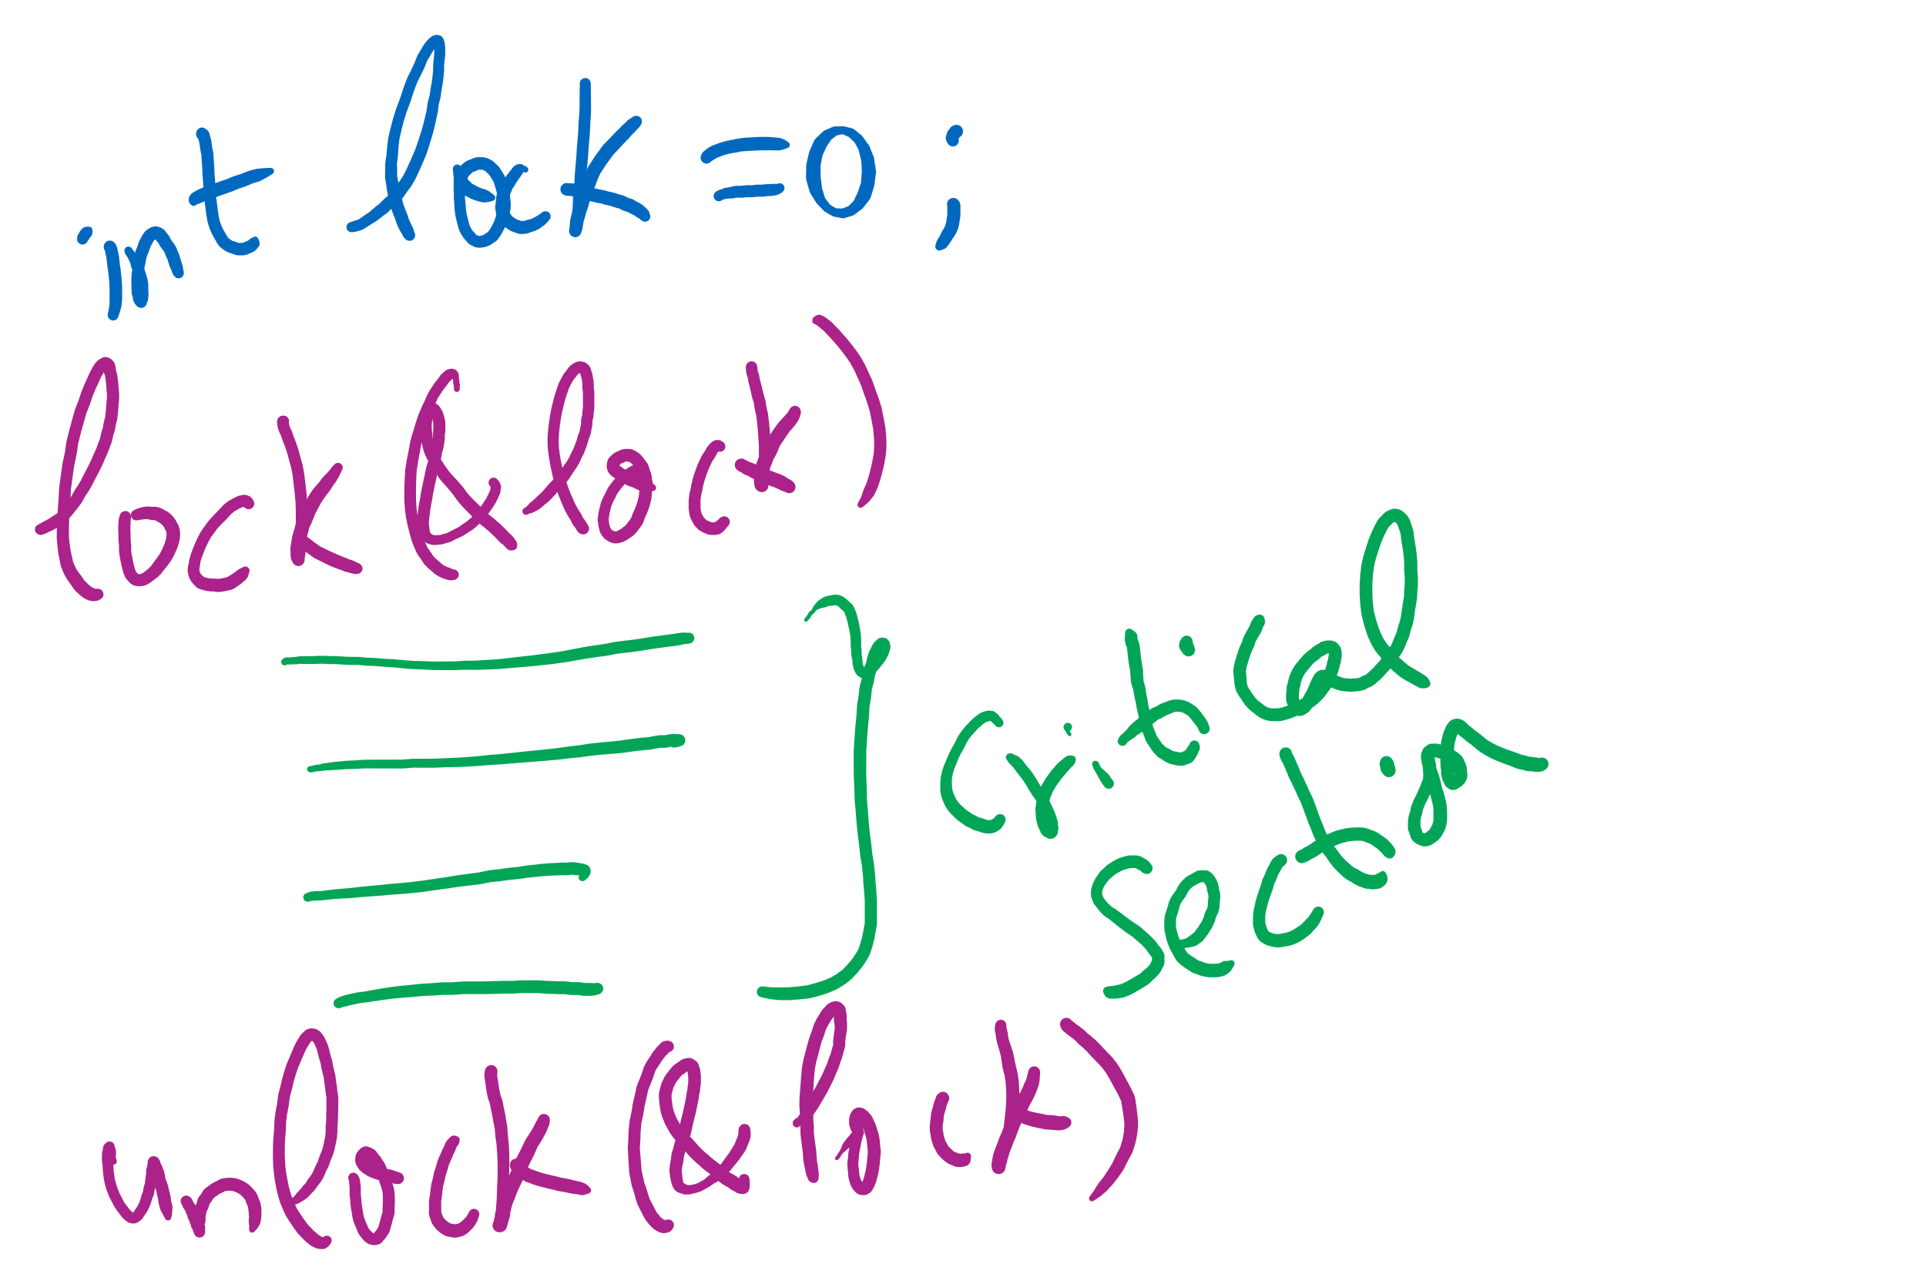
Lock Usage

Slide 6
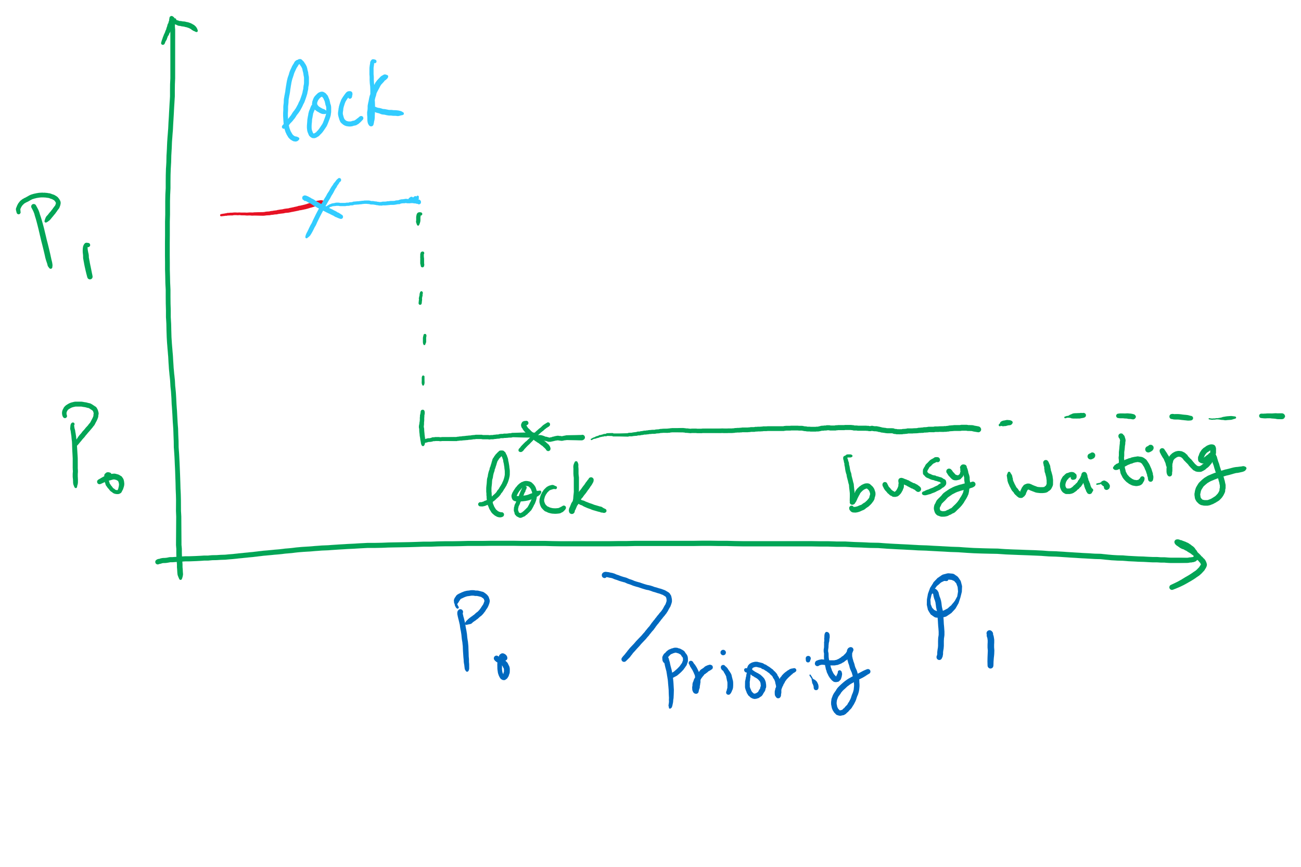
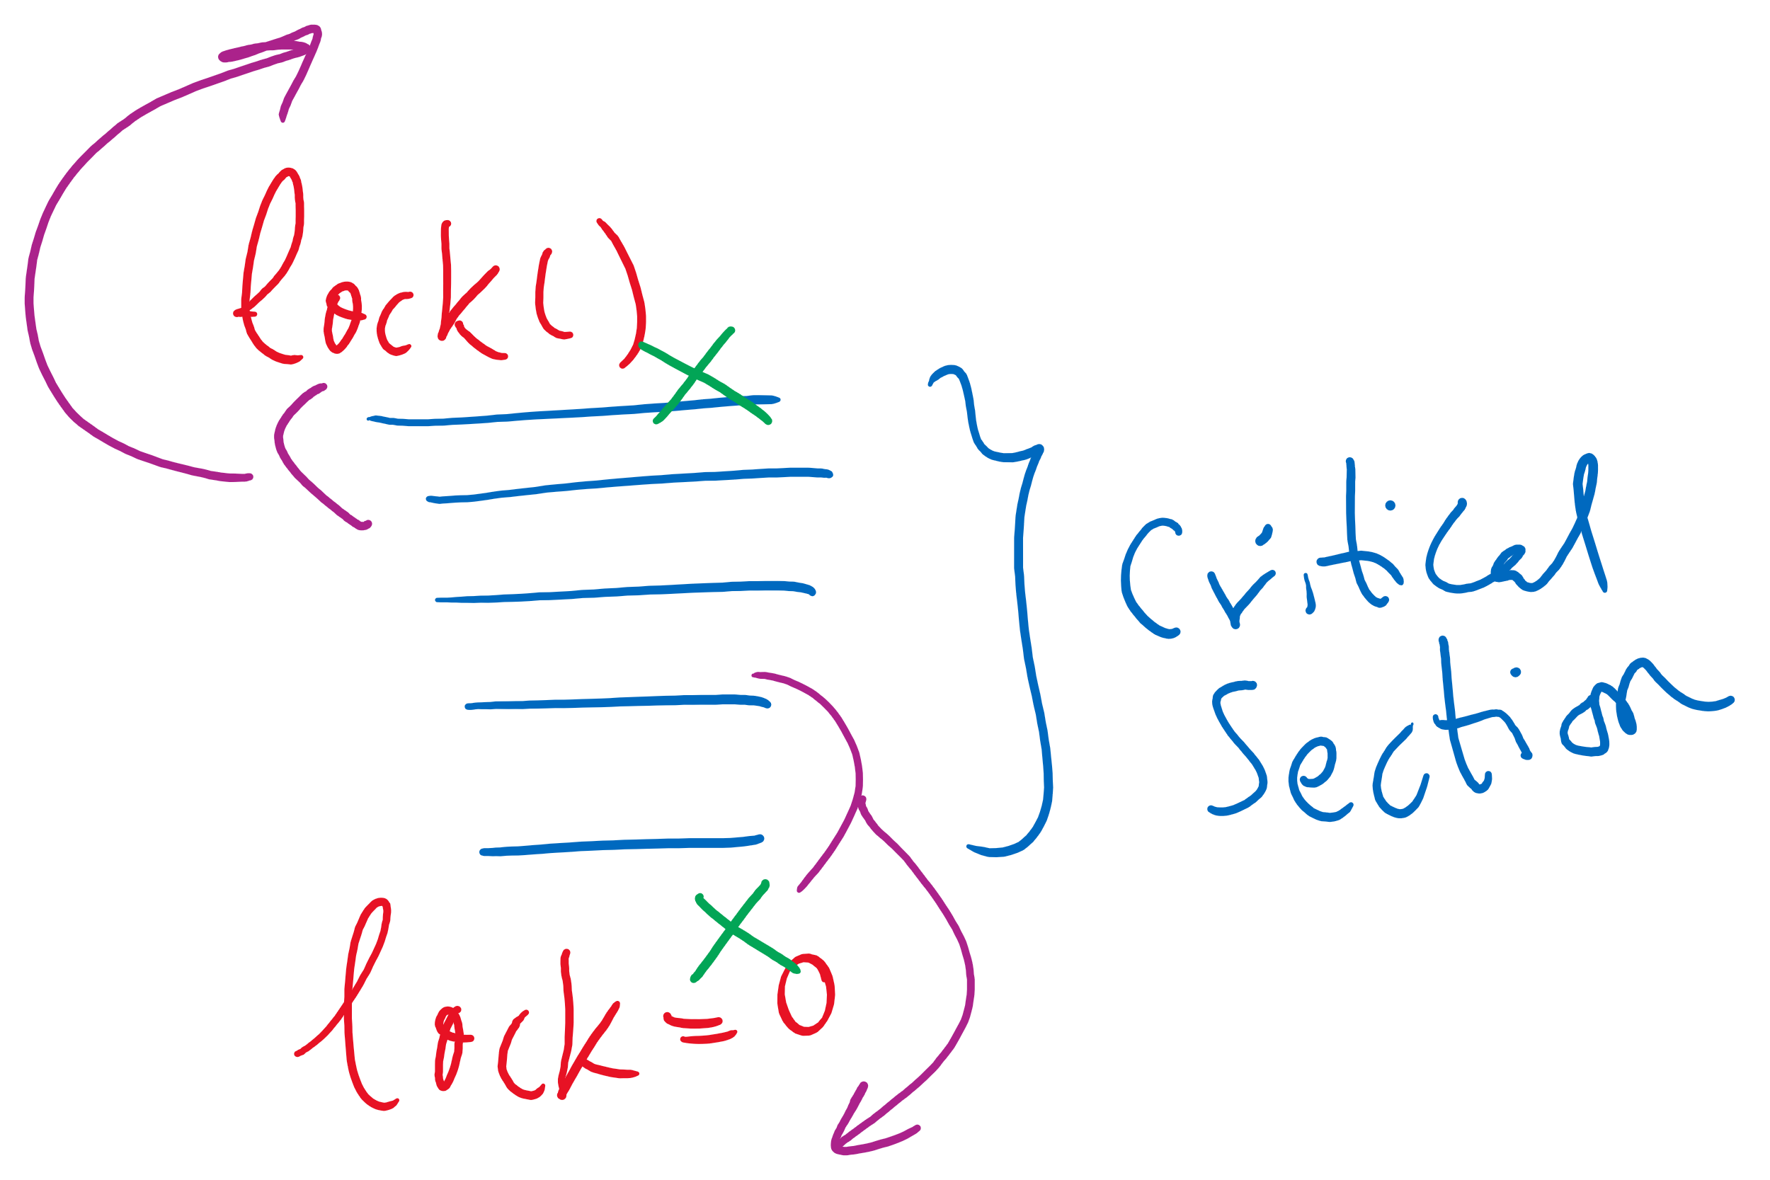


Spinlock Problems
Problem: wastes CPU time
Would be better to allow processes to sleep while they wait to execute their critical sections
Problem: priority inversion (higher priority process waits for lower priority process)
Problem: compiler and/or hardware instruction reordering

Slide 7
Semaphores
Solution: use semaphores
Synchronization mechanism that doesn’t require busy waiting
Implementation
Semaphore S accessed by two atomic operations
Down(S): while (S<=0) {}; S-= 1;
Up(S): S+=1;
Down() is another name for P()
Up() is another name for V()
Modify implementation to eliminate busy wait from Down()

Slide 8
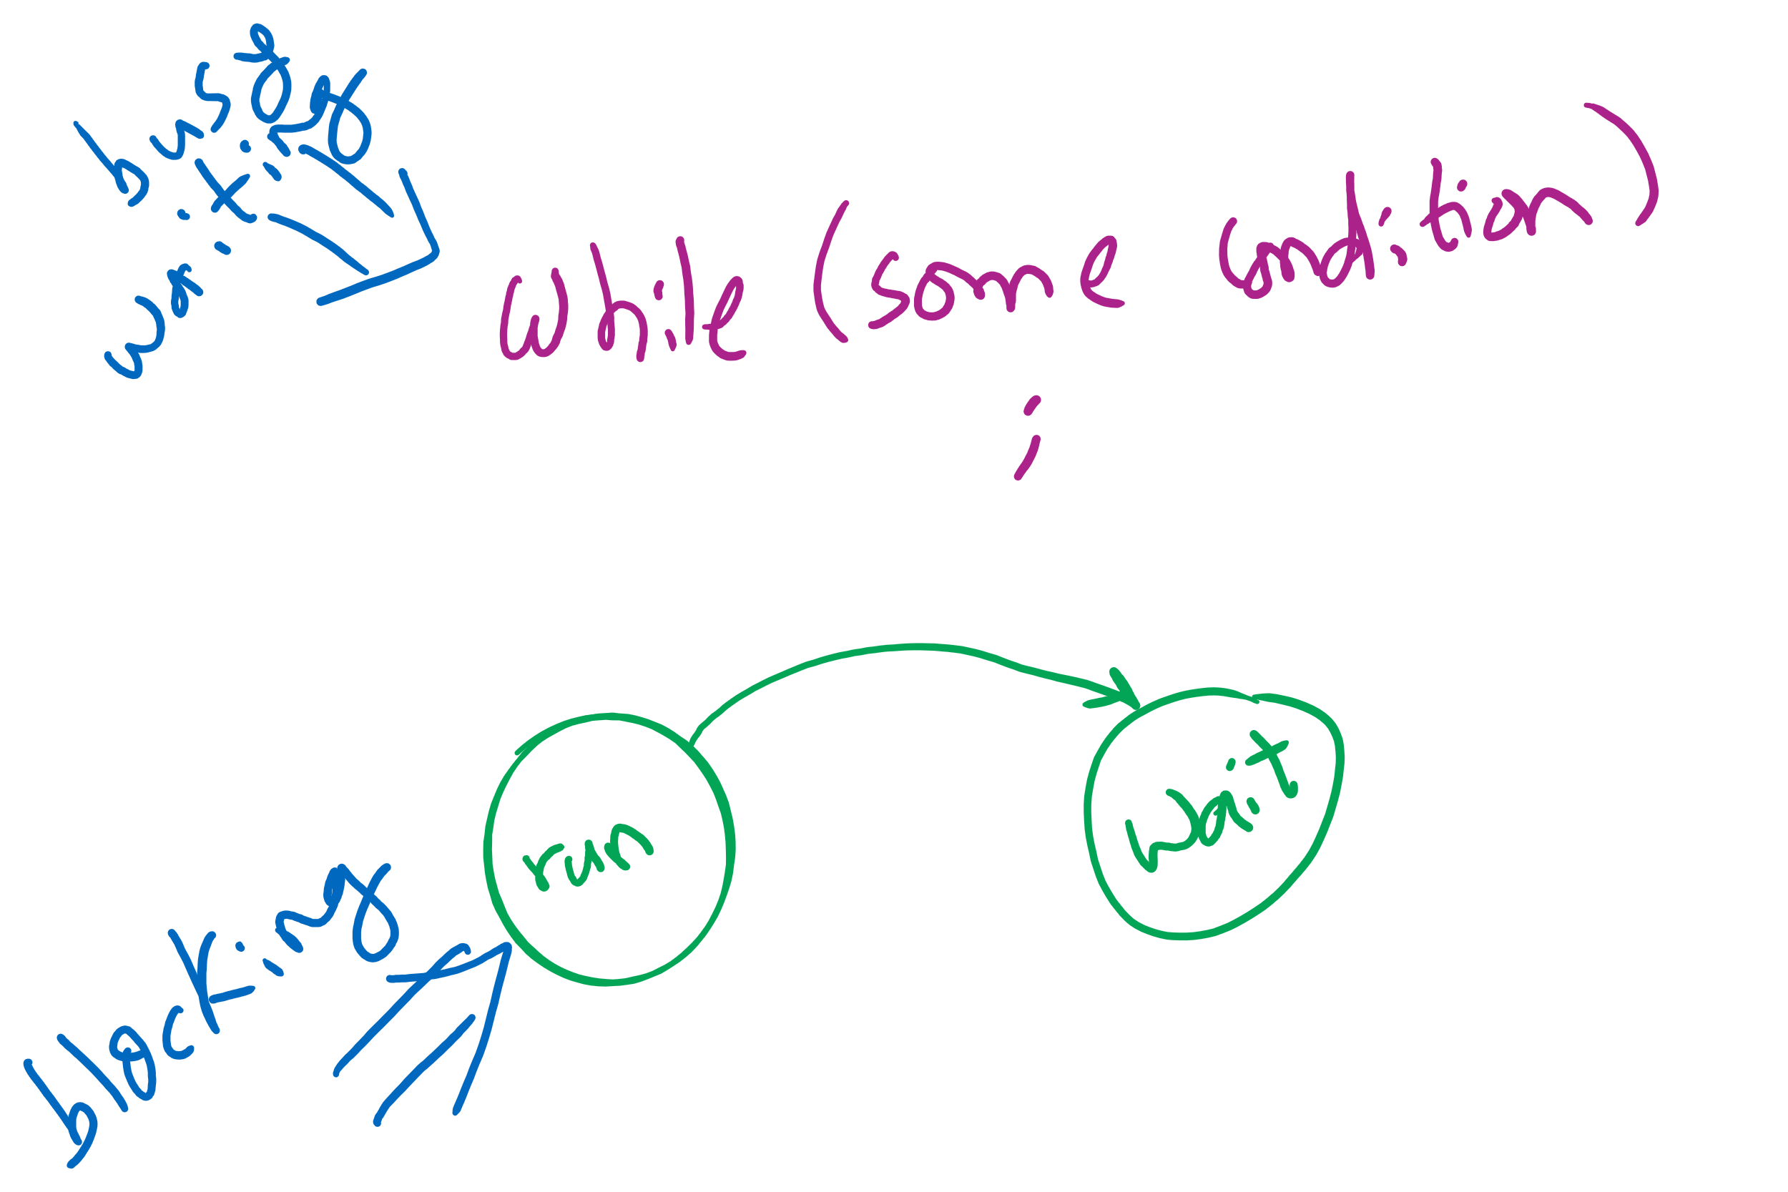
Busy waiting vs. Blocking

Slide 9
Critical sections using semaphores
Define a data structure called Semaphore
Details hidden from processes
Code for individual process is simple
Shared variables
Semaphore sem;
Code for process P_{i}
while (1) {
// non-critical section
down(sem);
// critical section
up(sem);
// non-critical section
}

Slide 10
Semaphores for general synchronization
We want to execute B in P1 only after A executes in P0
Use a semaphore initialized to 0
Use up() to notify P1 at the appropriate time
Shared variables
// flag initialized to 0
Semaphore flag(0);
Process P₀
.
.
.
// Execute code for A
flag.up ();
Process P₁
.
.
.
flag.down ();
// Execute code for B

Slide 11
Types of semaphores
Two different types of semaphores
Counting semaphores
Binary semaphores
Counting semaphore
Value can range over an unrestricted range
Binary semaphore
Only two values possible
1 means the semaphore is available
0 means a process has acquired the semaphore
May be simpler to implement
Possible to implement one type using the other

Slide 12
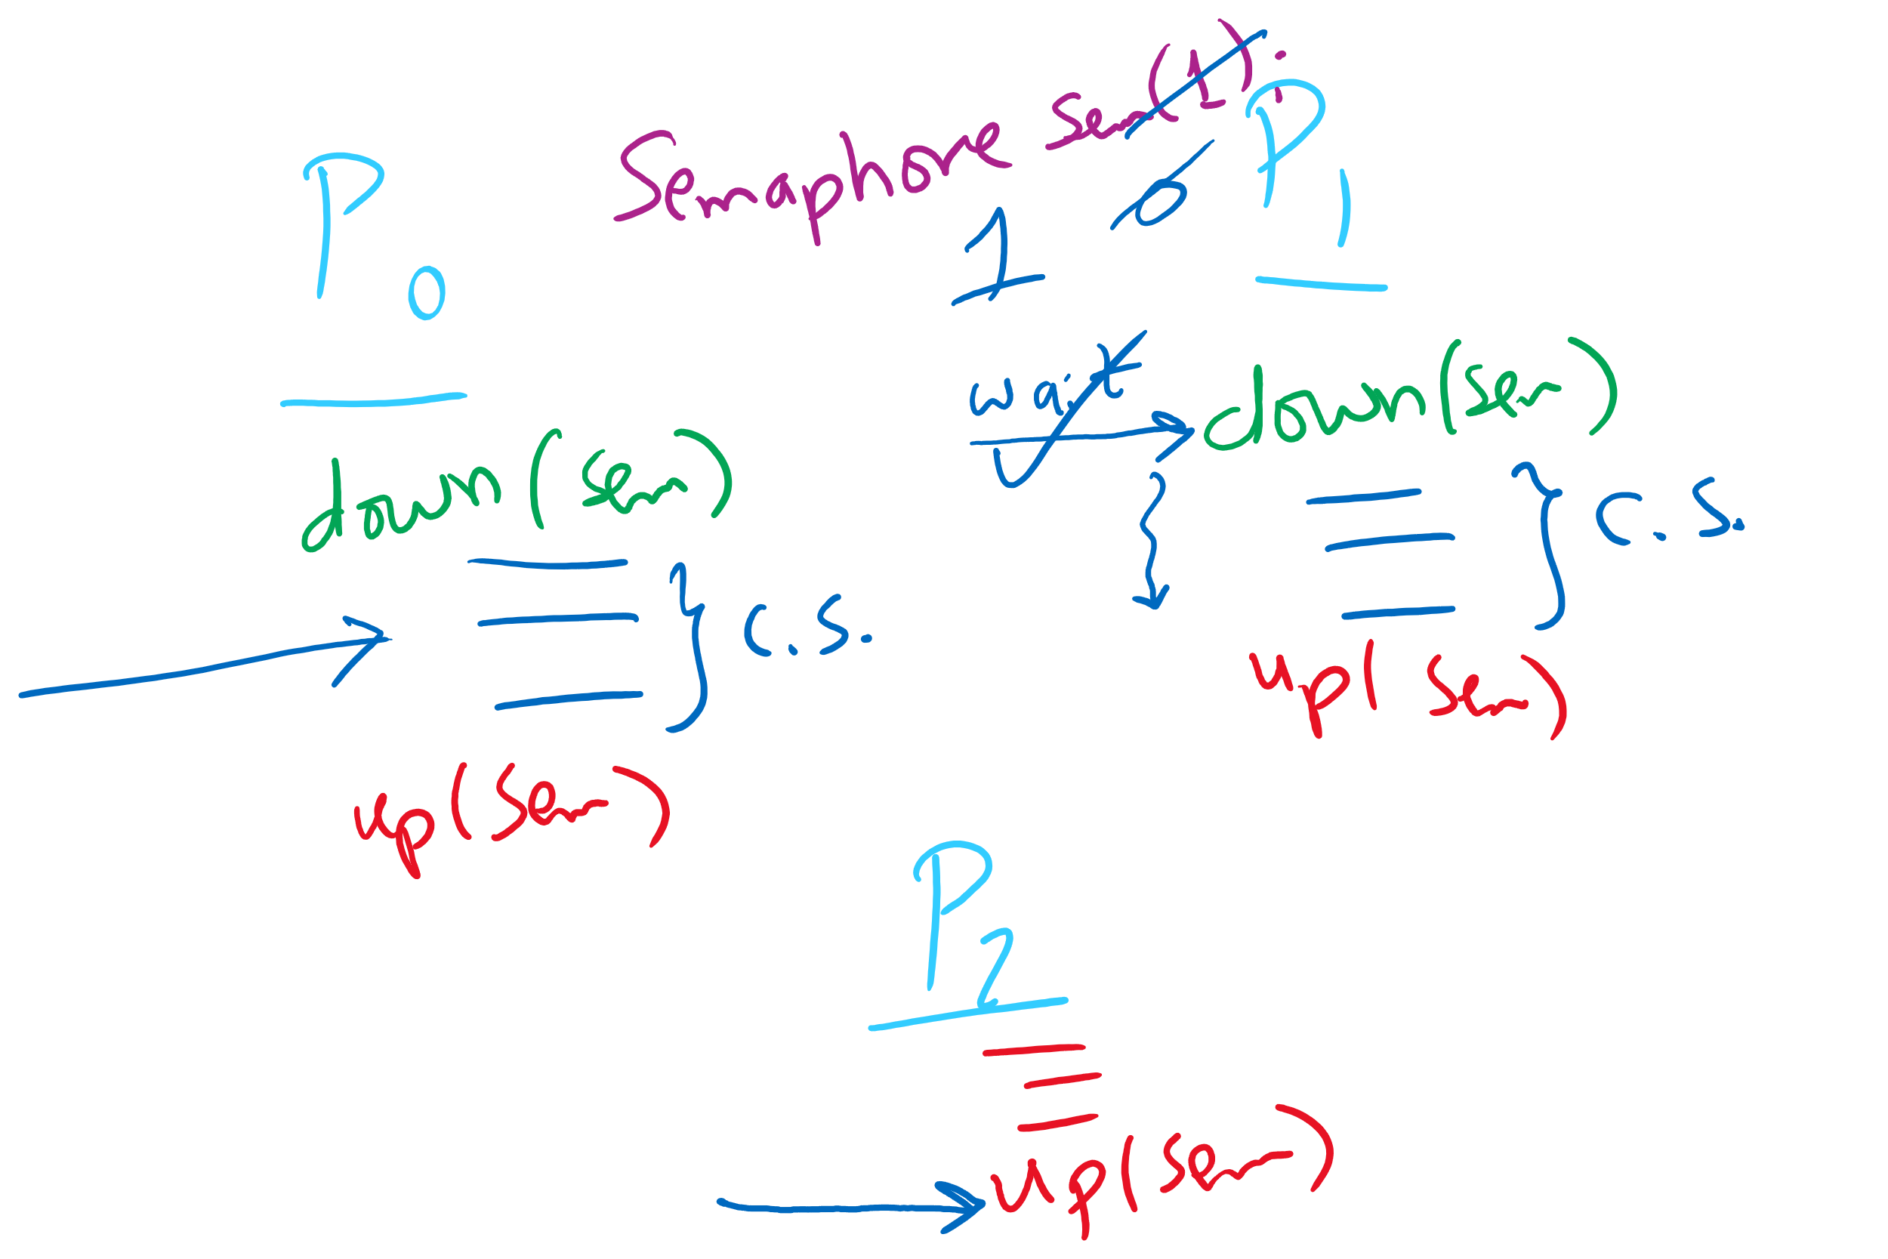
Semaphore Usage Problem: Compromising Mutual Exclusion
Any process can up() the semaphore
Solution: A Mutex can be up()’d only by the same process that down()’d it

Slide 13
Semaphore Usage Problem: Deadlock and Starvation
Deadlock: two or more processes are waiting indefinitely for an event that can only be caused by a waiting process
P0 gets A, needs B
P1 gets B, needs A
Each process waiting for the other to signal
Starvation: indefinite blocking
Process is never removed from the semaphore queue in which its suspended
May be caused by ordering in queues (priority)
Shared variables
Semaphore A(1),B(1);
Process P₀
A.down();
B.down();
.
.
.
B.up();
A.up();
Process P₁
B.down();
A.down();
.
.
.
A.up();
B.up();

Slide 14
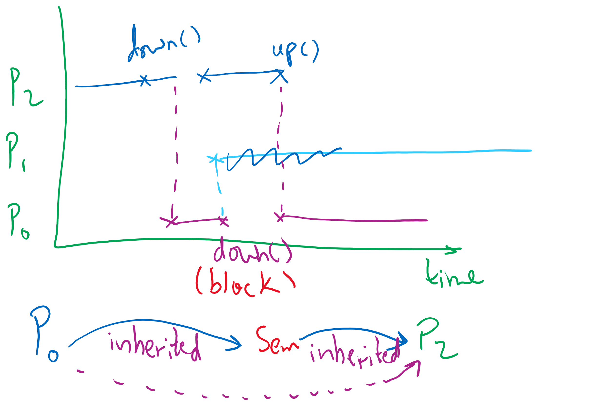
Semaphore Usage Problem: Priority Inversion
Priority inversion is still possible using semaphores
Slightly less likely
Needs at least three processes

Slide 15
Why do we need Synchronization?
Each process operates sequentially
All is fine until processes want to share data
Exchange data between multiple processes
Allow processes to navigate critical regions
Maintain proper sequencing of actions in multiple processes
These issues apply to threads as well
Threads can share data easily (same address space)
Other two issues apply to threads

Slide 16
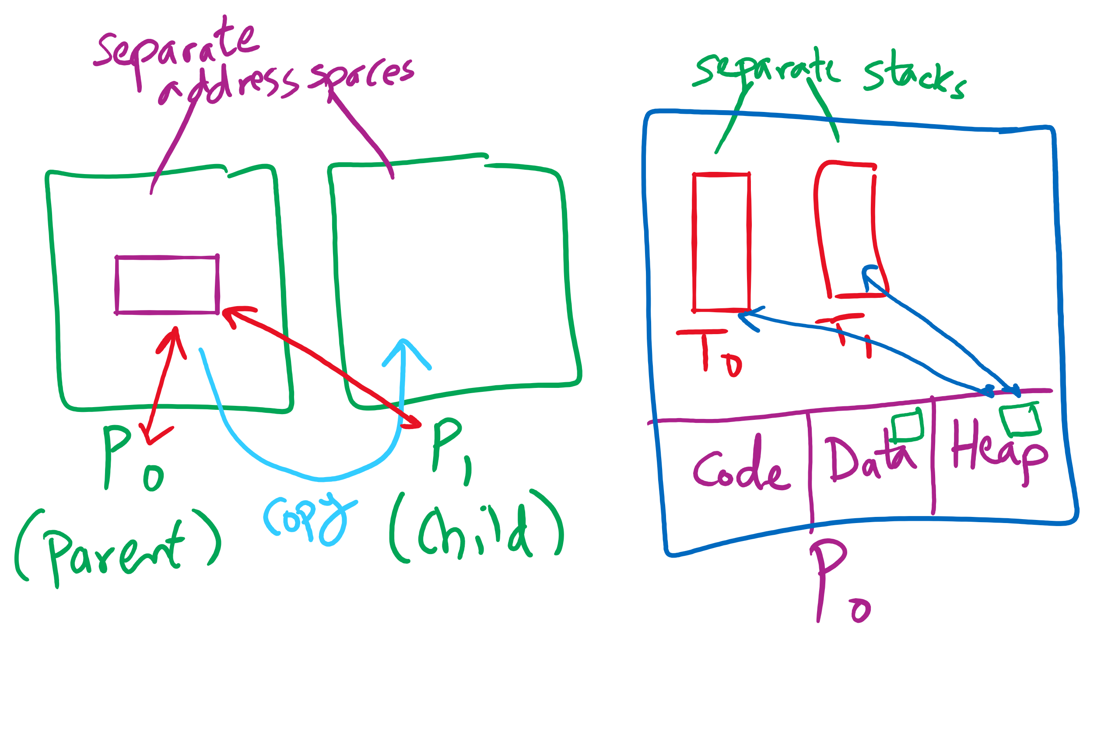
Process vs. Thread

Slide 17
Process Termination
Some operating systems do not allow a child to exist if its parent has terminated. If a process terminates, then all its children must also be terminated.
cascading termination. All children, grandchildren, etc. are terminated.
The termination is initiated by the operating system.
The parent process may wait for termination of a child process by using the wait()system call. The call returns status information and the pid of the terminated process
pid = wait(&status);
If no parent waiting (did not invoke wait()) process is a zombie
If parent terminated without invoking wait , process is an orphan

Slide 18
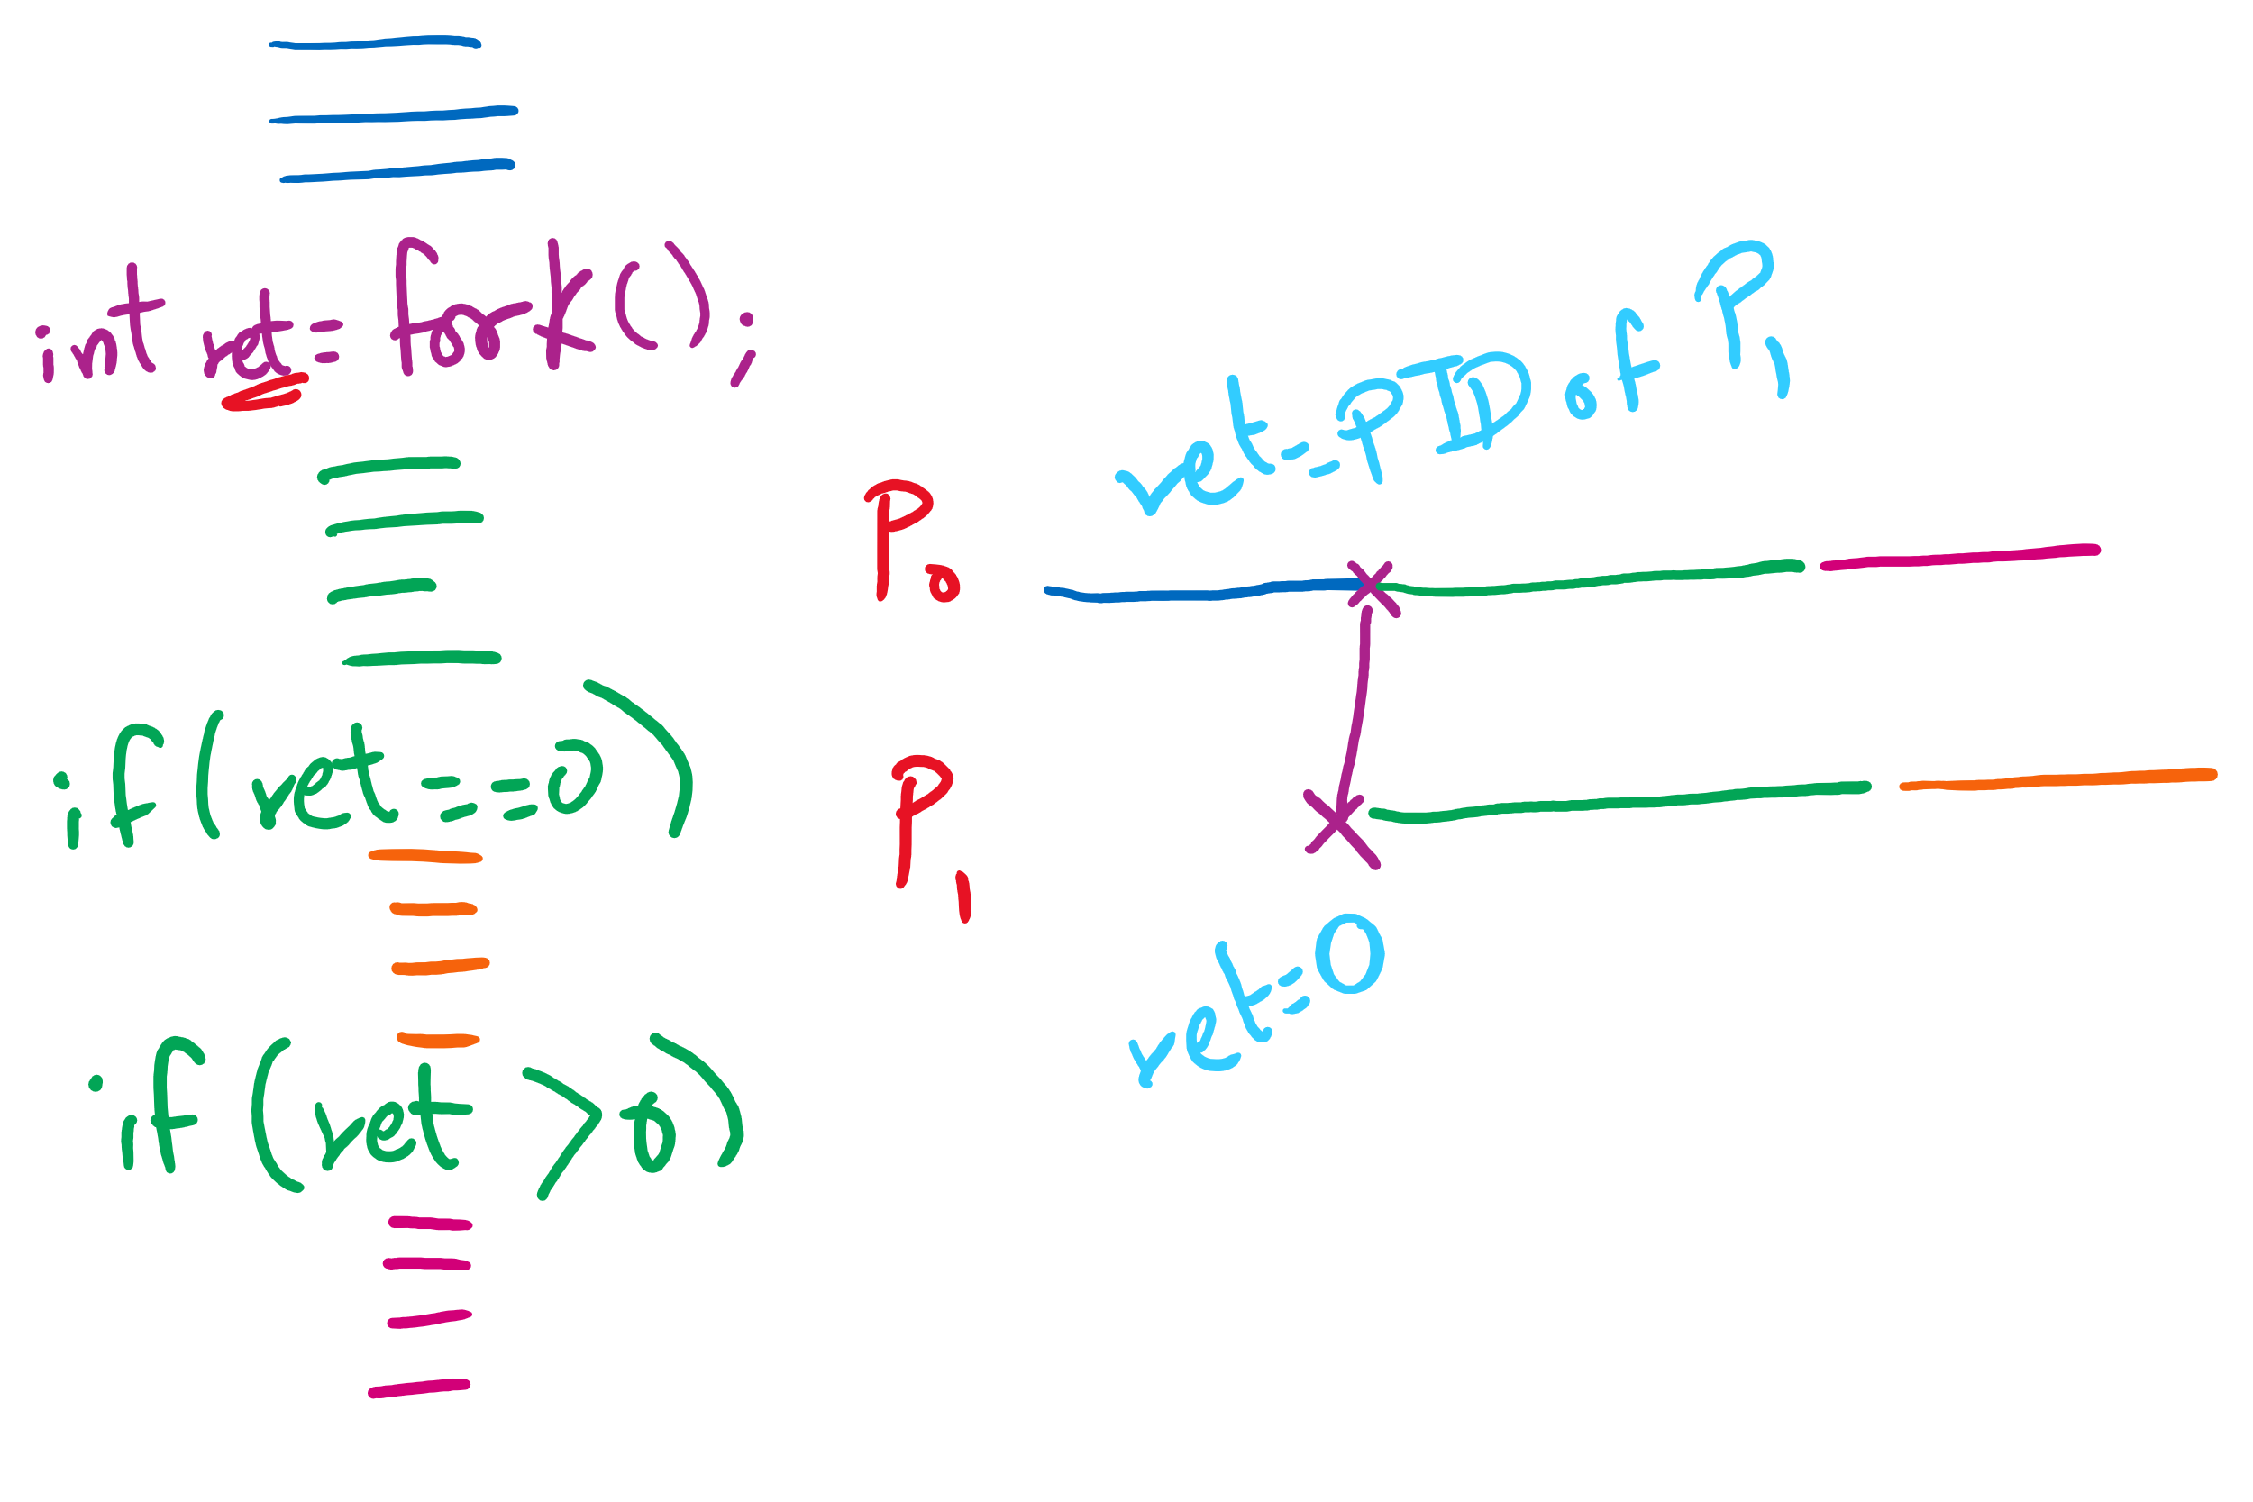
fork() tracing

Slide 19
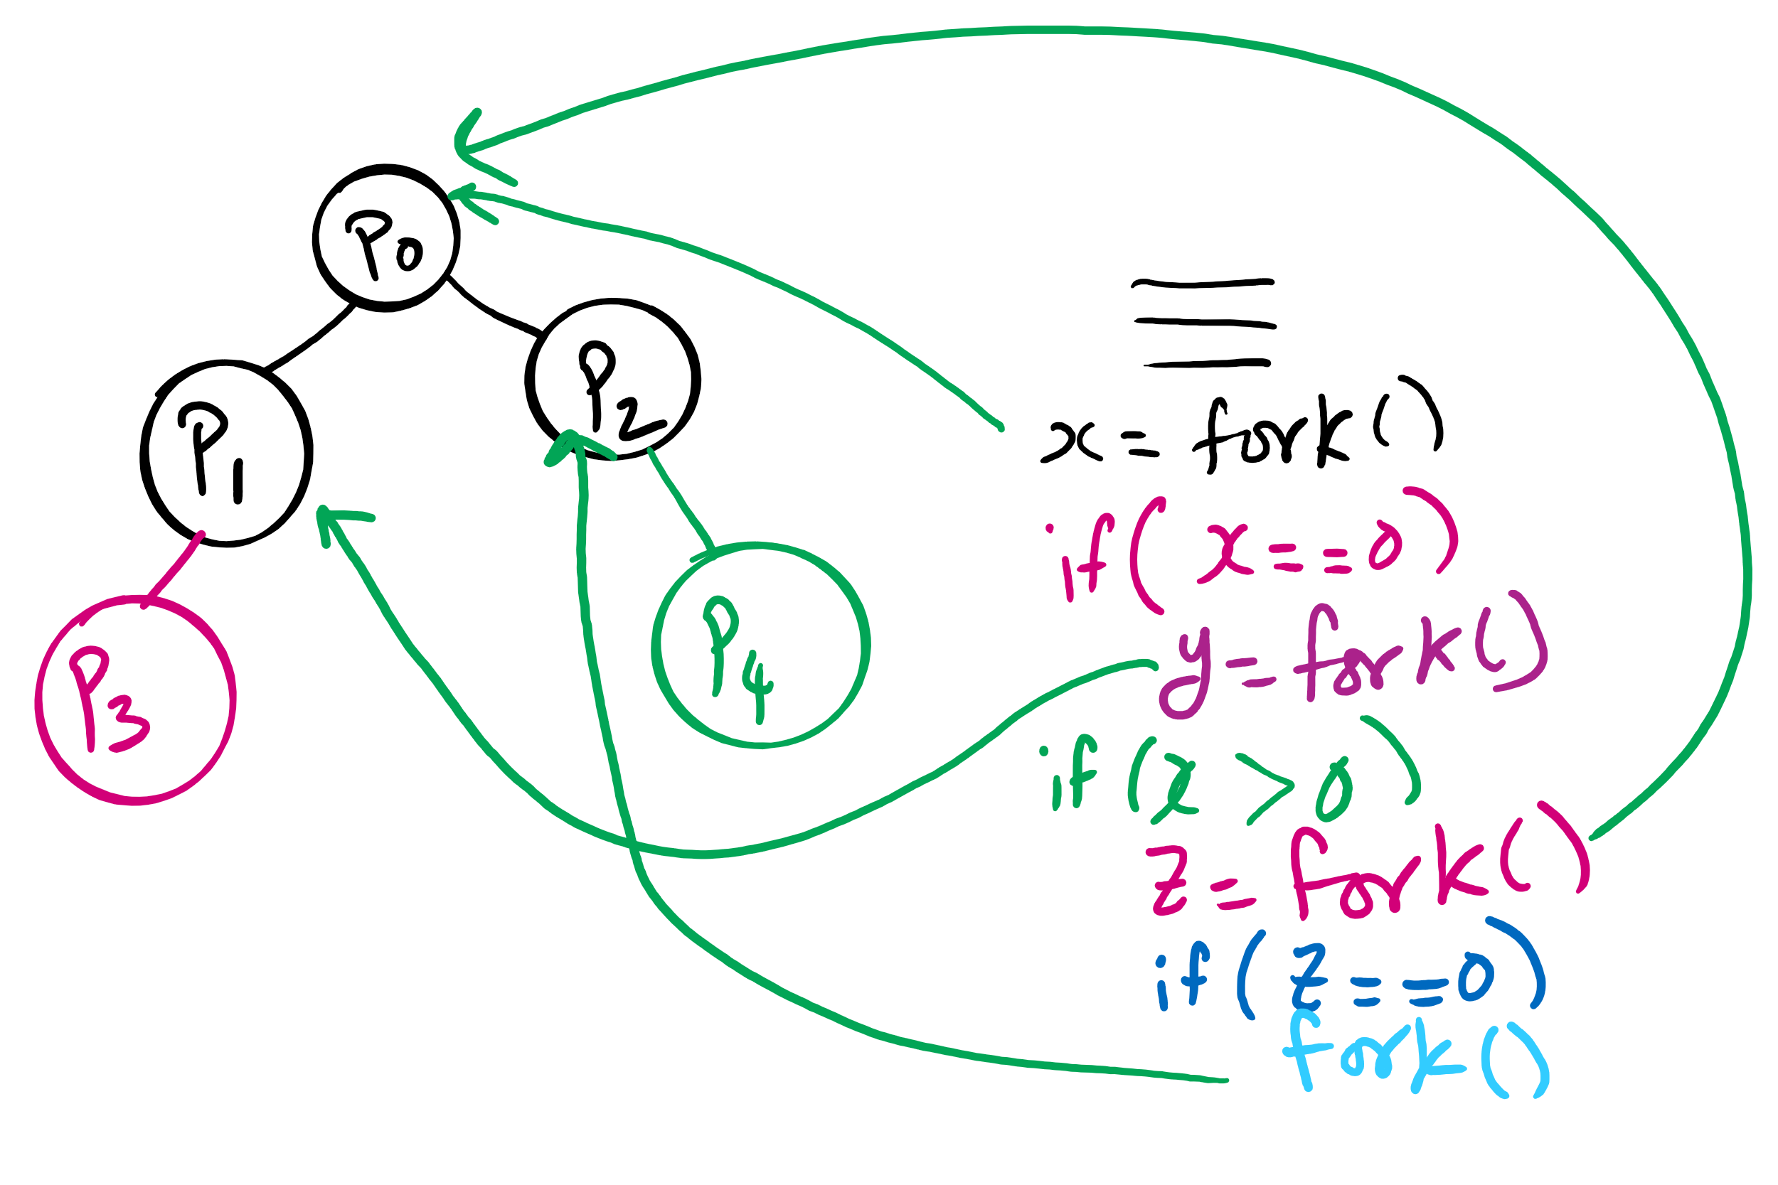
fork()’s of fork()’s

Slide 20
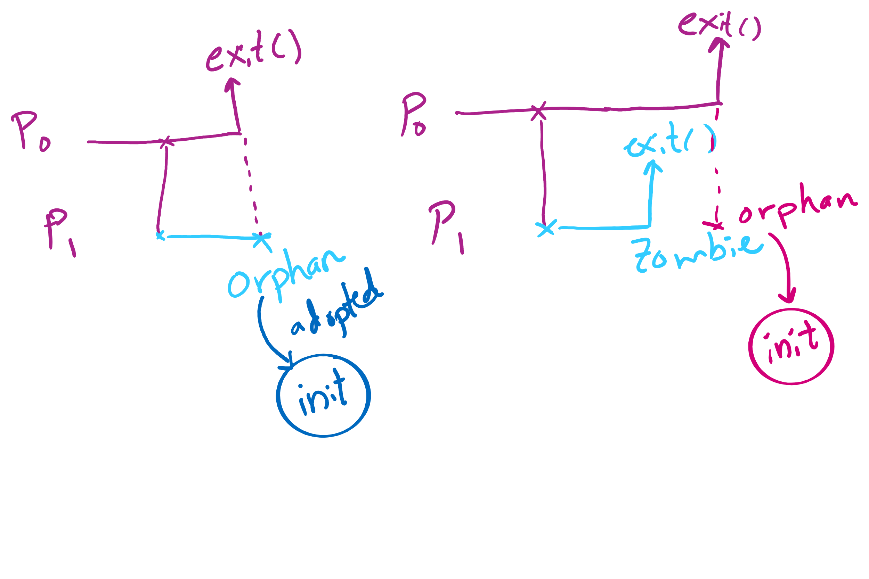
Orphan vs. Zombie Processes

Slide 21
Benefits of Orphan Processes
Allow a long-running job to continue running even after session (e.g., ssh connection) ends.
The nohup command does that
Create deamon processes
Long-running background processes adopted by the init process.

Slide 22
Xv6 Code Walkthrough
Context switching
Calling of the swtch routine
fork()
exit()
wait()

Slide 23
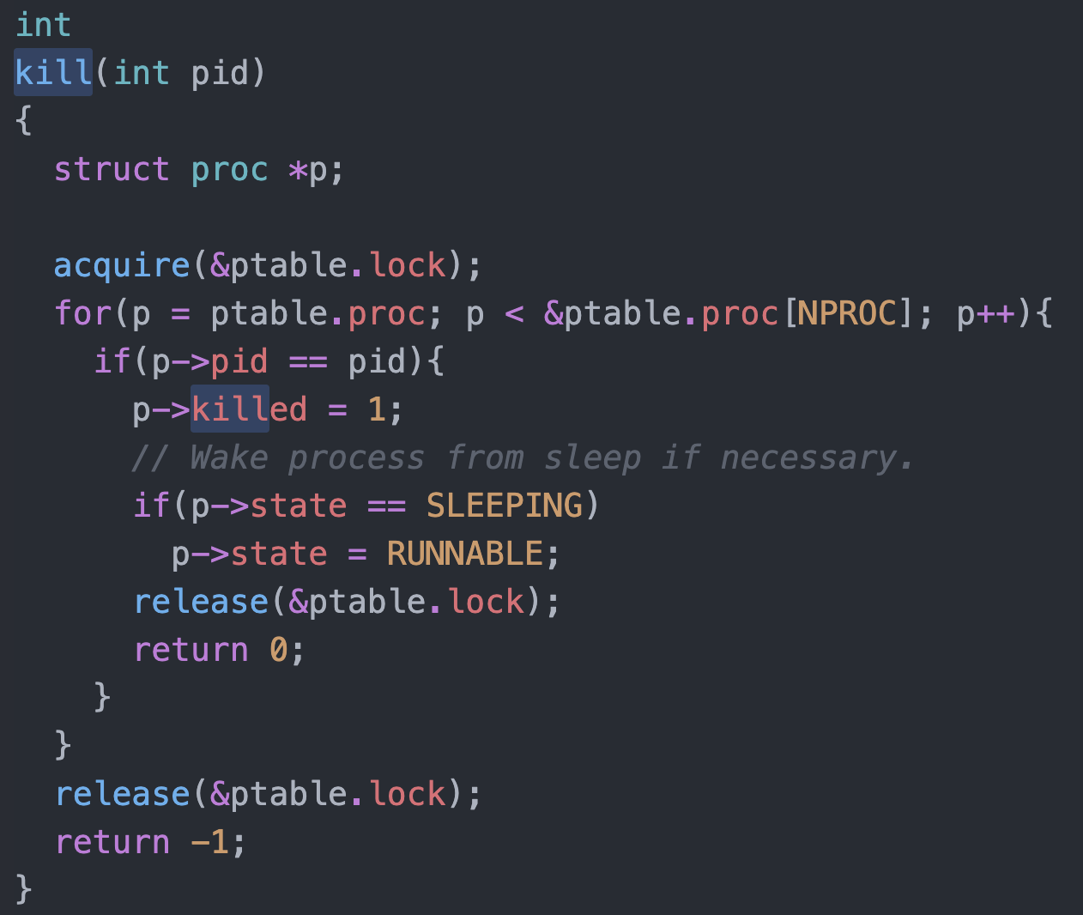
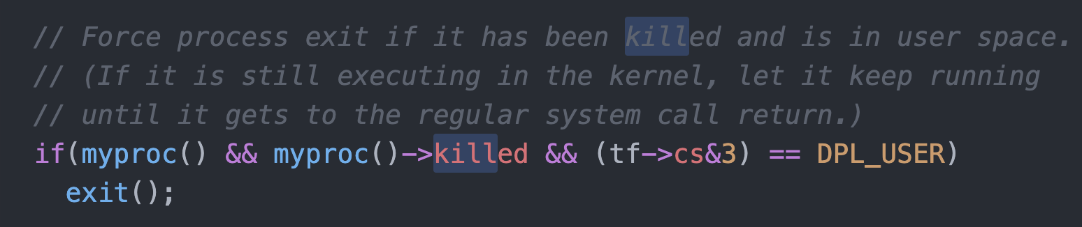
Killing a waiting process

