Slide 1

Introduction to Operating Systems CS/COE 1550
Fall 2021
Sherif Khattab
ksm73@pitt.edu
(Some slides are from Silberschatz, Galvin and Gagne ©2013)

Slide 2
Announcements
Homework 2 is due this Friday at 11:59 pm
Lab 1 is due on 9/20 at 11:59 pm
Using GitHub Classroom
Explained in last week’s recitation
TA Office hours available on the syllabus page
Project 1 is up on Canvas
Docker images are available on Canvas
Tophat questions of this and the previous lectures are assigned as homework

Slide 3
Process Termination
Some operating systems do not allow a child to exist if its parent has terminated. If a process terminates, then all its children must also be terminated.
cascading termination. All children, grandchildren, etc. are terminated.
The termination is initiated by the operating system.
The parent process may wait for termination of a child process by using the wait()system call. The call returns status information and the pid of the terminated process
pid = wait(&status);
If no parent waiting (did not invoke wait()) process is a zombie
If parent terminated without invoking wait , process is an orphan

Slide 4
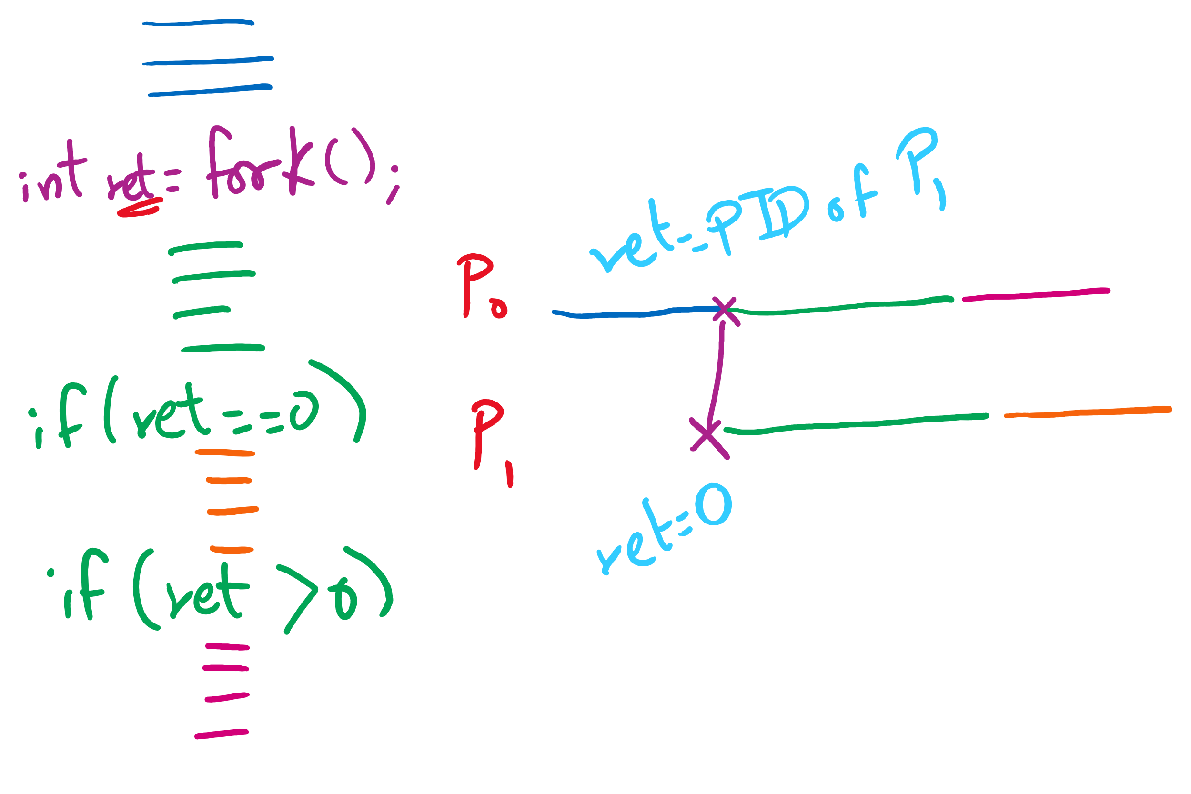
fork() tracing

Slide 5
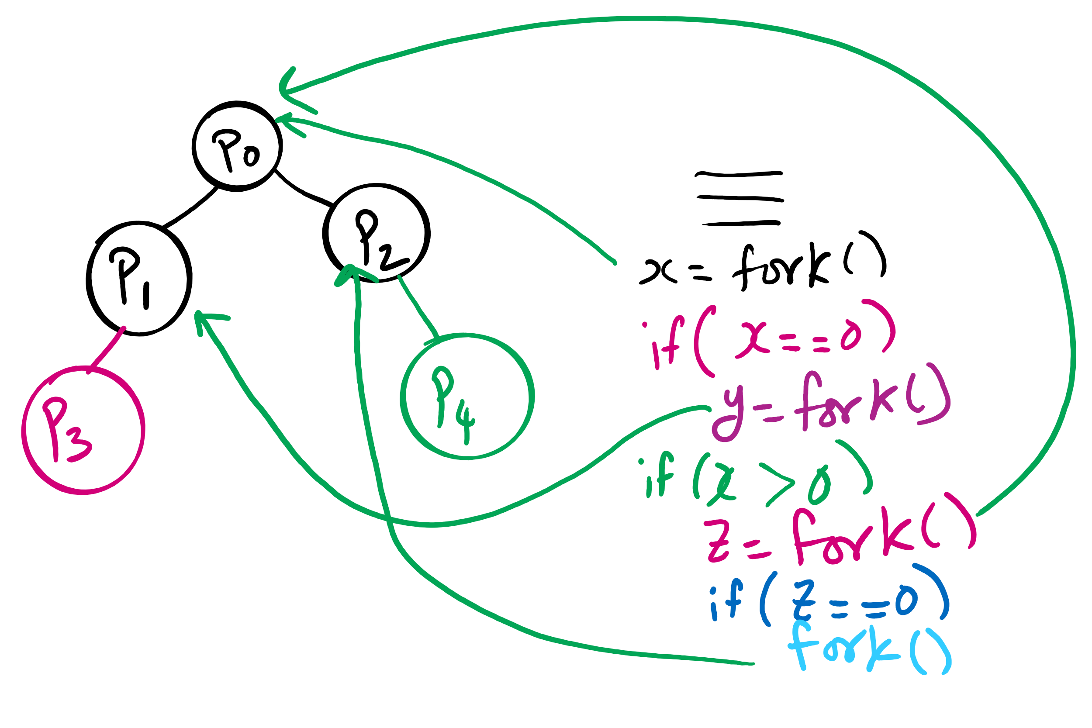
fork()’s of fork()’s

Slide 6
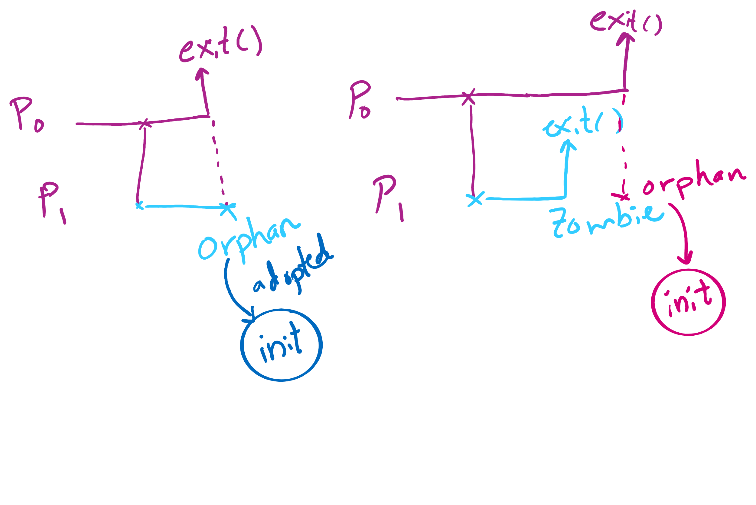
Orphan vs. Zombie Processes

Slide 7
Benefits of Orphan Processes
Allow a long-running job to continue running even after session (e.g., ssh connection) ends.
The nohup command does that
Create deamon processes
Long-running background processes adopted by the init process.

Slide 8
Xv6 Code Walkthrough
Context switching
Calling of the swtch routine
fork()
exit()
wait()

Slide 9
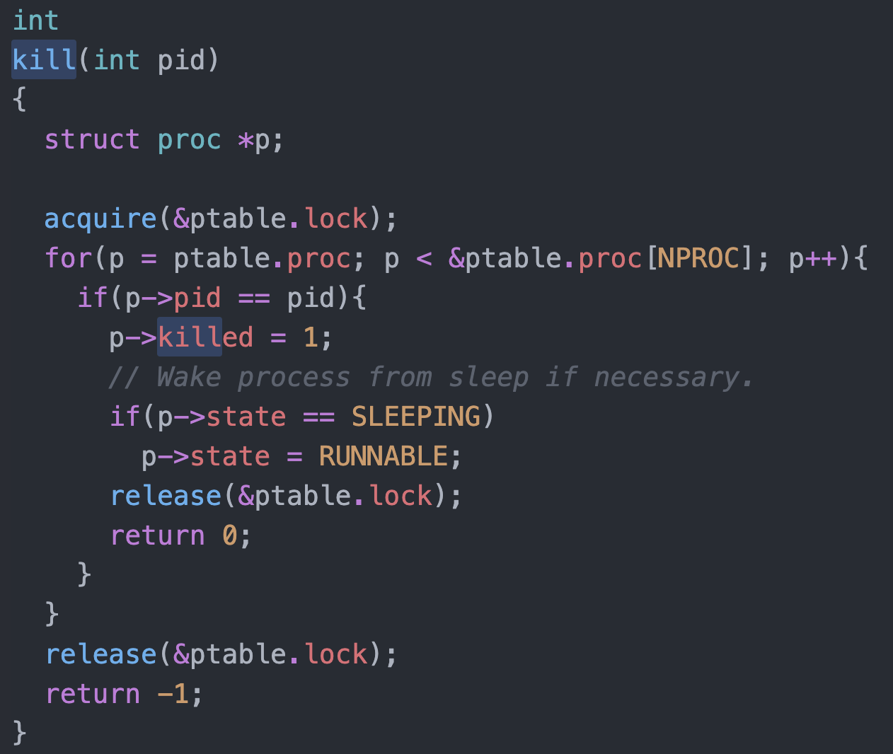
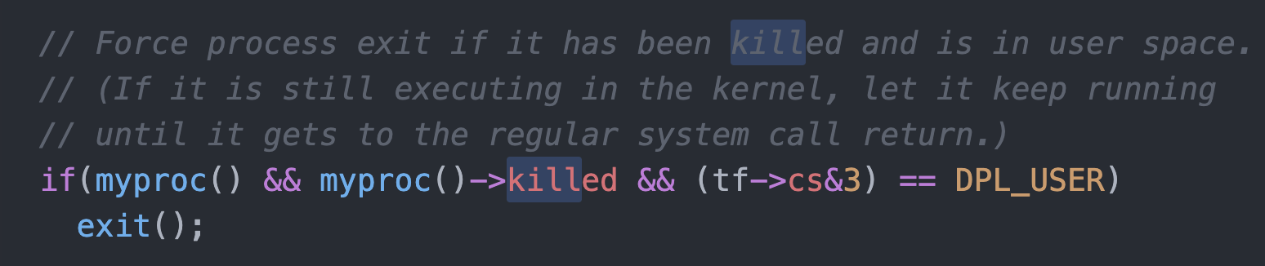
Killing a waiting process

