Slide 1

Introduction to Operating Systems CS 1550
Spring 2022
Sherif Khattab
ksm73@pitt.edu
(Some slides are from Silberschatz, Galvin and Gagne ©2013)

Slide 2
Announcements
Upcoming deadlines:
Project 2: due on 3/18
Homework 8: due on 3/21
Quiz 2: due on 3/25
Lab 3: due on 4/1

Slide 3
Previous lecture …
Memory Sharing and Protection (Take I)

Slide 4
Muddiest Points (Memory)
How the first 2 graphs on the basic memory management slide would be even useful for more than 1 process. Could you then not run more than 1 program?
How to increase CPU utilization
Why do we want to keep 100% CPU utilization when unexpected processes might arise and cause system slowdown because they increase the load on the CPU?
I/O wait and processor utilization
memory management in general devices with many programs running (laptops, tablets, etc.)
How the memory is moved around to make things look like an ideal world
Is logical address the same as virtual address?
The last slide
fixed vs variable partition
Can you have different base and limit registers for different processes?

Slide 5
Muddiest Points (misc)
will we be getting pseudo code for museum sim? it was extremely helpful for project 1

Slide 6
Problem of the Day
How can we allocate computer’s memory to multiple processes?
Using fixed-size partitions, not variable-size
what’s wrong with variable-size?
How can the OS know the size of the process’s address space?
On-demand allocation?
How can the OS load only part of a process’s address space in memory?
Why would that be useful?
How can we protect each process’s memory allocation from other processes?

Slide 7
Virtual and physical addresses
Program uses virtual addresses
Addresses local to the process
Hardware translates virtual address to physical address
Translation done by the Memory Management Unit
Usually on the same chip as the CPU
Only physical addresses leave the CPU/MMU chip
Physical memory indexed by physical addresses
CPU chip
CPU
MMU
Virtual addresses from CPU to MMU
Memory
Physical addresses on bus, in memory
Disk controller

Slide 8
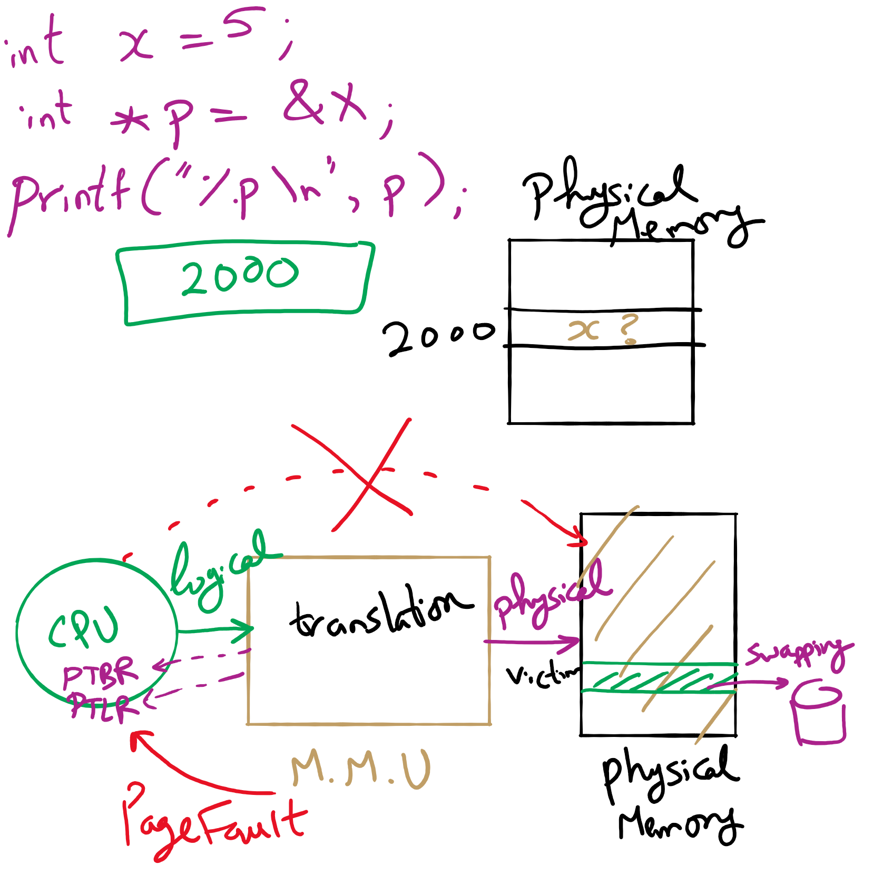
Address Translation

Slide 9
Virtual memory
Basic idea: allow the OS to hand out more memory than exists on the system
Keep recently used stuff in physical memory
Move less recently used stuff to disk
Keep all this hidden from processes
Processes still see an address space from 0 – max address
Movement of information to and from disk handled by the OS without process help
Virtual memory (VM) especially helpful in multiprogrammed system
CPU schedules process B while process A waits for its memory to be retrieved from disk

Slide 10
Paging and page tables
Virtual addresses mapped to physical addresses
Unit of mapping is called a page
All addresses in the same virtual page are in the same physical page
Page table entry (PTE) contains translation for a single page
Table translates virtual page number to physical page number
Not all virtual memory has a physical page
Not every physical page need be used
Example:
64 KB virtual memory
32 KB physical memory
60–64K
-
56–60K
-
52–56K
-
48–52K
6
-
44–48K
5
-
40–44K
-
1
36–40K
-
32–36K
-
28–32K
-
3
28–32K
24–28K
-
24–28K
20–24K
-
20–24K
16–20K
0
16–20K
-
12–16K
-
12–16K
8–12K
-
8–12K
4–8K
4
4–8K
-
0–4K
7
0–4K
-
Virtual address space
Physical memory

Slide 11
What’s in a page table entry?
Each entry in the page table contains
Valid bit: set if this logical page number has a corresponding physical frame in memory
If not valid, remainder of PTE is irrelevant
Page frame number: page in physical memory
Referenced bit: set if data on the page has been accessed
Dirty (modified) bit :set if data on the page has been modified
Protection information
Protection
D
R
V
Page frame number
Dirty bit
Referenced bit
Valid bit

Slide 12
Implementing page tables in hardware
Page table resides in main (physical) memory
CPU uses special registers for paging
Page table base register (PTBR) points to the page table
Page table length register (PTLR) contains length of page table: restricts maximum legal logical address
Translating an address requires two memory accesses
First access reads page table entry (PTE)
Second access reads the data / instruction from memory
Reduce number of memory accesses
Can’t avoid second access (we need the value from memory)
Eliminate first access by keeping a hardware cache (called a translation lookaside buffer or TLB) of recently used page table entries

Slide 13
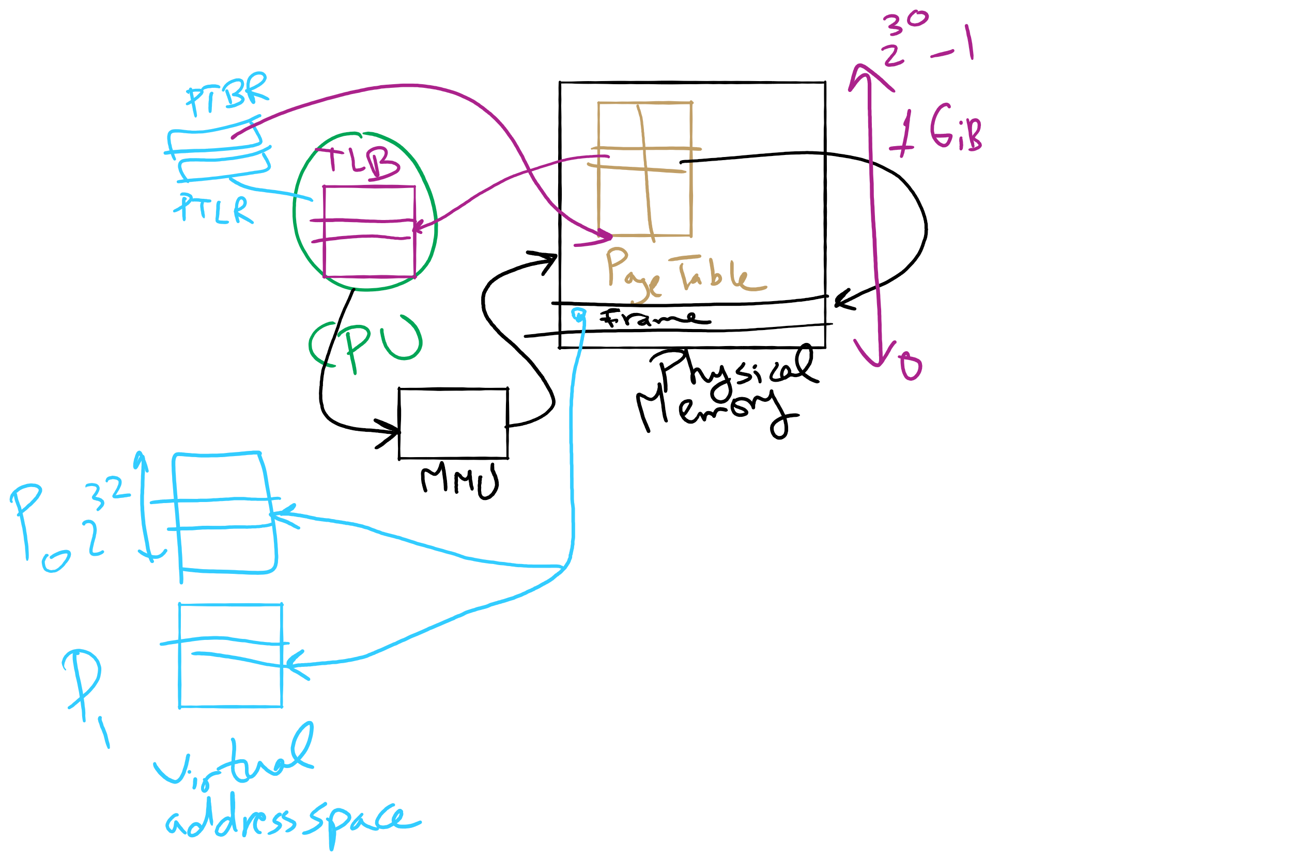
Address Translation

