Slide 1

Introduction to Operating Systems CS/COE 1550
Fall 2021
Sherif Khattab
ksm73@pitt.edu
(Some slides are from Silberschatz, Galvin and Gagne ©2013)

Slide 2
Announcements
Upcoming deadlines:
11/19: Homework 9
11/19: Project 3

Slide 3
Previous lecture …
Address Translation with conventional page tables
Address translation relations
# pages = # PTEs
# frames
Page Table size

Slide 4
Today…
What happens when the page table is too large?
2-level page tables
Inverted page table
Miscellaneous issues in Memory management

Slide 5
Muddiest Points (Address Translation)
Number of frames and the relevance of frames and how they differ from page numbers
Is it possible to go over the equations again briefly.
Confused on when to use each equation
Difference between page and frame?
two-level page tables
converting page sizes in gb to bit amounts.
numbers of bits to represent the different page table values
Slower review of all the breakdowns of address. Or just a sheet with all of them.
How are multi-level page tables used?
page table indirection
What are the differences between what you do when solving problems with a one-level page table vs a multi-level page table?

Slide 6
Muddiest Points (Page Replacement)
I'm still confused about tracing the page table and how we determine whether something is old, or a dirty bit, and when we need the disc to write something.
when to use a hash table vs an array for the project

Slide 7
Muddiest Points (Logistics)
Also, can you give a rough timeline for the rest of the assignments remaining (projects, labs, HWs, and quizzes) how many left and their rough due dates because I think we're behind 1 week on material?

Slide 8
Two-level page tables
Problem: page tables can be too large
2³² bytes in 4KB pages need 1 million PTEs
Solution: use multi-level page tables
“Page size” in first page table is large (megabytes)
PTE marked invalid in first page table needs no 2nd level page table
1st level page table has pointers to 2nd level page tables
2nd level page table has actual physical page numbers in it
. . .
220
. . .
657
. . .
. . .
401
. . .
. . .
. . .
125
613
. . .
. . .
. . .
1st level page table
961
. . .
884
960
. . .
2nd level page tables
. . .
main memory
955

Slide 9
More on two-level page tables
Tradeoffs between 1st and 2nd level page table sizes
Total number of bits indexing 1st and 2nd level table is constant for a given page size and logical address length
Tradeoff between number of bits indexing 1st and number indexing 2nd level tables
More bits in 1st level: fine granularity at 2nd level
Fewer bits in 1st level: maybe less wasted space?
All addresses in table are physical addresses
Protection bits kept in 2nd level table

Slide 10
Two-level paging: example
System characteristics
8 KB pages
32-bit logical address divided into 13 bit page offset, 19 bit page number
Page number divided into:
10 bit page number
9 bit page offset
Logical address looks like this:
p₁ is an index into the 1st level page table
p₂ is an index into the 2nd level page table pointed to by p₁
page number
page offset
p₁ = 10 bits
p₂ = 9 bits
offset = 13 bits

Slide 11
2-level address translation example
page number
page offset
p₁ = 10 bits
p₂ = 9 bits
offset = 13 bits
frame number
0
Page table base
physical address
1
0
19
13
. . .
1
. . .
0
1
p₁
. . .
. . .
. . .
p₂
main memory
1st level page table
. . .
2nd level page table

Slide 12
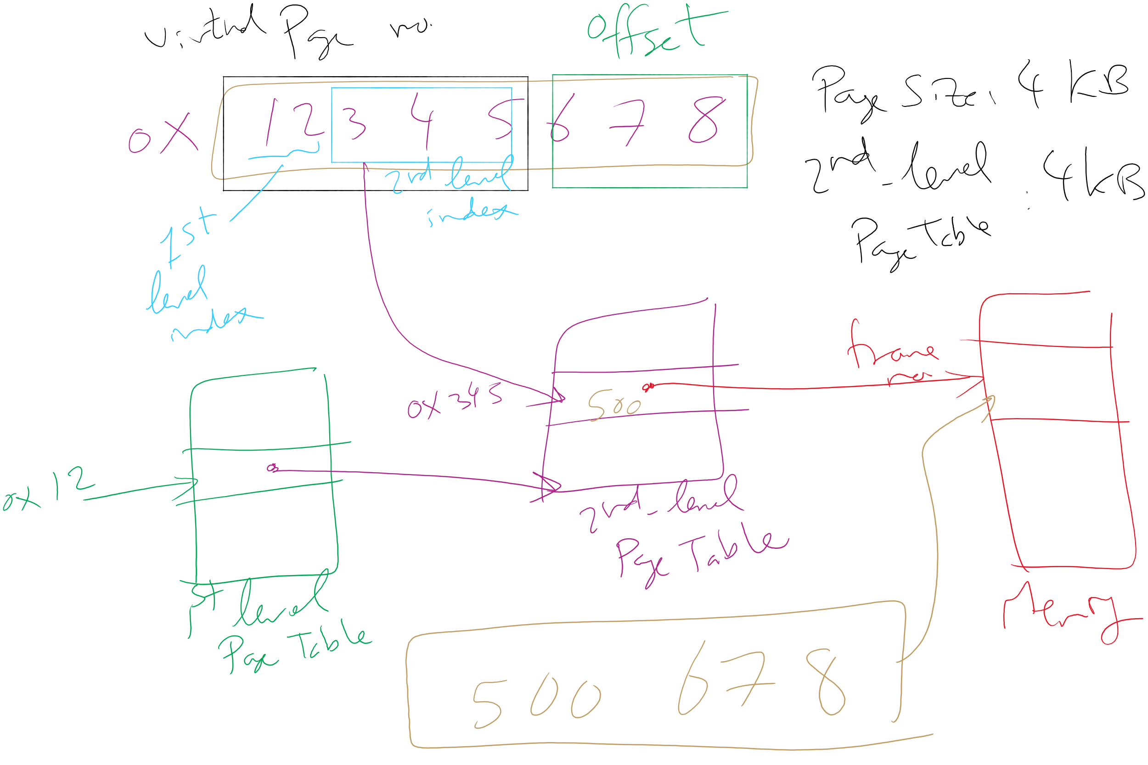
Address Translation: 2-level Page Table

Slide 13
Translation Lookaside Buffer (TLB)
Search the TLB for the desired logical page number
Search entries in parallel
Use standard cache techniques
If desired logical page number is found, get frame number from TLB
If desired logical page number isn’t found
Get frame number from page table in memory
Replace an entry in the TLB with the logical & physical page numbers from this reference
Logical page #
Physical frame #
8
3
unused
2
1
3
0
12
12
29
6
22
11
7
4
Example TLB

Slide 14
Handling TLB misses
If PTE isn’t found in TLB, OS needs to do the lookup in the page table
Lookup can be done in hardware or software
Hardware TLB replacement
CPU hardware does page table lookup
Can be faster than software
Less flexible than software, and more complex hardware
Software TLB replacement
OS gets TLB exception
Exception handler does page table lookup & places the result into the TLB
Program continues after return from exception
Larger TLB (lower miss rate) can make this feasible

Slide 15
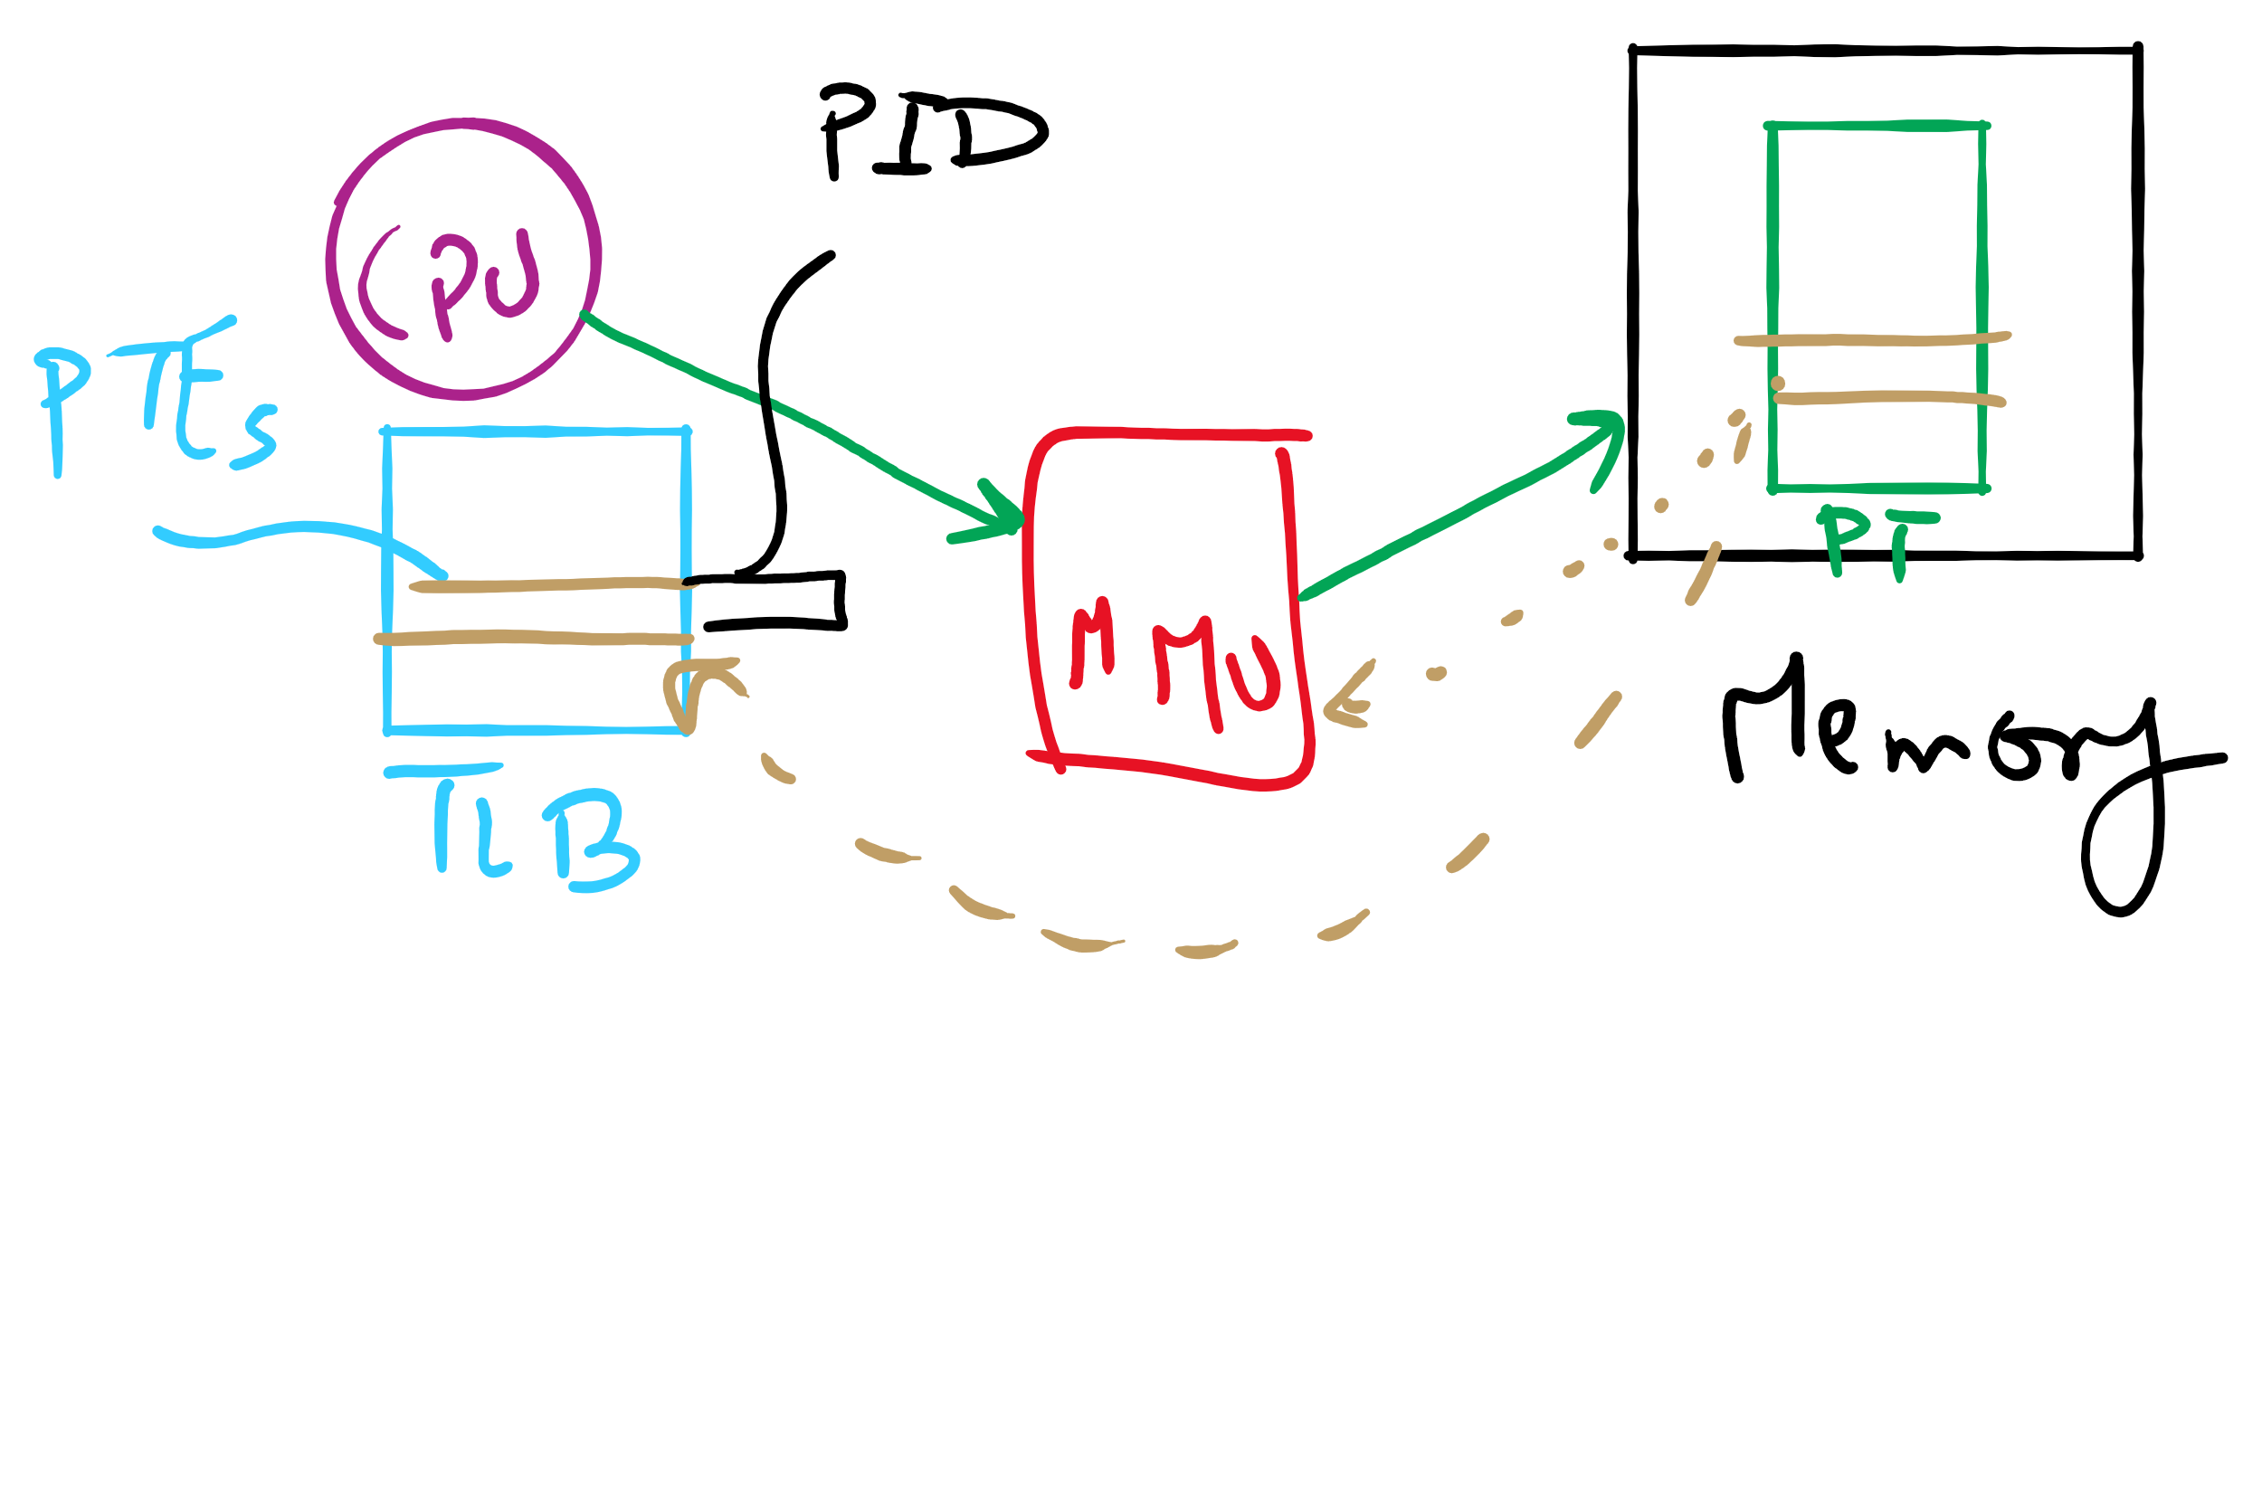
TLB

Slide 16
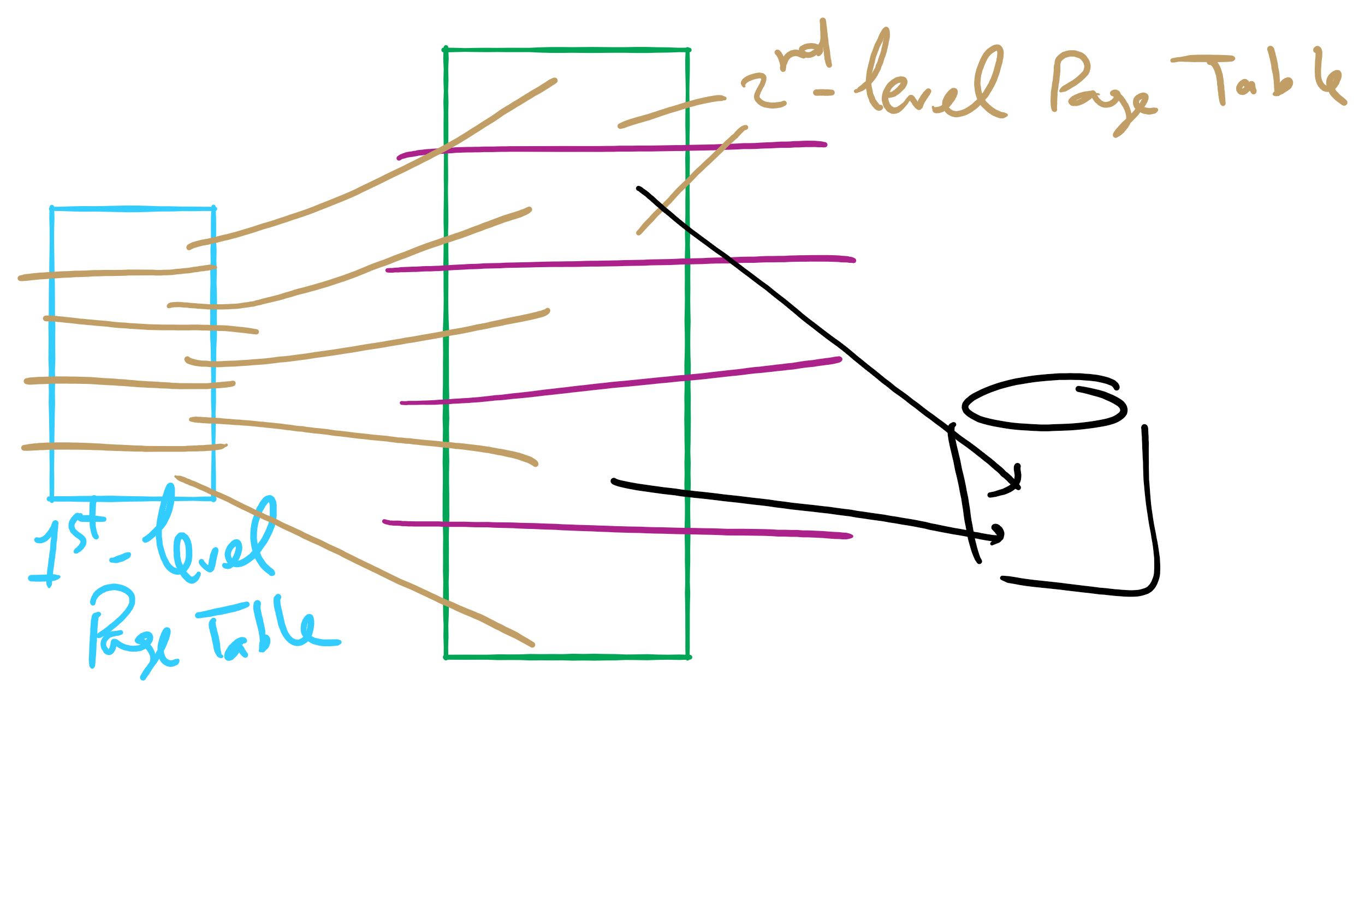
Two-level Page Table

Slide 17
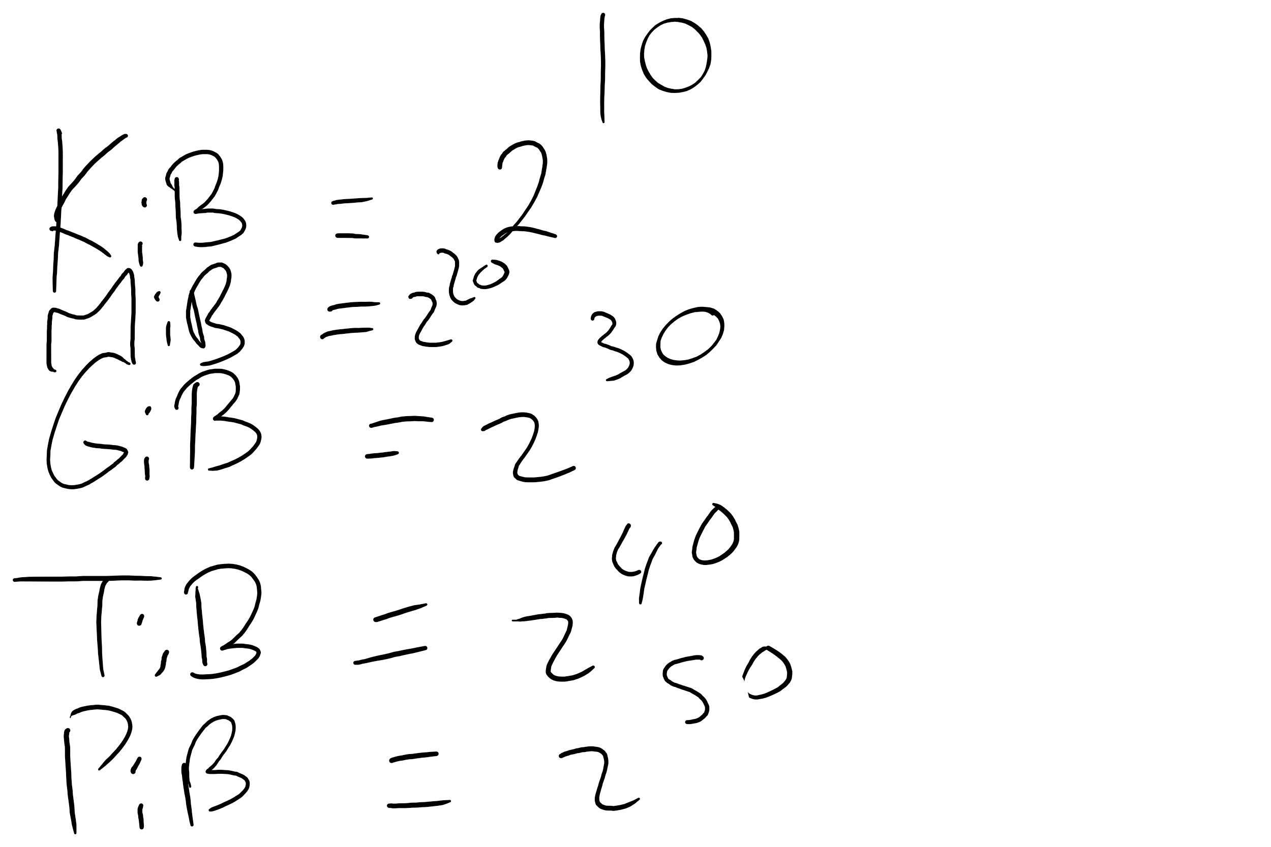
Memory Sizes

Slide 18
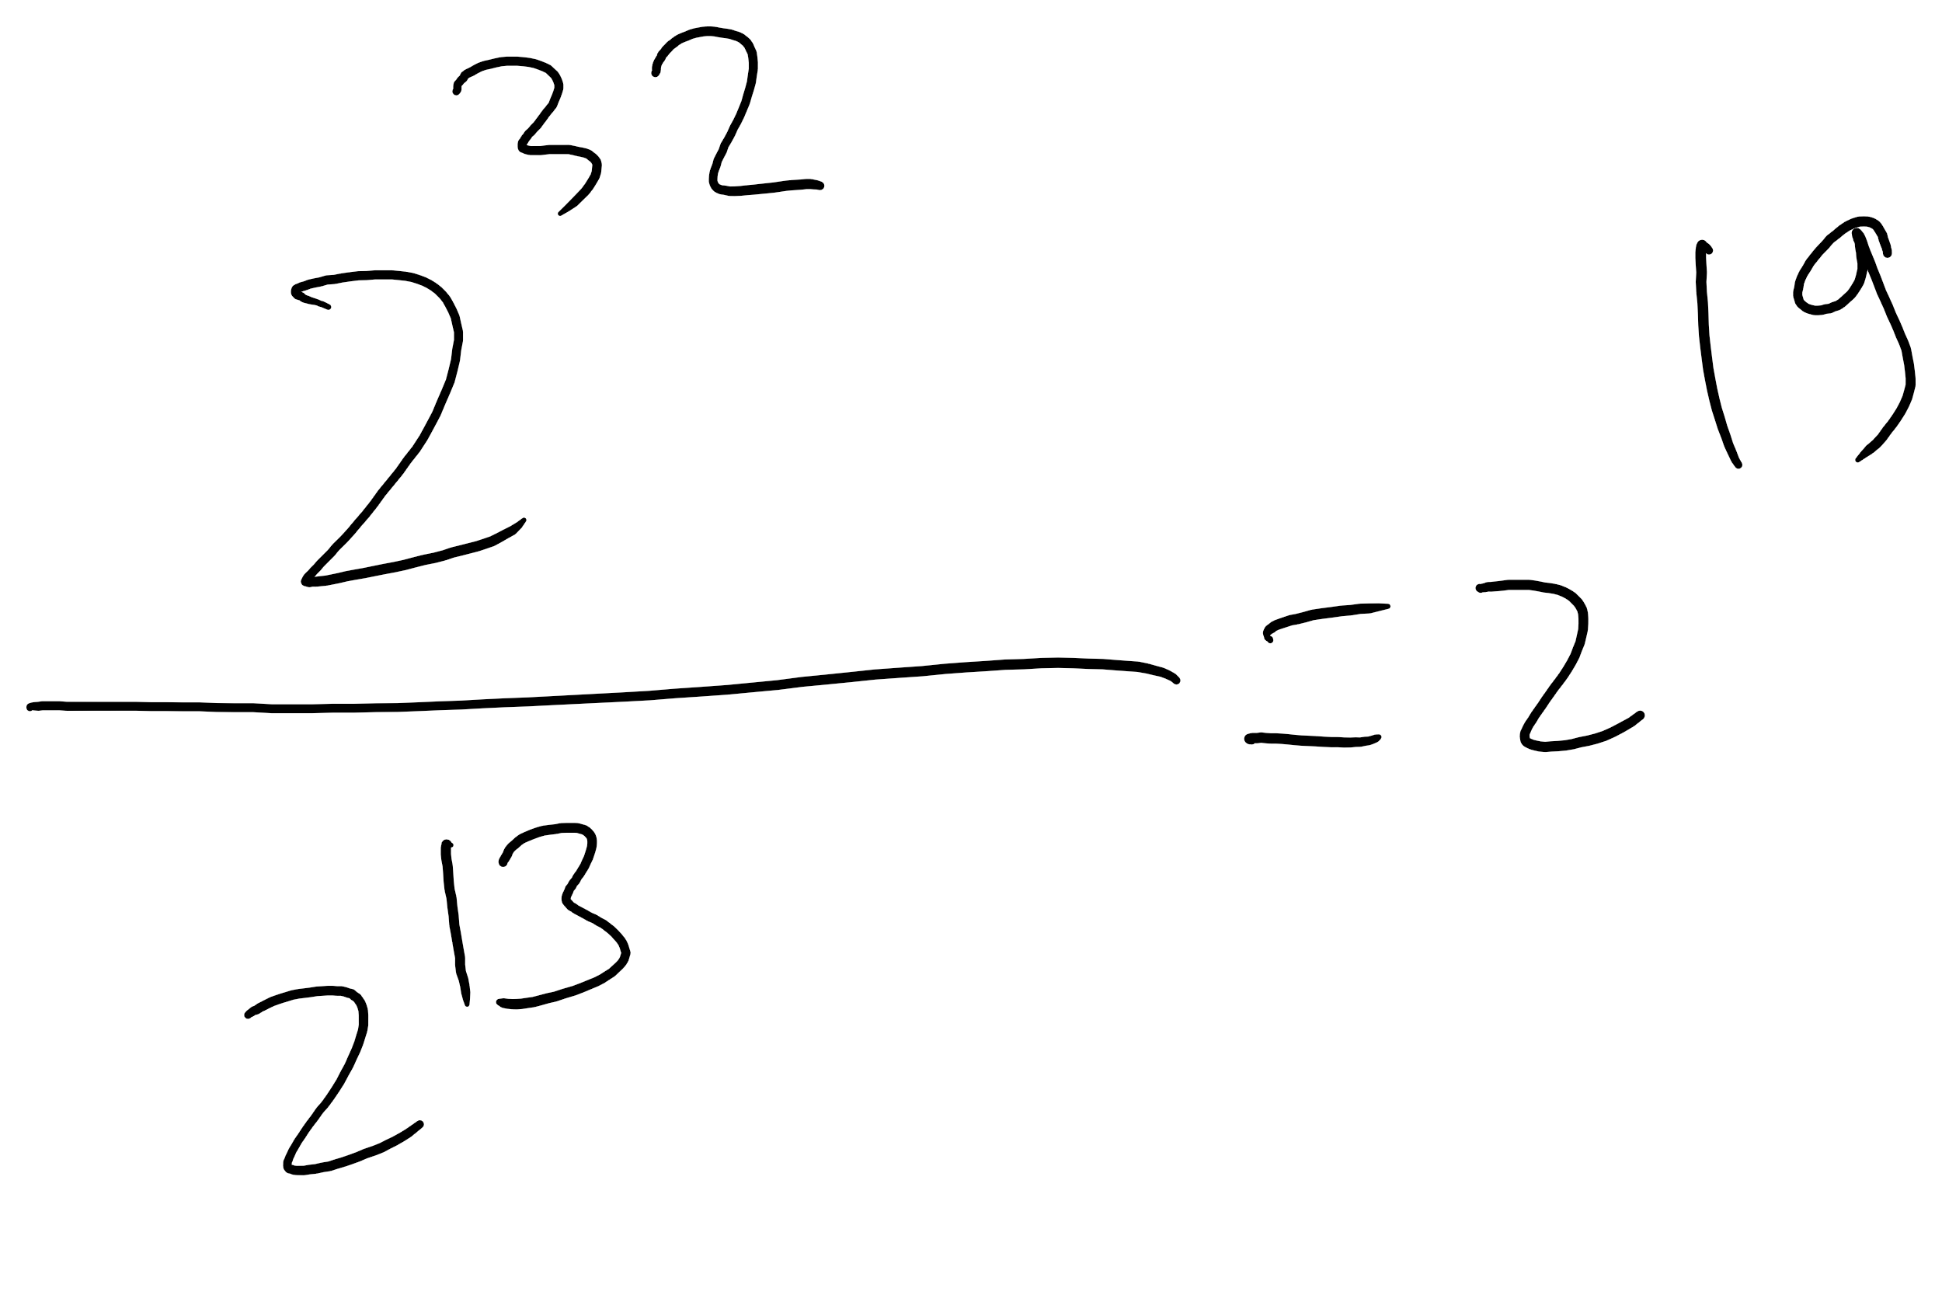
HW 8 Q 8

Slide 19
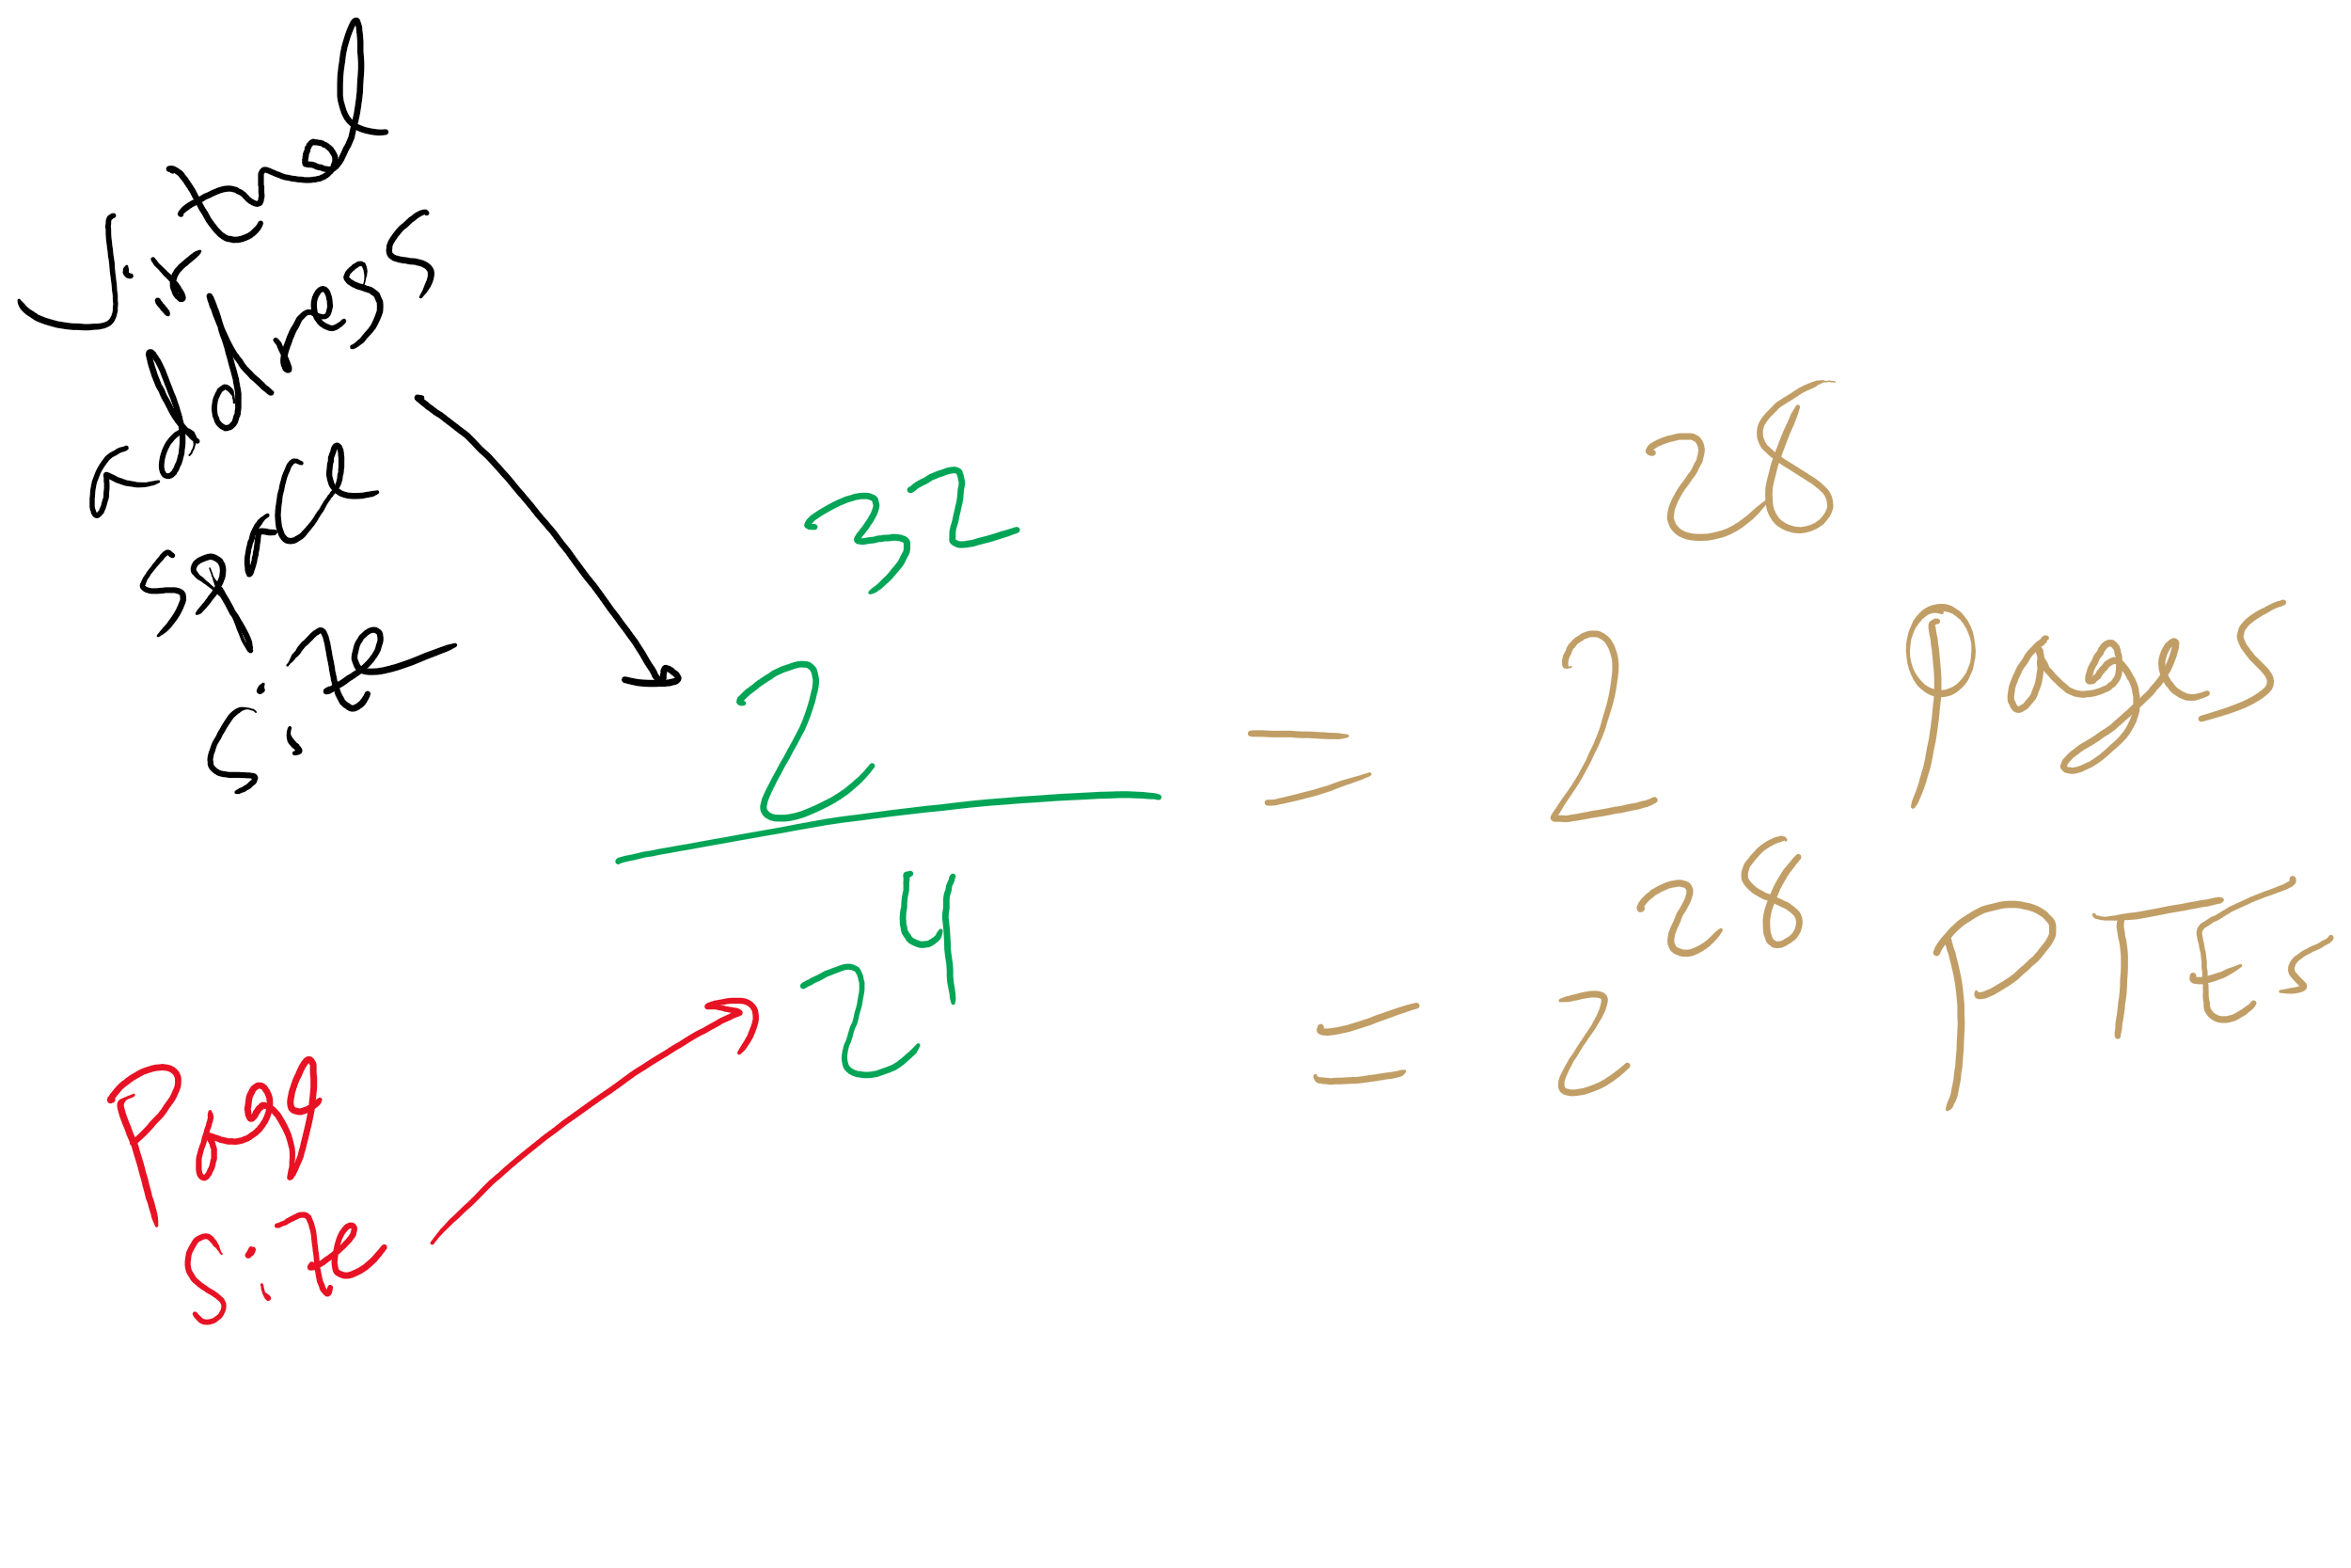
HW 8 Q11

Slide 20
How long do memory accesses take?
Assume the following times:
TLB lookup time = a (often zero - overlapped in CPU)
Memory access time = m
Hit ratio (h) is percentage of time that a logical page number is found in the TLB
Larger TLB usually means higher h
TLB structure can affect h as well
Effective access time (an average) is calculated as:
EAT = (m + a)h + (m + m + a)(1-h)
EAT =a + (2-h)m
Interpretation
Reference always requires TLB lookup, 1 memory access
TLB misses also require an additional memory reference

Slide 21
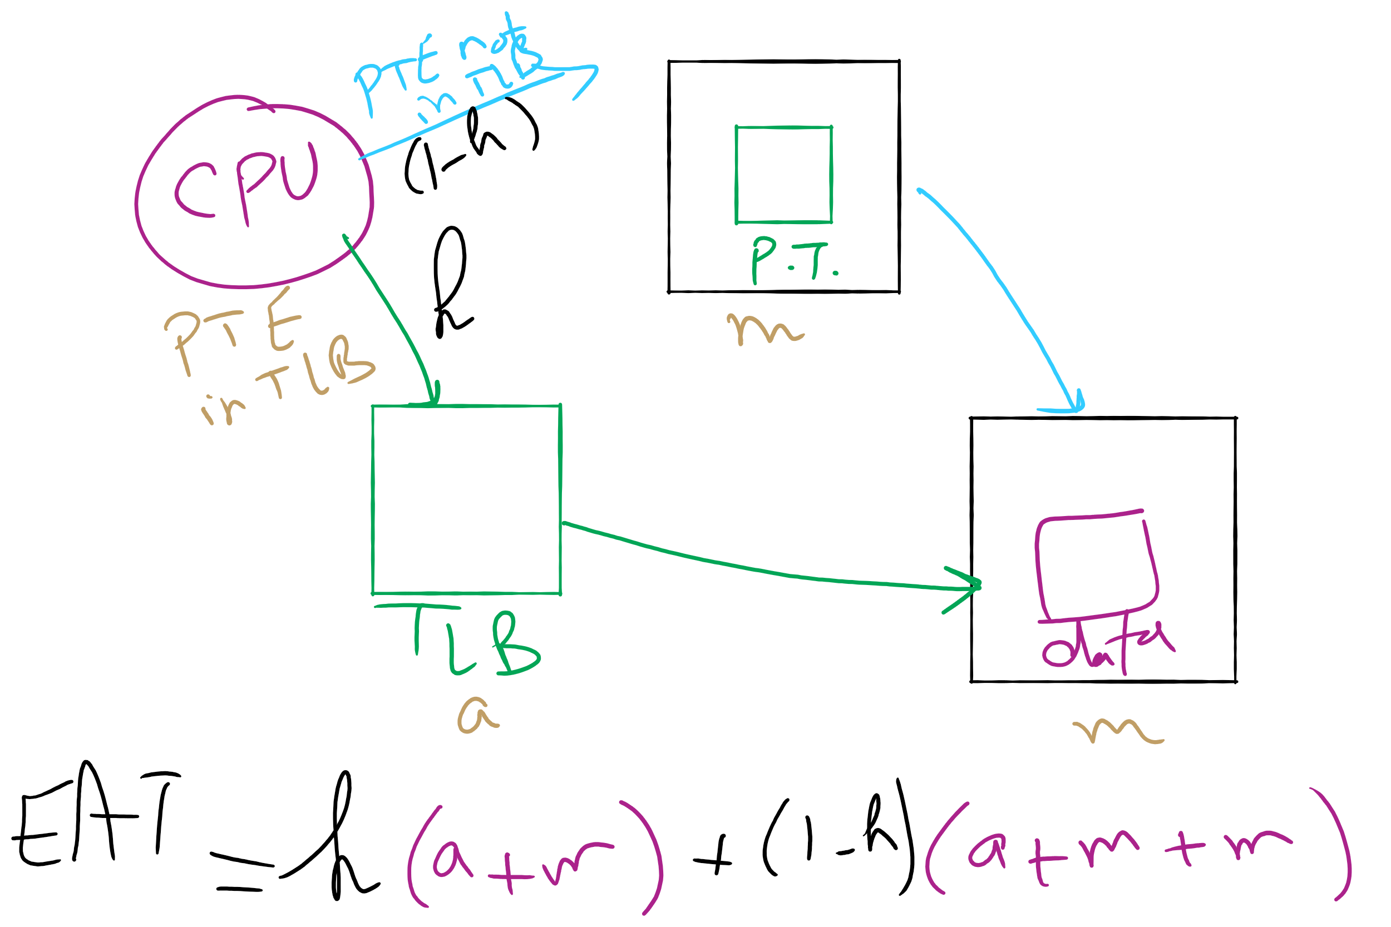
Effective Access Time

Slide 22
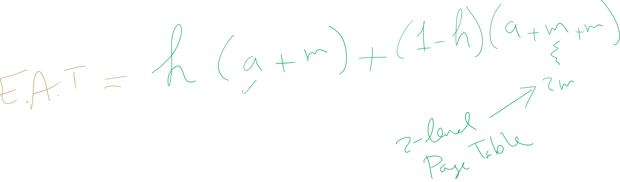
EAT Calculation

Slide 23
Inverted page table
Reduce page table size further: keep one entry for each frame in memory
PTE contains
Virtual address pointing to this frame
Information about the process that owns this page
Search page table by
Hashing the virtual page number and process ID
Starting at the entry corresponding to the hash result
Search until either the entry is found or a limit is reached
Page frame number is index of PTE
Improve performance by using more advanced hashing algorithms

Slide 24
Inverted page table architecture
page number
page offset
process ID
p = 19 bits
offset = 13 bits
Page frame number
0
pid
p
physical address
1
19
13
. . .
search
0
pid₀
p₀
1
pid₁
p₁
. . .
. . .
k
k
pid_{k}
p_{k}
main memory
. . .
inverted page table

Slide 25
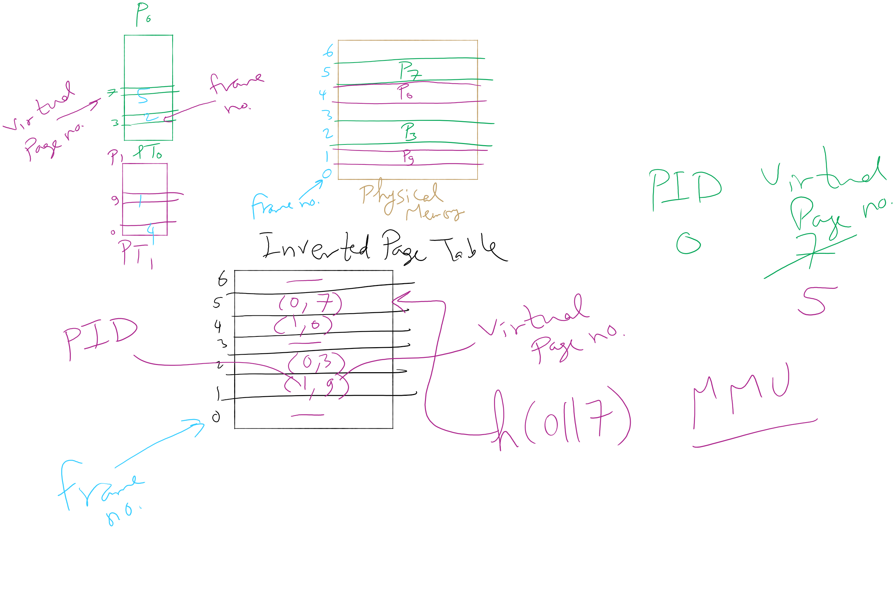
Inverted Page Table Example

Slide 26
Local vs. global allocation policies
What is the pool of pages eligible to be replaced?
Pages belonging to the process needing a new page
All pages in the system
Local allocation: replace a page from this process
May be more “fair”: penalize processes that replace many pages
Can lead to poor performance: some processes need more pages than others
Global allocation: replace a page from any process
Last access time
Page
A0
14
A1
12
Local allocation
A2
8
A3
A4
5
A4
B0
10
B1
9
Global allocation
B2
A4
3
C0
16
C1
12
C2
8
C3
5
C4
4

Slide 27
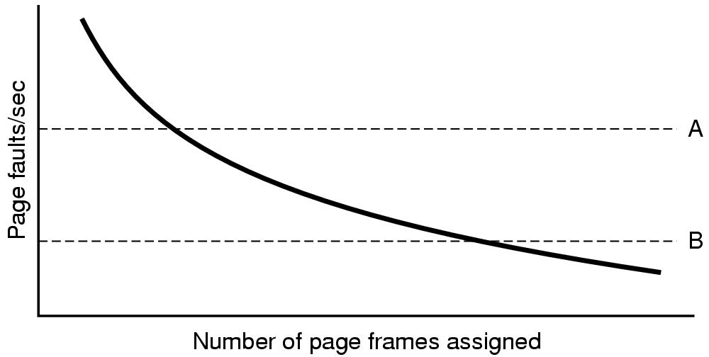
Page fault rate vs. allocated frames
Local allocation may be more “fair”
Don’t penalize other processes for high page fault rate
Global allocation is better for overall system performance
Take page frames from processes that don’t need them as much
Reduce the overall page fault rate (even though rate for a single process may go up)

Slide 28
Control overall page fault rate
Despite good designs, system may still thrash
Most (or all) processes have high page fault rate
Some processes need more memory, …
but no processes need less memory (and could give some up)
Problem: no way to reduce page fault rate
Solution : Reduce number of processes competing for memory
Swap one or more to disk, divide up pages they held
Reconsider degree of multiprogramming

Slide 29
How big should a page be?
Smaller pages have advantages
Less internal fragmentation
Better fit for various data structures, code sections
Less unused physical memory (some pages have 20 useful bytes and the rest isn’t needed currently)
Larger pages are better because
Less overhead to keep track of them
Smaller page tables
TLB can point to more memory (same number of pages, but more memory per page)
Faster paging algorithms (fewer table entries to look through)
More efficient to transfer larger pages to and from disk

Slide 30
Separate I & D address spaces
One user address space for both data & code
Simpler
Code/data separation harder to enforce
More address space?
One address space for data, another for code
Code & data separated
More complex in hardware
Less flexible
CPU must handle instructions & data differently
Instructions
Data
2³²-1
Data
Data
Code
Code
0

Slide 31
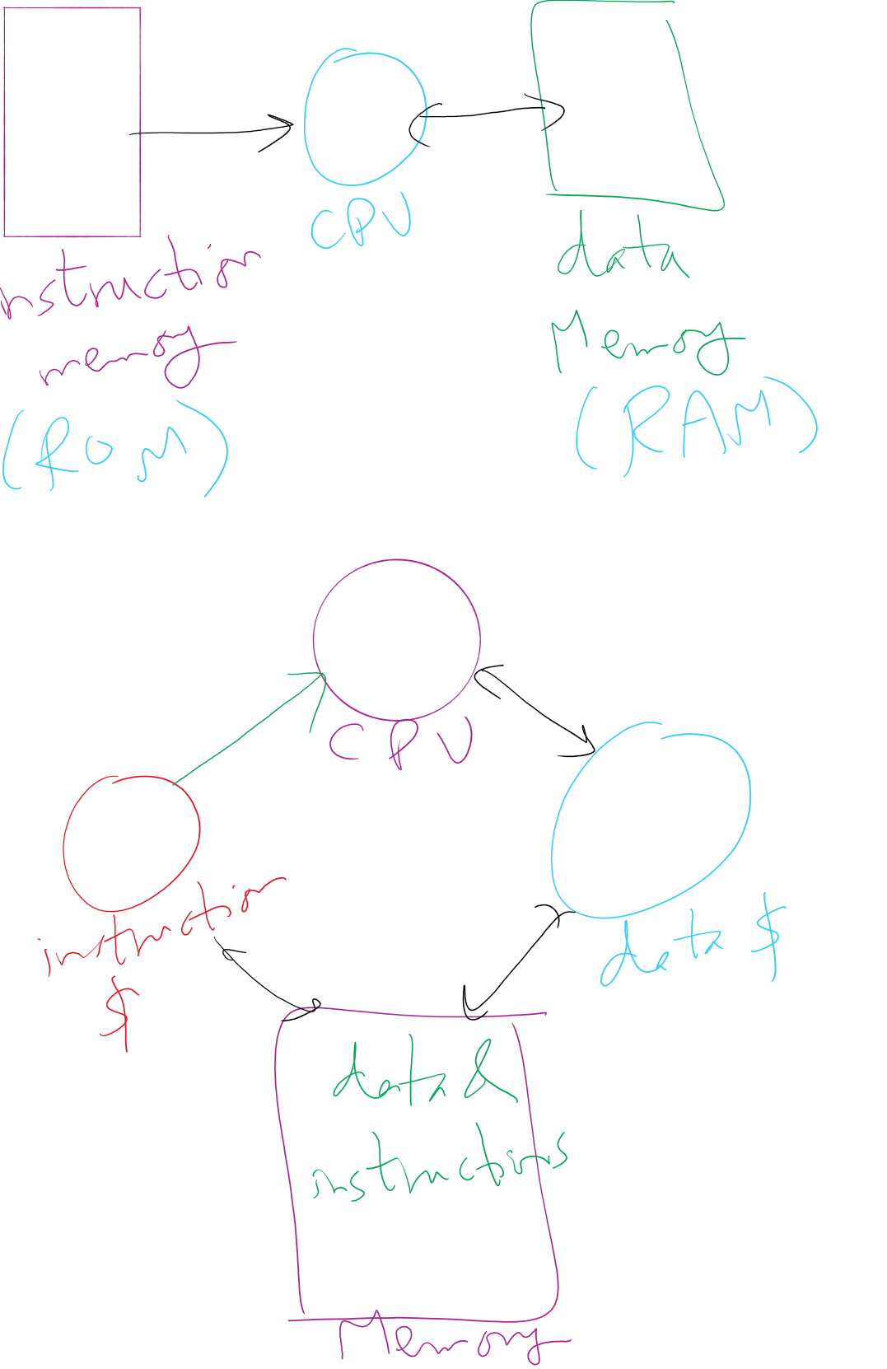
Separate I&D Address Spaces (Pure and modified)

