Slide 1

Introduction to Operating Systems CS/COE 1550
Fall 2021
Sherif Khattab
ksm73@pitt.edu
(Some slides are from Silberschatz, Galvin and Gagne ©2013)

Slide 2
Announcements
Upcoming deadlines:
11/19: Homework 9
11/19: Project 3
Bonus opportunities
Bonus homework
Post-course test
OMET bonus (response rate >= 80%)

Slide 3
Previous Lecture …
2-level and inverted page table
TLB
Effective memory access time
Miscellaneous issues
Local vs global
Controlling memory allocation using page fault rate

Slide 4
Muddiest Points (Page Tables)
Is there any reason to use a TLB on a 1-level page table?
inverted page table.
how it differs from page table/multilevel page tables. and calculating its size, is that calculation different from a normal page table?
Inverted table / associative memory
why we need them
Are inverted tables used when space is more important than speed?
comparison between methodology of conventional and inverted page tables
Multi-level page table
Where is Second and Further Level Page Tables stored?
how to implement multi level page tables
How many levels are the page tables in modern systems?

Slide 5
Muddiest Points (Other Address Translation Issues)
use of EAT equation
Changing of frames between processes
Frame allocation through thrashing
how are frames taken from one process and given to another
Thresholds for page faults/allocation
What are important differences between pure and modified separation?

Slide 6
Muddiest Points (Project 3 and logistics)
for the p3 write up - can we just pick any trace file to run all the statistics on? it is not specified
Project 3 small extension?
Not having slides ahead of time makes it difficult to follow.

Slide 7
How big should a page be?
Smaller pages have advantages
Less internal fragmentation
Better fit for various data structures, code sections
Less unused physical memory (some pages have 20 useful bytes and the rest isn’t needed currently)
Larger pages are better because
Less overhead to keep track of them
Smaller page tables
TLB can point to more memory (same number of pages, but more memory per page)
Faster paging algorithms (fewer table entries to look through)
More efficient to transfer larger pages to and from disk

Slide 8
Separate I & D address spaces
One user address space for both data & code
Simpler
Code/data separation harder to enforce
More address space?
One address space for data, another for code
Code & data separated
More complex in hardware
Less flexible
CPU must handle instructions & data differently
Instructions
Data
2³²-1
Data
Data
Code
Code
0

Slide 9
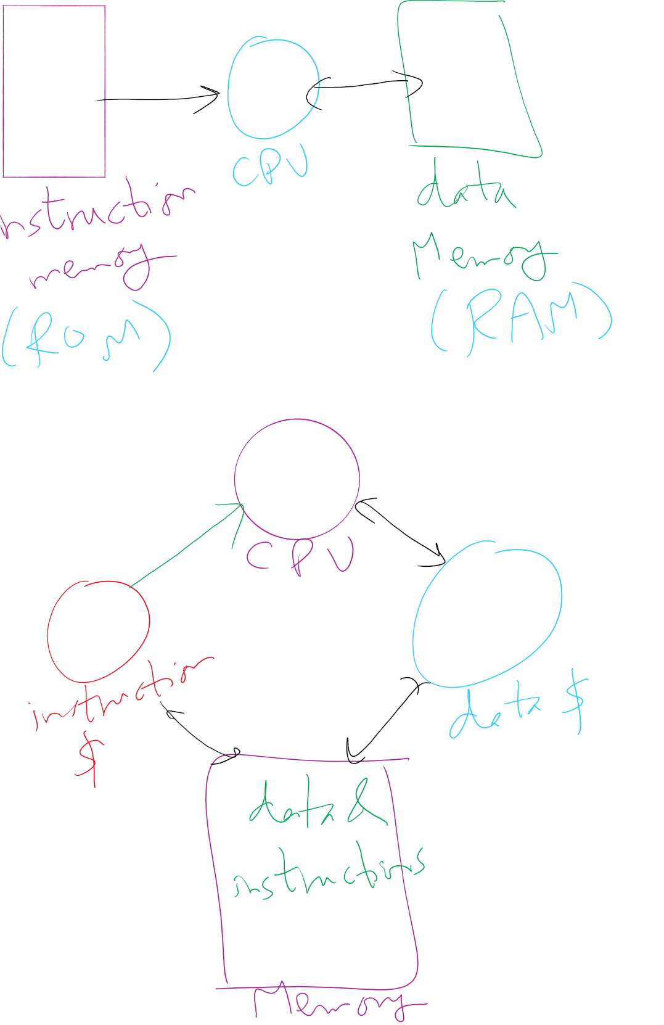
Separate I&D Address Spaces (Pure and modified)

