Slide 1


Introduction to Operating Systems CS 1550
Spring 2023
Sherif Khattab
ksm73@pitt.edu
(Some slides are from Silberschatz, Galvin and Gagne ©2013)

Slide 2
Announcements
Upcoming deadlines
Homework 2 is due this Friday at 11:59 pm
Lab 1 is due on Tuesday 2/7 at 11:59 pm
Project 1 is due on Friday 2/17 at 11:59 pm
Student Support Hours available on the syllabus page

Slide 3
Previous Lecture …
Critical Region
Using Spinlock to implement Critical Regions
Busy Waiting problem

Slide 4
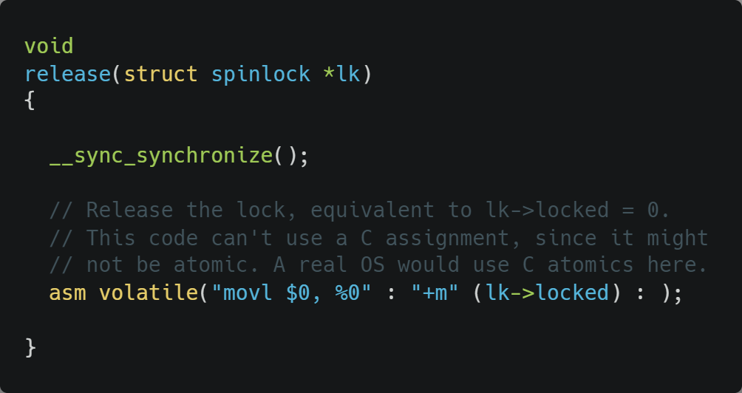
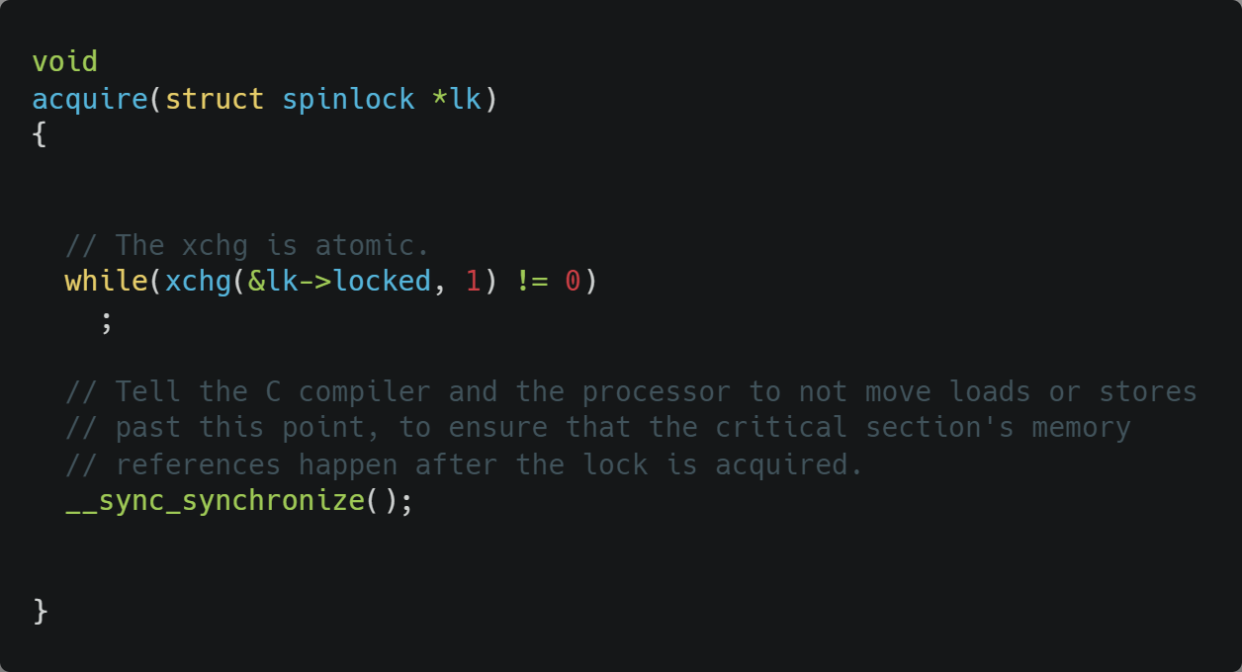
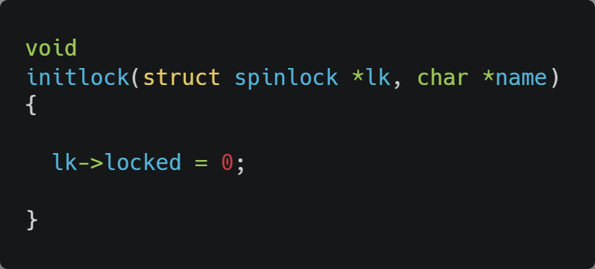
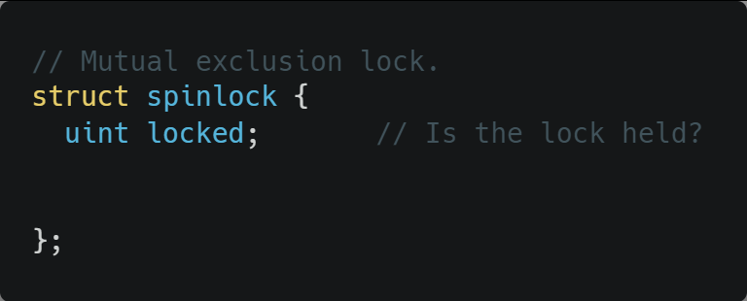
Xv6 Walkthrough of Spinlock Implementation
__sync_synchronize() is a memory barrier instruction

Slide 5
Semaphores
Solution to the Busy Waiting problem: use semaphores
Semaphores are Synchronization mechanism that doesn’t require busy waiting
Implementation
Semaphore S accessed by two atomic operations
Down(S): decrement the semaphore if > 0; block otherwise
Up(S): increment the semaphore and wakeup one blocked process if any
Down() is another name for P()
also called wait
Up() is another name for V()
also called signal

Slide 6
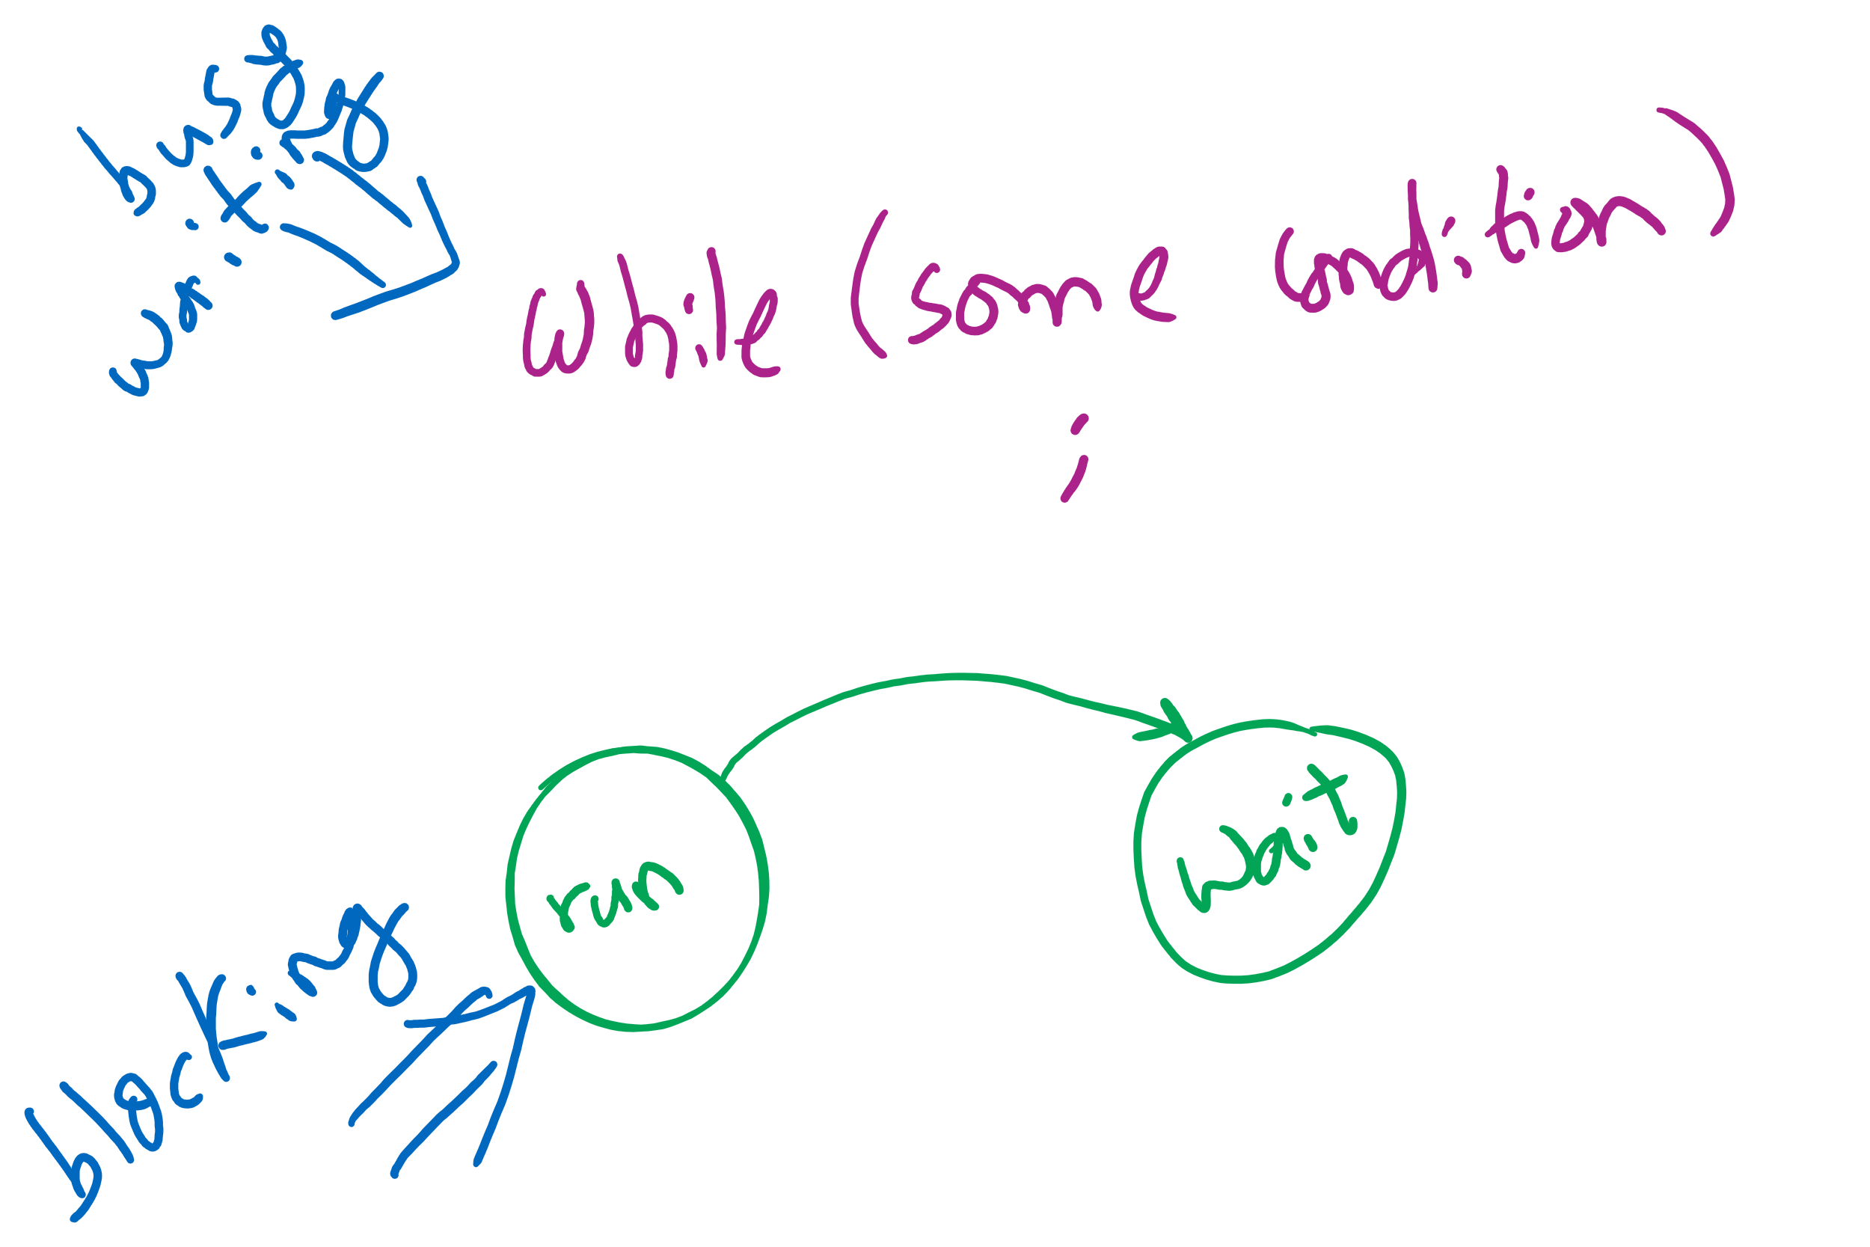
Busy waiting vs. Blocking
Blocking involves 2 context switches

Slide 7
Critical sections using semaphores
Shared variables
Semaphore sem(1);
Code for process P_{i}
while (1) {
// non-critical section
down(sem);
// critical section
up(sem);
// non-critical section
}

Slide 8
Semaphore Implementation
But how do semaphores avoid busy waiting?

Slide 9
Implementing semaphores with blocking
Assume two operations:
Sleep(): suspends current process
Wakeup(P): allows process P to resume execution
Semaphore data structure
Tracks value of semaphore
Keeps a list of processes waiting for the semaphore
down ()
{
value -= 1;
if (value < 0) {
// add this process to pl
Sleep ();
}
}
up () {
Process P;
value += 1;
if (value <= 0) {
// remove a process P
// from pl
Wakeup (P);
}
}
struct Semaphore {
int value;
ProcessList pl;
};
How to protect these shared variables??

Slide 10
Spinlocks in Semaphores
down ()
{
value -= 1;
if (value < 0) {
// add this process to pl
Sleep ();
}
}
up () {
Process P;
value += 1;
if (value <= 0) {
// remove a process P
// from pl
Wakeup (P);
}
}
struct Semaphore {
int value;
ProcessList pl;
};

Slide 11
Spinlocks are sometimes better than Semaphores
Very (very) short waiting time to enter the critical section < the 2 context switches needed for blocking
Multi-core
so that the spinlock can be unlocked while the process is busy waiting
Few contending processes for the critical section
Short critical section code

Slide 12
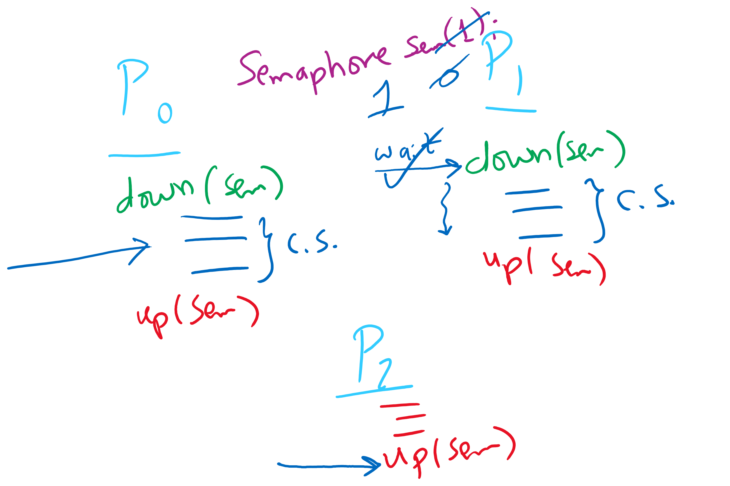
Semaphore Usage Problem: Compromising Mutual Exclusion
Any process can up() the semaphore
Solution: A Mutex can be up()’d only by the same process that down()’d it

Slide 13
Semaphore Usage Problem: Deadlock and Starvation
Deadlock: two or more processes are waiting indefinitely for an event that can only be caused by a waiting process
P0 gets A, needs B
P1 gets B, needs A
Each process waiting for the other to signal
Starvation: indefinite blocking
Process is never removed from the semaphore queue in which its suspended
May be caused by ordering in queues (priority)
Shared variables
Semaphore A(1),B(1);
Process P₀
A.down();
B.down();
.
.
.
B.up();
A.up();
Process P₁
B.down();
A.down();
.
.
.
A.up();
B.up();

Slide 14
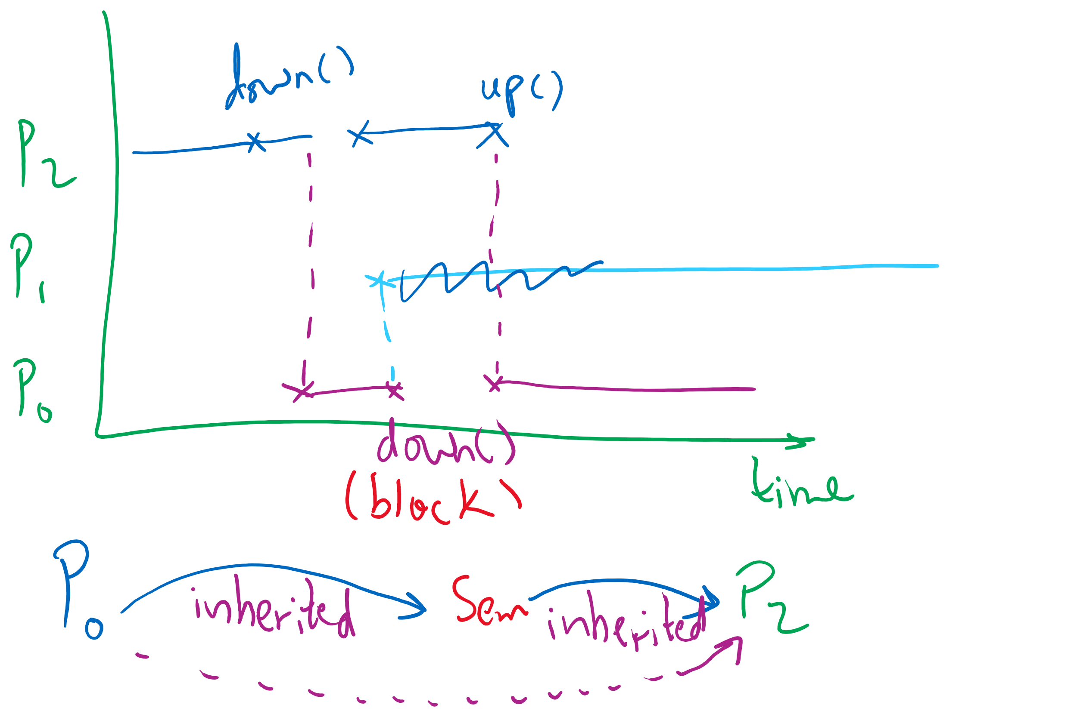
Semaphore Usage Problem: Priority Inversion
Priority inversion is still possible using semaphores
Slightly less likely
Needs at least three processes

Slide 15
Types of semaphores
Two different types of semaphores
Counting semaphores
Binary semaphores
Counting semaphore
Value can range over an unrestricted range
Binary semaphore
Only two values possible
1 means the semaphore is available
0 means a process has acquired the semaphore
May be simpler to implement
Possible to implement one type using the other

Slide 16
Question
How are processes created, maintained, and terminated?

Slide 17
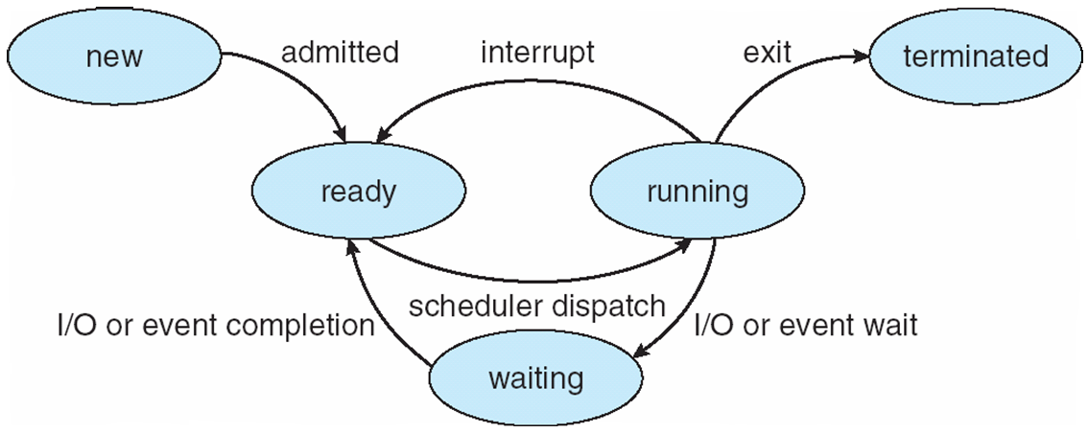
Process Lifecycle (AKA Process States)

Slide 18
Process Creation
Via fork() syscall
Parent process: the process that calls fork()
Child process: the process that gets created
Child process has a new context
new PCB

Slide 19
Process Creation
Memory of parent process copied to child process
Too much copying
Even not necessary sometimes
e.g., fork() followed by exec() to run a different program
Optimization trick:
copy-on-write
copy when any of the two processes writes into its memory
copy the affected memory “part” only
How would the OS know when a process writes to its memory?

Slide 20
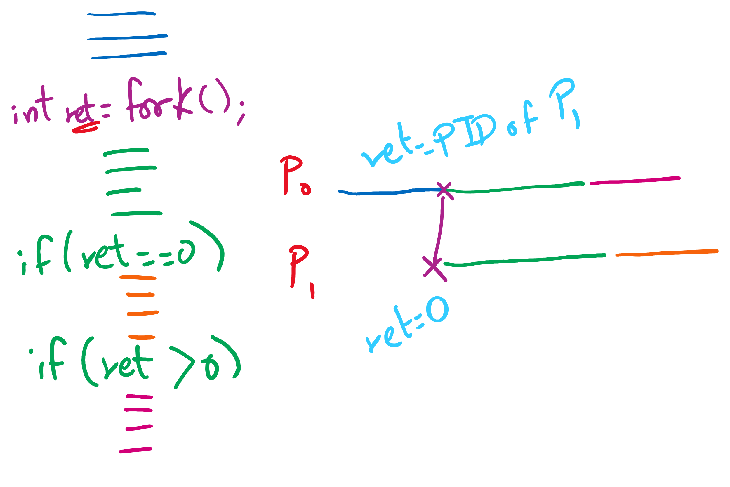
fork() tracing

Slide 21
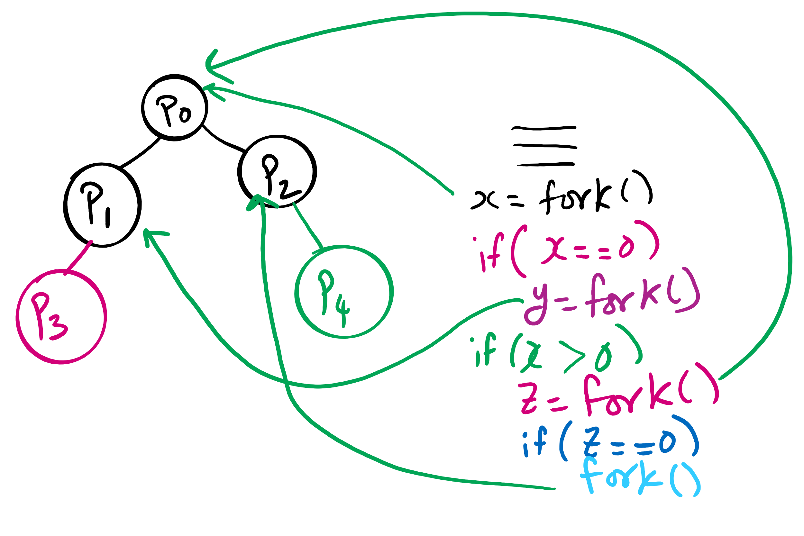
fork()’s of fork()’s

Slide 22
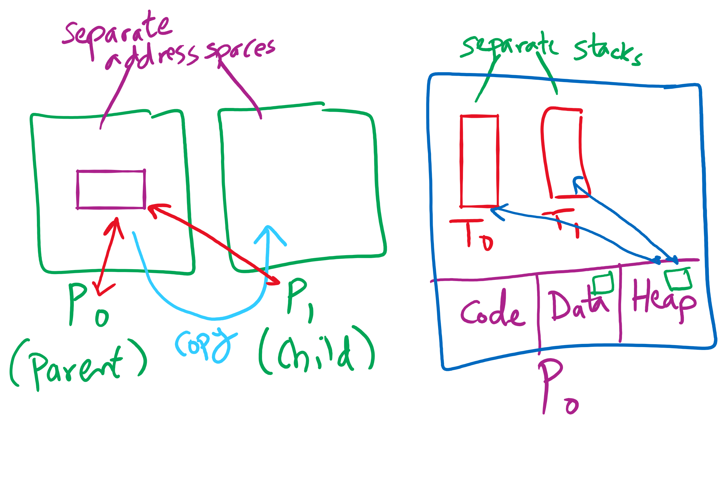
Process vs. Thread

