Slide 1


Introduction to Operating Systems CS 1550
Spring 2023
Sherif Khattab
ksm73@pitt.edu
(Some slides are from Silberschatz, Galvin and Gagne ©2013)

Slide 2
Announcements
Upcoming deadlines
Homework 7 is due this Friday
Quiz 1 and Lab 2 due on Tuesday 2/28 at 11:59 pm
Project 2 is due Friday 3/17 at 11:59 pm
Talk by candidate faculty
This Wednesday 3/15 @ 10 am at 5317 Sennott Square
Donuts will be served!

Slide 3
Last Lecture …
How to implement Condition Variables and Locks using semaphores
CPU scheduling
SJF
Priority
RR

Slide 4
Today …
CPU scheduling
Multi-Level Feedback Queues
CPU burst estimation
Memory

Slide 5
Multilevel Feedback Scheduling
Preemptive scheduling with dynamic priorities
N ready to execute queues with decreasing priorities:
P(RQ₀) > P(RQ₁) > ... > P(RQ_{N-1})
Dispatcher selects a process for execution from RQ_{i} only if RQ_{i-1} to RQ₀ are empty

Slide 6
Multilevel Feedback Scheduling
New process are placed in RQ₀
After the first quantum, they are moved to RQ₁, and to RQ₂ after the second quantum, … and to RQ_{N-1} after the Nth quantum
I/O-bound processes remain in higher priority queues.
CPU-bound jobs drift downward.
Hence, long jobs may starve

Slide 7
Multiple Feedback Queues
Different RQs may have different quantum values

Slide 8
Time Quantum for feedback Scheduling
With a fixed quantum time, the turn-around time of longer processes can be high
To alleviate this problem, the time quantum can be increased based on the depth of the queue
Time quantum of RQ_{i} = 2^{i-1}
May still cause longer processes to suffer starvation.
Possible fix is to promote a process to higher queue after some time
Process
Arrival Time
Service Time
1
0
3
2
2
6
3
4
4
4
6
5
5
8
2

Slide 9

Time Quantum for feedback Scheduling
With a fixed quantum time, the turn-around time of longer processes can be high
To alleviate this problem, the time quantum can be increased based on the depth of the queue
Time quantum of RQ_{i} = 2^{i-1}
May still cause longer processes to suffer starvation.
Possible fix is to promote a process to higher queue after some time
Process
Arrival Time
Service Time
1
0
3
2
2
6
3
4
4
4
6
5
5
8
2

Slide 10

Time Quantum for feedback Scheduling
With a fixed quantum time, the turn-around time of longer processes can be high
To alleviate this problem, the time quantum can be increased based on the depth of the queue
Time quantum of RQ_{i} = 2^{i-1}
May still cause longer processes to suffer starvation.
Possible fix is to promote a process to higher queue after some time
Process
Arrival Time
Service Time
1
0
3
2
2
6
3
4
4
4
6
5
5
8
2

Slide 11

Time Quantum for feedback Scheduling
With a fixed quantum time, the turn-around time of longer processes can be high
To alleviate this problem, the time quantum can be increased based on the depth of the queue
Time quantum of RQ_{i} = 2^{i-1}
May still cause longer processes to suffer starvation.
Possible fix is to promote a process to higher queue after some time
Process
Arrival Time
Service Time
1
0
3
2
2
6
3
4
4
4
6
5
5
8
2

Slide 12

Time Quantum for feedback Scheduling
With a fixed quantum time, the turn-around time of longer processes can be high
To alleviate this problem, the time quantum can be increased based on the depth of the queue
Time quantum of RQ_{i} = 2^{i-1}
May still cause longer processes to suffer starvation.
Possible fix is to promote a process to higher queue after some time
Process
Arrival Time
Service Time
1
0
3
2
2
6
3
4
4
4
6
5
5
8
2

Slide 13

Time Quantum for feedback Scheduling
With a fixed quantum time, the turn-around time of longer processes can be high
To alleviate this problem, the time quantum can be increased based on the depth of the queue
Time quantum of RQ_{i} = 2^{i-1}
May still cause longer processes to suffer starvation.
Possible fix is to promote a process to higher queue after some time
Process
Arrival Time
Service Time
1
0
3
2
2
6
3
4
4
4
6
5
5
8
2

Slide 14


Time Quantum for feedback Scheduling
With a fixed quantum time, the turn-around time of longer processes can be high
To alleviate this problem, the time quantum can be increased based on the depth of the queue
Time quantum of RQ_{i} = 2^{i-1}
May still cause longer processes to suffer starvation.
Possible fix is to promote a process to higher queue after some time
Process
Arrival Time
Service Time
1
0
3
2
2
6
3
4
4
4
6
5
5
8
2

Slide 15


Time Quantum for feedback Scheduling
With a fixed quantum time, the turn-around time of longer processes can be high
To alleviate this problem, the time quantum can be increased based on the depth of the queue
Time quantum of RQ_{i} = 2^{i-1}
May still cause longer processes to suffer starvation.
Possible fix is to promote a process to higher queue after some time
Process
Arrival Time
Service Time
1
0
3
2
2
6
3
4
4
4
6
5
5
8
2

Slide 16

Time Quantum for feedback Scheduling
With a fixed quantum time, the turn-around time of longer processes can be high
To alleviate this problem, the time quantum can be increased based on the depth of the queue
Time quantum of RQ_{i} = 2^{i-1}
May still cause longer processes to suffer starvation.
Possible fix is to promote a process to higher queue after some time
Process
Arrival Time
Service Time
1
0
3
2
2
6
3
4
4
4
6
5
5
8
2

Slide 17

Time Quantum for feedback Scheduling
With a fixed quantum time, the turn-around time of longer processes can be high
To alleviate this problem, the time quantum can be increased based on the depth of the queue
Time quantum of RQ_{i} = 2^{i-1}
May still cause longer processes to suffer starvation.
Possible fix is to promote a process to higher queue after some time
Process
Arrival Time
Service Time
1
0
3
2
2
6
3
4
4
4
6
5
5
8
2

Slide 18

Time Quantum for feedback Scheduling
With a fixed quantum time, the turn-around time of longer processes can be high
To alleviate this problem, the time quantum can be increased based on the depth of the queue
Time quantum of RQ_{i} = 2^{i-1}
May still cause longer processes to suffer starvation.
Possible fix is to promote a process to higher queue after some time
Process
Arrival Time
Service Time
1
0
3
2
2
6
3
4
4
4
6
5
5
8
2

Slide 19

Time Quantum for feedback Scheduling
With a fixed quantum time, the turn-around time of longer processes can be high
To alleviate this problem, the time quantum can be increased based on the depth of the queue
Time quantum of RQ_{i} = 2^{i-1}
May still cause longer processes to suffer starvation.
Possible fix is to promote a process to higher queue after some time
Process
Arrival Time
Service Time
1
0
3
2
2
6
3
4
4
4
6
5
5
8
2

Slide 20

Time Quantum for feedback Scheduling
With a fixed quantum time, the turn-around time of longer processes can be high
To alleviate this problem, the time quantum can be increased based on the depth of the queue
Time quantum of RQ_{i} = 2^{i-1}
May still cause longer processes to suffer starvation.
Possible fix is to promote a process to higher queue after some time
Process
Arrival Time
Service Time
1
0
3
2
2
6
3
4
4
4
6
5
5
8
2

Slide 21

Time Quantum for feedback Scheduling
With a fixed quantum time, the turn-around time of longer processes can be high
To alleviate this problem, the time quantum can be increased based on the depth of the queue
Time quantum of RQ_{i} = 2^{i-1}
May still cause longer processes to suffer starvation.
Possible fix is to promote a process to higher queue after some time
Process
Arrival Time
Service Time
1
0
3
2
2
6
3
4
4
4
6
5
5
8
2

Slide 22
Algorithm Comparison
Which one is the best?
The answer depends on many factors:
the system workload (extremely variable)
hardware support for the dispatcher
relative importance of performance criteria (response time, CPU utilization, throughput...)
The evaluation method used (each has its limitations...)

Slide 23
Back to SJF: CPU Burst Estimation
Let T[i] be the execution time for the ith instance of this process: the actual duration of the ith CPU burst of this process
Let S[i] be the predicted value for the ith CPU burst of this process. The simplest choice is:
S[n+1] =(1/n)(T[1]+…+T[n])=(1/n) Σ{i=1 to n} T[i]
This can be more efficiently calculated as:
S[n+1] = (1/n) T[n] + ((n-1)/n) S[n]
This estimate, however, results in equal weight for each instance

Slide 24
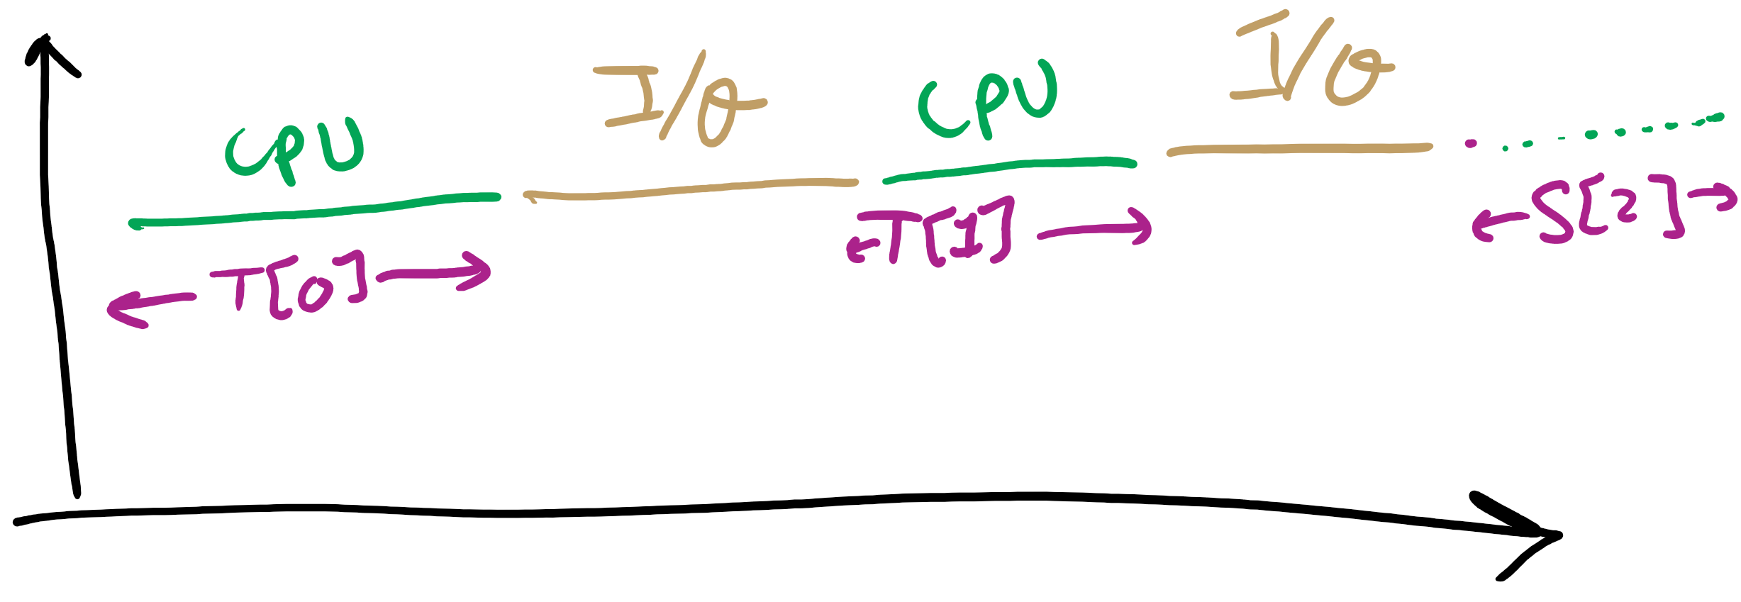
CPU Burst Estimation

Slide 25
Estimating the required CPU burst
Recent instances are more likely to better reflect future behavior
A common technique to factor the above observation into the estimate is to use exponential averaging :
S[n+1] = α T[n] + (1- α) S[n] ; 0 < α < 1

Slide 26
CPU burst Estimate (Exponential Average)
Recent instances have higher weights, whenever α > 1/n
Expanding the estimated value shows that the weights of past instances decrease exponentially
S[n+1] = α T[n] + (1- α) α T[n-1] + ... (1- α)^{i} α T[n-i] +
... + (1- α)^{n}S[1]
The predicted value of 1st instance, S[1], is usually set to 0 to give priority to new processes

Slide 27
Exponentially Decreasing Coefficients

Slide 28
Exponentially Decreasing Coefficients
S[1] = 0 to give high priority to new processes
Exponential averaging tracks changes in process behavior much faster than simple averaging

Slide 29
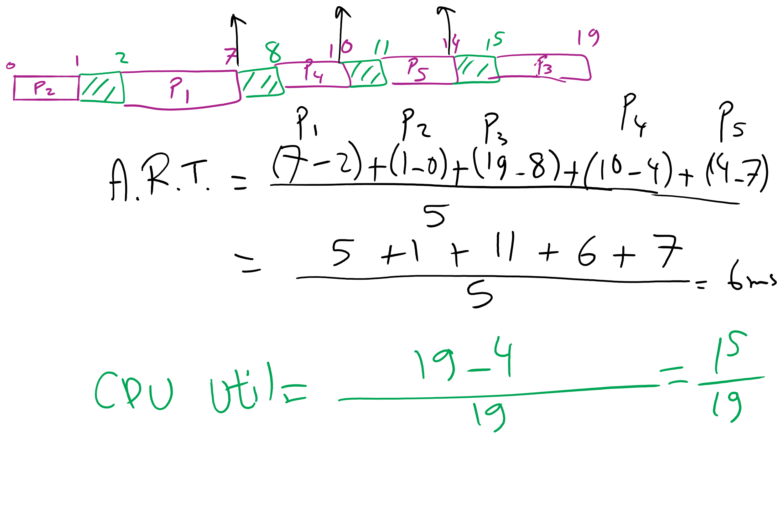
FCFS Problem in HW7

Slide 30
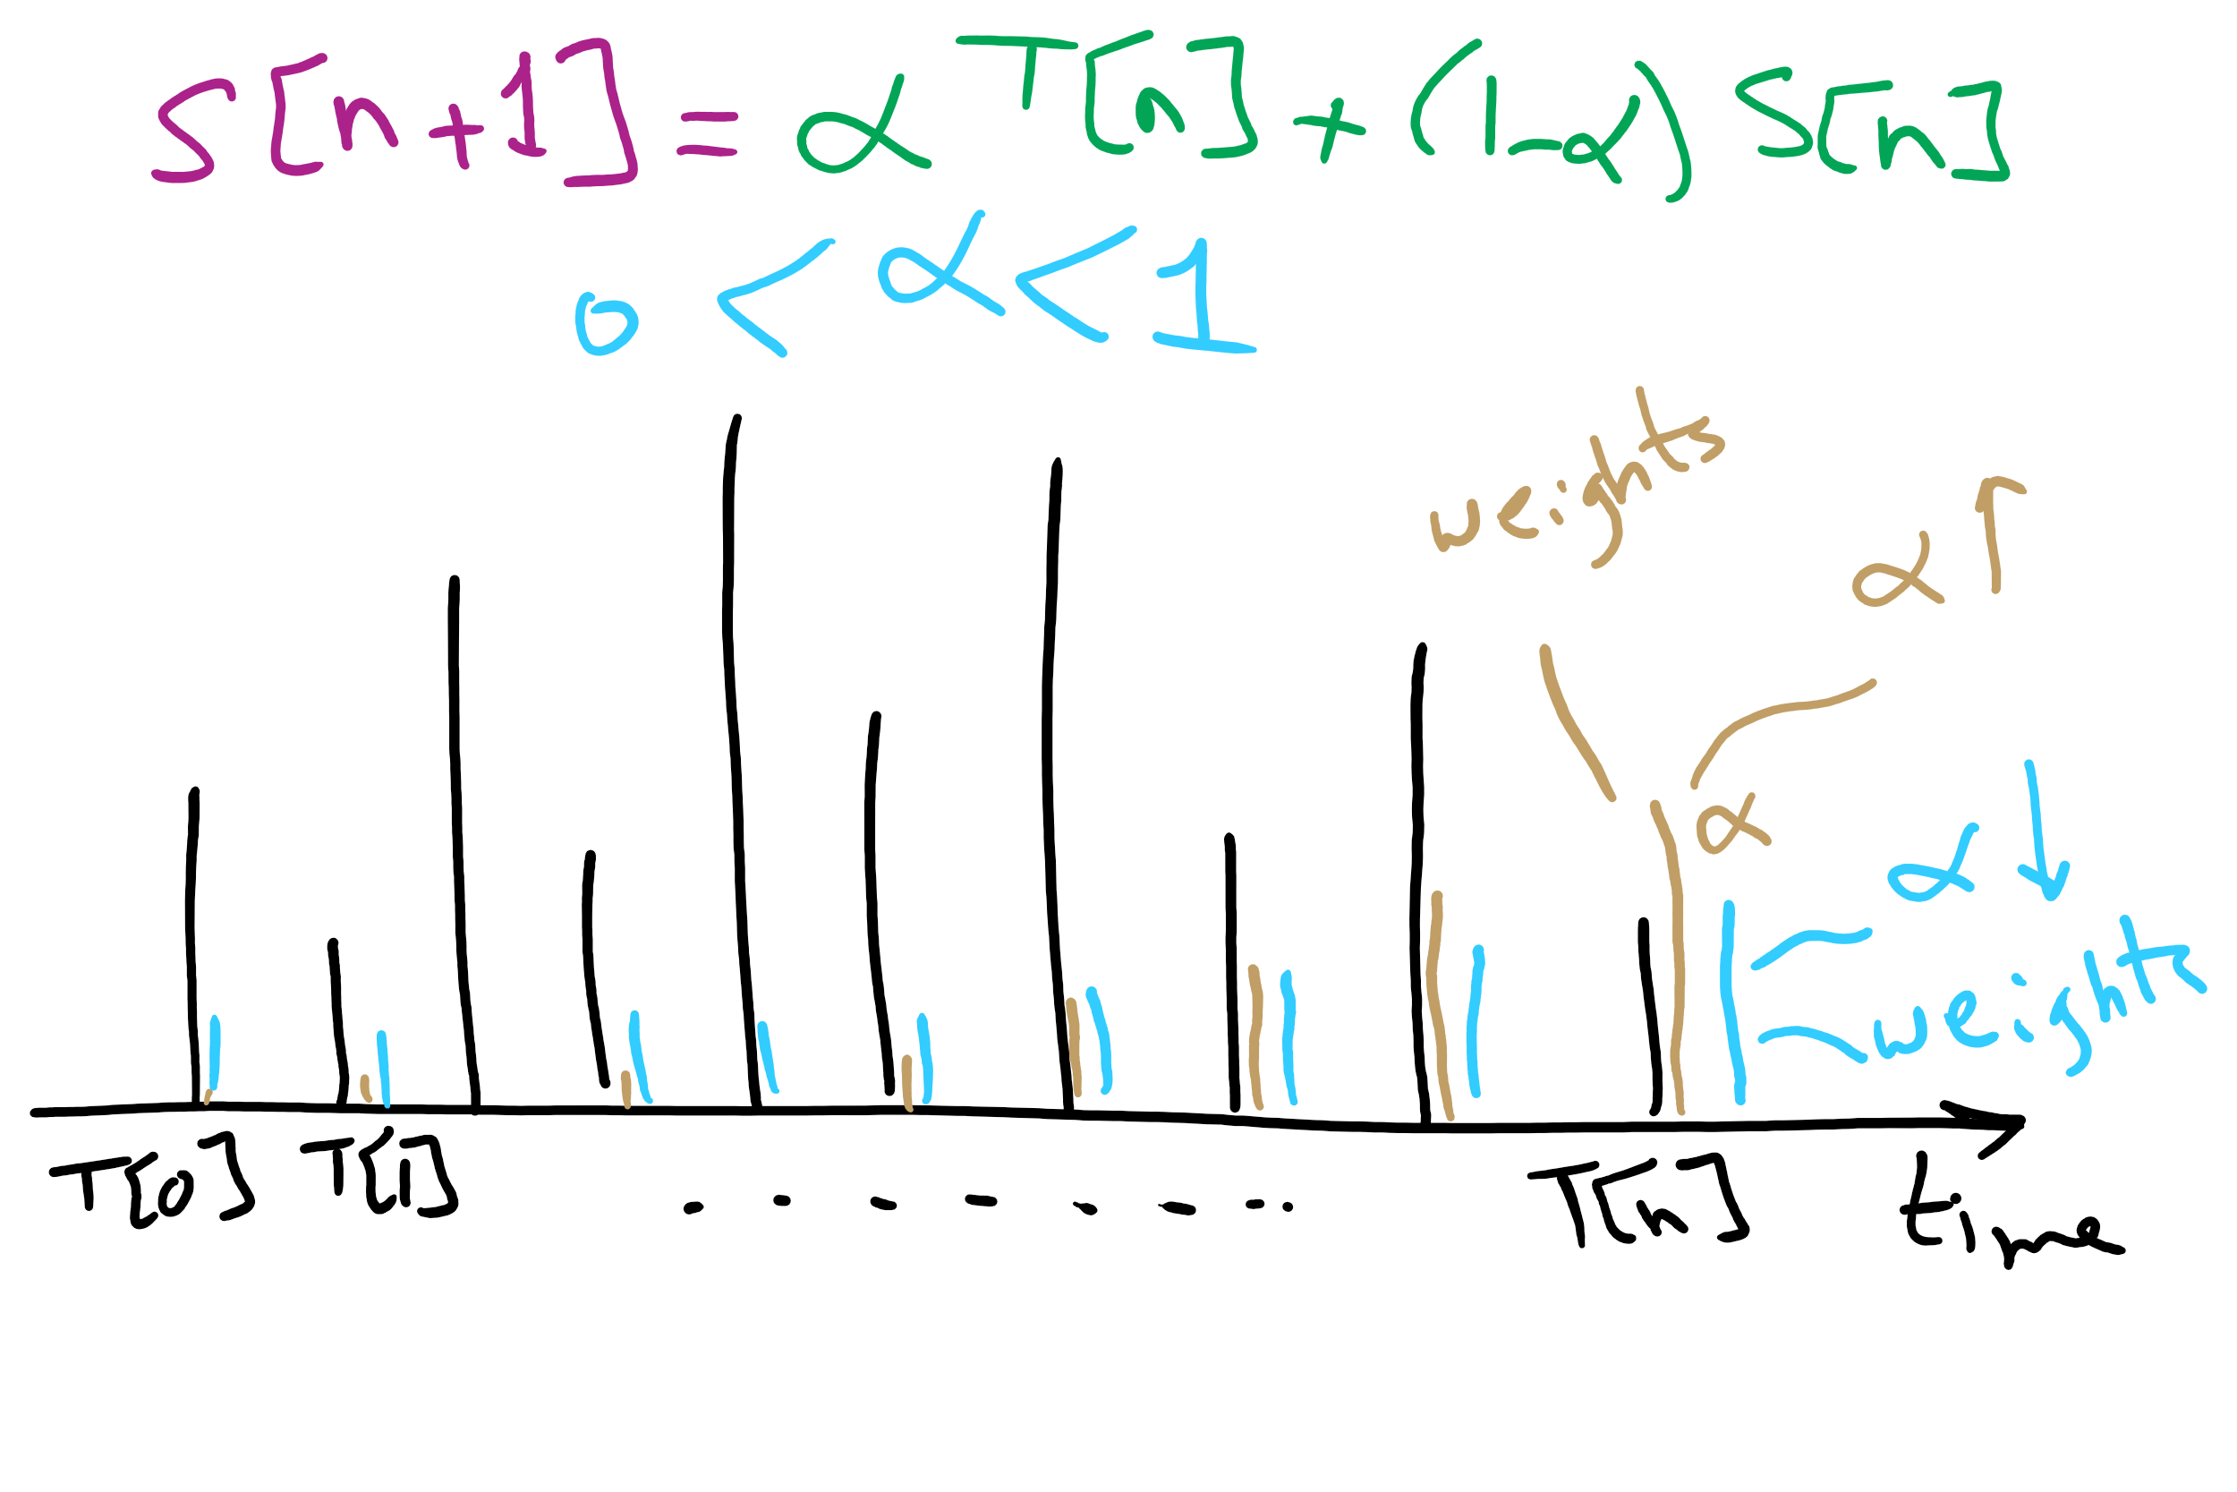
CPU Burst Estimation

Slide 31
In an ideal world…
The ideal world has memory that is
Very large
Very fast
Non-volatile (doesn’t go away when power is turned off)
The real world has memory that is:
Very large
Very fast
Affordable!
Pick any two…
Memory management goal: make the real world look as much like the ideal world as possible

Slide 32
Memory hierarchy
What is the memory hierarchy?
Different levels of memory
Some are small & fast
Others are large & slow
What levels are usually included?
Cache: small amount of fast, expensive memory
L1 (level 1) cache: usually on the CPU chip
L2 & L3 cache: off-chip, made of SRAM
Main memory: medium-speed, medium price memory (DRAM)
Disk: many gigabytes of slow, cheap, non-volatile storage
Memory manager handles the memory hierarchy

Slide 33
Problem of the Day
How can we share computer’s memory between multiple processes?
How can we protect each process’s memory partition from other processes?

Slide 34
How many programs is enough?
Several memory partitions (fixed or variable size)
Lots of processes wanting to use the CPU
Tradeoff
More processes utilize the CPU better
Fewer processes use less memory (cheaper!)
How many processes do we need to keep the CPU fully utilized?
This will help determine how much memory we need
Is this still relevant with memory costing $10/GB?

Slide 35
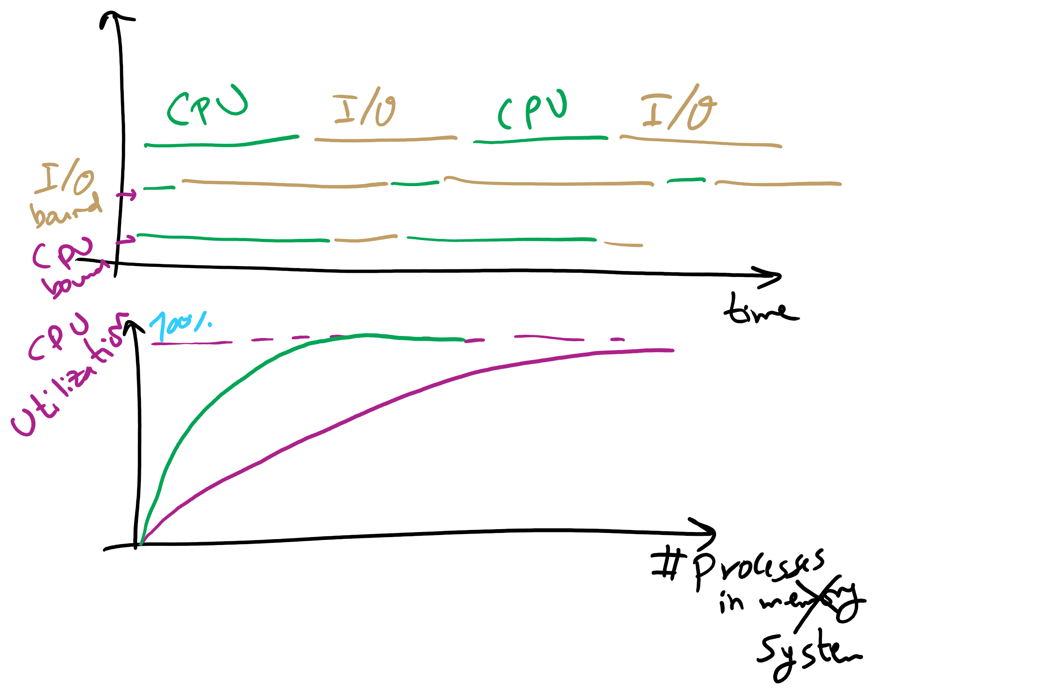
Why do we need more processes?

Slide 36
Modeling multiprogramming
More I/O wait means less processor utilization
At 20% I/O wait, 3–4 processes fully utilize CPU
At 80% I/O wait, even 10 processes aren’t enough
This means that the OS should have more processes if they’re I/O bound
More processes => memory management & protection more important!

Slide 37
Basic memory management
Components include
Operating system (perhaps with device drivers)
Single process
Goal: lay these out in memory
Memory protection may not be an issue (only one program)
Flexibility may still be useful (allow OS changes, etc.)
No swapping or paging
0xFFFF
0xFFFF
User program (RAM)
Operating system (ROM)
Device drivers (ROM)
User program (RAM)
User program (RAM)
Operating system (RAM)
Operating system (RAM)
0
0

Slide 38

Memory Management for Embedded Systems

Slide 39
Fixed partitions: multiple programs
Fixed memory partitions
Divide memory into fixed spaces
Assign a process to a space when it’s free
Mechanisms
Separate input queues for each partition
Single input queue: better ability to optimize CPU usage
Partition 4
900K
Partition 4
900K
Partition 3
700K
Partition 3
700K
Partition 2
600K
Partition 2
600K
Partition 1
500K
Partition 1
500K
100K
100K
OS
OS
0
0

Slide 40
Problem of the Day
How can we share computer’s memory between multiple processes?
How can we protect each process’s memory partition from other processes?

Slide 41
Base and limit registers
Special CPU registers: base & limit
Access to the registers limited to kernel (privileged) mode
Registers contain
Base: start of the process’s memory partition
Limit: length of the process’s memory partition
Address generation
Physical address: location in actual memory
Logical address: location from the process’s point of view
Physical address = base + logical address
Logical address larger than limit => error
0xFFFF
0x2000
Limit
Process partition
Base
0x9000
OS
0
Logical address: 0x1204 Physical address: 0x1204+0x9000 = 0xa204

Slide 42
Virtual and physical addresses
Program uses virtual addresses
Addresses local to the process
Hardware translates virtual address to physical address
Translation done by the Memory Management Unit
Usually on the same chip as the CPU
Only physical addresses leave the CPU/MMU chip
Physical memory indexed by physical addresses
CPU chip
CPU
MMU
Virtual addresses from CPU to MMU
Memory
Physical addresses on bus, in memory
Disk controller

Slide 43
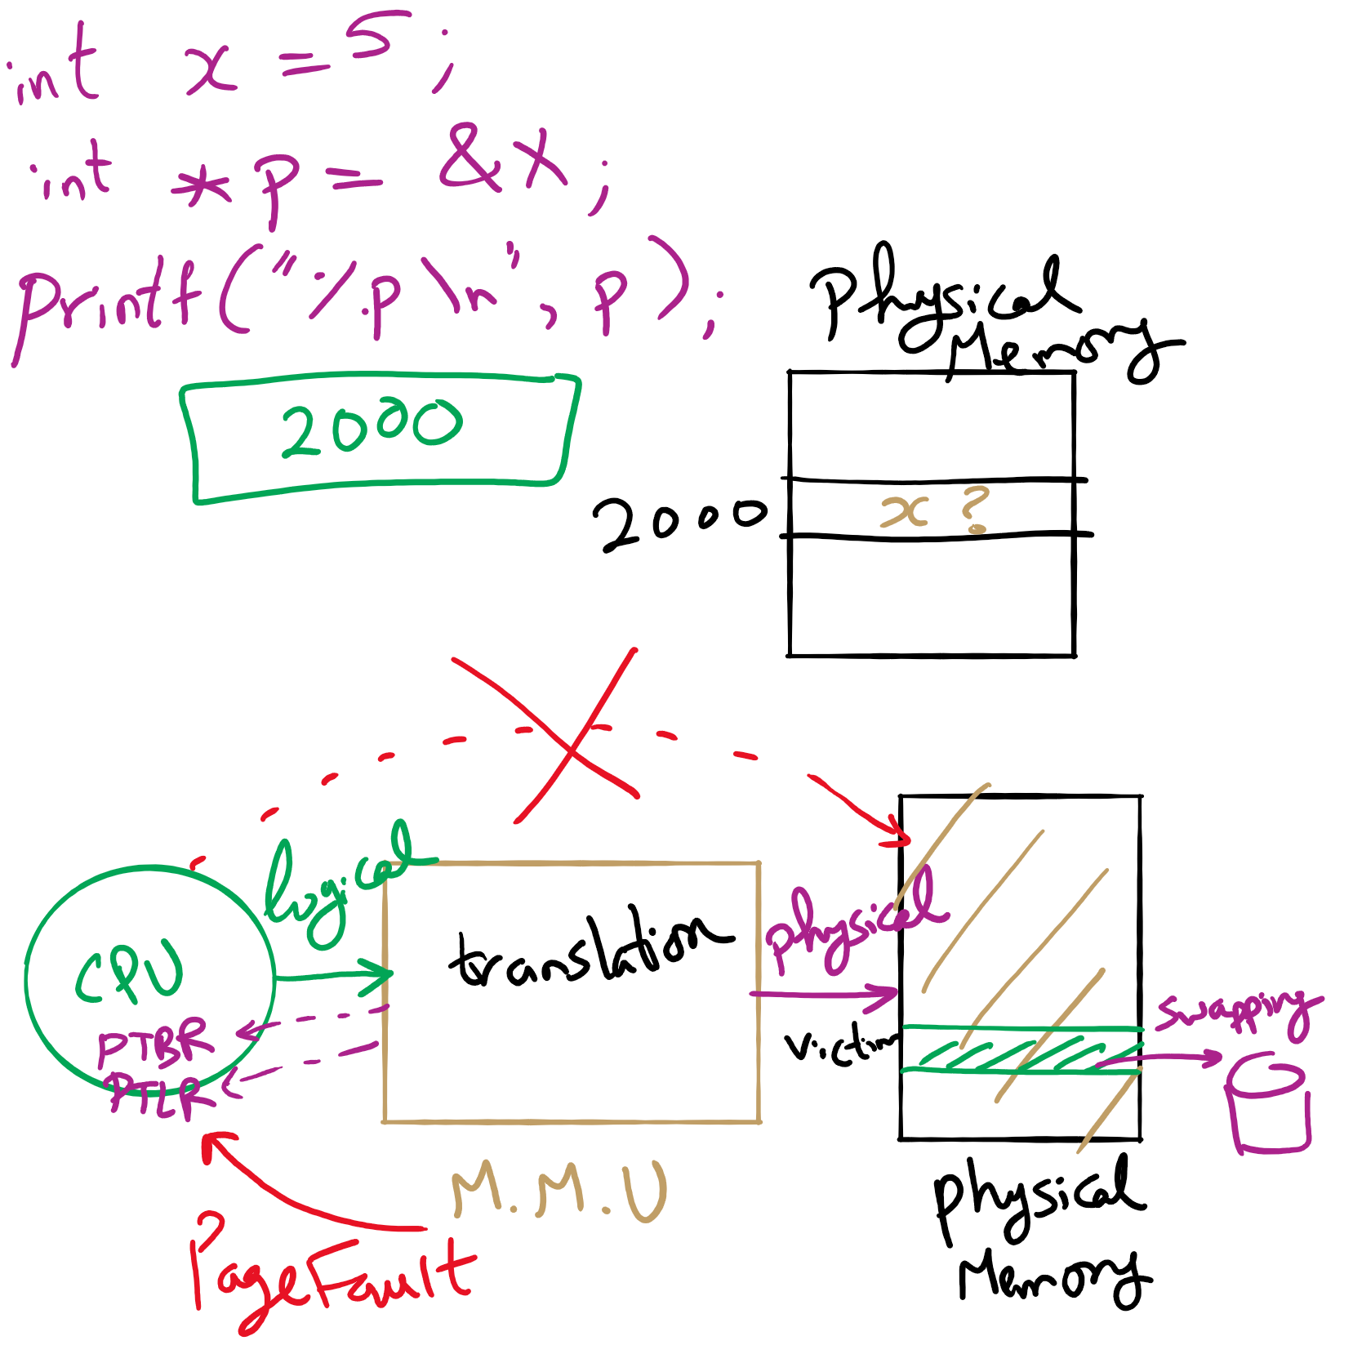
Address Translation

Slide 44
Virtual memory
Basic idea: allow the OS to hand out more memory than exists on the system
Keep recently used stuff in physical memory
Move less recently used stuff to disk
Keep all of this hidden from processes
Processes still see an address space from 0 – max address
Movement of information to and from disk handled by the OS without process help
Virtual memory (VM) especially helpful in multiprogrammed system
CPU schedules process B while process A waits for its memory to be retrieved from disk

Slide 45
Paging and page tables
Virtual addresses mapped to physical addresses
Unit of mapping is called a page
All addresses in the same virtual page are in the same physical page
Page table entry (PTE) contains translation for a single page
Table translates virtual page number to physical page number
Not all virtual memory has a physical page
Not every physical page need be used
Example:
64 KB virtual memory
32 KB physical memory
60–64K
-
56–60K
-
52–56K
-
48–52K
6
44–48K
5
40–44K
1
36–40K
-
32–36K
-
28–32K
3
28–32K
24–28K
-
24–28K
20–24K
-
20–24K
16–20K
0
16–20K
12–16K
-
12–16K
8–12K
-
8–12K
4–8K
4
4–8K
0–4K
7
0–4K
Virtual address space
Physical memory

Slide 46
What’s in a page table entry?
Each entry in the page table contains
Valid bit: set if this logical page number has a corresponding physical frame in memory
If not valid, remainder of PTE is irrelevant
Page frame number: page in physical memory
Referenced bit: set if data on the page has been accessed
Dirty (modified) bit :set if data on the page has been modified
Protection information
Protection
D
R
V
Page frame number
Dirty bit
Referenced bit
Valid bit

Slide 47
Implementing page tables in hardware
Page table resides in main (physical) memory
CPU uses special registers for paging
Page table base register (PTBR) points to the page table
Page table length register (PTLR) contains length of page table: restricts maximum legal logical address
Translating an address requires two memory accesses
First access reads page table entry (PTE)
Second access reads the data / instruction from memory
Reduce number of memory accesses
Can’t avoid second access (we need the value from memory)
Eliminate first access by keeping a hardware cache (called a translation lookaside buffer or TLB) of recently used page table entries

