Slide 1


Introduction to Operating Systems CS 1550
Spring 2023
Sherif Khattab
ksm73@pitt.edu
(Some slides are from Silberschatz, Galvin and Gagne ©2013)

Slide 2
Announcements
Upcoming deadlines
Homework 5 is due this Friday
Project 1 is due this Friday at 11:59 pm
Lab 2 is due on Tuesday 2/28 at 11:59 pm
Project 2 will be posted this Friday

Slide 3
Previous lecture …
Deadlock detection and avoidance using the Banker’s algorithm
Sleepy Barbers problem

Slide 4
Problem of the Day: Sleepy Barbers
We have two sets of processes
Worker processes (e.g., barbers)
Customer processes
Customer processes may arrive at anytime
Worker processes check in when they are not serving any customers
Each worker process must wait until it gets matched with a customer process
Each customer process must wait until it gets matched with a worker process
The customer process cannot leave until the matched worker process finishes the work
The worker process cannot check in for the next customer until the matched customer process leaves

Slide 5
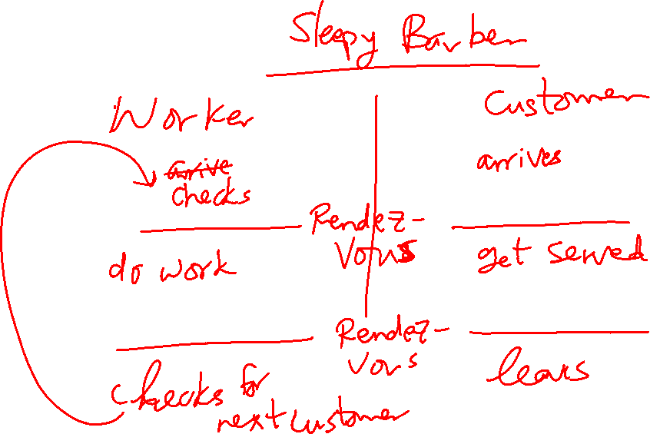
Rendezvous Pattern

Slide 6
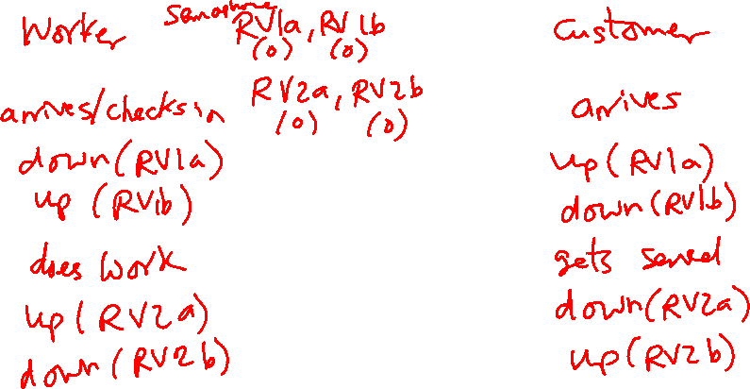
Solution Using Semaphores: Take 1
One pair of semaphores per rendezvous
RV1a and RV1b
RV2a and RV2b
Notice the flipped order of the down and up calls in the two processes

Slide 7
Solution Using Semaphores: Take 1
This solution doesn’t work for multiple workers and multiple customers
In that case, a customer can leave before its associated worker finishes

Slide 8
Sleepy Barbers Solution: Take 2
struct mysems {
Semaphore RV1a(0), RV1b(0), RV2a(0), RV2b(0);
};
SharedBuffer buff; //From producers-consumers problem
Worker Process
struct mysems sems = buff.consume();
up(sems.RV1a);
down(sems.RV1b);
//do work
down(sems.RV2a);
up(sems.RV2b);
//check-in for next customer
Customer Process
struct mysems sems = new struct mysems
buff.produce(sems);
down(sems.RV1a);
up(sems.RV1b);
//get work
up(sems.RV2a);
down(sems.RV2b);
//leave

Slide 9
Solution using Mutex and Condition Variables
https://cs1550-2214.github.io/cs1550-code-handouts/ProcessSynchronization/Slides/

Slide 10
How to implement Condition Variables?
How to implement condition variables?
Reflect more on all the solutions/problems that we have studied

Slide 11
User-level implementation of Condition Variables
A Lock with two waiting queues
struct Lock {
Semaphore mutex(1);
Semaphore next(0);
int nextCount = 0;
}
Acquire(){
mutex.down();
}
Release(){
if(nextCount > 0){
next.up();
nextCount--;
} else mutex.up();
}

Slide 12
Condition Variable
struct ConditionVariable {
Semaphore condSem(0);
int semCount = 0;
Lock *lk;
}
Wait(){
if(lk->nextCount > 0)
lk->next.up();
lk->nextCount--;
else {
lk->mutex.up();
}
semCount++;
condSem.down();
semCount--;
}
Signal(){
if(semCount > 0){
condSem.up()
lk->nextCount++
lk->next.down();
lk->nextCount—
}
}

Slide 13
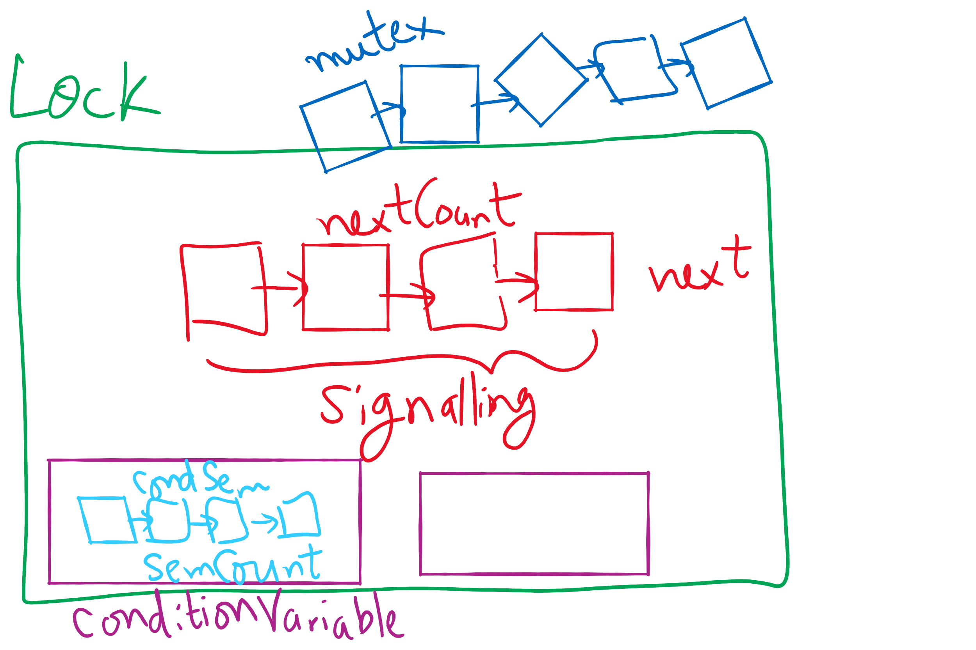
Lock and Condition Variable Implementation

Slide 14
Implementing locks with semaphores
Use mutex to ensure exclusion within the lock bounds
Use next to give lock to processes with a higher priority (why?)
nextCount indicates whether there are any higher priority waiters
class Lock {
Semaphore mutex(1);
Semaphore next(0);
int nextCount = 0;
};
Lock::Acquire()
{
mutex.down();
}
Lock::Release()
{
if (nextCount > 0)
next.up();
else
mutex.up();
}

Slide 15
Implementing condition variables
Are these Hoare or Mesa semantics?
Can there be multiple condition variables for a single Lock?
class Condition {
Lock *lock;
Semaphore condSem(0);
int semCount = 0;
};
Condition::Signal ()
{
if (semCount > 0) {
lock->nextCount += 1;
condSem.up ();
lock->next.down ();
lock->nextCount -= 1;
}
}
Condition::Wait ()
{
semCount += 1;
if (lock->nextCount > 0)
lock->next.up();
else
lock->mutex.up();
condSem.down ();
semCount -= 1;
}

Slide 16
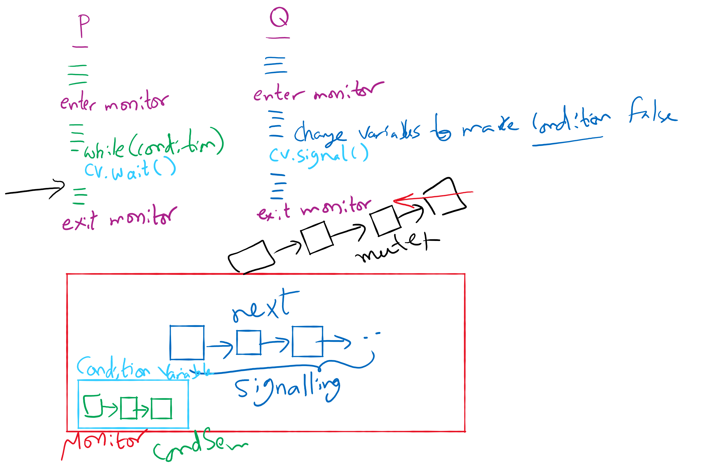
Process Synchronization inside Monitors

Slide 17
Reflections on semaphore usage
Semaphores can be used as
Resource counters
Waiting spaces
For mutual exclusion

Slide 18
Reflections on Condition Variables
Define a class and put all shared variables inside the class
Include a mutex and a condition variable in the class
For each public method of the class
Start by locking the mutex lock
If need to wait, use a while loop and wait on the condition variable
Before broadcasting on the condition variable, make sure to change the waiting condition

