Slide 1


Introduction to Operating Systems CS 1550
Spring 2023
Sherif Khattab
ksm73@pitt.edu
(Some slides are from Silberschatz, Galvin and Gagne ©2013)

Slide 2
Announcements
Upcoming deadlines
Homework 8 is due this Friday
Quiz 1 and Lab 2 due on Tuesday 2/28 at 11:59 pm
Project 2 is due Friday 3/17 at 11:59 pm
Talk by candidate faculty
This Wednesday 3/15 @ 10 am at 5317 Sennott Square
Donuts will be served!

Slide 3
Last Lecture …
How to implement Condition Variables and Locks using semaphores
CPU scheduling
SJF
Priority
RR

Slide 4
Today …
CPU scheduling
Multi-Level Feedback Queues
CPU burst estimation

Slide 5
Multilevel Feedback Scheduling
Preemptive scheduling with dynamic priorities
N ready to execute queues with decreasing priorities:
P(RQ₀) > P(RQ₁) > ... > P(RQ_{N-1})
Dispatcher selects a process for execution from RQ_{i} only if RQ_{i-1} to RQ₀ are empty

Slide 6
Multilevel Feedback Scheduling
New process are placed in RQ₀
After the first quantum, they are moved to RQ₁, and to RQ₂ after the second quantum, … and to RQ_{N-1} after the Nth quantum
I/O-bound processes remain in higher priority queues.
CPU-bound jobs drift downward.
Hence, long jobs may starve

Slide 7
Multiple Feedback Queues
Different RQs may have different quantum values

Slide 8
Time Quantum for feedback Scheduling
With a fixed quantum time, the turn-around time of longer processes can be high
To alleviate this problem, the time quantum can be increased based on the depth of the queue
Time quantum of RQ_{i} = 2^{i-1}
May still cause longer processes to suffer starvation.
Possible fix is to promote a process to higher queue after some time
Process
Arrival Time
Service Time
1
0
3
2
2
6
3
4
4
4
6
5
5
8
2

Slide 9

Time Quantum for feedback Scheduling
With a fixed quantum time, the turn-around time of longer processes can be high
To alleviate this problem, the time quantum can be increased based on the depth of the queue
Time quantum of RQ_{i} = 2^{i-1}
May still cause longer processes to suffer starvation.
Possible fix is to promote a process to higher queue after some time
Process
Arrival Time
Service Time
1
0
3
2
2
6
3
4
4
4
6
5
5
8
2

Slide 10

Time Quantum for feedback Scheduling
With a fixed quantum time, the turn-around time of longer processes can be high
To alleviate this problem, the time quantum can be increased based on the depth of the queue
Time quantum of RQ_{i} = 2^{i-1}
May still cause longer processes to suffer starvation.
Possible fix is to promote a process to higher queue after some time
Process
Arrival Time
Service Time
1
0
3
2
2
6
3
4
4
4
6
5
5
8
2

Slide 11

Time Quantum for feedback Scheduling
With a fixed quantum time, the turn-around time of longer processes can be high
To alleviate this problem, the time quantum can be increased based on the depth of the queue
Time quantum of RQ_{i} = 2^{i-1}
May still cause longer processes to suffer starvation.
Possible fix is to promote a process to higher queue after some time
Process
Arrival Time
Service Time
1
0
3
2
2
6
3
4
4
4
6
5
5
8
2

Slide 12

Time Quantum for feedback Scheduling
With a fixed quantum time, the turn-around time of longer processes can be high
To alleviate this problem, the time quantum can be increased based on the depth of the queue
Time quantum of RQ_{i} = 2^{i-1}
May still cause longer processes to suffer starvation.
Possible fix is to promote a process to higher queue after some time
Process
Arrival Time
Service Time
1
0
3
2
2
6
3
4
4
4
6
5
5
8
2

Slide 13

Time Quantum for feedback Scheduling
With a fixed quantum time, the turn-around time of longer processes can be high
To alleviate this problem, the time quantum can be increased based on the depth of the queue
Time quantum of RQ_{i} = 2^{i-1}
May still cause longer processes to suffer starvation.
Possible fix is to promote a process to higher queue after some time
Process
Arrival Time
Service Time
1
0
3
2
2
6
3
4
4
4
6
5
5
8
2

Slide 14


Time Quantum for feedback Scheduling
With a fixed quantum time, the turn-around time of longer processes can be high
To alleviate this problem, the time quantum can be increased based on the depth of the queue
Time quantum of RQ_{i} = 2^{i-1}
May still cause longer processes to suffer starvation.
Possible fix is to promote a process to higher queue after some time
Process
Arrival Time
Service Time
1
0
3
2
2
6
3
4
4
4
6
5
5
8
2

Slide 15


Time Quantum for feedback Scheduling
With a fixed quantum time, the turn-around time of longer processes can be high
To alleviate this problem, the time quantum can be increased based on the depth of the queue
Time quantum of RQ_{i} = 2^{i-1}
May still cause longer processes to suffer starvation.
Possible fix is to promote a process to higher queue after some time
Process
Arrival Time
Service Time
1
0
3
2
2
6
3
4
4
4
6
5
5
8
2

Slide 16

Time Quantum for feedback Scheduling
With a fixed quantum time, the turn-around time of longer processes can be high
To alleviate this problem, the time quantum can be increased based on the depth of the queue
Time quantum of RQ_{i} = 2^{i-1}
May still cause longer processes to suffer starvation.
Possible fix is to promote a process to higher queue after some time
Process
Arrival Time
Service Time
1
0
3
2
2
6
3
4
4
4
6
5
5
8
2

Slide 17

Time Quantum for feedback Scheduling
With a fixed quantum time, the turn-around time of longer processes can be high
To alleviate this problem, the time quantum can be increased based on the depth of the queue
Time quantum of RQ_{i} = 2^{i-1}
May still cause longer processes to suffer starvation.
Possible fix is to promote a process to higher queue after some time
Process
Arrival Time
Service Time
1
0
3
2
2
6
3
4
4
4
6
5
5
8
2

Slide 18

Time Quantum for feedback Scheduling
With a fixed quantum time, the turn-around time of longer processes can be high
To alleviate this problem, the time quantum can be increased based on the depth of the queue
Time quantum of RQ_{i} = 2^{i-1}
May still cause longer processes to suffer starvation.
Possible fix is to promote a process to higher queue after some time
Process
Arrival Time
Service Time
1
0
3
2
2
6
3
4
4
4
6
5
5
8
2

Slide 19

Time Quantum for feedback Scheduling
With a fixed quantum time, the turn-around time of longer processes can be high
To alleviate this problem, the time quantum can be increased based on the depth of the queue
Time quantum of RQ_{i} = 2^{i-1}
May still cause longer processes to suffer starvation.
Possible fix is to promote a process to higher queue after some time
Process
Arrival Time
Service Time
1
0
3
2
2
6
3
4
4
4
6
5
5
8
2

Slide 20

Time Quantum for feedback Scheduling
With a fixed quantum time, the turn-around time of longer processes can be high
To alleviate this problem, the time quantum can be increased based on the depth of the queue
Time quantum of RQ_{i} = 2^{i-1}
May still cause longer processes to suffer starvation.
Possible fix is to promote a process to higher queue after some time
Process
Arrival Time
Service Time
1
0
3
2
2
6
3
4
4
4
6
5
5
8
2

Slide 21

Time Quantum for feedback Scheduling
With a fixed quantum time, the turn-around time of longer processes can be high
To alleviate this problem, the time quantum can be increased based on the depth of the queue
Time quantum of RQ_{i} = 2^{i-1}
May still cause longer processes to suffer starvation.
Possible fix is to promote a process to higher queue after some time
Process
Arrival Time
Service Time
1
0
3
2
2
6
3
4
4
4
6
5
5
8
2

Slide 22
Algorithm Comparison
Which one is the best?
The answer depends on many factors:
the system workload (extremely variable)
hardware support for the dispatcher
relative importance of performance criteria (response time, CPU utilization, throughput...)
The evaluation method used (each has its limitations...)

Slide 23
Back to SJF: CPU Burst Estimation
Let T[i] be the execution time for the ith instance of this process: the actual duration of the ith CPU burst of this process
Let S[i] be the predicted value for the ith CPU burst of this process. The simplest choice is:
S[n+1] =(1/n)(T[1]+…+T[n])=(1/n) Σ{i=1 to n} T[i]
This can be more efficiently calculated as:
S[n+1] = (1/n) T[n] + ((n-1)/n) S[n]
This estimate, however, results in equal weight for each instance

Slide 24
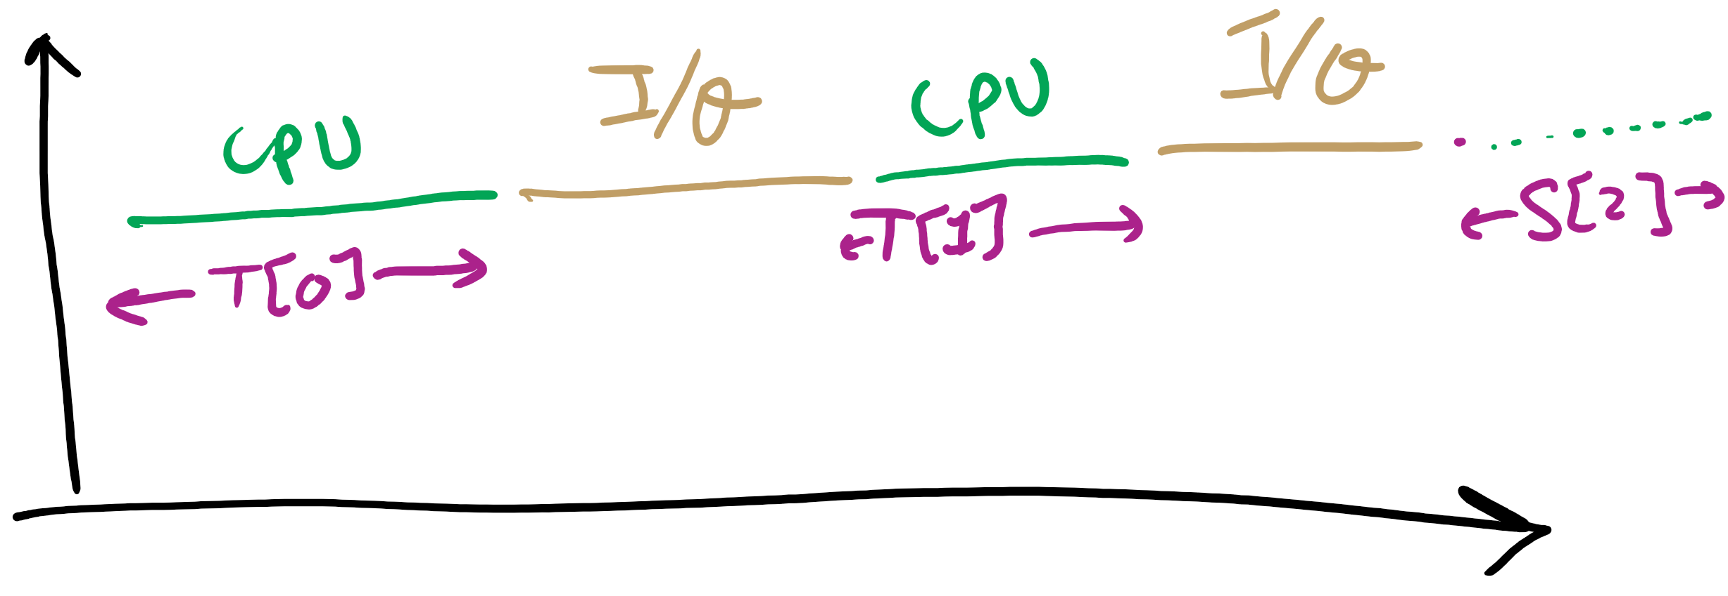
CPU Burst Estimation

Slide 25
Estimating the required CPU burst
Recent instances are more likely to better reflect future behavior
A common technique to factor the above observation into the estimate is to use exponential averaging :
S[n+1] = α T[n] + (1- α) S[n] ; 0 < α < 1

Slide 26
CPU burst Estimate (Exponential Average)
Recent instances have higher weights, whenever α > 1/n
Expanding the estimated value shows that the weights of past instances decrease exponentially
S[n+1] = α T[n] + (1- α) α T[n-1] + ... (1- α)^{i} α T[n-i] +
... + (1- α)^{n}S[1]
The predicted value of 1st instance, S[1], is usually set to 0 to give priority to new processes

Slide 27
Exponentially Decreasing Coefficients

Slide 28
Exponentially Decreasing Coefficients
S[1] = 0 to give high priority to new processes
Exponential averaging tracks changes in process behavior much faster than simple averaging

Slide 29
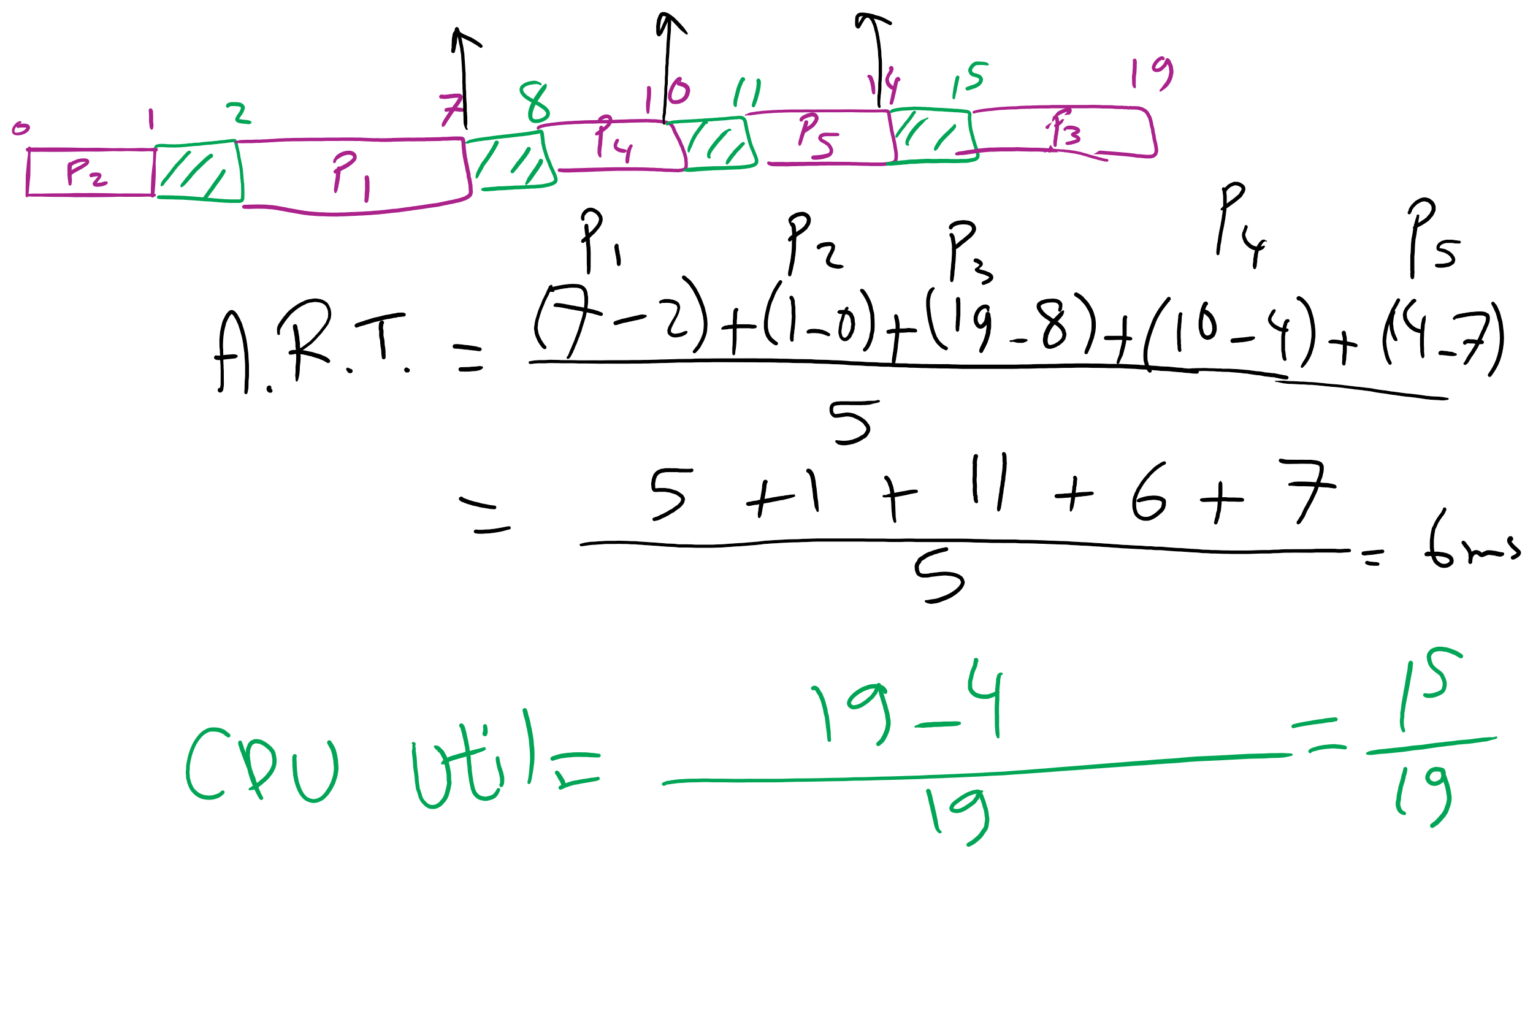
FCFS Problem in HW7

Slide 30
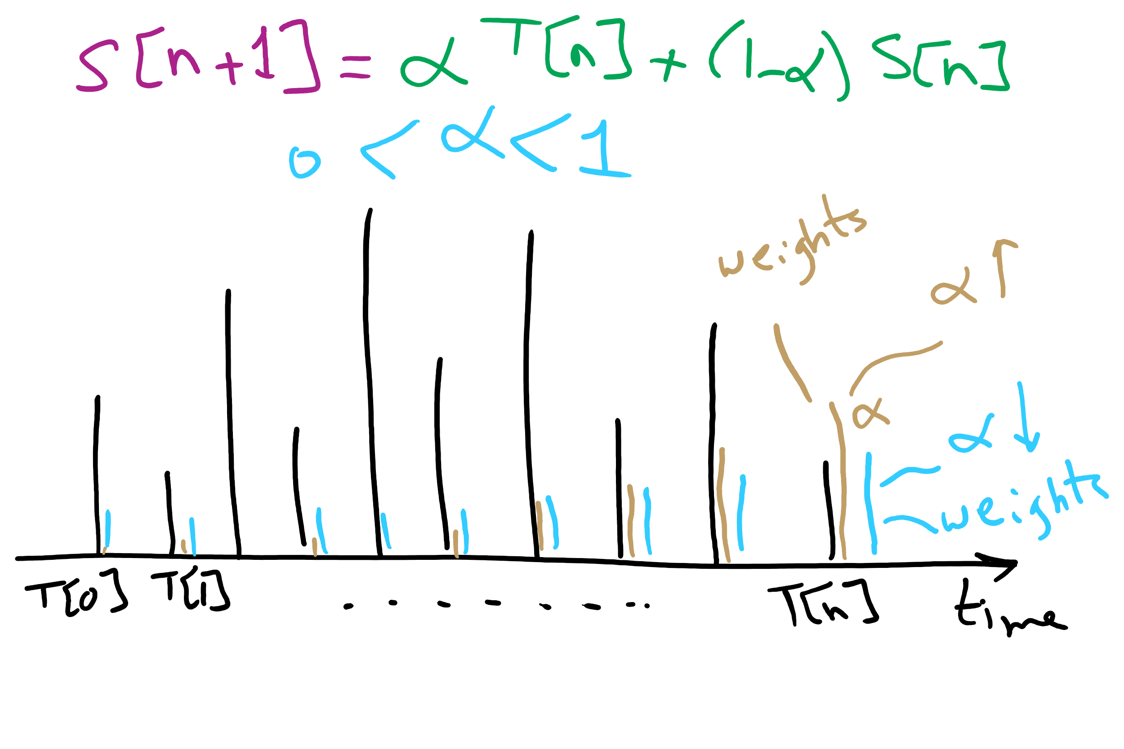
CPU Burst Estimation

