Slide 1


Introduction to Operating Systems CS 1550
Spring 2023
Sherif Khattab
ksm73@pitt.edu
(Some slides are from Silberschatz, Galvin and Gagne ©2013)

Slide 2
Announcements
Upcoming deadlines:
Project 1: due on 2/18
Homework 5: due 2/21
Lab 2: due on 2/28

Slide 3
Previous lecture …
Deadlock detection and avoidance using the Banker’s algorithm
Sleepy Barbers problem

Slide 4
Muddiest Points
Checked on Tophat

Slide 5
Sleepy Barbers Solution: Take 2
struct mysems {
Semaphore RV1a(0), RV1b(0), RV2a(0), RV2b(0);
};
SharedBuffer buff; //producers-consumers problem
Worker Process
struct mysems sems = buff.consume();
up(sems.RV1a);
down(sems.RV1b);
//do work
down(sems.RV2a);
up(sems.RV2b);
//check-in for next customer
Customer Process
struct mysems sems = new struct mysems
buff.produce(sems);
down(sems.RV1a);
up(sems.RV1b);
//get work
up(sems.RV2a);
down(sems.RV2b);
//leave

Slide 6
Questions of the Day
How to implement condition variables?
Reflect more on all the solutions/problems that we have studied

Slide 7
User-level implementation of Condition Variables
A Lock with two waiting queues
struct Lock {
Semaphore mutex(1);
Semaphore next(0);
int nextCount = 0;
}
Acquire(){
mutex.down();
}
Release(){
if(nextCount > 0){
next.up();
nextCount--;
} else mutex.up();
}

Slide 8
Condition Variable
struct ConditionVariable {
Semaphore condSem(0);
int semCount = 0;
Lock *lk;
}
Wait(){
if(lk->nextCount > 0)
lk->next.up();
lk->nextCount--;
else {
lk->mutex.up();
}
semCount++;
condSem.down();
semCount--;
}
Signal(){
if(semCount > 0){
condSem.up()
lk->nextCount++
lk->next.down();
lk->nextCount—
}
}

Slide 9
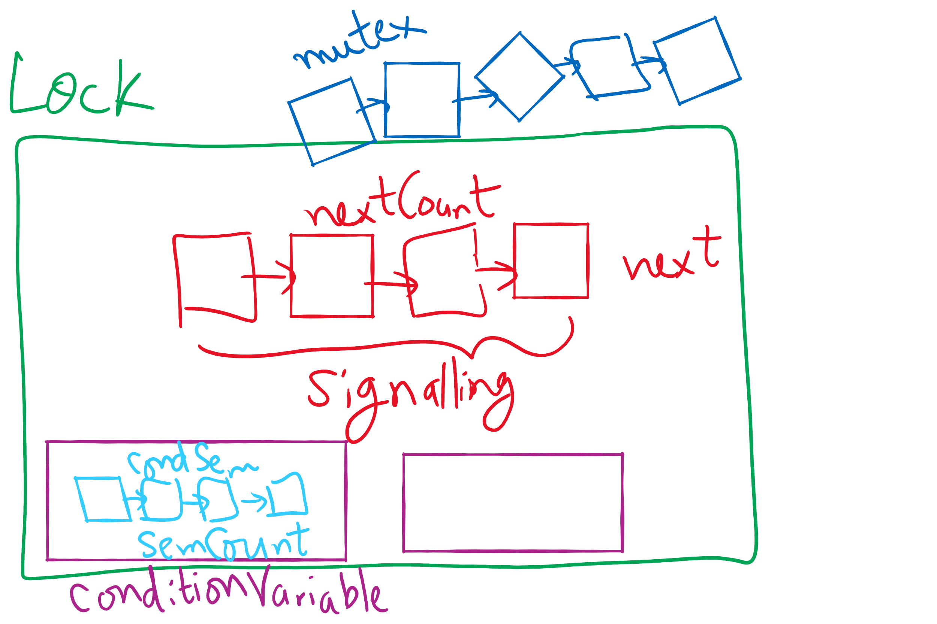
Lock and Condition Variable Implementation

Slide 10
Implementing locks with semaphores
Use mutex to ensure exclusion within the lock bounds
Use next to give lock to processes with a higher priority (why?)
nextCount indicates whether there are any higher priority waiters
class Lock {
Semaphore mutex(1);
Semaphore next(0);
int nextCount = 0;
};
Lock::Acquire()
{
mutex.down();
}
Lock::Release()
{
if (nextCount > 0)
next.up();
else
mutex.up();
}

Slide 11
Implementing condition variables
Are these Hoare or Mesa semantics?
Can there be multiple condition variables for a single Lock?
class Condition {
Lock *lock;
Semaphore condSem(0);
int semCount = 0;
};
Condition::Signal ()
{
if (semCount > 0) {
lock->nextCount += 1;
condSem.up ();
lock->next.down ();
lock->nextCount -= 1;
}
}
Condition::Wait ()
{
semCount += 1;
if (lock->nextCount > 0)
lock->next.up();
else
lock->mutex.up();
condSem.down ();
semCount -= 1;
}

Slide 12
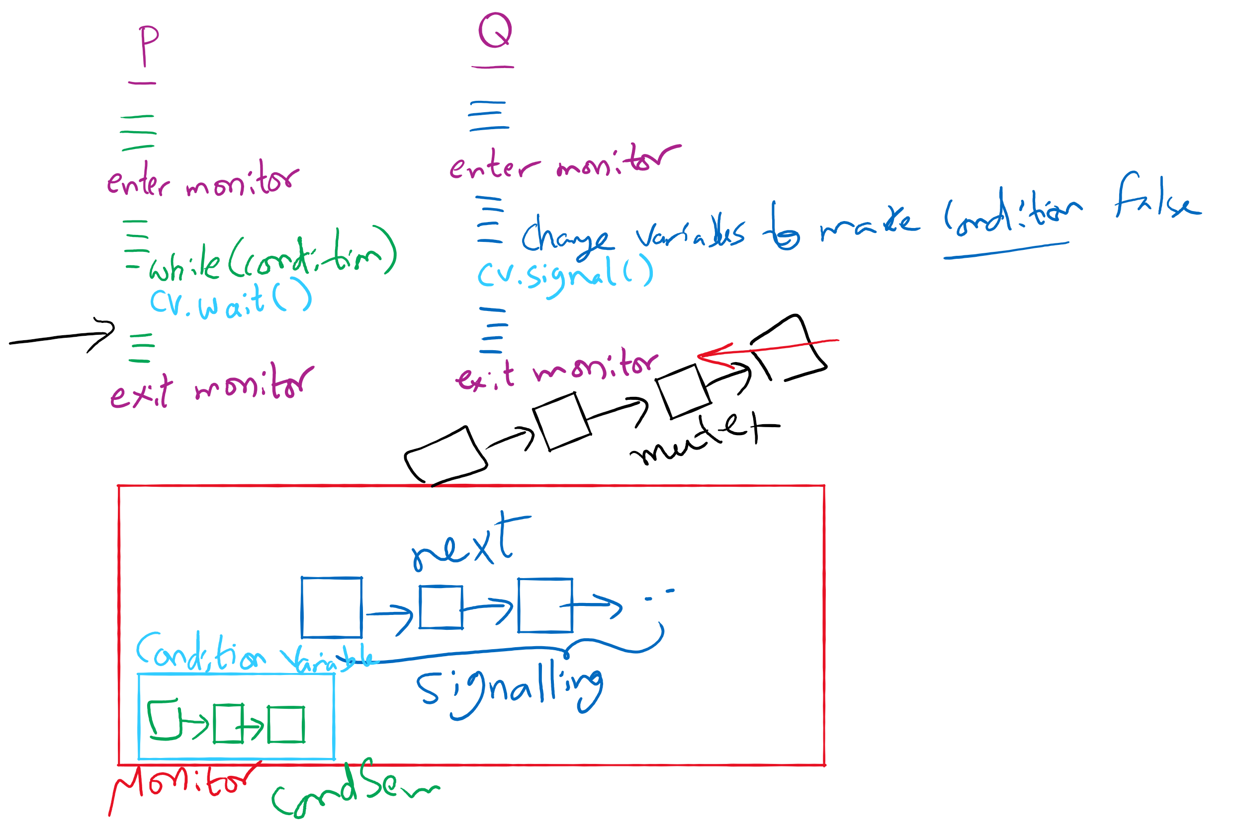
Process Synchronization inside Monitors

Slide 13
Condition Variable-based Solutions
Code Walkthrough at:
https://cs1550-2214.github.io/cs1550-code-handouts/ProcessSynchronization/Slides/

Slide 14
Reflections on semaphore usage
Semaphores can be used as
Resource counters
Waiting spaces
For mutual exclusion

Slide 15
Reflections on Condition Variables
Define a class and put all shared variables inside the class
Include a mutex and a condition variable in the class
For each public method of the class
Start by locking the mutex lock
If need to wait, use a while loop and wait on the condition variable
Before broadcasting on the condition variable, make sure to change the waiting condition

