Slide 1


Introduction to Operating Systems CS 1550
Spring 2023
Sherif Khattab
ksm73@pitt.edu
(Some slides are from Silberschatz, Galvin and Gagne ©2013)

Slide 2
Announcements
Upcoming deadlines:
Project 2: due on 3/18
Homework 8: due on 3/21
Quiz 2: due on 3/25
Lab 3: due on 4/1

Slide 3
Previous Lecture …
Memory allocation and protection (Take II)
Virtual memory
Fixed-size pages, on-demand, appear as if having more memory that physically in the system

Slide 4
Problem of the Day
Page fault forces a choice
No room for new page (steady state)
A page must be removed to make room for an incoming page.
Which page to select?
Victim page
Evicted/purged

Slide 5
Page replacement algorithms
How is a page removed from physical memory?
If the page is unmodified, simply overwrite it: a copy already exists on disk
If the page has been modified, it must be written back to disk: prefer unmodified pages?
Better not to choose an often used page
It’ll probably need to be brought back in soon

Slide 6
Optimal page replacement algorithm
What’s the best we can possibly do?
Assume perfect knowledge of the future
Not realizable in practice (usually)
Useful for comparison: if another algorithm is within 5% of optimal, not much more can be done…
Algorithm: replace the page that will be used furthest in the future
Only works if we know the whole sequence!
Can be approximated by running the program twice
Once to generate the reference trace
Once (or more) to apply the optimal algorithm
Nice, but not achievable in real systems!

Slide 7
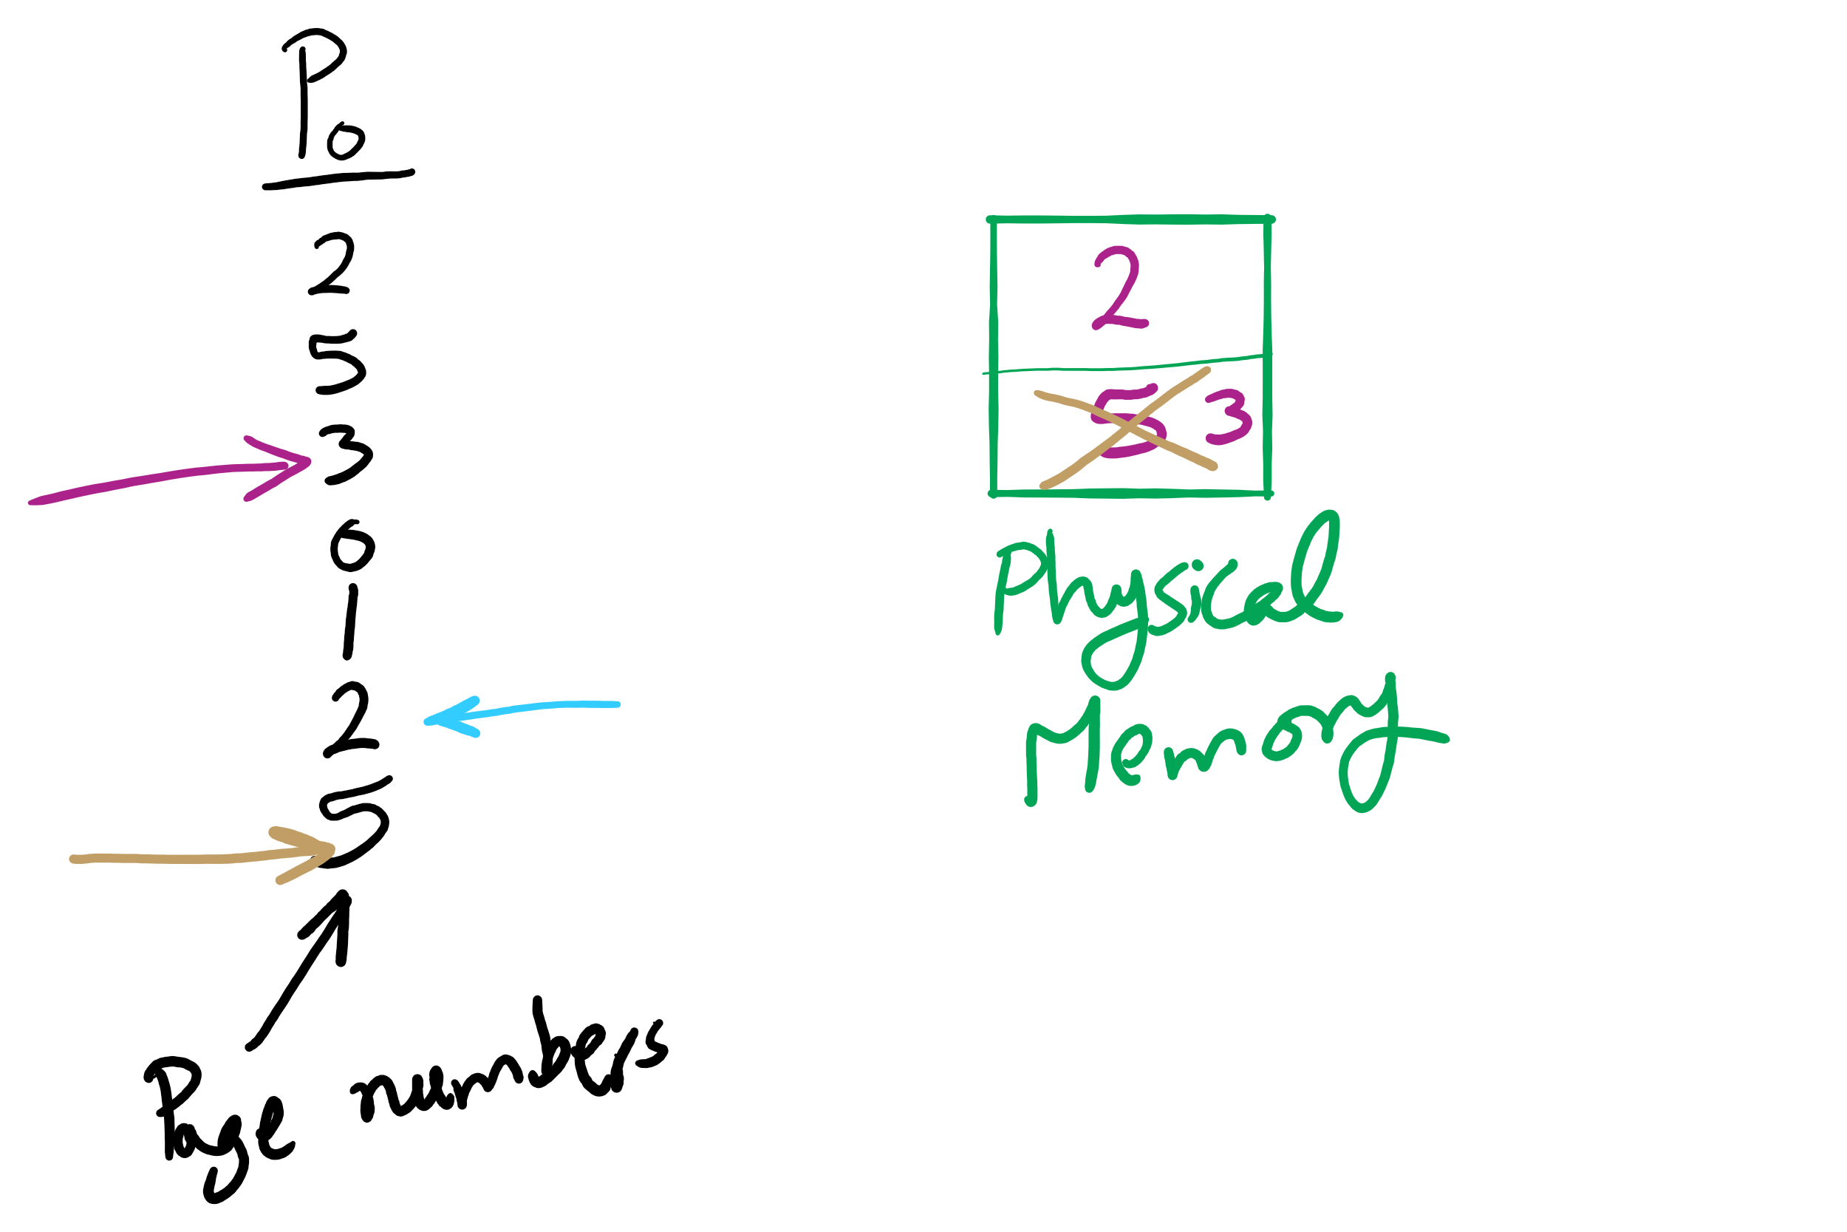
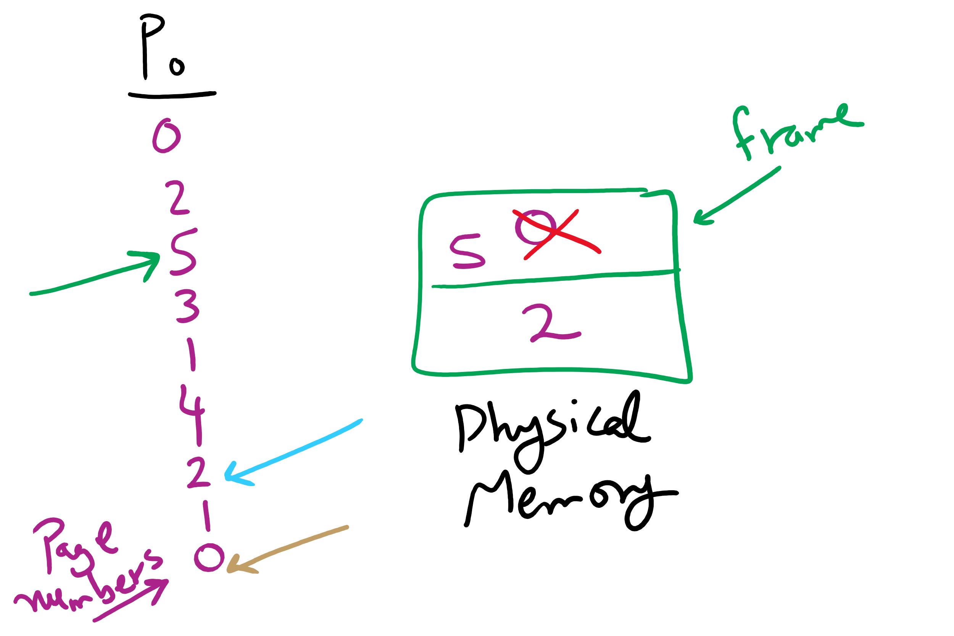
OPT Examples

Slide 8
Not-recently-used (NRU) algorithm
Each page has reference bit and dirty bit
Bits are set when page is referenced and/or modified
Pages are classified into four classes
0: not referenced, not dirty
1: not referenced, dirty
2: referenced, not dirty
3: referenced, dirty
Clear reference bit for all pages periodically
Can’t clear dirty bit: needed to indicate which pages need to be flushed to disk
Class 1 contains dirty pages where reference bit has been cleared
Algorithm: remove a page from the lowest non-empty class
Select a page at random from that class
Easy to understand and implement
Performance adequate (though not optimal)

Slide 9
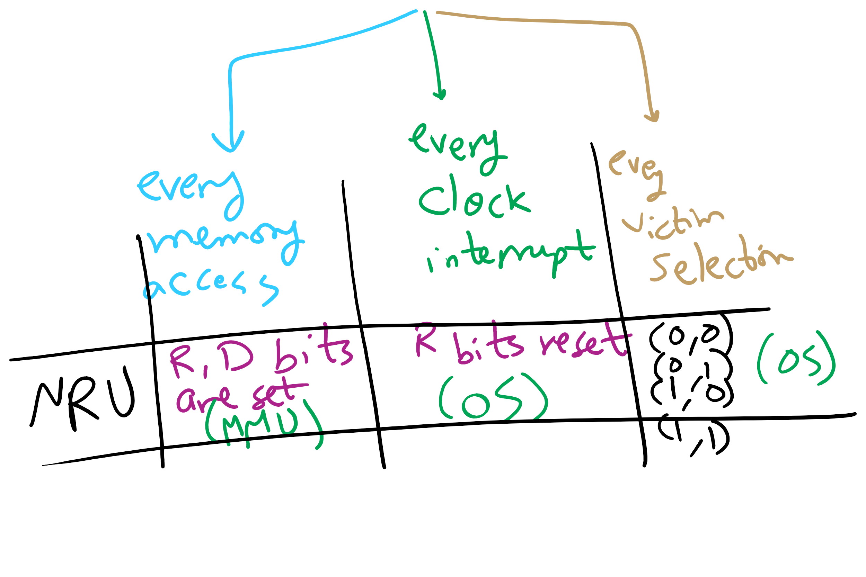
NRU Operation

Slide 10
First-In, First-Out (FIFO) algorithm
Maintain a linked list of all pages
Maintain the order in which they entered memory
Page at front of list replaced
Advantage: (really) easy to implement
Disadvantage: page in memory the longest may be often used
This algorithm forces pages out regardless of usage
Usage may be helpful in determining which pages to keep

Slide 11
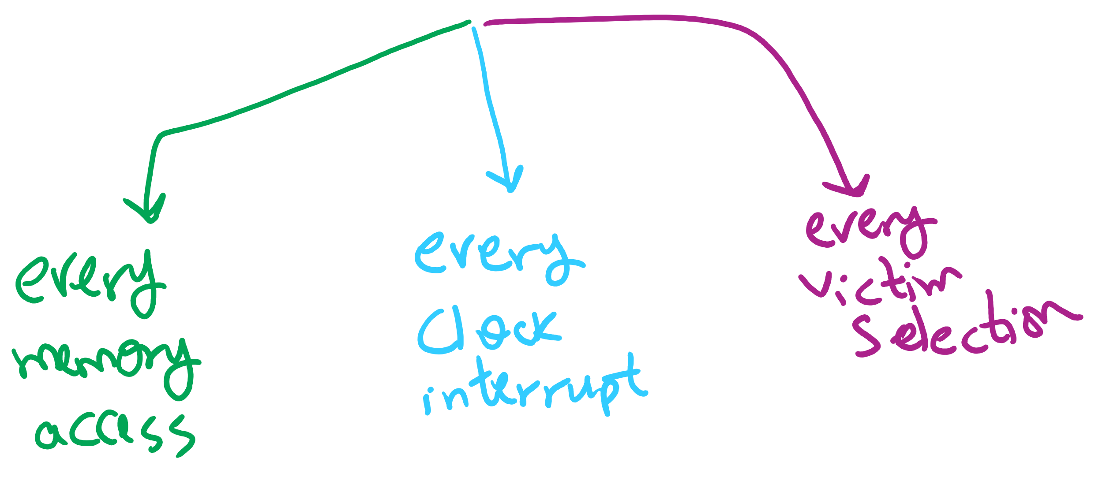
Page Replacement Algorithms Components

Slide 12
Second chance page replacement
Modify FIFO to avoid throwing out heavily used pages
If reference bit is 0, throw the page out
If reference bit is 1
Reset the reference bit to 0
Move page to the tail of the list
Continue search for a free page
Still easy to implement, and better than plain FIFO
referenced
unreferenced
A t=0
B t=4
C t=8
D t=15
E t=21
F t=22
G t=29
H t=30
A t=32

Slide 13
Clock algorithm
Same functionality as second chance
Simpler implementation
“Clock” hand points to next page to replace
If R=0, replace page
If R=1, set R=0 and advance the clock hand
Continue until page with R=0 is found
This may involve going all the way around the clock…
A t=0
A t=32
H t=30
B t=4
B t=32
G t=29
C t=8
C t=32
F t=22
D t=15
J t=32
E t=21
referenced
unreferenced

Slide 14
Least Recently Used (LRU)
Assume pages used recently will be used again soon
Throw out page that has been unused for longest time
Must keep a linked list of pages
Most recently used at front, least at rear
Update this list every memory reference!
This can be somewhat slow: hardware has to update a linked list on every reference!
Alternatively, keep counter in each page table entry
Global counter increments with each CPU cycle
Copy global counter to PTE counter on a reference to the page
For replacement, evict page with lowest counter value

Slide 15
Simulating LRU in software
Few computers have the necessary hardware to implement full LRU
Linked-list method impractical in hardware
Counter-based method could be done, but it’s slow to find the desired page
Approximate LRU with Not Frequently Used (NFU) algorithm
At each clock interrupt, scan through page table
If R=1 for a page, add one to its counter value
On replacement, pick the page with the lowest counter value
Problem: no notion of age—pages with high counter values will tend to keep them!

Slide 16
Aging replacement algorithm
Reduce counter values over time
Divide by two every clock cycle (use right shift)
More weight given to more recent references!
Select page to be evicted by finding the lowest counter value
Algorithm is:
Every clock tick, shift all counters right by 1 bit
On reference, set leftmost bit of a counter (can be done by copying the reference bit to the counter at the clock tick)
Referenced this tick
Tick 0
Tick 1
Tick 2
Tick 3
Tick 4
Page 0
10000000
11000000
11100000
01110000
10111000
Page 1
00000000
10000000
01000000
00100000
00010000
Page 2
10000000
01000000
00100000
10010000
01001000
Page 3
00000000
00000000
00000000
10000000
01000000
Page 4
10000000
01000000
10100000
11010000
01101000
Page 5
10000000
11000000
01100000
10110000
11011000

Slide 17
Working set
Demand paging: bring a page into memory when it’s requested by the process
How many pages are needed?
Could be all of them, but not likely
Instead, processes reference a small set of pages at any given time—locality of reference
Set of pages can be different for different processes or even different times in the running of a single process
Set of pages used by a process in a given interval of time is called the working set
If entire working set is in memory, no page faults!
If insufficient space for working set, thrashing may occur
Goal: keep most of working set in memory to minimize the number of page faults suffered by a process

Slide 18
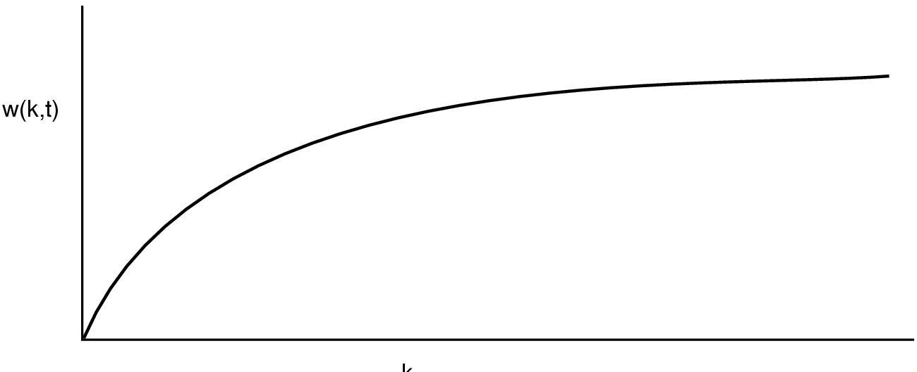
How big is the working set?
w(k,t)
k
Working set is the set of pages used by the k most recent memory references
w(k,t) is the size of the working set at time t
Working set may change over time
Size of working set can change over time as well…

Slide 19
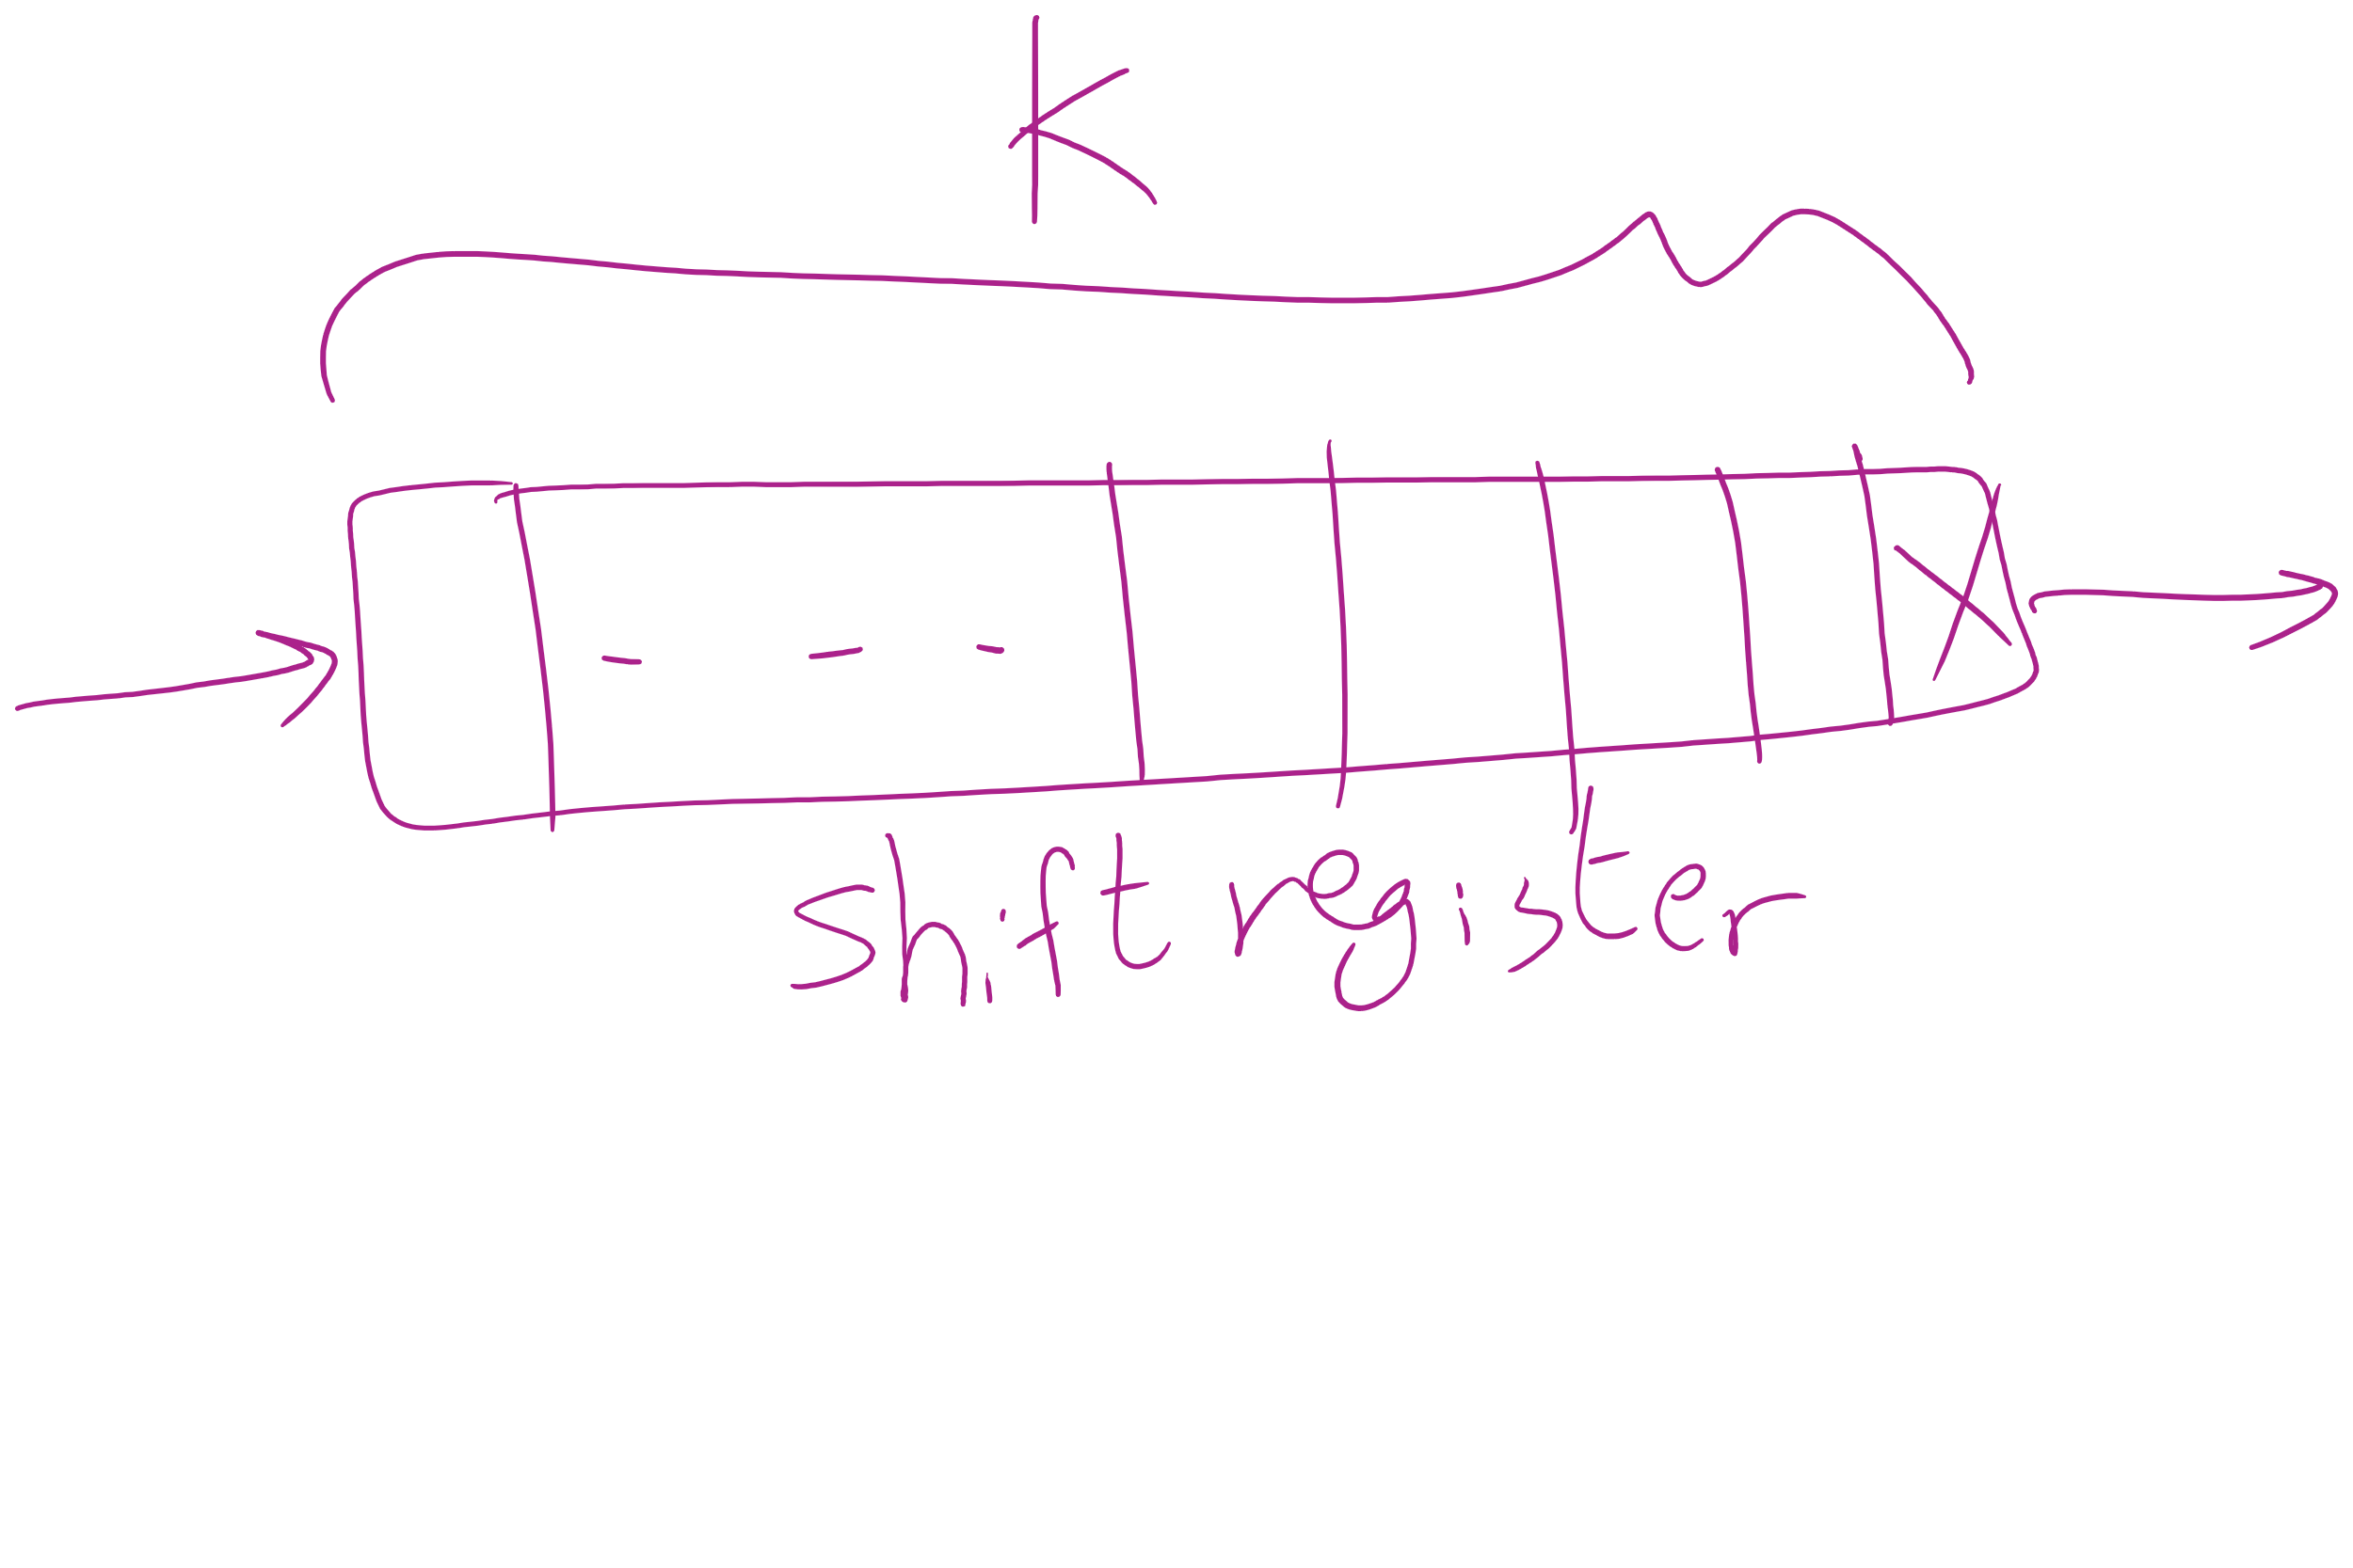
Keeping track of the Working Set

Slide 20
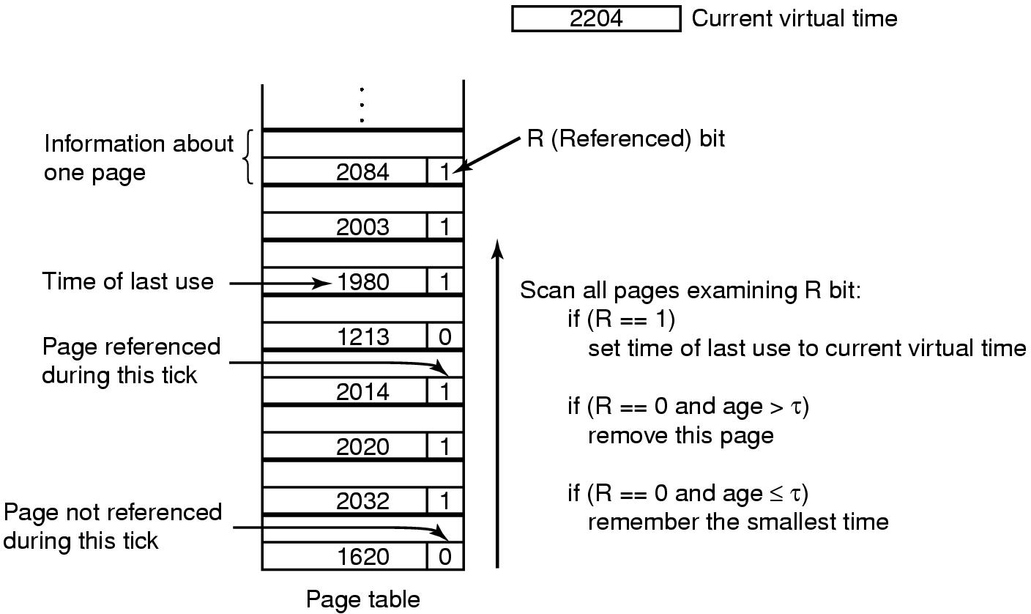
Working set page replacement algorithm

