Slide 1


Introduction to Operating Systems CS 1550
Spring 2023
Sherif Khattab
ksm73@pitt.edu
(Some slides are from Silberschatz, Galvin and Gagne ©2013)

Slide 2
Announcements
Upcoming deadlines:
Project 1: due on 2/18
Homework 5: due 2/21
Lab 2: due on 2/28

Slide 3
Previous lecture …
Dining philosophers
Deadlock prevention

Slide 4
Muddiest Points
Checked on Tophat

Slide 5
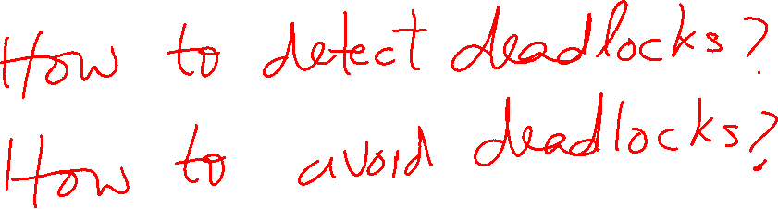
Questions of the Day

Slide 6
Banker’s Algorithm
We can use the same algorithm for both detecting and avoiding deadlocks

Slide 7


Deadlock detection algorithm
current=avail;
for (j = 0; j < N; j++) {
for (k=0; k<N; k++) {
if (finished[k])
continue;
if (want[k] <= current) {
finished[k] = 1;
current += hold[k];
break;
}
}
if (k==N) {
printf “Deadlock!\n”;
// finished[k]==0 means process is in
// the deadlock
break;
}
}
 | A | B | C | D
Avail | 2 | 3 | 0 | 1
Process | A | B | C | D
1 | 0 | 3 | 0 | 0
2 | 1 | 0 | 1 | 1
3 | 0 | 2 | 1 | 0
4 | 2 | 2 | 3 | 0
Hold
Process | A | B | C | D
1 | 3 | 2 | 1 | 0
2 | 2 | 2 | 0 | 0
3 | 3 | 5 | 3 | 1
4 | 0 | 4 | 1 | 1
Want
Note: want[j], hold[j], current, avail are arrays!

Slide 8



Deadlock detection algorithm
current=avail;
for (j = 0; j < N; j++) {
for (k=0; k<N; k++) {
if (finished[k])
continue;
if (want[k] <= current) {
finished[k] = 1;
current += hold[k];
break;
}
}
if (k==N) {
printf “Deadlock!\n”;
// finished[k]==0 means process is in
// the deadlock
break;
}
}
 | A | B | C | D
current | 2 | 3 | 0 | 1
Process | A | B | C | D
1 | 0 | 3 | 0 | 0
2 | 1 | 0 | 1 | 1
3 | 0 | 2 | 1 | 0
4 | 2 | 2 | 3 | 0
Hold
Process | A | B | C | D
1 | 3 | 2 | 1 | 0
2 | 2 | 2 | 0 | 0
3 | 3 | 5 | 3 | 1
4 | 0 | 4 | 1 | 1
Want
Note: want[j], hold[j], current, avail are arrays!

Slide 9


Deadlock detection algorithm
current=avail;
for (j = 0; j < N; j++) {
for (k=0; k<N; k++) {
if (finished[k])
continue;
if (want[k] <= current) {
finished[k] = 1;
current += hold[k];
break;
}
}
if (k==N) {
printf “Deadlock!\n”;
// finished[k]==0 means process is in
// the deadlock
break;
}
}
 | A | B | C | D
current | 2 | 3 | 0 | 1
Process | A | B | C | D
1 | 0 | 3 | 0 | 0
2 | 1 | 0 | 1 | 1
3 | 0 | 2 | 1 | 0
4 | 2 | 2 | 3 | 0
Hold
Process | A | B | C | D
1 | 3 | 2 | 1 | 0
2 | 2 | 2 | 0 | 0
3 | 3 | 5 | 3 | 1
4 | 0 | 4 | 1 | 1
Want
Note: want[j], hold[j], current, avail are arrays!

Slide 10

Deadlock detection algorithm
current=avail;
for (j = 0; j < N; j++) {
for (k=0; k<N; k++) {
if (finished[k])
continue;
if (want[k] <= current) {
finished[k] = 1;
current += hold[k];
break;
}
}
if (k==N) {
printf “Deadlock!\n”;
// finished[k]==0 means process is in
// the deadlock
break;
}
}
 | A | B | C | D
current | 3 | 3 | 1 | 2
Process | A | B | C | D
1 | 0 | 3 | 0 | 0
2 | 1 | 0 | 1 | 1
3 | 0 | 2 | 1 | 0
4 | 2 | 2 | 3 | 0
Hold
Process | A | B | C | D
1 | 3 | 2 | 1 | 0
2 | 2 | 2 | 0 | 0
3 | 3 | 5 | 3 | 1
4 | 0 | 4 | 1 | 1
Want
Note: want[j], hold[j], current, avail are arrays!

Slide 11

Deadlock detection algorithm
current=avail;
for (j = 0; j < N; j++) {
for (k=0; k<N; k++) {
if (finished[k])
continue;
if (want[k] <= current) {
finished[k] = 1;
current += hold[k];
break;
}
}
if (k==N) {
printf “Deadlock!\n”;
// finished[k]==0 means process is in
// the deadlock
break;
}
}
 | A | B | C | D
current | 3 | 3 | 1 | 2
Process | A | B | C | D
1 | 0 | 3 | 0 | 0
2 | 1 | 0 | 1 | 1
3 | 0 | 2 | 1 | 0
4 | 2 | 2 | 3 | 0
Hold
Process | A | B | C | D
1 | 3 | 2 | 1 | 0
2 | 2 | 2 | 0 | 0
3 | 3 | 5 | 3 | 1
4 | 0 | 4 | 1 | 1
Want
Note: want[j], hold[j], current, avail are arrays!

Slide 12


Deadlock detection algorithm
current=avail;
for (j = 0; j < N; j++) {
for (k=0; k<N; k++) {
if (finished[k])
continue;
if (want[k] <= current) {
finished[k] = 1;
current += hold[k];
break;
}
}
if (k==N) {
printf “Deadlock!\n”;
// finished[k]==0 means process is in
// the deadlock
break;
}
}
 | A | B | C | D
current | 3 | 3 | 1 | 2
Process | A | B | C | D
1 | 0 | 3 | 0 | 0
2 | 1 | 0 | 1 | 1
3 | 0 | 2 | 1 | 0
4 | 2 | 2 | 3 | 0
Hold
Process | A | B | C | D
1 | 3 | 2 | 1 | 0
2 | 2 | 2 | 0 | 0
3 | 3 | 5 | 3 | 1
4 | 0 | 4 | 1 | 1
Want
Note: want[j], hold[j], current, avail are arrays!

Slide 13



Deadlock detection algorithm
current=avail;
for (j = 0; j < N; j++) {
for (k=0; k<N; k++) {
if (finished[k])
continue;
if (want[k] <= current) {
finished[k] = 1;
current += hold[k];
break;
}
}
if (k==N) {
printf “Deadlock!\n”;
// finished[k]==0 means process is in
// the deadlock
break;
}
}
 | A | B | C | D
current | 3 | 3 | 1 | 2
Process | A | B | C | D
1 | 0 | 3 | 0 | 0
2 | 1 | 0 | 1 | 1
3 | 0 | 2 | 1 | 0
4 | 2 | 2 | 3 | 0
Hold
Process | A | B | C | D
1 | 3 | 2 | 1 | 0
2 | 2 | 2 | 0 | 0
3 | 3 | 5 | 3 | 1
4 | 0 | 4 | 1 | 1
Want
Note: want[j], hold[j], current, avail are arrays!

Slide 14


Deadlock detection algorithm
current=avail;
for (j = 0; j < N; j++) {
for (k=0; k<N; k++) {
if (finished[k])
continue;
if (want[k] <= current) {
finished[k] = 1;
current += hold[k];
break;
}
}
if (k==N) {
printf “Deadlock!\n”;
// finished[k]==0 means process is in
// the deadlock
break;
}
}
 | A | B | C | D
current | 3 | 6 | 1 | 2
Process | A | B | C | D
1 | 0 | 3 | 0 | 0
2 | 1 | 0 | 1 | 1
3 | 0 | 2 | 1 | 0
4 | 2 | 2 | 3 | 0
Hold
Process | A | B | C | D
1 | 3 | 2 | 1 | 0
2 | 2 | 2 | 0 | 0
3 | 3 | 5 | 3 | 1
4 | 0 | 4 | 1 | 1
Want
Note: want[j], hold[j], current, avail are arrays!

Slide 15




Deadlock detection algorithm
current=avail;
for (j = 0; j < N; j++) {
for (k=0; k<N; k++) {
if (finished[k])
continue;
if (want[k] <= current) {
finished[k] = 1;
current += hold[k];
break;
}
}
if (k==N) {
printf “Deadlock!\n”;
// finished[k]==0 means process is in
// the deadlock
break;
}
}
 | A | B | C | D
current | 3 | 6 | 1 | 2
Process | A | B | C | D
1 | 0 | 3 | 0 | 0
2 | 1 | 0 | 1 | 1
3 | 0 | 2 | 1 | 0
4 | 2 | 2 | 3 | 0
Hold
Process | A | B | C | D
1 | 3 | 2 | 1 | 0
2 | 2 | 2 | 0 | 0
3 | 3 | 5 | 3 | 1
4 | 0 | 4 | 1 | 1
Want
Note: want[j], hold[j], current, avail are arrays!

Slide 16


Deadlock detection algorithm
current=avail;
for (j = 0; j < N; j++) {
for (k=0; k<N; k++) {
if (finished[k])
continue;
if (want[k] <= current) {
finished[k] = 1;
current += hold[k];
break;
}
}
if (k==N) {
printf “Deadlock!\n”;
// finished[k]==0 means process is in
// the deadlock
break;
}
}
 | A | B | C | D
current | 5 | 8 | 4 | 2
Process | A | B | C | D
1 | 0 | 3 | 0 | 0
2 | 1 | 0 | 1 | 1
3 | 0 | 2 | 1 | 0
4 | 2 | 2 | 3 | 0
Hold
Process | A | B | C | D
1 | 3 | 2 | 1 | 0
2 | 2 | 2 | 0 | 0
3 | 3 | 5 | 3 | 1
4 | 0 | 4 | 1 | 1
Want
Note: want[j], hold[j], current, avail are arrays!

Slide 17






Deadlock detection algorithm
current=avail;
for (j = 0; j < N; j++) {
for (k=0; k<N; k++) {
if (finished[k])
continue;
if (want[k] <= current) {
finished[k] = 1;
current += hold[k];
break;
}
}
if (k==N) {
printf “Deadlock!\n”;
// finished[k]==0 means process is in
// the deadlock
break;
}
}
 | A | B | C | D
current | 5 | 8 | 4 | 2
Process | A | B | C | D
1 | 0 | 3 | 0 | 0
2 | 1 | 0 | 1 | 1
3 | 0 | 2 | 1 | 0
4 | 2 | 2 | 3 | 0
Hold
Process | A | B | C | D
1 | 3 | 2 | 1 | 0
2 | 2 | 2 | 0 | 0
3 | 3 | 5 | 3 | 1
4 | 0 | 4 | 1 | 1
Want
Note: want[j], hold[j], current, avail are arrays!

Slide 18
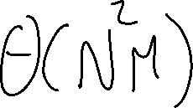


Deadlock detection algorithm
current=avail;
for (j = 0; j < N; j++) {
for (k=0; k<N; k++) {
if (finished[k])
continue;
if (want[k] <= current) {
finished[k] = 1;
current += hold[k];
break;
}
}
if (k==N) {
printf “Deadlock!\n”;
// finished[k]==0 means process is in
// the deadlock
break;
}
}
 | A | B | C | D
current | 5 | 10 | 5 | 2
Process | A | B | C | D
1 | 0 | 3 | 0 | 0
2 | 1 | 0 | 1 | 1
3 | 0 | 2 | 1 | 0
4 | 2 | 2 | 3 | 0
Hold
Process | A | B | C | D
1 | 3 | 2 | 1 | 0
2 | 2 | 2 | 0 | 0
3 | 3 | 5 | 3 | 1
4 | 0 | 4 | 1 | 1
Want
Note: want[j], hold[j], current, avail are arrays!

Slide 19





Deadlock detection algorithm
current=avail;
for (j = 0; j < N; j++) {
for (k=0; k<N; k++) {
if (finished[k])
continue;
if (want[k] <= current) {
finished[k] = 1;
current += hold[k];
break;
}
}
if (k==N) {
printf “Deadlock!\n”;
// finished[k]==0 means process is in
// the deadlock
break;
}
}
 | A | B | C | D
current | 5 | 10 | 5 | 2
Process | A | B | C | D
1 | 0 | 3 | 0 | 0
2 | 1 | 0 | 1 | 1
3 | 0 | 2 | 1 | 0
4 | 2 | 2 | 3 | 0
Hold
Process | A | B | C | D
1 | 3 | 2 | 1 | 0
2 | 2 | 2 | 0 | 0
3 | 3 | 5 | 3 | 1
4 | 0 | 4 | 1 | 1
Want
Note: want[j], hold[j], current, avail are arrays!

Slide 20
Banker’s Algorithm Insights
It is possible that some event sequences lead a deadlock
What we are looking for is at least one event sequence that can make all processes finish
If such sequence exists, the state is safe
The Banker’s algorithm finds such sequence if it exists

Slide 21
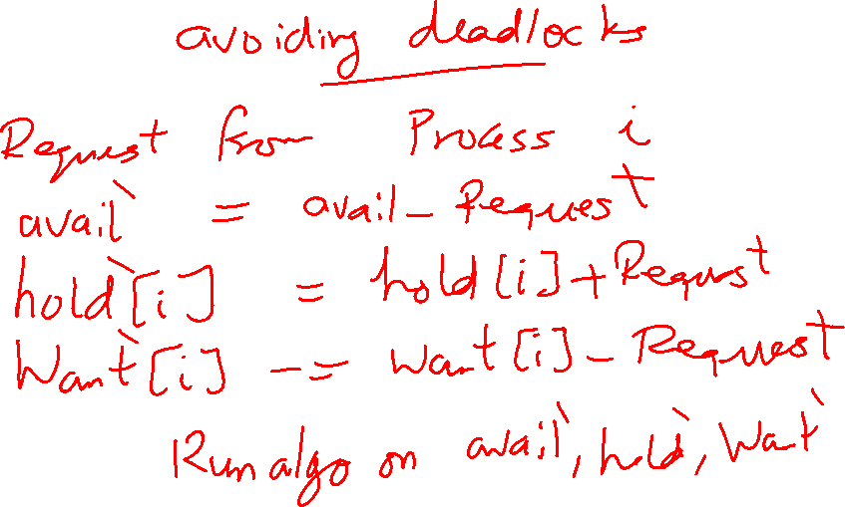
Using the Banker’s Algorithm for Deadlock Avoidance
Call the algorithm on the following ``What-if” state instead of the current state

Slide 22
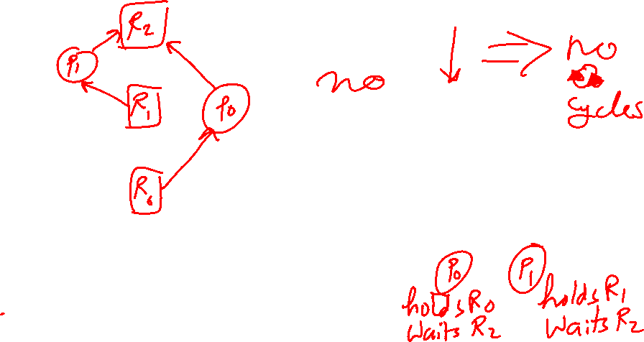
Proof sketch for Deadlock Prevention
If resources are ordered and resource requests within each process follow the resource ordering, the resource allocation graph will have no downward arrows.

Slide 23
Problem of the Day: Sleepy Barbers
We have two sets of processes
Worker processes (e.g., barbers)
Customer processes
Customer processes may arrive at anytime
Worker processes check in when they are not serving any customers
Each worker process must wait until it gets matched with a customer process
Each customer process must wait until it gets matched with a worker process
The customer process cannot leave until the matched worker process finishes the work
The worker process cannot check in for the next customer until the matched customer process leaves
Many applications in the real-world

Slide 24
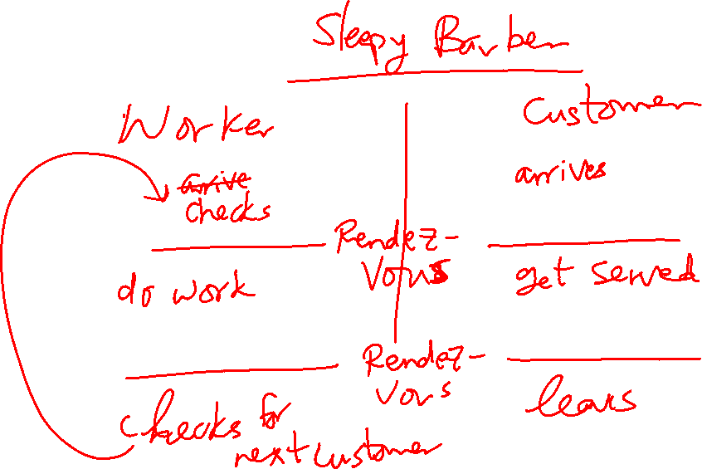
Rendezvous Pattern

Slide 25
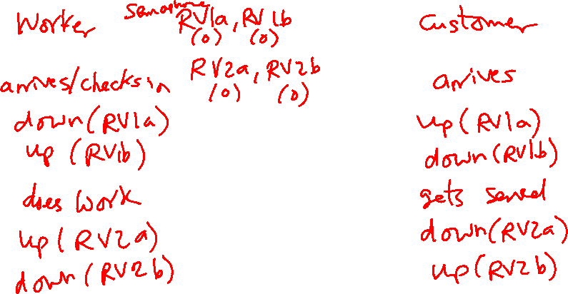
Solution Using Semaphores: Take 1
One pair of semaphores per rendezvous
RV1a and RV1b
RV2a and RV2b
Notice the flipped order of the down and up calls in the two processes

Slide 26
Solution Using Semaphores: Take 1
This solution doesn’t work for multiple workers and multiple customers
A customer can leave before its associated worker finishes

