Slide 1


Introduction to Operating Systems CS 1550
Spring 2023
Sherif Khattab
ksm73@pitt.edu
(Some slides are from Silberschatz, Galvin and Gagne ©2013)

Slide 2
Announcements
Upcoming deadlines:
Quiz 1: due 2/25
Homework 6: due 2/28
Lab 2: due on 2/28
Project 2: due on 3/18
Midterm exam on Thursday 3/3
In-person, on paper, closed book

Slide 3
Previous Lecture …
How to implement condition variables”
Reflections on using semaphores and condition variables

Slide 4
Muddiest Points (Condition Variable Implementation)
for the user side implementation of condition variables, is the next queue only holding processes that have signaled and yielded to the awakened process and therefore have to sleep?
Hoare and Mesa semantics.
are there any performance drawbacks when implementing condition variables at the application level?
I think the code for the implementation of the CV was a little fast, so I'm not confident I got it fully.
How you can connect the cv implementation in and outside kernel
I don't understand what all the locks do for the condition variable implementation.
Would you please explain the implementation of Signal() in User-level implement of Condition variable? Thank you.
Why Hoare semantics are necessary for a user level implementation. The implementation of the user level condition variable was also generally confusing without fully understanding why it’s being done that way. I’ll need to review this on my own

Slide 5
Muddiest Points (Deadlocks)
How often do deadlocks occur even if the algorithm tells us it is possible to not deadlock

Slide 6
Muddiest Points (Misc.)
n/a BUT PLEASE EXTEND PROJ 1. THOTH IS ALWAYSSS DOWNNN!!!!
where the sleepy barber would actually be used

Slide 7
Final Remarks on Process Synchronization
Many other synchronization mechanisms
Message passing
Barriers
Futex
Re-entrant locks
Atomic*

Slide 8
Problem of the Day: CPU Scheduling
How does the short-term scheduler select the next process to run?

Slide 9
CPU Scheduling
Scheduling the processor among all ready processes
User-oriented criteria
Response Time: Elapsed time between the submission of a request and the receipt of a response
Turnaround Time: Elapsed time between the submission of a process to its completion
System-oriented criteria
Processor utilization
Throughput: number of process completed per unit time
Fairness

Slide 10
Short-Term Scheduler Dispatcher
The dispatcher is the module that gives control of the CPU to the process selected by the short-term scheduler
The functions of the dispatcher include:
Switching context
Switching to user mode
Jumping to the location in the user program to restart execution
The dispatch latency must be minimal

Slide 11





The CPU-I/O Cycle
Processes require alternate use of processor and I/O in a repetitive fashion
Each cycle consist of a CPU burst followed by an I/O burst
A process terminates on a CPU burst
CPU-bound processes have longer CPU bursts than I/O-bound processes

Slide 12
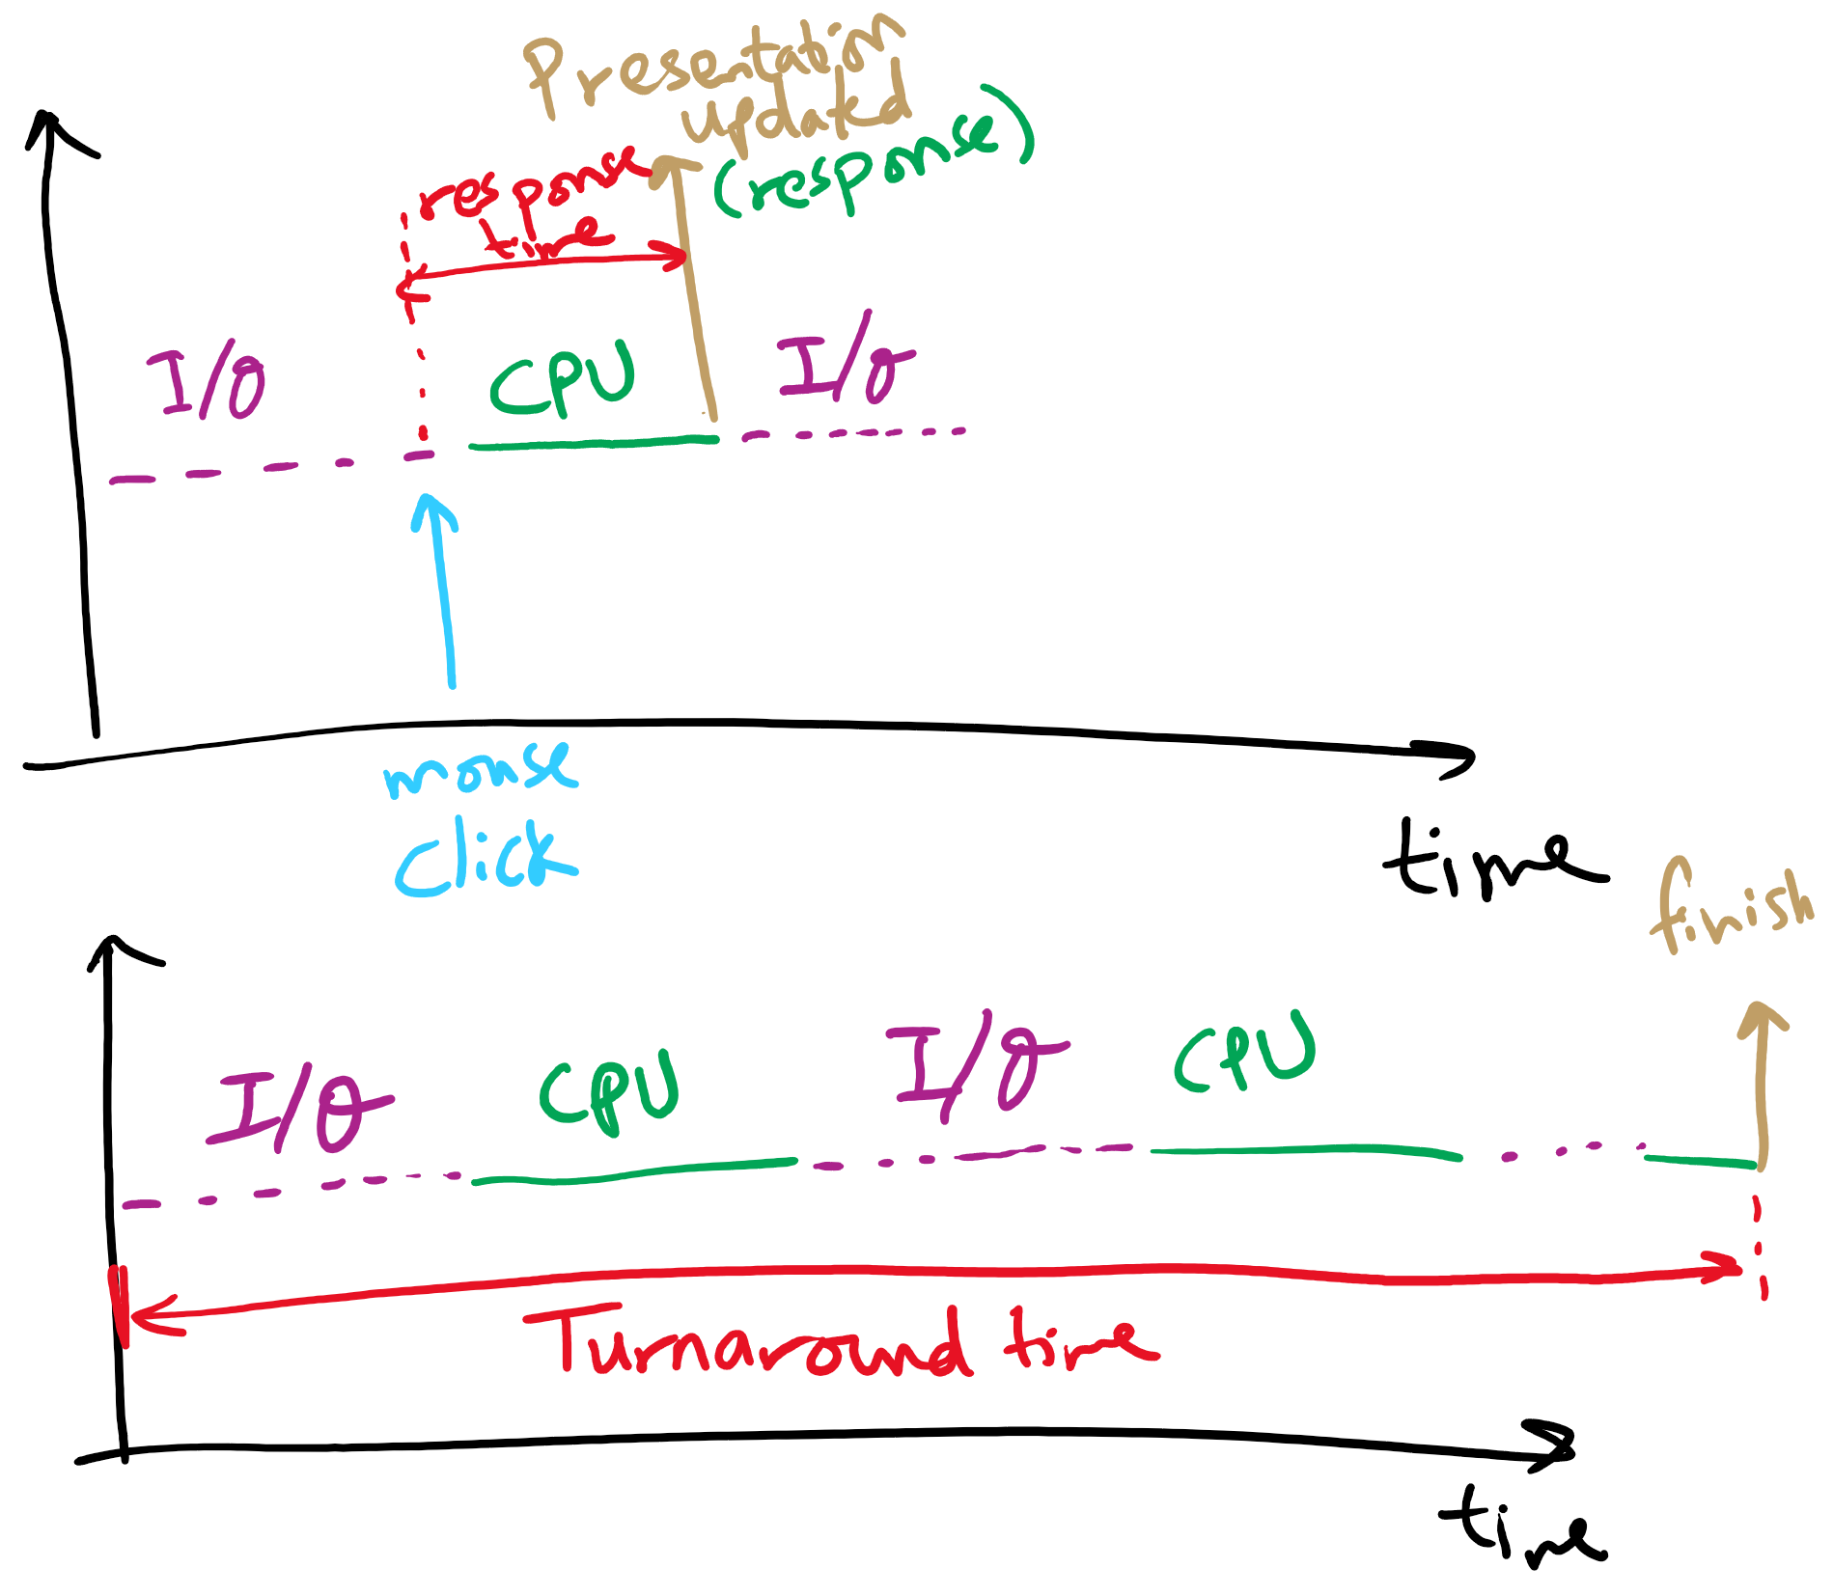
Response time vs. Turnaround time

Slide 13
Scheduling Algorithms
First-Come, First-Served Scheduling
Shortest-Job-First Scheduling
Also referred to as Shortest Process Next
Priority Scheduling
Round-Robin Scheduling
Multilevel Queue Scheduling
Multilevel Feedback Queue Scheduling

Slide 14
Characterization of Scheduling Policies
The selection function determines which ready process is selected next for execution
The decision mode specifies the instants in time the selection function is exercised
Nonpreemptive
Once a process is in the running state, it will continue until it terminates or blocks for an I/O
Preemptive
Currently running process may be interrupted and moved to the Ready state by the OS
Prevents one process from monopolizing the processor

Slide 15
Process Mix Example
Process
Arrival Time
Service Time
1
0
3
2
2
6
3
4
4
4
6
5
5
8
2
Service time = total processor time needed in one (CPU-I/O) cycle
Jobs with long service time are CPU-bound jobs and are referred
to as “long jobs”

Slide 16







First Come First Served (FCFS)
Selection function: the process that has been waiting the longest in the ready queue (hence, FCFS)
Decision mode: non-preemptive
a process runs until it blocks for an I/O
Process
Arrival Time
Service Time
1
0
3
2
2
6
3
4
4
4
6
5
5
8
2

Slide 17
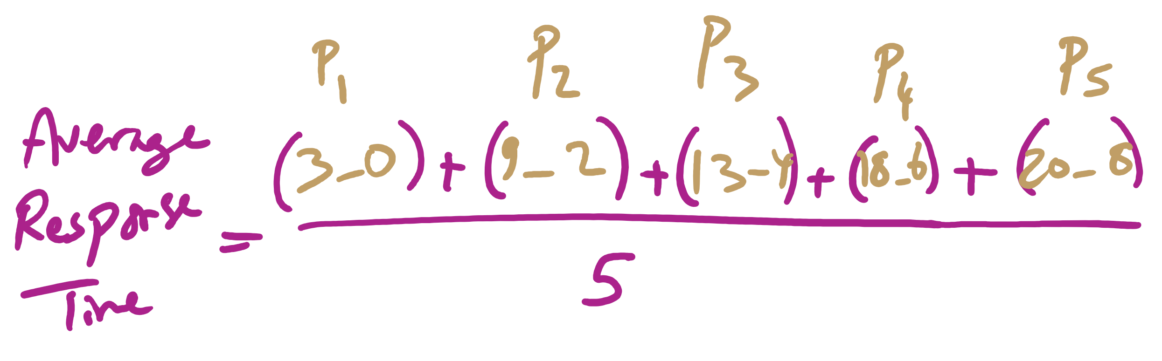
Average Response Time

Slide 18
FCFS drawbacks
Favours CPU-bound processes
CPU-bound processes monopolize the processor
I/O-bound processes have to wait until completion of CPU-bound process
I/O-bound processes may have to wait even after their I/Os are completed (poor device utilization)
Convoy effect
Better I/O device utilization could be achieved if I/O bound processes had higher priority

Slide 19
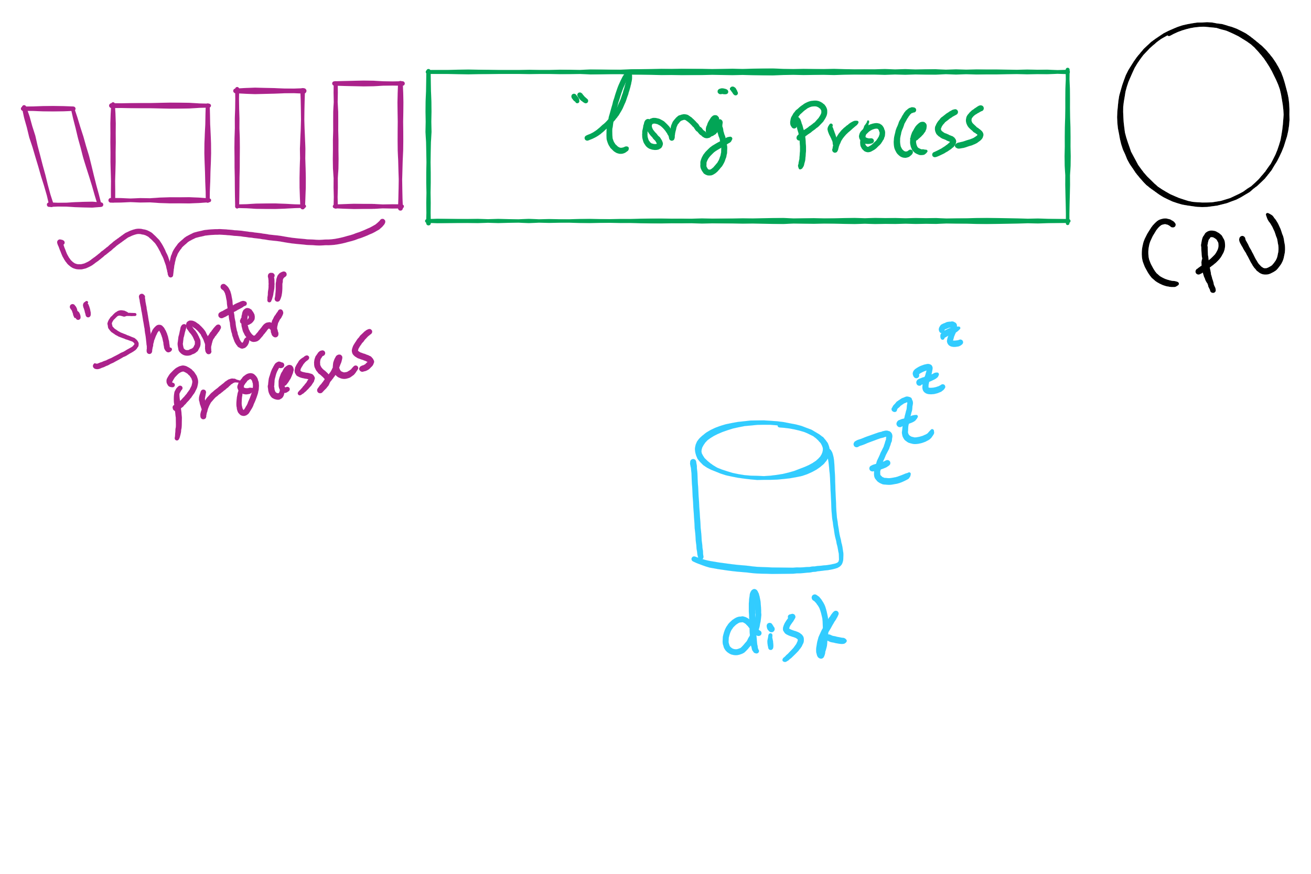
Convoy Effect

Slide 20











Shortest Job First (Shortest Process Next)
Selection function: the process with the shortest expected CPU burst time
I/O-bound processes will be selected first
Decision mode: non-preemptive
The required processing time, i.e., the CPU burst time, must be estimated for each process
Process
Arrival Time
Service Time
1
0
3
2
2
6
3
4
4
4
6
5
5
8
2

Slide 21
SJF / SPN Critique
Possibility of starvation for longer processes
Lack of preemption is not suitable in a time sharing environment
SJF/SPN implicitly incorporates priorities
Shortest jobs are given preference
CPU bound processes have lower priority, but a process doing no I/O could still monopolize the CPU if it is the first to enter the system

Slide 22
Priorities
Implemented by having multiple ready queues to represent each level of priority
Scheduler selects the process of a higher priority over one of lower priority
Lower-priority may suffer starvation
To alleviate starvation allow dynamic priorities
The priority of a process changes based on its age or execution history

Slide 23
Round-Robin
Selection function: same as FCFS
Decision mode: pre-emptive
a process is allowed to run until the time slice period (quantum, typically from 10 to 100 ms) has expired
a clock interrupt occurs and the running process is put on the ready queue
Process
Arrival Time
Service Time
1
0
3
2
2
6
3
4
4
4
6
5
5
8
2

Slide 24

Round-Robin
Selection function: same as FCFS
Decision mode: pre-emptive
a process is allowed to run until the time slice period (quantum, typically from 10 to 100 ms) has expired
a clock interrupt occurs and the running process is put on the ready queue
Process
Arrival Time
Service Time
1
0
3
2
2
6
3
4
4
4
6
5
5
8
2

Slide 25

Round-Robin
Selection function: same as FCFS
Decision mode: pre-emptive
a process is allowed to run until the time slice period (quantum, typically from 10 to 100 ms) has expired
a clock interrupt occurs and the running process is put on the ready queue
Process
Arrival Time
Service Time
1
0
3
2
2
6
3
4
4
4
6
5
5
8
2

Slide 26

Round-Robin
Selection function: same as FCFS
Decision mode: pre-emptive
a process is allowed to run until the time slice period (quantum, typically from 10 to 100 ms) has expired
a clock interrupt occurs and the running process is put on the ready queue
Process
Arrival Time
Service Time
1
0
3
2
2
6
3
4
4
4
6
5
5
8
2

Slide 27


Round-Robin
Selection function: same as FCFS
Decision mode: pre-emptive
a process is allowed to run until the time slice period (quantum, typically from 10 to 100 ms) has expired
a clock interrupt occurs and the running process is put on the ready queue
Process
Arrival Time
Service Time
1
0
3
2
2
6
3
4
4
4
6
5
5
8
2

Slide 28

Round-Robin
Selection function: same as FCFS
Decision mode: pre-emptive
a process is allowed to run until the time slice period (quantum, typically from 10 to 100 ms) has expired
a clock interrupt occurs and the running process is put on the ready queue
Process
Arrival Time
Service Time
1
0
3
2
2
6
3
4
4
4
6
5
5
8
2

Slide 29

Round-Robin
Selection function: same as FCFS
Decision mode: pre-emptive
a process is allowed to run until the time slice period (quantum, typically from 10 to 100 ms) has expired
a clock interrupt occurs and the running process is put on the ready queue
Process
Arrival Time
Service Time
1
0
3
2
2
6
3
4
4
4
6
5
5
8
2

Slide 30

Round-Robin
Selection function: same as FCFS
Decision mode: pre-emptive
a process is allowed to run until the time slice period (quantum, typically from 10 to 100 ms) has expired
a clock interrupt occurs and the running process is put on the ready queue
Process
Arrival Time
Service Time
1
0
3
2
2
6
3
4
4
4
6
5
5
8
2

Slide 31


Round-Robin
Selection function: same as FCFS
Decision mode: pre-emptive
a process is allowed to run until the time slice period (quantum, typically from 10 to 100 ms) has expired
a clock interrupt occurs and the running process is put on the ready queue
Process
Arrival Time
Service Time
1
0
3
2
2
6
3
4
4
4
6
5
5
8
2

Slide 32

Round-Robin
Selection function: same as FCFS
Decision mode: pre-emptive
a process is allowed to run until the time slice period (quantum, typically from 10 to 100 ms) has expired
a clock interrupt occurs and the running process is put on the ready queue
Process
Arrival Time
Service Time
1
0
3
2
2
6
3
4
4
4
6
5
5
8
2

Slide 33


Round-Robin
Selection function: same as FCFS
Decision mode: pre-emptive
a process is allowed to run until the time slice period (quantum, typically from 10 to 100 ms) has expired
a clock interrupt occurs and the running process is put on the ready queue
Process
Arrival Time
Service Time
1
0
3
2
2
6
3
4
4
4
6
5
5
8
2

Slide 34


Round-Robin
Selection function: same as FCFS
Decision mode: pre-emptive
a process is allowed to run until the time slice period (quantum, typically from 10 to 100 ms) has expired
a clock interrupt occurs and the running process is put on the ready queue
Process
Arrival Time
Service Time
1
0
3
2
2
6
3
4
4
4
6
5
5
8
2

Slide 35

Round-Robin
Selection function: same as FCFS
Decision mode: pre-emptive
a process is allowed to run until the time slice period (quantum, typically from 10 to 100 ms) has expired
a clock interrupt occurs and the running process is put on the ready queue
Process
Arrival Time
Service Time
1
0
3
2
2
6
3
4
4
4
6
5
5
8
2

Slide 36

Round-Robin
Selection function: same as FCFS
Decision mode: pre-emptive
a process is allowed to run until the time slice period (quantum, typically from 10 to 100 ms) has expired
a clock interrupt occurs and the running process is put on the ready queue
Process
Arrival Time
Service Time
1
0
3
2
2
6
3
4
4
4
6
5
5
8
2

Slide 37


Round-Robin
Selection function: same as FCFS
Decision mode: pre-emptive
a process is allowed to run until the time slice period (quantum, typically from 10 to 100 ms) has expired
a clock interrupt occurs and the running process is put on the ready queue
Process
Arrival Time
Service Time
1
0
3
2
2
6
3
4
4
4
6
5
5
8
2

Slide 38

Round-Robin
Selection function: same as FCFS
Decision mode: pre-emptive
a process is allowed to run until the time slice period (quantum, typically from 10 to 100 ms) has expired
a clock interrupt occurs and the running process is put on the ready queue
Process
Arrival Time
Service Time
1
0
3
2
2
6
3
4
4
4
6
5
5
8
2

Slide 39

Round-Robin
Selection function: same as FCFS
Decision mode: pre-emptive
a process is allowed to run until the time slice period (quantum, typically from 10 to 100 ms) has expired
a clock interrupt occurs and the running process is put on the ready queue
Process
Arrival Time
Service Time
1
0
3
2
2
6
3
4
4
4
6
5
5
8
2

Slide 40


Round-Robin
Selection function: same as FCFS
Decision mode: pre-emptive
a process is allowed to run until the time slice period (quantum, typically from 10 to 100 ms) has expired
a clock interrupt occurs and the running process is put on the ready queue
Process
Arrival Time
Service Time
1
0
3
2
2
6
3
4
4
4
6
5
5
8
2

Slide 41

Round-Robin
Selection function: same as FCFS
Decision mode: pre-emptive
a process is allowed to run until the time slice period (quantum, typically from 10 to 100 ms) has expired
a clock interrupt occurs and the running process is put on the ready queue
Process
Arrival Time
Service Time
1
0
3
2
2
6
3
4
4
4
6
5
5
8
2

Slide 42
RR Time Quantum
Quantum must be substantially larger than the time required to handle the clock interrupt and dispatching
Quantum should be larger then the typical interaction
but not much larger, to avoid penalizing I/O bound processes

Slide 43
RR Time Quantum

Slide 44
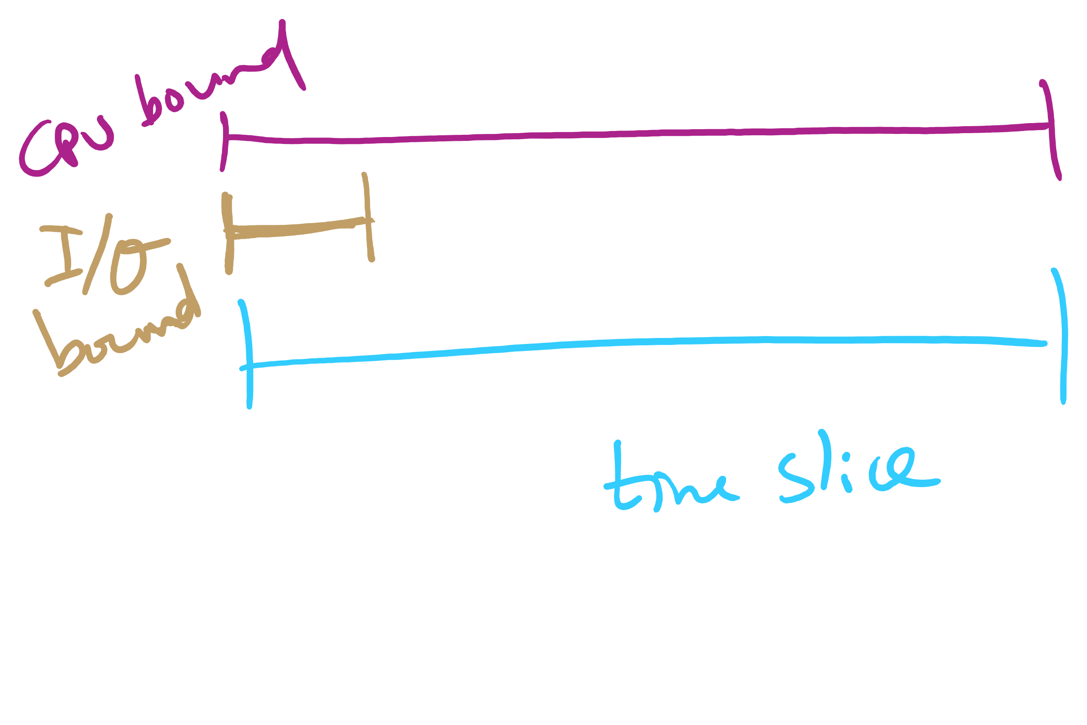
Quantum Length

Slide 45
Round Robin: critique
Still favors CPU-bound processes
An I/O bound process uses the CPU for a time less than the time quantum before it is blocked waiting for an I/O
A CPU-bound process runs for all its time slice and is put back into the ready queue
May unfairly get in front of blocked processes

