Slide 1


Introduction to Operating Systems CS 1550
Spring 2023
Sherif Khattab
ksm73@pitt.edu
(Some slides are from Silberschatz, Galvin and Gagne ©2013)

Slide 2
Announcements
Upcoming deadlines:
Quiz 1: due 2/25
Homework 6: due 2/28
Lab 2: due on 2/28
Project 2: due on 3/18
Midterm exam on Thursday 3/3
In-person, on paper, closed book

Slide 3
Previous lecture …
How does the short-term scheduler select the next process to run?
FCFS, SJF, Priority, RR

Slide 4
Muddiest Points (Scheduling)
can a mix of scheduling algorithms be utilized by the scheduler?
What makes the priorities algorithm significantly different from the shortest process first algorithm?
How does First Come First Serve avoid starvation? What if a process runs indefinitely?
What is the most commonly used in modern computer design ?
Convoy Effect
In some points, we use Service Time for finding out which process is short time, is there any table that has the times of all process? or cpu or user predict these times?
non-preemptive versus pre-emptive
First Come First Serve Scheduling and Arrival Time how they work together

Slide 5
Muddiest Points (Round Robin)
Why does making the time quantum much longer than the CPU burst penalize I/O bound processes?
What actually is "quantum"? Is it something that can be implemented? Or is it just conceptual
quantum/time slice size choice
Can the round-robin time quantum be dynamically selected?
Round robin vs FCFS

Slide 6
Muddiest Points (misc.)
Will practice exam be posted
I'm from the future and Thoth went down again. Project 2 extension?
What specific material is covered on the midterm exam? I'm somewhat unclear on that question.

Slide 7
Problem of the Day: CPU Scheduling
How does the short-term scheduler select the next process to run?

Slide 8
Multilevel Feedback Scheduling
Preemptive scheduling with dynamic priorities
N ready to execute queues with decreasing priorities:
P(RQ₀) > P(RQ₁) > ... > P(RQ_{N-1})
Dispatcher selects a process for execution from RQ_{i} only if RQ_{i-1} to RQ₀ are empty

Slide 9
Multilevel Feedback Scheduling
New process are placed in RQ₀
After the first quantum, they are moved to RQ₁, and to RQ₂ after the second quantum, … and to RQ_{N-1} after the Nth quantum
I/O-bound processes remain in higher priority queues.
CPU-bound jobs drift downward.
Hence, long jobs may starve

Slide 10
Multiple Feedback Queues
Different RQs may have different quantum values

Slide 11
Time Quantum for feedback Scheduling
With a fixed quantum time, the turn-around time of longer processes can be high
To alleviate this problem, the time quantum can be increased based on the depth of the queue
Time quantum of RQ_{i} = 2^{i-1}
May still cause longer processes to suffer starvation.
Possible fix is to promote a process to higher queue after some time
Process
Arrival Time
Service Time
1
0
3
2
2
6
3
4
4
4
6
5
5
8
2

Slide 12

Time Quantum for feedback Scheduling
With a fixed quantum time, the turn-around time of longer processes can be high
To alleviate this problem, the time quantum can be increased based on the depth of the queue
Time quantum of RQ_{i} = 2^{i-1}
May still cause longer processes to suffer starvation.
Possible fix is to promote a process to higher queue after some time
Process
Arrival Time
Service Time
1
0
3
2
2
6
3
4
4
4
6
5
5
8
2

Slide 13

Time Quantum for feedback Scheduling
With a fixed quantum time, the turn-around time of longer processes can be high
To alleviate this problem, the time quantum can be increased based on the depth of the queue
Time quantum of RQ_{i} = 2^{i-1}
May still cause longer processes to suffer starvation.
Possible fix is to promote a process to higher queue after some time
Process
Arrival Time
Service Time
1
0
3
2
2
6
3
4
4
4
6
5
5
8
2

Slide 14

Time Quantum for feedback Scheduling
With a fixed quantum time, the turn-around time of longer processes can be high
To alleviate this problem, the time quantum can be increased based on the depth of the queue
Time quantum of RQ_{i} = 2^{i-1}
May still cause longer processes to suffer starvation.
Possible fix is to promote a process to higher queue after some time
Process
Arrival Time
Service Time
1
0
3
2
2
6
3
4
4
4
6
5
5
8
2

Slide 15

Time Quantum for feedback Scheduling
With a fixed quantum time, the turn-around time of longer processes can be high
To alleviate this problem, the time quantum can be increased based on the depth of the queue
Time quantum of RQ_{i} = 2^{i-1}
May still cause longer processes to suffer starvation.
Possible fix is to promote a process to higher queue after some time
Process
Arrival Time
Service Time
1
0
3
2
2
6
3
4
4
4
6
5
5
8
2

Slide 16

Time Quantum for feedback Scheduling
With a fixed quantum time, the turn-around time of longer processes can be high
To alleviate this problem, the time quantum can be increased based on the depth of the queue
Time quantum of RQ_{i} = 2^{i-1}
May still cause longer processes to suffer starvation.
Possible fix is to promote a process to higher queue after some time
Process
Arrival Time
Service Time
1
0
3
2
2
6
3
4
4
4
6
5
5
8
2

Slide 17


Time Quantum for feedback Scheduling
With a fixed quantum time, the turn-around time of longer processes can be high
To alleviate this problem, the time quantum can be increased based on the depth of the queue
Time quantum of RQ_{i} = 2^{i-1}
May still cause longer processes to suffer starvation.
Possible fix is to promote a process to higher queue after some time
Process
Arrival Time
Service Time
1
0
3
2
2
6
3
4
4
4
6
5
5
8
2

Slide 18


Time Quantum for feedback Scheduling
With a fixed quantum time, the turn-around time of longer processes can be high
To alleviate this problem, the time quantum can be increased based on the depth of the queue
Time quantum of RQ_{i} = 2^{i-1}
May still cause longer processes to suffer starvation.
Possible fix is to promote a process to higher queue after some time
Process
Arrival Time
Service Time
1
0
3
2
2
6
3
4
4
4
6
5
5
8
2

Slide 19

Time Quantum for feedback Scheduling
With a fixed quantum time, the turn-around time of longer processes can be high
To alleviate this problem, the time quantum can be increased based on the depth of the queue
Time quantum of RQ_{i} = 2^{i-1}
May still cause longer processes to suffer starvation.
Possible fix is to promote a process to higher queue after some time
Process
Arrival Time
Service Time
1
0
3
2
2
6
3
4
4
4
6
5
5
8
2

Slide 20

Time Quantum for feedback Scheduling
With a fixed quantum time, the turn-around time of longer processes can be high
To alleviate this problem, the time quantum can be increased based on the depth of the queue
Time quantum of RQ_{i} = 2^{i-1}
May still cause longer processes to suffer starvation.
Possible fix is to promote a process to higher queue after some time
Process
Arrival Time
Service Time
1
0
3
2
2
6
3
4
4
4
6
5
5
8
2

Slide 21

Time Quantum for feedback Scheduling
With a fixed quantum time, the turn-around time of longer processes can be high
To alleviate this problem, the time quantum can be increased based on the depth of the queue
Time quantum of RQ_{i} = 2^{i-1}
May still cause longer processes to suffer starvation.
Possible fix is to promote a process to higher queue after some time
Process
Arrival Time
Service Time
1
0
3
2
2
6
3
4
4
4
6
5
5
8
2

Slide 22

Time Quantum for feedback Scheduling
With a fixed quantum time, the turn-around time of longer processes can be high
To alleviate this problem, the time quantum can be increased based on the depth of the queue
Time quantum of RQ_{i} = 2^{i-1}
May still cause longer processes to suffer starvation.
Possible fix is to promote a process to higher queue after some time
Process
Arrival Time
Service Time
1
0
3
2
2
6
3
4
4
4
6
5
5
8
2

Slide 23

Time Quantum for feedback Scheduling
With a fixed quantum time, the turn-around time of longer processes can be high
To alleviate this problem, the time quantum can be increased based on the depth of the queue
Time quantum of RQ_{i} = 2^{i-1}
May still cause longer processes to suffer starvation.
Possible fix is to promote a process to higher queue after some time
Process
Arrival Time
Service Time
1
0
3
2
2
6
3
4
4
4
6
5
5
8
2

Slide 24

Time Quantum for feedback Scheduling
With a fixed quantum time, the turn-around time of longer processes can be high
To alleviate this problem, the time quantum can be increased based on the depth of the queue
Time quantum of RQ_{i} = 2^{i-1}
May still cause longer processes to suffer starvation.
Possible fix is to promote a process to higher queue after some time
Process
Arrival Time
Service Time
1
0
3
2
2
6
3
4
4
4
6
5
5
8
2

Slide 25
Algorithm Comparison
Which one is the best?
The answer depends on many factors:
the system workload (extremely variable)
hardware support for the dispatcher
relative importance of performance criteria (response time, CPU utilization, throughput...)
The evaluation method used (each has its limitations...)

Slide 26
Back to SJF: CPU Burst Estimation
Let T[i] be the execution time for the ith instance of this process: the actual duration of the ith CPU burst of this process
Let S[i] be the predicted value for the ith CPU burst of this process. The simplest choice is:
S[n+1] =(1/n)(T[1]+…+T[n])=(1/n) Σ{i=1 to n} T[i]
This can be more efficiently calculated as:
S[n+1] = (1/n) T[n] + ((n-1)/n) S[n]
This estimate, however, results in equal weight for each instance

Slide 27
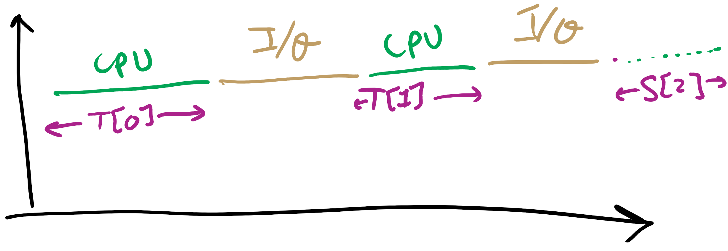
CPU Burst Estimation

Slide 28
Estimating the required CPU burst
Recent instances are more likely to better reflect future behavior
A common technique to factor the above observation into the estimate is to use exponential averaging :
S[n+1] = α T[n] + (1- α) S[n] ; 0 < α < 1

Slide 29
CPU burst Estimate (Exponential Average)
Recent instances have higher weights, whenever α > 1/n
Expanding the estimated value shows that the weights of past instances decrease exponentially
S[n+1] = α T[n] + (1- α) α T[n-1] + ... (1- α)^{i} α T[n-i] +
... + (1- α)^{n}S[1]
The predicted value of 1st instance, S[1], is usually set to 0 to give priority to new processes

Slide 30
Exponentially Decreasing Coefficients

Slide 31
Exponentially Decreasing Coefficients
S[1] = 0 to give high priority to new processes
Exponential averaging tracks changes in process behavior much faster than simple averaging

Slide 32
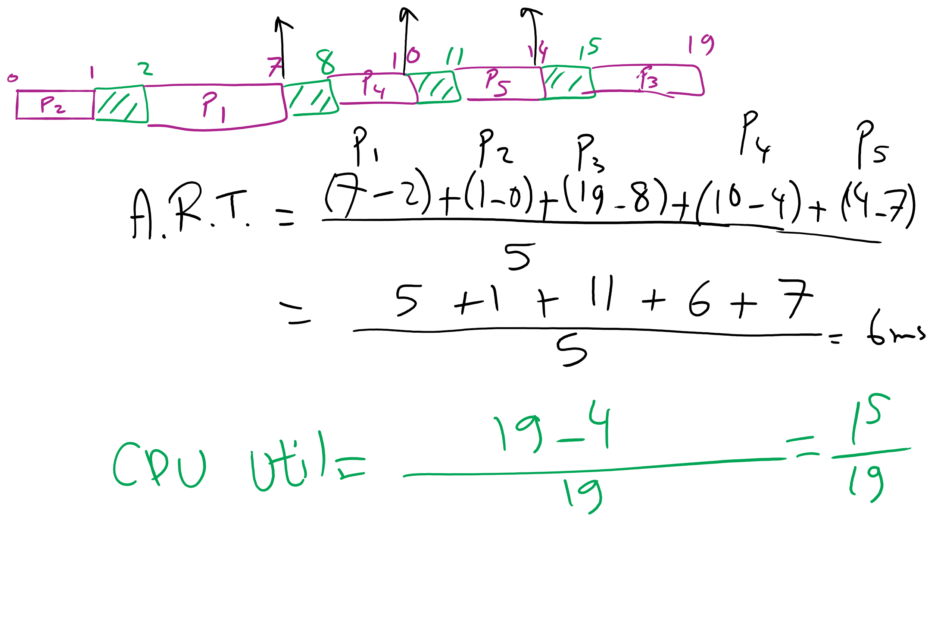
FCFS Problem in HW7

Slide 33
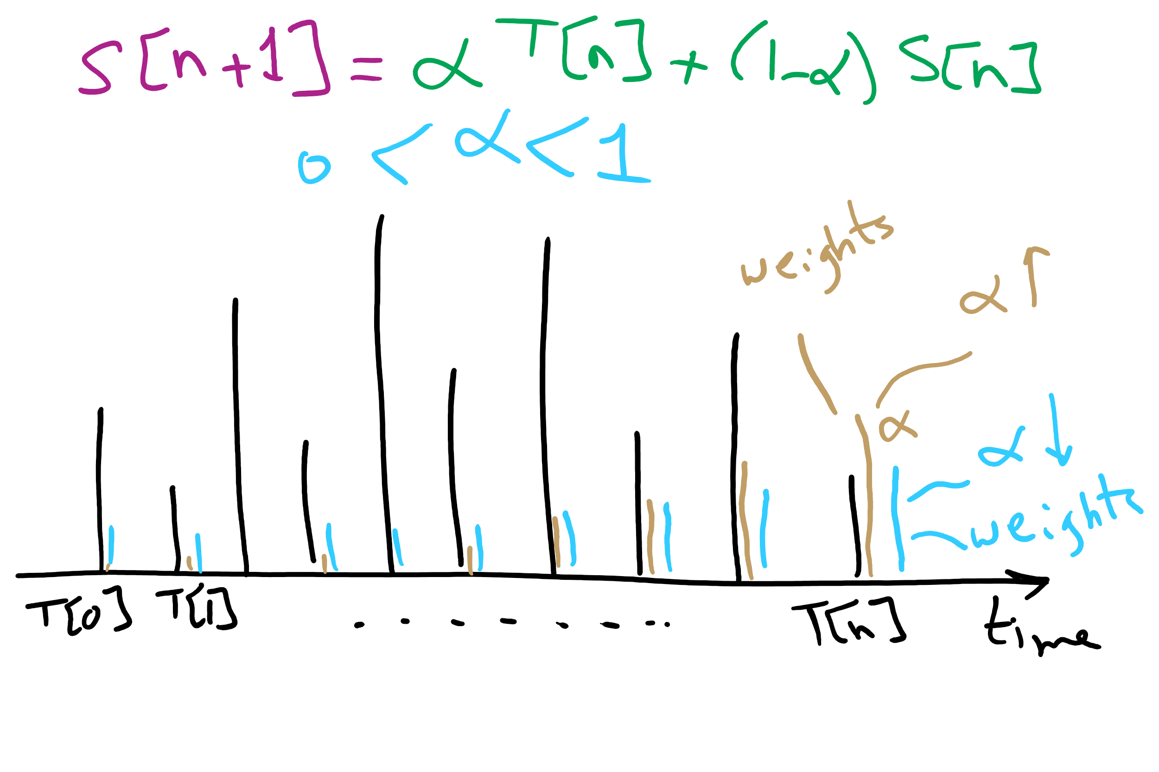
CPU Burst Estimation

