Slide 1


Introduction to Operating Systems CS 1550
Spring 2023
Sherif Khattab
ksm73@pitt.edu
(Some slides are from Silberschatz, Galvin and Gagne ©2013)

Slide 2
Announcements
Upcoming deadlines:
Quiz 2: due on 3/25
Homework 9: due on 3/28
Lab 3: due on 4/1
Project 3: due on 4/11

Slide 3
Previous lecture …
Page replacement algorithms
Algorithm | Comment
OPT (Optimal) | Not implementable, but useful as a benchmark
NRU (Not Recently Used) | Crude
FIFO (First-In, First Out) | Might throw out useful pages
Second chance | Big improvement over FIFO
Clock | Better implementation of second chance
LRU (Least Recently Used) | Excellent, but hard to implement exactly
NFU (Not Frequently Used) | Poor approximation to LRU
Aging | Good approximation to LRU, efficient to implement
Working Set | Somewhat expensive to implement
WSClock | Implementable version of Working Set

Slide 4
Muddiest Points (Memory)
Difference between NRU and NFU
For NRU, what is the way in which it separates the pages into classes in order to pick a victim from a group of the lowest non-empty class
On the clock for the clock algorithm, what is t and why does it change to 32 on the referenced pages?
What are we adding to the shift register in the working set replacement algorithm?
Why is the tracking of a process’ working set necessary?
Which page replacement algorithm is the best (generally)?
The question on the homework that has the numerical entry answer. I'm not quite sure how to adapt what we discussed in class to that question.
How the eviction happens in the pages

Slide 5
Muddiest Points (Memory)
How do we determine tau again?
On the last slide about working set page, does the page table get updated every clock tick? Or do we only care about evey clock interrupt here? I am a little confused about how is the clock interrupt concept applied to the working set page replacement algorithm.
What is k in the working set graph?
in second chance and clock replacement, why do referenced pages have their ref bit set back to 0?
Do most algorithms need to iterate through all pages (O(N) runtime)?
I am confused on the details of thrashing
LRU page replacement

Slide 6
Muddiest Points (Misc.)
i had a bit of a hard time keeping up with pretty much everything but i think that's just a side effect of coming back from break
what is it that makes the TLB access fast while being slower for memory PTE access
when is the midterm grades posted also will there be makeup to get up to 30% back?
When are TLB entries replaced
Is "Frame" the same thing as a physical page?
How is the page table indexed?
redo a walk through the address translation process with the CPU, MMU, & TLB caching

Slide 7
Problem of the Day
How to simulate page replacement algorithms
FIFO/Clock
LRU, OPT

Slide 8
How is modeling done?
Generate a list of references
Artificial (made up)
Trace a real workload (set of processes)
Use an array (or other structure) to track the pages in physical memory at any given time
May keep other information per page to help simulate the algorithm (modification time, time when paged in, etc.)
Run through references, applying the replacement algorithm
Example: FIFO replacement on reference string 0 1 2 3 0 1 4 0 1 2 3 4
Page replacements highlighted in yellow
Page referenced |  | 0 | 1 | 2 | 3 | 0 | 1 | 4 | 0 | 1 | 2 | 3 | 4
Youngest page |  | 0 | 1 | 2 | 3 | 0 | 1 | 4 | 4 | 4 | 2 | 3 | 3
 |  |  | 0 | 1 | 2 | 3 | 0 | 1 | 1 | 1 | 4 | 2 | 2
Oldest page |  |  |  | 0 | 1 | 2 | 3 | 0 | 0 | 0 | 1 | 4 | 4

Slide 9
Interactive Simulation Tool
https://sim-50.github.io/cs-tools/

Slide 10
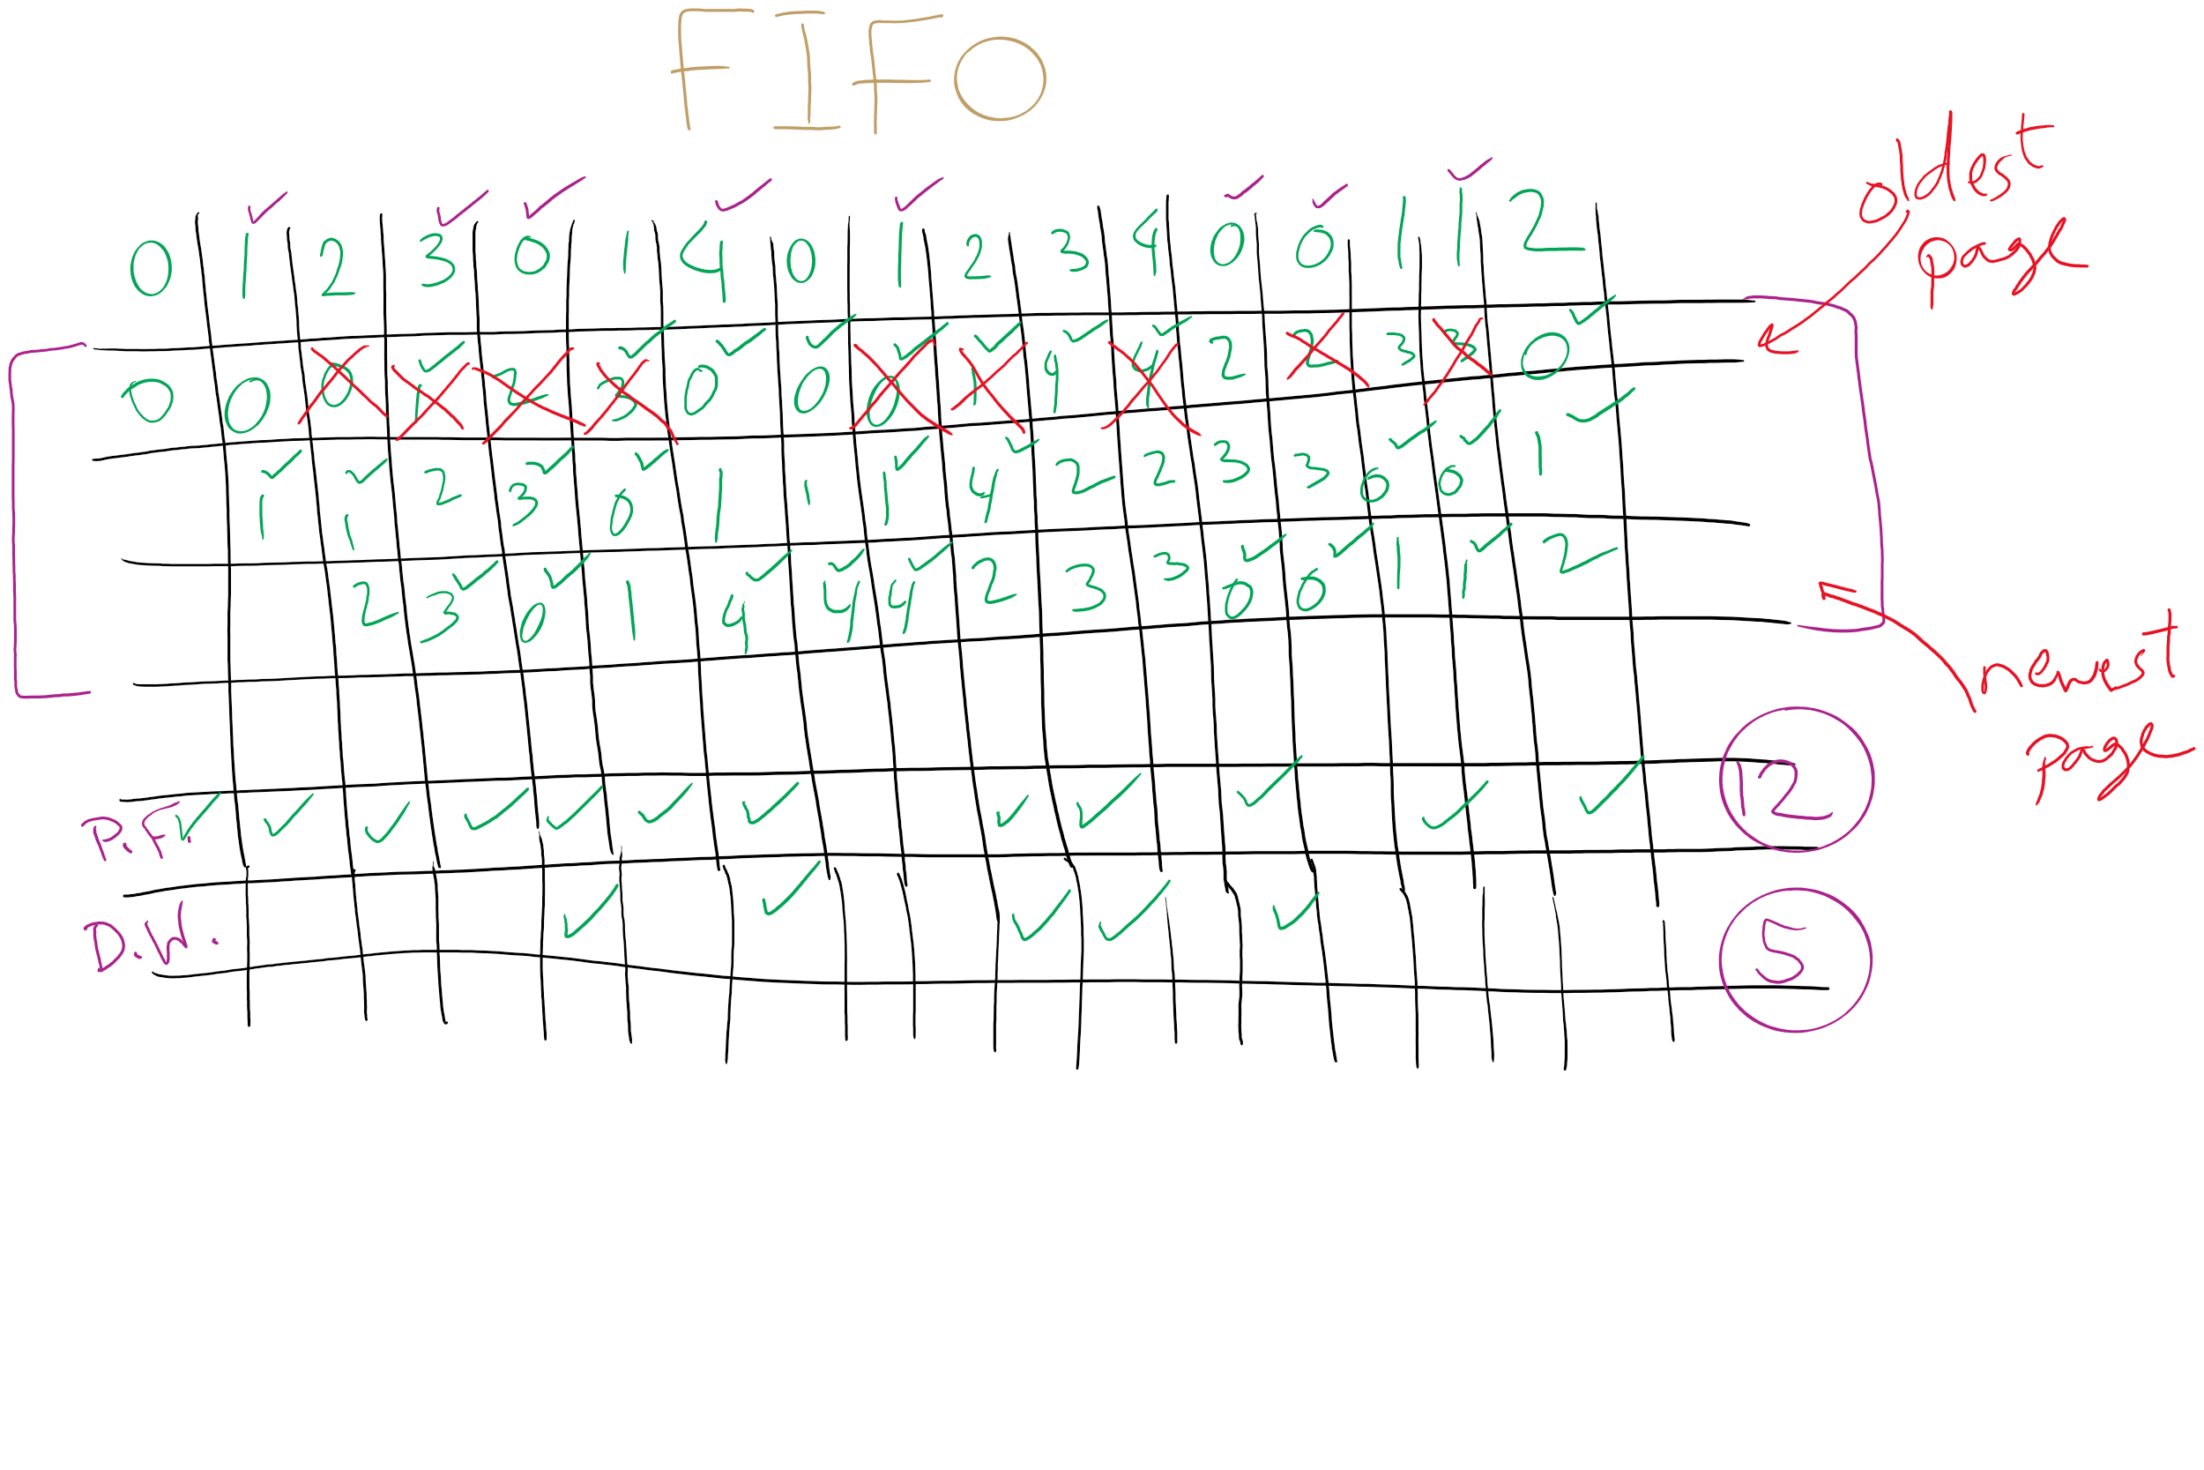
FIFO with 3 frames

Slide 11
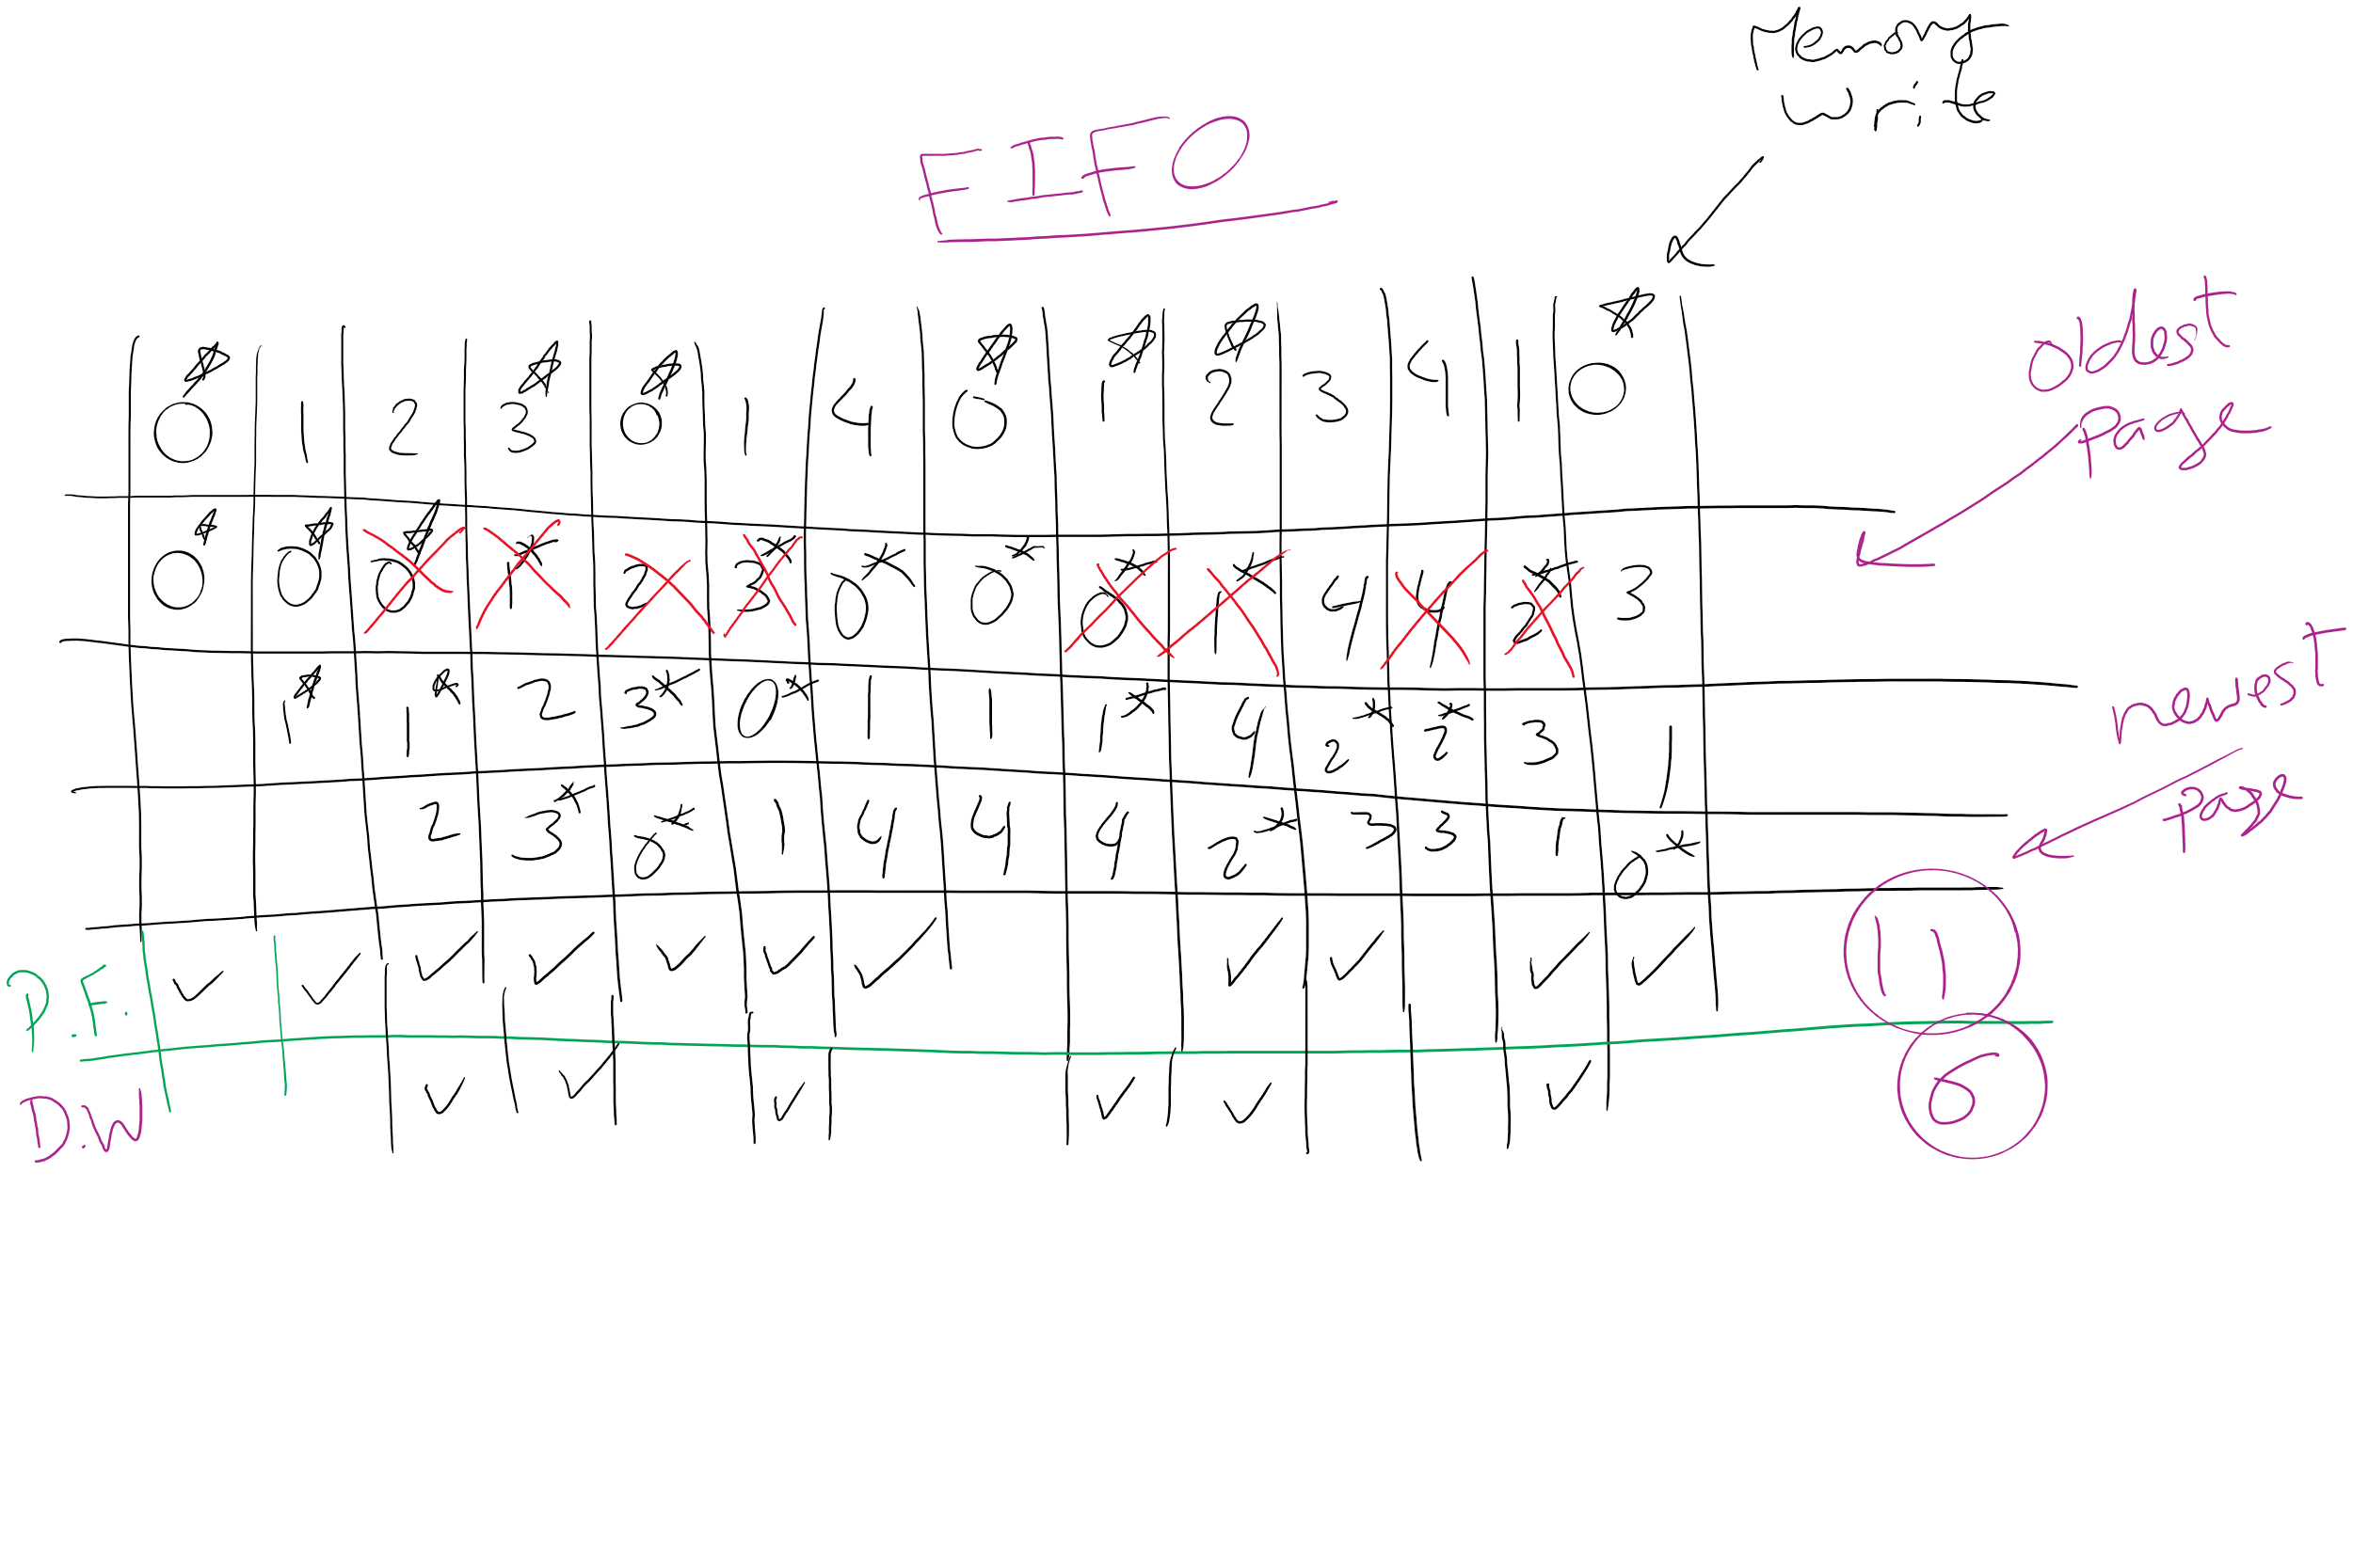
FIFO Example 1

Slide 12
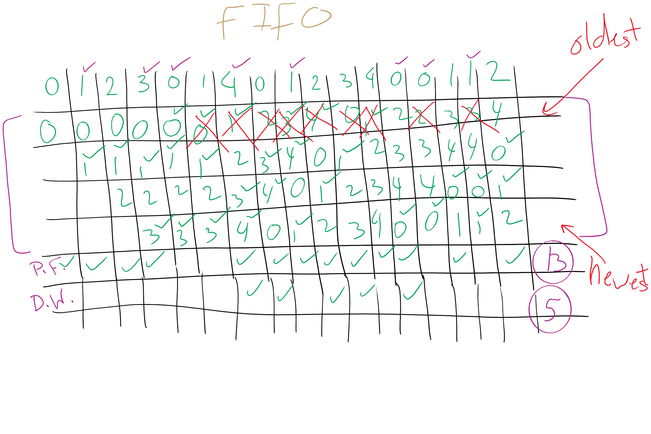
FIFO with 4 frames

Slide 13
Belady’s anomaly
Reduce the number of page faults by supplying more memory
Use previous reference string and FIFO algorithm
Add another page to physical memory (total 4 pages)
More page faults (10 vs. 9), not fewer!
This is called Belady’s anomaly
Adding more pages shouldn’t result in worse performance!
Motivated the study of paging algorithms

Slide 14
CLOCK Simulation

Slide 15
Modeling more replacement algorithms
Paging system characterized by:
Reference string of executing process
Page replacement algorithm
Number of page frames available in physical memory (m)
Model this by keeping track of all n pages referenced in array M
Top part of M has m pages in memory
Bottom part of M has n-m pages stored on disk
Page replacement occurs when page moves from top to bottom
Top and bottom parts may be rearranged without causing movement between memory and disk

Slide 16
Example: LRU
Model LRU replacement with
8 unique references in the reference string
4 pages of physical memory
Array state over time shown below
LRU treats list of pages like a stack
 | 0 | 2 | 1 | 3 | 5 | 4 | 6 | 3 | 7 | 4 | 7 | 3 | 3 | 5 | 5 | 3 | 1 | 1 | 1 | 7 | 1 | 3 | 4 | 1
 | 0 | 2 | 1 | 3 | 5 | 4 | 6 | 3 | 7 | 4 | 7 | 3 | 3 | 5 | 5 | 3 | 1 | 1 | 1 | 7 | 1 | 3 | 4 | 1
 |  | 0 | 2 | 1 | 3 | 5 | 4 | 6 | 3 | 7 | 4 | 7 | 7 | 3 | 3 | 5 | 3 | 3 | 3 | 1 | 7 | 1 | 3 | 4
 |  |  | 0 | 2 | 1 | 3 | 5 | 4 | 6 | 3 | 3 | 4 | 4 | 7 | 7 | 7 | 5 | 5 | 5 | 3 | 3 | 7 | 1 | 3
 |  |  |  | 0 | 2 | 1 | 3 | 5 | 4 | 6 | 6 | 6 | 6 | 4 | 4 | 4 | 7 | 7 | 7 | 5 | 5 | 5 | 7 | 7
 |  |  |  |  | 0 | 2 | 1 | 1 | 5 | 5 | 5 | 5 | 5 | 6 | 6 | 6 | 4 | 4 | 4 | 4 | 4 | 4 | 5 | 5
 |  |  |  |  |  | 0 | 2 | 2 | 1 | 1 | 1 | 1 | 1 | 1 | 1 | 1 | 6 | 6 | 6 | 6 | 6 | 6 | 6 | 6
 |  |  |  |  |  |  | 0 | 0 | 2 | 2 | 2 | 2 | 2 | 2 | 2 | 2 | 2 | 2 | 2 | 2 | 2 | 2 | 2 | 2
 |  |  |  |  |  |  |  |  | 0 | 0 | 0 | 0 | 0 | 0 | 0 | 0 | 0 | 0 | 0 | 0 | 0 | 0 | 0 | 0

Slide 17
Stack algorithms
LRU is an example of a stack algorithm
For stack algorithms
Any page in memory with m physical pages is also in memory with m+1 physical pages
Increasing memory size is guaranteed to reduce (or at least not increase) the number of page faults
Stack algorithms do not suffer from Belady’s anomaly
Distance of a reference == position of the page in the stack before the reference was made
Distance is ∞ if no reference had been made before
Distance depends on reference string and paging algorithm: might be different for LRU and optimal (both stack algorithms)

Slide 18
Predicting page fault rates using distance
Distance can be used to predict page fault rates
Make a single pass over the reference string to generate the distance string on-the-fly
Keep an array of counts
Entry j counts the number of times distance j occurs in the distance string
The number of page faults for a memory of size m is the sum of the counts for j>m
This can be done in a single pass!
Makes for fast simulations of page replacement algorithms
This is why virtual memory theorists like stack algorithms!

Slide 19
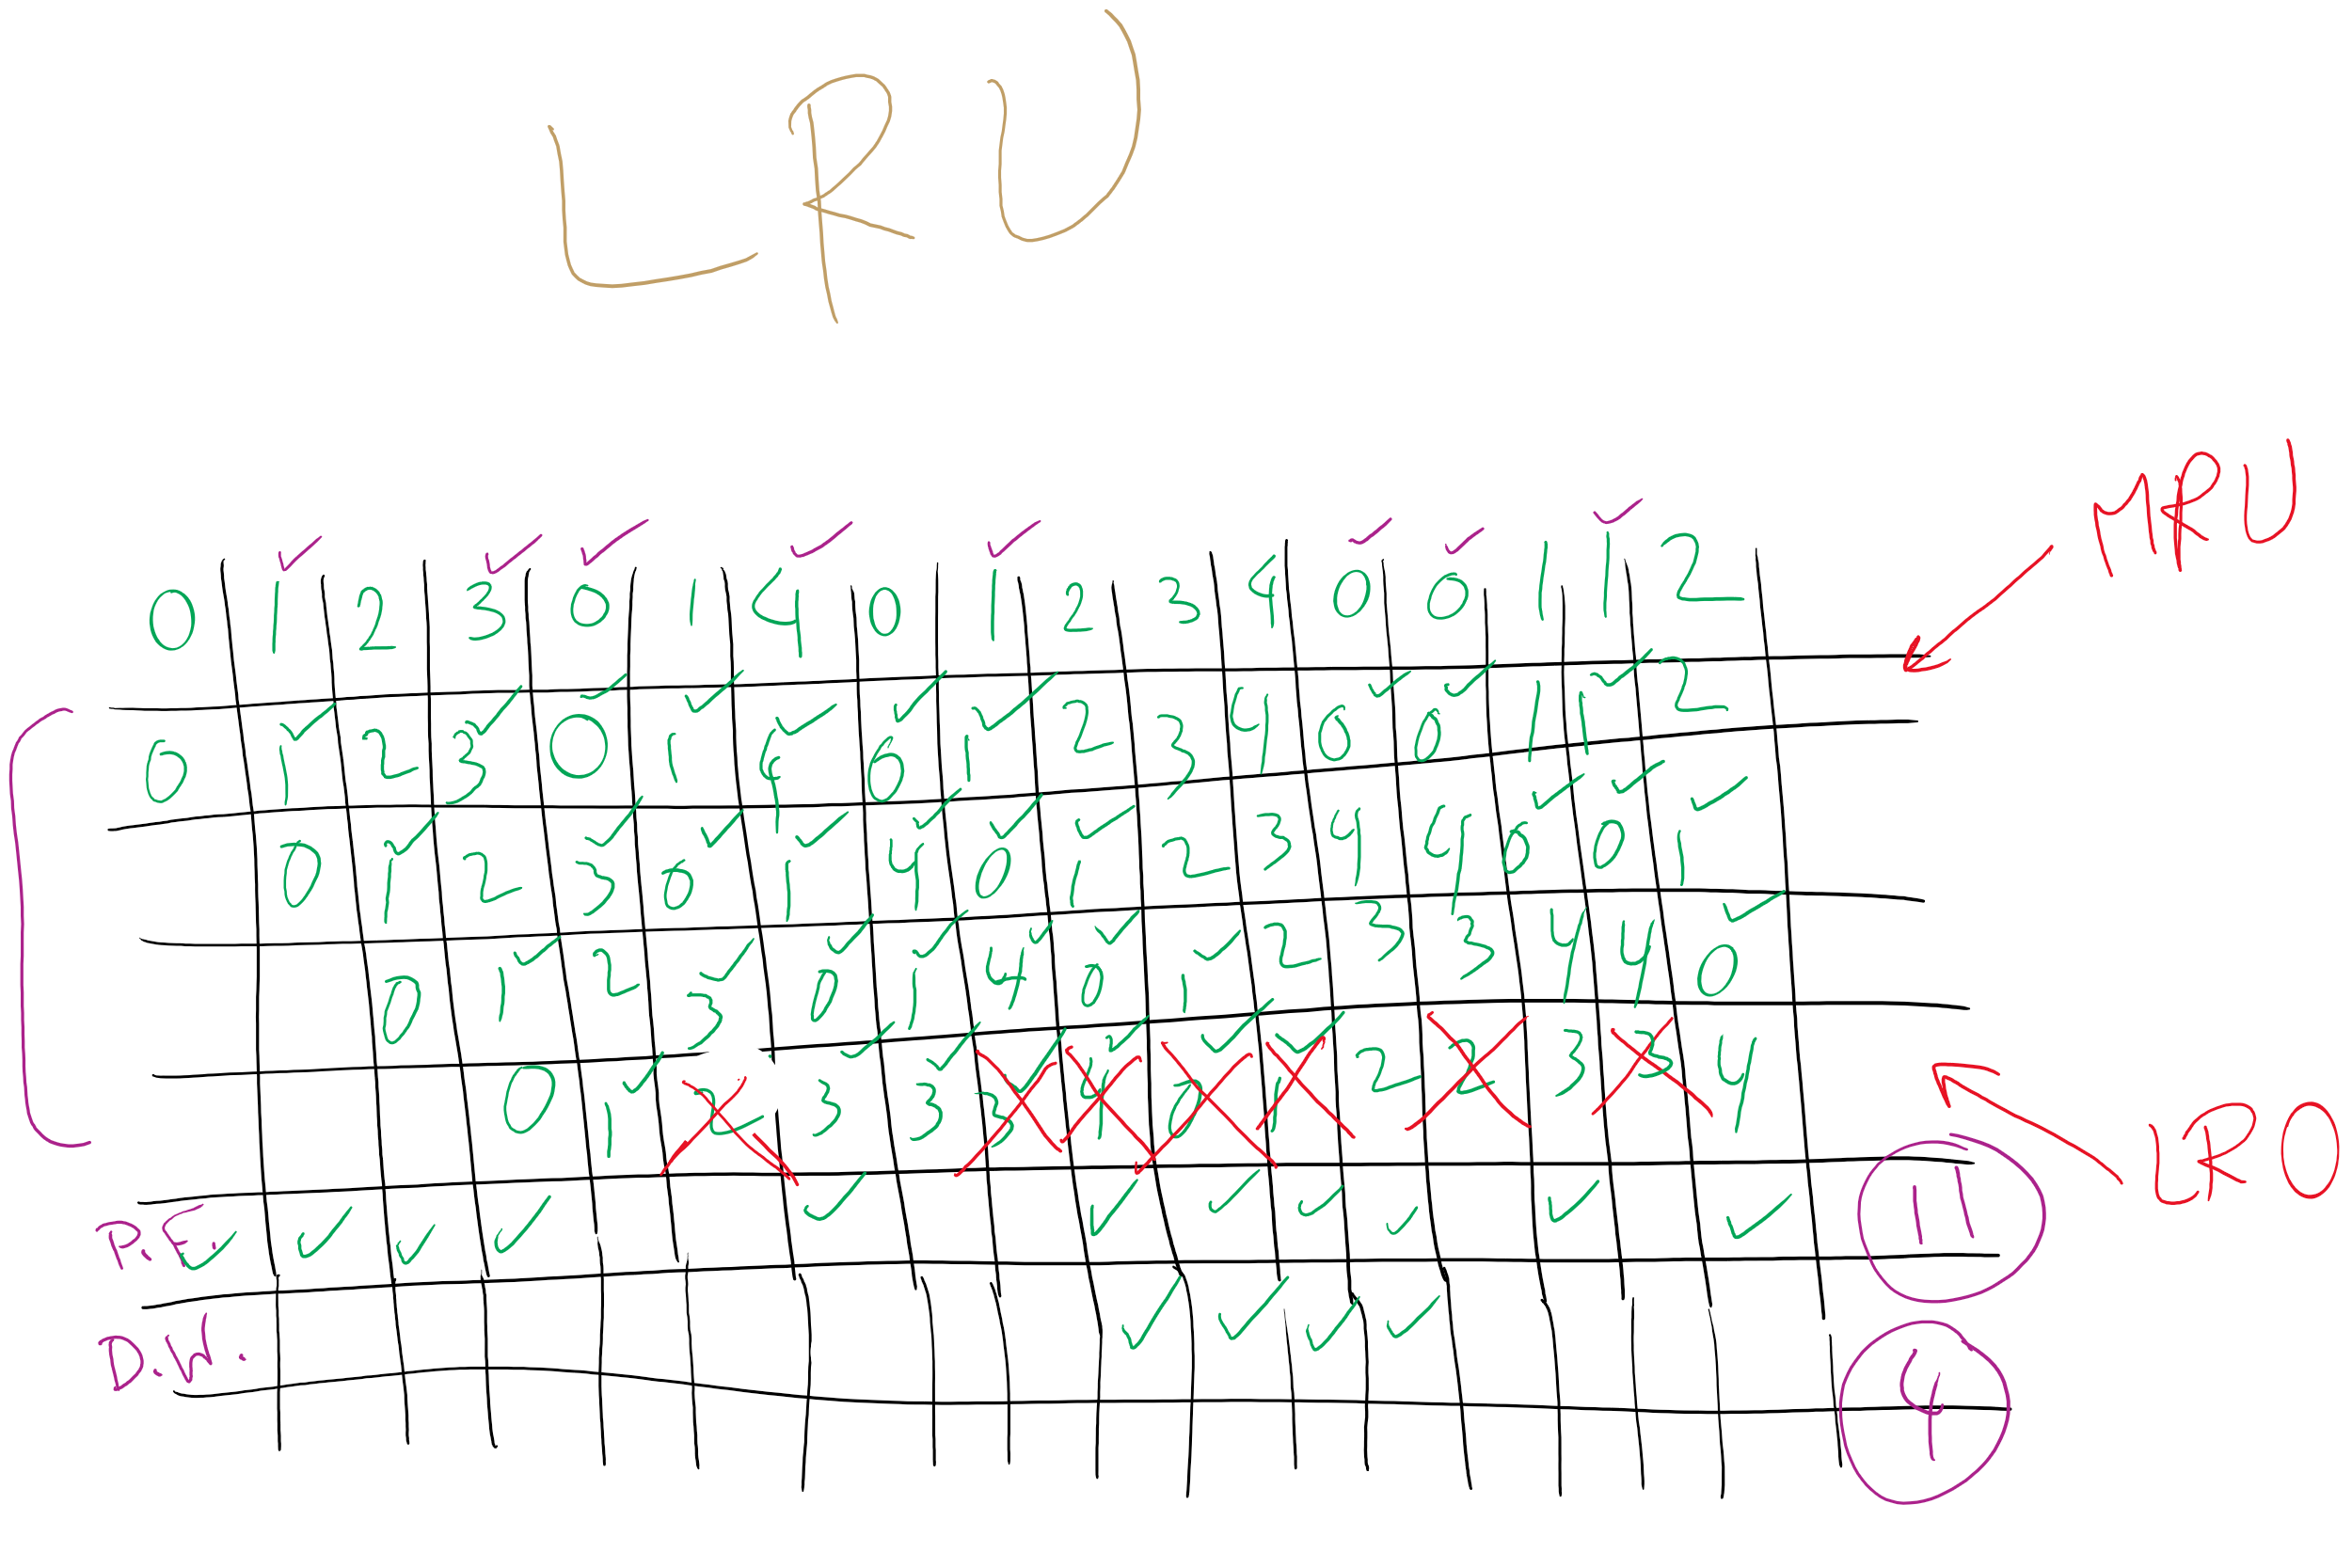
LRU

Slide 20
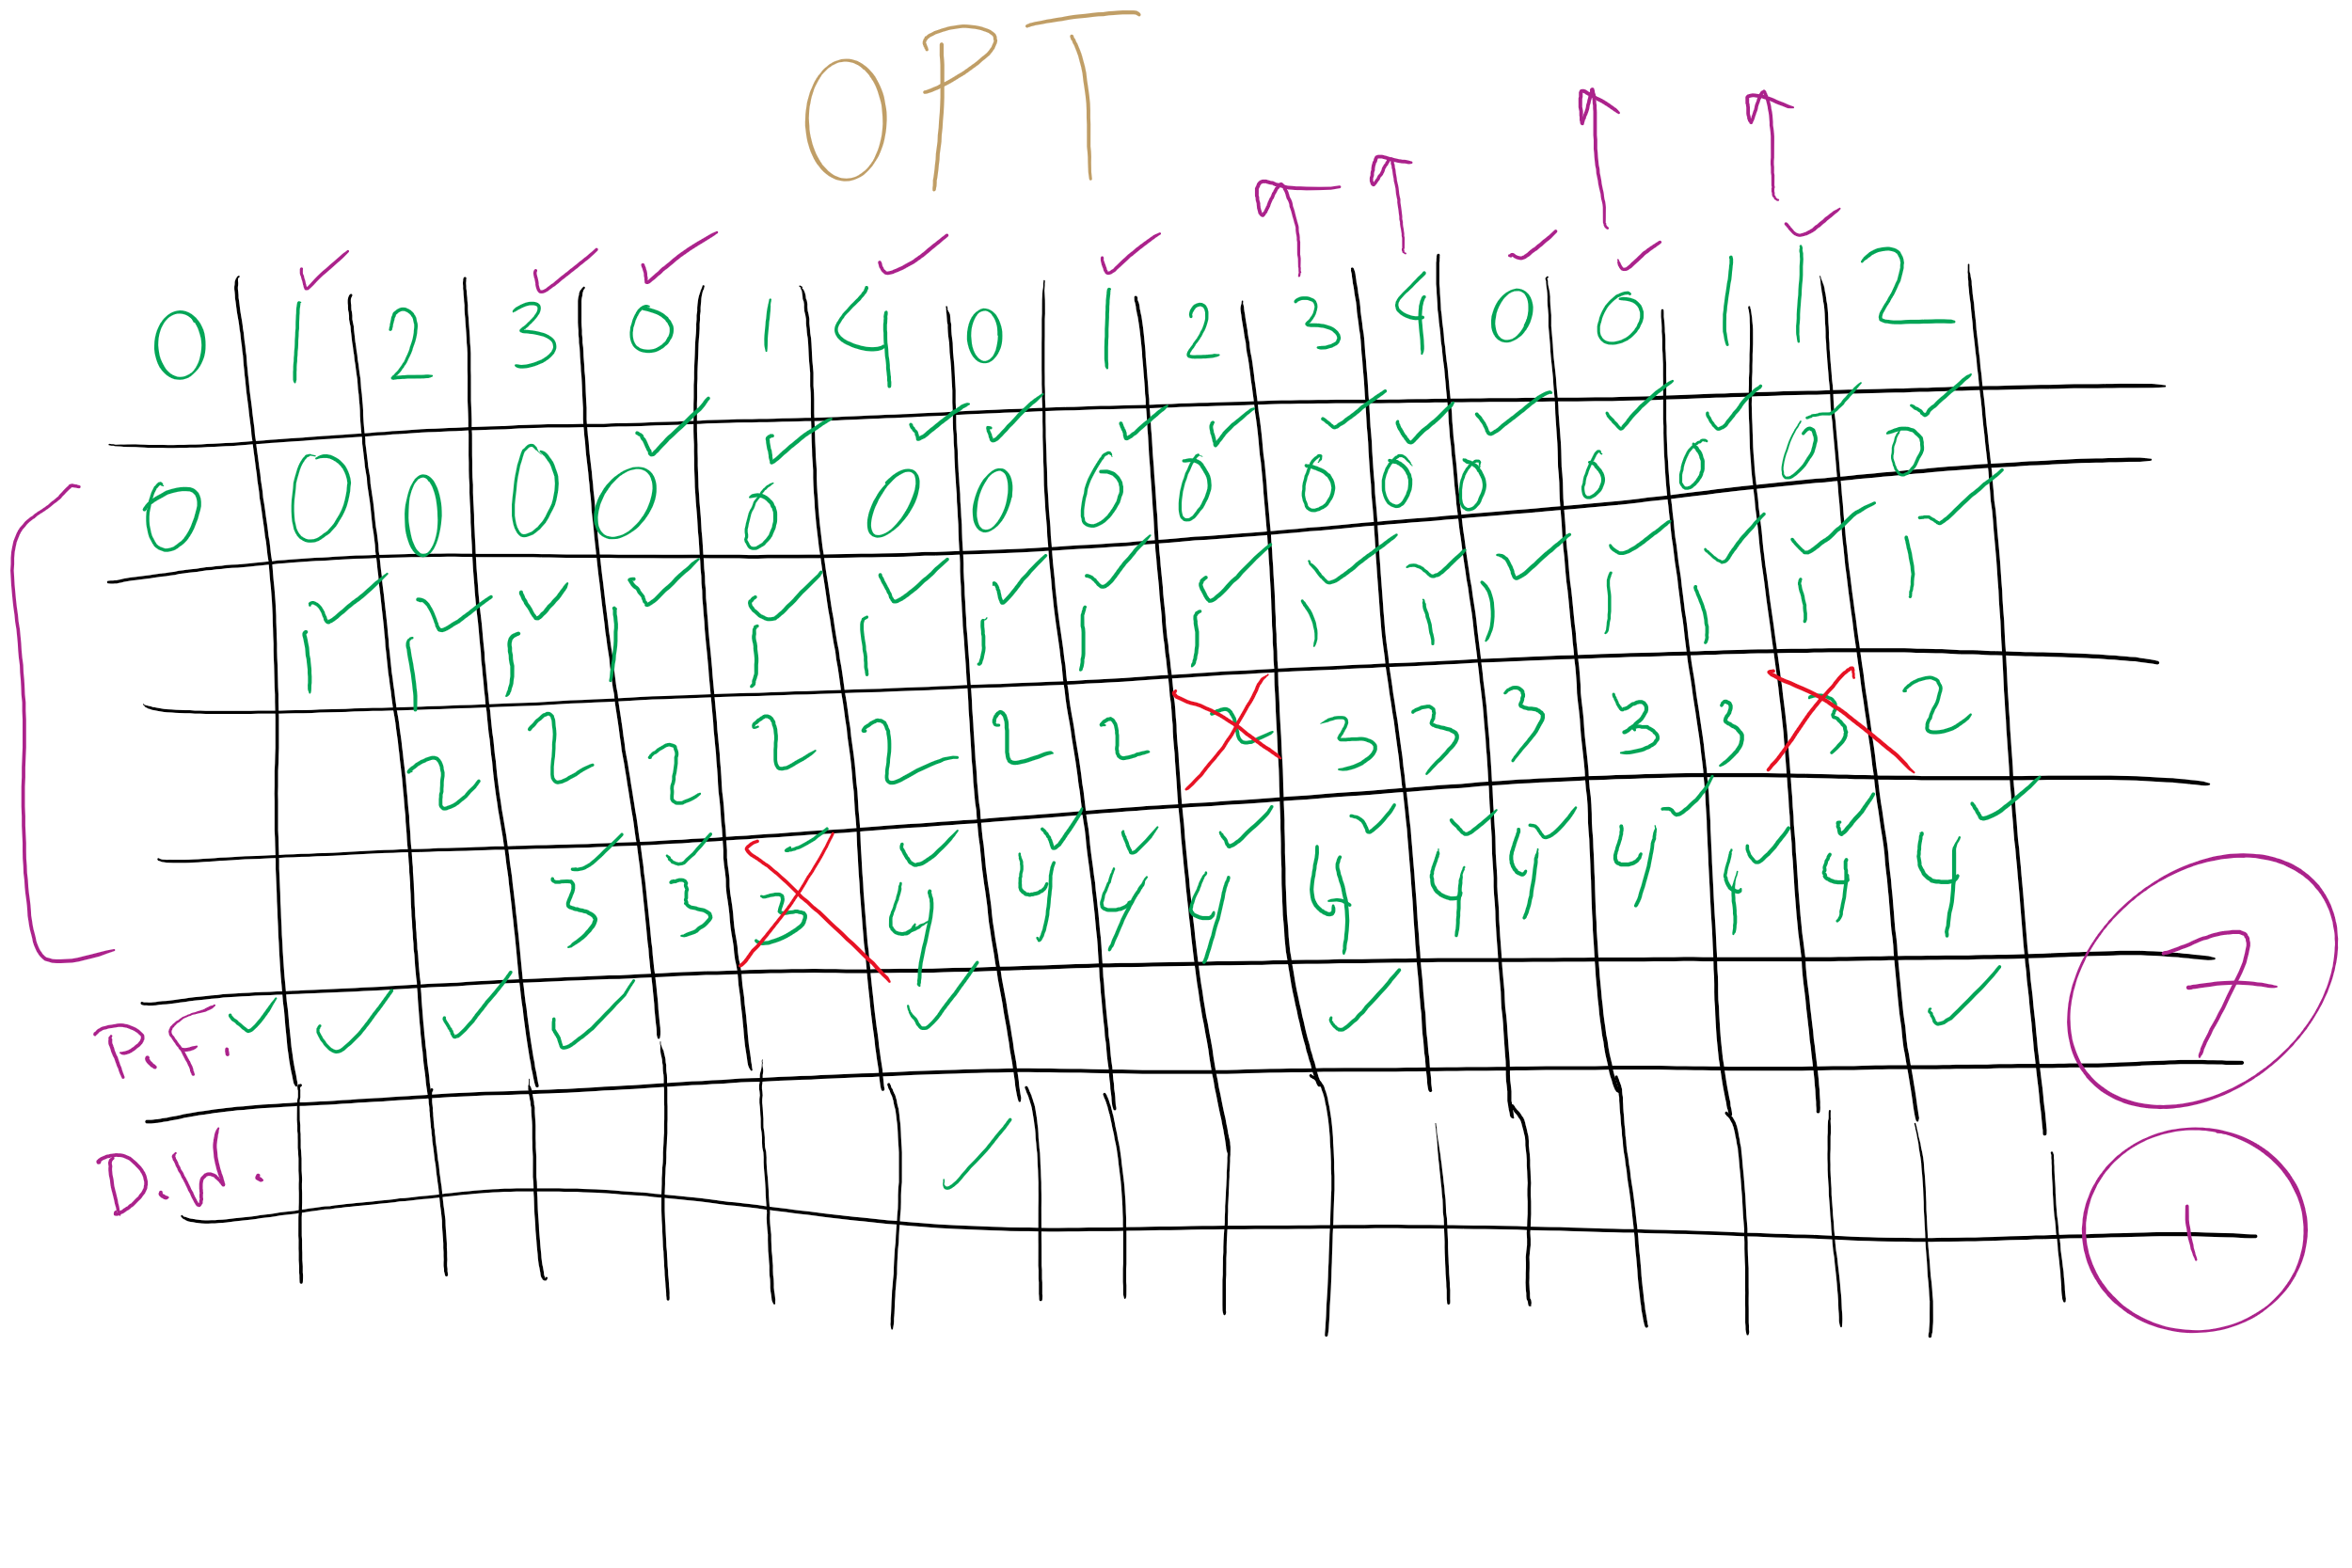
OPT

